Slide 1
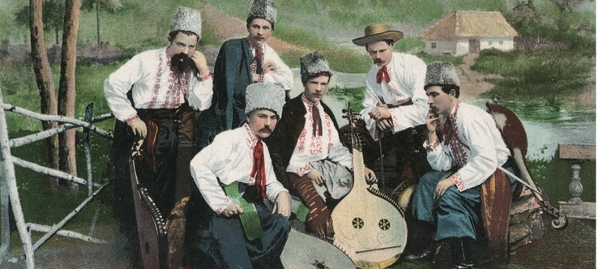
The Kobzar Tradition and the 1908 Expedition in Ukraine

Slide 2
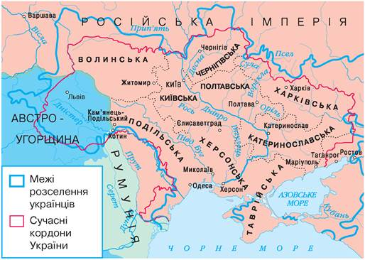
Ukraine between empires – Russian and Austro-Hungarian

Slide 3
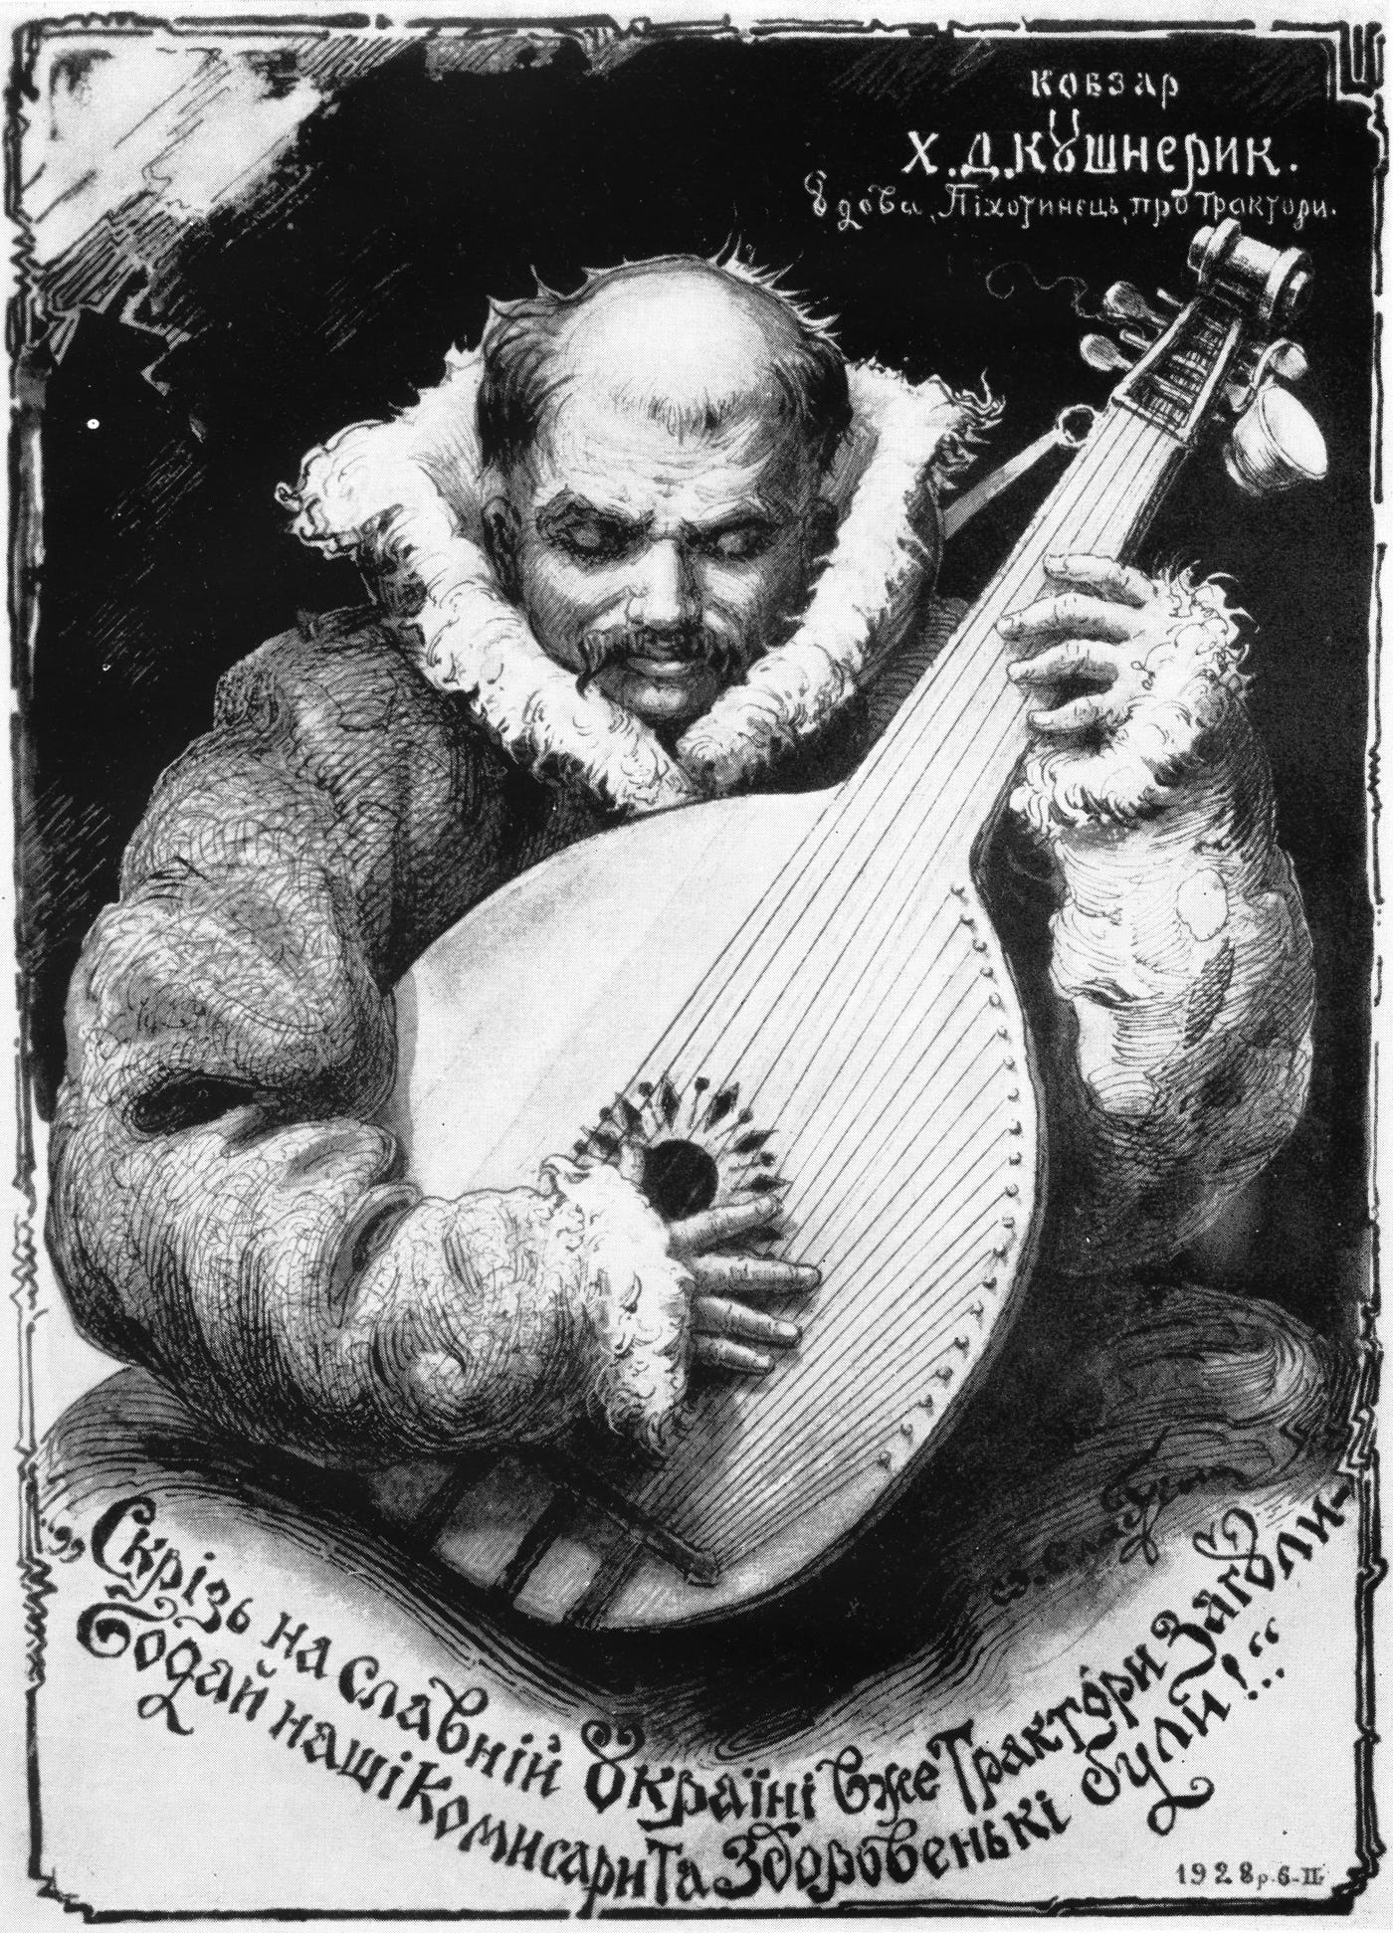
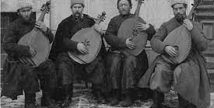
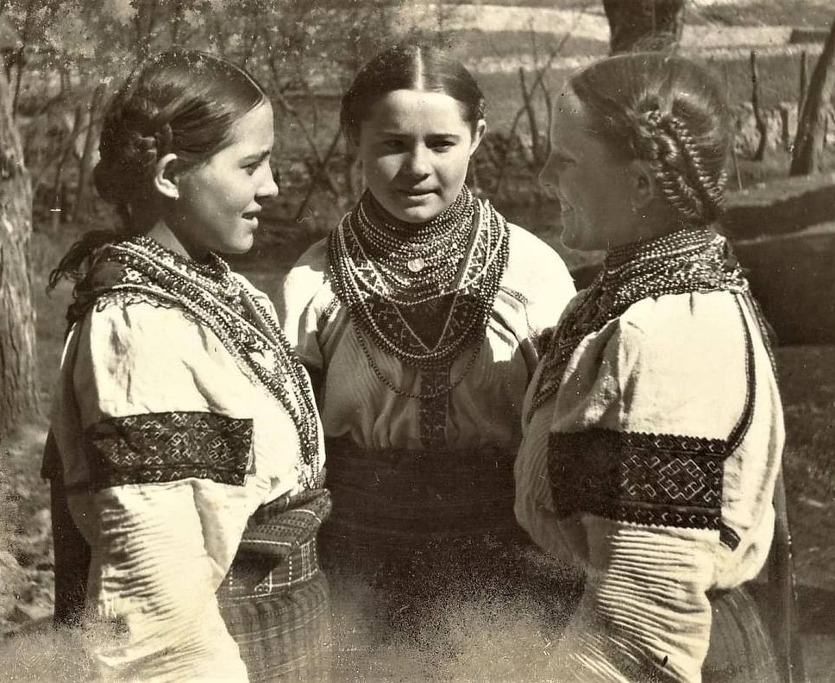
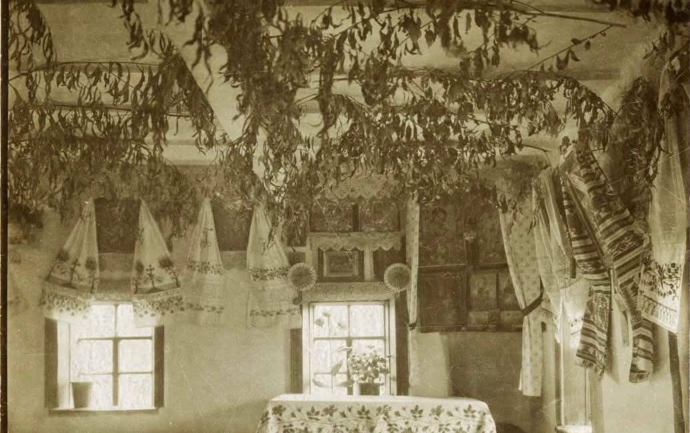
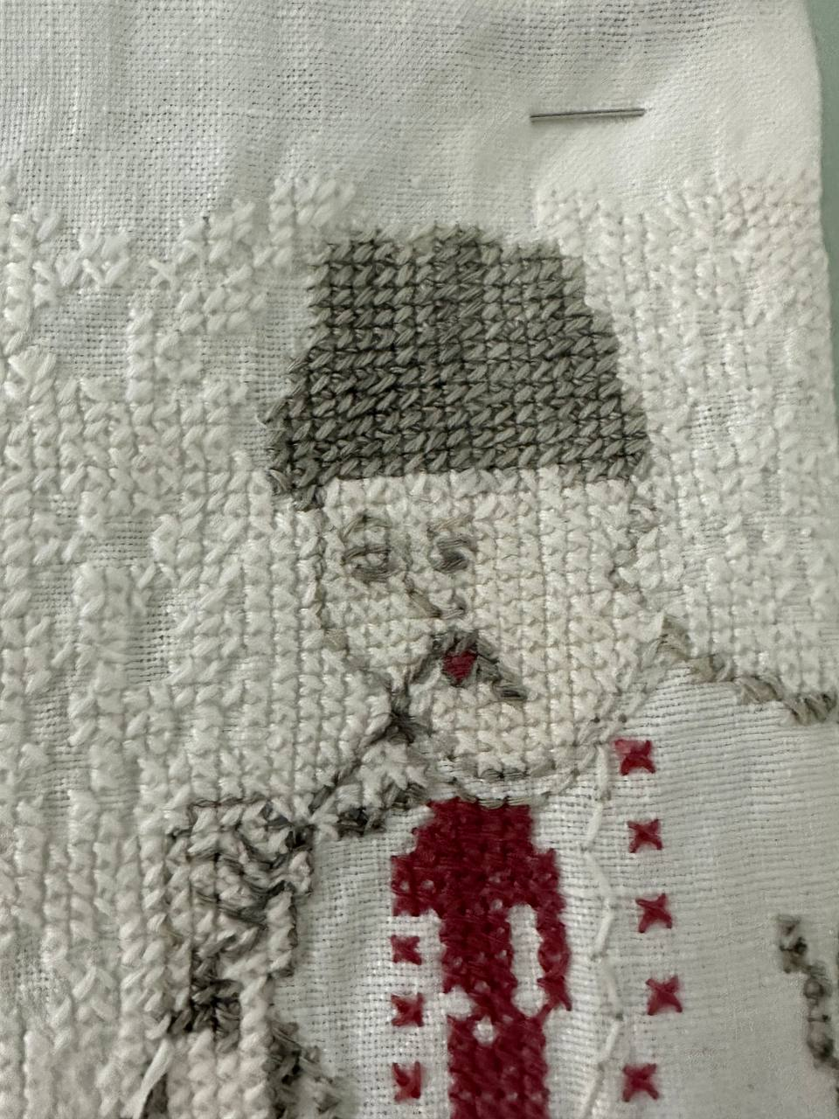
Why Ethnography
was so important in Ukraine?

Slide 4
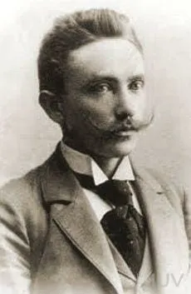
“All Ukrainian writers, starting with Kotlyarevsky, became at the same time ethnographers, collecting folk songs and using them in their works.” — Kolessa

Slide 5
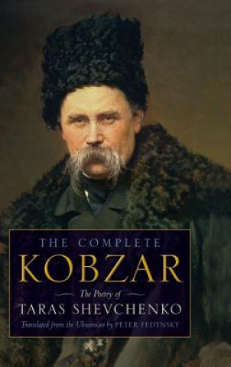
Taras Shevchenko — The Great Kobzar

Slide 6
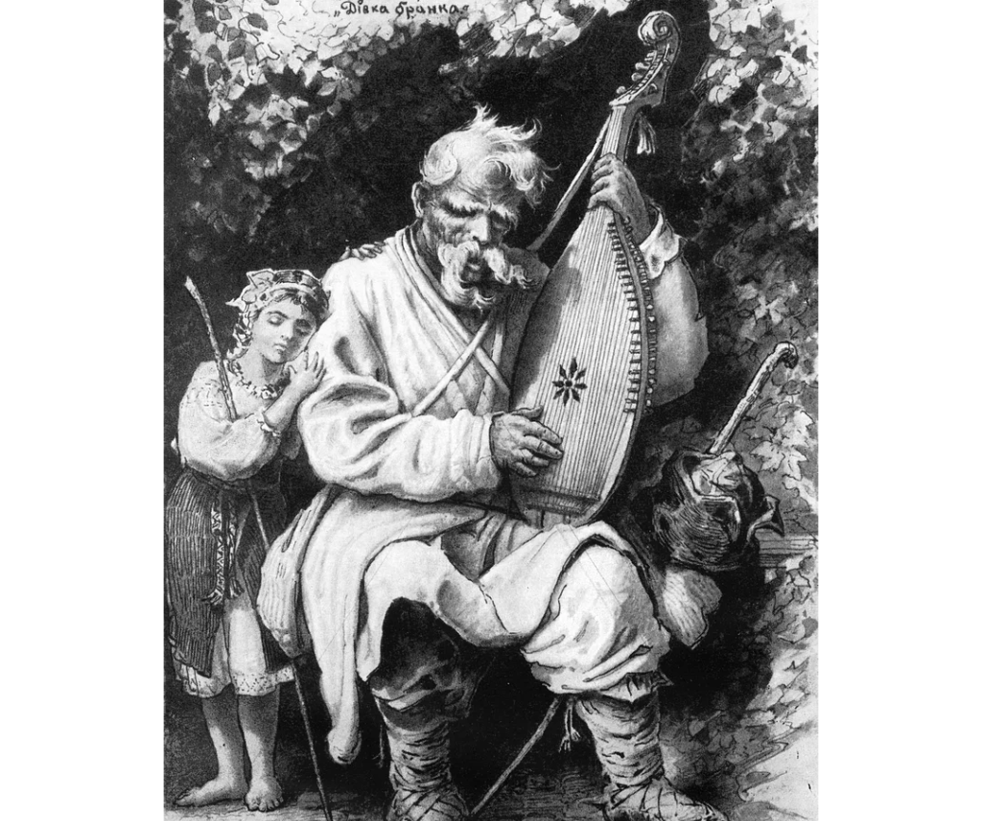
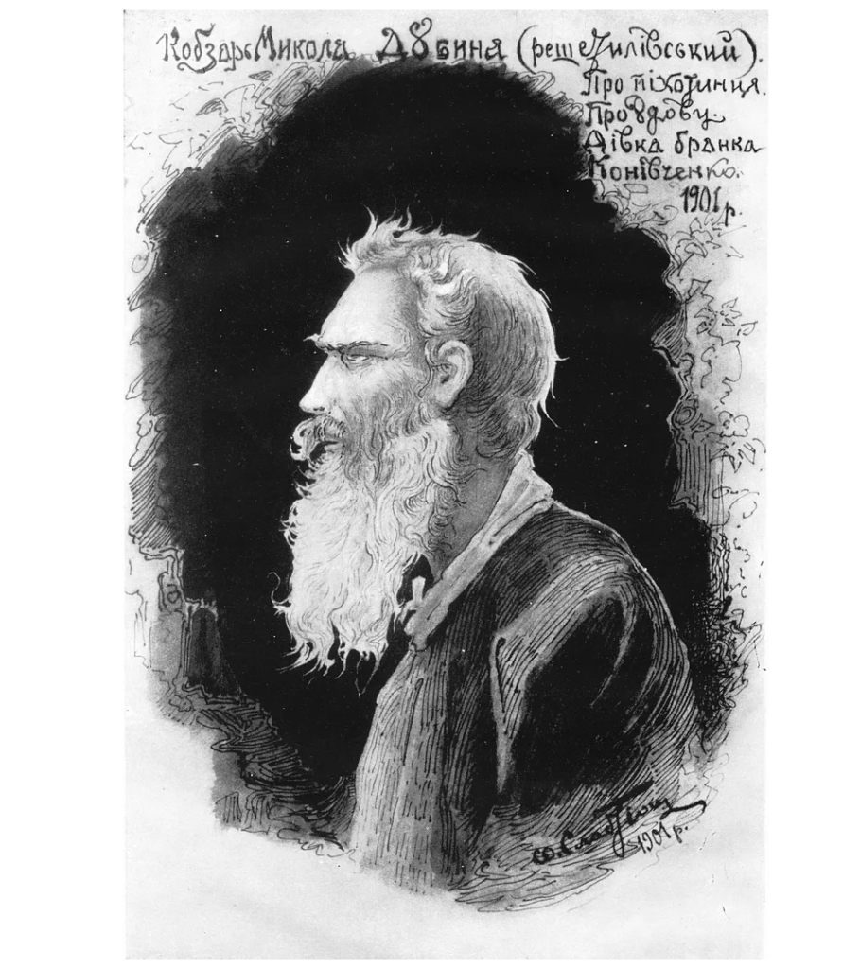
Who Were the Kobzars?

Slide 7
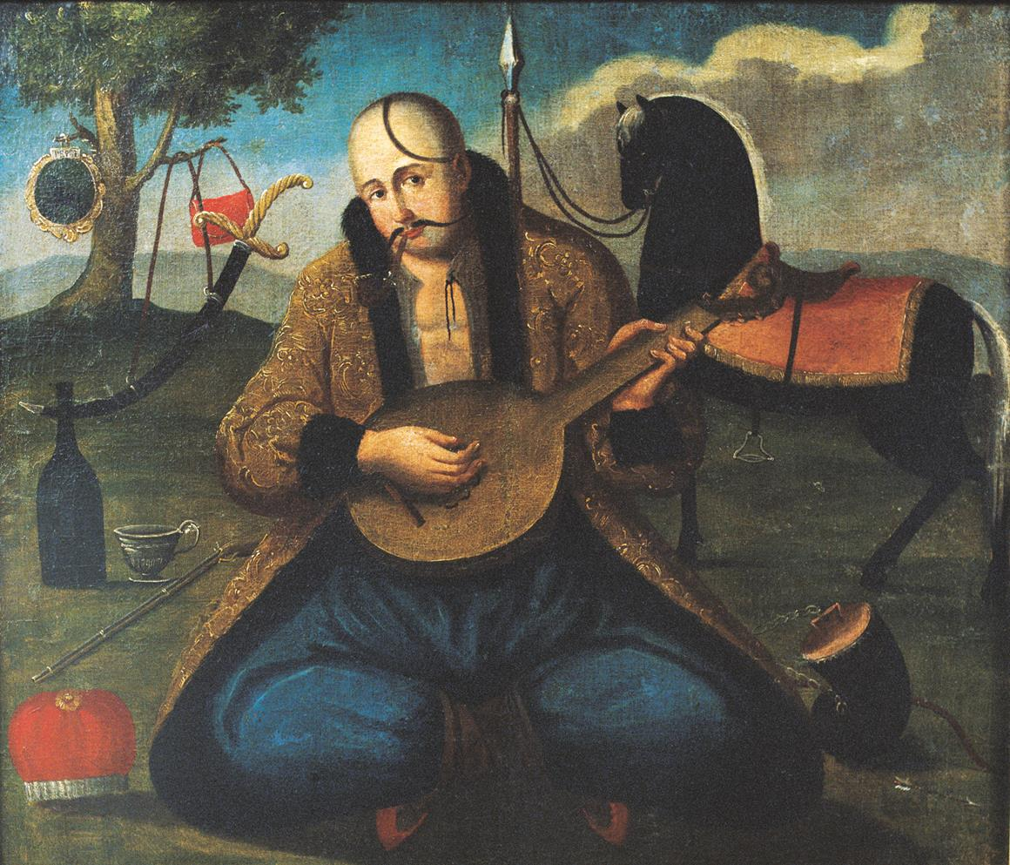
Cossack Origins
It is believed that The professional kobzar tradition was established in Ukraine during the Cossack Era around the 16th century.
The first composers and singers of the “dumas” were military musicians linked to the Cossacks, reflecting their heroic ethos and oral traditions.

Slide 8
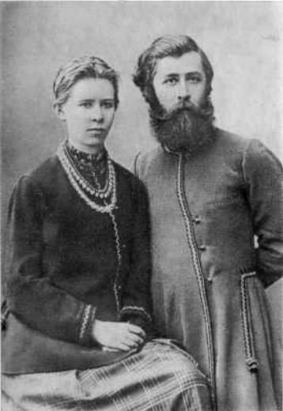
Lesya and Klyment Kvitka — The Expedition Organizers
For them, it was more than research — it was a cultural mission:
"The publication of kobzar melodies will give a new and perhaps the greatest foundation for national pride, for it is a phenomenon with which our neighbors have nothing to compare." (Lesia Ukrainka. Letters: 1903–1913, p. 407)

Slide 9
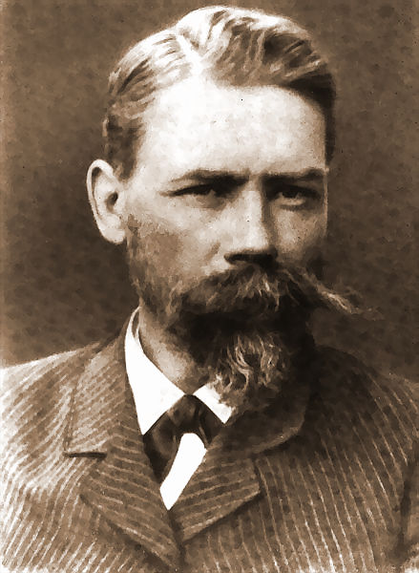
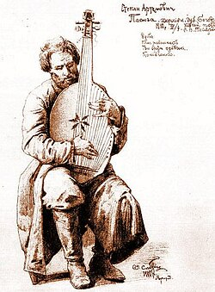
Challenges with Expedition

Slide 10
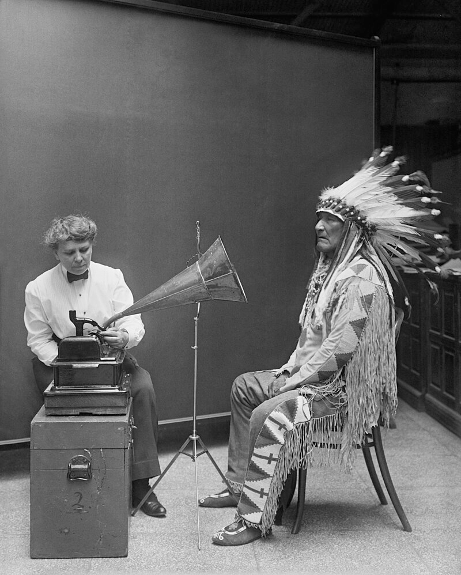
Recording Difficulties

Slide 11

Happy end!
For the first time, F. Kolessa published the results of his expedition at the Scientific Congress of the International Musical Society in Vienna in May 1909, delivering a paper "On the melodic and rhythmic structure of Ukrainian reciting songs, the so-called "Kosakenlieder"".

Slide 12
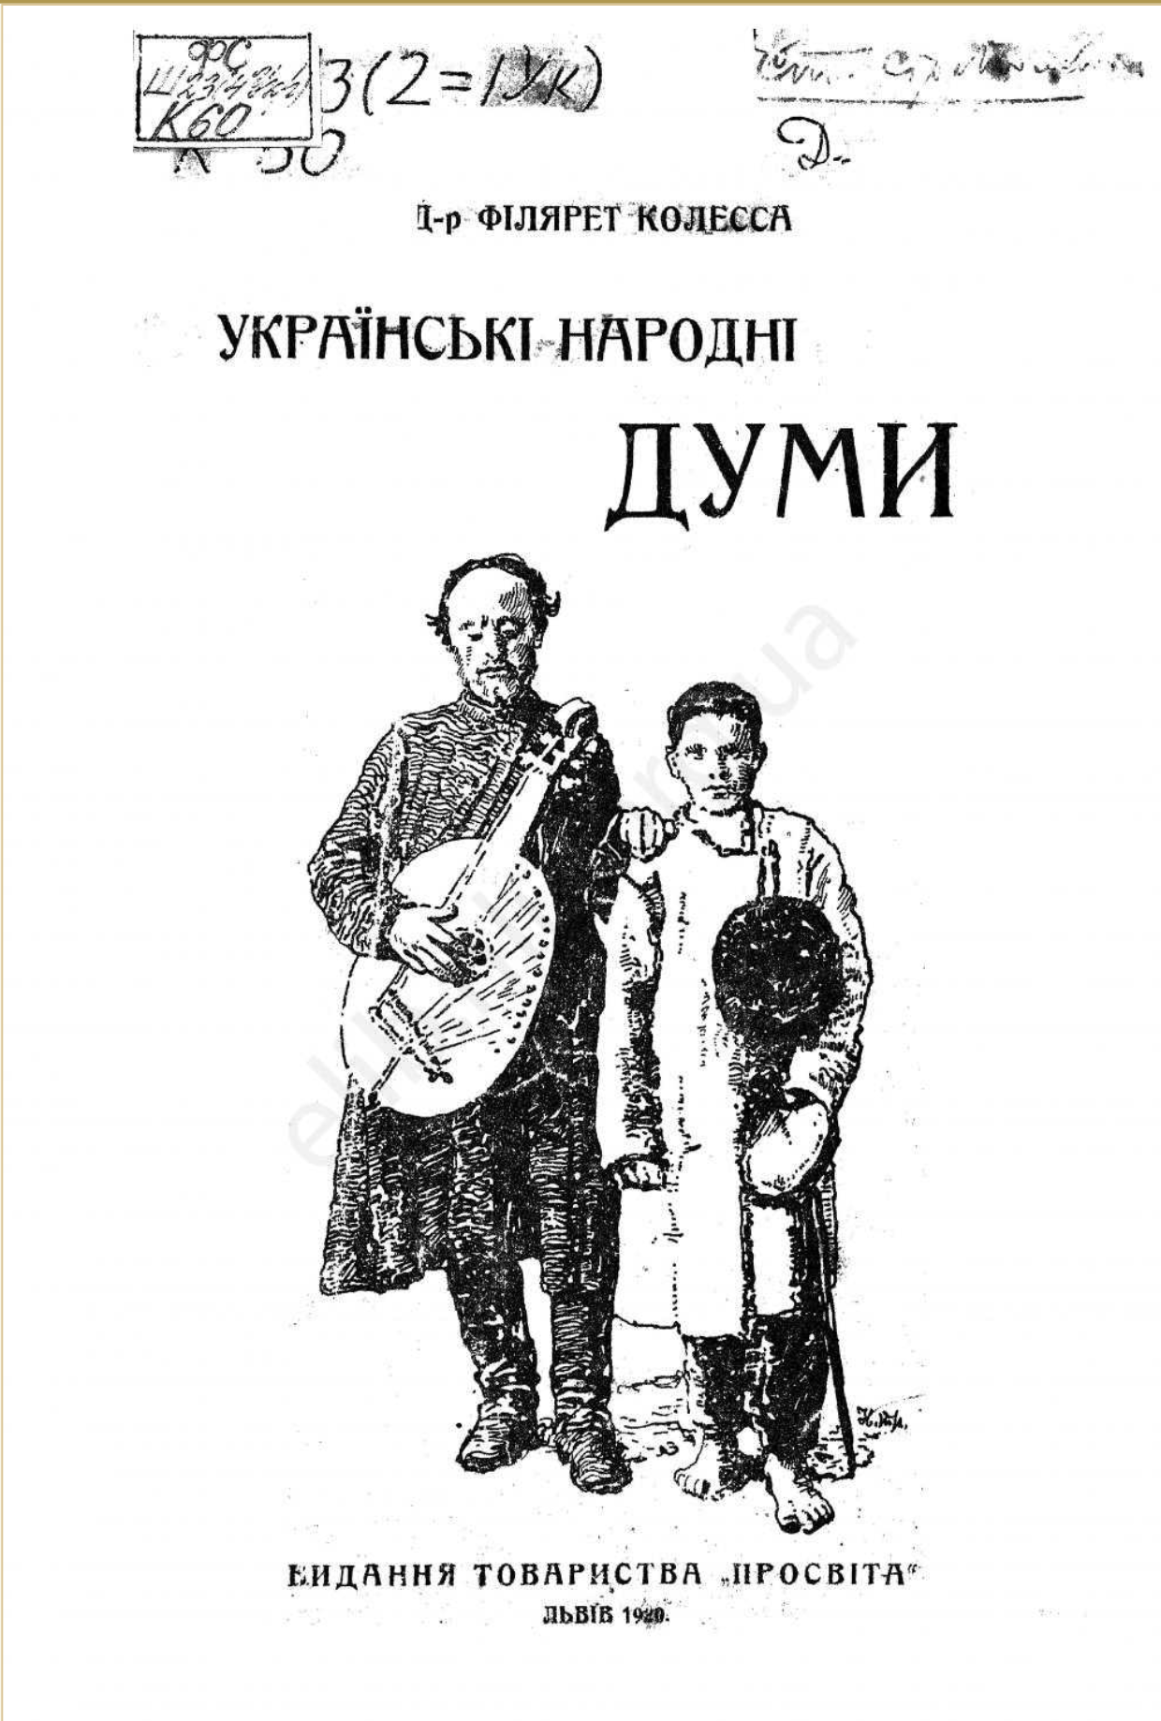
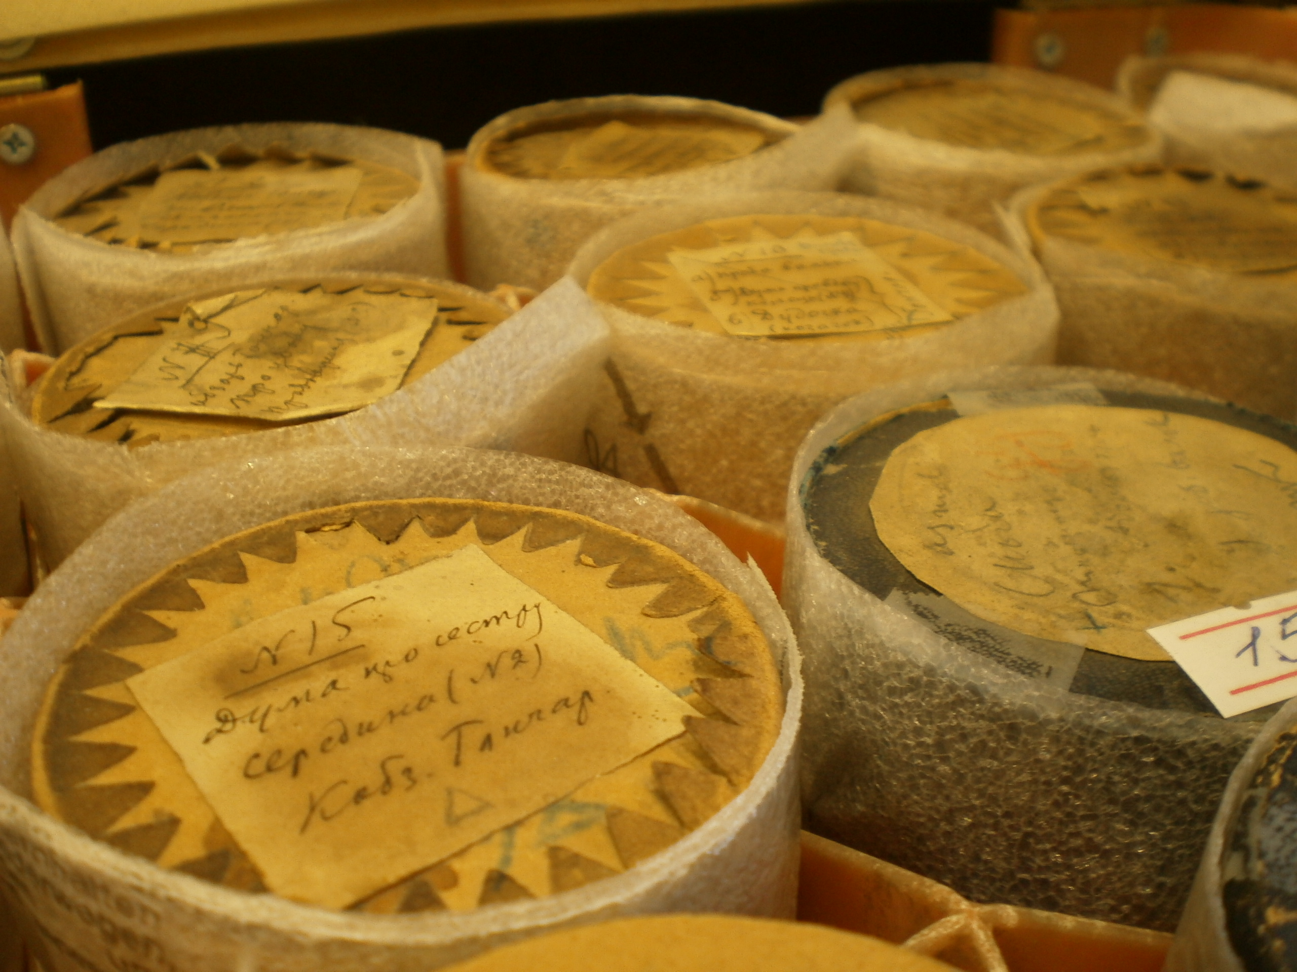

Slide 13
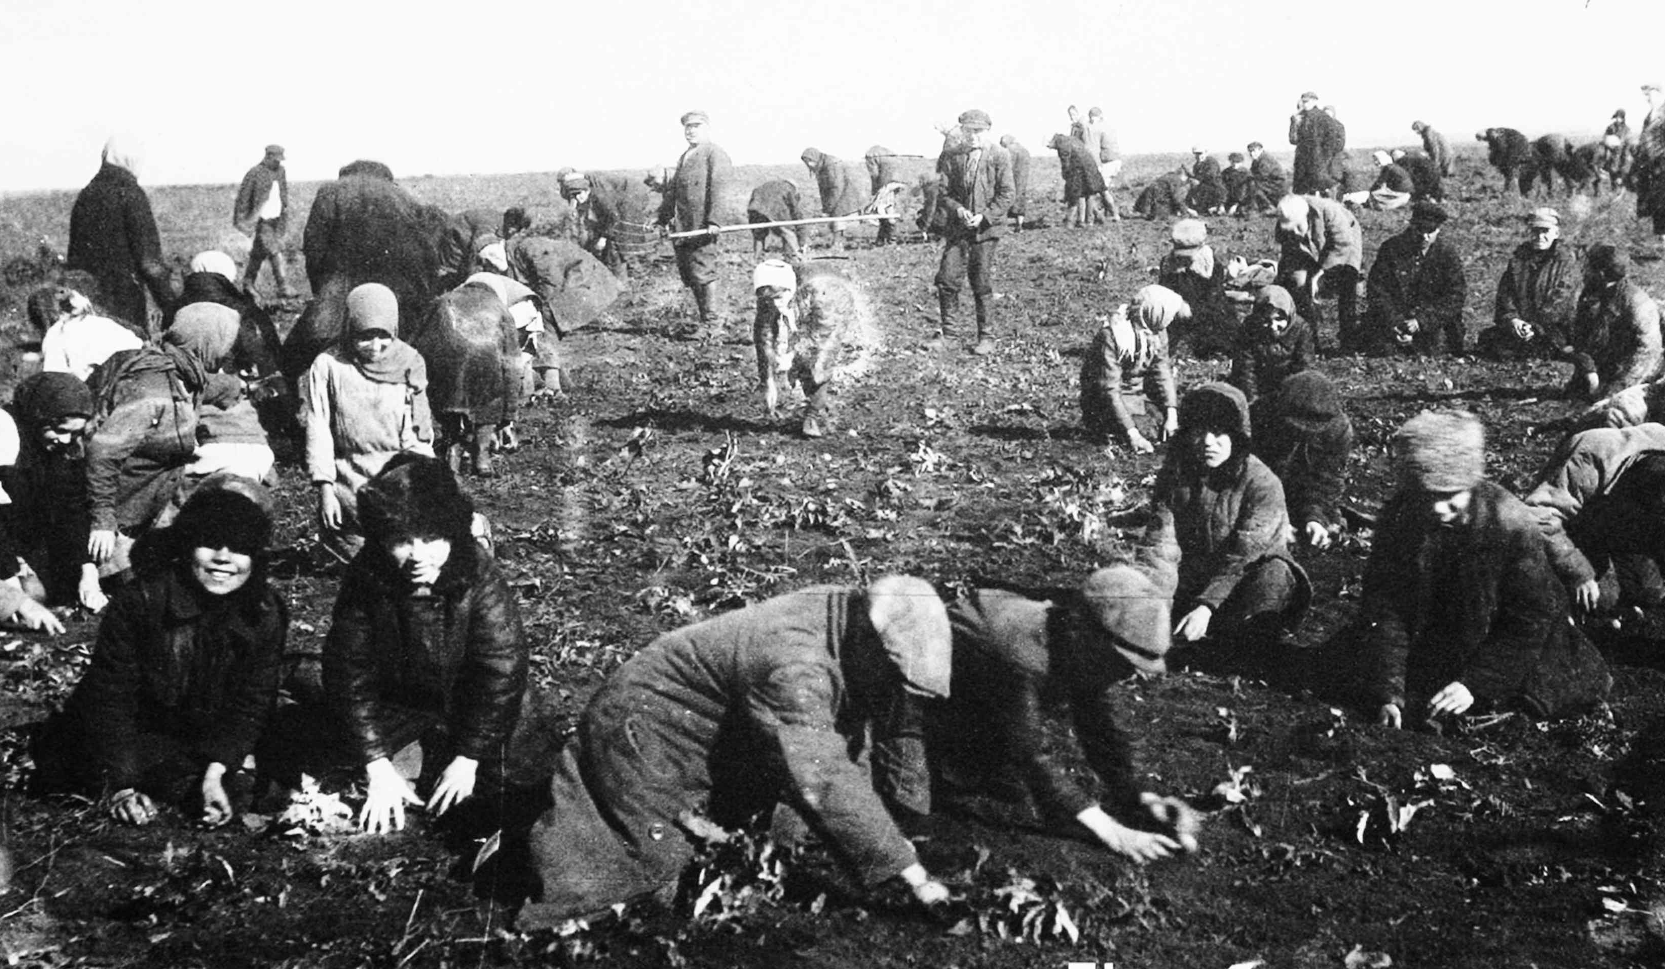
End of kobzardom in 1930
In the 1930s during the period of the Holodomor, on the order of Stalin, the Soviet authorities called on all Ukrainian Kobzars to attend a congress in Kharkiv.
Those that arrived were taken outside the city and were all put to death

Slide 14
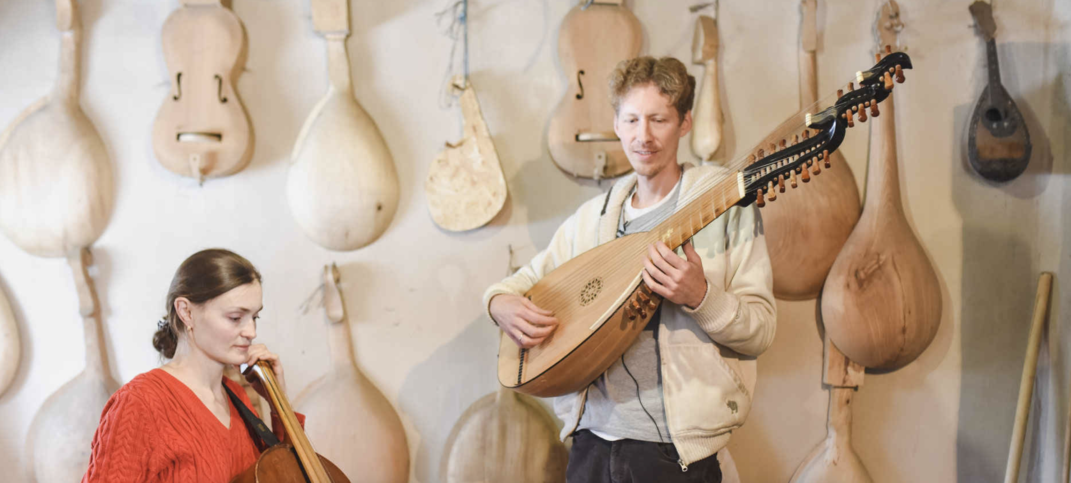
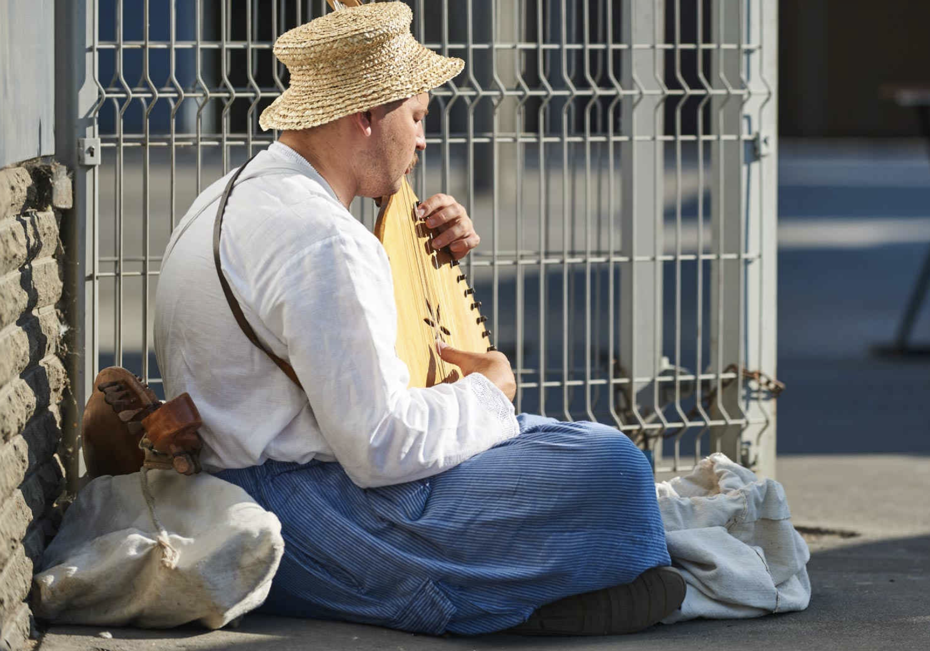
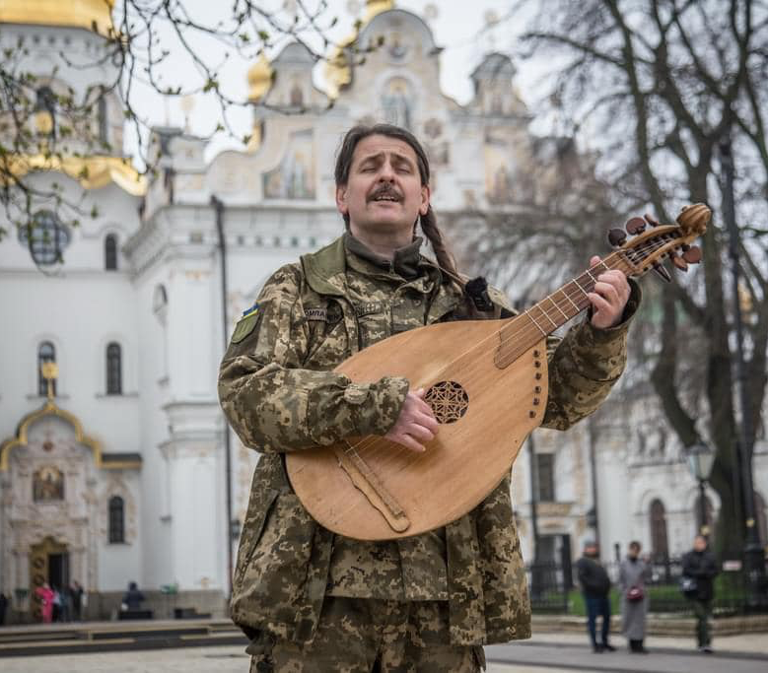
Re-establishment and preservation

