Slide 1
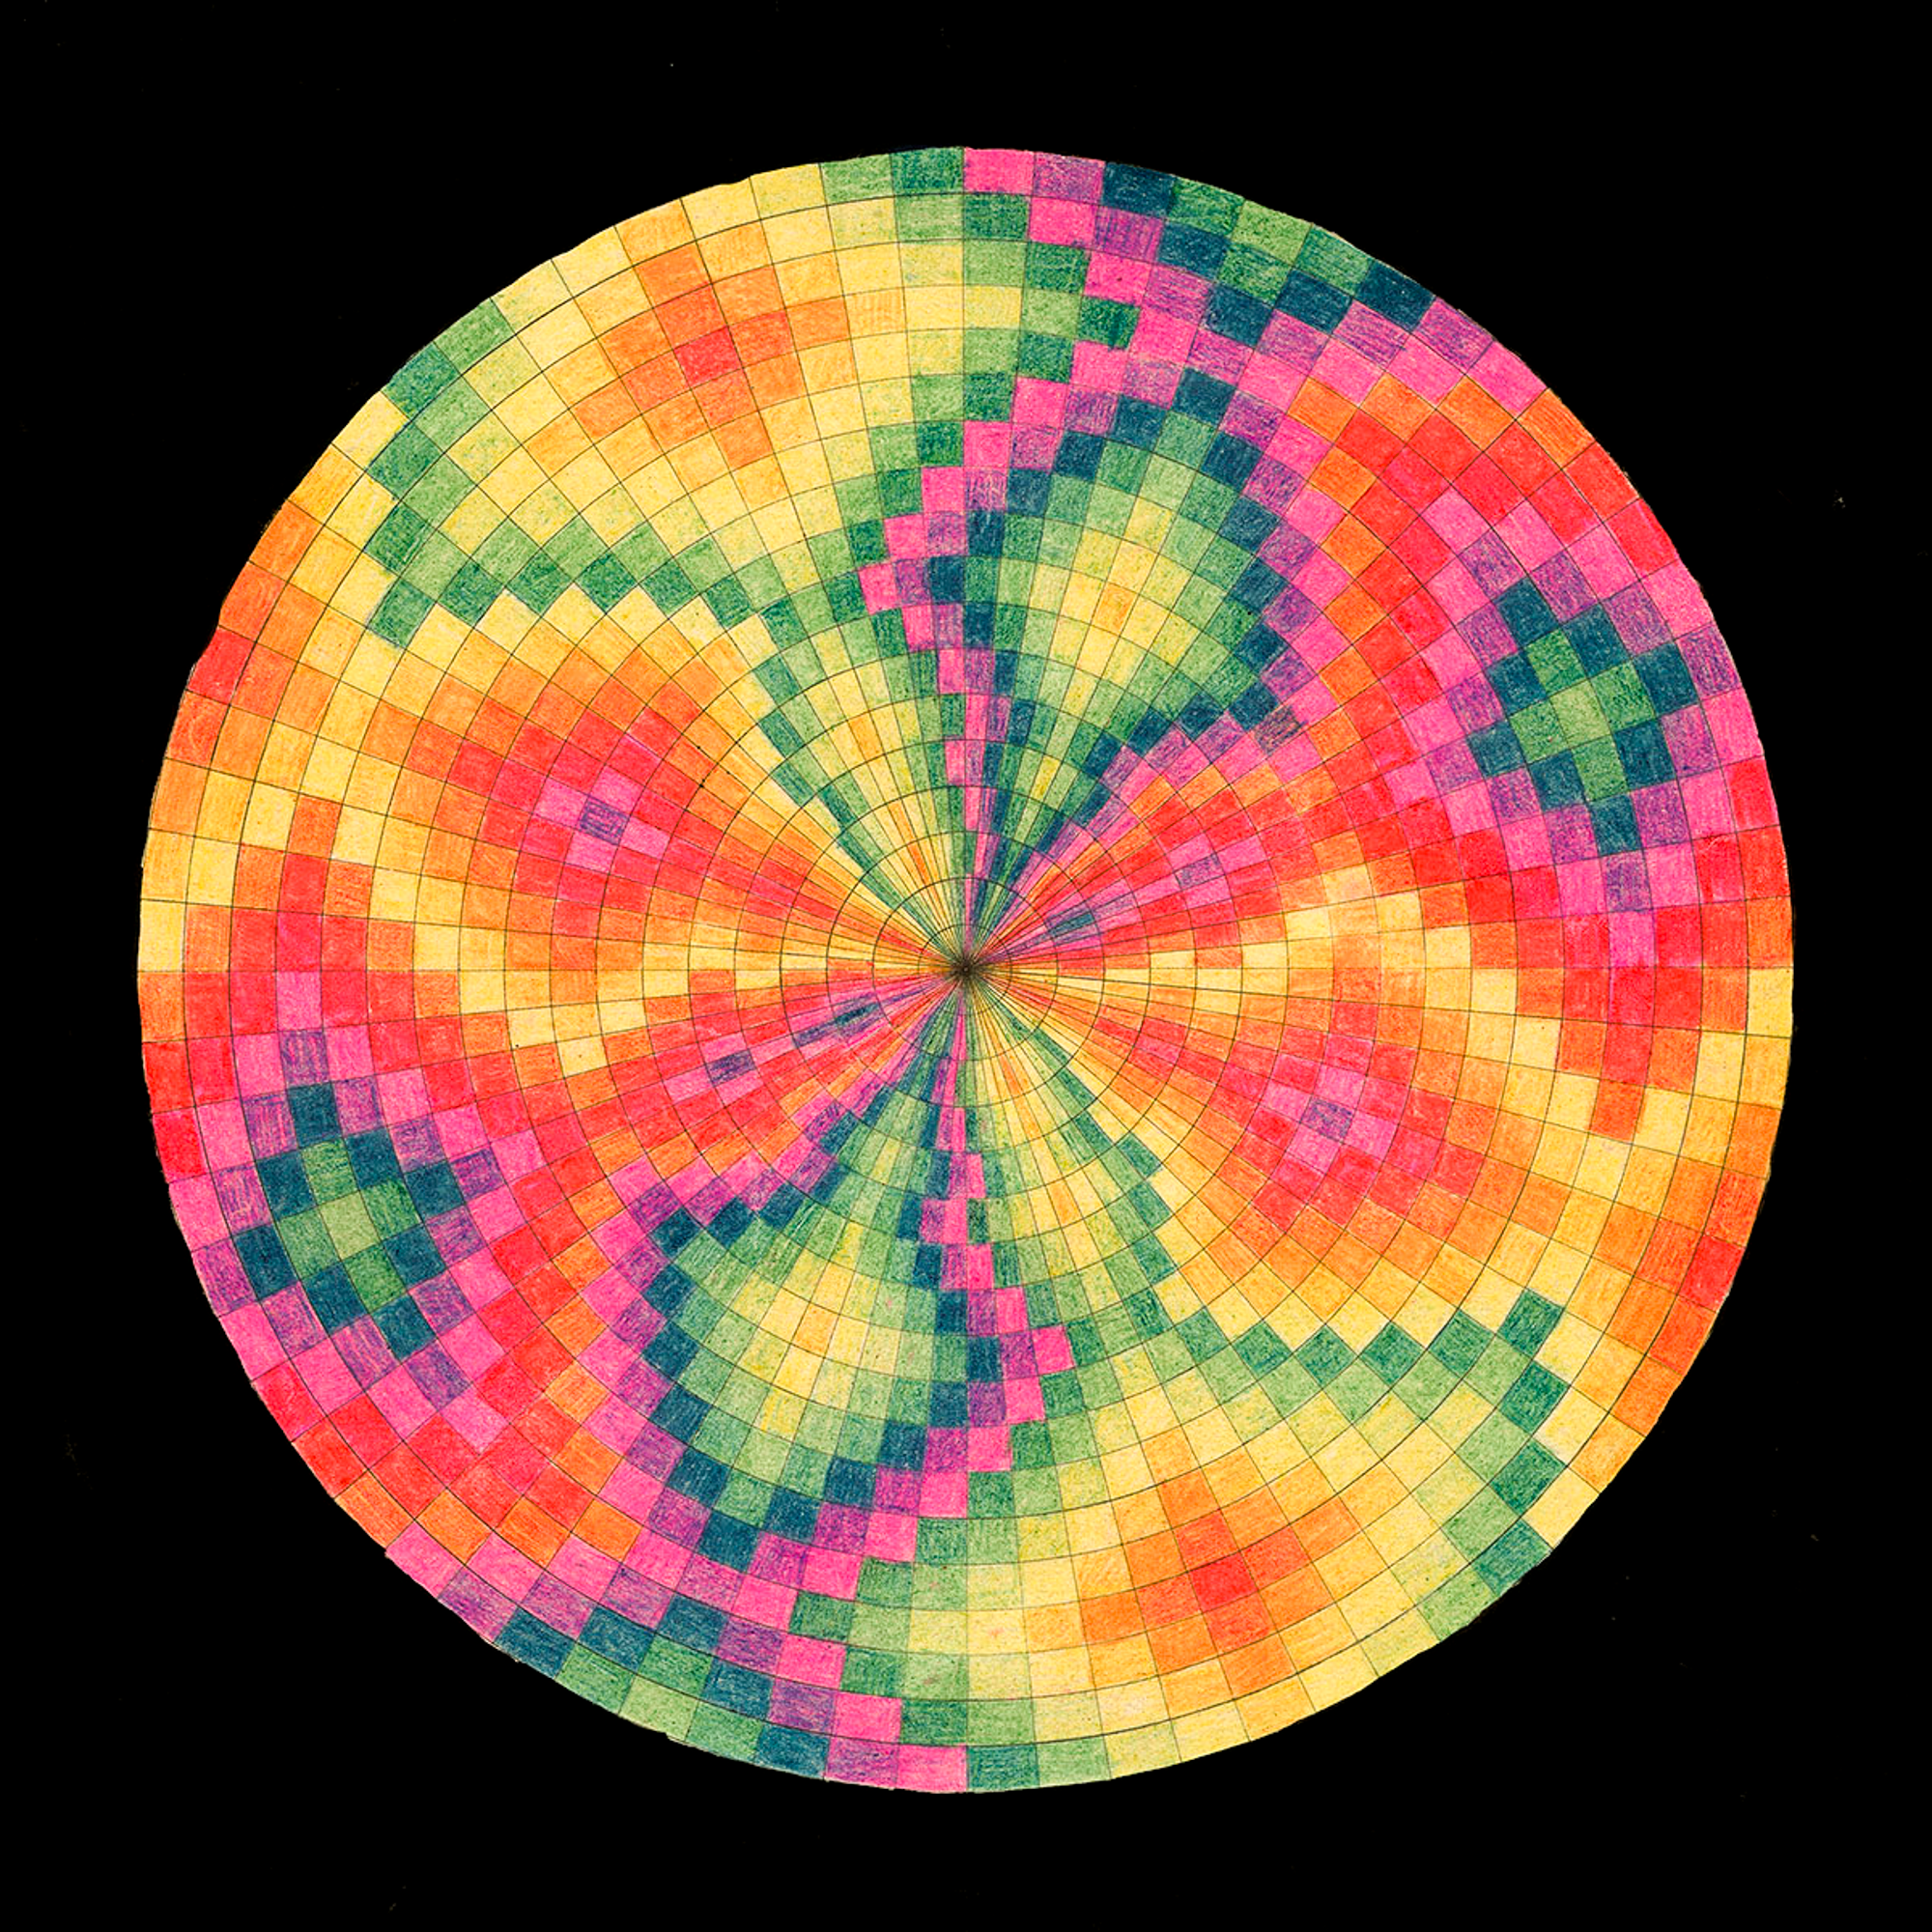
An Examination of Two Soviet Electronic Instruments
Sensory Synthesis:
Sam Tubbs

Slide 2
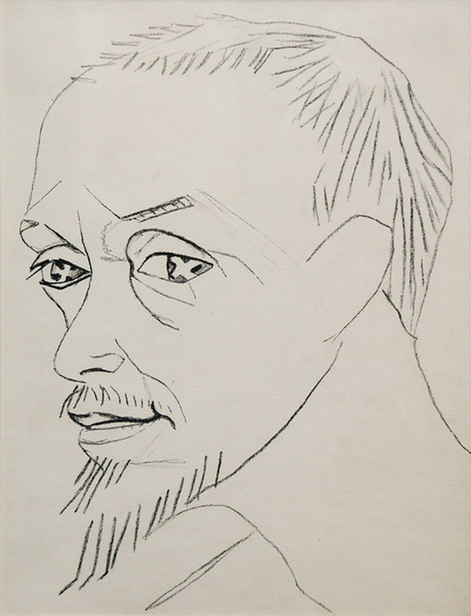
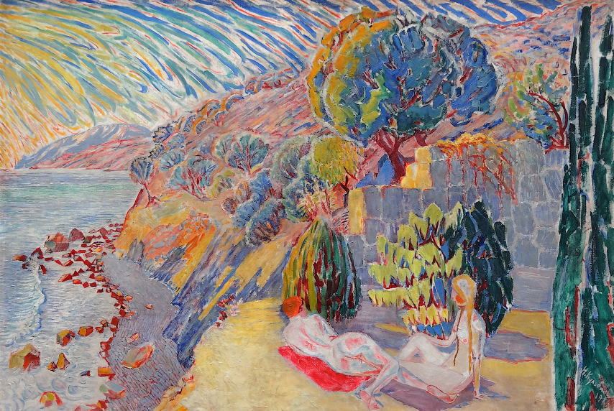
Nikolai Kulbin - Free Music
“The Advantage of Free Music:
New enjoyment of unusual tone combinations.
New harmony with new chords.
New dissonances with new resolutions.
New melodies. The choice of possible chords and melodies is very much enlarged. The power of musical poetry is magnified. This is most important because music is mainly poetry. Free music has many more possibilities for affecting the listener and exciting his soul.
Delicate combinations and changing tones strongly affect man’s soul.”

Slide 3
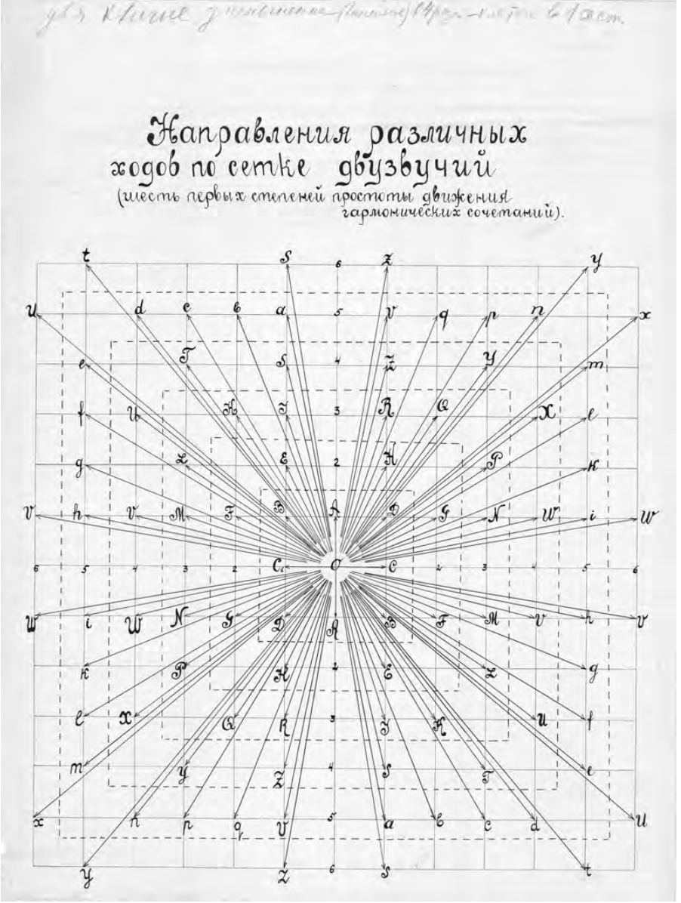
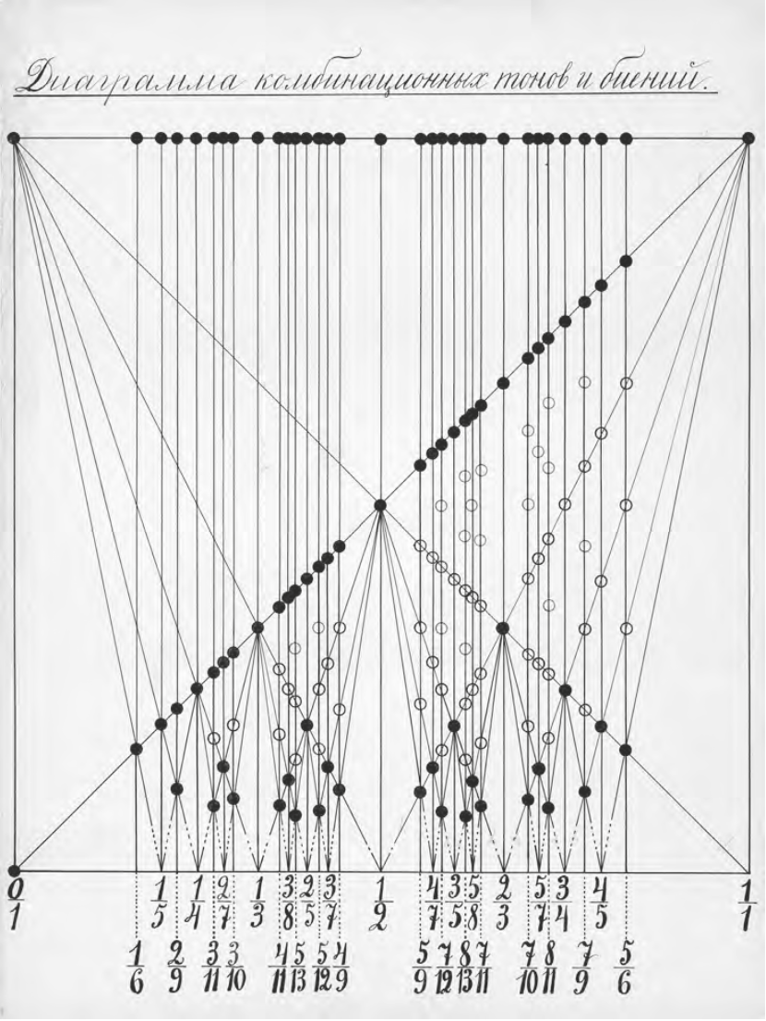
Harmony diagram of microtonal duads. GIMN. 1923-27. TCA
Microtonal diagrams by Pavel Leiberg. ‘Diagram of combinational tones and beats’. GIMN. 1926. TCA.

Slide 4
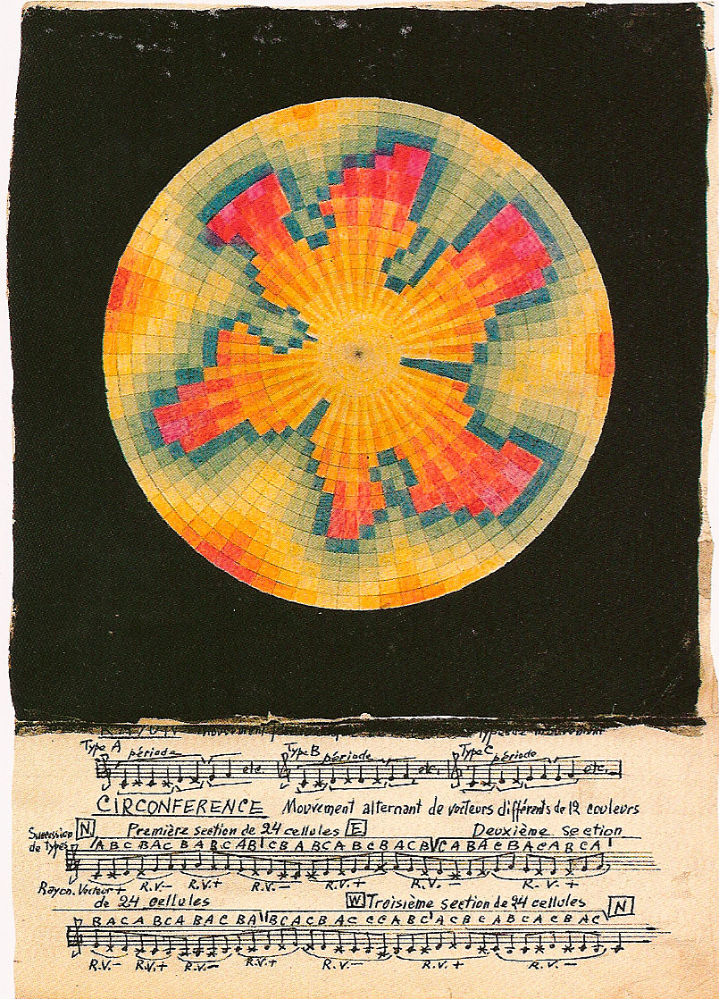
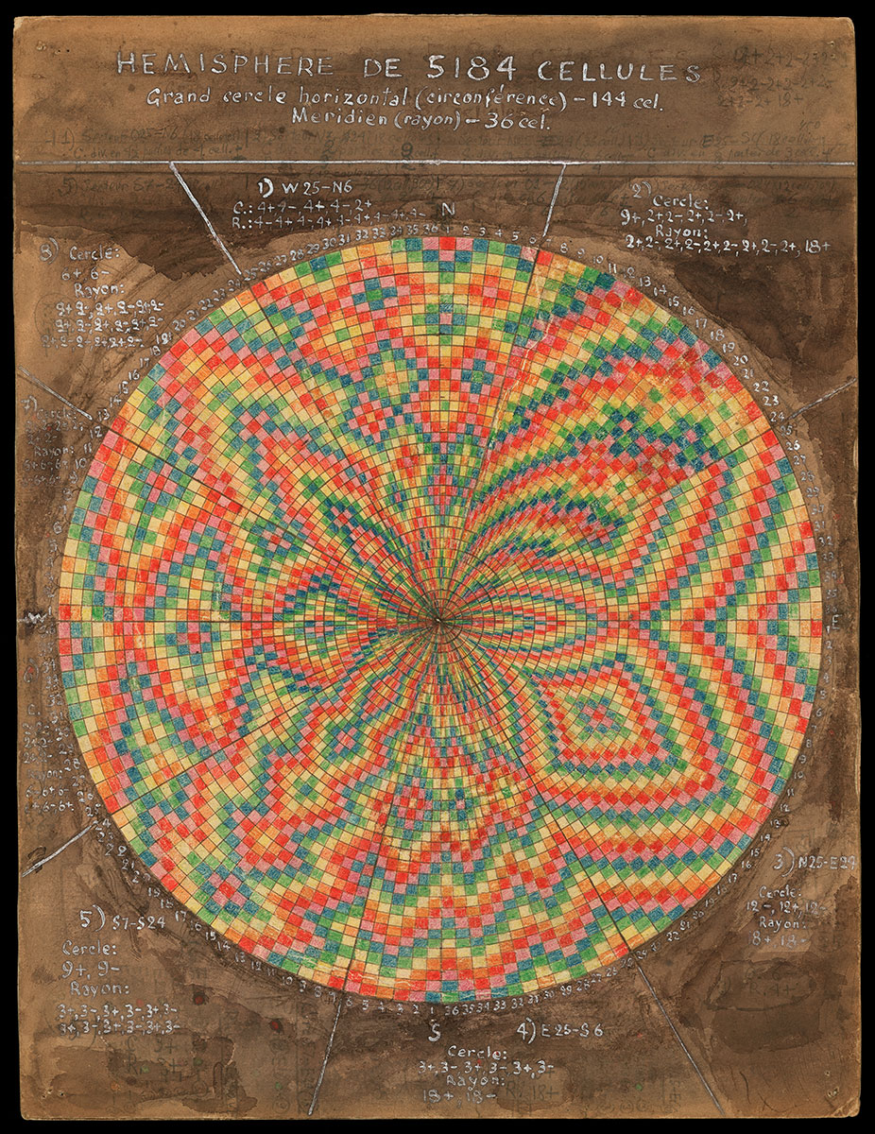

Slide 5
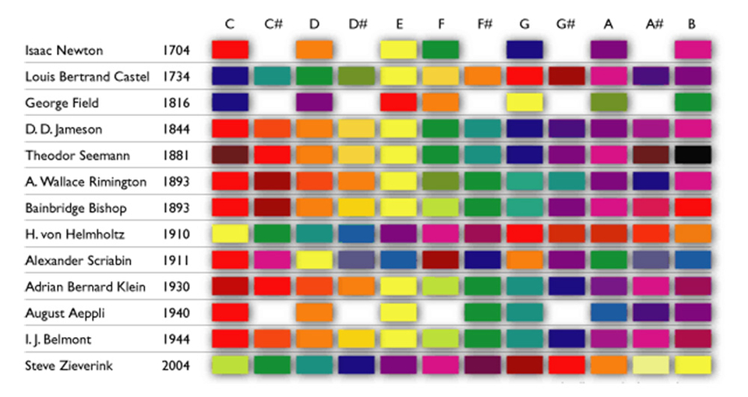
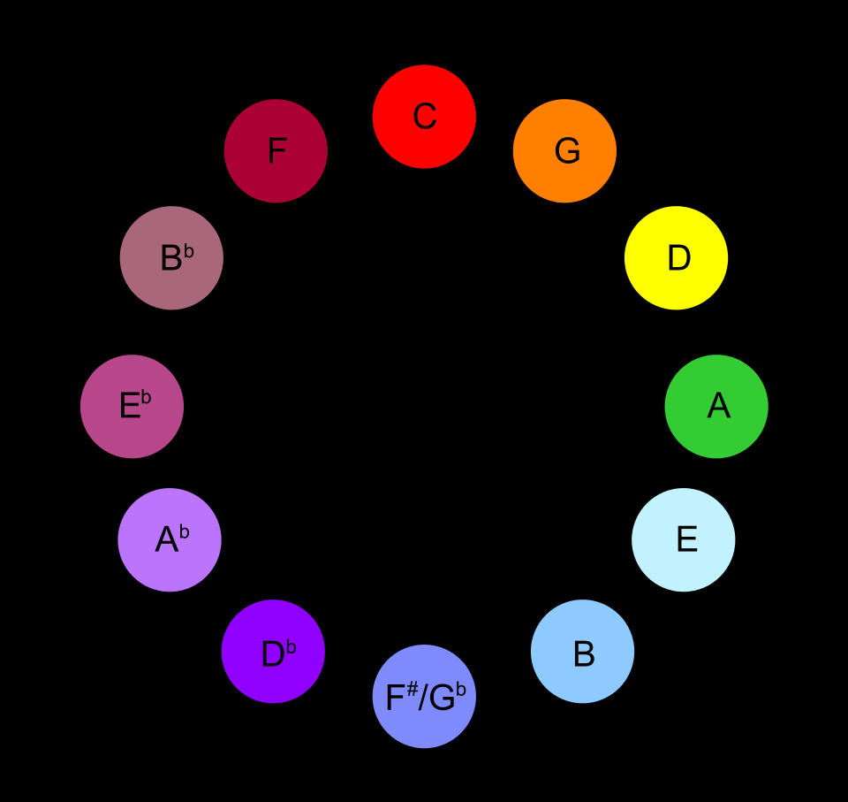
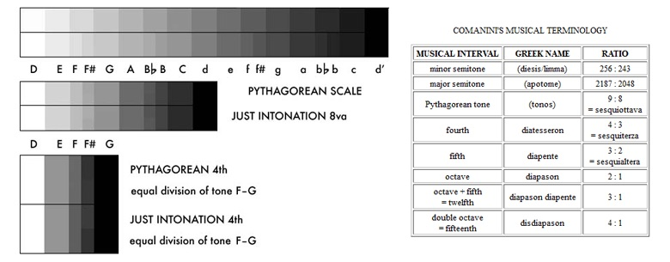
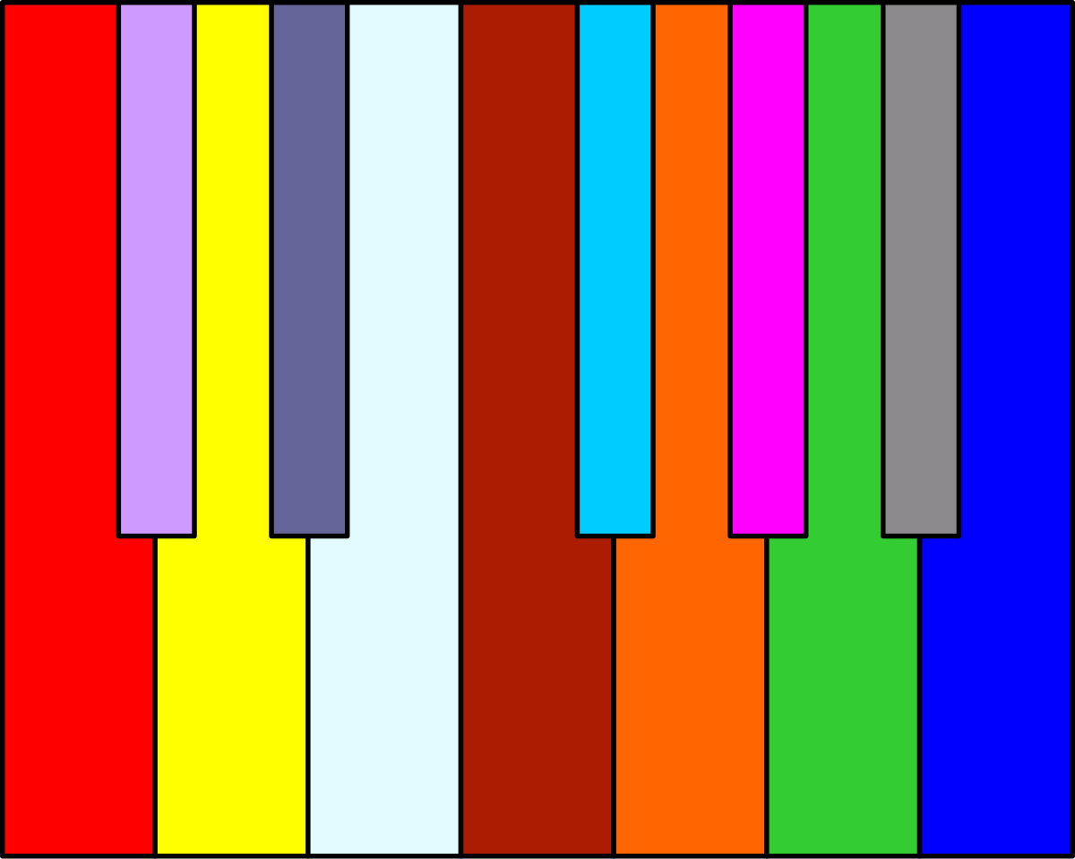

Slide 6
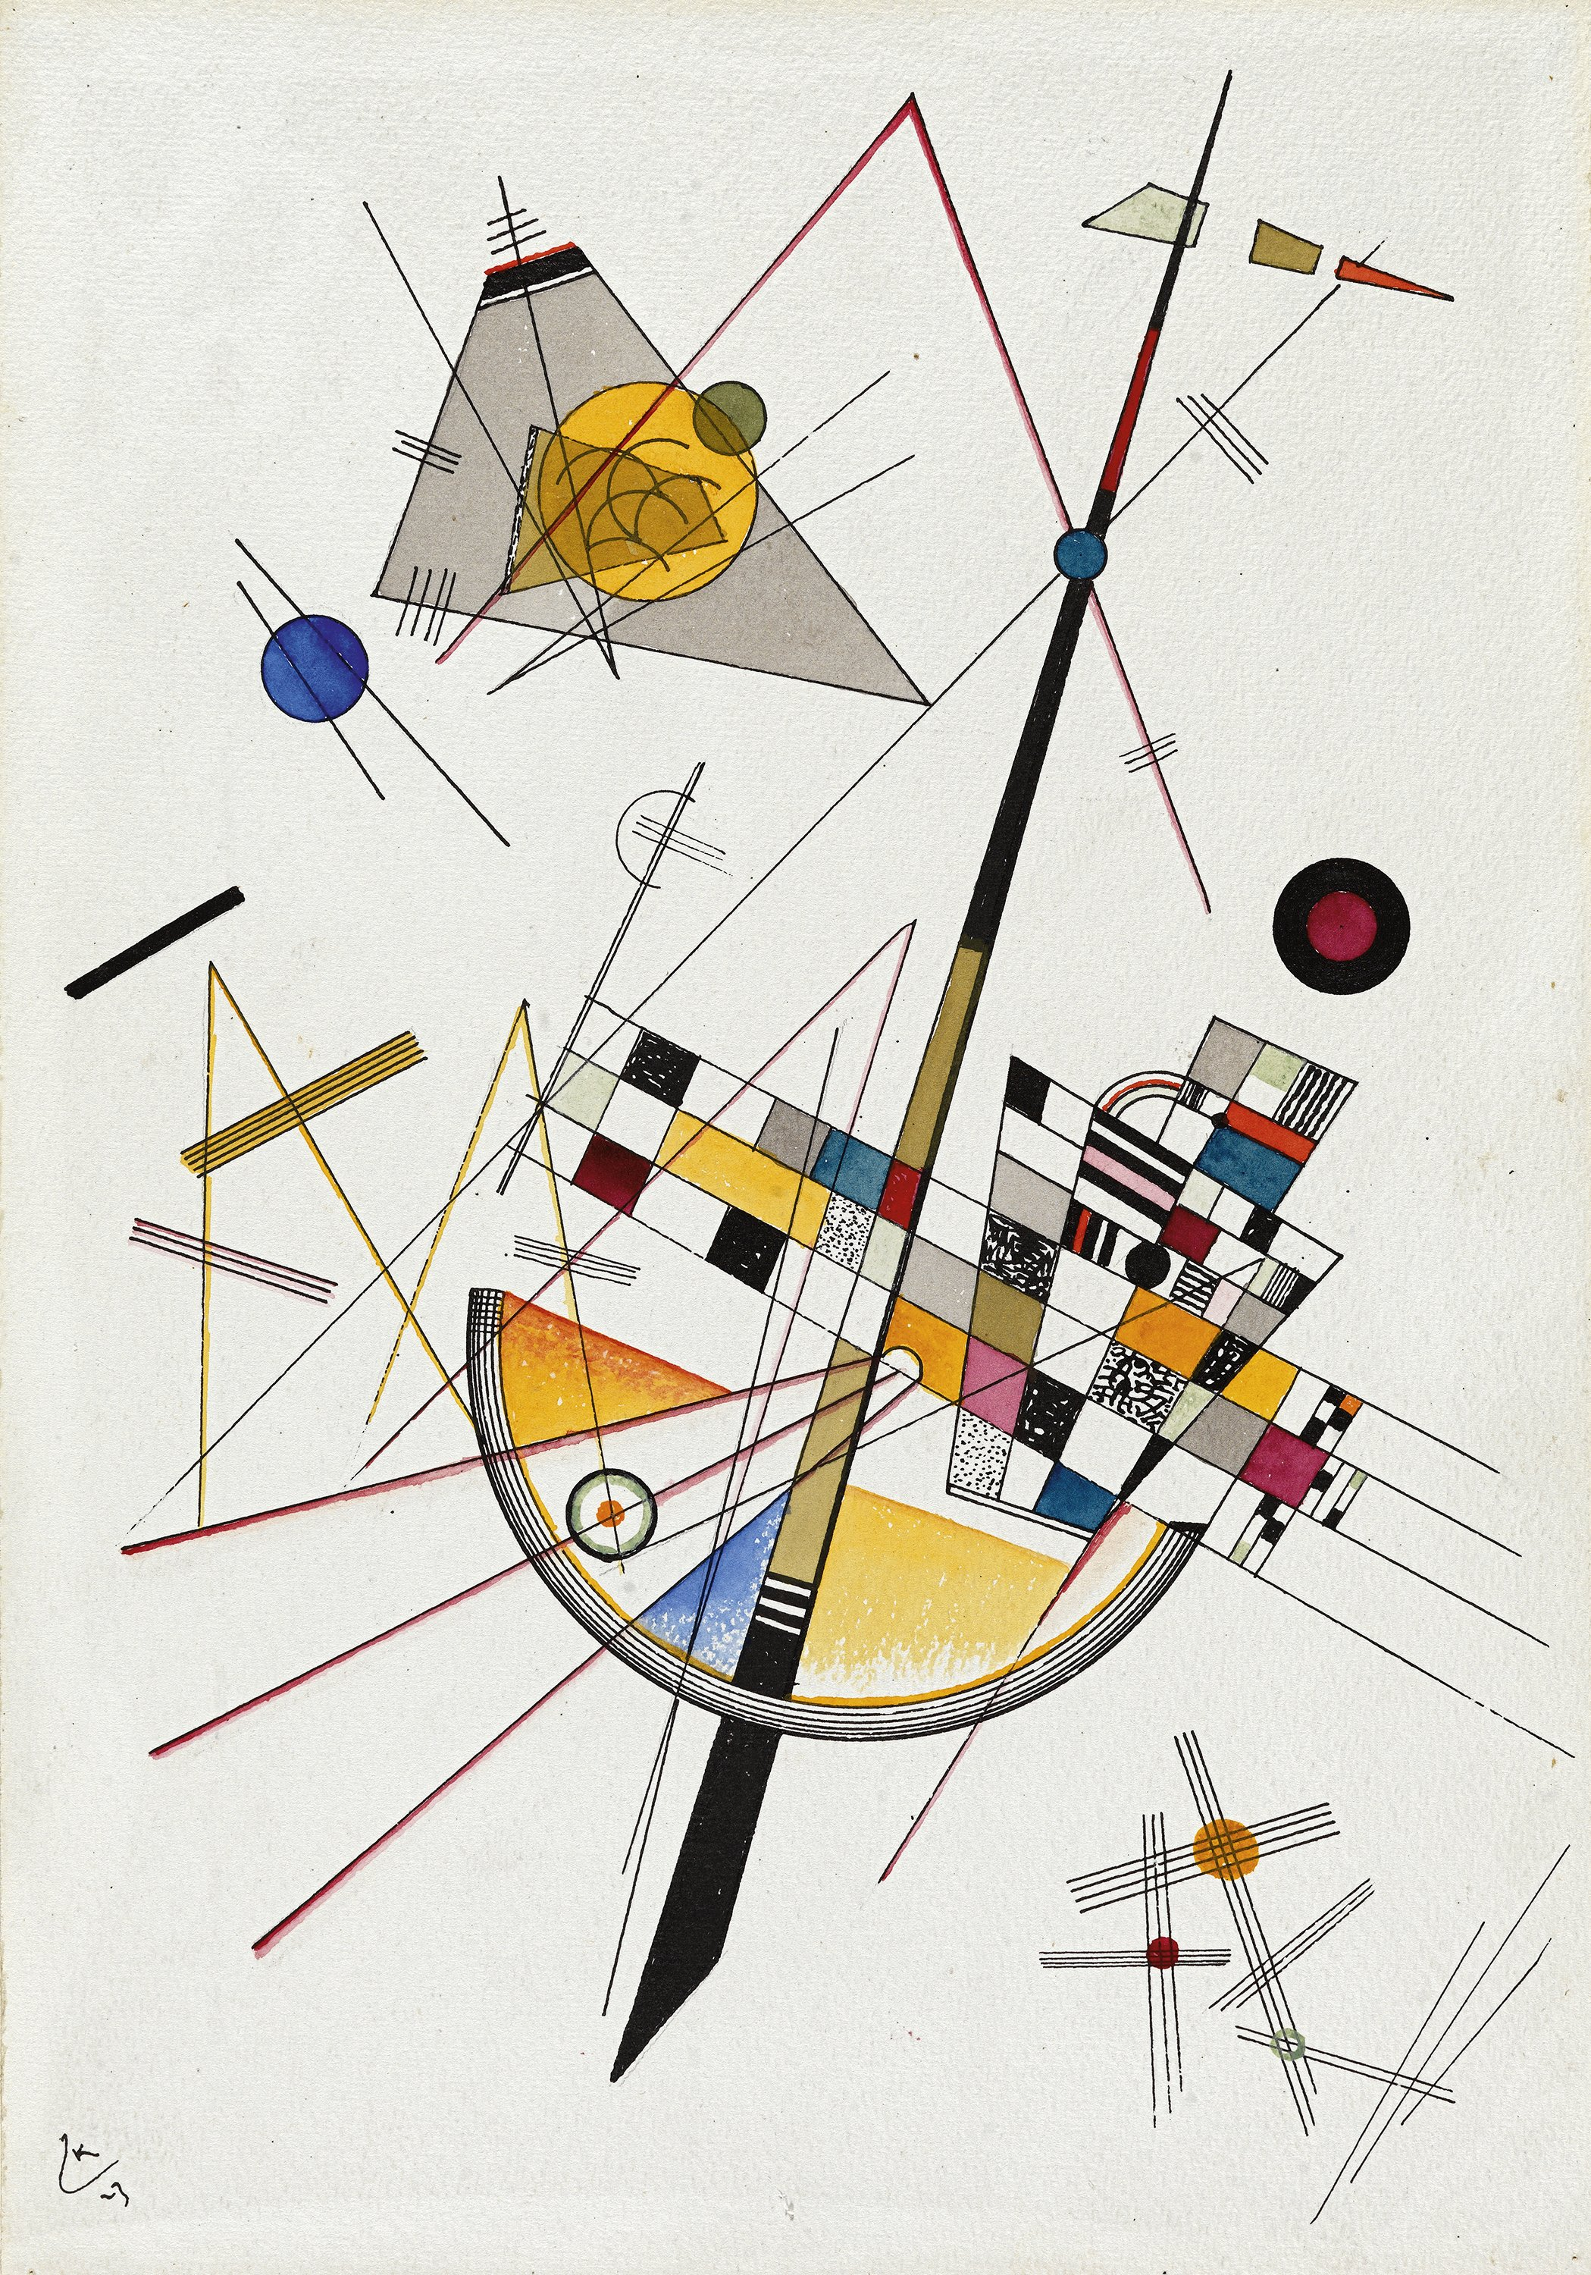
Wasily Kandinsky
“Red, however, which plays a considerable part in [the constitution of] orange, also preserves in this colour an undertone of seriousness ... [It] is like a medium-toned church bell ringing the Angelus or a powerful contralto voice, or a viola playing a largo...
Violet … is a cooled-down red in both a physical and a psychological sense. It therefore has something sad, an air of something sickly, something extinguished about it... It is like the sound of the cor anglais or the shawm, whereas its deeper tones resemble those of the lower woodwind (e.g. the bassoon).”

Slide 7
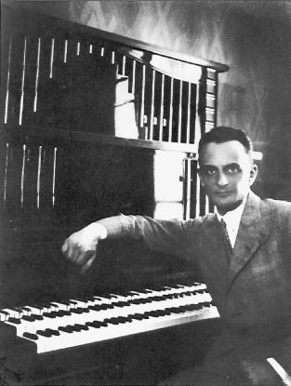
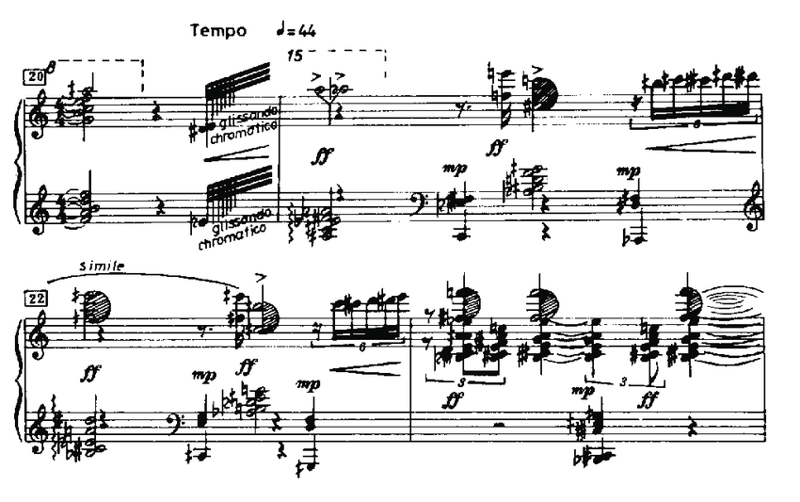
Ivan Wyschnegradsky

Slide 8
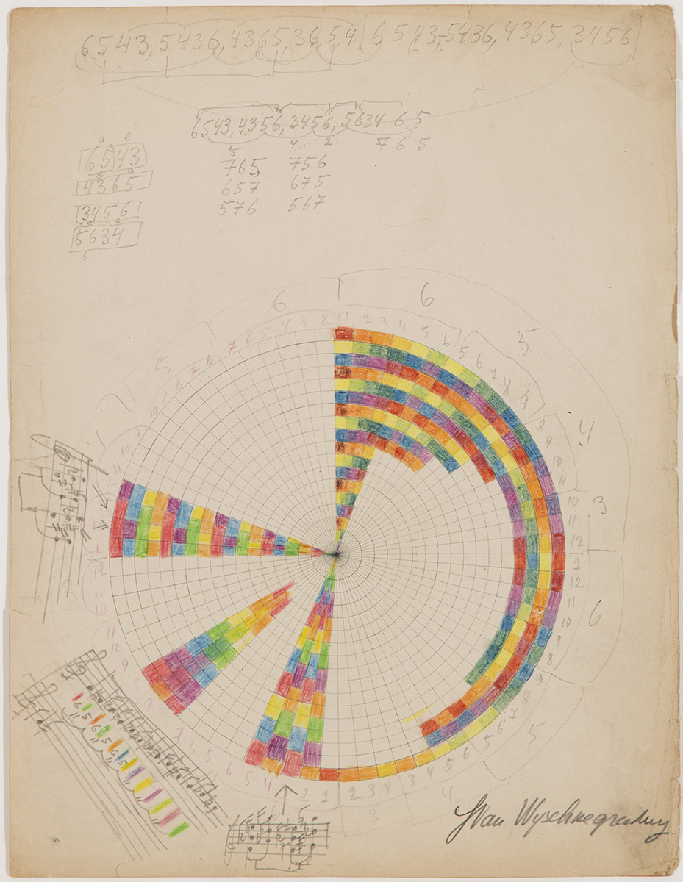
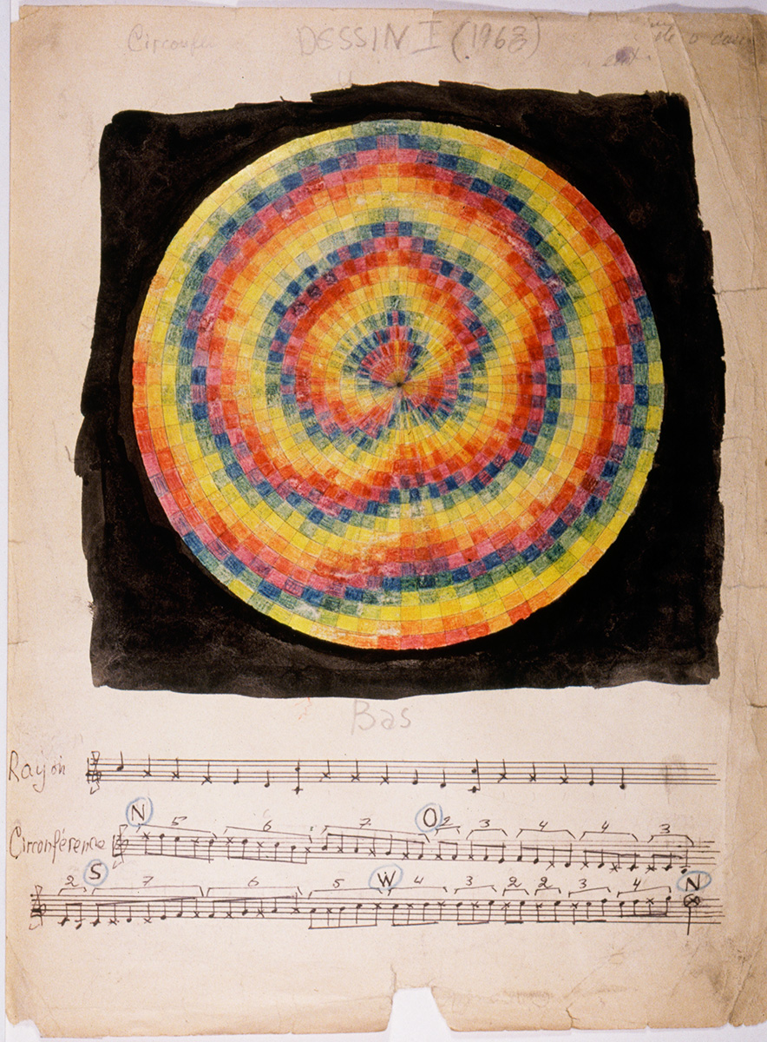

Slide 9
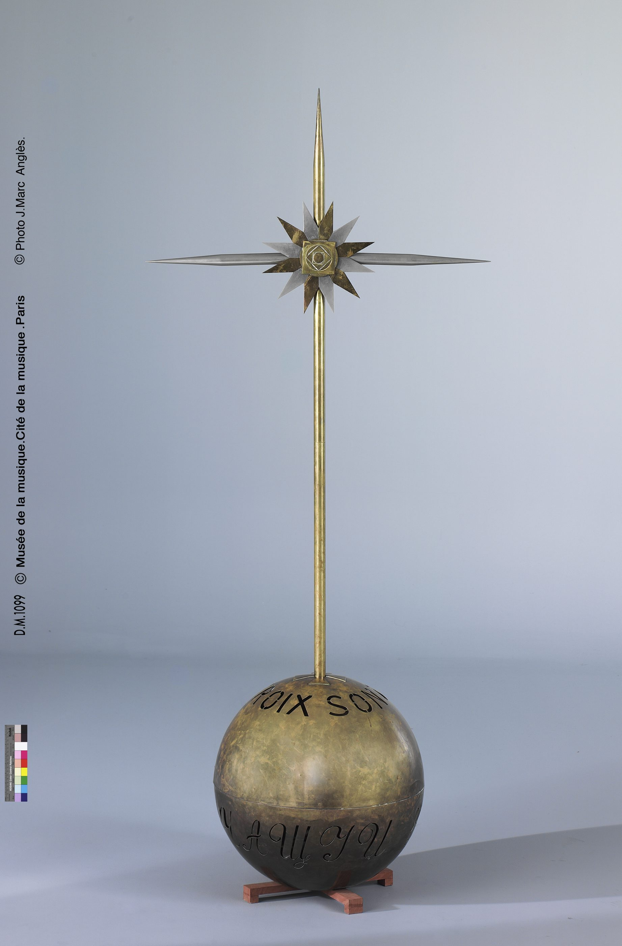
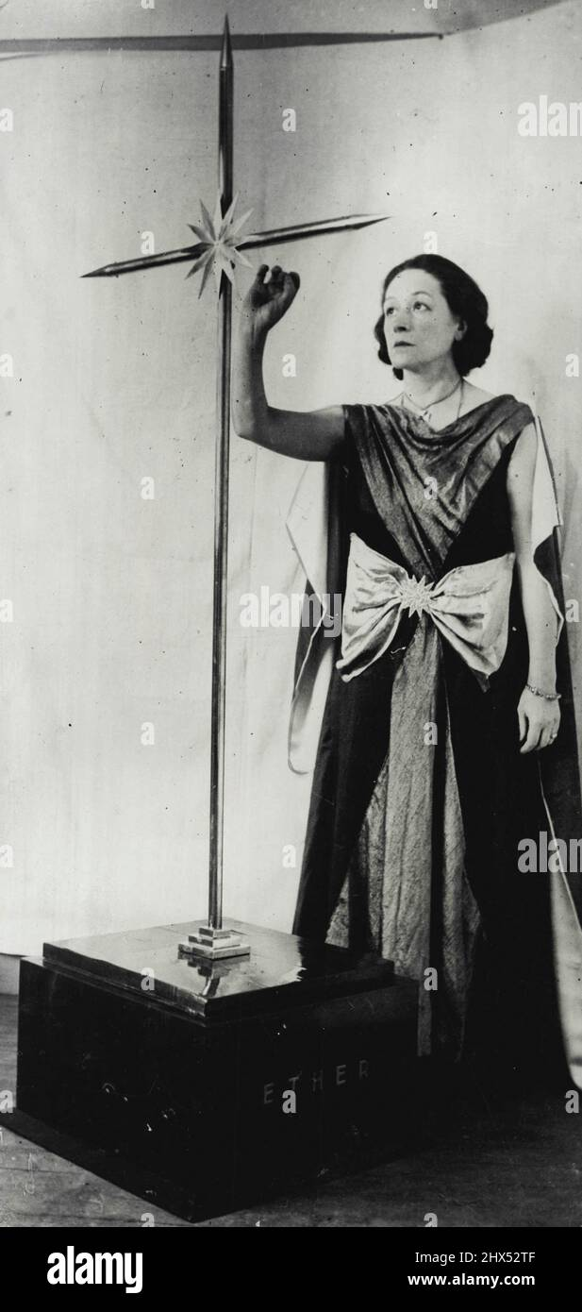
La Croix sonore

Slide 10
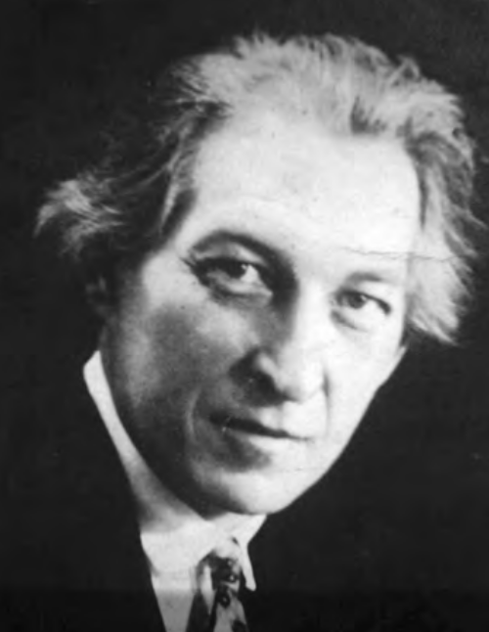
The Theremin will lead to:
“An extension of the European tonal system, which has brought out today’s music in the above mentioned deadlock.
A connection with the grandiose art of the East, hitherto not able to be realized because of the well-tempered twelve-tone system.
An all-time deep synthesis with the art of words, for speech intonations and timbres covering the Theremin range[…]
The creation of an absolutely new, unprecedented ‘differential’ music (Differenz-Musik) — grandiose harmonious ‘glissando’ in parallel and counter movement, without having already mentioned the enrichment of means even within the limits of old [musical] forms.” - Arseny Avraamov

Slide 11
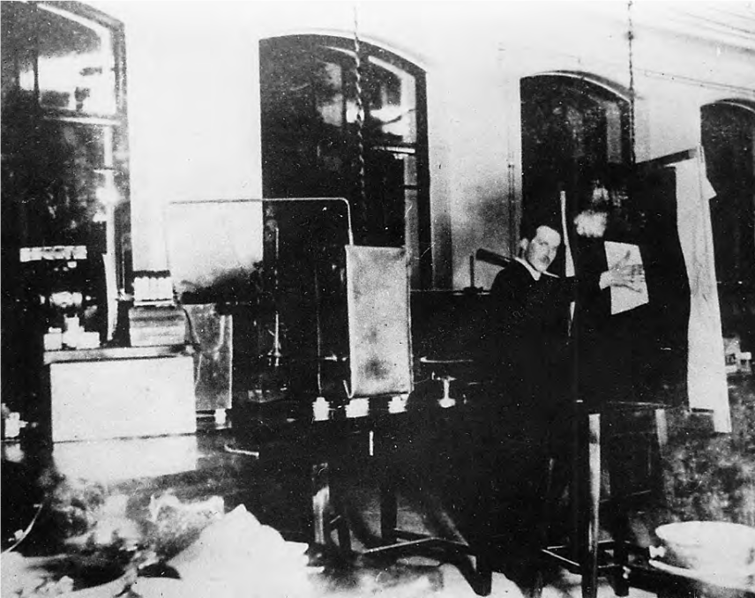
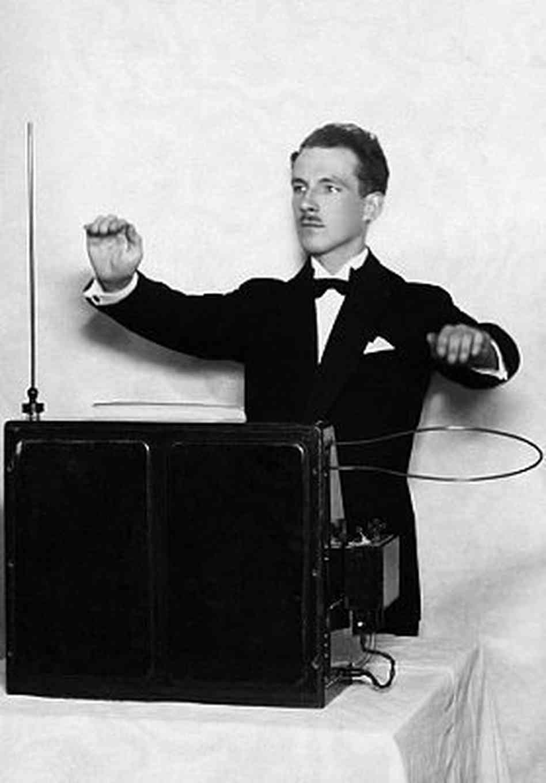
Leon Theremin
“Theremin was not really interested in details. He wanted to discover all the basic relationships and fundamental laws governing the system we call ‘the World’. He wanted to investigate and take under control the phenomena of life and death” (Smirnov).

Slide 12
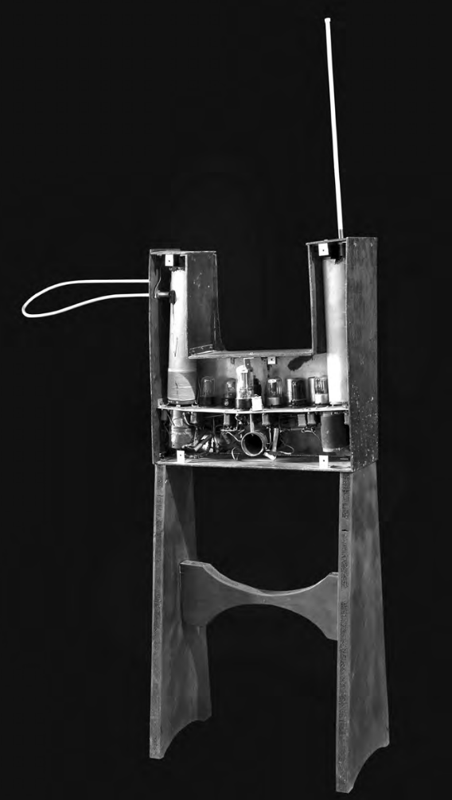

Slide 13
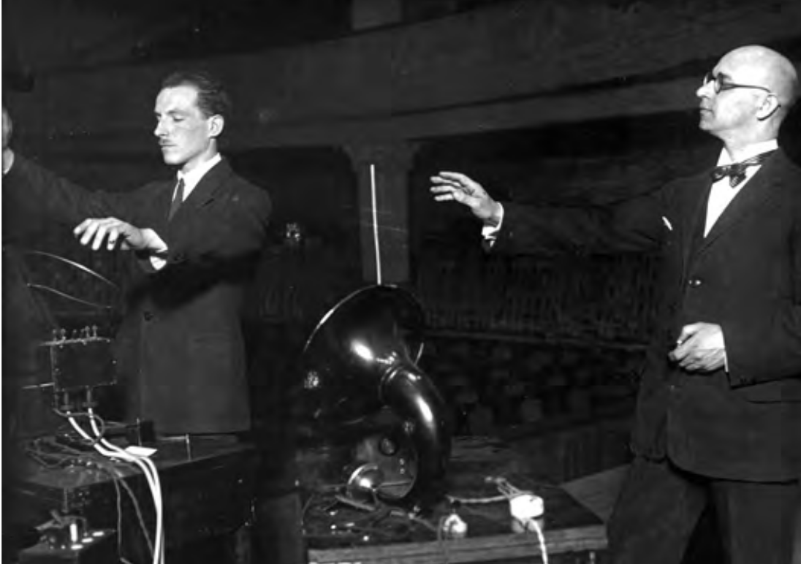
Leon Theremin and Konstantin Kovalsky (Moscow, 1926)

Slide 14
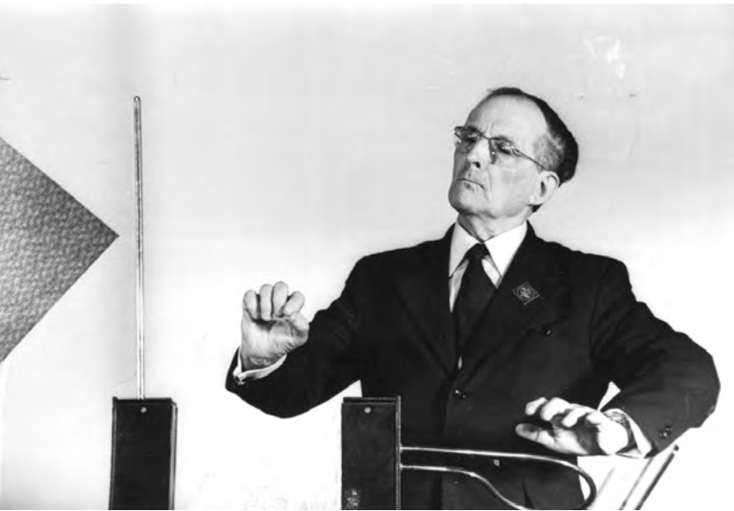
Leon Theremin (Moscow, 1965)

Slide 15
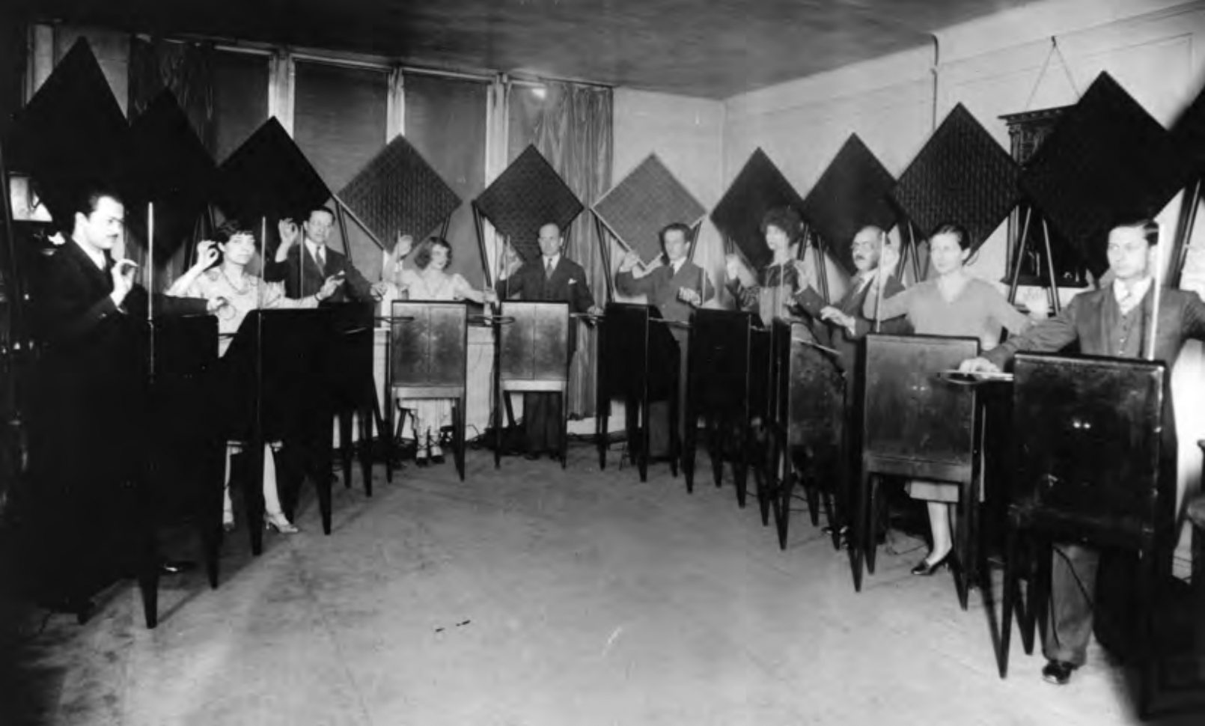
The 10 Victor Theremin ensemble in 1930

Slide 16
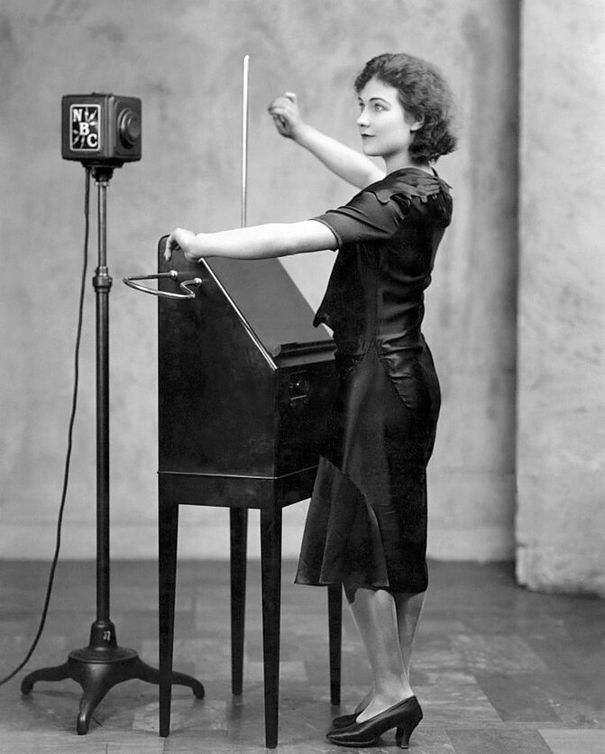
Clara Rockmore – The first Theremin virtuoso

Slide 17
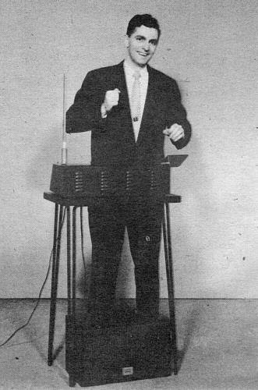
A Young Robert Moog with D.I.Y. Theremin.

Slide 18
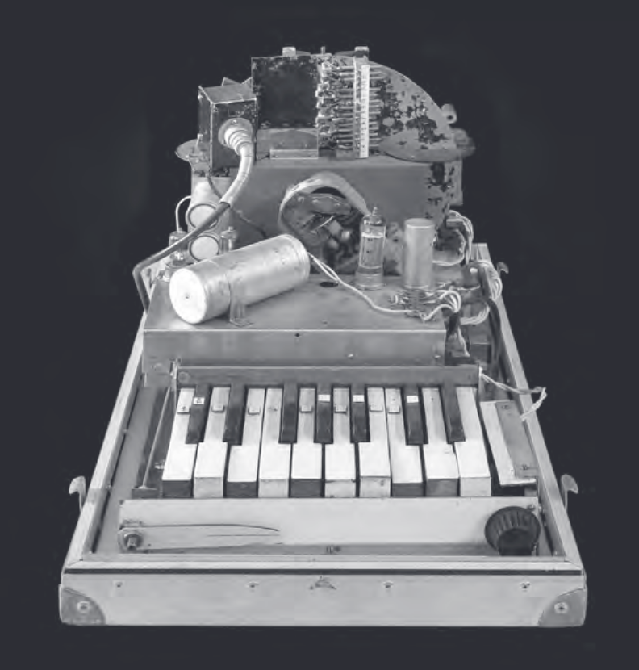
The Rhythmicon

Slide 19
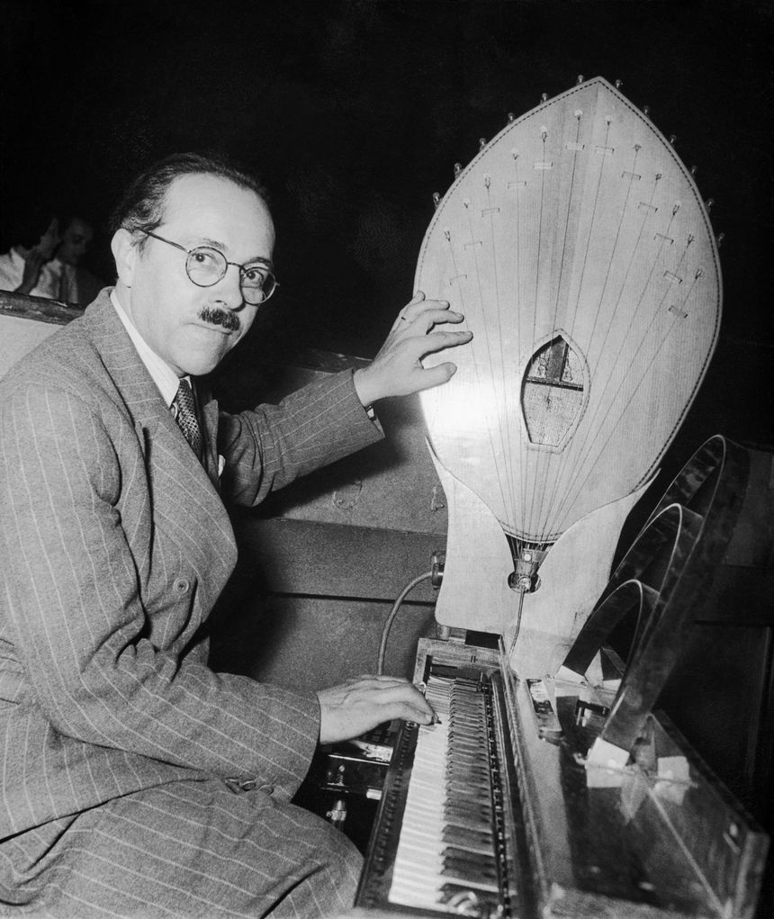
The Ondes Martinot

Slide 20
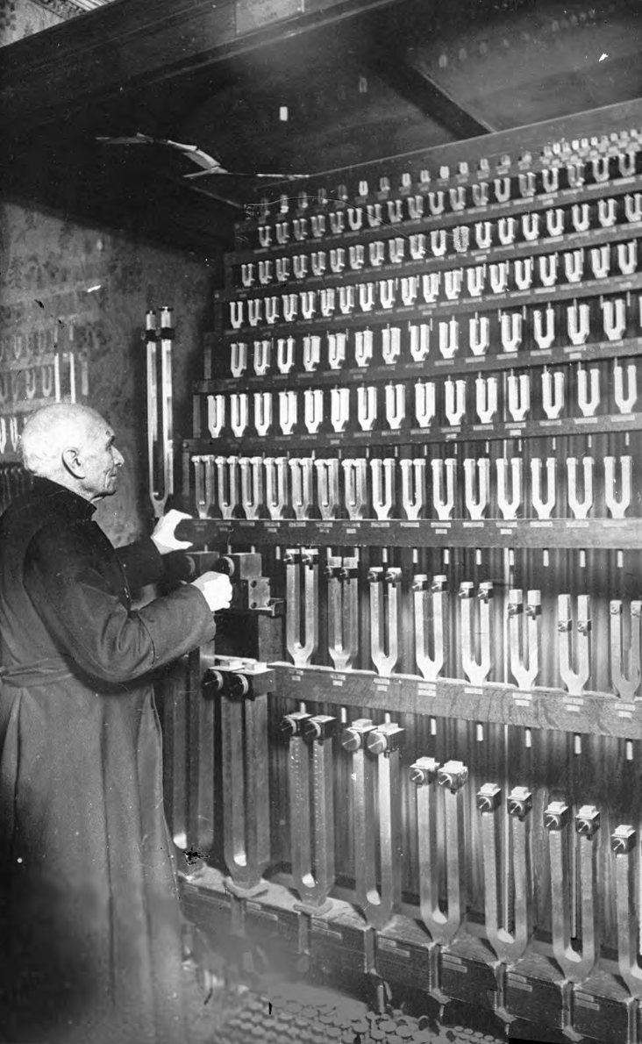
The Grand Tonometer

Slide 21
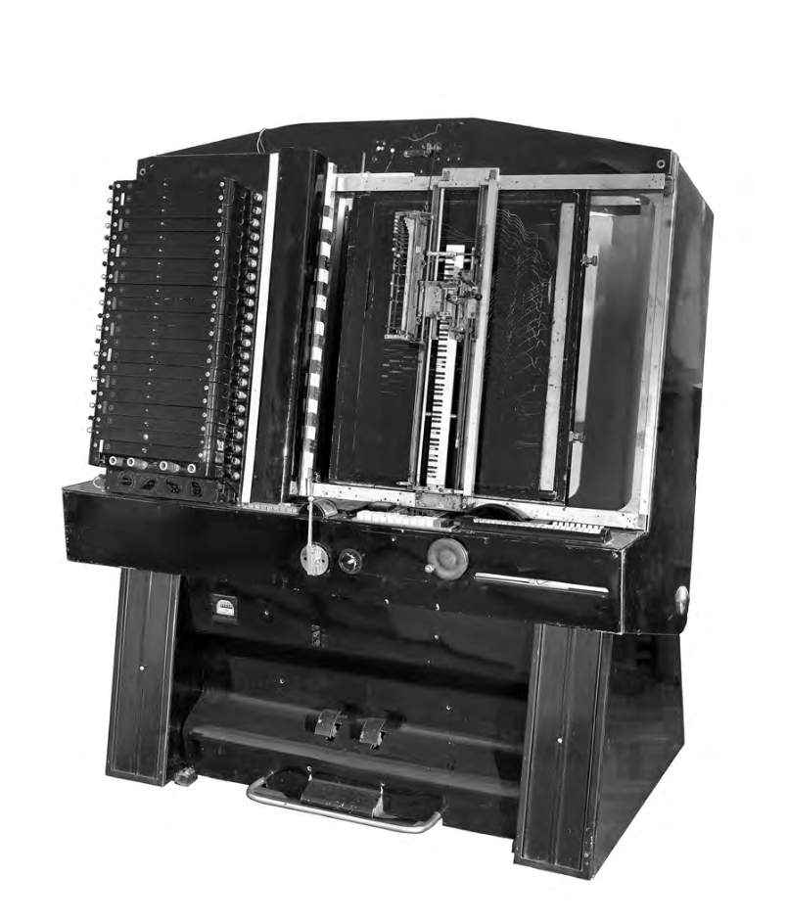
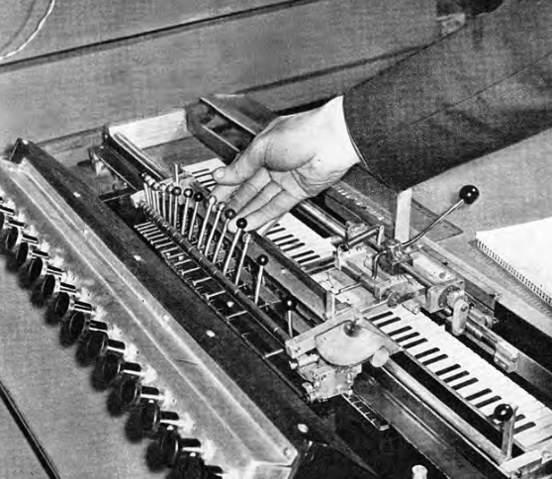
The ANS Synthesizer

Slide 22
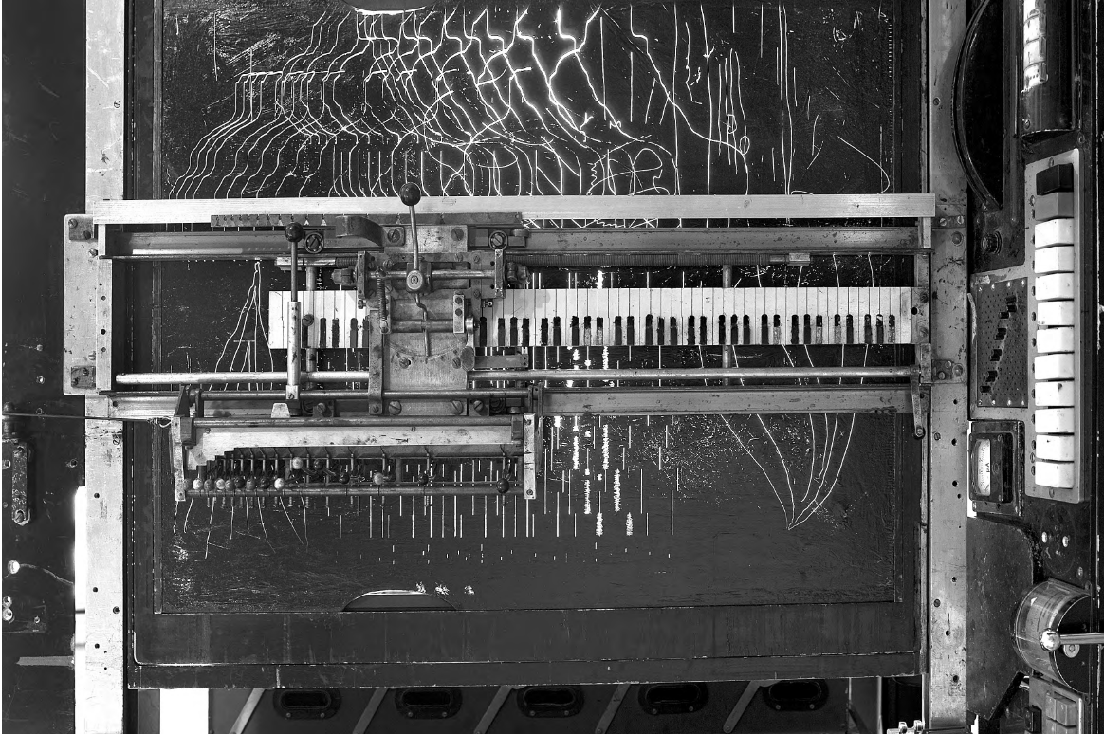

Slide 23
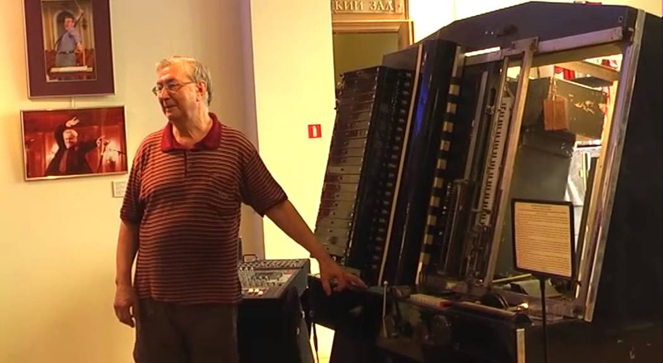
1:18:19

Slide 24
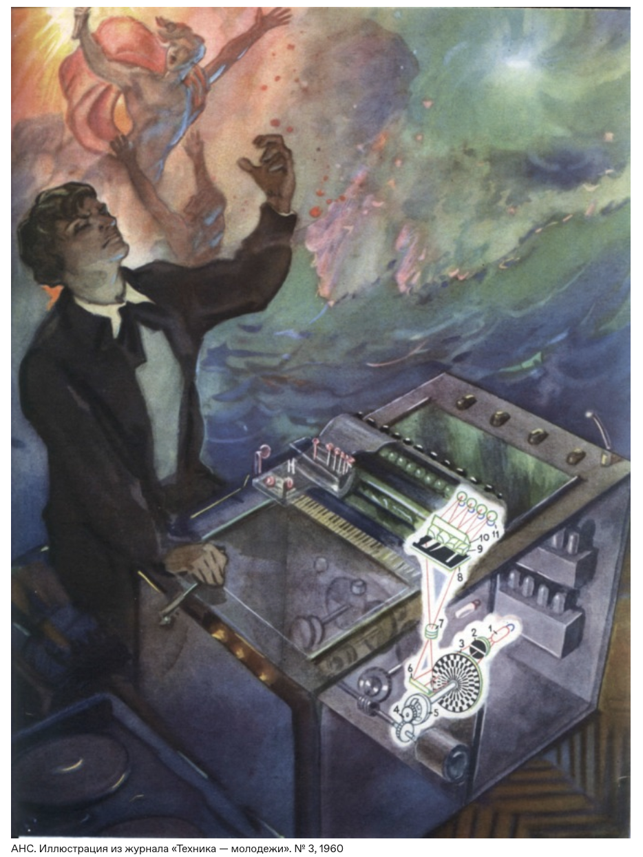
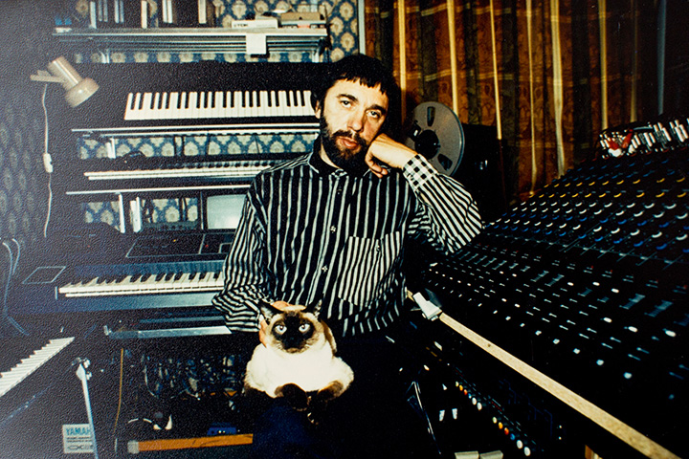
Edward Artemyev

Slide 25
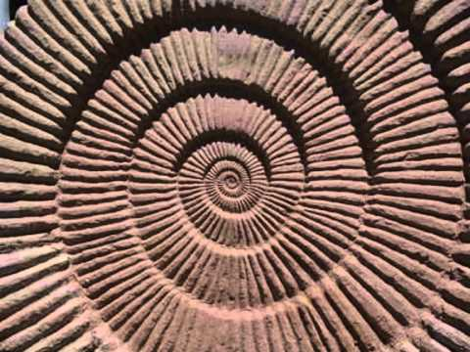
Sofia Gubaidulina: Vivente - Non vivente (1970)

Slide 26
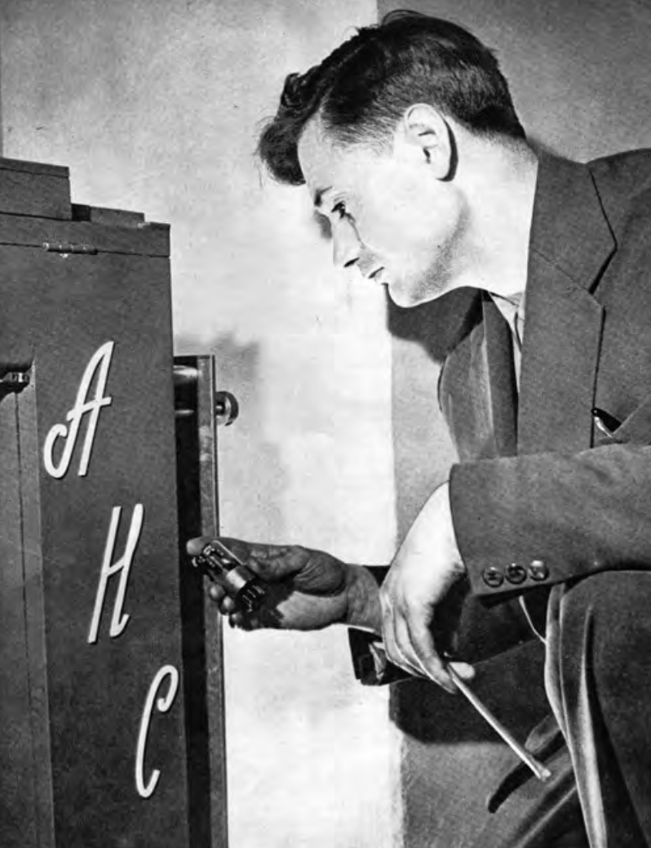
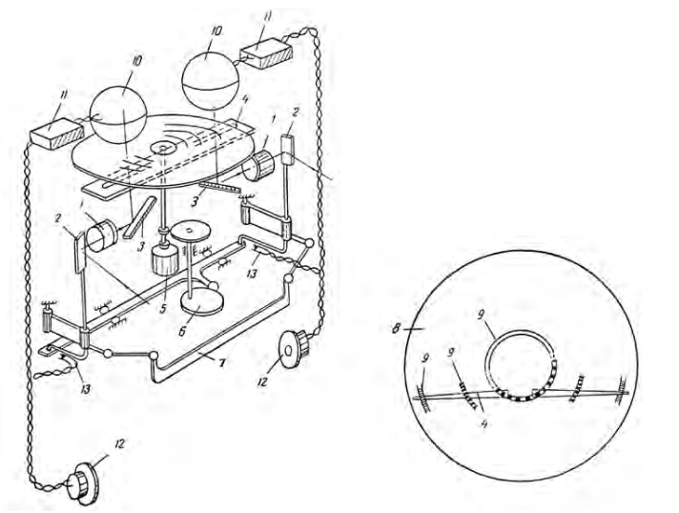
Artificial Synesthesia
Evgeny Murzin

Slide 27
