Slide 1
Asya Kurtuldu
Sound, Music, Noise: Historical Perspectives, 2025/26 Fall
Central European University, Vienna
Controlling noise and sound: architectural acoustics

Slide 2
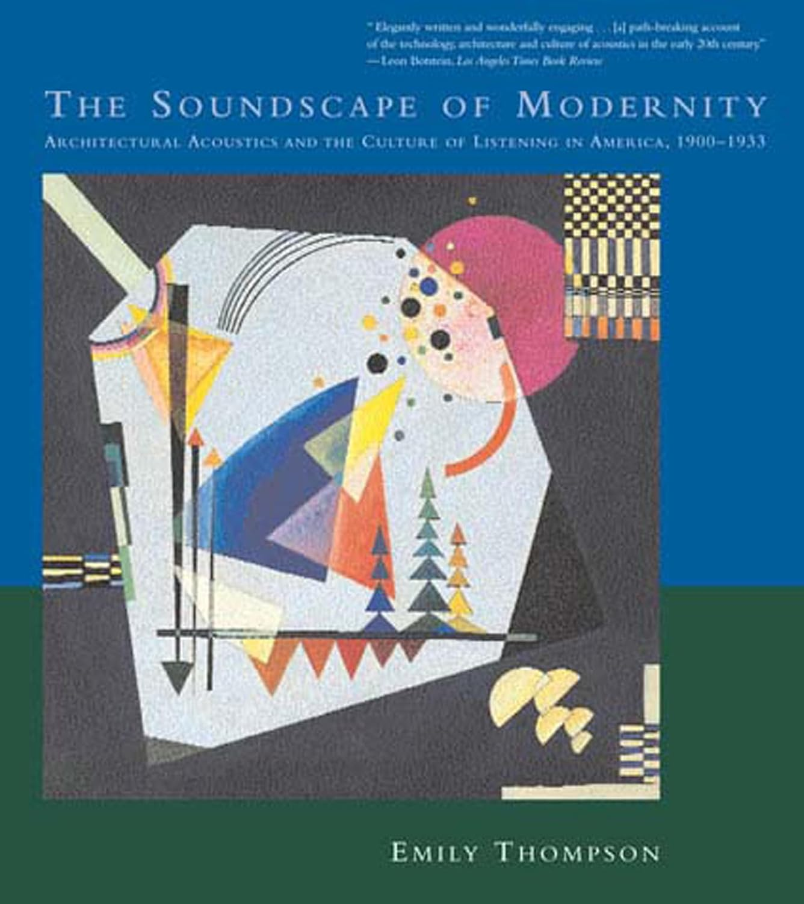
Emily Ann Thompson, The soundscape of modernity: architectural acoustics and the culture of listening in America, 1900-1933, Cambridge, MA: MIT Press, 2008.

Slide 3
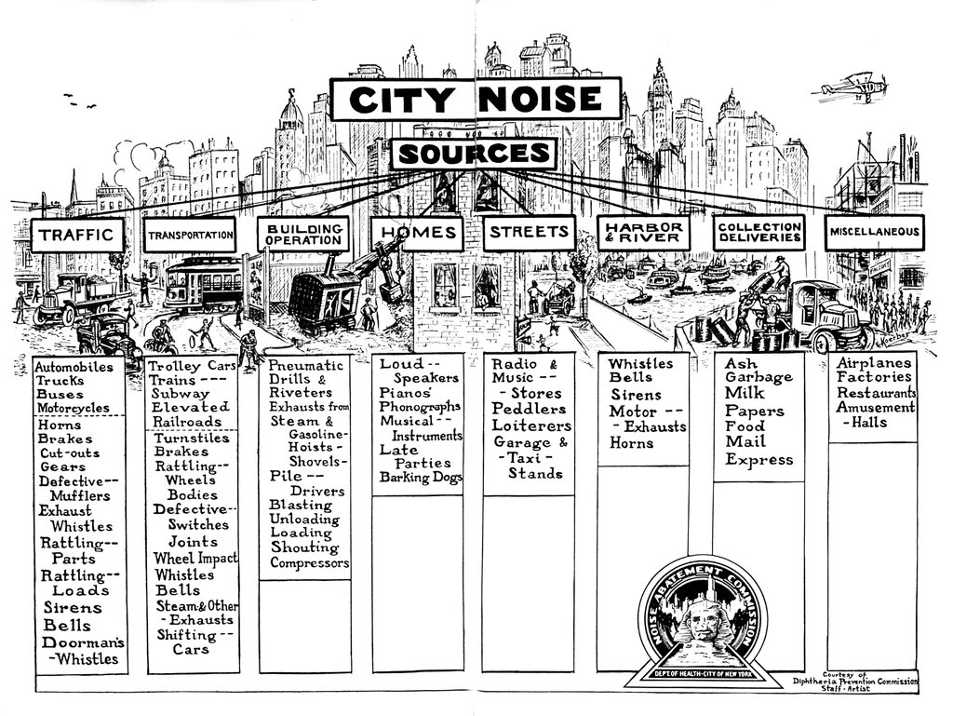
Frontispiece for the 1930 report of the Noise Abatement Commission of New York City. Taken from Emily Ann Thompson, The soundscape of modernity: architectural acoustics and the culture of listening in America, 1900-1933, Cambridge, MA: MIT Press, 2008, 118.

Slide 4
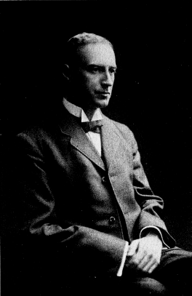
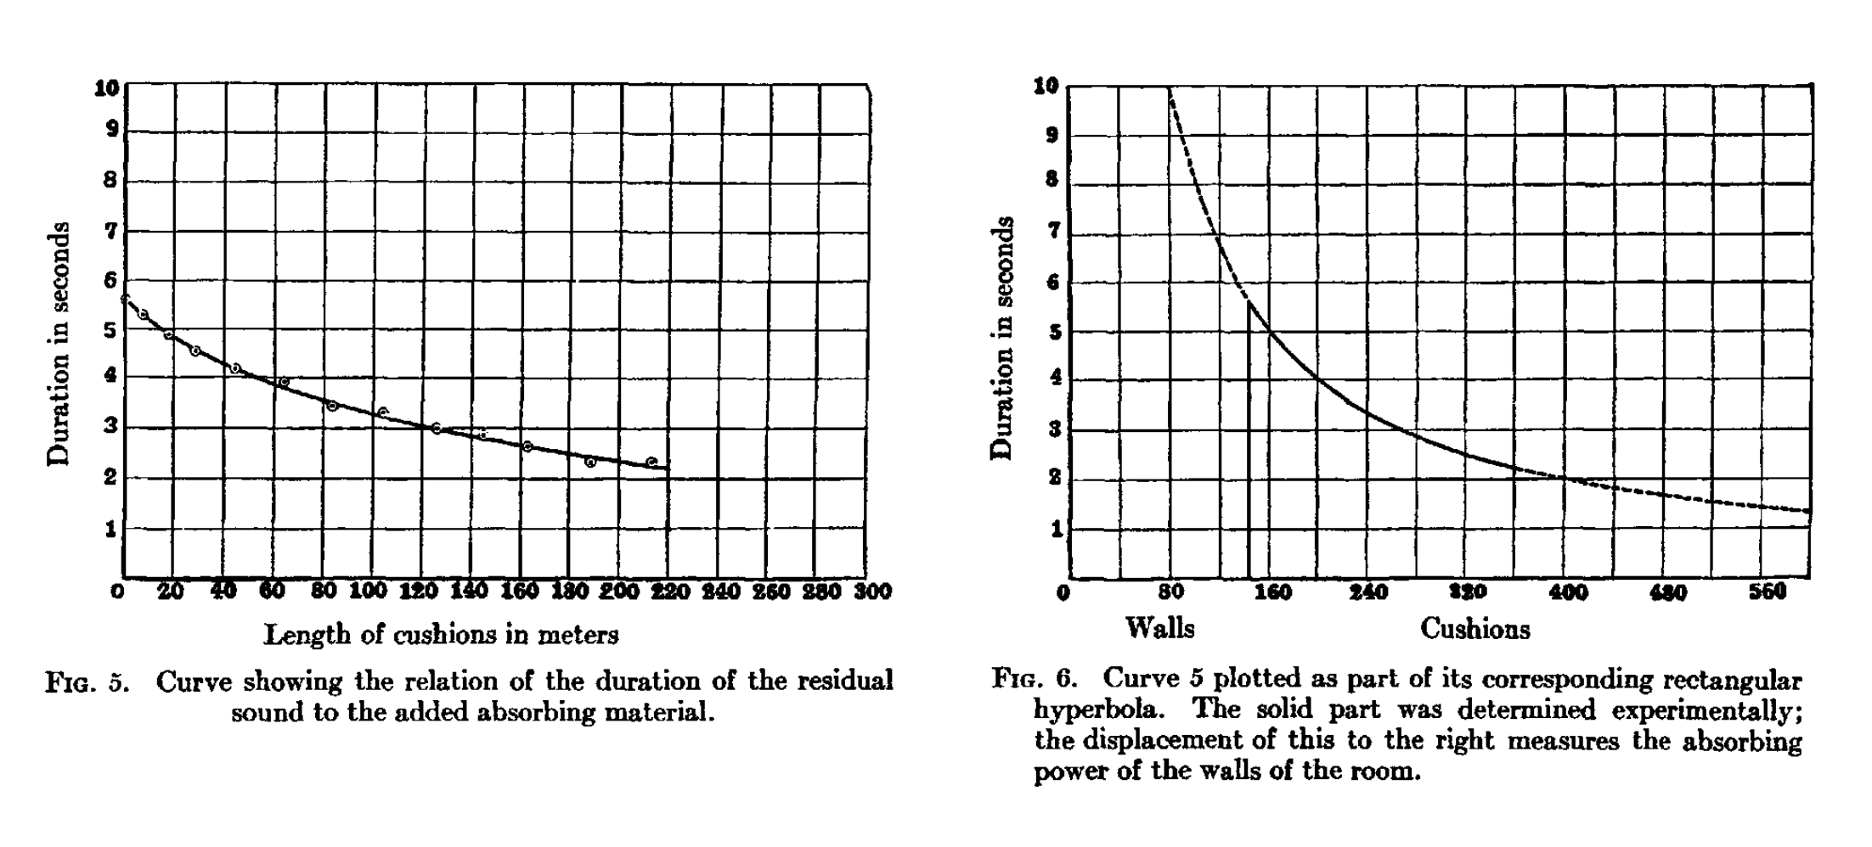
“Wallace Sabine's plots of reverberation time versus the amount of sound-absorbing material in a room, 1900. The first graph shows his experimentally derived data. The second graph shows how he extrapolated this curve to discover the hyperbolic relationship between the two quantities.” Taken from Emily Ann Thompson, The soundscape of modernity: architectural acoustics and the culture of listening in America, 1900-1933, Cambridge, MA: MIT Press, 2008, 38.
Wallace Clement Sabine (1868-1919). Taken from: https://de.wikipedia.org/wiki/Wallace_Clement_Sabine (4.12.2024).

Slide 5
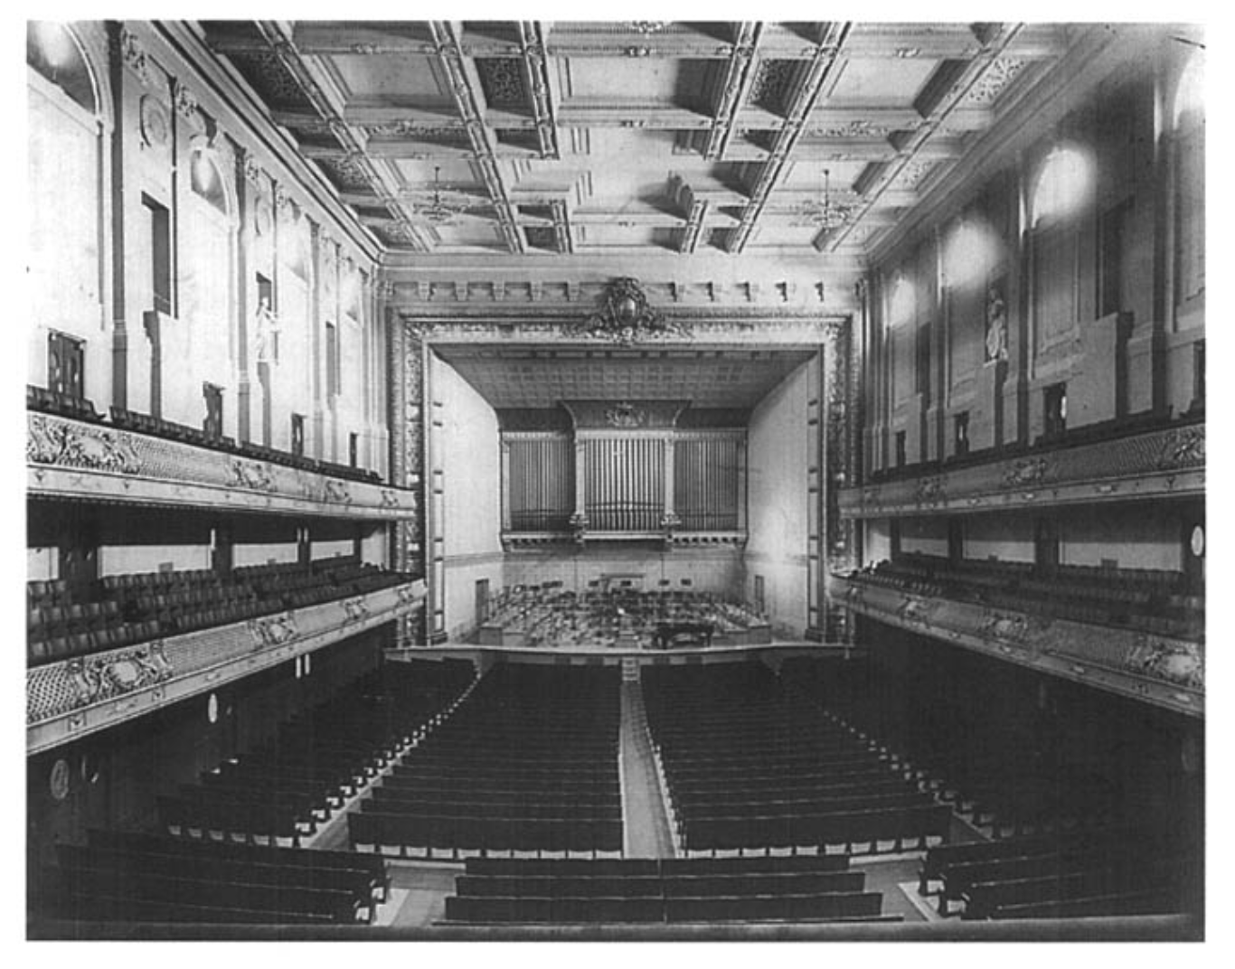
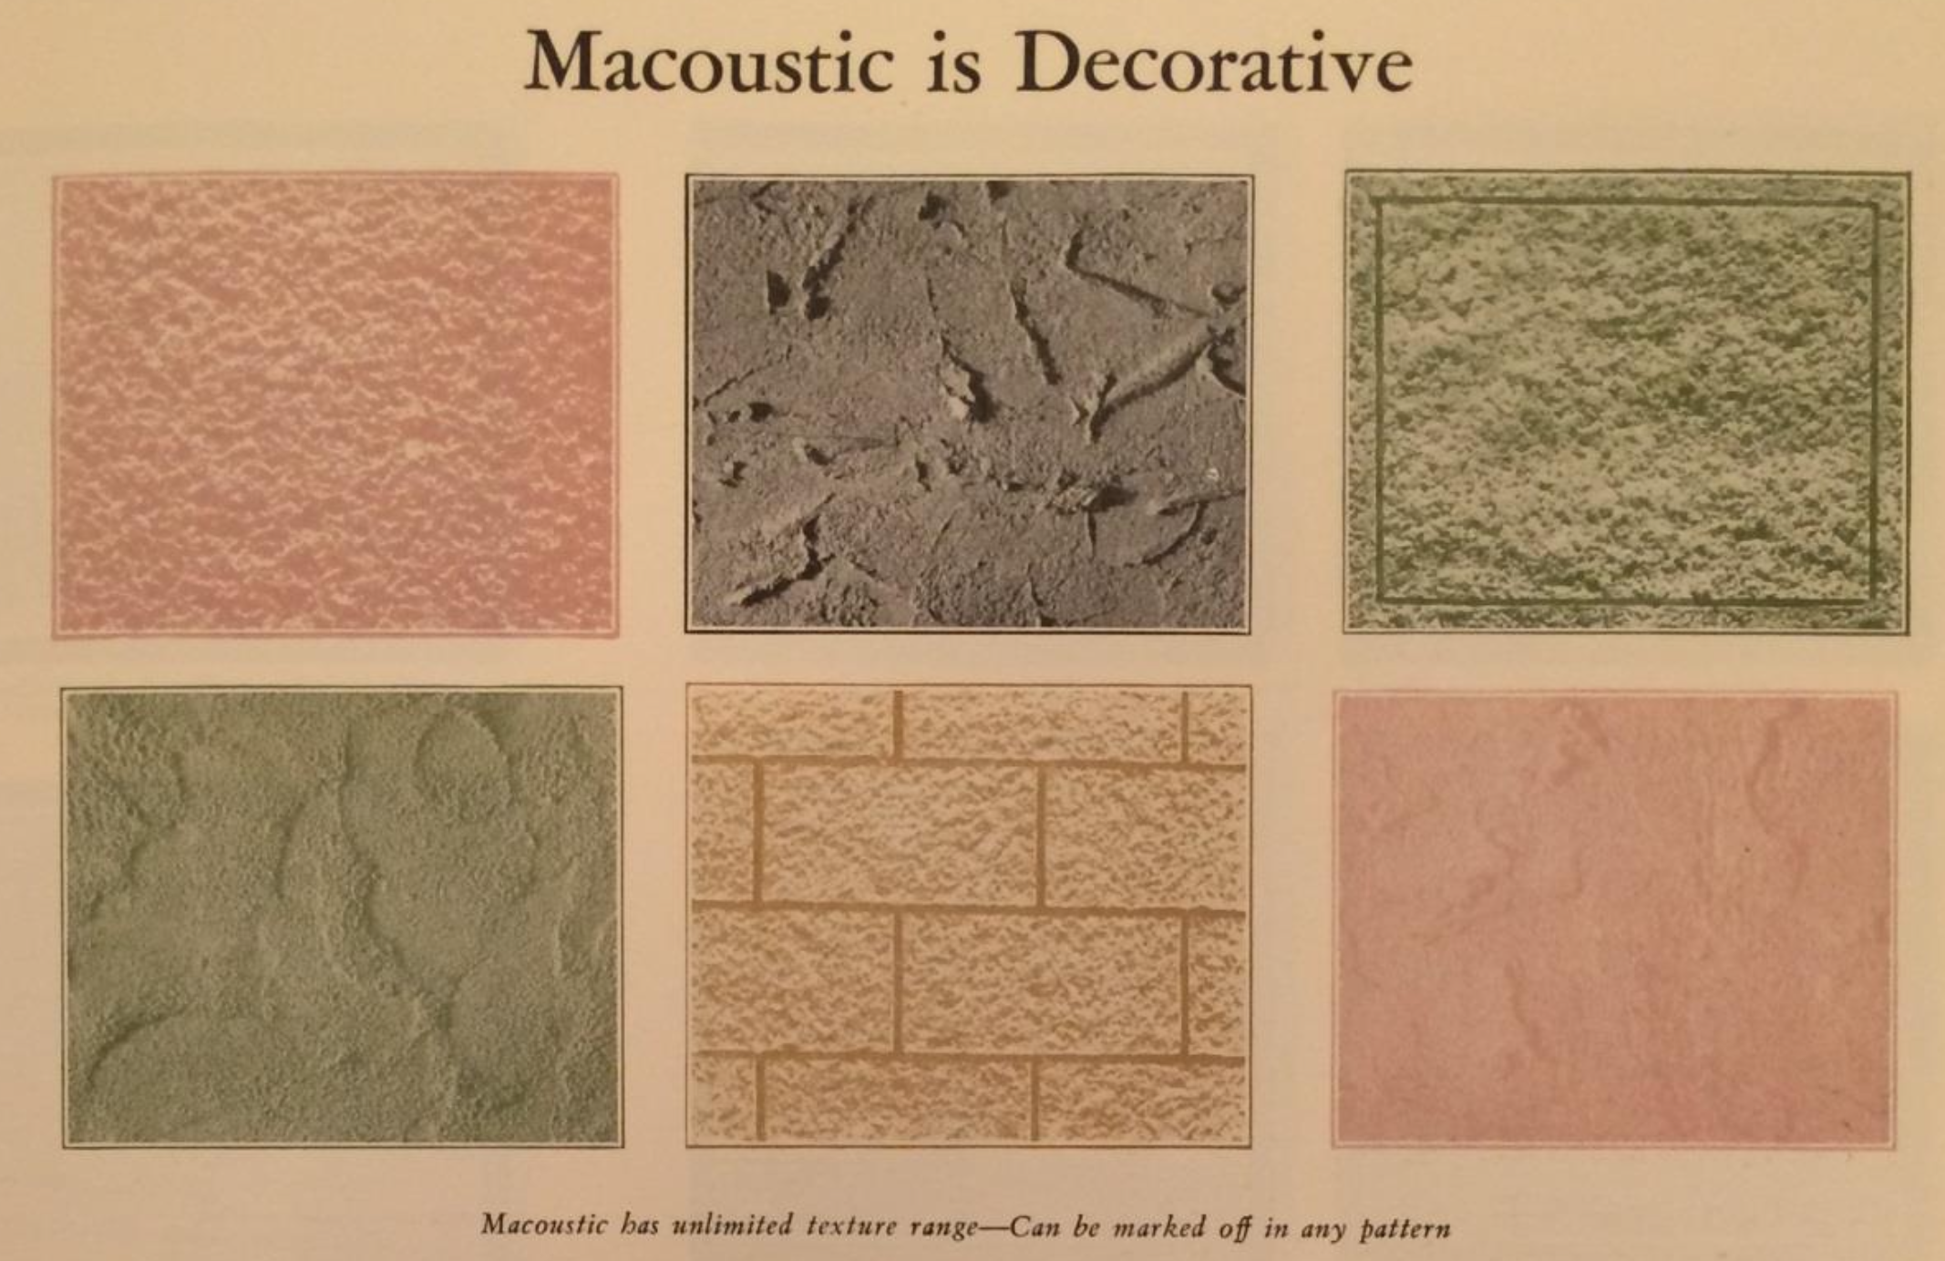
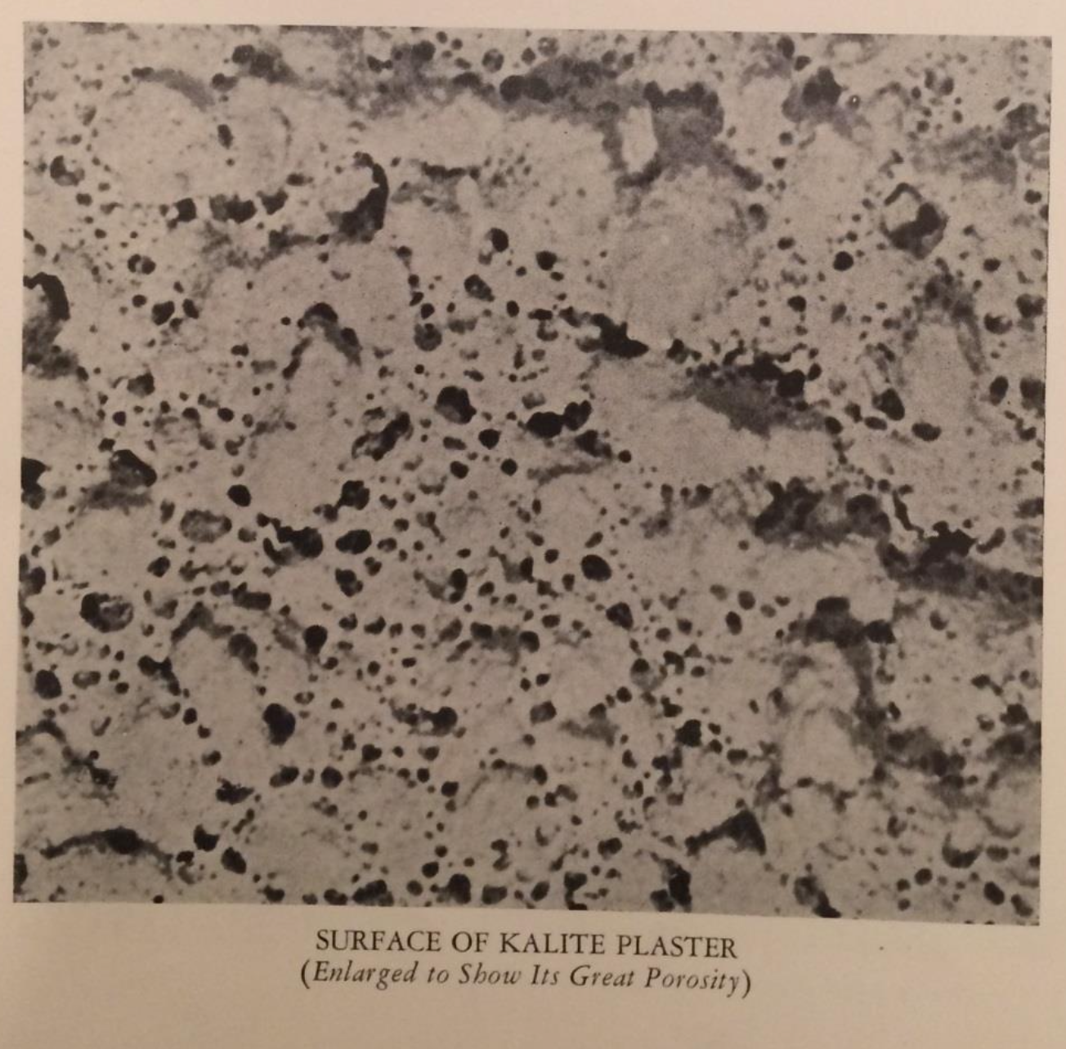
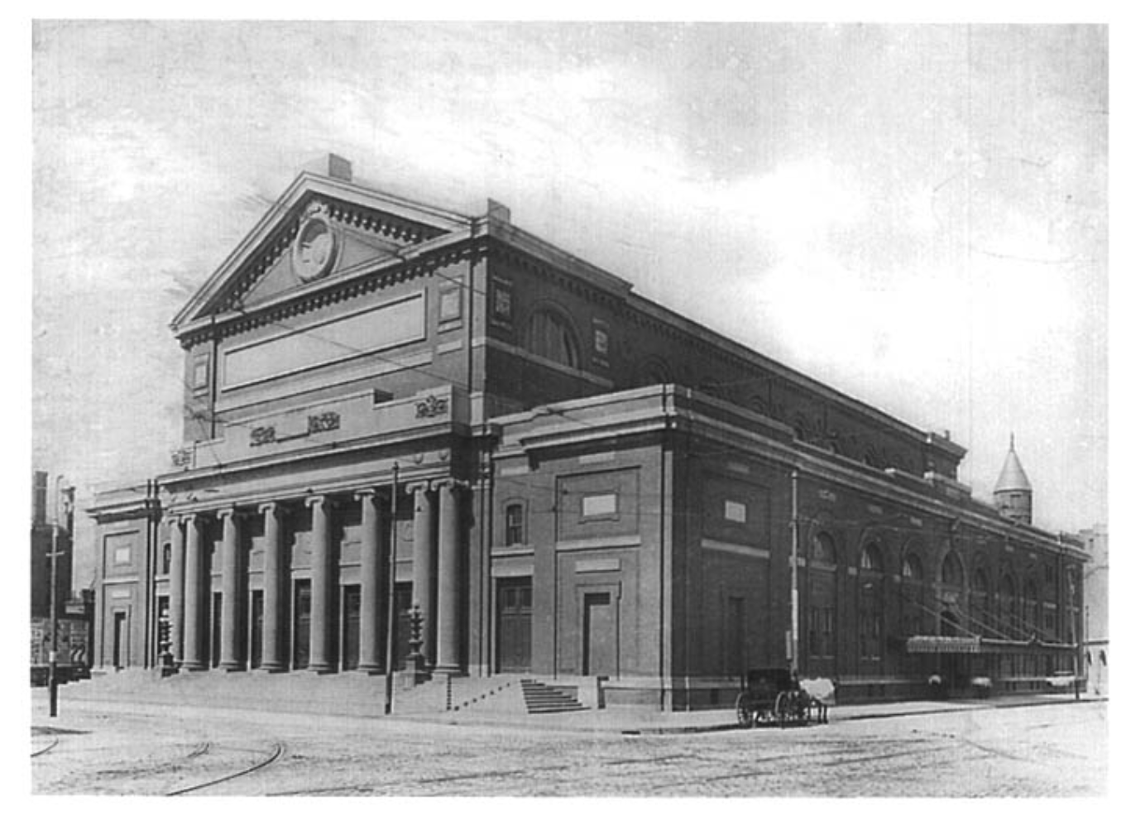
Advertisement brochure: Macoustic Engineering Company, “Macoustic: sound control.” Taken from Dona Yu, “Sound advice: the development and use of early 20th century acoustical wall and ceiling materials,” MA-thesis, Columbia University, 2015, 156.
Advertisement brochure: Certain-Teed Products Corp., “Kalite: sound absorbing plaster,” New York. Taken from Dona Yu, “Sound advice: the development and use of early 20th century acoustical wall and ceiling materials,” MA-thesis, Columbia University, 2015, 129.
Symphony Hall, Boston, c. 1900. Taken from Emily Ann Thompson, The soundscape of modernity: architectural acoustics and the culture of listening in America, 1900-1933, Cambridge, MA: MIT Press, 2008, 14.

Slide 6
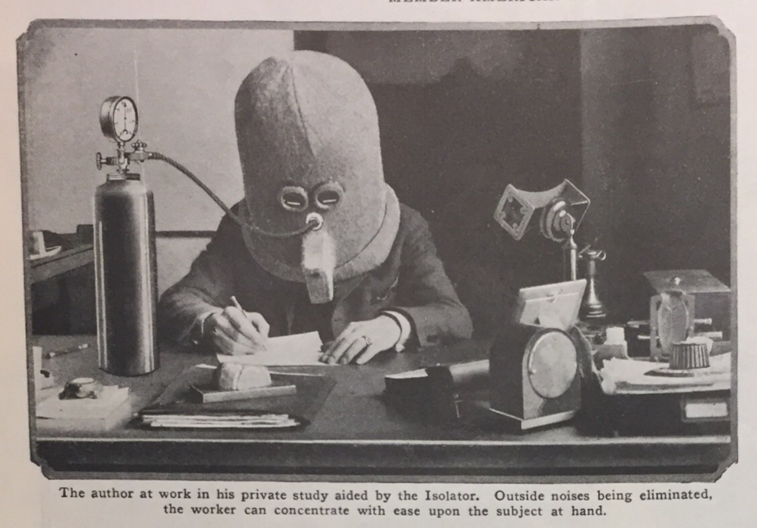
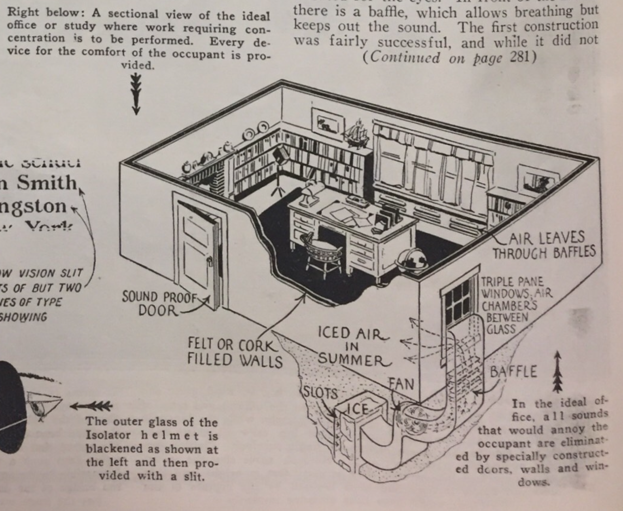
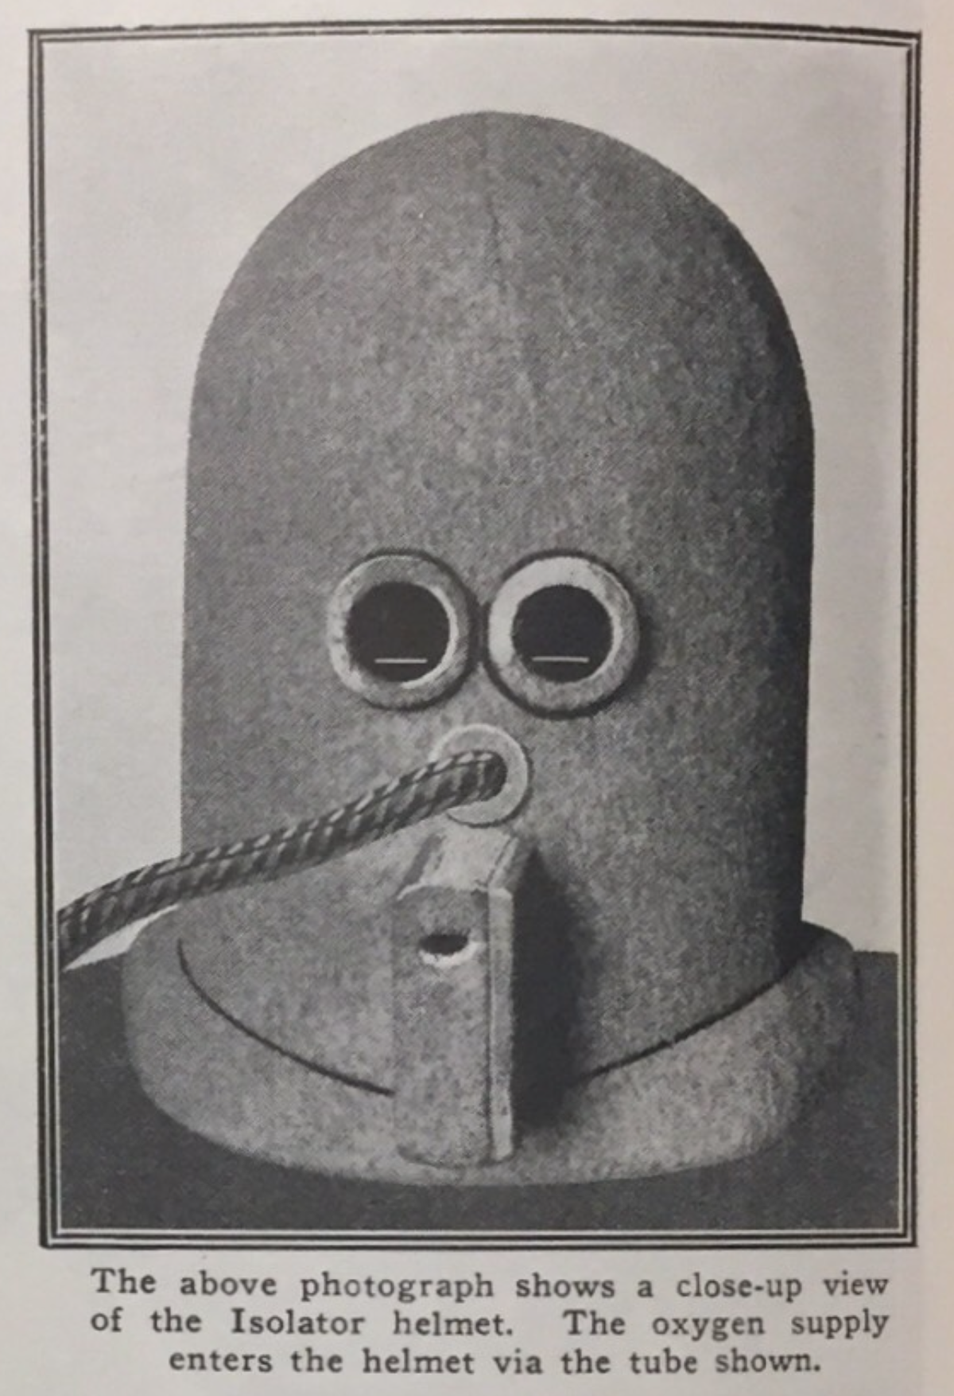
“Most people who desire thus to concentrate find it necessary to shut themselves up in an almost soundproof room in order to go ahead with their work, but even here there are many things that distract their attention.
[…]
The writer thought that shutting out the noises was not sufficient. The eye would still wander around, thereby distracting attention.”
Hugo Gernsbach, “The isolator,” Science and invention: in pictures 13, no. 147 (1925): 214, 281.

Slide 7
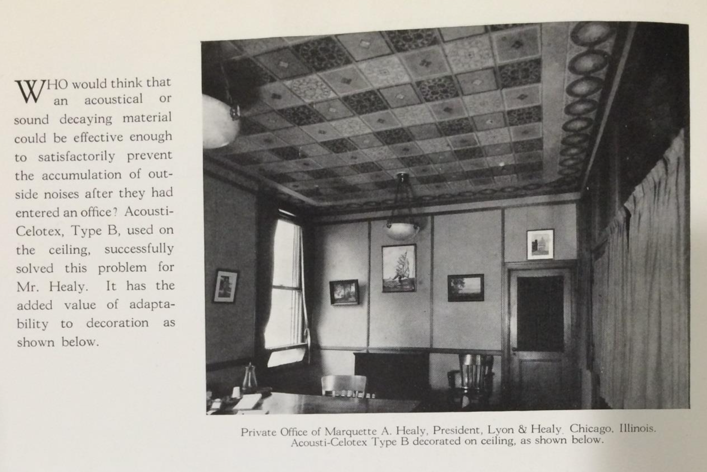
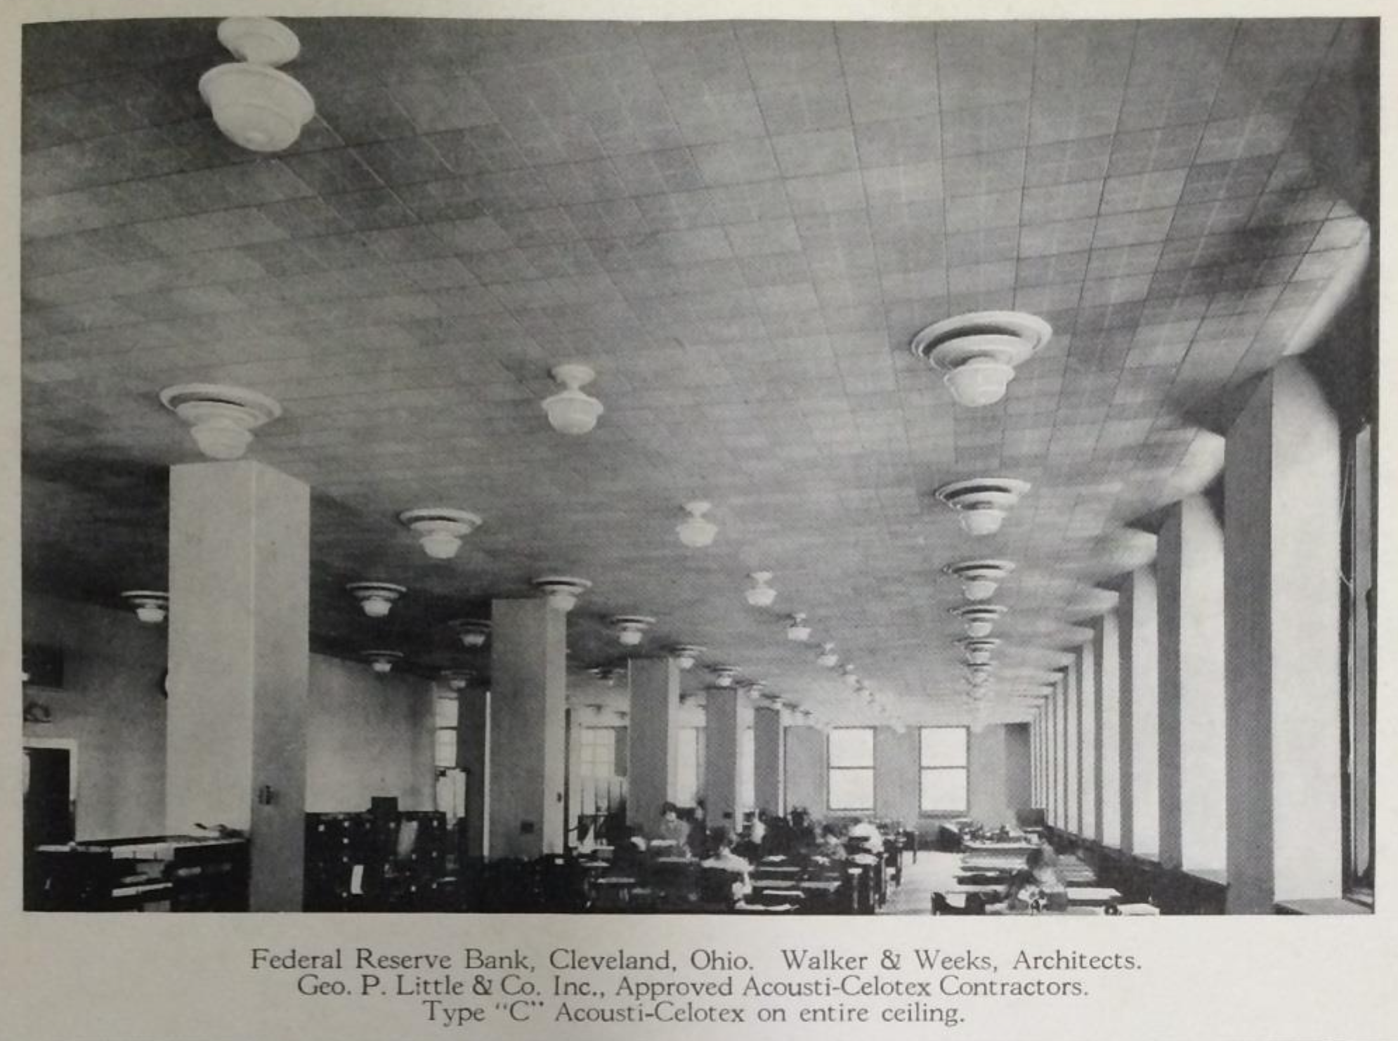
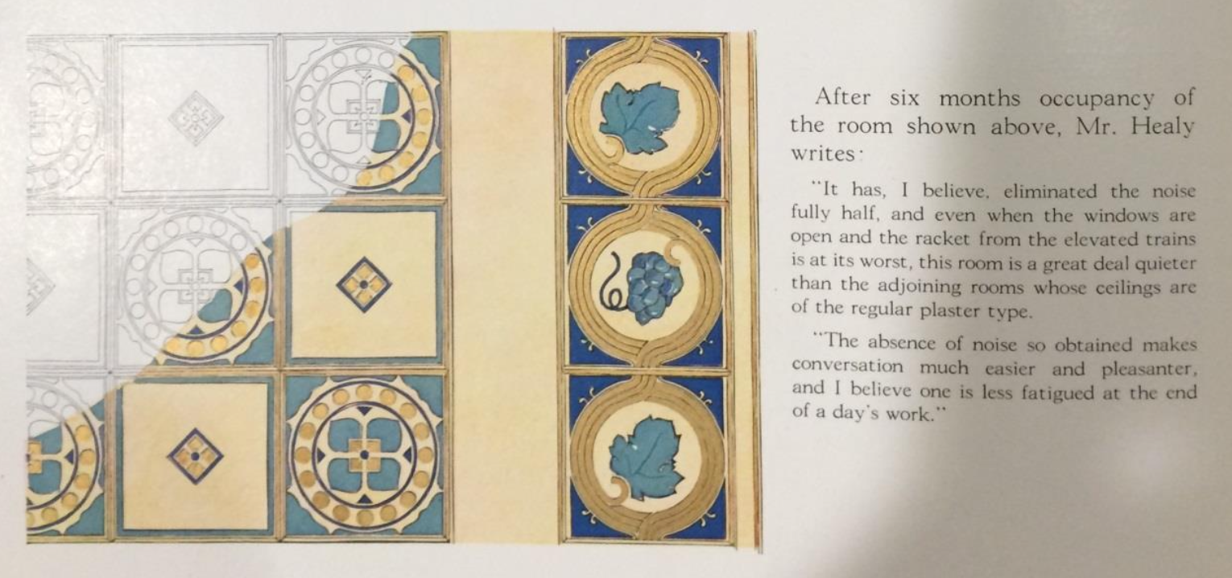
Advertisement brochure: The Celotex Company, “Acousti-Celotex: used in buildings of all types for acoustical and sound quiting purposes,” Chicago: 1925. Taken from Dona Yu, “Sound advice: the development and use of early 20th century acoustical wall and ceiling materials,” MA-thesis, Columbia University, 2015,113.

Slide 8
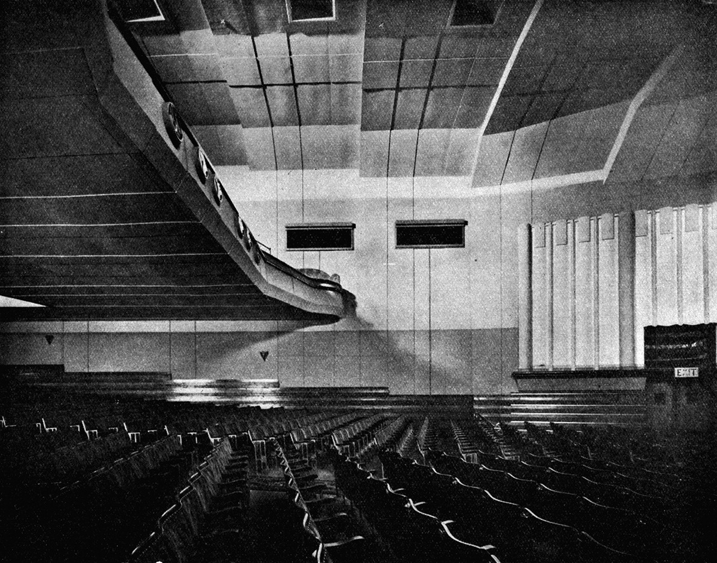
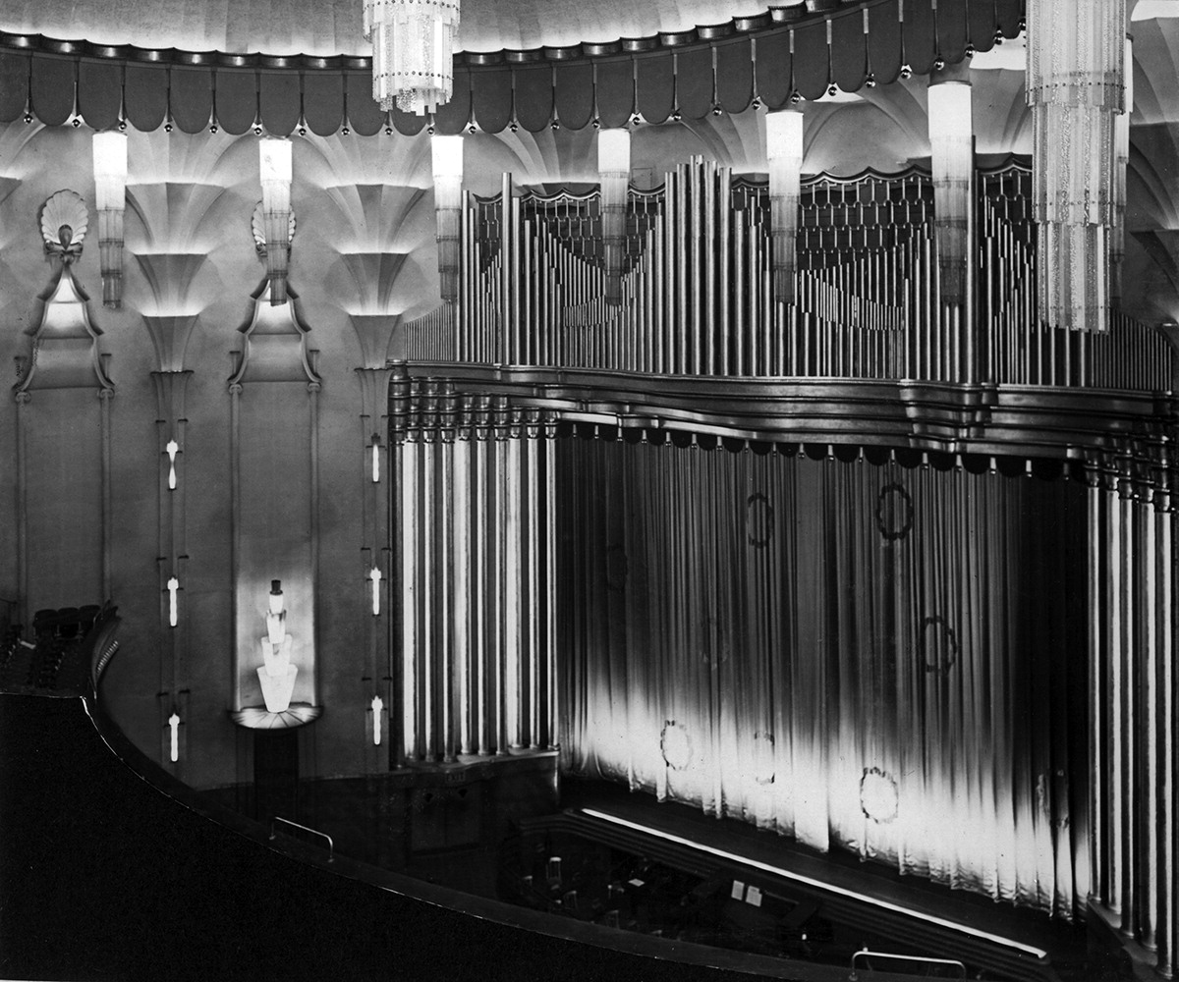
Interior of the Angus Playhouse Montrose, opened in 1932/33 Bruce Peter collection.
Interior of the New Victoria London, opened in 1930, Bruce Peter collection.
Both pictures taken from Bruce Peter, “The impact of the talkies on Scottish cinema architecture,” Visual Culture in Britain 20, no. 3 (2019): 202-220.

Slide 9
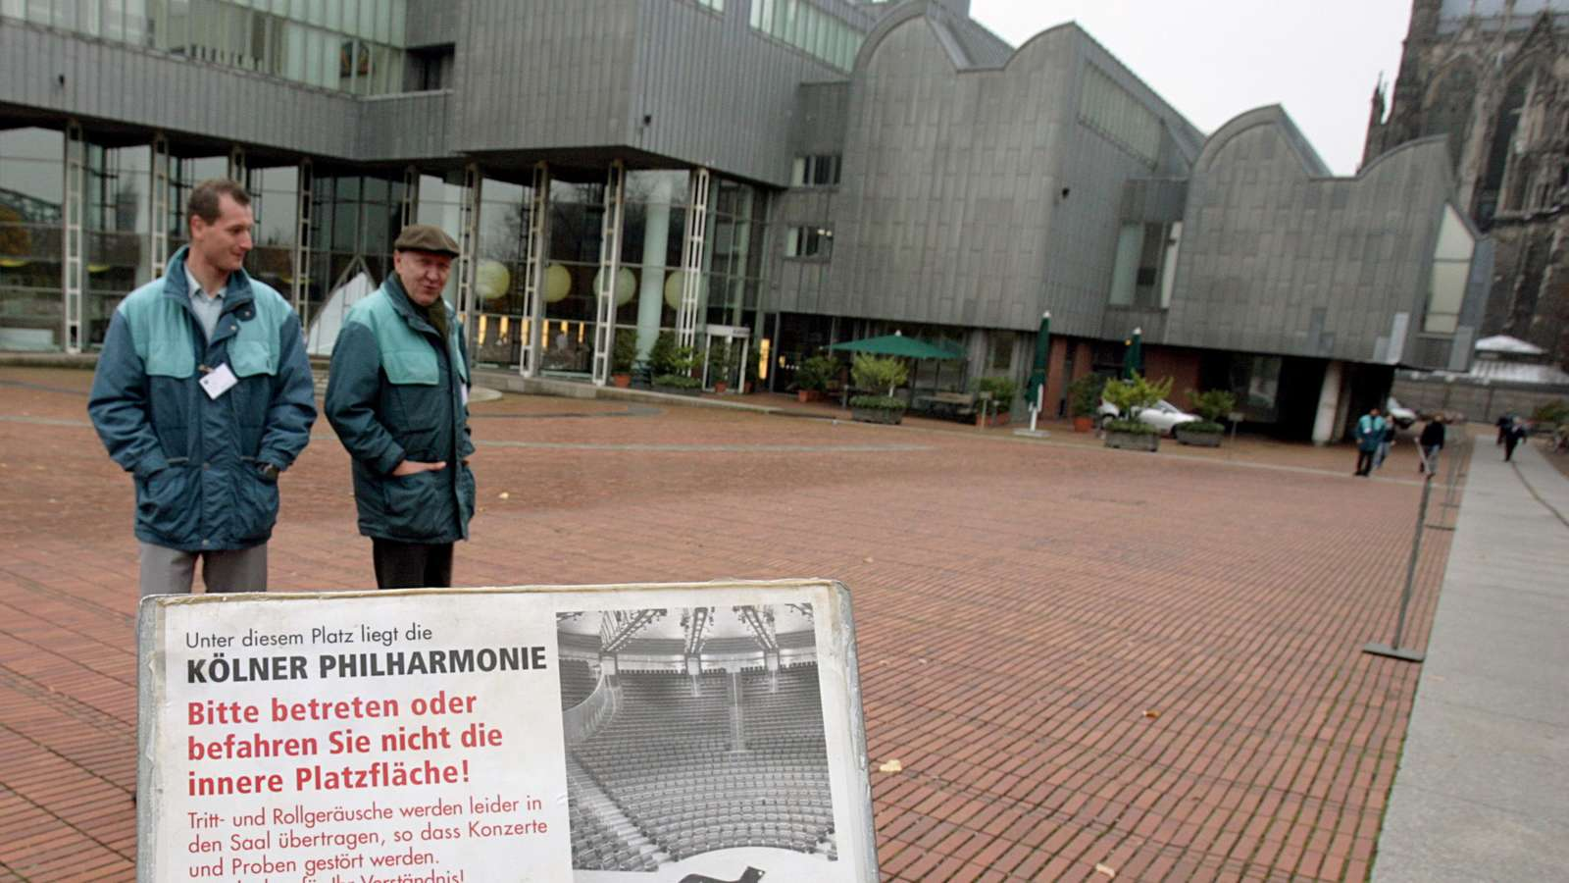
“Security personnel at Heinrich-Böll-Platz in Cologne ensure that the square remains empty during concerts”, Federico Gambarini/picture alliance/dpa. Taken from: https://www.24rhein.de/koeln/innenstadt/philharmonie-platz-sperrung-koeln-bewacht-koelner-dom-kosten-sanierung-akustik-91999125.html (4.12.2025).

Slide 10
Bibliography
Bijsterveld, Karin. “Sound waves of protest: noise abatement movements.” In The Routledge companion to sound studies, edited by Michael Bull, 81-89. London: Routledge, 2019.
Dommann, Monika. “Antiphon: Zur Resonanz des Lärms in der Geschichte.” Historische Anthropologie 14, no. 1 (2006): 133-146.
Morat, Daniel. “The sound of the new era: on the transformation of auditory and urban experience in the long fin de siècle, 1880-1930.” International Journal for History, Culture and Modernity 7 (2019): 591-609.
Peter, Bruce. “The impact of the talkies on Scottish cinema architecture.” Visual Culture in Britain 20, no. 3 (2019): 202-220.
Thompson, Emily Ann. The soundscape of modernity: architectural acoustics and the culture of listening in America, 1900-1933. Cambridge, MA: MIT Press, 2008.
von Fischer, Sabine. “From seat cushions to formulae: understanding spatial acoustics in physics and architecture.” In Germany in the loud twentieth century: an introduction, edited by Florence Feiereisen and Alexandra Merley Hill, 63-77. Oxford: Oxford University Press, 2012.
Yu, Dona. “Sound advice: the development and use of early 20th century acoustical wall and ceiling materials.” MA-thesis, Columbia University, 2015.

