Slide 1
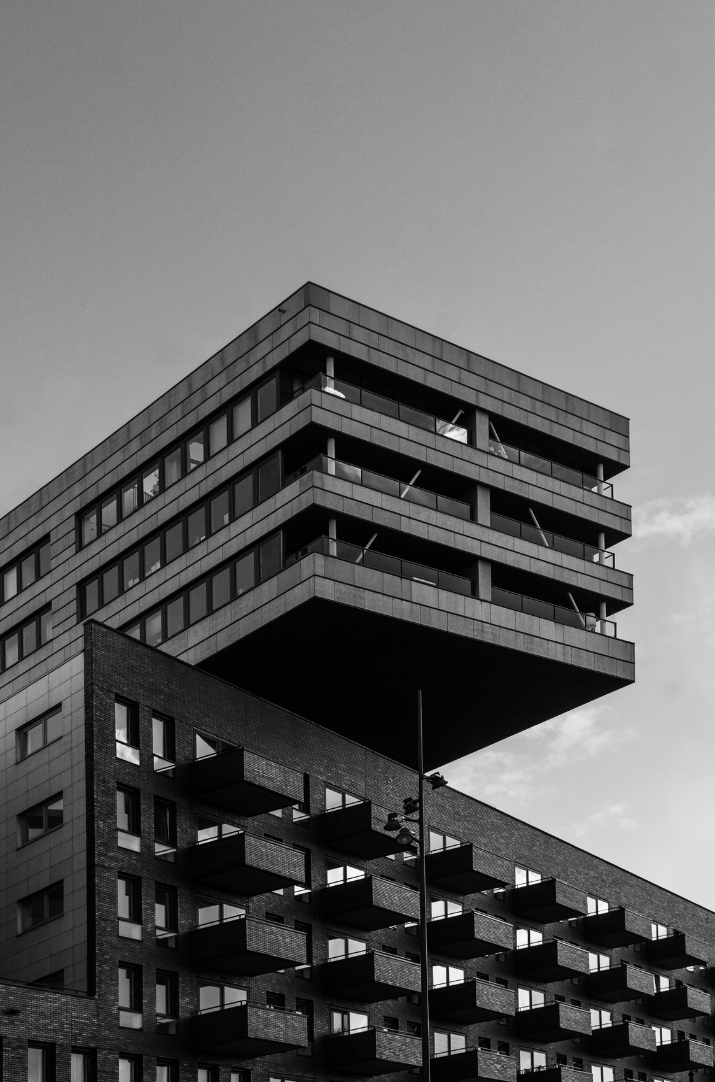

Radio and the Soviet audience

Slide 2
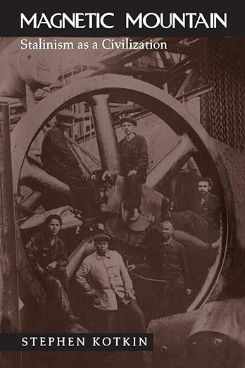
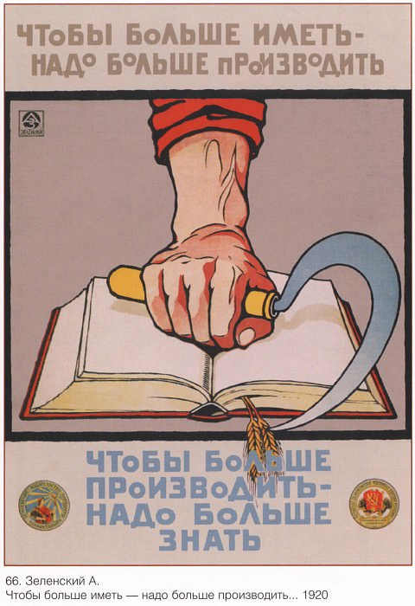
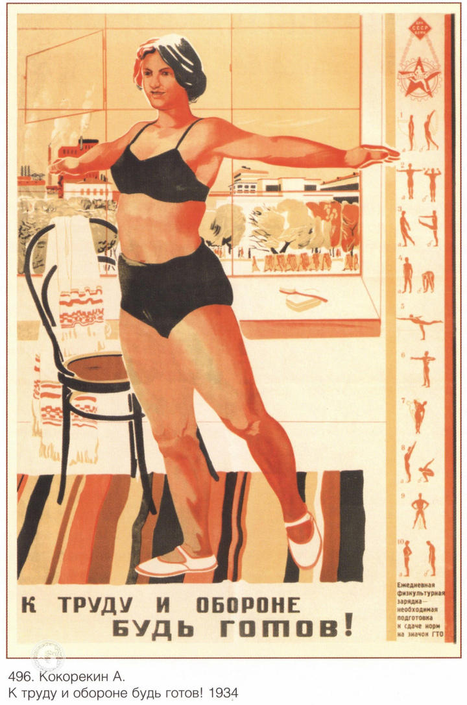
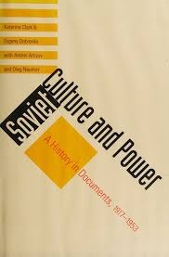
The “New Soviet man” project
Stephen Kotkin’s idea of the
“Stalinism as civilization”
A. Zelenskiy, 1920. The banner reads,
“To have more, one needs to produce more.
To produce more, one needs to know more”
Katerina Klark’s concept of Soviet culture
A. Kokorekin, 1934. The banner reads,
“Be ready for labour and defense!”

Slide 3
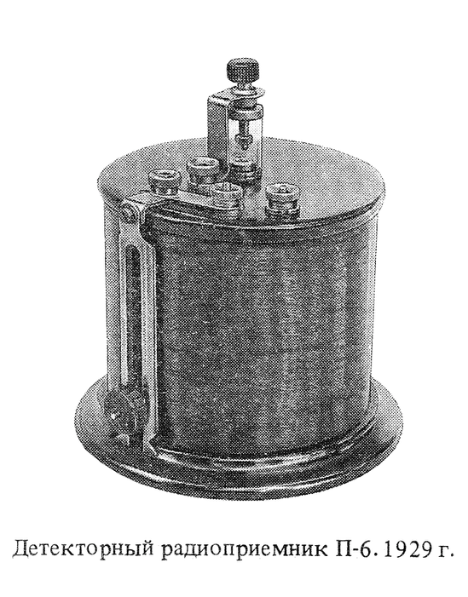
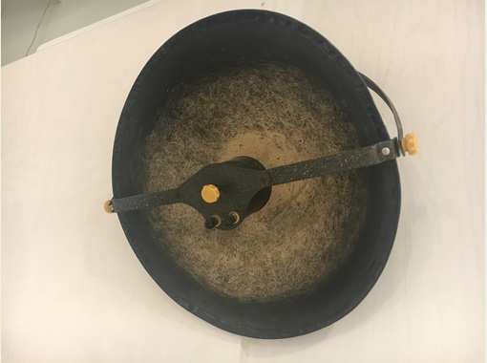
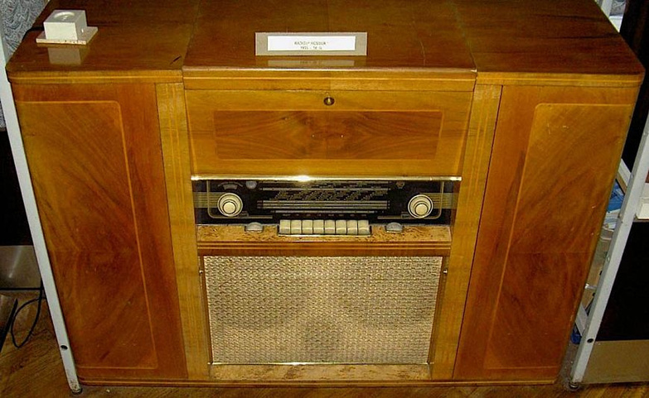
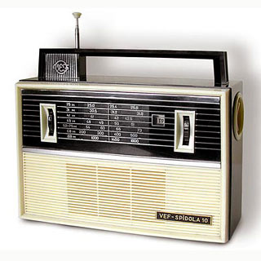
Fast Technological Changes
The crystal set receiver
P-6, 1929
The “radio dish” Rekord,
1925-1952
The tube radio Druzhba,
from 1956
The transistor radio VEF-Spidola-10, from 1965

Slide 4
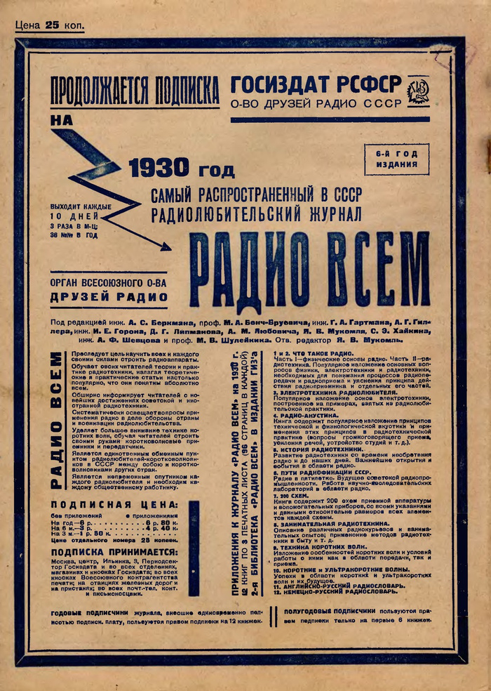
Contents
PROGRAM OF JANUARY 1, 1939
COMINTERN STATION
The issue 2 of the journal Radio Vsem [Radio for Everyone], 1930
Topics mentioned:
1 and 2: what is radio
3. Electrotechnics of the radio amator
4. Radio acoustics
5. History of radio
6. Approaches to radiofixation of the USSR
7. 200 wired diagrams
8. Amusing electronics
9. The short waves technology
10. Short and ultrashort waves
11:00. Academician Gorev’s speech “The Belarus Soviet Socialist Republic’s Academy of Science to the 20th anniversary of the Belarus SSR”
12:00. Opera broadcast
15:30. International news
16:00. Theatre by the microphone
18:30. Literature program. Soviet squib
19:00. Songs and dances of the USSR’s nations
20:00. Broadcast from Minsk
21:00. The New Year concert upon the stakhanovtsy requests

Slide 5
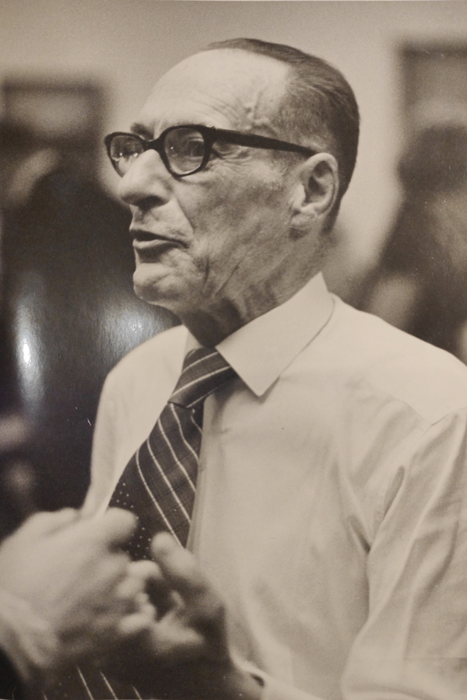
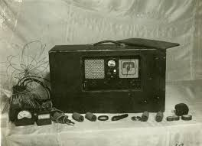
Radio as a Contested Space
October 1943. The Ukrainian Insurgent Army started the radio station Samostiina Ukraiina (Independent Ukraine) - the code name Aphrodite
Albertus Hasenbroekx
Radio operator of the Aphrodite station
The equipment of the Aphrodite station, confiscated in 1945

Slide 6
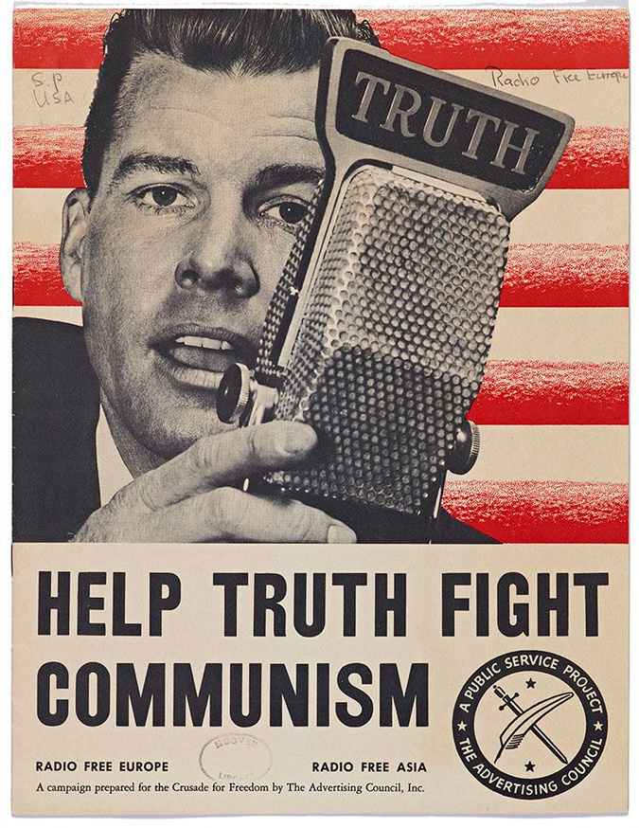
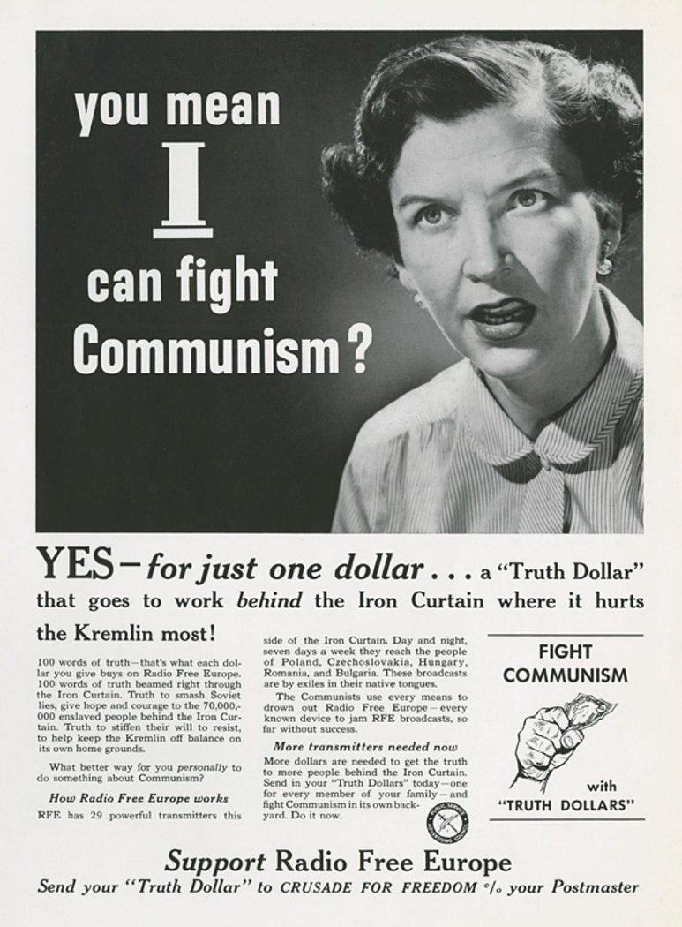
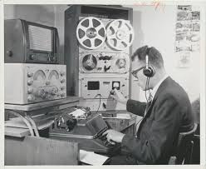
Piercing the Iron Curtain
Radio Monitoring at Radio Liberty. Blinken OSA Archivum
Help Truth Fight Communism, 1951.
Pamplet Collection, Hoover Institution Library
Hoover Archives, RFE/RL Collection

Slide 7
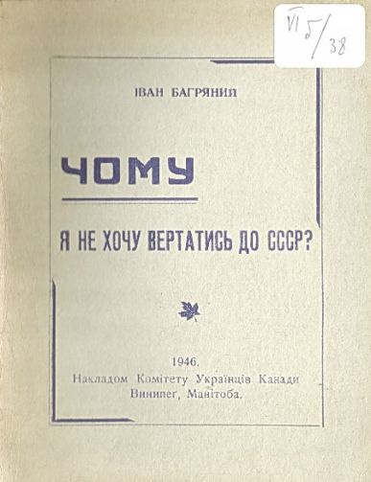
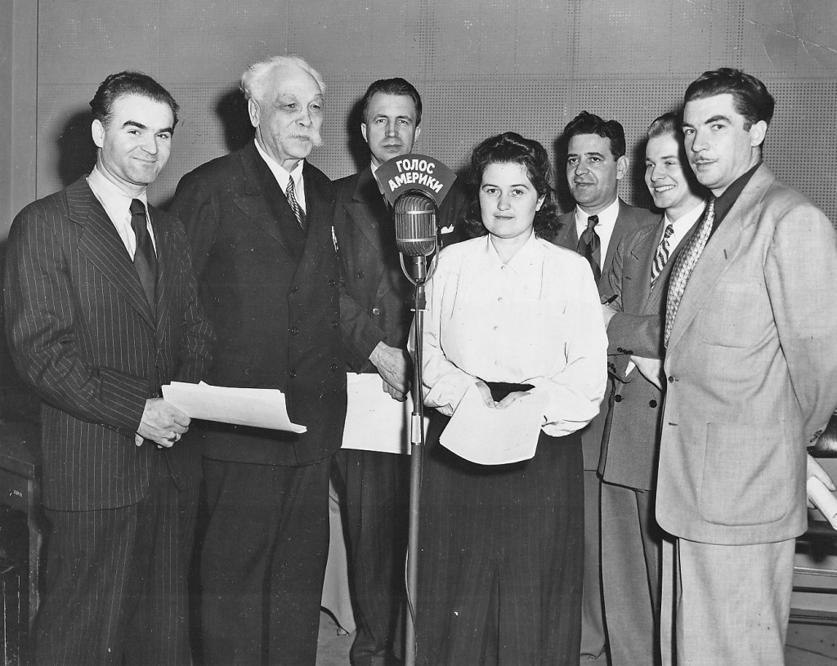
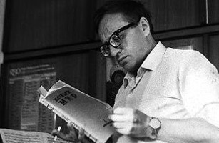
Immigraniada
Ivan Bahrianyi, Why do I not want to return to the USSR? Manitoba, Canada, 1946. Library of the OUN Archive, The Ukrainian Information Sevice, London
Anatoly Kuznetsov. London Daily Telegraph, 1968
Ukrainian Service of the VOA, 1950s (Nykyfor Hryhoriiv is the second from the left)

Slide 8
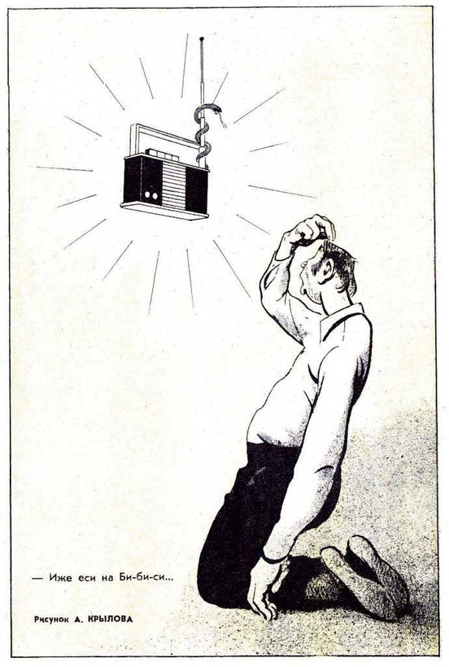
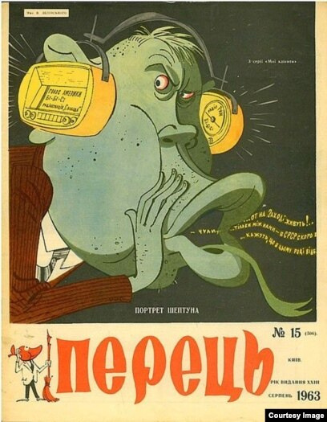
Perception
Valerii Zelinskii, Portret sheptuna (The portrait of a Whisperer), Perets, 1963.
The captions on the “headpones”: Voice of America, BBC, Radio “Liberty,” Radio Rome
The banner reads, “Whereas people in the West live! ... Between us, did you hear that in the USSR... They say that in this year...”
Andrey Krylov. The banner reads,
“Our BBC, who art in heaven...”

Slide 9
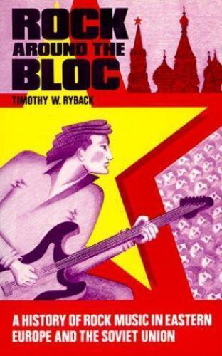
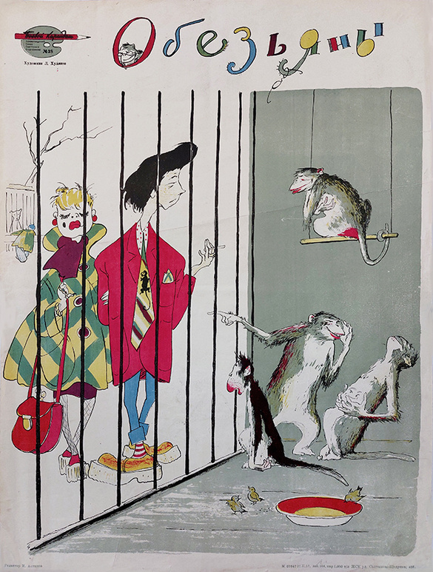
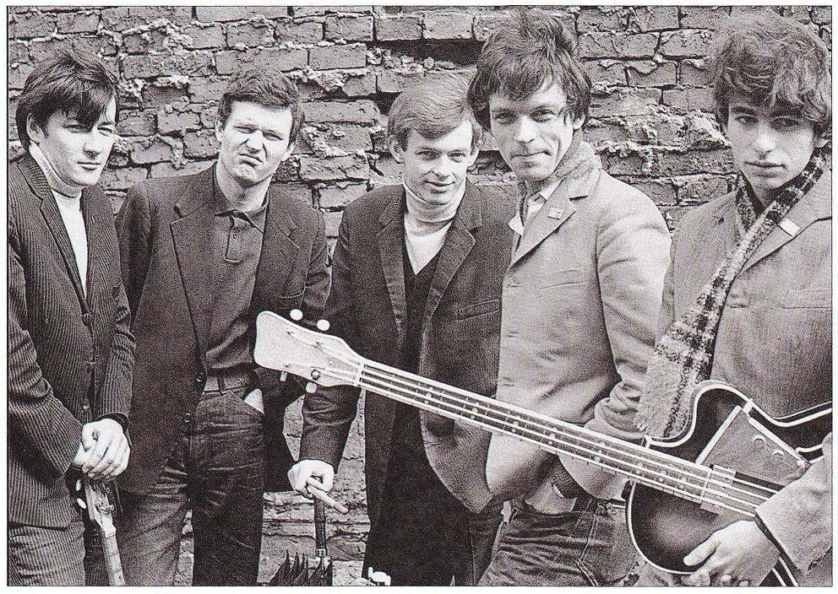
Radio and Soviet Subculture(s)?
Timothy W. Ryback, Rock Around the Bloc, 1990
Leonid Khudiakov, Apes, 1957.
The poster mockes the Soviet stiliagi (style-hunters)
Czerwone Gitary, 1966

Slide 10
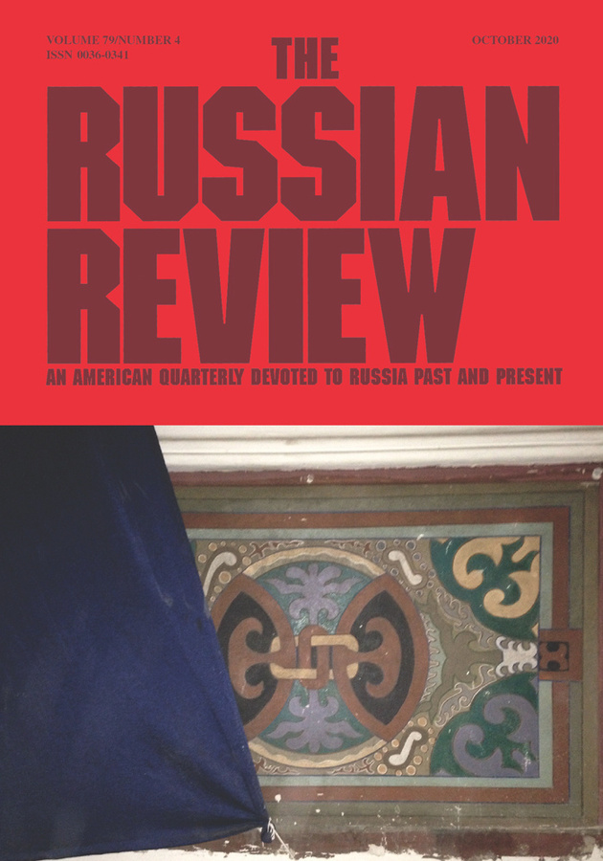
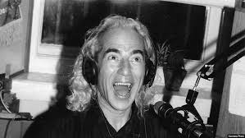
The Case of Rock-posevy
Kristin Roth-Ey “Listening Out, Listening For, Listening In: Radio Broadcasting and the Late Soviet Audience.” (2020)
Seva Novgorodtsev

Slide 11

Albright, Neil. “A Policy of Rock: How Rock and Roll Undermined the Communist Revolution in Cold War Russia.” Historical Perspectives: Santa Clara University Undergraduate Journal of History. Vol. 16, article 14 (2011): 143-164.
Cushman, Thomas. Notes from Underground: Rock Music Counterculture in Russia. State University of New York Press, 1996.
“Czerwone Gitary.” Polski bigbit i nie tylko, September 2, 2012.
Kahanov, Yurii. “Vorozhi holosy”: ideolohichne protystoiiannia na radiokhvyliakh u radianskii Ukraiini (druha polovyna XX st.). Historians.ua, October 17, 2013.
Karpova, Yuliia. “The Stilyagi: Soviet Youth (Sub)Culture of the 1950s and Its Fashion.” MA Thesis. Central European University, 2009.
Kolchina, Anna. “Pisateli-emigranti u mikrofona «Radio Svoboda» v 1970-1980 godi.” Mediascope. Vyp. 3 (2010).

Slide 12
Lovell, Stephen. Russia in the Microphone Age: A History of Soviet Radio, 1919-1970. Oxford University Press, 2015.
Mikkonen, Simo. “Radio Liberty – the Enemy Within? The Dissemination of Western Values through US Cold War Broadcasts” in Europe – Evropa: Crosscultural Dialogues between the West, Russia and Southeastern Europe, edited by Juhani Nuorluoto and Maija Könönen, pp. 243-257. Uppsala University Press, 2010.
Miskii, Vadym, and Tamara Huseinova. Ukraiinske Radio. Istoriia Buremnoho Stolittia. Laboratoriia, 2025.
O’Rourke, Patrick. “Jazz Behind the Iron Curtain.” Perspectives. Issue 46 (2019): 1-16.
Ryback, Timothy W. “Leninism vs Lennonism; Reflections on Rock Music Culture in East Europe and the Soviet Union.” Etnomüzikoloji Dergisi. Issue 2 (2018): 217-228.
Roth-Ey, Kristin. “Listening Out, Listening For, Listening In: Radio Broadcasting and the Late Soviet Audience.” Russian Review. Vol. 79, issue 4 (2020): 556-577.
Tolstoy, Ivan. “Seva Novgorodtsev. Muzyka, molodost’, pokolenie.” Radio Svoboda, December 16, 2018. Albright, Neil. “A Policy of Rock: How Rock and Roll Undermined the Communist Revolution in Cold War Russia.” Historical Perspectives: Santa Clara University Undergraduate Journal of History. Vol. 16, article 14 (2011): 143-164.
Cushman, Thomas. Notes from Underground: Rock Music Counterculture in Russia. State University of New York Press, 1996.
“Czerwone Gitary.” Polski bigbit i nie tylko, September 2, 2012.
Kahanov, Yurii. “Vorozhi holosy”: ideolohichne protystoiiannia na radiokhvyliakh u radianskii Ukraiini (druha polovyna XX st.). Historians.ua, October 17, 2013.
Karpova, Yuliia. “The Stilyagi: Soviet Youth (Sub)Culture of the 1950s and Its Fashion.” MA Thesis. Central European University, 2009.
Kolchina, Anna. “Pisateli-emigranti u mikrofona «Radio Svoboda» v 1970-1980 godi.” Mediascope. Vyp. 3 (2010).

Slide 13
Sukhobokova, Olha. “Ukraiinskii holos z-za okeanu.” Ukraiina XX stolittia: kultura, ideolohiia, polityka. Vyp. 15 (2009): 246-260.
Sukhobokova, Olha. “Pershyi director “Holosu Ameryky” Nykyfor Hryhoriiv – rechnyk ukraiinskoii demokratii.” Ukrainian Magazine Chicago, February 6, 2019.
Tolstoy, Ivan. “Seva Novgorodtsev. Muzyka, molodost’, pokolenie.” Radio Svoboda, December 16, 2018.

Slide 14
Thank You!

