Slide 1
Progressive Writers’ Association and the Indian People’s Theatre Association: Against the volk in music

Slide 2
A Brief History
PWA was founded in 1934 in London by Sajjad Zaheer and Mulk Raj Anand. Their manifesto was drafted in 1935
In 1936, they had their first conference in Lucknow, India.
Immediate context--- Soviet Writers’ Congress in 1934, and the International Congress for Defence of Culture in 1935. (Global Anti-fascism)
The Spanish Civil War is the key global event, influencing the need for such a movement.
The Indian People’s Theatre Association was founded in 1943 in the backdrop of the Bengal Famine.

Slide 3
What is progressive literature?
“For, it seemed to us that through the rigours of the last quarter of a century in Indian political and social life, a generation of declassed intellectuals had appeared who were not only beginning to see the crisis in our culture brought about by the breakdown of our old social values, literary codes and grammars, but who, while recognising the necessity for a common cause with the movements which were slowly liberating us, sought for a more revolutionary ideology in all spheres”.
“This theory of cognition is not abstract analysis for the sake of analysis; it dictates a new approach to the various ideologies, it provides us with a method by which we can understand the complete manner of the ideological reflections of social reality of any period by placing this ideology side by side with the actual social reality of that period, with all its contradictions of classes and interests… Lenin’s occasional essays and notes on literature are examples of this method…”
Mulk Raj Anand, 1939.

Slide 4
But before progressivism, there’s a modernity debate
This is a debate that concerns all branches of the arts since the last decade of the 19th century till the 1920s.
What is modernist literature? Is it a complete invention or a rediscovery of the classical past?
If the classical past is to be rejected, then what are the national projects that need to be undertaken?
A return to the volk, the authentic indigenous culture?
Modern music must have lyrics.

Slide 5
Try and know your country but do not dare to know your ‘nation’
Tagore develops a highly productive relationship with Romain Rolland after WW1.
Writes a text titled নেশন কি? (What is a nation?) (engages with Ernst Renan)
Argues that ‘nation’ as a word can not be rendered into any Indian language.
Know the people and their habits (দেশ) --- but do not claim any specificity or exclusivity for any customs and traditions.
If anything, people’s lives have to be understood in terms of human experiences, which are universal.
PWA artists have to grapple with Tagore (he is the figure from the landed gentry, not a Marxist by any stretch, but speaks of a weird kind of internationalism)

Slide 6
Music from the masses, but it cannot be ‘national’ music
“Mass music (গণসংগীত) is a kind of music that gives voice to the aspirations of the peasantry and the working classes.”
Salil Chaudhuri
Youth Cultural Institute (YCI) in 1941 in Calcutta distinguished this type of mass music from the earlier ‘nationalist’ or ‘national’ (স্বদেশী) music.
Cosmopolitanism in music, but not ‘rootless’ cosmopolitanism.
The idea of rootedness--- appeals to the folk traditions (draws from their social content) (draws from bardic traditions existing at the liminalities of Islam and the Hindu pantheon) (বাউল ও ভাটিয়ালী)।
But there is also an implicit defence of classicism (the grammar of music--- powerful especially in Urdu music)
The question of cosmopolitanism--- the folk traditions have to be rediscovered within the globality of music and the globality of social struggles (Brecht and Paul Robeson are significant influences).

Slide 7
“I am not an artist, I am a propagandist”
PWA is a movement of what can be classified as high literature.
Faiz Ahmad Faiz takes to a highly ornate Persian-inflected Urdu in his music, something that has minimal ‘folk’ in it. (but wields a party card).
Kazi Nazrul Islam writes Hindu and Islamic sectarian devotional music whilst translating the Internationale into Bengali (one of the earliest proponents of anything that can be called astutely socialist-realist).
But with the foundation of the IPTA in 1943, these literary efforts are given a concrete political orientation. (A vanguard of artists)
Breaking the fourth wall, music from and to the people.
Creation of theatre groups who would tour the corners of India in the backdrop of the famine.
Musicians, poets, painters are dispatched to compose music, make sketches, about the lives of coal miners, share-croppers, etc (Subhas Mukhopadhyay, Zainul Abedin, Chittoprasad)

Slide 8
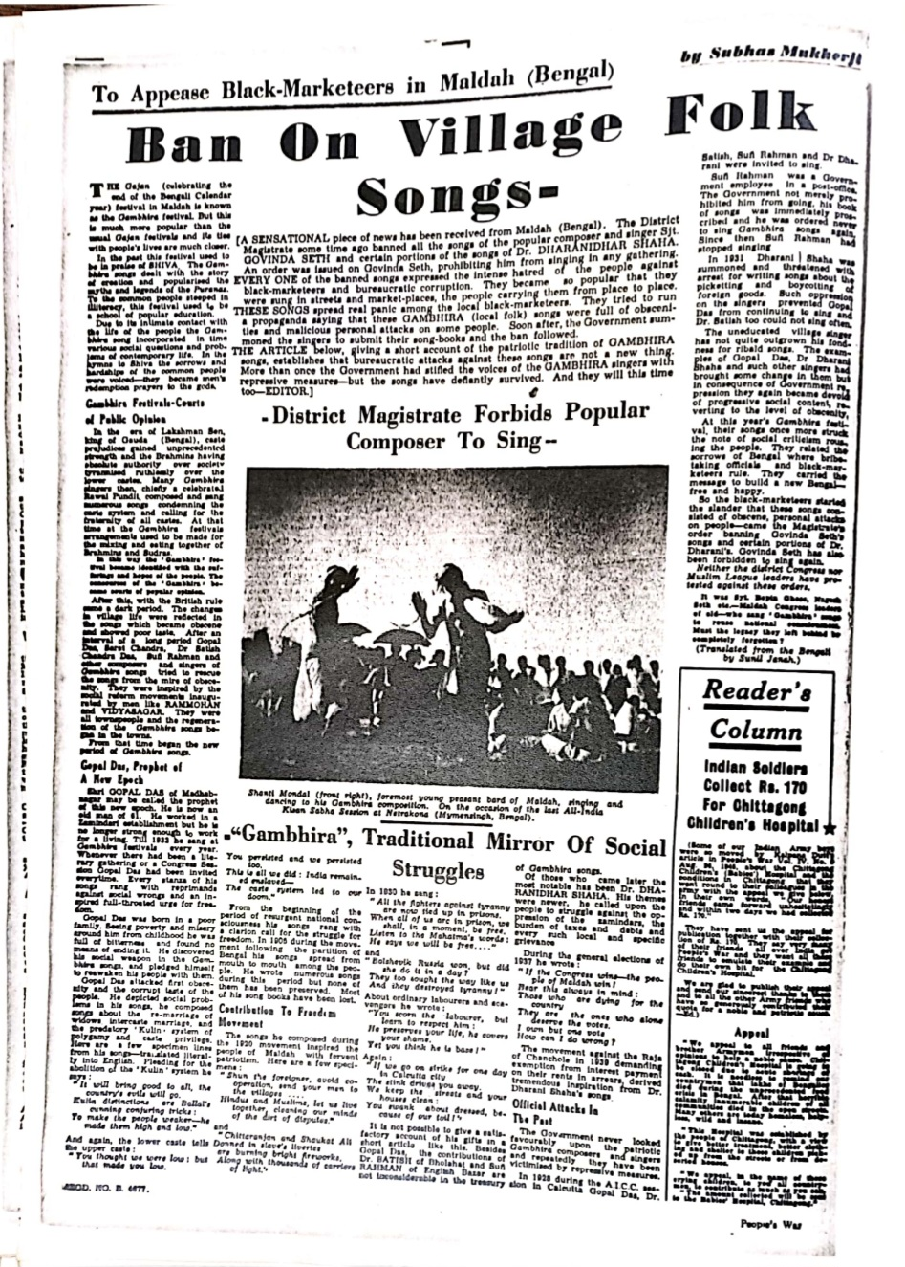
Do they have an audience?

Slide 9
End of this movement
PWA and IPTA members form the very core of Bengali, Hindi and Urdu literary traditions till the 1980s.
PWA continues very strongly in Pakistan (actually, they fare better than they do in India, where the movement gets fragmented very soon) till the 1960s, before the key literary figures are hounded into oblivion.
In the Eastern part of Bengal (former East Pakistan, later to be Bangladesh), the movement finds a common cause with the language movement over there.
In West Bengal, that is in India, musicians (most notably Hemango Biswas, their most significant musical proponent) say we will not make pro-establishment music--- the communist party comes to power in 1977, governs for 34 years.

Slide 10
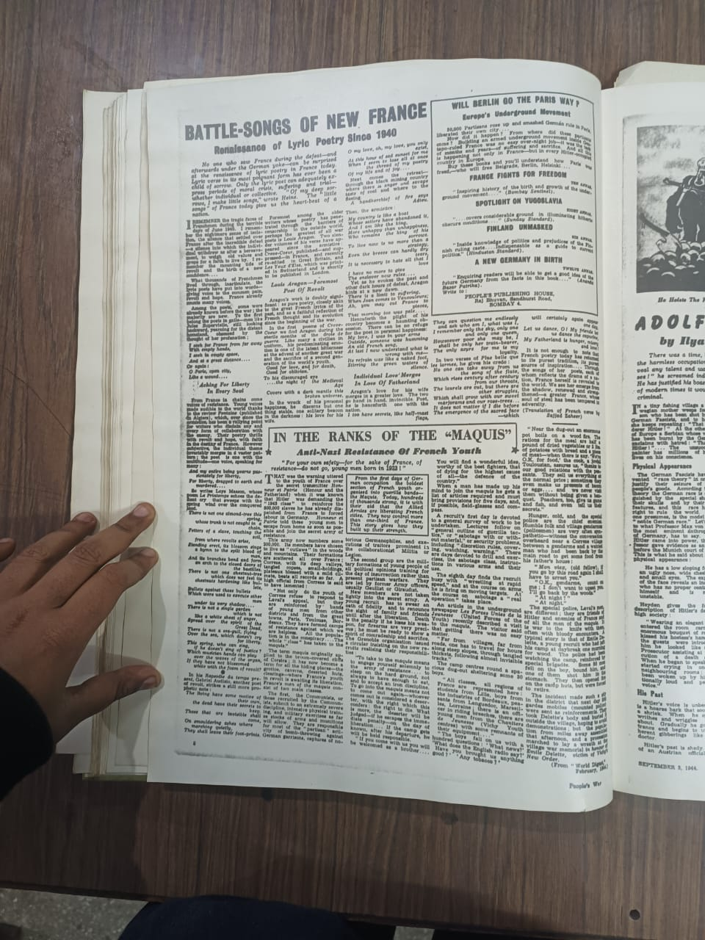

Slide 11
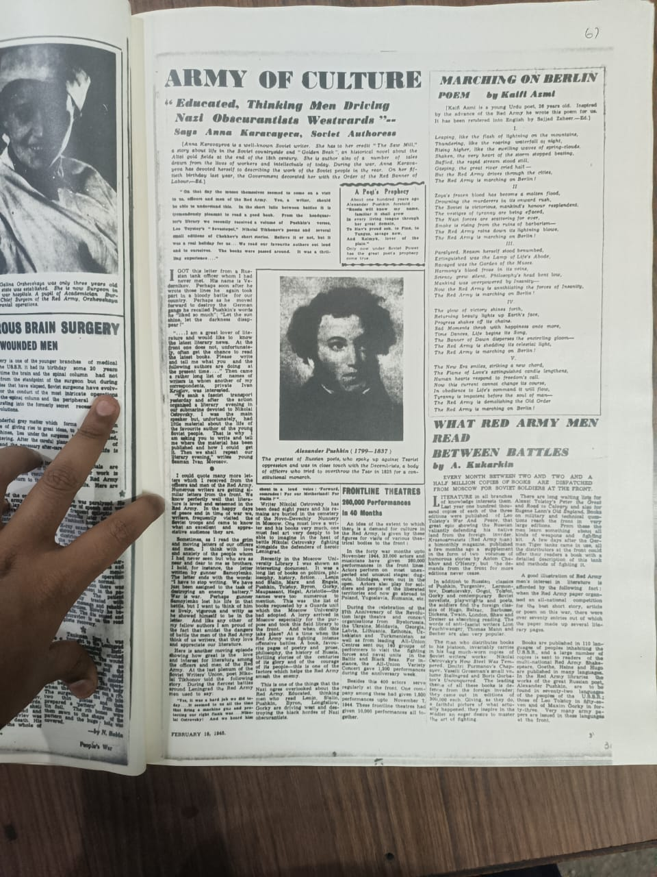

Slide 12
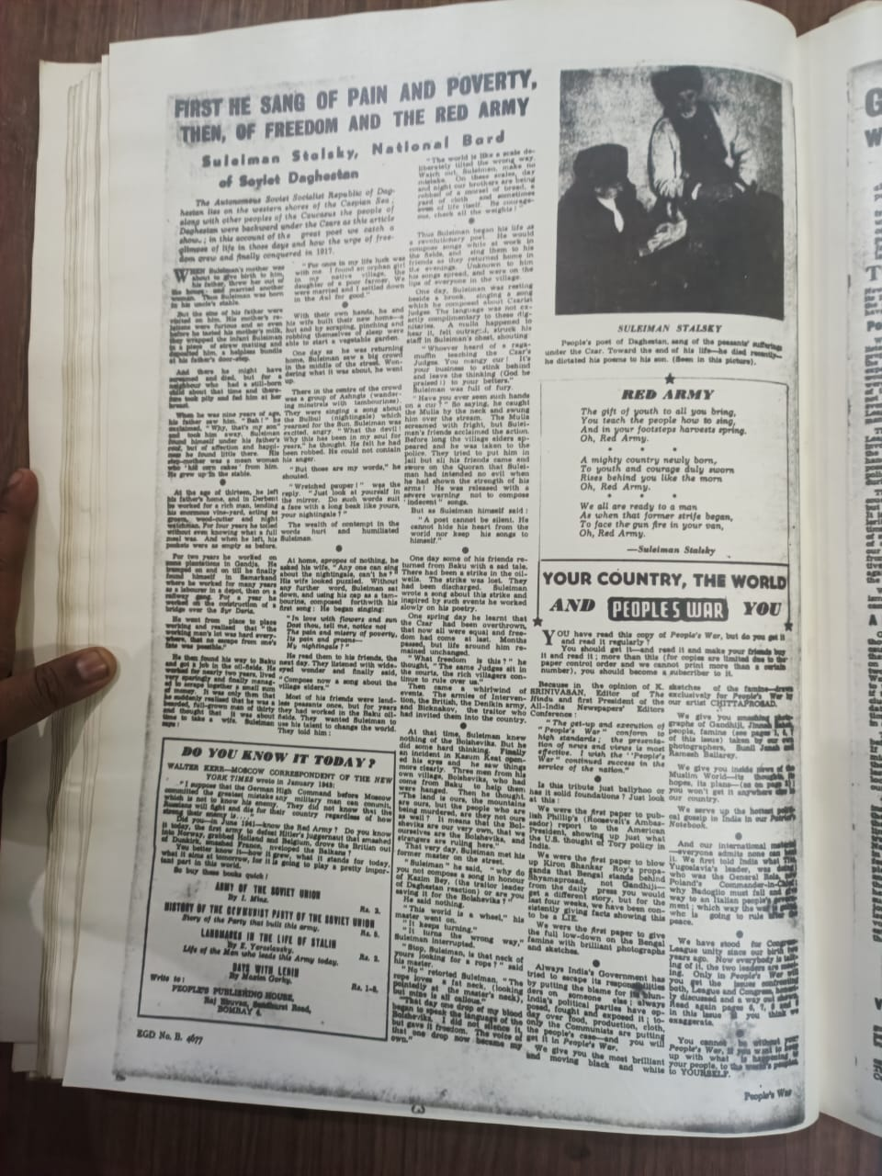

Slide 13
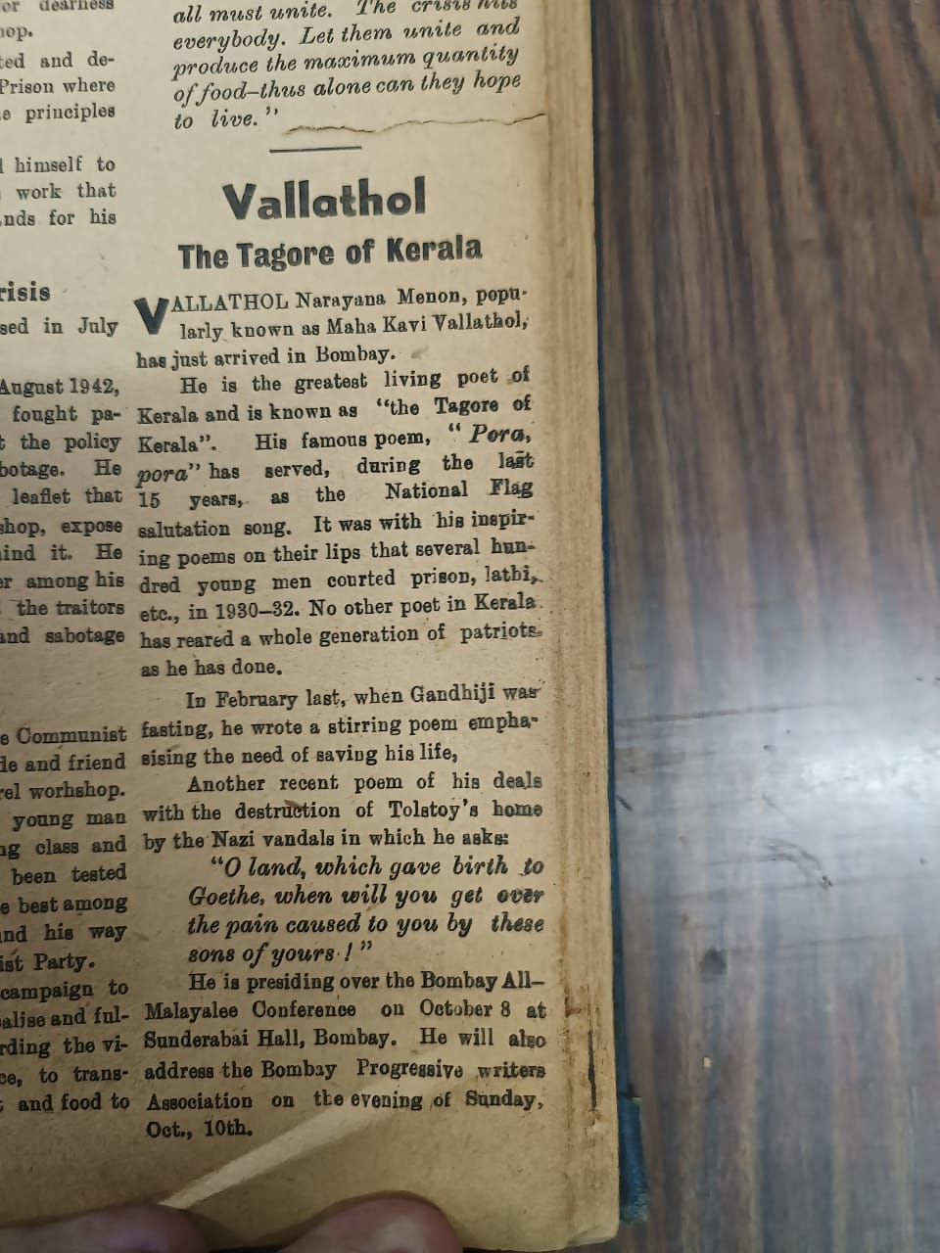

Slide 14
https://www.youtube.com/watch?v=jMQ1YMTkxrE
Minute 0.50-4.00

