Slide 1

Constructing a National Sound:
Music as Social Engineering in the Early Turkish Republic
Sound, Music, Noise: Historical Perspectives 2025/26 Fall
D. Giray Kalkan
The cover of Ali Rıfat Bey's composition of the National Anthem (before the Latin alphabet reform)

Slide 2
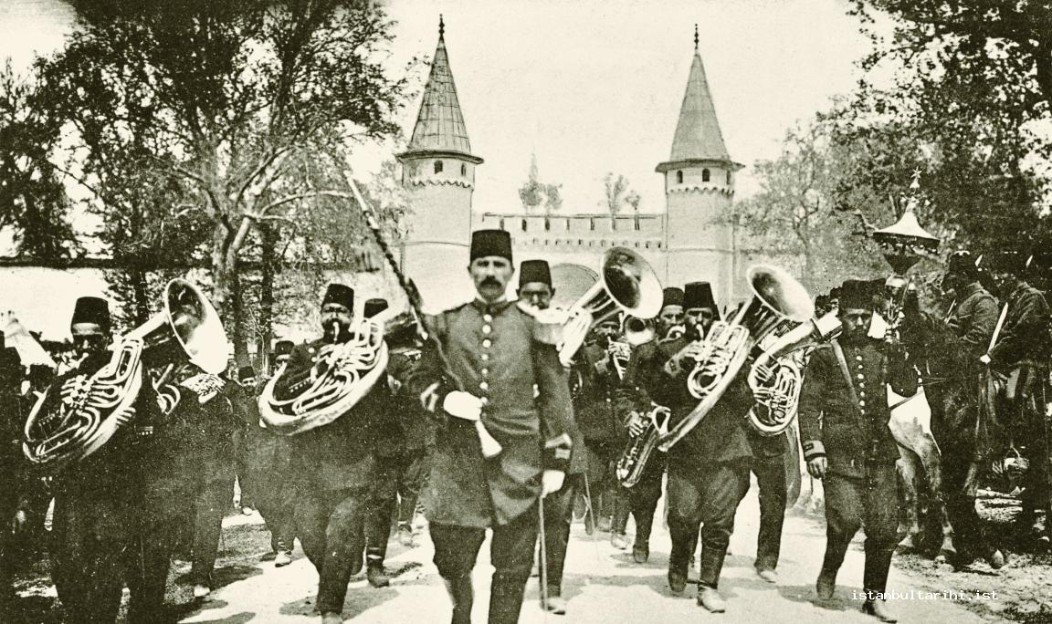
"Alaturka" vs. "Alafranga"
Alafranga is music or other cultural expression in an adopted western or European style (with its own tradition).
Alaturka is music or other cultural expression in a traditional Ottoman-Turkish style.
Military band at the imperial palace on April 25, 1909
Sample, https://www.youtube.com/watch?v=lWKMsOK1hRU

Slide 3
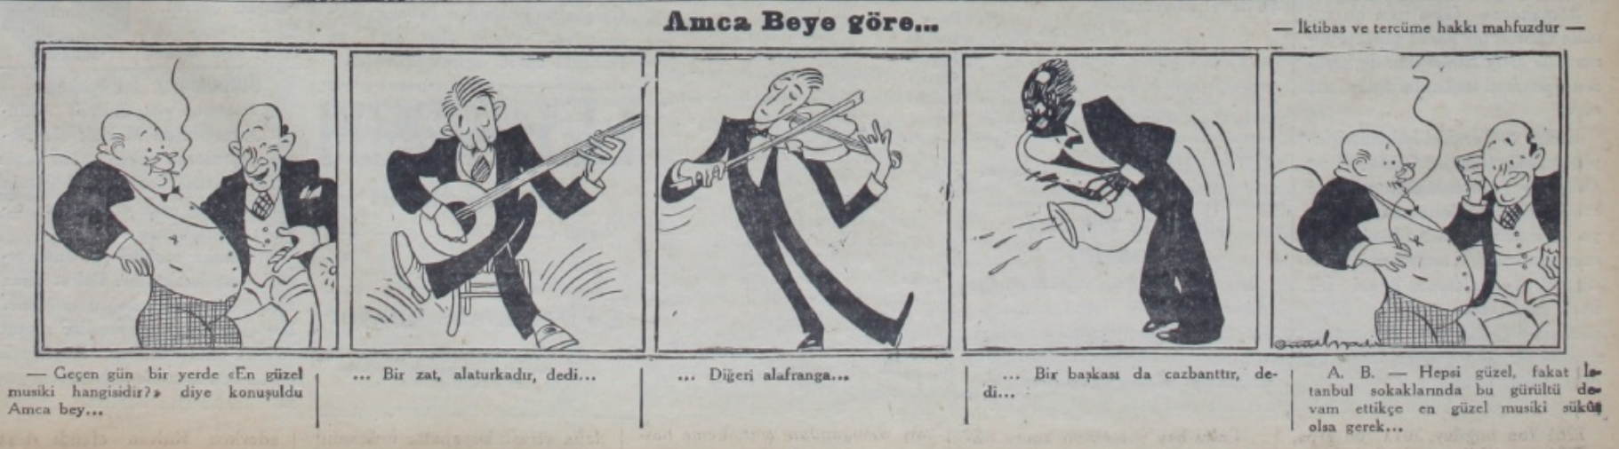
"Alaturka" vs. "Alafranga"
Alafranga is music or other cultural expression in an adopted western or European style (with its own tradition).
Alaturka is music or other cultural expression in a traditional Ottoman-Turkish style.
"They are all beautiful, but as long as this noise continues in the streets of Istanbul, the most beautiful music must be silence."
Amca Bey’e göre. (1934, 30 January). Akşam newspaper, s. 3;
The other day, at a gathering, they were discussing 'which is the most beautiful music?
"...One gentleman said, 'it is Alaturka'..."
"...Another said, 'Alafranga'..."
"...Someone else said, 'it is jazz'..."

Slide 4
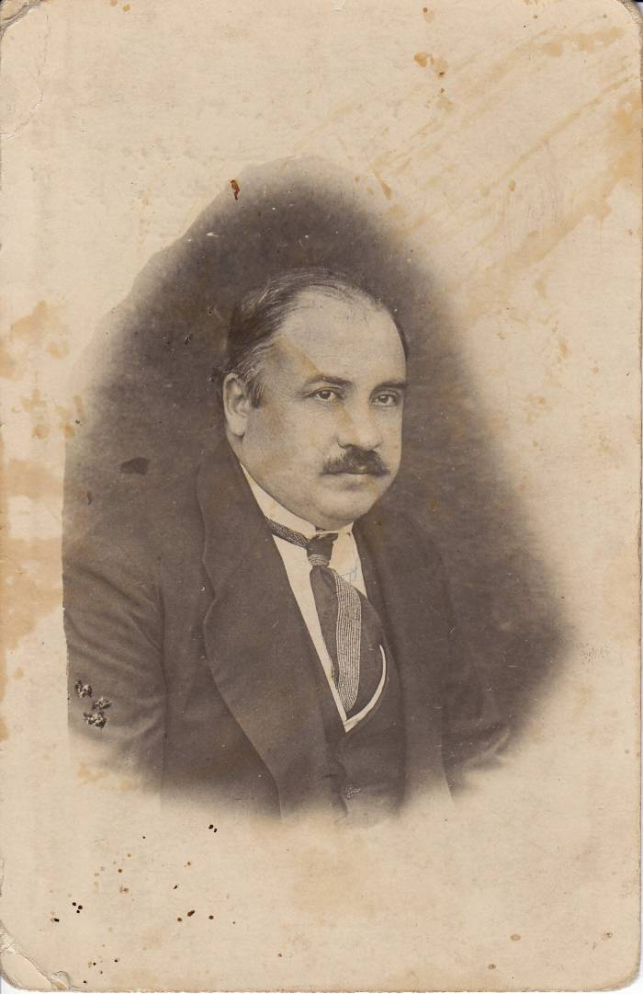
"There are also two musical forms in our country. The first is Turkish music, which evolved naturally among the people, while the second is Ottoman music, which was adapted from Byzantium by al-Fārābi. Turkish music has been the product of inspiration, not an imitation of something imported from abroad, whereas Ottoman music has been imitative and perpetuated by conscious action. The first is the music of our culture, the second of our civilization..."
"Today, we are thus confronted with three kinds of music: Eastern, Western and folk, I wonder which of them is our real national music? We have already noted that Eastern music is both sick and non- national, whereas neither folk nor Western music is foreign to us since the first is the music of our culture and the second that of our new civilization, I submit, therefore, that our national music will be born of a marriage between folk and Western music. Our folk music has given us many melodies. If we collect these and harmonize them in the Western manner, we shall have both national and European music. The music committees of the Türk Ocağı clubs are among those who will carry out this task. This, essentially, is the Turkist program in the field of music; the rest is up to our national musicians. "
Ziya Gökalp, The Principles of Turkism, trans. Robert Devereux (Leiden: Brill, 1968 [1920]).

Slide 5
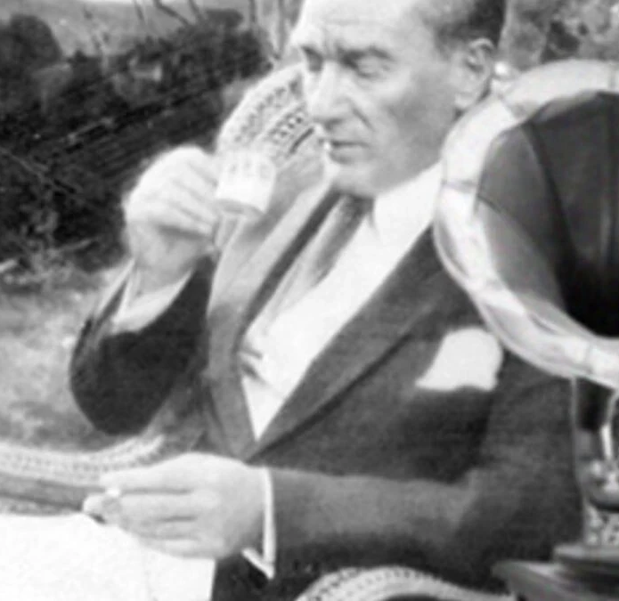
"By a fortunate coincidence, I listened to two of the most distinguished musical ensembles of the region here tonigh. Miss Müniretül Mehdiye, who first adorned the stage, was particularly successful in her artistry. However, to my Turkish sensibilities, this simple music no longer suffices to satisfy the Turk's highly sophisticated soul and feelings… «
- Sarayburnu Speech 1928
"Fellows, I know how you want to advance the national youth in all of the fine arts. This is being realized. However, it is Turkish music that has to be the most urgent one and given top priority. The scale in the new transformation of a nation is the ability of comprehension and adaptation of the transformation in the music. The music which is intended to be listened to by the foreigners is not our music. In this sense, it is far from the value that will bleach the face. We should explicitly know this. It is a necessity of collecting the noble deyiş, [another name of folk poems] songs which express the delicate, national emotions and opinions and of elaborating them in terms of the last general music rules as soon as possible."
-TBMM Zabıt Ceridesi, 1934, p. 3.

Slide 6
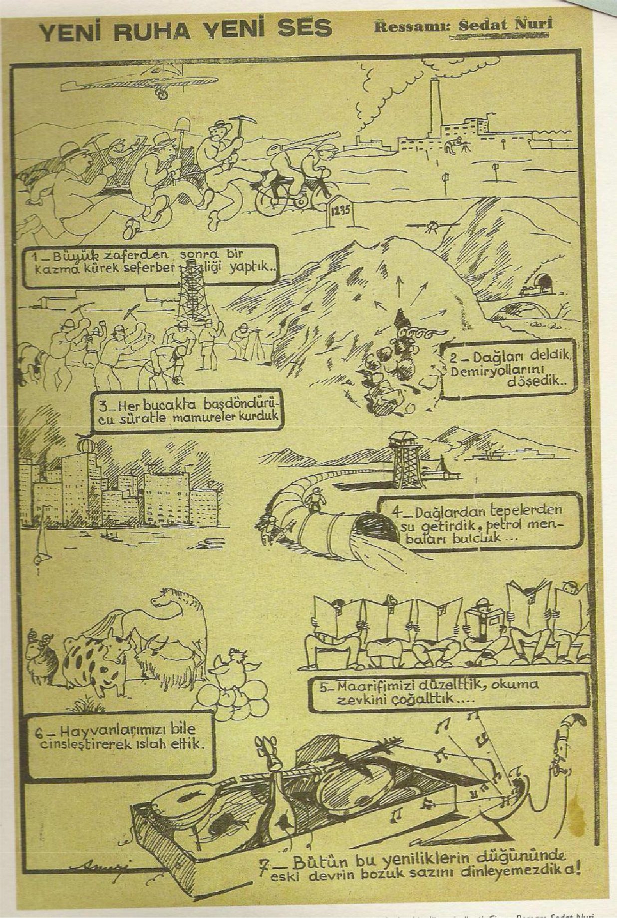
Sedat Nuri İleri, Yeni Ruha Yeni Ses, 1935 in 75 Yılda Değişen Yaşam Değişen İnsan Cumhuriyet Modaları, (İstanbul, Tarih Vakfı, 1999), p.21.
A NEW VOICE FOR A NEW SPIRIT
1_After the great victory, we formed a shovel and pickaxe mobilization unit...
2_We pierced the mountains, we laid down railways...
3_In every corner, we built modern structures with dizzying speed...
4_We brought water from the mountains and hills, we found sources of oil...
5_We fixed our education, we increased the joy of reading..
6_We even improved our animals by breeding them...
7_ At the anniversary of all these innovations, we couldn't listen to the 'broken saz' (corrupt/degenerate instrument) of the old era, could we?!

Slide 7
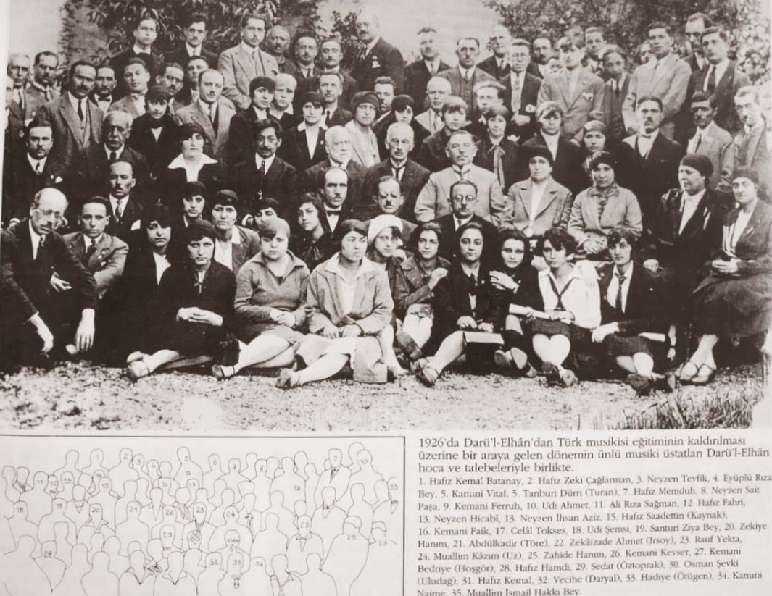
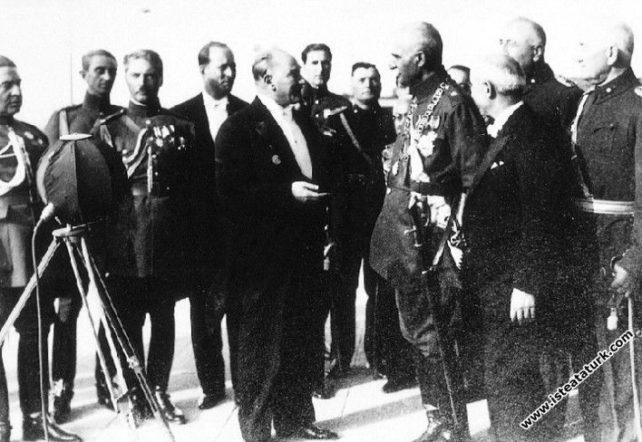
Building a New Music Infrastructure
Darülelhan → Istanbul Conservatory
Ottoman-era institution (1917)
taught both traditional Turkish 'Alaturka' music and Western 'Alafranga' music
Şark Musikisi Şubesi (Oriental Music Branch) was abolished and renamed the Istanbul Conservatory in 1927.
Özsoy Opera
Prepared for Persian Shah Reza Pahlavi’s visit to Turkey in 1934
union of Turkish and Persian mythologies using Firdevsi's Sahname.
Dramatization of the state's new ideology: the Turkish History Thesis
written by Ahmet Adnan Saygun, used pentatonic scales to sound "authentically" Central Asian, all within a grand Western opera structure.
See. https://youtu.be/JPDSWe2R9dU?si=bXVvxHaRv0I31W9g

Slide 8
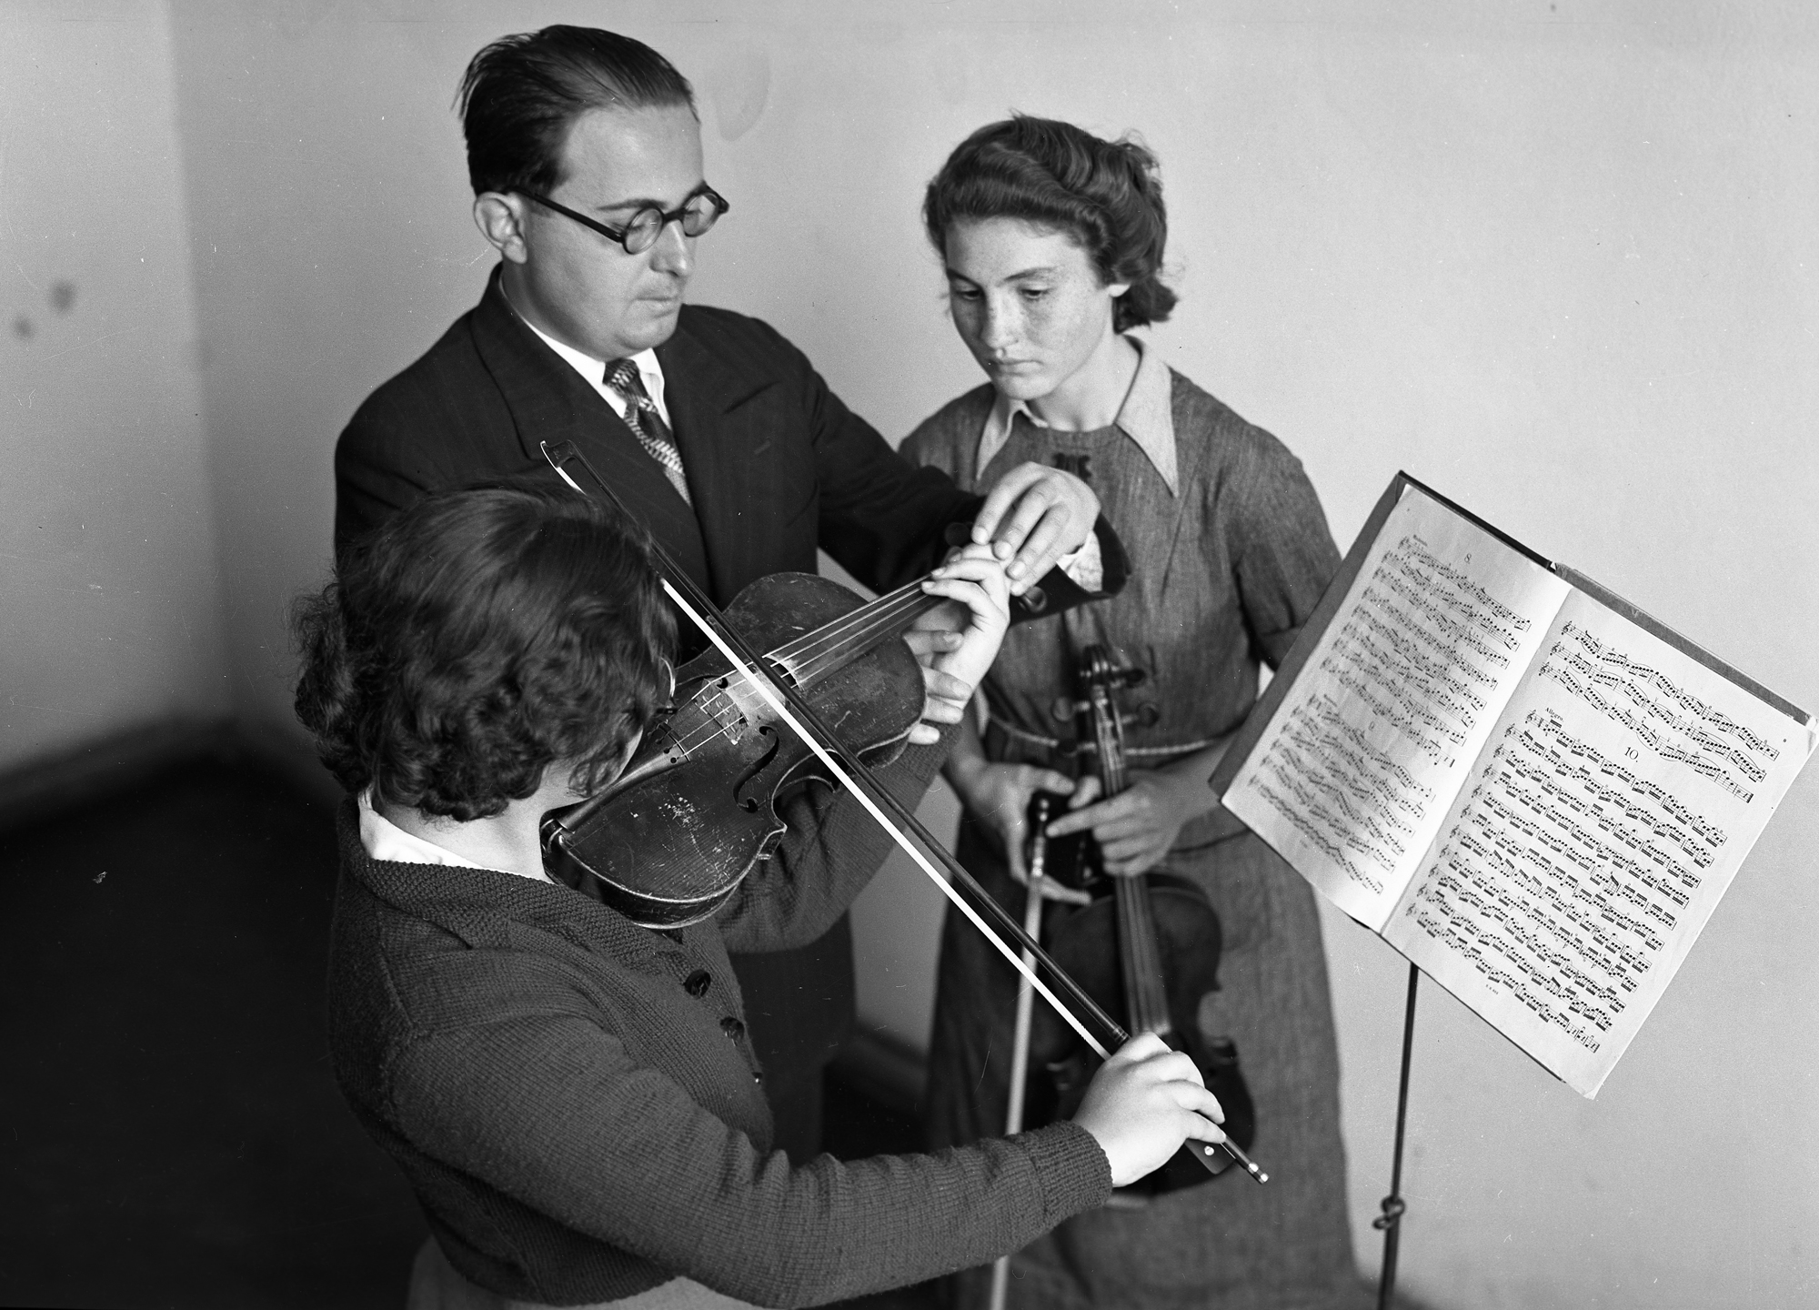
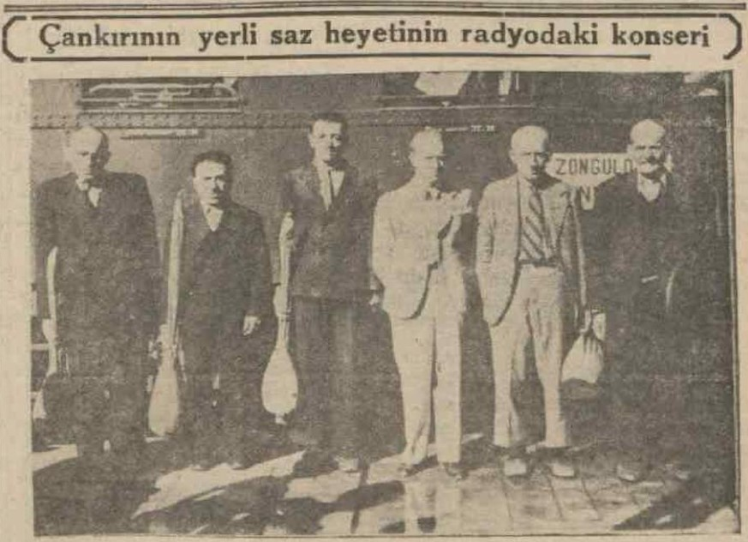
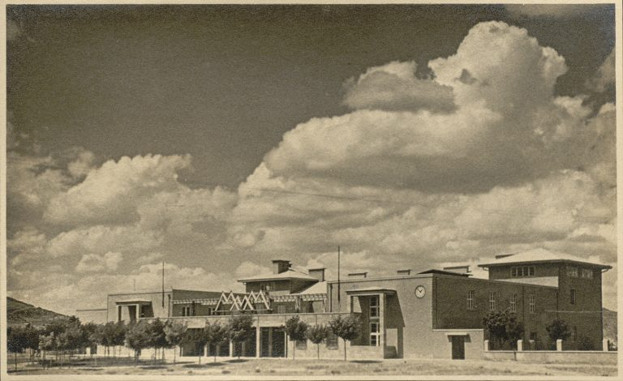
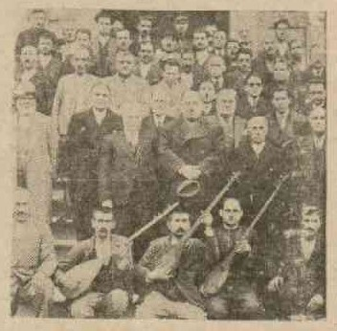
Musiki Muallim Mektebi (Music Teachers’ School)
established in Ankara in 1924
The first principal of the school was Zeki Güngör who was also the first conductor of the Presidential Symphony Orchestra.
Halk Evleri (the People's Houses)
operated as a state organization from 1932 till 1951
Dissemination of modern music
Collection of 'pure' folk song
Article 33: '...international modern music and our national folk songs will be the basis' and '...international music techniques and instruments will be used' .
"Çankırı People's Houses Saz Committee," (Son Posta Newspaper, August 25, 1939, p. 5)
"Local folk music at People’s Houses in Tokat,"
Son Posta Newspaper, March, 1940, p. 10

Slide 9
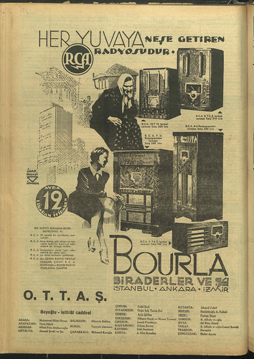
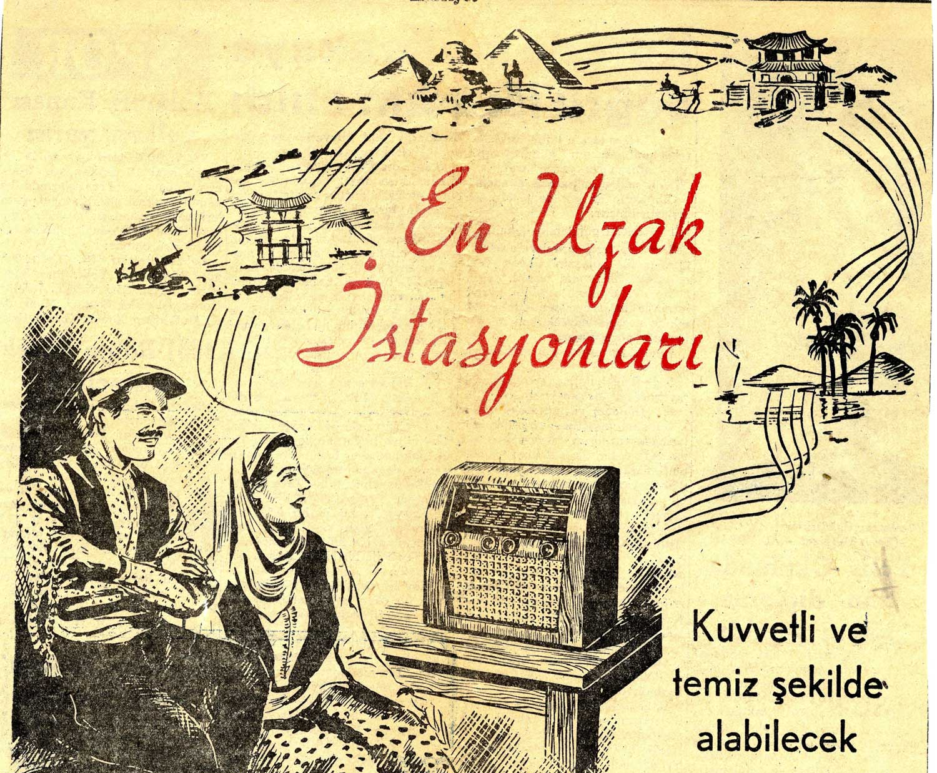
Radio
In November 1934, the state banned all 'Alaturka' music from state radio broadcasts
Replaceded by the new "purified" national folk music and Western classical composers.
Backfire: people began to listen to Arabic music and the ban was lifted nearly two years later
Still, the broadcasts of the Ottoman Classic Music was dominant among the programmes of Turkish music between 1937-40 on both İstanbul and Ankara radios.
Advertisement page of a newspaper,
22 November, 1937 Aksam Newspaper, p. 16)
An Audiola ad in an unidentified newspaper (1930/40s?)

Slide 10
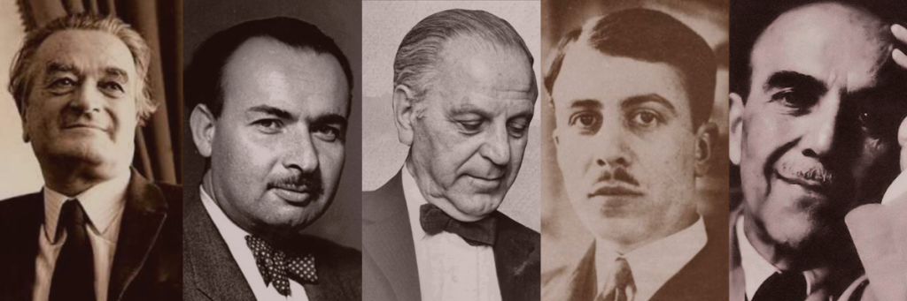
The Agents of the Constructing National Music: Composers, Experts, and Collectors
The Turkish Five.
state-sponsored composers that were sent to Europe to be educated
Ahmet Adnan Saygun, Necil Kazım Akses Ulvi Cemal Erkin Hasan Ferit Alnar Cemal Reşit Rey
During his years of study in Vienna, under the guidance of his teacher Joseph Marx, he composed his early works
When he returned, he began working as the music director of the Istanbul City Theater in 1932.
became a student of pianist Marguerite Long in France.
Taught at the Istanbul Conservatory starting in 1923 and composed his foundational 12 Anatolian Folk Songs in 1925.
Studied in France
writer of Özsoy Opera and the one
accompanied Béla Bartók on his 1936 research trip.
Studied in Austria assigned by the Ministry of Education to guide Paul Hindemith in the founding of the Ankara State Conservatory in 1935-1936
studied in Paris, and returned in 1930 to teach at the Musiki Muallim Mektebi (Music Teachers School) in Ankara

Slide 11
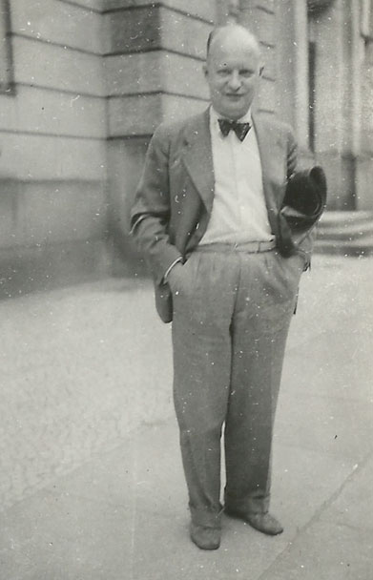
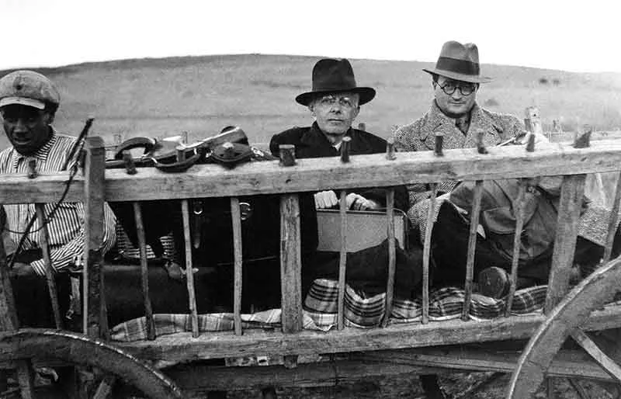
2. The Foreign Experts:
Paul Hindemith
Invited in 1935 and hired to establish the Ankara Conservatory.
reports “Suggestions on how to emancipate the musical life in Turkey” were published in March and May 1936 and the Ankara conservatory was founded in the same year."
Béla Bartók
was invited in 1935 by the László Rásonyi—a Hungarian-born philologist and professor at the newly founded University of Ankara, and in 1936 by People’s Houses
to find the raw material for the national folklore collection.
His companions were the composer A. Adnan Saygun, whose task was the collecting of data from the performers as well as the jotting down of the texts
"I very gladly accepted the invitation as I had long desired to investigate Turkish folk music at first hand and, especially, to find out if there was any relation between Old Hungarian and Old Turkish folk music... "
Béla Bartók and composer Ahmet Adnan Saygun in Anatolia

Slide 12
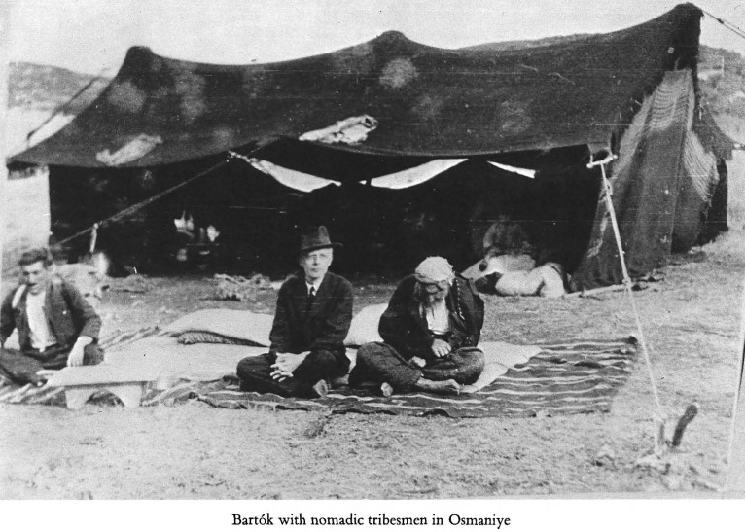
Shortcomings of his trip
What had been achieved did not come up to his standards of perfection
inability to obtain all the relevant information about the collected material
obtained data were either incorrect or contradictory; there was not enough time to thoroughly check these data and simultaneously pursue the recording of the available performers
linguistic problems: he could not talk to the peasants directly.
"All my trials resulted in a complete failure, which would indicate that singing in chorus was unknown in this part of the world. But even that statement should be accepted with caution. It is almost unthinkable that Turkish people should never sing together, never form a chorus (if only in one part).«
inability to record songs performed by Moslem women who did not not sing in public
The old Edison recording machine that Bartok brought with him from Budapest could not clearly record both voice and accompanying instruments at the same time.
"Bekir oglu Mustafa was the first singer to sing into the phonograph in his tribal settlement, and he could only be persuaded with great difficulty to do so; he was afraid he would "lose his voice" permanently if the machine should "take it." It is a joy for the student of folk music to find that as late as 1936 there were still people quite unfamiliar with talking machines, though it is quite natural that nomad tribes neither possess nor transport gramaphones on the backs of their camels to and fro between their summer and winter settlements! "
Bela Bartok, Turkish Folk Music from Asia Minor, ed. Benjamin Suchoff, (Princeton: 1976), 58.

Slide 13
Summary of his findings
The Classification System: He immediately classified the 78 vocal melodies he collected based on Rhythm (Primarily "Parlando" (a free, speech-like rhythm) versus "Tempo giusto" (a strict, rigid rhythm).
He argued that his system "proved" the hypothesis.
  He found that the "Old Hungarian" melodies and the "Old Turkish" melodies were "practically identical".
  He finds "irrefutable proof" that this shared musical style must be at least "fifteen hundred years old" and originates from a common period in Central Asia, before the Ottoman Empire.
  He explicitly rejects the idea that the Ottoman occupation of Hungary caused this similarity, claiming there was "no social interaction"
  He found evidence of Old Turkish linguistic influences, exerted by some Turkish people on the Finno-Ugrian Hungarian language.
"And now, in step, musicology brings proof of the identity of the Old Hungarian and the Old Turkish music, proof corroborated by the specimens of the mentioned Cheremiss and Kazan-Turkish folk music, which show a related music structure and even near-variants of Hungarian melodies. Considering the historical fact that these peoples lived near each other twelve to fifteen centuries ago, later moved apart to rather distant territories, and could not have had any contact with each other since their separation, it is evident that this musical style must be at least fifteen hundred years old. The fact that such a statement is at all possible makes this subject of international importance, for there is no other instance known in the world, to my knowledge, which offers the possibility of this kind of irrefutable determination of the age of folk music traced back for so many centuries. "
Bela Bartok, Turkish Folk Music from Asia Minor, ed. Benjamin Suchoff, (Princeton: 1976), 40.

Slide 14
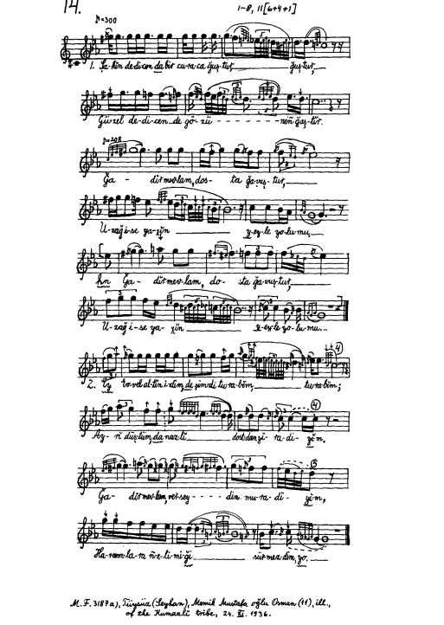

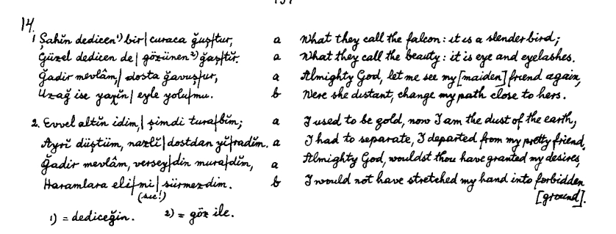
"Memik Mustafa oglu Osman, a boy, was the only singer available at the tent settlement, since all the men were away and the women refused to sing."
https://www.youtube.com/watch?v=a55S1nsFlgw&list=OLAK5uy_ml-xVMKs8VVuVnOzhufIVDsjeM3vZ-vKo&index=72

Slide 15
Thank You
Balkıç, Özgür. “Kemalist Views and Works on Turkish Folk Music During the Early Republican Period,” Master's thesis, Middle East Technical Univesity, 2005.
Bartók, Béla. Turkish Folk Music from Asia Minor. Edited by Benjamin Suchoff. Princeton N.J.: Princeton University Press, 1976.
Demirci, Sevtap, and Okan Ceylan. “Constructing Turkish National Identity: Role of Folklore and Folk Music.” In Europe and the Orient: Past Encounters, Heritage, Present-Day Interactions, edited by Evgenii︠a︡ Troeva-Grigorova, Nikolai Vukov, and Galina Lozanova, 248–64. Sofia: Prof. Marin Drinov Publishing House, 2022.
Duman, Olcay Özkaya. “Yüzüncü Yılında Darülelhan’dan Konservatuar’a Musiki Eğitimi ve Cumhuriyet Dönemi Modernleşme ile Musikinin Millileşme Meselesi ‘Saray Müziğinden Salon Müziğine.’” Ankara Üniversitesi Türk İnkılap Tarihi Enstitüsü Atatürk Yolu Dergisi, no. 61 (2017): 111–43.
Gökalp, Ziya. The Principles of Turkism. Translated by Robert Devereux. Leiden: Brill, 1968.
Helvaci, Ayhan. “Contemporary Turkish Composers - Turkish Five.” Procedia - Social and Behavioral Sciences 46 (2012): 2630–34.
Işıktaş , Bilen, and Namık Sinan Turan. “Erken Cumhuriyet Dönemi’nde Ulusal Kimlik ve Kültür Kurgusunda Müziğin Yeri.” In Yüzüncü Yılında Türkiye Tarih, Toplum, Siyaset, edited by Serap Yolcu Yavuz and Ünsal Yavuz, 113–63. Paradigma Akademi, 2022.
Işıktaş, Bilen. “Sentez Arayişlariyla Geçen Tari̇hsel Bi̇r Müzi̇koloji̇k Tartişma: Cumhuri̇yet Dönemi̇nde Milli Müzi̇k İ̇nşasi [Historical Musicological Discussion in Search of Syntheses: Constructing National Music in the Republican Era.]” International Journal of Interdisciplinary and Intercultural Art 2, no. 2 (2017): 23–53.
Turan, Namık Sinan, and Bilen Işıktaş. “The Deadlock of Nation State: The Problem of Nationalisation of Music During the Early Republican Era in Turkey.” Rast Müzikoloji Dergisi 4, no. 1 (April 15, 2016): 1076–92.
Turan, Namık Sinan. “Erken Cumhuriyet Döneminde ‘Ulus Kimliğin’ Opera Sahnesinde İnşası: Özsoy.” Ahenk Müzikoloji Dergisi 2 (September 2018): 1–30.
İşkodral, Musa Eren. “Cumhuriyet, Türk Müziği ve Türk Beşlileri.” Balkan Müzik ve Sanat Dergisi 1 (April 2019): 23–30.

