Slide 1
Modernism at the “margins”
Collecting Folklore in Andalucia and Transylvania
Hannah Szabó | 24 October | Sound, Music, Noise

Slide 2
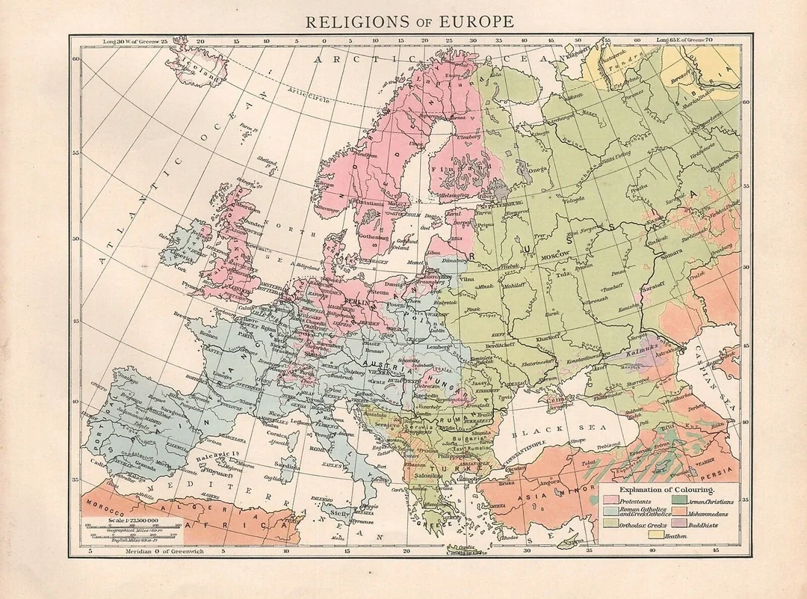
Europe, c. 1900

Slide 3
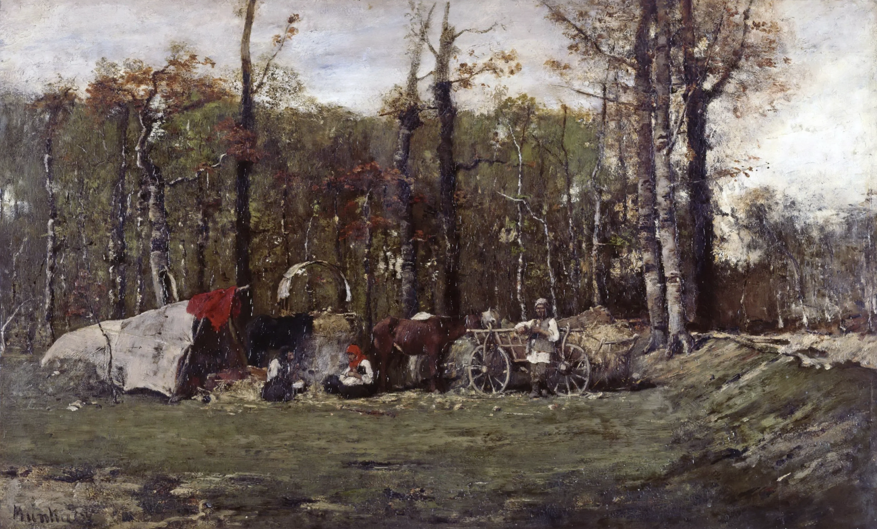
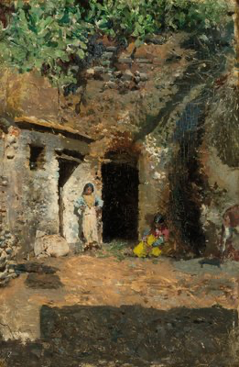
Andalucia and Transylvania in comparative perspective
Rural, less industrialized regions memorialized as borderlands of European Christianity, with sizeable Romani populations. Function as “internal Orient” for Spain and Hungary, respectively
Cigánytábor
Mihály Munkácsy
1873
Cueva de gitanos
Marià Foruny
1872

Slide 4
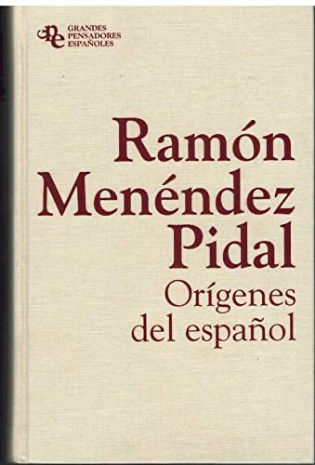
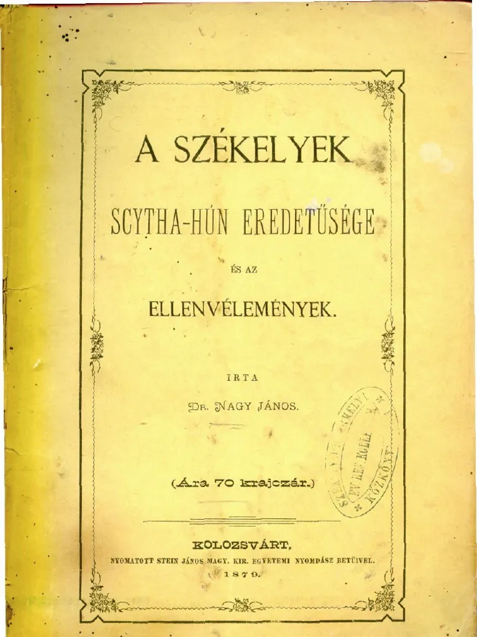
Historicism and Organicism in
Philology
19th-century European philology treated language as the vessel of a people’s geist
  “The nature of a thing is shown by its origin.” — Johann Gottfried Herder (History of Linguistics, vol. IV, p. 84)
  Language seen as a living organism, unfolding from its roots.
Peripheral dialects as “conservative zones”
  Southern Spain and Eastern Hungary cast as preservers of ‘original’ language, repositories of national essence

Slide 5
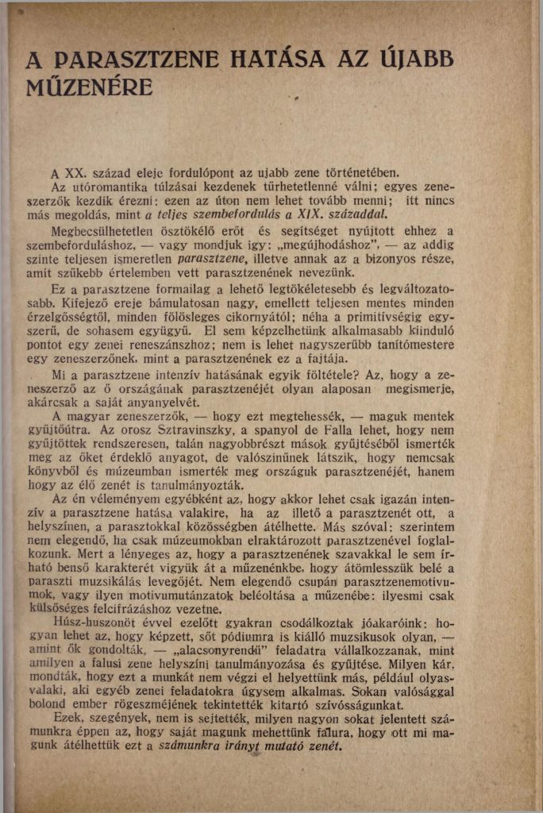
Bartók, The Influence of Peasant Music on Modern Music (1931)
What is best way for a composer to reap the full benefits of his studies in peasant music is to assimilate the idiom of peasant music so completely that he is able to forget all about it and use it as his musical mother-tongue. In order to achieve this, Hungarian composers went into the country and made their collections there. It may be that the Russian Strawinsky and the Spaniard Falla did not go on journeys of collection, and mainly drew their material from the collections of others, but they too, I feel sure, must have studied not only books and museums but the living music of their countries.
Folk-music will have an immense transforming influence on music in countries with little or no musical tradition. Most countries of southern and eastern Europe; Hungary, too, are in this position.
quoting Kodály: “It is known that folk language has many similarities with the ancient language of a people. In the same way folk-music must for us replace the remains of our old music.”

Slide 6
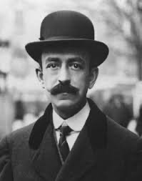
Manuel de Falla (1876-1946)
Leading Spanish modernist composer. Studied Bartók’s “pianistic stylization of folklore”
“ …Early 20th-centuray primitivism fantasized the reconstruction of art as perceived by the “natural” man. Stravinsky, Bartok, Falla and other composers appreciated atavism as a musical value, and artistic convention…”
“Falla … maintained that deep song imitates the natural order. As an enharmonic musical genre, whereby the voice or the instrument glides through intervals excluded by the rigid Western tempered scale, cante jondo mirrors “birdsong, animal screams, and the infinite noises of matter.”
(Orringer, Lorca In Tune With Falla : Literary And Musical Interludes)

Slide 7
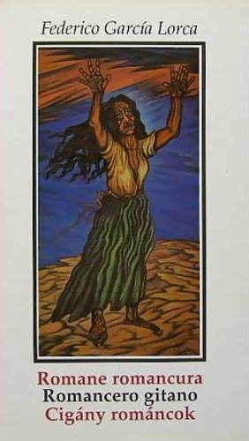
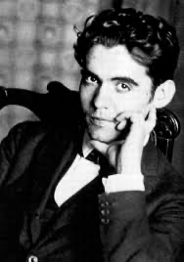
Federico García Lorca
Born in Granada in 1898, the year Spain loses the Spanish-American war and its last imperial holdings → Generacion del ’98
- Romancero gitano (1928) — cycle of poetic
ballads fusing Romani folklore, Andalusian
imagery, surrealist symbolism
Murdered in 1936 during the Spanish Civil War by Nationalist forces, likely for leftist sympathies and open
homosexuality (martyrized)

Slide 8
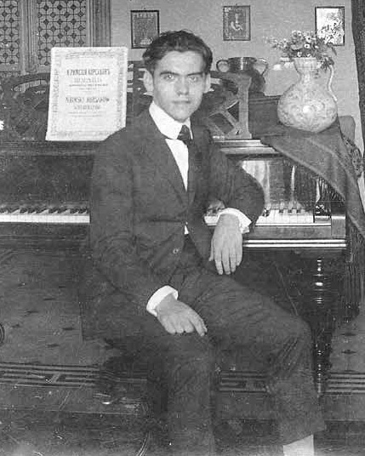
Federico García Lorca
“As a child, Lorca imbibed traditional Andalusian songs from the lips of his family maids, whom he would remember with affection years later. At a very early age he began to study piano, and during his adolescence, music and poetry competed for primacy among his interests….” (Stanton, The Tragic Myth: Lorca and Cante Jondo)
Likewise, in Bartók’s childhood…
“His nanny sang to him a lot, and he always listened to her with delight … When from time to time gipsy music was played in our town (on some special occasion), he urged us to take him there and then listened to the music with amazing concentration.”(Trumpener, “Bartók and the Rise of Comparative Ethnomusicology)
1919

Slide 9
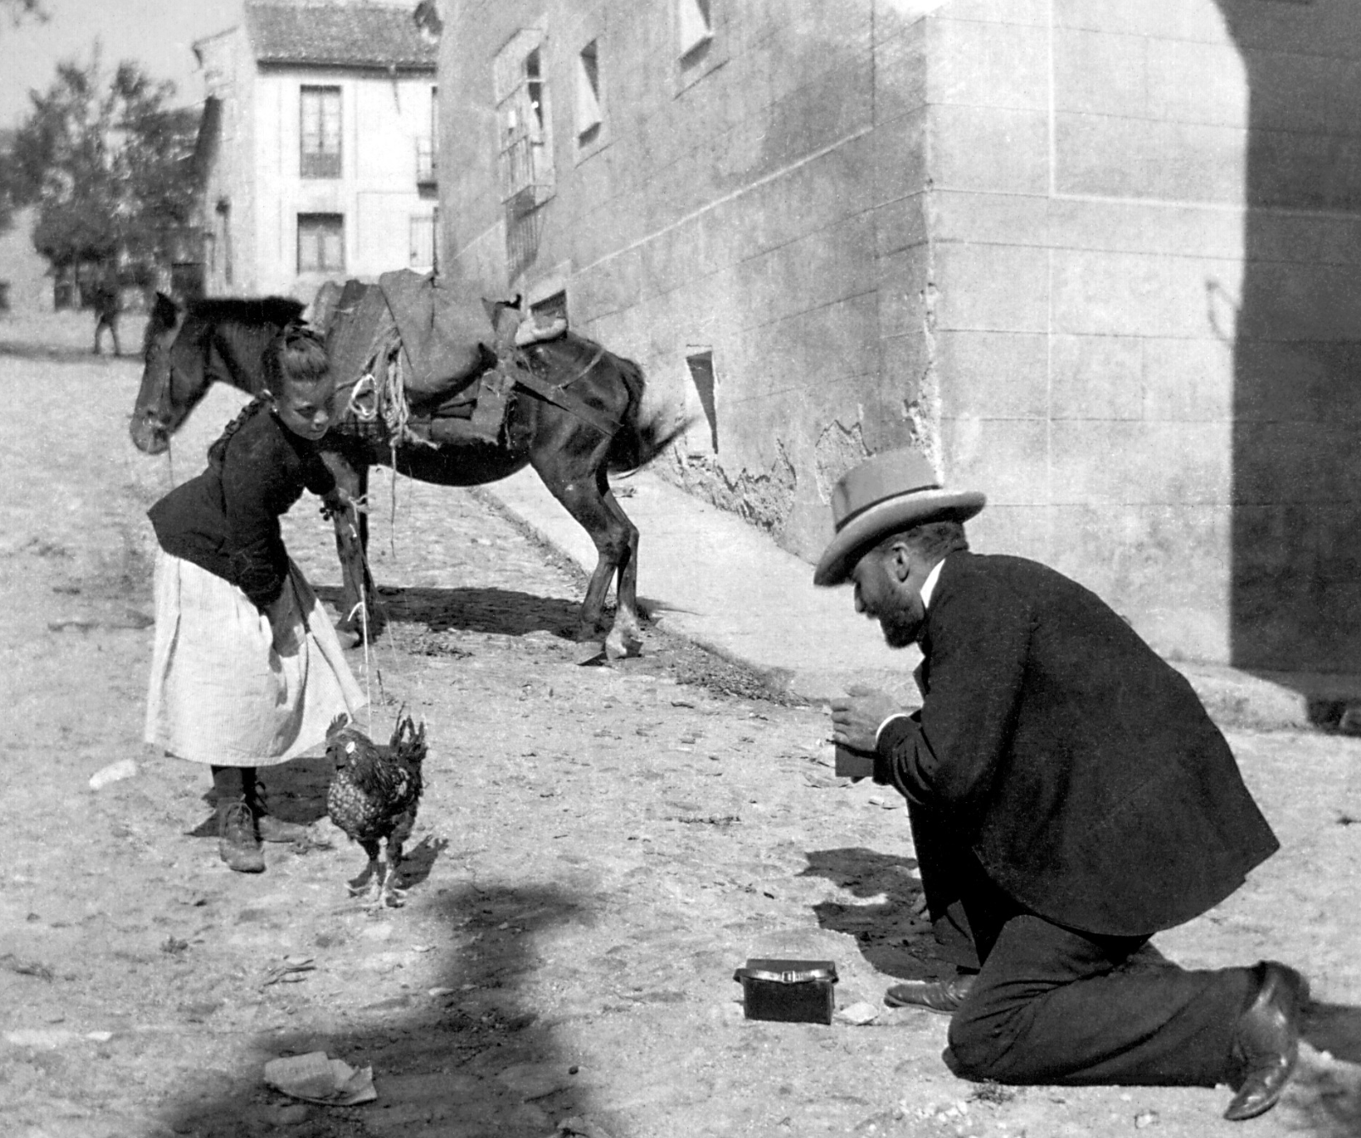
Federico García Lorca
Joins philologist Ramón Menéndez Pidal to collect folk music around Andalucia:
  I remember that when, in 1920, I made a trip to Granada, a young boy accompanied me for several days, guiding me through the streets of the Albaicín and the caves of Sacromonte so that I could collect oral ballads in those Gypsy neighborhoods of the city (recoger romances orales en aquellos barrios gitanos de la ciudad). That boy was Federico García Lorca.
  R. Menéndez Pidal
Menéndez Pidal with camera, 1902

Slide 10
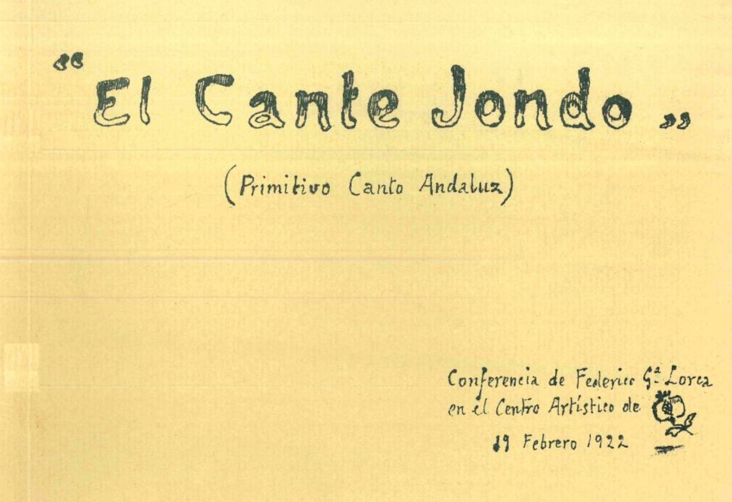
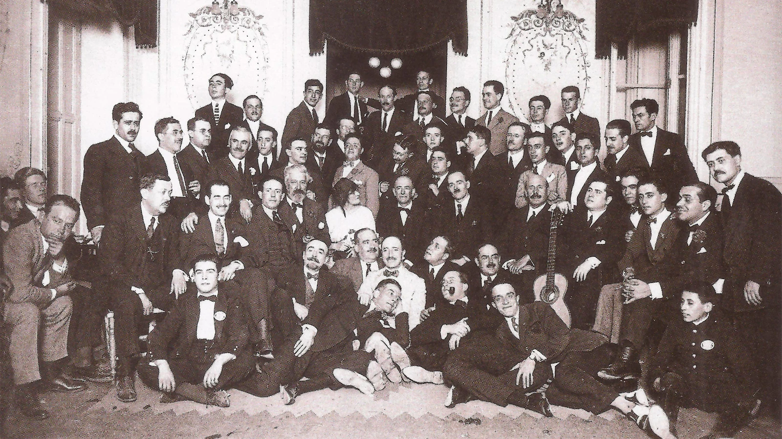
El Cante Jondo conference, Granada, February 1922
https://archive.org/details/i-concurso-de-cante-jondo-granada-1922
Lorca’s speech
…Que el canto es anterior al lenguaje...
… Riemann, en su Estética Musical, afirma que el canto de los de los pájaros se acerca a la verdadera música y no cabe acer [sic.] distinción entre éste y el canto del hombre por cuanto que ambos son expresión de una sensibilidad…

Slide 11
Bartók and Lorca:
The ‘Margin’ as Central to Nationhood
Bartók: Everyone knows that, from the standpoint of folklore, the oldest, most deep-rooted, and most interesting part of the Hungarian people lives almost without exception in the detached territories. Among these, Transylvania—treasure-house of our linguistic, folk-poetic, and folk-art antiquities (mint nyelvi, népöltészeti és népművészeti régiségeink kincsesháza)—has long stood in first place.
(Erdélyi Magyarság, 1923)
Lorca: The peculiar song of Andalusia… though its essential elements coincide with those of peoples so distant geographically from our own, bears so intimate, so national a character (acusa un carácter tan intimo, tan nacional) that it becomes unmistakable.
It is a purely Andalusian song, which already existed in germ in this region before the Gypsies arrived.
    (Cante Jondo, 1922)

Slide 12
Bartók and Lorca:
“Asiatic” origins
Bartók: The melodies of the old Hungarian peasant music style were not derived from the peasant music of the neighbouring peoples. Their partiality for the pentatonic scale renders more plausible the conjecture that they are remnants of our primitive Asian musical culture…. They are quite free from any Western European influences. (“Hungarian Peasant Music,” 1933)
Lorca: That is, the cante jondo, in resemblance to the primitive musical systems of India, is but a kind of stammering — a pitched emission of the voice, a marvelous undulation of the mouth that shatters the sound-cells of our tempered scale, that cannot be contained within the rigid, cold staff of our present-day music, and that opens, into a thousand petals, the hermetic flowers of the semitone. (Cante Jondo, 1922)

Slide 13
Bartók and Lorca:
“Authentic” versus “Corrupted” music
Of the bulk of this music [our compatriots] know only those one or two hundred songs which our gipsy band leaders had the kindness to take over from the peasants and drum into the ears of the Hungarian gentry, which are unimaginably marred almost past recognition by their oriental fantasy. I recommend to all those who do not know the enormous difference between the Hungarian-type and the gypsy-type ornamentation to listen to the music of a Hungarian peasant musician…”
…the very valuable ancient Hungarian melodies from Transylvania, which are unlike any folk melodies they have heard before… thoroughly Hungarian folk music. (Bartók, On Hungarian Music, 1911)
Cante jondo originates from the primitive musical systems of India, whereas cante flamenco is a derivative of the former and does not take shape until the eighteenth century. (Lorca, El cante jondo, 1922)
“for nearly half a century, the traditional music of southern Spain had suffered the plague of commercialization. The music had emigrated to the theater and café chantant of the cities from its breeding gorunds in the country and small towns. In the popular mind it began to be associated with a world of vice and braggadocio …. Flamenco, on the other hand, is a modern development or corruption of cante jondo” (Stanton, The Tragic Myth)

Slide 14
Bartók and Lorca in comparison
Utilizing the shared logic of modernism, Bartók and Lorca transform ‘marginal’ regions of ‘marginal’ nations into centers of artistic authenticity.
Key differences in Lorca’s case:
  Hybridity as source of originality
    “Falla has advanced a sedimentary conception of Andalucian history, with each culture — Roman, Byzantine, Moorish, Gypsy — depositing its own stratum on the merging regional essence to bring deep song into being… Likewise Lorca finds that Andalucia has come into being through the sedimentation of its creative past” (Orringer 146, 159)
  Poetic, not scientific, emphasis; lack of recording
    “In Spain, the first recordings of traditional folk music were made in the early thirties.” (Katz, 73-4)

