Slide 1

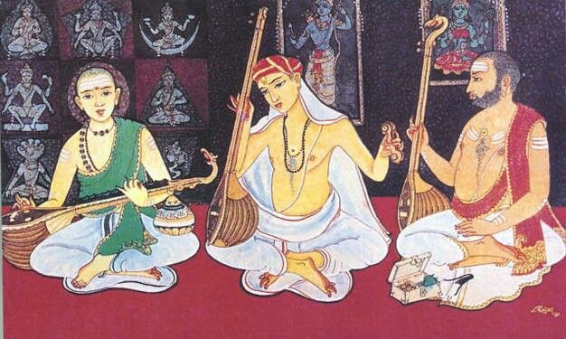




Creation ‘Classical’ Carnatic Music
Presented by
Grace P Johns

Slide 2


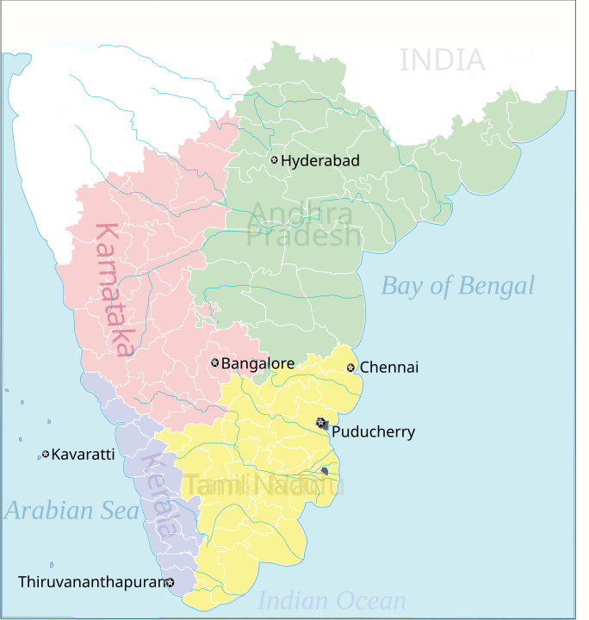
The word Carnatic comes from the state called Karnataka.
Purandaradasa is said to be the father of Carnatic music.
  He is non-Brahmin orgin
  Raga Mayamalavagowla as the basic scale for music instruction and fashioned a series of graded lessons such as swaravalis, janti swaras, alankaras, lakshana geetas, prabandhas, ugabhogas, daatu varase, geeta, sooladis and kritis.
  Dasa songs: criticising the existing caste system.
In north, a similar set of music is also called as Hindustani music.
To place a geographically Carnatic music comes from South from the states of Karnataka, Tamil Nadu and Kerala.

Slide 3

Can you identify which is classical and which is not?

Slide 4
Can you identify which is classical and which is not?
Periyamelam – performed by Issai Vellar
Thyagaraja Keerthanalu
Marukelara
Classical Carnatic music
Naiyandi Melam (Hunter)
-Sami Alaippu Naiyandi,
This instrument is very important

Slide 5
Music Trajectory
Pre: 17 C
1762 to 1835
Mid 19 C
Isai Vellalar
Rise of Madras (Chennai) and the Sabhas
Trinity of Carnatic music
Pre-Trinity composers in Tamil Nadu like Muthu Thandavar, Marimuthu Pillai, and Arunachala Kavi were non-Brahmins. Furthermore, Purandaradasa,
both vocal and instrumental were principally managed by the Isai Vellalar community (historically associated with the Devadasi system).
They were the undisputed masters of instruments such as the veena, mridangam, and flute.
Their knowledge was deeply embedded in temple rituals and royal court patronage, where performance was tied to their hereditary role as cultural specialists.
Syama Sastri | 1762–1827 | Telugu and Sanskrit | Śyāma Krishna | Complex Talas, Swarajati
Tyagaraja | 1767–1847 | Telugu and Sanskrit | Tyagaraja | Pancharatna Kritis
Muthuswami Dikshitar | 1775–1835 | Sanskrit; Some in Manipravalam | Guruguha | Nottuswara, Navagraha Kritis
Colonization & Migration
Royal courts and temple endowments became economically unviable under the British Raj
Musicians migrated in mass to the colonial city of Madras
music organizations, concert halls, and academies, known as Sabhas, were established by an upper-caste, predominantly Brahmin elite.
This elite positioned themselves as the patrons and managers of a "revival" of Karnatic music.
elite undertook the systematization and formalization of the music.
They successfully branded it as the "classical" art of South India- tradition and nationalist identity under colonial rule.
Trinity of Carnatic music is known for creating a new era in the history of carnatic music by bringing about a noticeable change in what was the existing carnatic music tradition.
⁻Panikkar, K N (2002). Culture, Ideology, Hegemony: Intellectuals and Social Consciousness in Colonial India. London: Anthem Press

Slide 6
The Tamil Melakkarans perform both the periyamelam and the nautch music. The latter consists of vocal music performed by a chorus of both sexes to the accompaniment of the pipe and cymbals. The class who perform it. are called Nattuvans,, and they are the instructors of the dancing women. The periyamelam always finds a place at weddings, but the nautch is a luxury.
Madras District Gazetteers Tanjore
by F.r. Hemingway Publication ( 1906 )

Slide 7

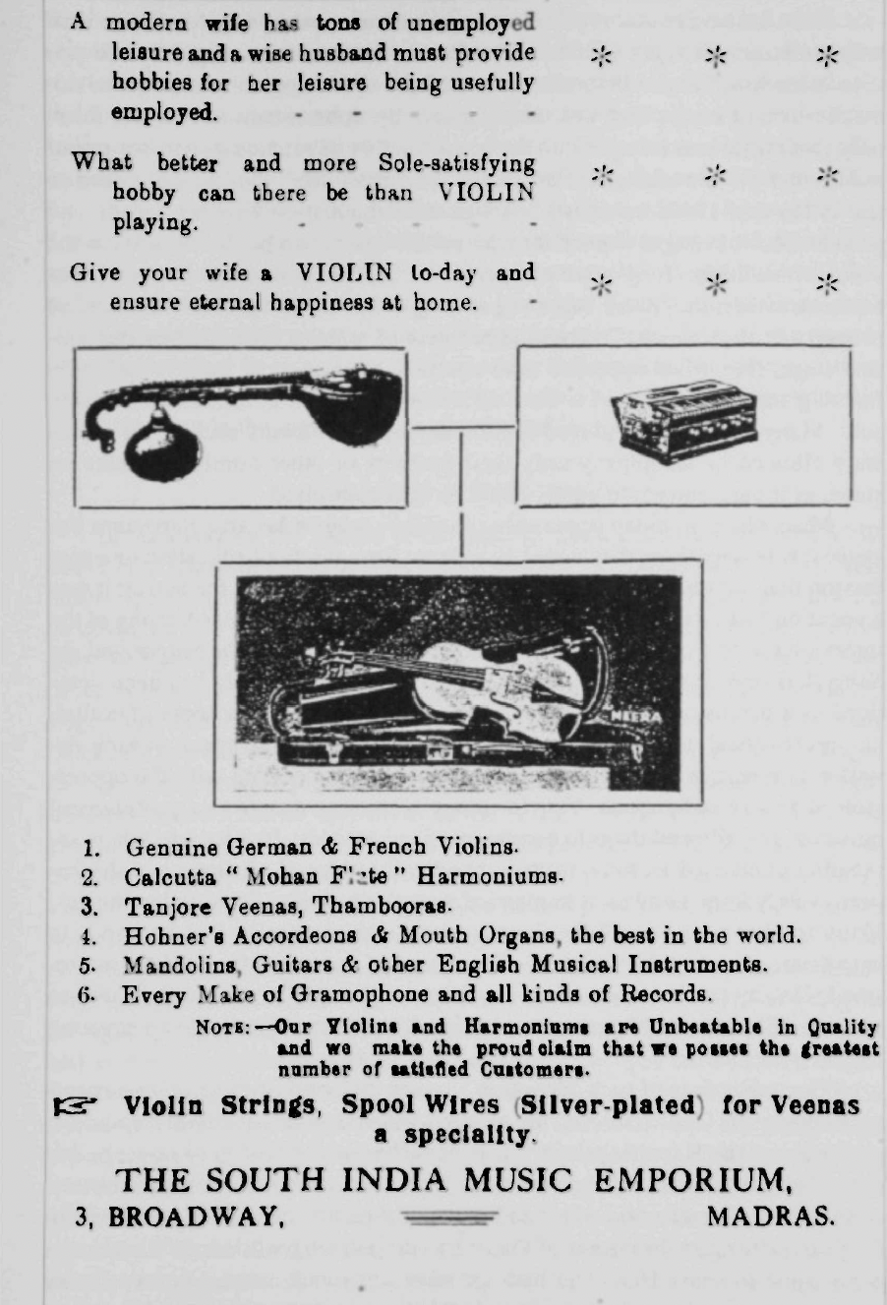
Early 20th Century
Marginalization of the Isai Vellalar : they no longer could perform in temples or in Sabha
Devadasi System then become according to the colonial framework ‘prostitutes’
The Emergence of Brahmin Women as Performers
M. S. Subbalakshmi, D. K. Pattammal, and M. L. Vasanthakumari, who are Carnatic musicians of the 20th century, are popularly referred to as the female Trinity of Carnatic Music.
Isai Vellalar people played background instruments for Carnatic music, which was later replaced by modern instruments. (older instruments, used animals, skin.)
Caste Conflicts and the Tamil Isai Iyakkam
Advertisement in the Madras Music Academy Souvenir, c. 1938.

Slide 8
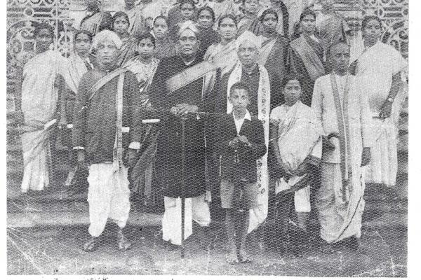
Madras Music Academy (August 18, 1928)
focused on codifying the ragas (scales/modes) and talas (rhythms)
‘Revival’ of the Indian classical dance form of Bharatnatyam
National and Nation’s Music
The Branding of "Classical” not just music, but also even in the Raga and Sruthi
many instruments were deemed to be classical, and others became ‘local or indigenous’
Western model of "Classical Music"
Annual conference of Madras music Academy 1935.

Slide 9
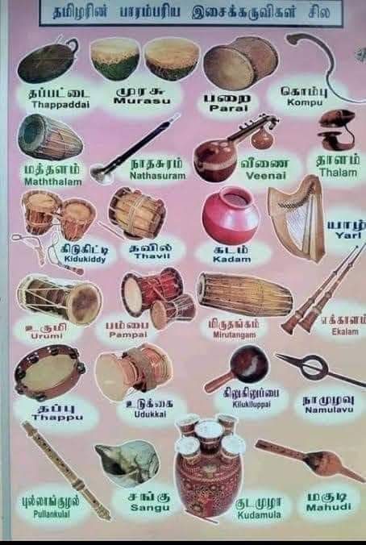
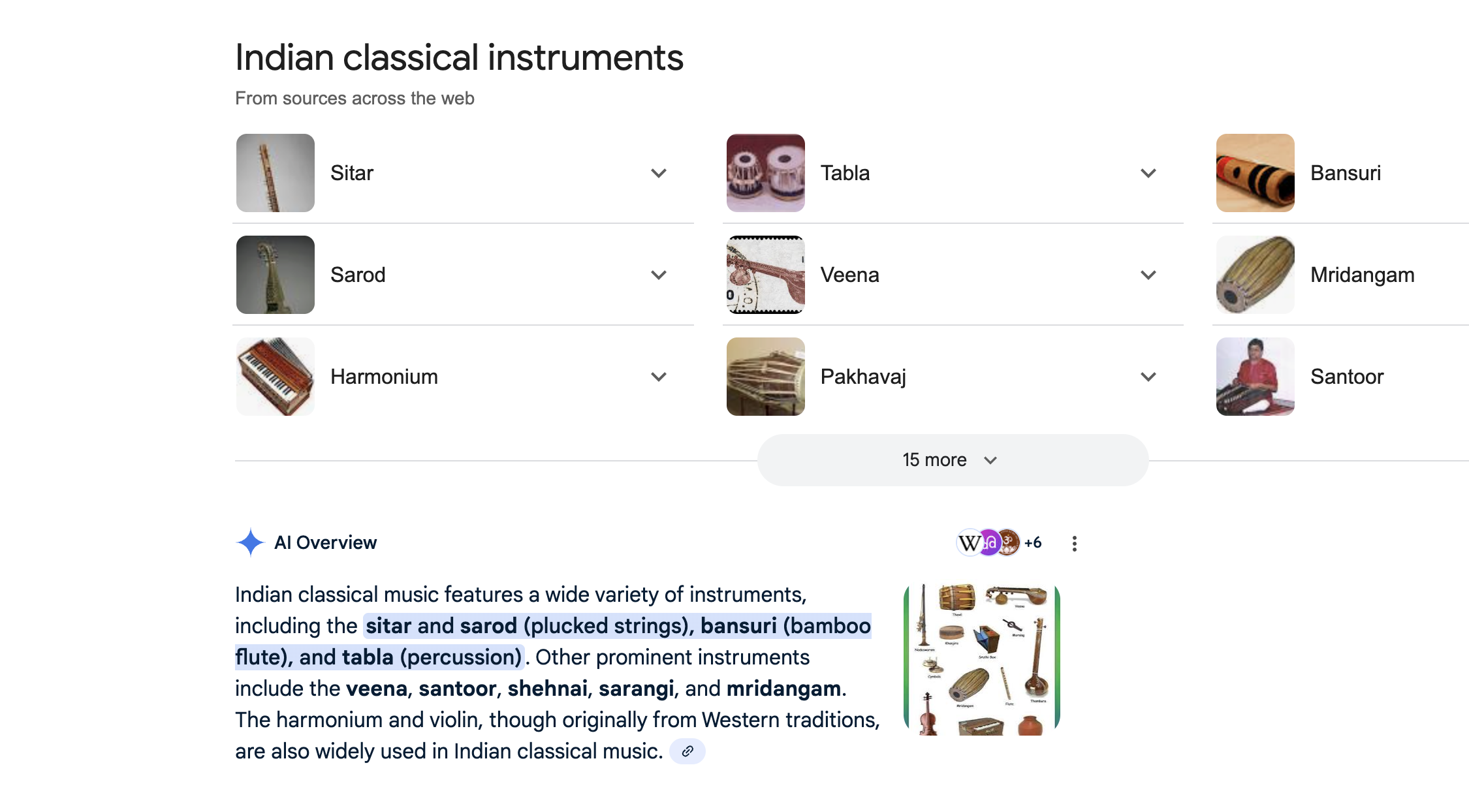
‘Folk’ Instrument

Slide 10
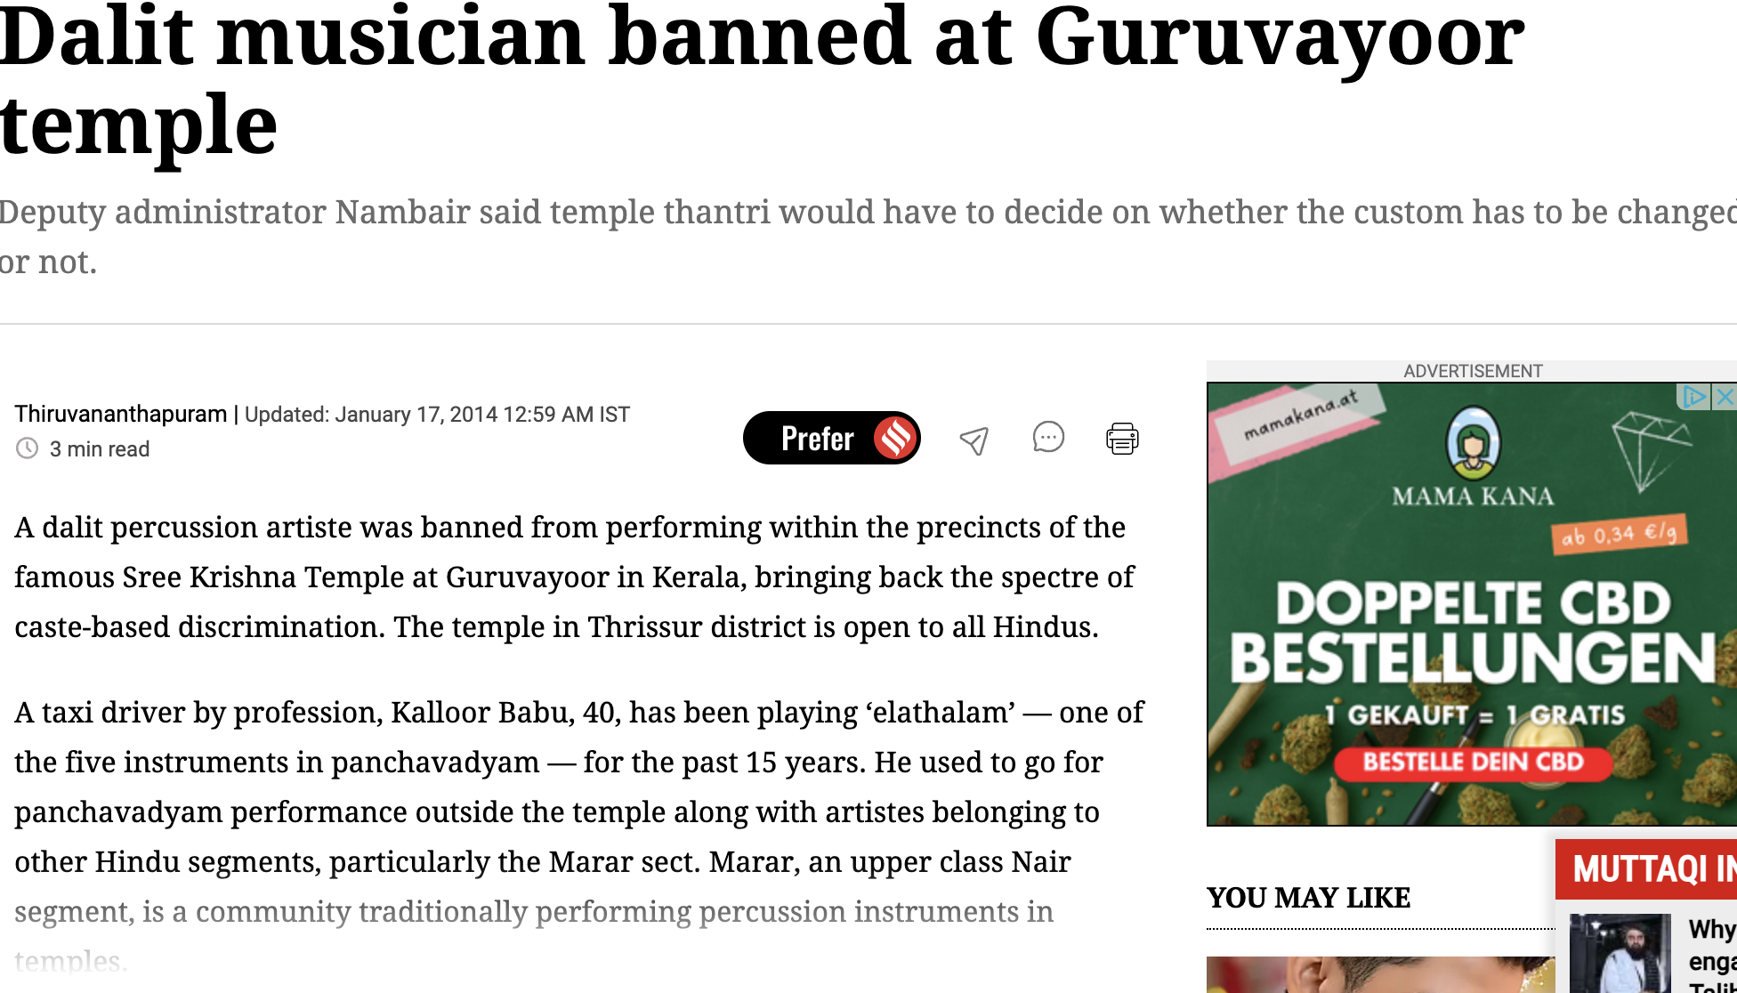
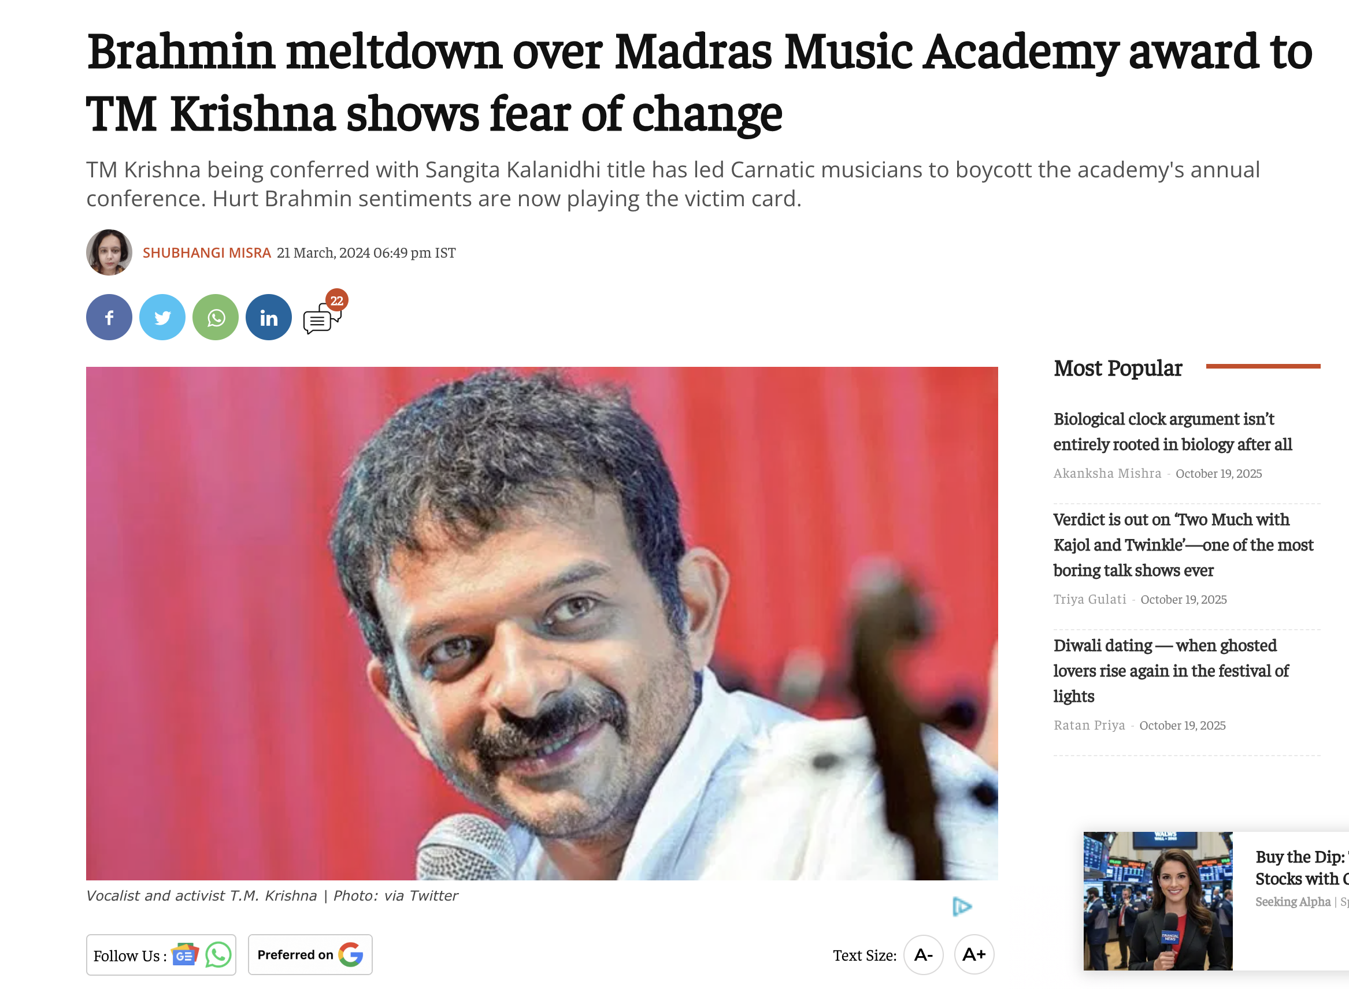
21st Century
Migration of musicians to outside India and music performance
Carnatic music: still trace out its legacy with its surname (which is caste name ideally ) and with the guru’s name.
certain aesthetic distinctions make it inappropriate to conflate diverse forms (like comparing Carnatic music with Parai-attam),
Many struggle for equivalence and mutual respect among all art forms, challenging the implicit social hierarchies still embedded in the "classical" label.

