Slide 1


Zydeco:
Creole music tradition in Louisiana
Analina Barnes

Slide 2
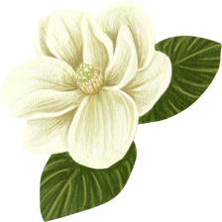
Overview
Introduction
History
1
2
3
Social and Cultural
4
Zydeco today

Slide 3
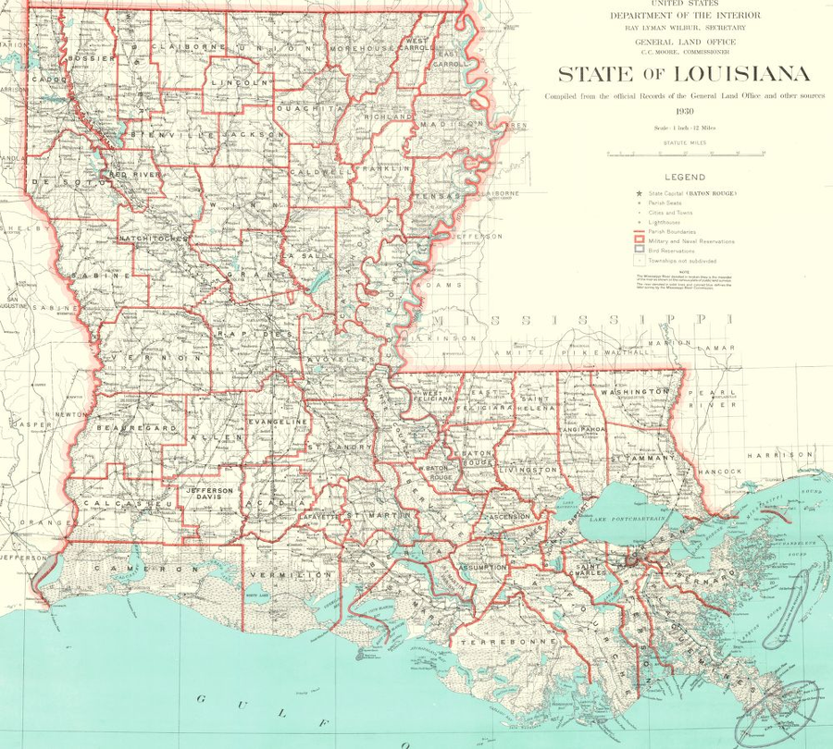
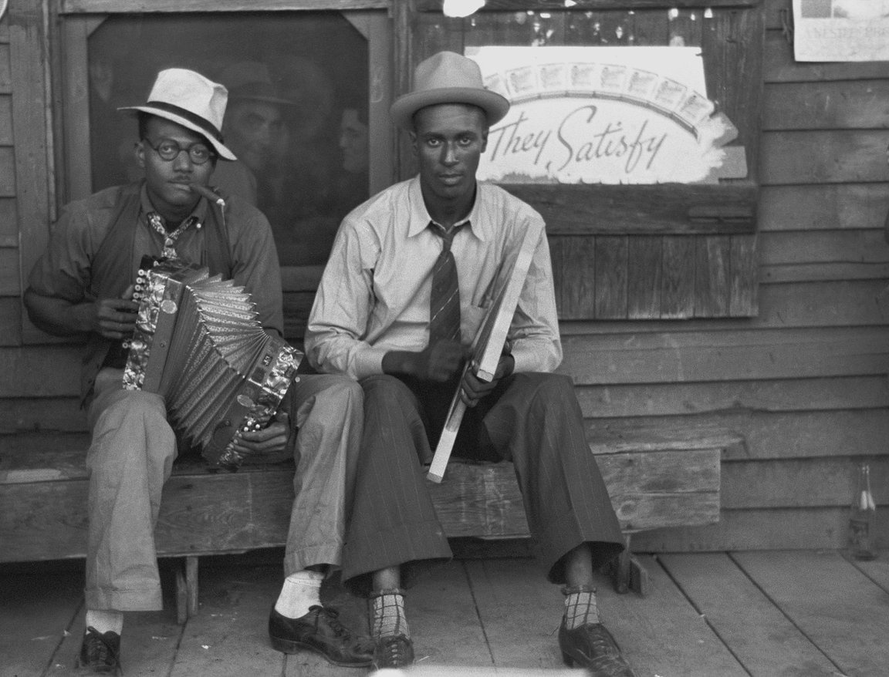
Introduction
Who? What? Where is Zydeco music?
Map dated 1930, Birmingham Public Library Cartography Collection.
Creole musicians, 1938. Image from Library of Congress, Prints and Services division.

Slide 4
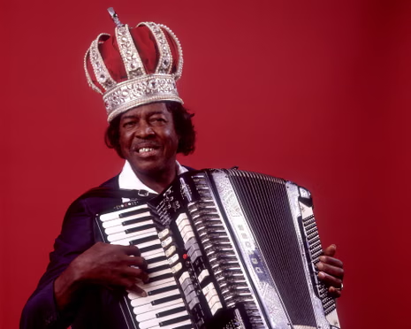

Zydeco, zodico, zaricots, “za” “re” “go”...
Les haricots sont pas salés
Clifton Chénier, the King of Zydeco. Paul Natkin/Getty Images.

Slide 5
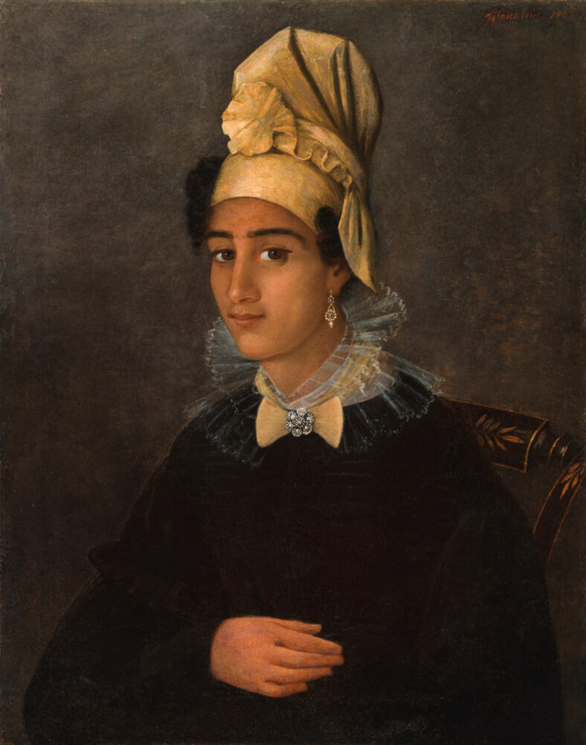
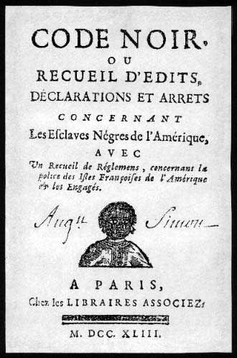
History
  Zydeco emerges from the heritage and communities of rural gens de couleur libres.
  Language is a mix of French, African, Spanish, Anglophone, and regional Native American influences.
  Geneology of zydeco: jurer/juré and Lala
Royaume de France, Libraires Associez.
Historic New Orleans Collection.
Portrait of a Free Woman of Color by François Jacques Fleischbein.

Slide 6
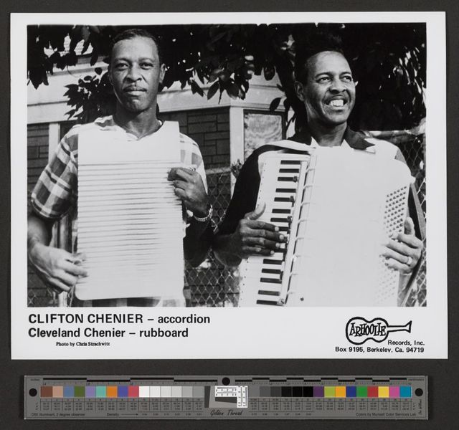
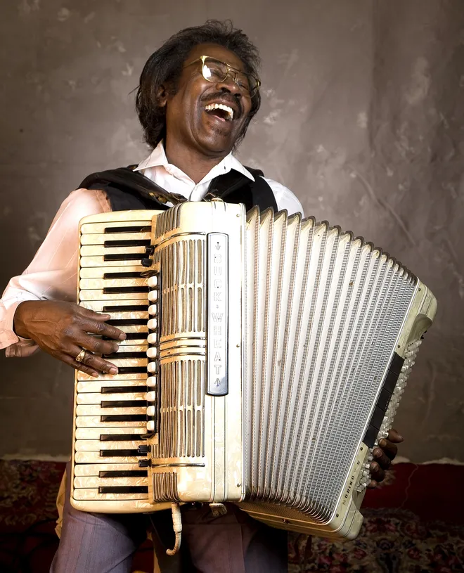
Instruments
Buckwheat Zydeco. Photo from Standard-Times.
Charles Deering McCormick Library of Special Collections, Northwestern University Libraries. "Clifton and Cleveland Chenier", Berkeley Folk Music Festival.

Slide 7
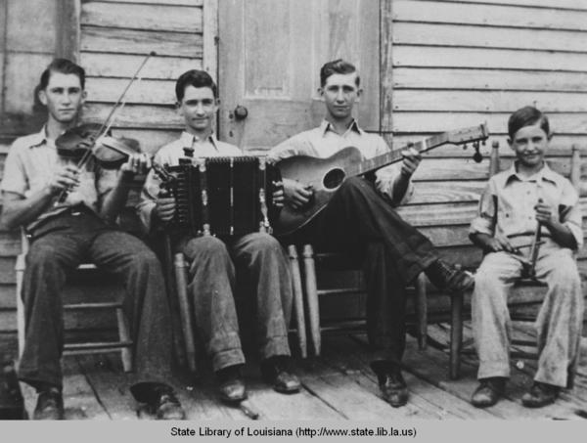
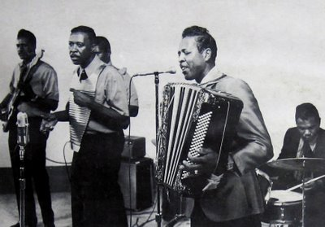
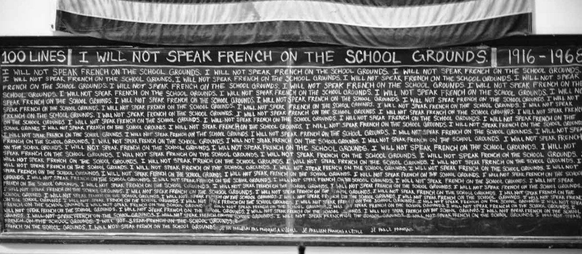
vs.
Clifton Chenier band.
Acadian folk musicians, southwest Louisiana, early 1930s. Courtesy of State Library of Louisiana.
Photograph courtesy of Bruce Sunpie Barnes.

Slide 8
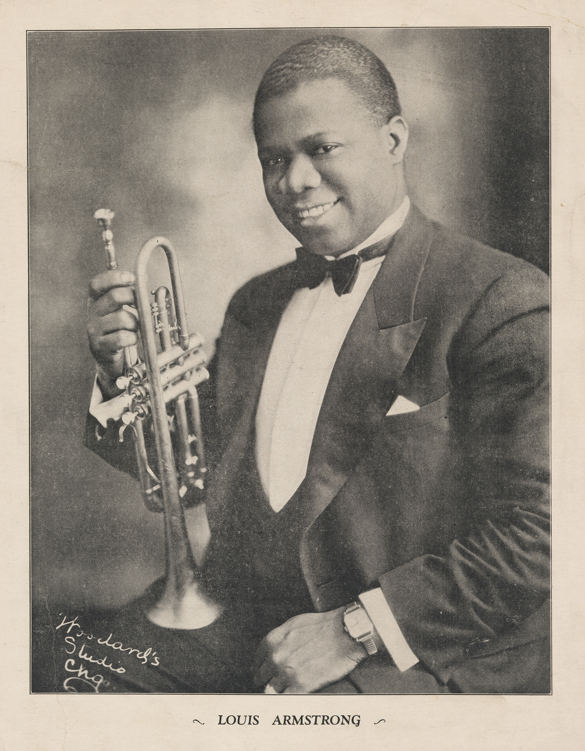
Bartók’s urban vs rural folkmusic

Slide 9
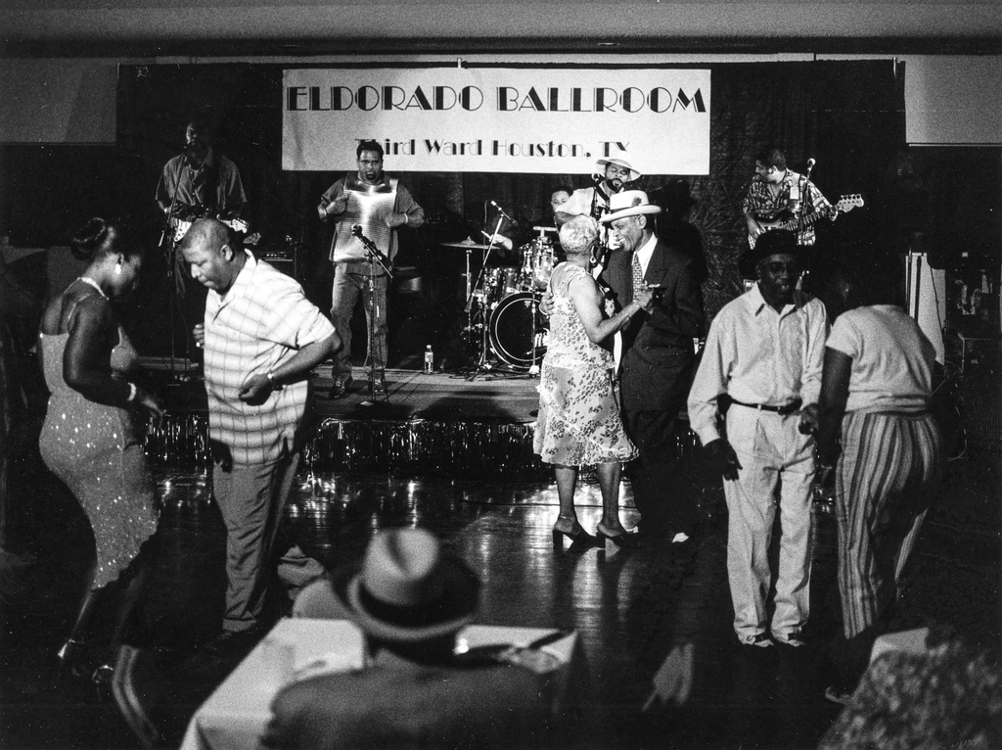
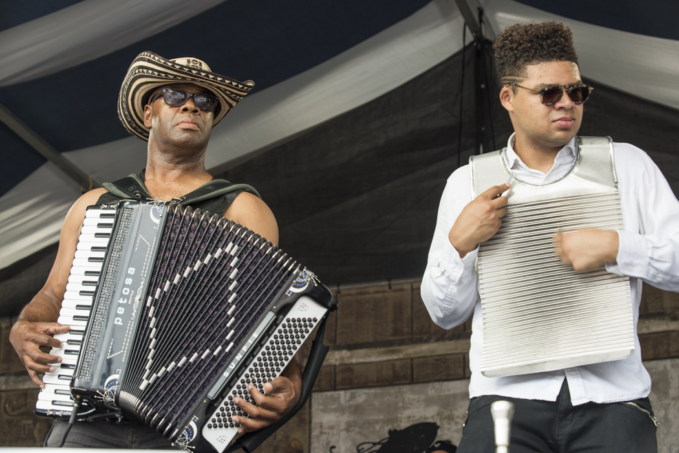

Where is Zydeco today?
Bruce “Sunpie” Barnes and Aurélien Barnes. Photo by Ryan Hodgson-Rigsbee.
Juneteenth Dance (with Step Rideau and the Zydeco Outlaws) at Eldorado Ballroom, Houston, Texas, 2003; from Roger Wood’s ‘Texas Zydeco’ and ‘Down in Houston: Bayou City Blues,’ University of Texas Press. (James Fraher)
Disney.

Slide 10
Questions?

