Slide 1

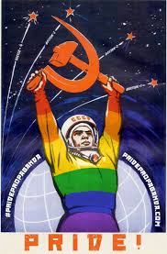
RUSSIAN GAYS UNDER THE SOVIET REGIME
“Destroy homosexuality, and fascism will disappear”
(Maxim Gorky)
“the Revolution of 1917 was the dawn of gay visibility and acceptance of homosexuality in Russian society”
(Simon Karlinsky)
Or:

Slide 2
Not All of the Same History:
Between The First Russian Revolution & The Bolshevik Revolution (1905-1917)
From Lenin To The Sodomy Law & Article 121 (1917-1933/4)
Stalin’s Homophobic Era (1934-1953)
After Stalin’s Death (1953-1964)
Western Sex Liberation & The End Of The Soviet Union (1964-1993)

Slide 3

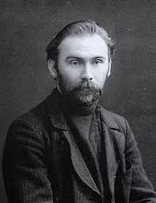
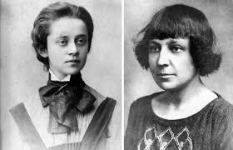
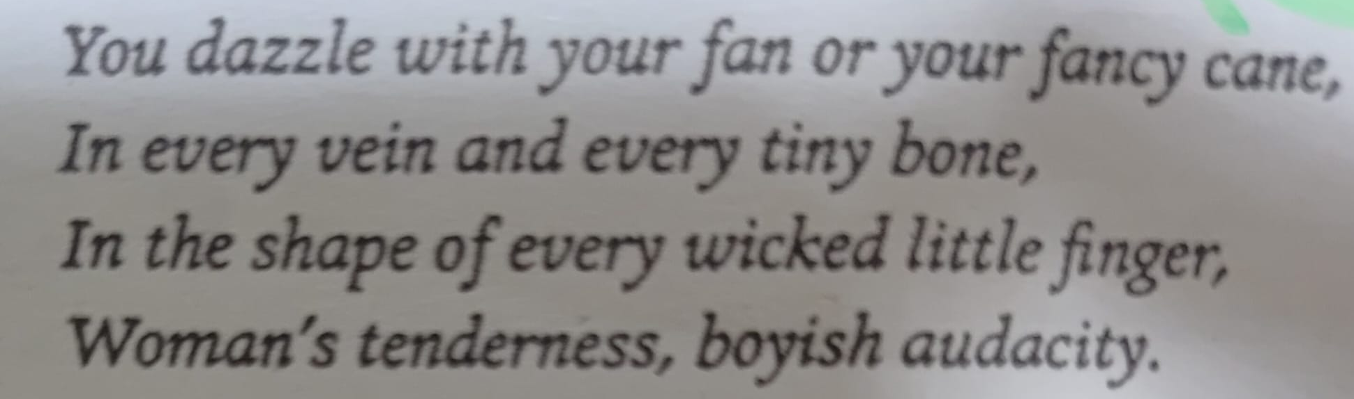
Lesbians & Homosexuals in Russian 20th Centaury Art:
The relationship of poets Sophia Parnok (1885-1933) & Marina Tsvetaeva (1892-1941)
Poet Nikolai Klyuev (1884-1937)
“The first decade of the Soviet Union was an era of unparalleled sexual experimentation”
(Author Christopher Isherwood)
Tsvetaeva’s poem “Girlfriend”

Slide 4
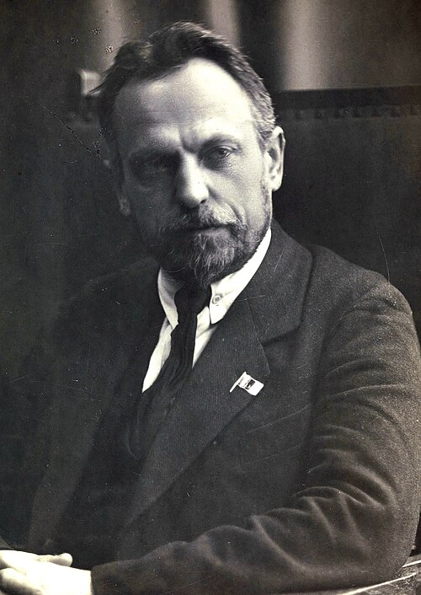
Homosexuality & Soviet Science:
Nikolai Semashko (Commissar of Health 1918-1930): Homosexuality as a medical condition that should be “understood”
“I learned that Homosexuals are mending their ways by reading Marx in concentration camps… that it is unhealthy for people to enjoy themselves sexually without reproducing. This all has been proven by science, and everybody bows down in awe before its decrees”
(Pierre Herbart, a French journalist visiting the Soviet Union in 1935)
“Many gays who had been prominent before the revolution married or sought a medical or psychological “cure”… and while the law did not forbid lesbianism, some woman were committed to psychiatric hospitals, or advised to undergo a sex-change operation” (David Tuller)

Slide 5
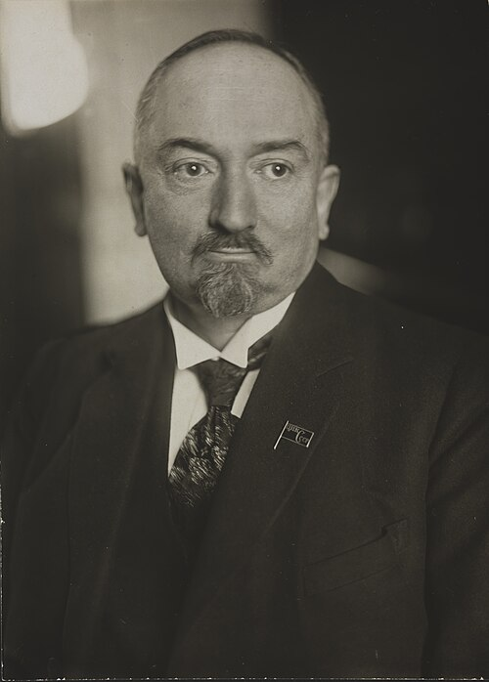
Gay “Green-Houses” in the Soviet Union:
Gulag’s Imprisonment & Work Camps
Rural Areas
The Red Army
Georgy Chicherin – Commissar for Foreign Affairs from 1918 to 1930

Slide 6
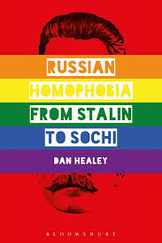
Ideologizing the Gay Community:
Fascism (Gorky, Stalin & others):
Genrikh Yagoda (Head of NKVD, 1934-1936) – fear of the
“counter-revolutionary fascist homosexual conspiracy“.
“A right-wing Nazi conspiracy”
(Nikolai Krylenko, Commissar of Justice 1931-1936):
Marxism (Harry Whyte’s letter to Stalin, 1934)

Slide 7
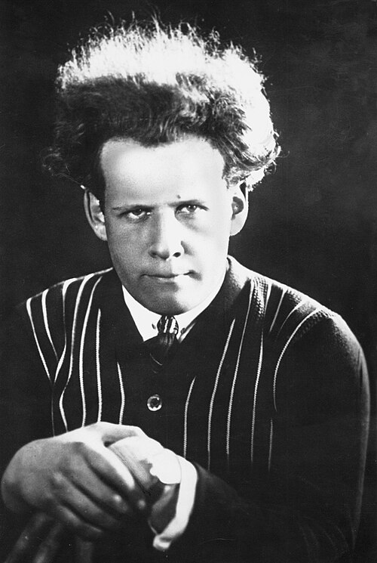
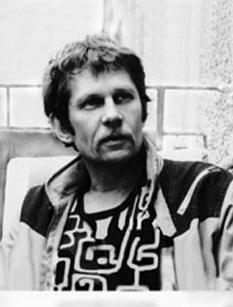
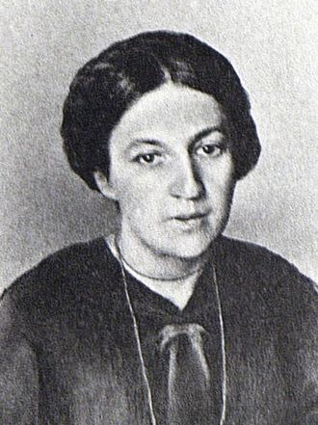
Was There Even a Pattern? The exceptions:
Sergei Eisenstein
(1898–1948)
Yevgeny Kharitonov
(1941–1981)
Varvara Yakovleva
(1884–1941)

Slide 8
Bibliography:
Amico, Stephen – “Roll Over, Tchaikovsky: Russian Popular Music and Post-Soviet Homosexuality” (2014)
Baer, Brian – “Making a Spectacle of Homosexuality: The Problem of Gay (In)Visibility” (2009)
Baer, Brian – “Russian Gays/Western Gaze: Mapping (Homo)Sexual Desire in Post-Soviet Russia” (2002)
Essig, Laurie – “Queer in Russia: A Story of Sex, Self, and the Other” (1999)
Healey, Dan – “Russian Homophobia From Stalin to Sochi” (2018)
Healey, Dan – “Homosexual Desire in Revolutionary Russia” (2001)
Karlinsky, Simon – “The Death and Resurrection of Mikhail Kuzmin” (2013)
Tuller, David – “Crakes in the Iron Closet” (1996)

Slide 9
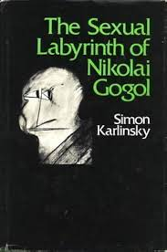
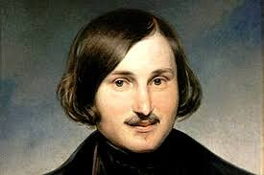
Further Questions:
What were the main reasons for Soviet change of approach towards homosexuality? was it only Stalin “to blame”?
is there a connection between today’s Russian policy regarding
the gay movement, and that of it’s past?
Are we talking about too many different variables and characters
over too many years?
should I narrow down my search to a shorter period?

Slide 10
