Slide 1
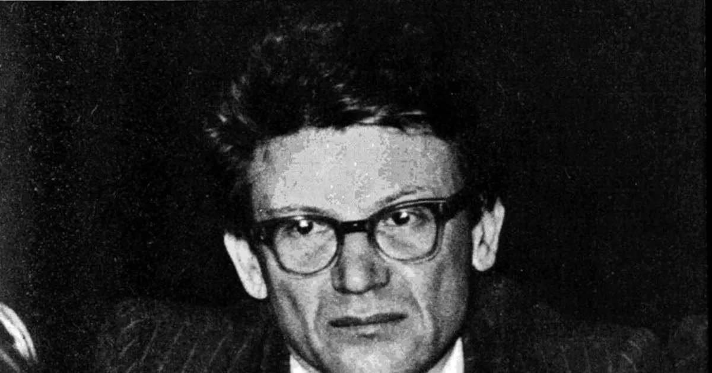
Аndrei Amalrik’s essay
"Will the USSR survive until 1984?"
Evgenii Kalanskii
December 4th 2025
Class 11

Slide 2
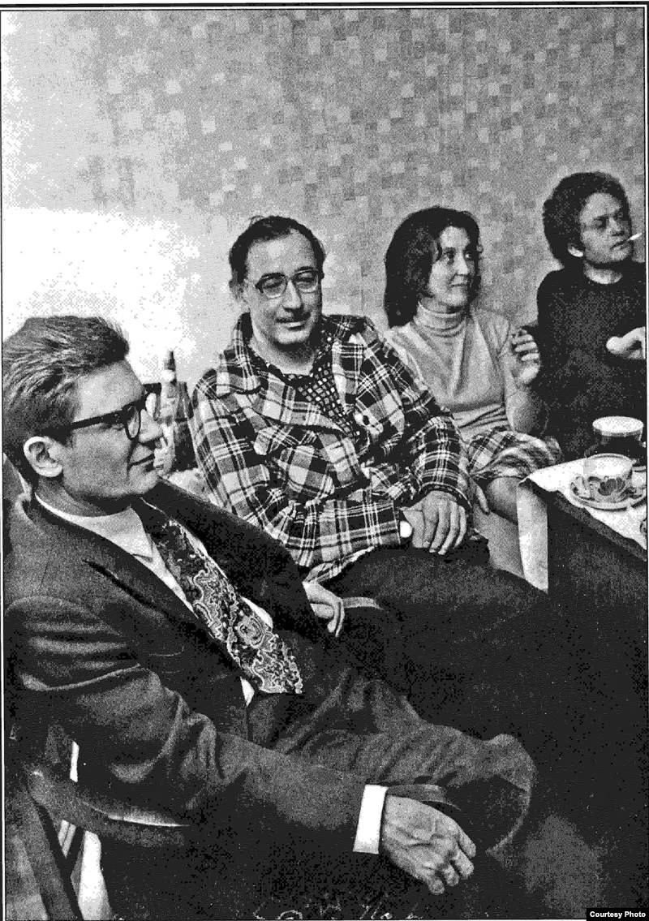
1938 – Born in Moscow.
1960 – Expelled from MSU for a paper on the Normanist theory.
1965 – First arrest for “parasitism” – one year of Siberian exile.
Late 1960s – Joins dissident circles, works odd jobs.
1969 (spring) – Writes “Will the Soviet Union Survive Until 1984?”
1969 (July 4) – Smuggles manuscript to the West
1969 (late) – Essay published abroad, translated widely. Gains international fame.

Slide 3
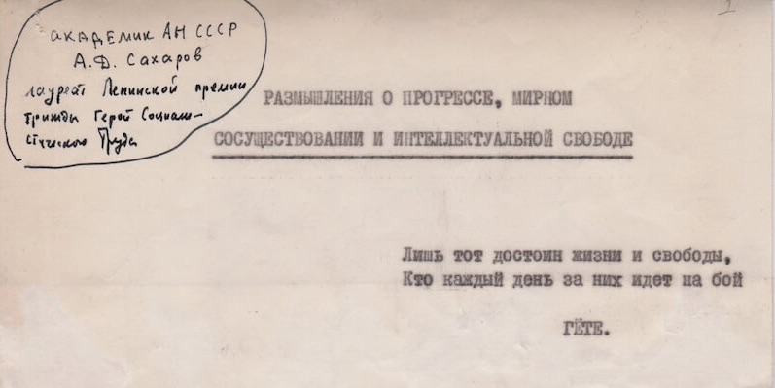
He alone is worthy of life and freedom
Who each day does battle for them anew!
Goethe
Sakharov, Andrei. 1968. Thoughts on Progress, Peaceful Coexistence and Intellectual Freedom. Manuscript.

Slide 4
1938 – Born in Moscow.
1960 – Expelled from MSU for a paper on the Normanist theory.
1965 – First arrest for “parasitism” – one year of Siberian exile.
Late 1960s – Joins dissident circles, works odd jobs.
1969 (spring) – Writes “Will the Soviet Union Survive Until 1984?”
1969 (July 4) – Smuggles manuscript to the West
1969 (late) – Essay published abroad, translated widely. Gains international fame.

Slide 5
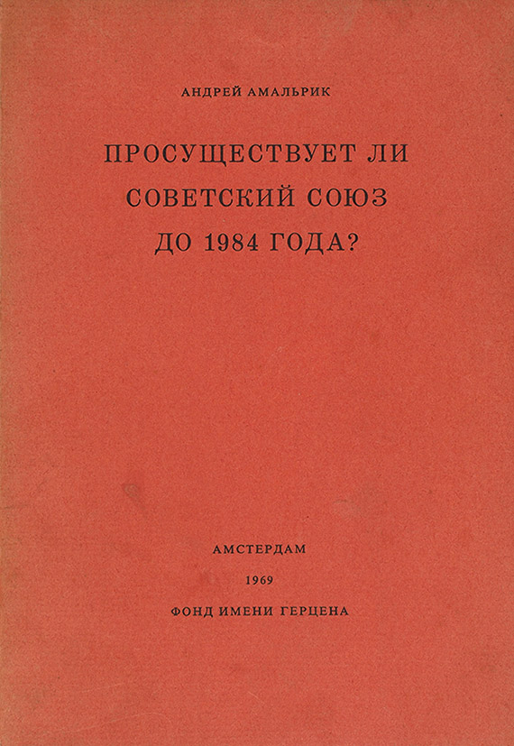
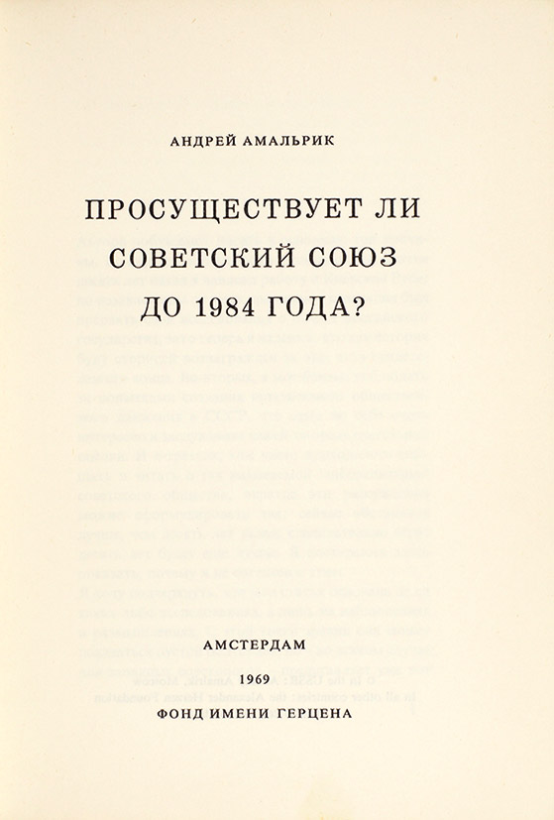
The first edition of Andrei Amalrik’s essay “Will the Soviet Union Survive Until 1984?”
Alexander Herzen Foundation, Amsterdam, 1970.

Slide 6
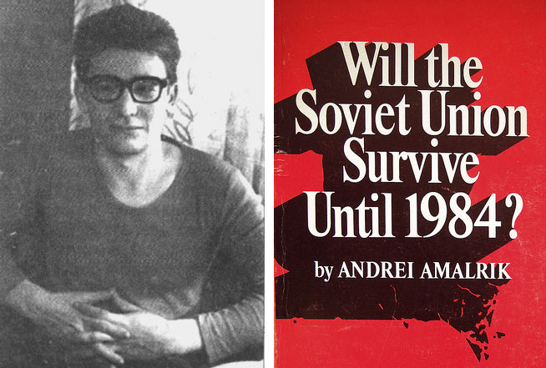
Internal decay of the Soviet system
Limits of reform (rejects the possibility of liberalisation of Soviet regime)
Surge of nationalism
Foreign-policy trigger of disintegration of USSR – China
Power vacuum enables German reunification and collapse of the Eastern Bloc
Collapse of the Soviet government – mass and violent social upheaval
Russian mentality?
Post-collapse trajectories

Slide 7
“Its motto is: ‘Do not touch us, and we will not touch you.’ Its aim is: ‘Let everything remain as it was.’”
Amalrik, Andrei. Will the Soviet Union Survive Until 1984? Amsterdam: Alexander Herzen Foundation, 1970

Slide 8
Internal decay of the Soviet system
Limits of reform (rejects the possibility of liberalisation of Soviet regime)
Surge of nationalism
Foreign-policy trigger of disintegration of USSR – China
Power vacuum enables German reunification and collapse of the Eastern Bloc
Collapse of the Soviet government – mass and violent social upheaval
Russian mentality?
Post-collapse trajectories

Slide 9
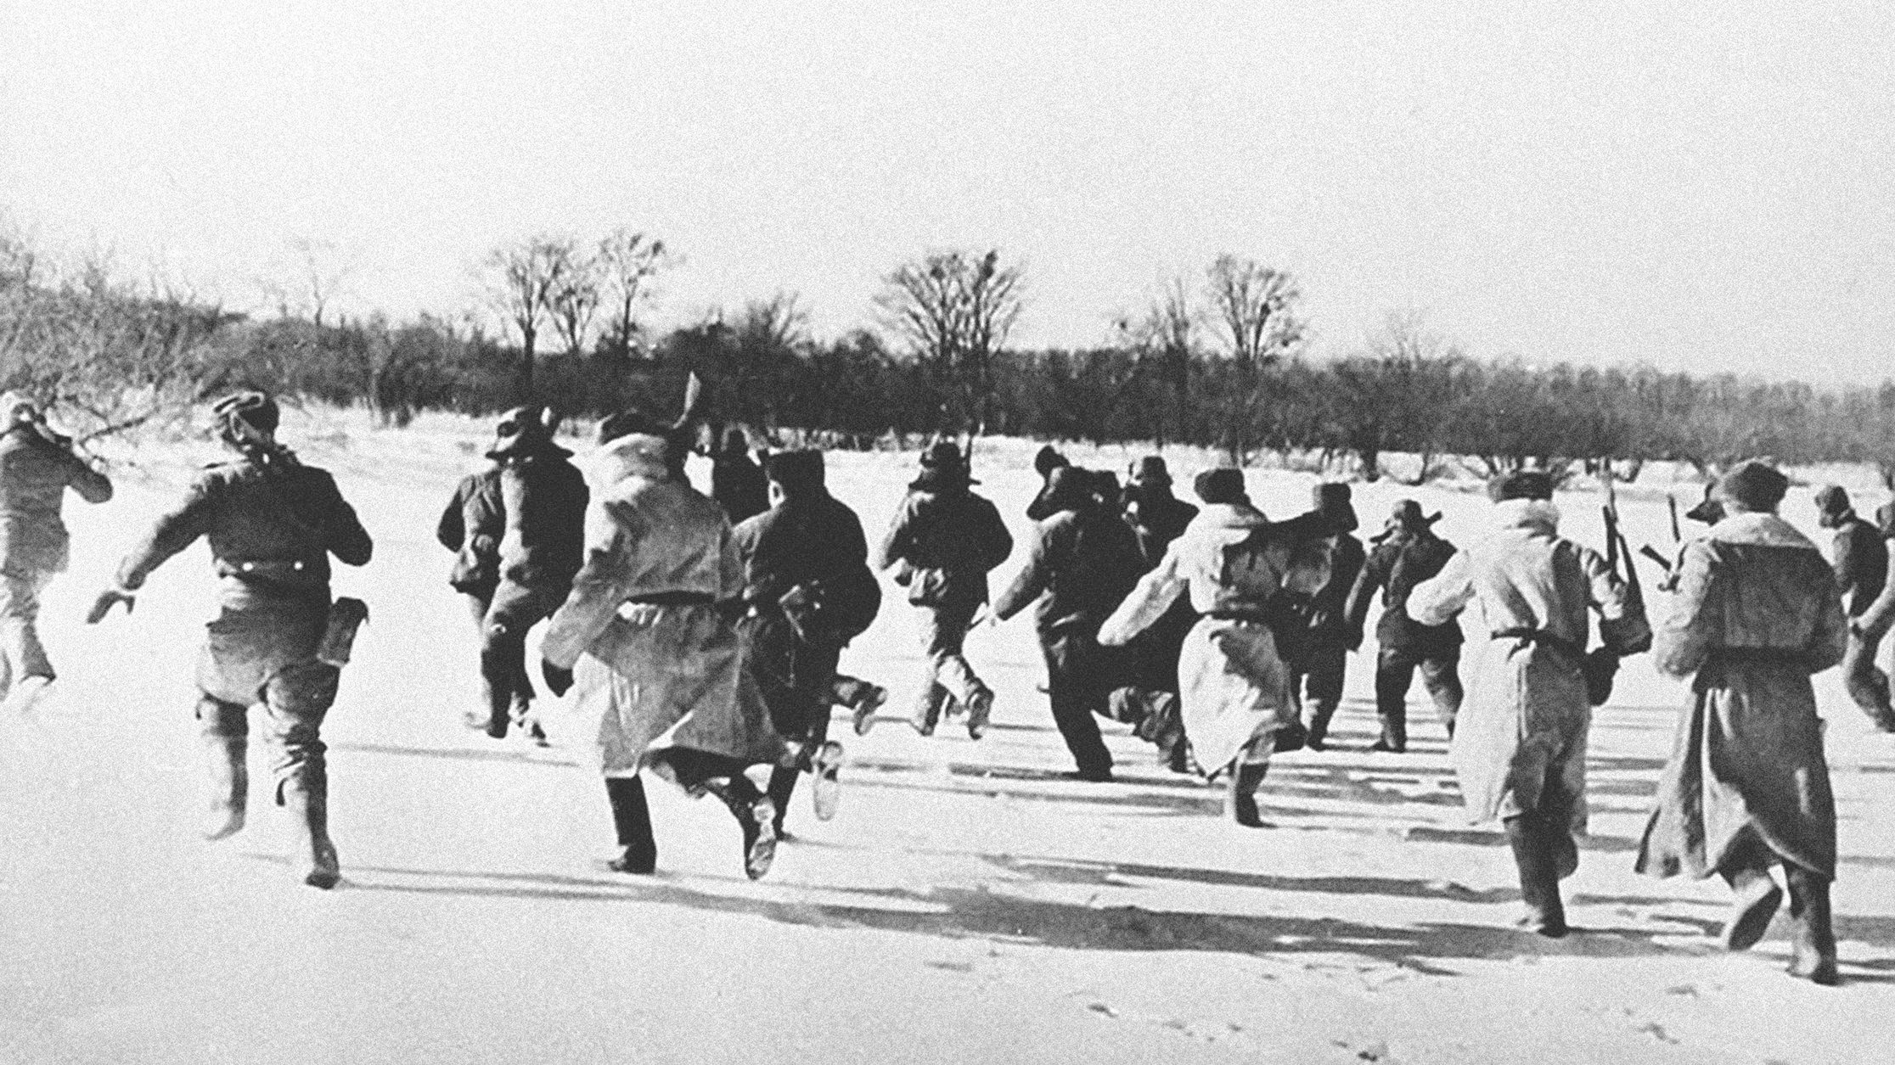
The Sino-Soviet Crisis of 1969

Slide 10
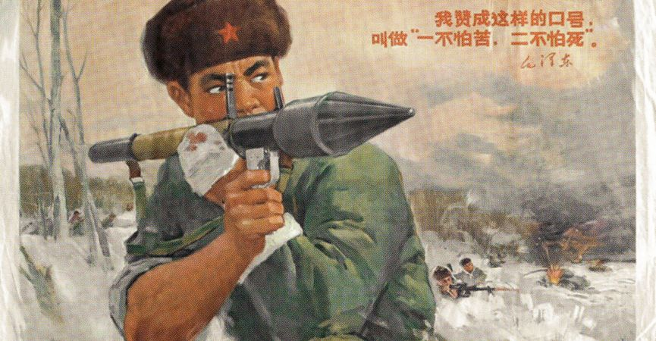

Slide 11
Internal decay of the Soviet system
Limits of reform (rejects the possibility of liberalisation of Soviet regime)
Surge of nationalism
Foreign-policy trigger of disintegration of USSR – China
Power vacuum enables German reunification and collapse of the Eastern Bloc
Collapse of the Soviet government – mass and violent social upheaval
Russian mentality?
Post-collapse trajectories

Slide 12
“…it is not difficult to imagine what forms popular discontent will take and what it will lead to if the regime exhausts itself on its own. The horrors of the Russian revolutions of 1905–07 and 1917–20 will then seem like merely idyllic scenes.”
Amalrik, Andrei. Will the Soviet Union Survive Until 1984? Amsterdam: Alexander Herzen Foundation, 1970

Slide 13
“Even the word ‘freedom’ is understood by most people as a synonym for ‘disorder’, as the possibility of committing certain antisocial and dangerous acts with impunity.”
“As for respect for the rights of the human person as such, this evokes nothing but bewilderment. One may respect strength, power, or even intelligence and education, but the idea that the human individual possesses intrinsic value is alien to the popular consciousness.”
“As a people, we have never experienced a period of the cult of the human individual; in Russian history, the individual has always been a means, never an end.”
Amalrik, Andrei. Will the Soviet Union Survive Until 1984? Amsterdam: Alexander Herzen Foundation, 1970

Slide 14
Internal decay of the Soviet system
Limits of reform (rejects the possibility of liberalisation of Soviet regime)
Surge of nationalism
Foreign-policy trigger of disintegration of USSR – China
Power vacuum enables German reunification and collapse of the Eastern Bloc
Collapse of the Soviet government – mass and violent social upheaval
Russian mentality?
Post-collapse trajectories

Slide 15
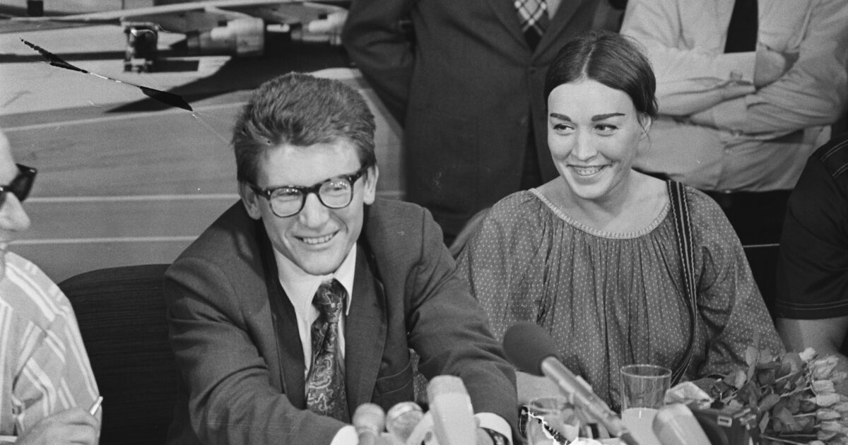
Reaction

Slide 16
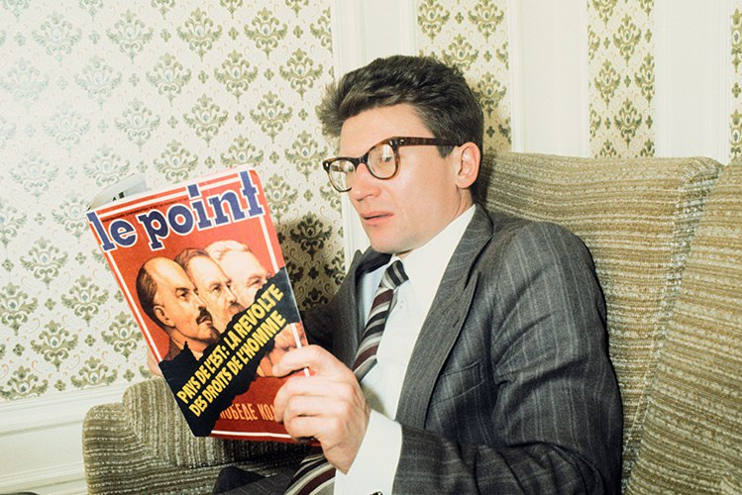
Dec 1969 – Book printed in the Netherlands
Late 1969 – Gives two major U.S. media interviews.
1969–1970 – Strong criticism inside the USSR and beyond. Russian émigrés react angrily.
Nov 1969 – Washington Evening Star publishes hints that Amalrik might be linked to the KGB.

Slide 17
“Amalrik’s essay was received in the West as brilliant literature… Practically no one took it seriously as a political prediction.”
Laqueur, Walter. The Dream That Failed: Reflections on the Soviet Union. Oxford: Oxford University Press, 1994

Slide 18
Dec 1969 – Book printed in the Netherlands
Late 1969 – Gives two major U.S. media interviews.
1969–1970 – Strong criticism inside the USSR and beyond. Russian émigrés react angrily.
Nov 1969 – Washington Evening Star publishes hints that Amalrik might be linked to the KGB.

Slide 19
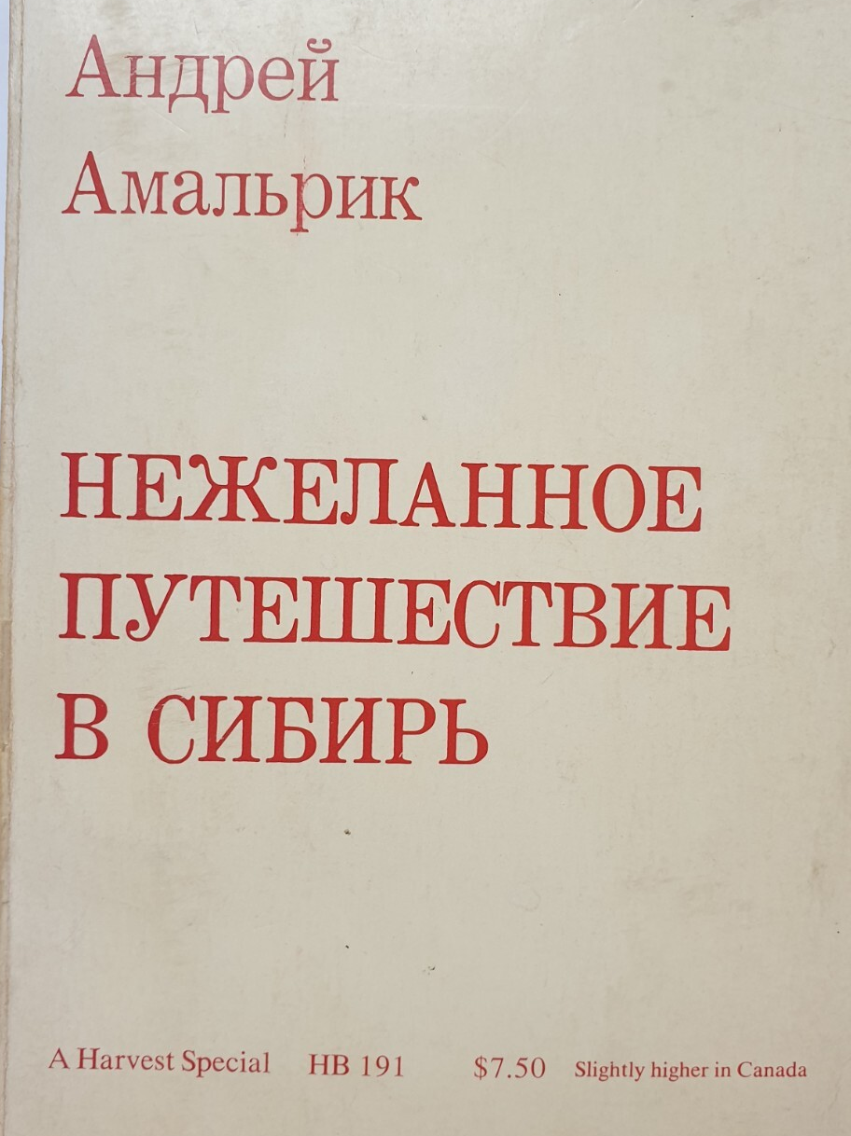
May 1970 – arrested.
November 1970 – tried as a dissident in Sverdlovsk.
1970–1973 – served in a high-security labor camp in Kolyma.
1973–1975 – lived in internal exile in Magadan Region.
1976 – left the USSR for the West.
1980 – died in a car accident in Spain.
Amalrik, Andrei. Involuntary Journey to Siberia. Mariner Books, 1971

Slide 20
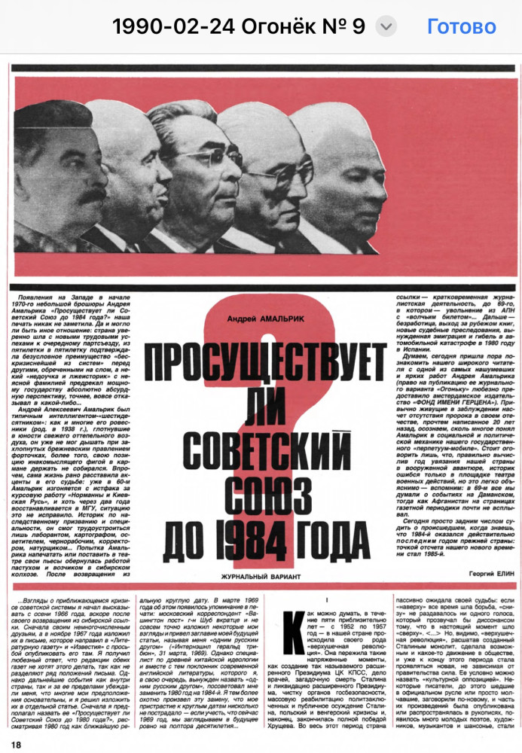
First publication in the Soviet press of the essay “Will the Soviet Union Survive Until 1984?”, February 1990, in the Ogonyok magazine.

Slide 21
Amalrik was right
Amalrik was wrong
The gradual formation of the group he called “the class of specialists”. (Amalrik avoided the term “intelligentsia.”).
The desire for a comfortable life, especially among the upper layers, as a key sign of the regime’s decay and stagnation.
Economic reforms and a relative liberalisation of the regime, driven by pragmatic economists in the leadership who understood the need for change. (Perestroika).
Rising living standards in China, its (economic) liberalisation, and a partnership between China and the United States. (Nixon’s visit to China took place in February 1972.)
German reunification (in Amalrik’s scenario – against the backdrop of a Soviet–Chinese war).
The desovietisation of Eastern Europe.
7. Economic and food shortages in the USSR.
8. The use of internal troops against nationalist movements in the Soviet republics.
Not 1984 but 1991.
A deconstructive uprising of the “lower class” like in 1905 and 1917. The miners’ strikes of 1989 were limited.
A war with China between 1975 and 1980. Instead – limited war in Afghanistan.
Territorial claims against the USSR from desovietised Eastern European countries.
Extremists did not come to power in every republic.
China did not exploit the USSR’s collapse for annexations.
The CIS (Commonwealth of Independent States) was stillborn, although it technically survives to this day.

Slide 22
References
Amalrik, Andrei. Will the Soviet Union Survive Until 1984? Amsterdam: Alexander Herzen Foundation, 1970
Amalrik, Andrei. Involuntary Journey to Siberia. Mariner Books, 1971.
Amalrik, Andrei. “I Want to Be Understood Correctly.” Survey, Winter–Spring 1970, pp. 102–109.
Laqueur, Walter. The Dream That Failed: Reflections on the Soviet Union. Oxford: Oxford University Press, 1994

Slide 23
Thank you!

