Slide 1
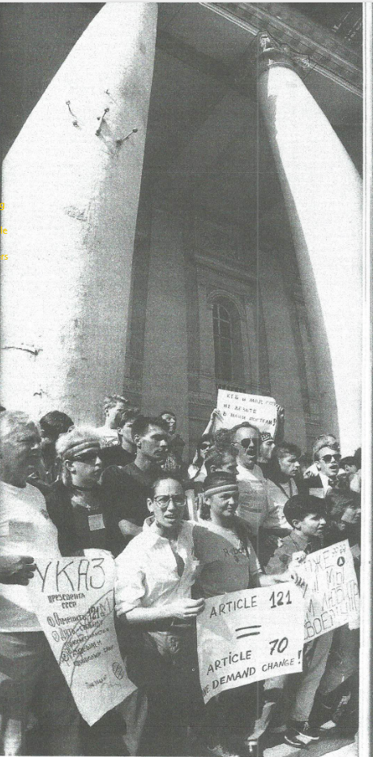
JULY-AUGUST 1991
THE INTERNATIONAL GAY AND LESBIAN SYMPOSIUM AND FILM FESTIVAL
CROSS-CULTURAL DISSIDENCE NEAR THE END OF THE SOVIET UNION
“From Russia with Homo Love,” OUT/LOOK 1992. Demonstration in front of the Bolshoi Theatre in Moscow protesting Article 121, July 31, 1991

Slide 2
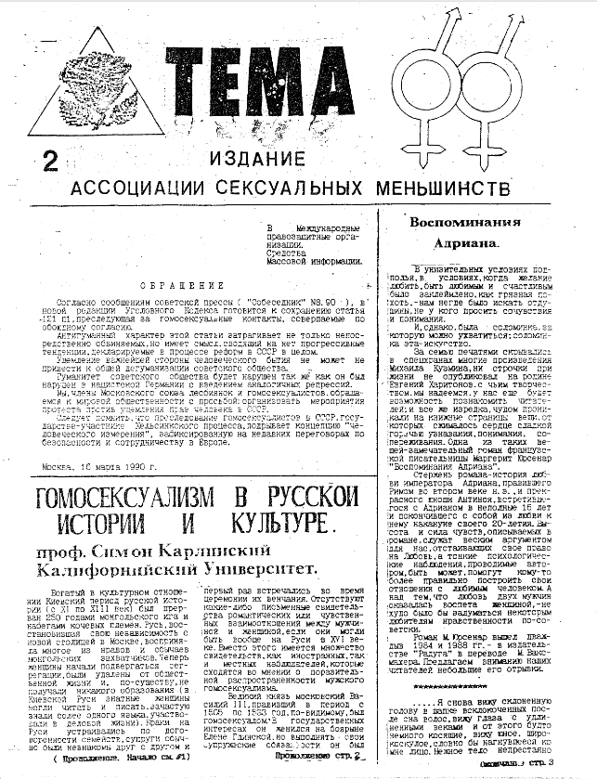
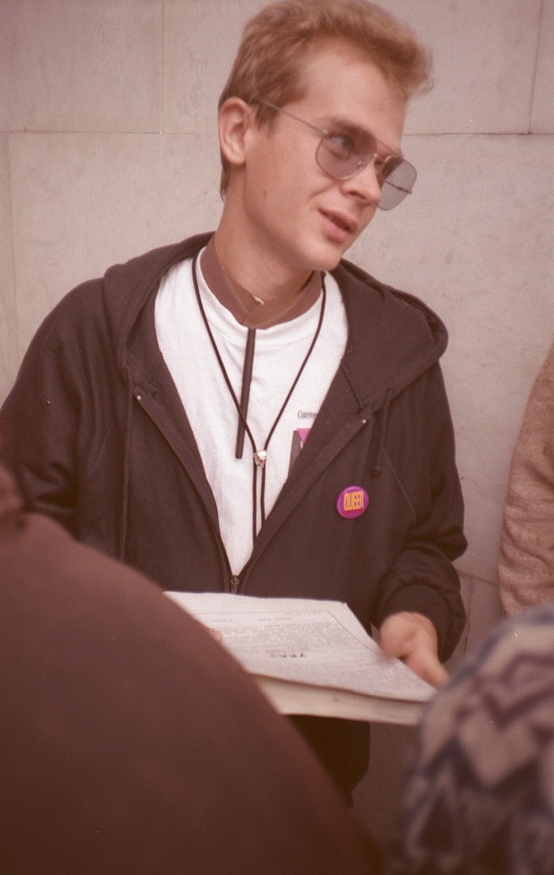
THE ASSOCIATION OF SEXUAL MINORITIES
  Founders: Roman Kalinin and Evgenia Debrianskaya
  Published Tema, the first Soviet gay and lesbian magazine, beginning in December 1989
  Goals: an end to persecution for sexual minorities, especially Article 121
  Kalinin and Debrianskaya were invited to San Francisco in 1990 on a speaking tour. Kalinin founded the International Gay and Lesbian Human Rights Commission (IGLHRC) with Julie Dorf and Jim Toevs
  Kalinin ran in the 1991 Russian presidential elections and distributed Yeltsin’s flyer during the August coup, with the Tema logo
  Debrianskaya did not approve of the International Conference, she later organized a conference by and for Russians in 1993
Roman Kalinin, during the August coup attempt. Tom Boellstorff’s personal archive: https://faculty.sites.uci.edu/boellstorff/miscellaneous/

Slide 3
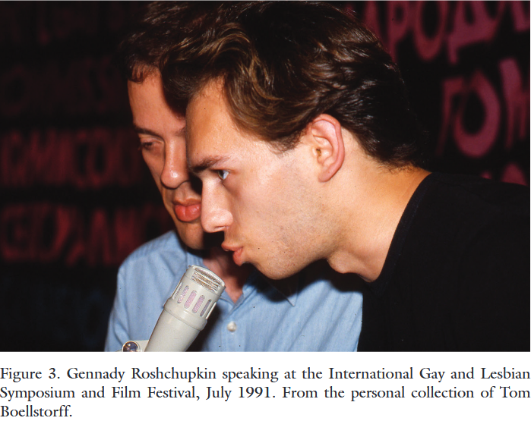
INSIDE THE INTERNATIONAL GAY AND LESBIAN SYMPOSIUM AND FILM FESTIVAL
  Around 70 foreigners (mostly American) and hundreds of Soviet attendees
  July 23rd to August 2nd - 5 days in Leningrad, 4 in Moscow
  Workshops: AIDS and Health, Education, Arts and Culture, and Politics and Activism
Gennady Roshchupkin, speaking at the conference, Tom Boellstoff’s personal collection
  Gennady Roshchupkin declared his HIV-positive status - first Soviet citizen to do so publicly, in front of journalists
“And when this guy [was] finishing his speech, Roman said ... something like this, ... that we're also a strong people, we also ... have to show some HIV positive among Soviet people. So, Genna, please go and make your coming out. That was absolutely unexpected, from my side, but I did it, I did it. ... I don't think there were a lot of people that were somehow suprised or had some strong feelings about that, but I was shocked that I did it.” - Gennady Roshchupkin
  Visits to people imprisoned under Article 121 and an AIDS treatment facility
  Film Festival: openly portraying queer relationships on screen was new, sold 20 000 tickets in Moscow

Slide 4
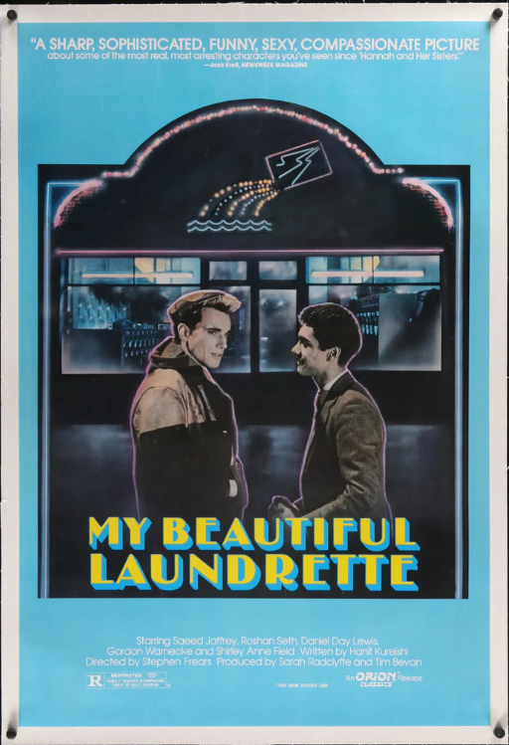
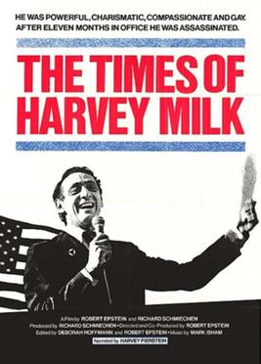
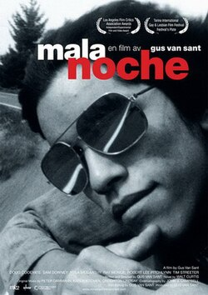
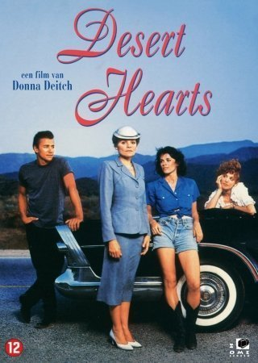
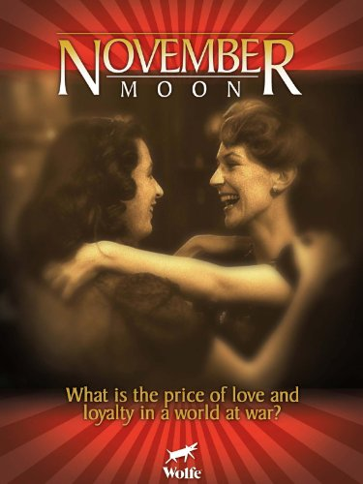

“An ambitious Pakistani Briton and his white boyfriend strive for success and hope when they open a glamorous laundromat.“
“While waiting for her divorce papers, a repressed professor of literature is unexpectedly seduced by a carefree, spirited young lesbian.”

Slide 5
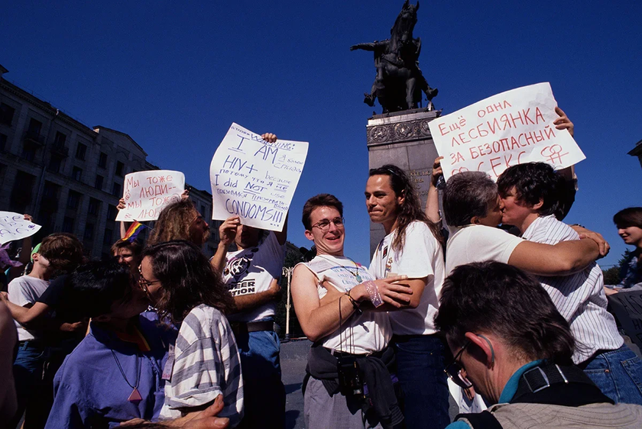
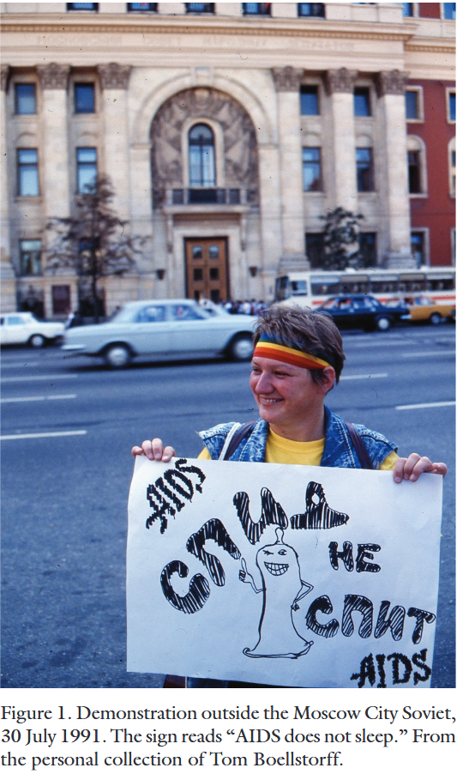
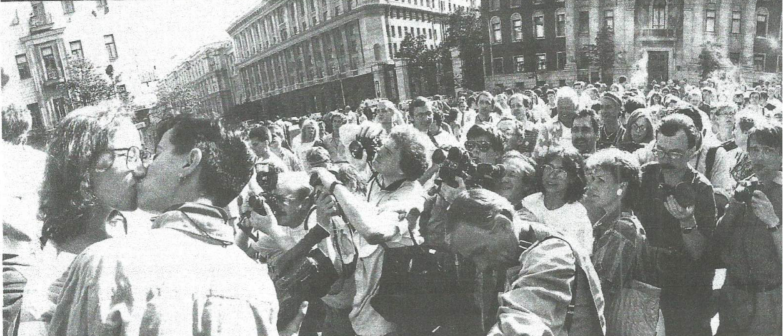
“The St. Petersburg organizers had made it clear for months that they viewed any potential publicity as a threat to their work and safety. They feared gay-bashers and provocateurs, as well as “undesirable” gay people--prostitutes and black-marketeers--whose presence might discredit the conference. Their fears went double for the press.”
“From the day we had arrived in St. Petersburg and begun negotiating with the Moscow organizers who met us there, it slowly and painfully sank in that there was a problem with holding a conference in Moscow: the Moscow organizers didn’t want one. They—meaning, primarily, Roman, who brought back from his US trip a decidedly un-Soviet appreciation for the mass media--believed strongly that grand-scale visibility and not small-scale skill building was the ultimate goal of our presence.” - Dorf and Gessen, “From Russia with Homo Love”
Colour photographs: Demonstration outside the Moscow City Soviet, Tom Boellstorff’s personal archive
“From Russia with Homo Love” (OUT/LOOK) caption:

Slide 6
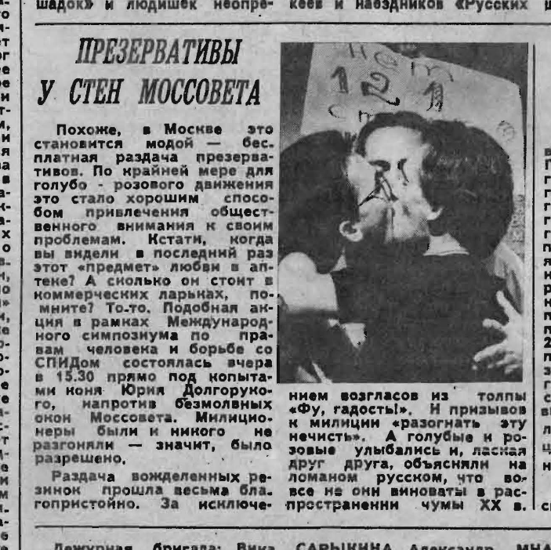
GOVERNMENT / PRESS RESPONSE
  Apparently, traffic police called for backup during a Moscow condom distribution event that turned into a kiss-in
  A group of Siberian activists appeared in the press as part of this conference, and were expelled from their universities as a result
  However:
  Foreign participants travelled independently of the government
  They were allowed to visit prisoners and an AIDS treatment centre
  Press of the conference was apparently largely positive, although Orthadox newspapers reported differently
Московский комсомолец, July 31st, 1991

Slide 7
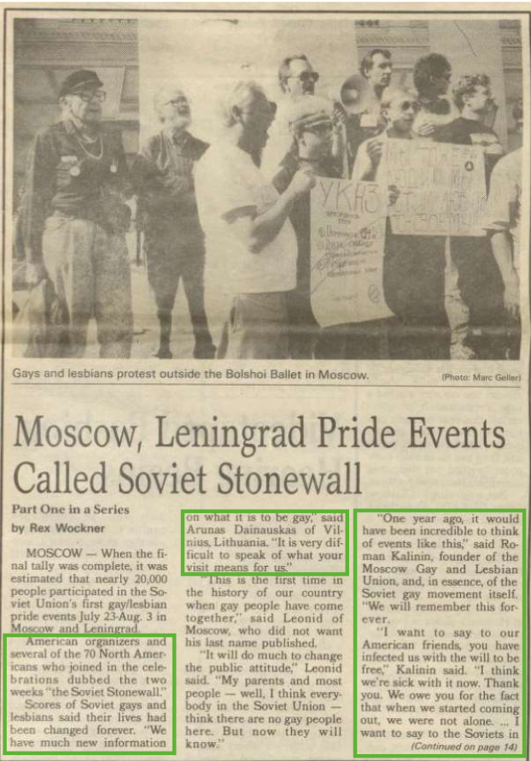
DEBATES
  Several Soviet activists felt that the conference was dangerous and unnecessary, and that Roman had been elevated by IGLHRC as the face of the Soviet queer movement (and the recipient of IGLHRC’s resources) due to his familiar approach to activism
  Some academics argue that Soviet activists were forced to adopt Western tactics to attract international attention and funds, to the detriment of the goals of the movement
  Some American press accounts of the conference take a strongly paternalistic view, referring to it as “Soviet Stonewall” and emphasizing the economic insecurity they encountered
The Bay Area Reporter, August 8, 1991

Slide 8
DEBATES
  Several Soviet activists felt that the conference was dangerous and unnecessary, and that Roman had been elevated by IGLHRC as the face of the Soviet queer movement (and the recipient of IGLHRC’s resources) due to his familiar approach to activism
  These critics tend to focus on the Moscow demonstrations, and ignore the low profile of the Leningrad conference, as desired by organizers
  There were far more Soviet attendees than foreign ones, making it a place to connect and discuss among Soviet queer people as well
  Some academics argue that Soviet activists were forced to adopt Western tactics to attract international attention and funds, to the detriment of the goals of the movement
  Gennady Roshchupkin: “You know, when you are young, many things look simpler than they are... And sure, the whole conference could be divided into two groups: Americans and Soviets, ‘cause different culture, different financial status, for instance... But in general it was really fun, first of all, and the political sense of that action I understood just, two, three years after the conference. So, first of all it was interesting, first of all that were new people I had never met before.”
  Some American press accounts of the conference take a strongly paternalistic view, referring to it as “Soviet Stonewall” and emphasizing the economic insecurity they encountered

Slide 9
BIBLIOGRAPHY
Dorf, Julie and Gessen, Masha. “From Russia with Homo Love.” OUT/LOOK, winter 1992.
Essig, Laurie. “Sex, Self, and the Other: The Production and Performance of Queer in Russia, 1989-1994.”
ProQuest Dissertations & Theses, 1996.
Healey, Dan. Russian Homophobia from Stalin to Sochi. New York: Bloomsbury Academic, 2017.
Hearne, Siobhán. “Transnational HIV-AIDS Action and Citizen Diplomacy in the Late Soviet Union, 1988–1991.” Journal of the history of sexuality 34, no. 2, 2025: 242–264.
Neufeld, Masha. ““We Will Get There, but We Have to Grow as High as That:” Spinning the Narrative of Backwardness in the Russian LGBT Movement.” In Queering Paradigms VII, 2018.
Schluter, Daniel P. “Fraternity without Community: Social Institutions in the Soviet Gay World.” ProQuest Dissertations & Theses, 1998.
Schwartz, Claire, and Masha Gessen. “Forward Thinking: Masha Gessen on Language and the Social Imagination.” The Virginia quarterly review 94, no. 3 (2018): 188–195.
Wockner, Rex. “Moscow, Leningrad Pride Events Called Soviet Stonewall.” The Bay Area Reporter, August 1991. https://archive.org/details/BAR_19910808/mode/2up

