Slide 1
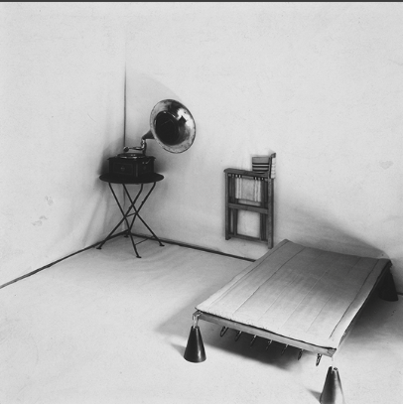
“Freedom consists in leaving the home”:
soviet architecture and the existenzminimum

Slide 2
Intelectual field
  XX thc. imagination was captured by organisational sciences
  “The human motor” as metaphor for modernity → ergonomics concerned with energy expenditures and labour fatigue
    Human body equated to the working machine, so logical, malleable and permitted for change
    Just as rational thinking could illuminate the natural sciences, so too could social life, especially labour, be engineered, optimised and mathematically regulated.
    → movement sciences
  “Productivism <...> was politically promiscuous.” (Rabinbach, 272 p.) → rise of humanised Taylorism in Europe in the afterwar period.
    Reegnineering society to minimise social conflict
    Frederick Winslow Taylor
      The division of all shop-floor tasks into their fundamental parts;
      The analysis and design of each task to achieve maximus efficiency and ease of imitation;
      The redesign of tools and machines at standardized models;
      The linking of wages to output;
      Rational coordination and administration of production

Slide 3

“Taylorised sence of beautiful”: modernist architecture
  “European modernist arhitects found an aesthetic message in scientific menagement, producing an unlikely synthesis between art and the mechanical world” (Mauro, 683)
  Architects needed to be social engeneers, who would lead rather than follow social revolution.
    CIAM → Congrès Internationaux d’Architecture Moderne
Soviet Union as place where all experimental architecture could have happened
“Speculative architecture hovered in the space between imagination and reality, making up for its physical nonexistence with overwhelming discursive presence.” (Vinokour, 90 p.)

Slide 4
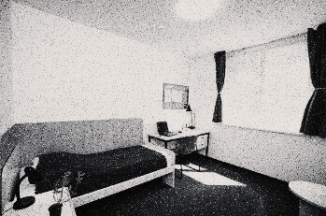
Practical utopia
Exhistenzeminimum - a minimal standar housing for an individual, a basic minimal requirements for healthy living
  Response to the housing crisis after the IWW
  Response to the emerging numbers of workers
Practical utopia: the most radical form of Taylorism and ergonomics
    “a wholly new dwelling type built on the cooperation of architects, sociologists, economists, health officials, physicians, social workers, politicians, and trade unionists.” (Teige, 3)
    A minimum could be determined on a more scientific basis, calculated according to objective quantitative criteria

Slide 5
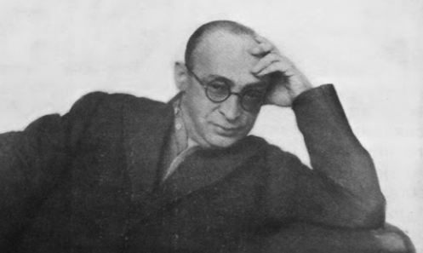
Moisei Ginzburg
  Soviet delegate to CIAM
  Founded OSA (Organization of Contemporary Architects)

Slide 6

“Style and epoch”, 1924
Revolutionary style of architecture, or Constructivism with labor at the front → “for all their destructive promises, appear to us at the present moment to be natural, necessary, and vivifying <…> the role for this, of course, must be sought not only in economic circumstances of modernity, but also in the extraordinary psychological role, which has begun to be assumed by the machine” (Ginzburg, 101 p.) → “The machine … gives rise to a conception of entirely new and modern organisms possessing the distinctly expressed characteristics of movement — its tension and intensity, as well as its keenly expressed direction” (Ginzburg, 103p.)

Slide 7
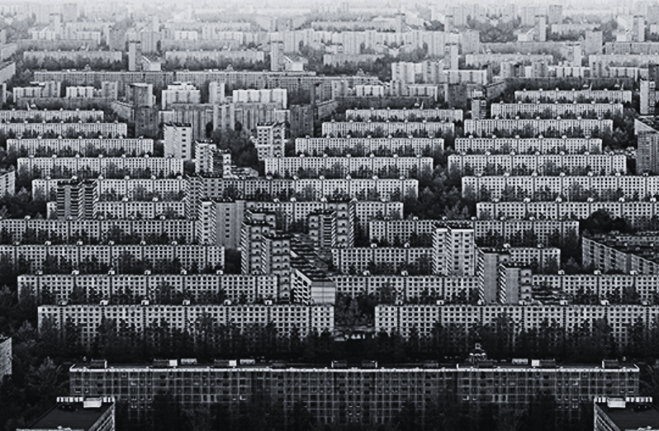
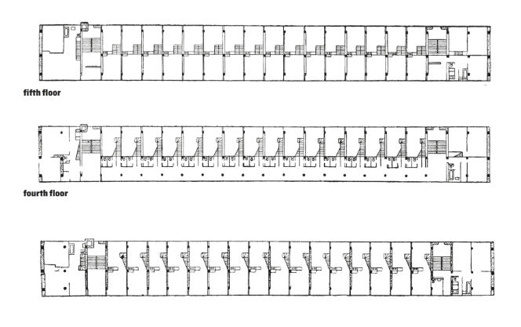
Rhythm and repetition -> the metaphor of modernity
“a picture of modernity is lucid and differenciated from the past; endless silhouettes of forcefully moving muscles of thousands arms and legs, the deafening roar of orderly monster - machines; the rhythmic operation of pulleys; uniting everything and everyone with their movement;” (Ginzburg, p.80)

Slide 8
Ginzburg “Dwelling: Five Years' Work on the Problem of the Habitation”, 1934
:(?

Slide 9
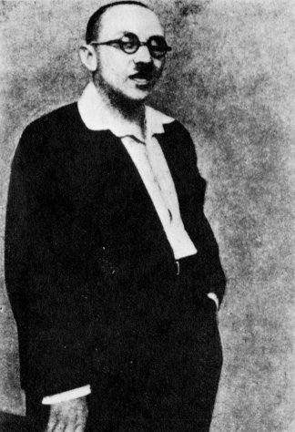
Nikolay Alexandrovich Milyutin
  Amateur architect
    Closely worked with Ginzburg
  Urban planner
    Sotsgorod - socialist linear city
  Trade unionist
  Commisar of Finanse

Slide 10
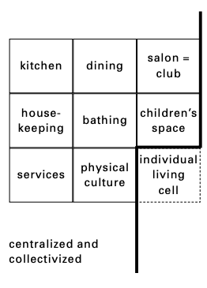
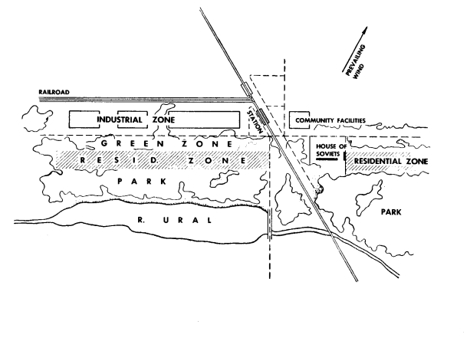
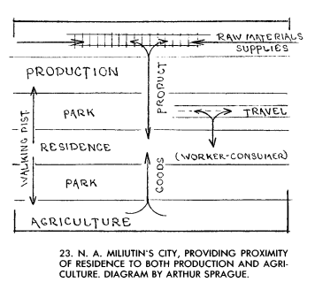
“Sostgorod: the problem of building socialist cities”, 1930
  City as functional-assembly-line system
  Maximum socialisation of everyday life →
    “The creation of collectivized dining halls, nurseries, kindergartens, dormitories, laundries and repair shops will really break radically with the existing family attitude towards property, and this will provide the economic premises for the extinction of the family as an economic unit.” (Milyuntin 81 p.)

Slide 11
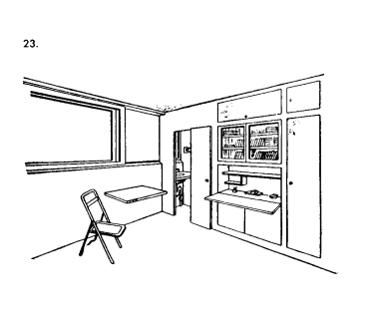
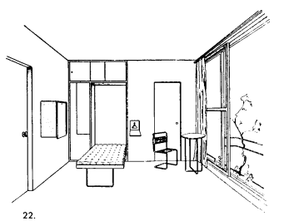
“The living cell”: between utopia and liberation
Living cell as standardised unit of housing → individual, minimal (break with bourgeoisie possession), acknowledging human dignity
“All the achievements of contemporary architecture and applied art must be mobilized so that a healthy and happy life can be achieved within the minimum space the living cell offers.” (Milyutin 86 p.)

Slide 12
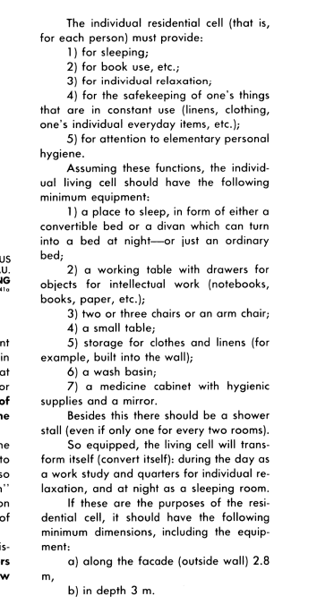
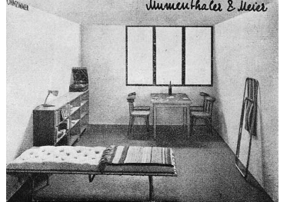
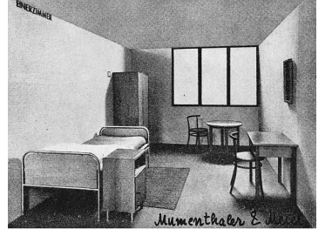
8,4 m²

Slide 13
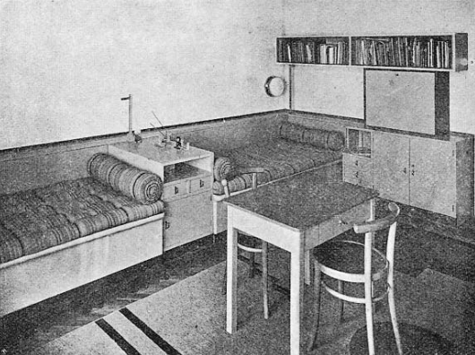
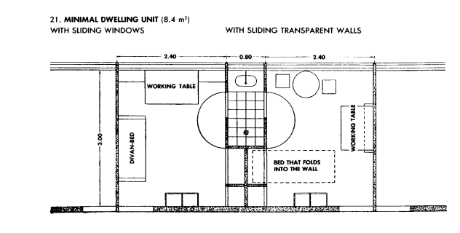
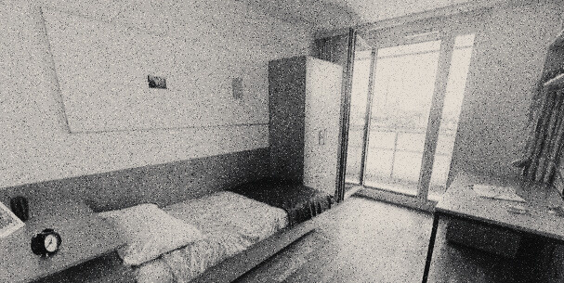

Slide 14
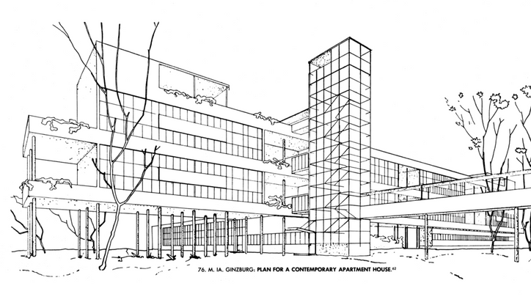
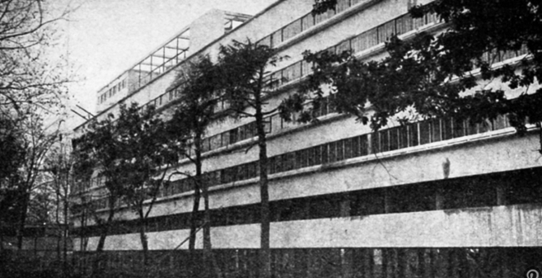
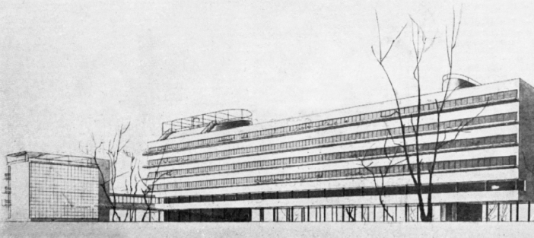
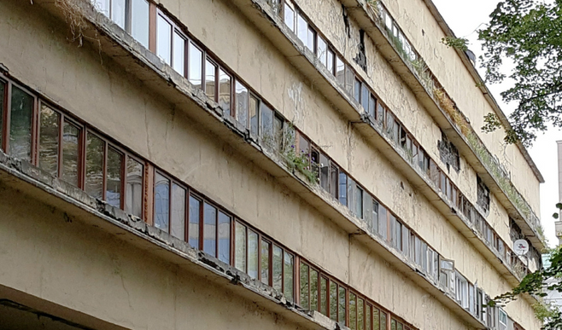
Real application
Narkomfin (housing for employees of the National Finance Ministry), 1928-1929 → Moisei Ginzburg + Ignaty Milinis, ordered by Milyutin.
“Yet the minimalism of Narkomfin’s dwelling units was tempered by the collective provisions in the other blocks and served as a physical mini-rehearsal of the desired optimum of fully-fledged collective living.” (Kallis, 210p.)
but.....

Slide 15
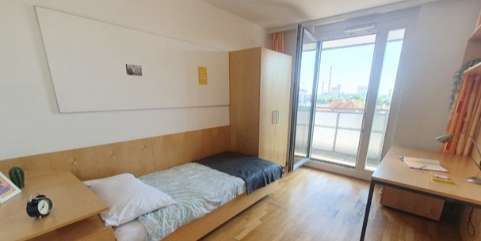
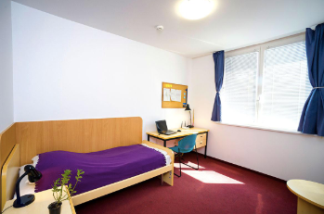

Slide 16
Sources
  Kallis, Aristotle, The minimum dwelling revisited, Bloomsbury visual arts, 2023.
  Ginzburg, Moisei, Style and epoch, MIT press, 1982.
  Guillén, Mauro ‘Scientifi c Management’s Lost Aesthetic. Architecture, Organization, and Taylorized Beauty of the Mechanical’, Administrative Science Quarterly, 1997, 682–715.
  Milyutin, Nikolai Aleksandrovich. Sotsgorod: The Problem of Building Socialist Cities, MIT Press, 1974.
  Teige, Karel. The minimum dwelling. MIT press, 2002.
  Rabinbach, Anson. The human motor: Energy, fatigue, and the origins of modernity. Univ of California Press, 1992.
  Vinokour Maya , Work Flows: Stalinist Liquids in Russian Labor Culture, 2024.

