Slide 1
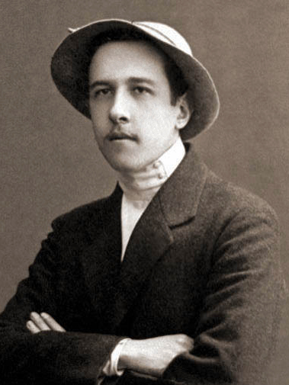
A.V. Chayanov
Is Economics too a partisan practice?

Slide 2
An Early Biography
In 1913, he was appointed professor at the Agricultural Institute of Petrovskoe.
In between 1911 and 1914, he carried out various surveys relating to the role of flax in peasant incomes.
During WW1, takes up a role in the co-operative movement in organising the flax market.
The Russian Revolution and the Peasant Utopia
Works alongside N.D. Kondratiev at the Institute of Agricultural Economy of Petrovskoe Razumovskoe at the Time of War Communism (1919)

Slide 3
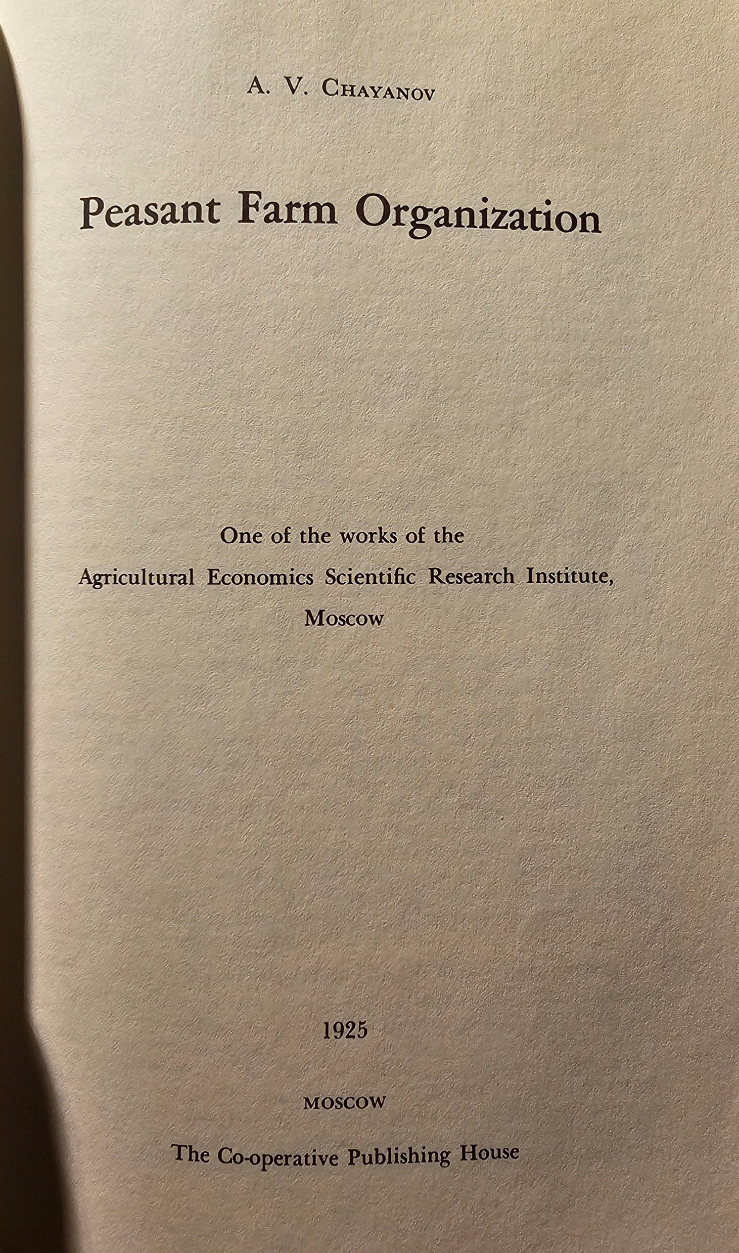

Slide 4
His Theoretical Positions
A theory of peasant labour farm (a non-capitalist farm need not be pre-capitalist)
A peasant economy has a unique conception of profitability. It is not seeking the highest net profit.
Consumption-Labour Balance in a peasant farm. (Peasants do not tend to produce more once their consumption needs are balanced).
The socialist way forward: one of co-operative farms

Slide 5
What is he accused of?
Being a utopian, a sympathiser of the Social Revolutionaries. (But he does not care)
What he takes great offence at is the accusations levelled against him for being an advocate for the Austrian marginalist school of economics.
His entire theory of consumption-labour balance is indeed based on the principle of marginal rates of substitution.
However, he takes wages out of the quantitative formulations and says compensation on the peasant farm is often unquantifiable. (Now, this is a reflection of his actual true conviction in Marxist Economic Theory).

Slide 6
Is Economics Partisan? His Intellectual Milieu
Chayanov is exceptionally well-versed in the German historical school of economics.
He is in Berlin in 1922, travelling throughout Germany. Most notably, he develops a productive relationship with Alfred Weber in Heidelberg.
Spends a brief time in London in the same year, where he perfects his economic methods. It is not a far cry to assume that he came in contact with the Austrian School in London (Austrian marginalists would find the perfect bedfellows in LSE, and not so perfect bedfellows in Cambridge, throughout the decades of the 1920s and 1930s)

