Slide 1

Aira Kaal and the sovietization of intellectual life
Richard Kask

Slide 2
Overview of the presentation
Why is the case of Aira Kaal interesting in the context of sovietization of intellectual life?
Short biography
Starting point: “On aestheticism and aesthetic values“
First turn: “Worldview of the academic intelligentsia“
Further changes: “The idealistic roots of formalism“
Loss of faith and outlines of later life

Slide 3
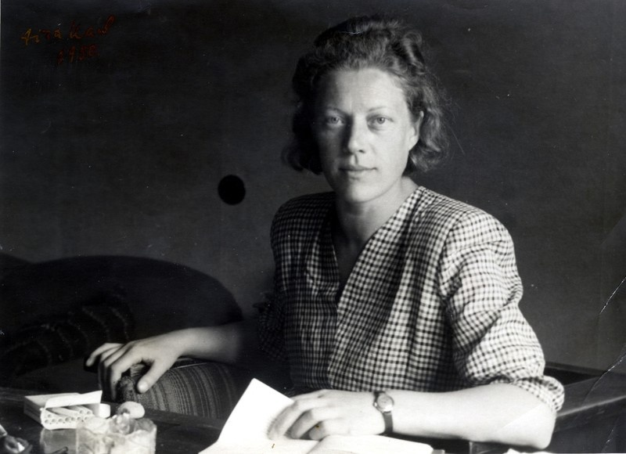
Why is the case of Aira Kaal interesting?
Aira Kaal (1911–1988)
  Estonian/Soviet intellectual, poet, writer
As an intellectual, went through rapid sovietization
  Multiple intellectual turns or developments throughout her life
Concurrently took part of the sovietization
  Articles and essays on who is to be considered a “true“ intellectual
  Lectures at the University of Tartu, shaping the next generation

Slide 4
A short biography of Aira Kaal
Born in 1911 into a peasant family in Saaremaa
1931–1940 student of philosophy at the University of Tartu
  Cultural critique, feminism, connections with the political left
  1938–1939 studies abroad in UK
In 1940 welcomes the Soviet coup, joins the Party, starts as a journalist
  During the war she keeps publishing and translating Marxist texts from Moscow
1945–1950 works as a senior lecturer of Marxism-Leninism in Tartu
Falls into disfavor after 1950 purge of bourgeoise-nationalists, loses her job, party membership and (slowly) her faith in the Soviet state
  Focuses on literature and cultural jouralism, participates only rarely in political discussion (Letter of the 40 in 1980)

Slide 5
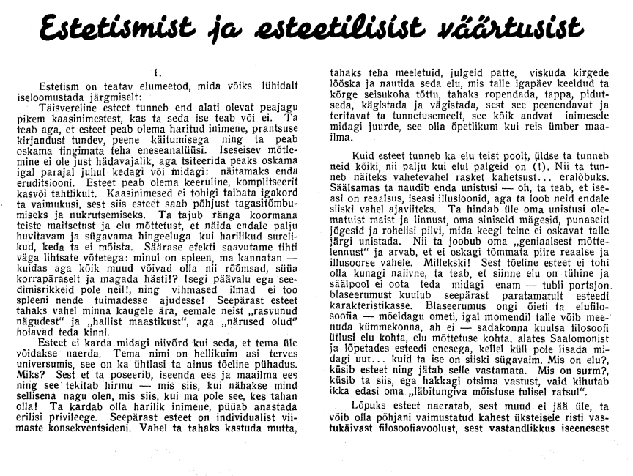
Starting point: “On aestheticism and aesthetic values“ (1937)
Kaal presents a relatively standard critique on aestheticism
  Adopting an ironic tone, she highlights the superficiality, social detachment, meaninglessness and lack of morality of European aestheticism
Aestheticism as a result of exaggerating aesthetics
  Trying to be deliberately peculiar versus being unique
  There is nothing wrong with focusing on aesthetics in art (Tuglas)
Aimed against contemporary Estonian intellectuals
  Nationalist and aestheticist “peacocking“ as a local issue
  Aestheticism as a characteristic of bourgeoisie isn’t mentioned/implied

Slide 6
Starting point: “On aestheticism and aesthetic values“ (1937)
Although much of her critique concurs with the Soviet critique on aestheticism, there are some contradictions
  For Kaal, aestheticism and decadence is not inherent to bourgeois intellectuals in general
  What does her accepting of aesthetic values mean?
Yet the critique fits quite well to the context of her contemporary Estonian leftist intellectuals
  Johannes Vares-Barbarus and Johannes Semper

Slide 7
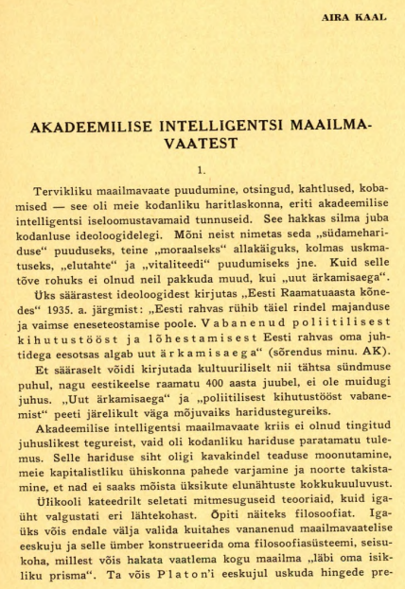
First turn: “Worldview of the academic intelligentsia“ (1941)
Combined critique of aestheticism, idealism, vulgar materialism and eclecticism
  Progress requires science and culture to have a historic direction and social purpose
  Western academic intelligentsia lacks these, unlike the Soviet intelligentsia, which is supported by a comprehensive worldview
Emphasis on aims of “true“ education and science
  Bourgeois education is fragmented, outdated, limiting and contains lies
  Truly free intelligentsia is focused on creativity and the study and change of reality

Slide 8
First turn: “Worldview of the academic intelligentsia“ (1941)
Kaal’s critique has become at least formally Soviet
  She has adopted Soviet terminology and argumentation
  Criticizes bourgeois intellectuals in general
  Stalinist approach (revealed by her anti-eclecticism), strict and simple educational tone
  Although her critique includes various intellectual currents, she focuses on aestheticism and idealism
Kaal is also sovietizing the still evasive Estonian intellectual life
  The text is greatly addressed to Estonian intellectuals and students
  She is shaping the Estonian understanding of what is to be considered the real, truly benefitial way of culture, science and education
  Fits well into the context of pre-war Soviet Estonia
A moment of samokritika?

Slide 9
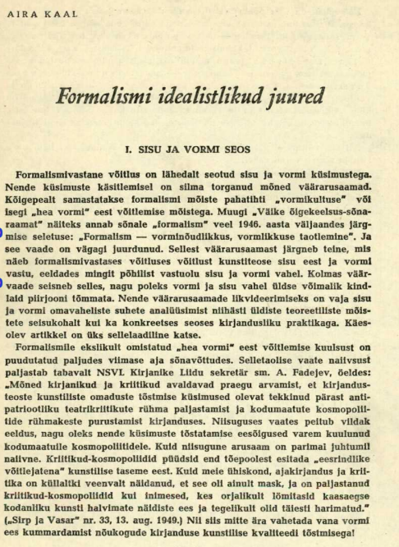
Further changes: “The idealistic roots of formalism“ (1950)
Formalism is essentially originating from bourgeois idealism
  Formalism denies the primacy of content and materialist worldview
  Her critique also mentions cosmopolitanism and aestheticism as examples of idealism
Discussing and reevaluating Estonian literature
Kritika on multiple contemporary Estonian intellectuals
  Nigol Andresen, Paul Viiding

Slide 10
Further changes: “The idealistic roots of formalism“ (1950)
The text fits well into the context of post-war scientific discussions
  Fight against cosmopolitanism and the context of bourgeois-natsionalist purge
  Highlights the role of the party and Stalin in scientific discussions
  Engages in diskussiia, kritika i samokritika
  Has Kaal become an exemplary Soviet intellectual?
Yet her style and approach has changed
  Unlike in the earlier texts, Kaal focuses her critique on a specific field (poetry), presenting a deeper analysis of the phenomena within the discipline

Slide 11
Loss of faith and outlines of later life
Kaal is reinstated to the party in 1955, but remains relatively silent until the late 1970s
  Focuses on poetry and short stories
E. Parhomenko: Kaal turns away from Marxism-Leninism towards “phenomenological observation and mystification of nature“
More or less implicit critique of Marxism and the Soviet system
  Idealism and Marxism can become intertwined
  Revolution did not bring change, but suffering
  Emancipation of women and men has not happened
  Letter of the 40 intellectuals in 1980

Slide 12
Used sources and literature
Kaal, Aira. “Akadeemilise intelligentsi maailmavaatest.“ Nõukogude Kõrgem Kool, no. 2 (1941): 95–102.
Kaal, Aira. “Estetismist ja esteetilisist väärtusist.“ Üliõpilasleht, March 23, 1937.
Kaal, Aira. “Formalismi idealistlikud juured I.“ Looming, no. 2 (1950): 245–253.
Kaal, Aira. “Formalismi idealistlikud juured II.“ Looming, no. 3 (1950): 352–372.
Kaal, Aira. “Formalismi idealistlikud juured III.“ Looming, no. 4 (1950): 464–479.
Kaal, Aira. “Ülikooli seinte vahel ja väljaspool ülikooli seinu.“ Looming, no. 6 (1984): 802–826.
Kojevnikov, Alexei. “Rituals of Stalinist culture at work: Science and the games of intraparty democracy circa 1948.“ Russian Review 57, no. 1 (1998): 25–52.
Parhomenko, Eduard and Laak, Marin. “„Ning minu maailmapilt laguneb hoogsalt“. Aira Kaalu kiri Ene Mihkelsonile 6. juulil 1984.“ Methis: Studia humaniora Estonica 34, no. 1 (2024): 192–201.
Tromly, Benjamin. Making the Soviet Intelligentsia: Universities and Intellectual Life under Stalin and Khrushchev. Cambridge University Press, 2014.
Undusk, Jaan et al.. Dekadents Eesti kultuuris: Tõlge ja tõlgendus. Underi ja Tuglase Kirjanduskeskus, 2023.

Slide 13
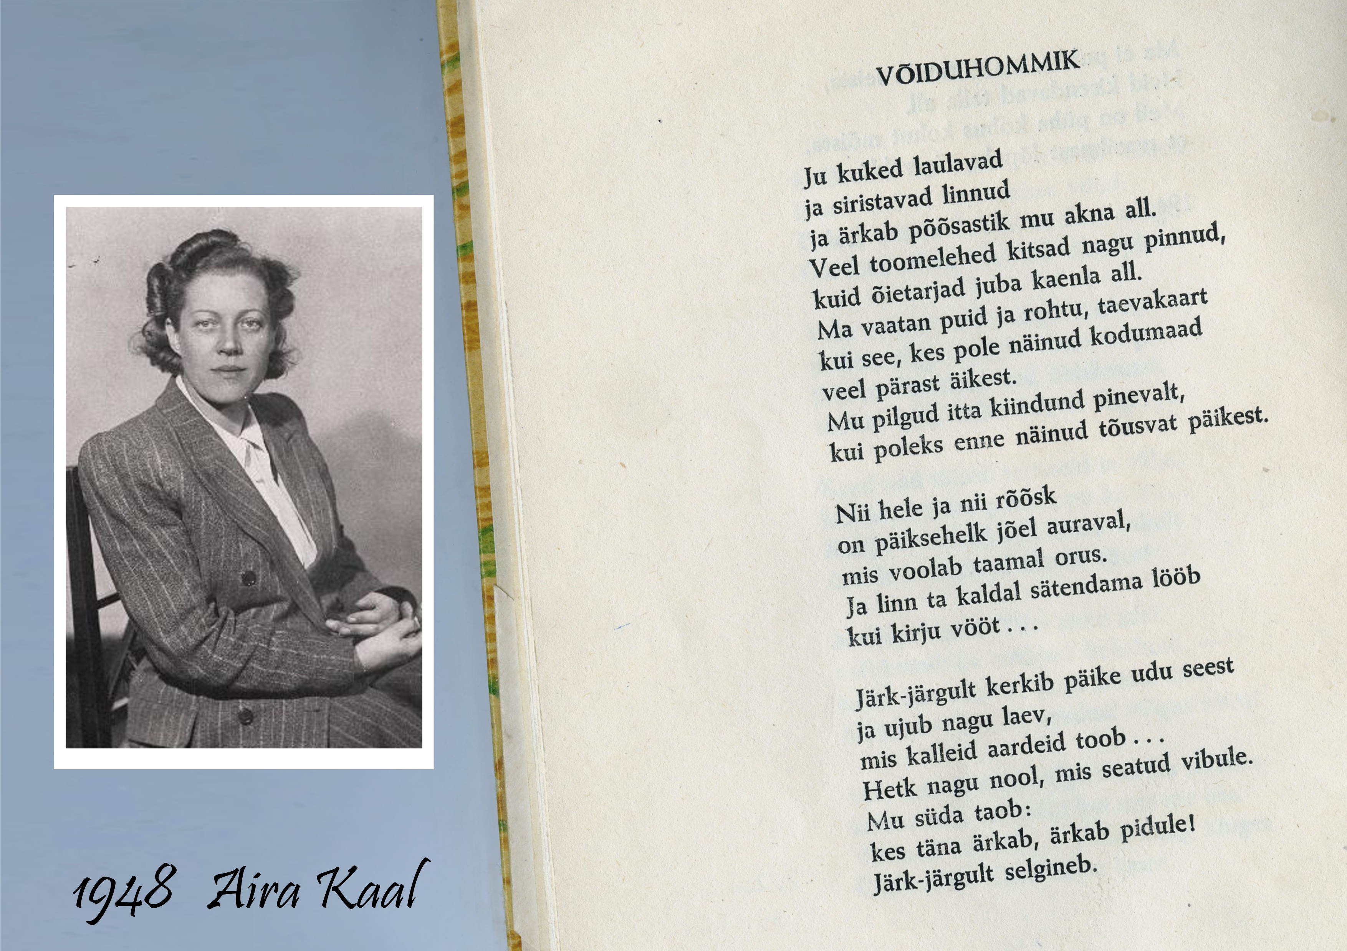
Thank you for your attention!

