Slide 1
Marietta Shaginyan
1888-1982

Slide 2
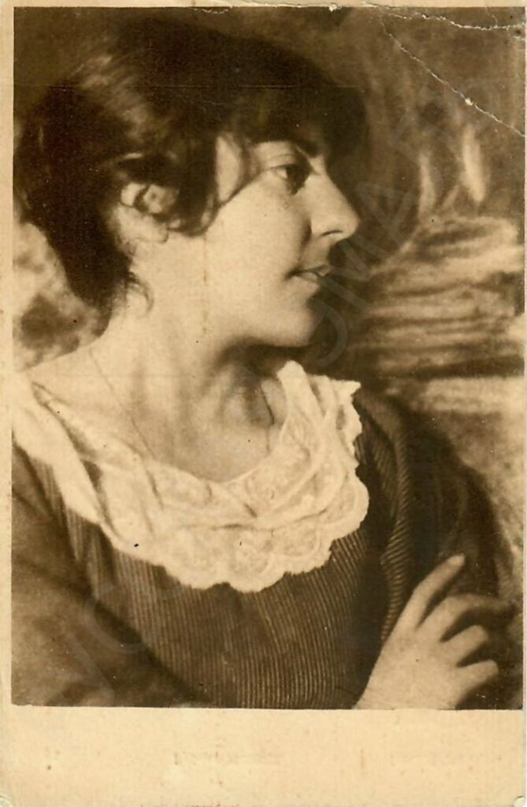
Biography
Born in Moscow into a family of Armenian intellectuals
Moscow 🡪 St. Petersburg 🡪 Rostov-on-Don 🡪 Petrograd 🡪 Moscow
Education: History and philosophy, Heidelberg University
Influences: Goethe, Russian symbolism (Blok, Merezhkovsky), Andrey Bely, Rachmaninoff

Slide 3
“A typical figure of our times.” – Nadezhda Mandelshtam
Novelist, historiographer, first science fiction writer, art critic, journalist, mountaineer
From symbolism to Stalinism, “Stalin’s favourite”
Selected Works: One’s Own Fate, Mess Mend: Yankees in Petrograd, The Ulyanov Family, Hydrocentral

Slide 4

Mess Mend: Yankees in Petrograd
First published in 1924 under the male alias Jim Dollar
Pseudo-translation
Experimental, “Communist Pinkerton,” satiric-fantastic fiction
Aristocratic degradation – Johann Gottfried Herder, Aron Zalkind
Notes:
To promote communist ideas in a popular manner, marxist view on biology

Slide 5
Shaginyan in perspective
“Fellow traveler” (poputchiki) who became a Soviet classic
Loyal to the regime – especially during the purges
  "Just because a few people have been arrested, they make all this fuss!"
“Persecuted” herself for the work on Lenin

