Slide 1
Angelina Guskova

Slide 2
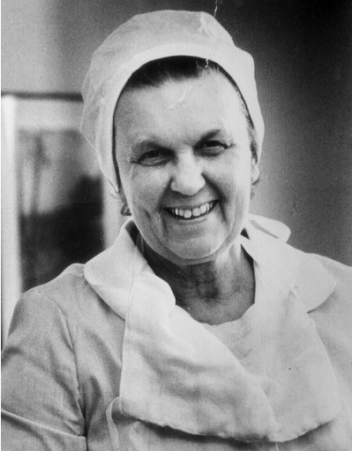
Early life
Born in 1924 in Krasnoyarsk
  Family of intellectuals
In 1926 the family moved to Nizhny Tagil
  Excelled in school, but chose Sverdlovsk over Moscow
1941–1948 studies in Sverdlovsk Medical Institute
1948–1949 assistant of David Schefer
  Focus on neurology (malignant brain tumors)
  Impact of X-ray and nervous system
  Second offer from Moscow

Slide 3
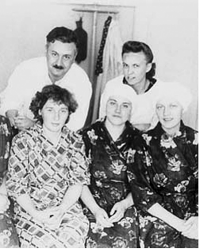
First contacts with radiation sickness
In 1949, Guskova was sent to Chelyabinsk-40 (Ozersk)
  Treatment of plutonium plant workers exposed to radiation
  Head of the neurology department at age 25
Member of Grigory Baisagolov’s research group
  Noticed the dire situations at the plant where signs of radiation sickness were instead diagnosed as Asthenovegetative syndrome or “blood issues”
1950s: formulation of principles of classification and treatment of radiation sickness
  In collaboration with Baisagolov
  Foundation of Moscow Institute of Biophysics Ural branch in 1953
  Emergence of a Soviet school of radiation research

Slide 4
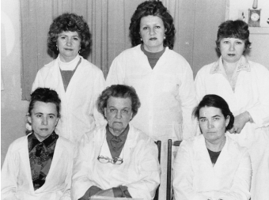
Guskova as an established scientist
Move to Moscow in 1957
  Positions in Moscow IBP and in the Academy of Sciences
  Studied radiation sickness on radiologists
  Publication of many articles and monographs, including “Radiation Sickness in Man” (1971, with Baisagolov)
In 1974 Guskova became the director of Moscow IBP clinical department
  Study for diagnosing, predicting and treating of acute radiation sickness, helpful during Chernobyl
  “Danger of Nuclear War” (1982), threat of reactor accident – access to the paper was limited until Chernobyl events, when it was discovered as the only study of the topic
Chernobyl
  Organizing of hospital nr. 6
  International connections and participation in global organizations

Slide 5
Understanding Guskova’s Career Requires Examining Three Structural Axes:
The Soviet postwar medical system: a politicized institution where healthcare was redefined from a profession to a state duty, centralized under the Semashko model.
The nuclear program: a classified scientific-military environment where authority depended on both expertise and political reliability.
Her role during Chernobyl: a moment that reveals her ability to operate across medicine, bureaucracy, secrecy, and public communication.

Slide 6
What Does Guskova’s Career Reveal About Power, Expertise, and Gender in the Soviet System?
How did she navigate a male-dominated, high-prestige medical field structured by bureaucratic hierarchies and party expectations?
To what extent did advancement depend on medical expertise/skill vs. political utility, especially in classified areas like radiation medicine?
During Chernobyl, how did she balance scientific accuracy, state secrecy, and political narratives under intense scrutiny?
Did her authority reinforce existing institutional norms or challenge gendered assumptions within Soviet scientific circles?

Slide 7
Sources and bibliography
Bernstein, Frances Lee, Christopher Burton, and Dan Healey. Soviet Medicine : Culture, Practice, and Science. DeKalb: Northern Illinois University Press, 2010.
Efimova, Irina. “Angelina Konstantinovna Guskova (for the 100th Anniversary of her Birth).” In Medical Radiology and Radiation Safety 69, 2 (2024): 83–88.
Field, Mark G.. (1957). SOME RECENT SOVIET MEDICAL STATISTICS PERSONNEL, HOSPITAL BEDS, BIRTH AND DEATH RATES. Journal of the American Medical Association, 164(6), 695–.
Ilyin, L., Barabanova A. “Obituary: Angelina Konstantinova Guskova.” In Journal of Radiological Protection 35, 1 (2015): 733–734.
Manning, Roberta T. Science & Society 40, no. 4 (1976): 487–90.
Solomon, Susan Gross. “Social Hygiene in Soviet Medical Education, 1922–30.” Journal of the history of medicine and allied sciences 45, no. 4 (1990): 607–643.

