Slide 1
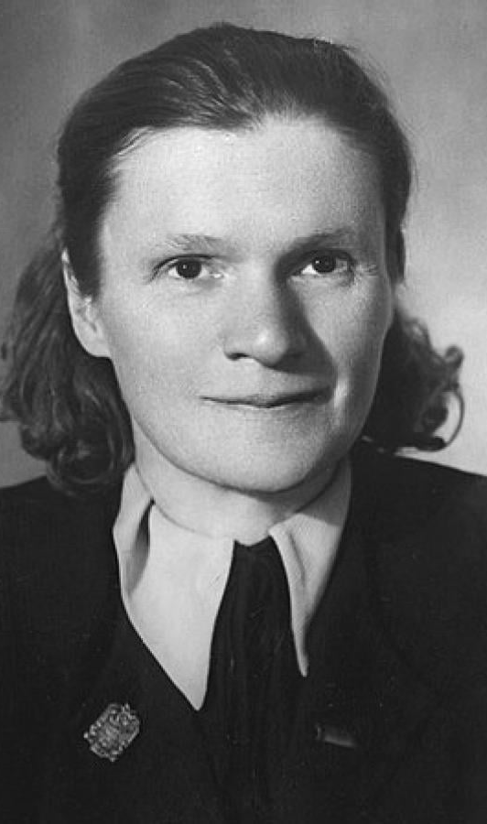
Anna Pankratova (1897-1957)
Born in Odesa in a poor family, but graduated with a degree in history in 1917
First, she became an Eser, but in 1919, she joined the Bolsheviks
From 1922, she attended the Institute of Red Professors, where she met Mikhail Pokrovsky and her husband
From 1926, she taught at every major higher education institute
Accused of Trotskyism but survives the purges, teaches in Saratov
Her historiography initially was characterised by the Pokrovsky School
  Focus on class struggle and economics instead of „great personalities”
  The Russian Empire as the ”prison of peoples”
  Most of her work was on factory committees and trade unions
In the late 1930s, she denounced Pokrovsky, exactly on Russian nationalist grounds influenced by Stalin

Slide 2
