Slide 1
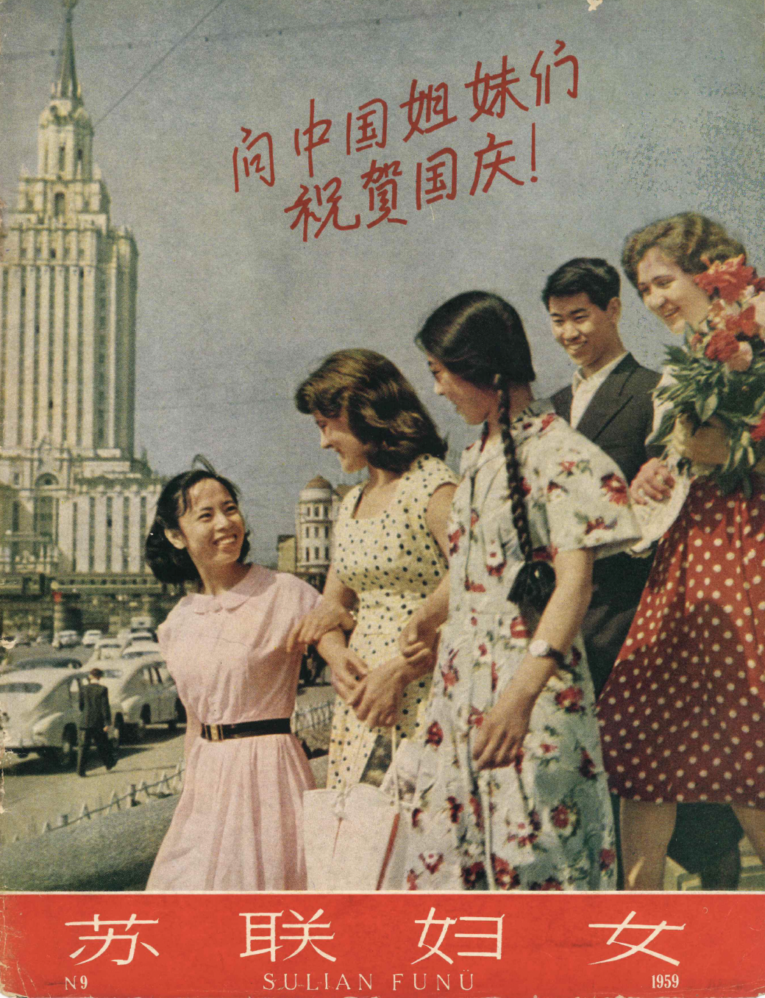
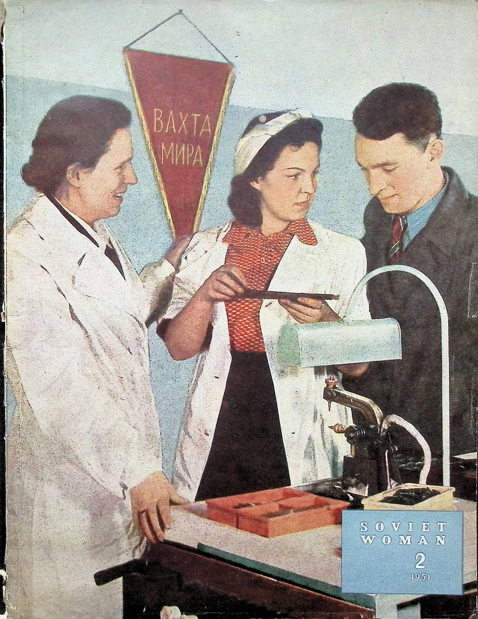

Slide 2
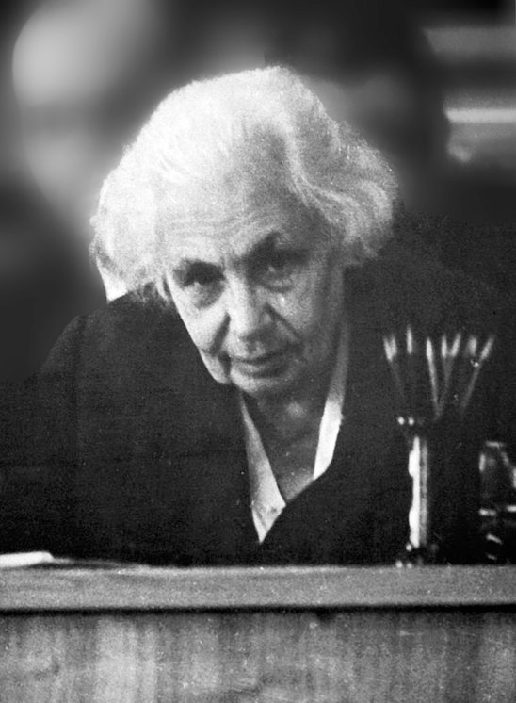
Maria Klenova (1898—1976)
“If I’d a gift for artistic writing, it would be a novel about the life of scientists,
showing all the depths and hideousness of the vestiges of capitalism in the consciousness
of representatives of the upper levels of the Soviet intelligentsia.”
“It’s always possible to establish friendly
relationships when nobody looks on a female scientist as ‘a woman’. I’m not a
woman; I’m a professor, I’m 56 years old!
Kalemeneva, Ekaterina, and Julia Lajus. "Soviet female experts in the polar regions." In The Palgrave Handbook of Women and Gender in Twentieth-Century Russia and the Soviet Union, pp. 267-283. London: Palgrave Macmillan UK, 2017.

Slide 3
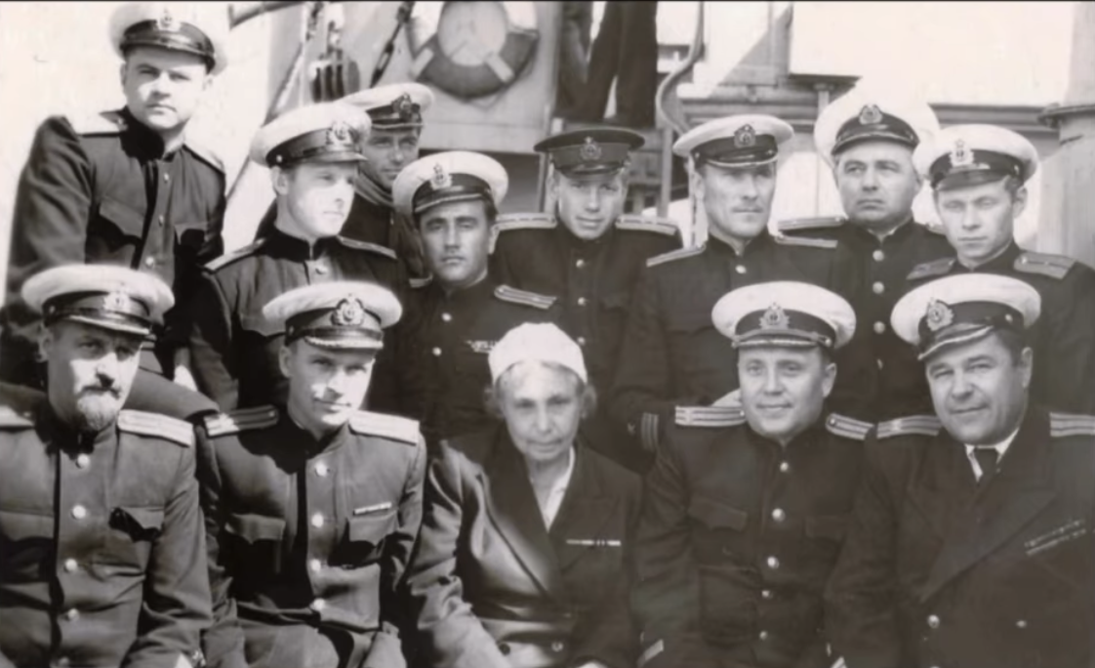
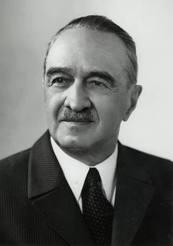
Shantara, 1953
“...female scientists shouldn’t only fulfil their scientific work but should also fight for their right to work equally with men. … It requires much moderation, delicacy, moral purity and endurance in order to overcome all of these attitudes.”

Slide 4
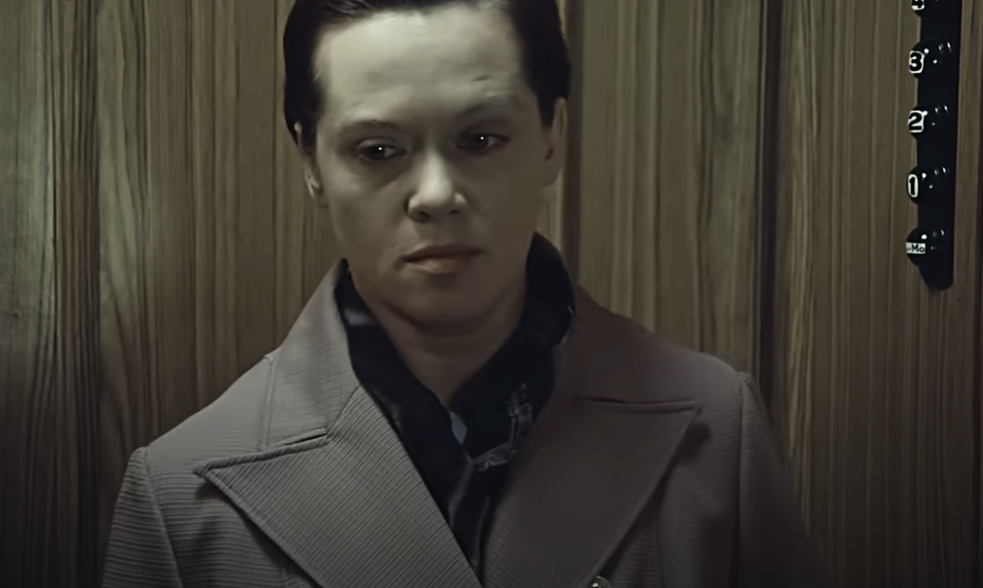
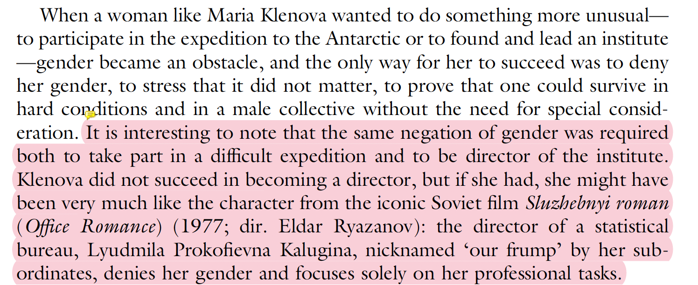
“наша мымра”

Slide 5
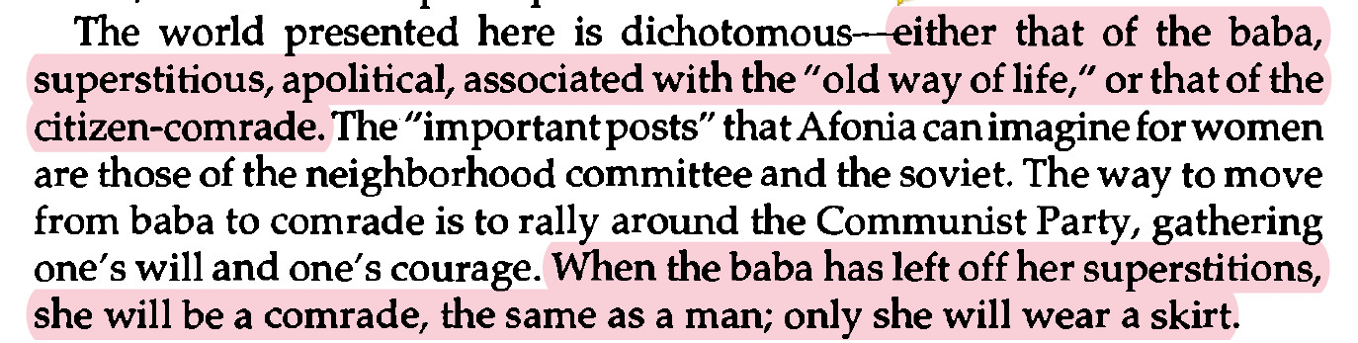
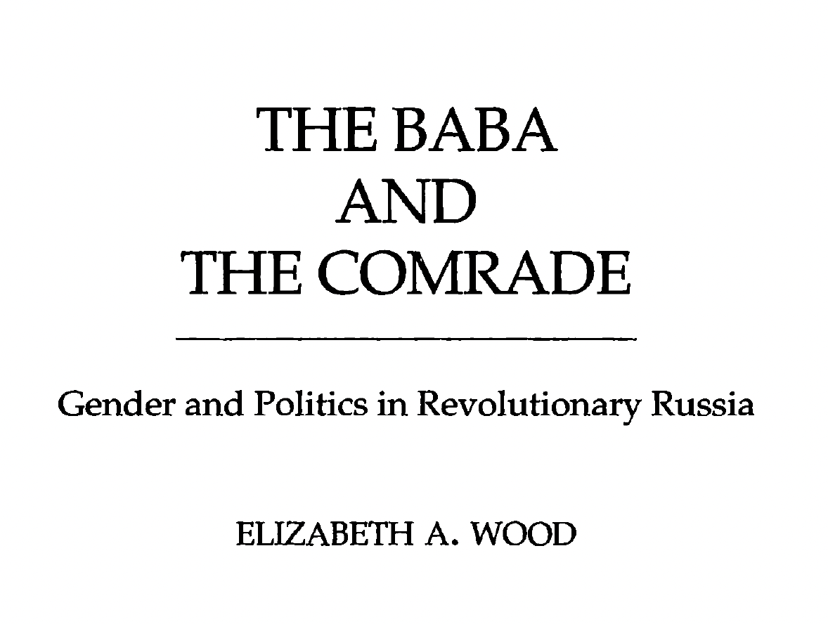
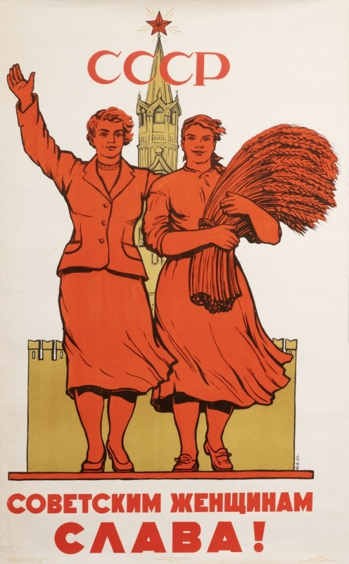
The Woman Question

Slide 6
The Woman Question
“With the possible exception of the Soviet leader Mikhail Kalinin, who was identified as a peasant for his whole life despite being the equivalent of president of the Soviet Union, peasants in general could cease to be peasants and could "rise" into the working class if they moved to the cities and joined the vanguard of the proletariat. Russian and Soviet women, however, remained "women" no matter how many advanced degrees they might have in physics or mathematics. Thus Kollontai and Krupskaia had to battle against the notion that they were "just women" their whole lives.”

Slide 7
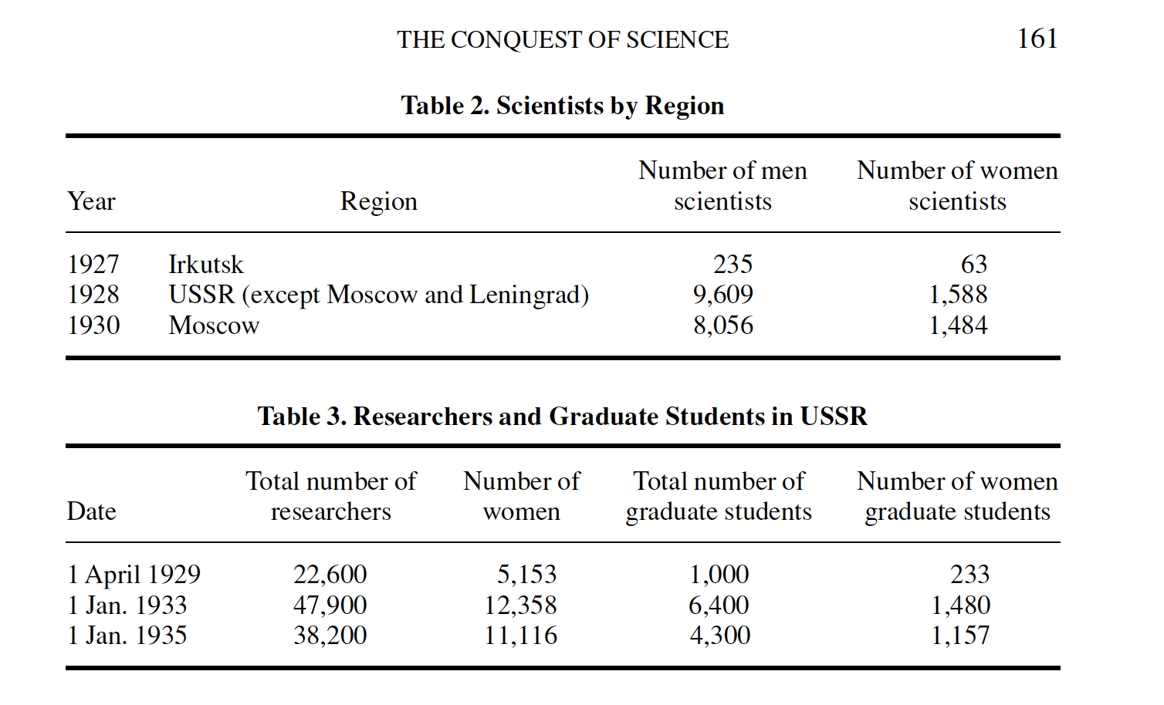
Valkova, Olga. "The conquest of science: women and science in Russia, 1860–1940." Osiris 23, no. 1 (2008): 136-165.
“3 ways”
“...the treatment of women in the scientific community changed now that they had become real competitors.”

Slide 8
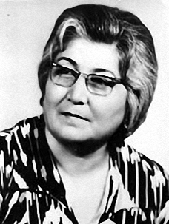
Non-Russian Women
Zhenotdel VS KUTBZh (Commission for the Improvement of the Work and Everyday Life of Women)
Sofia Hakimova
Tajikistani obstetrician and gynecologist

Slide 9
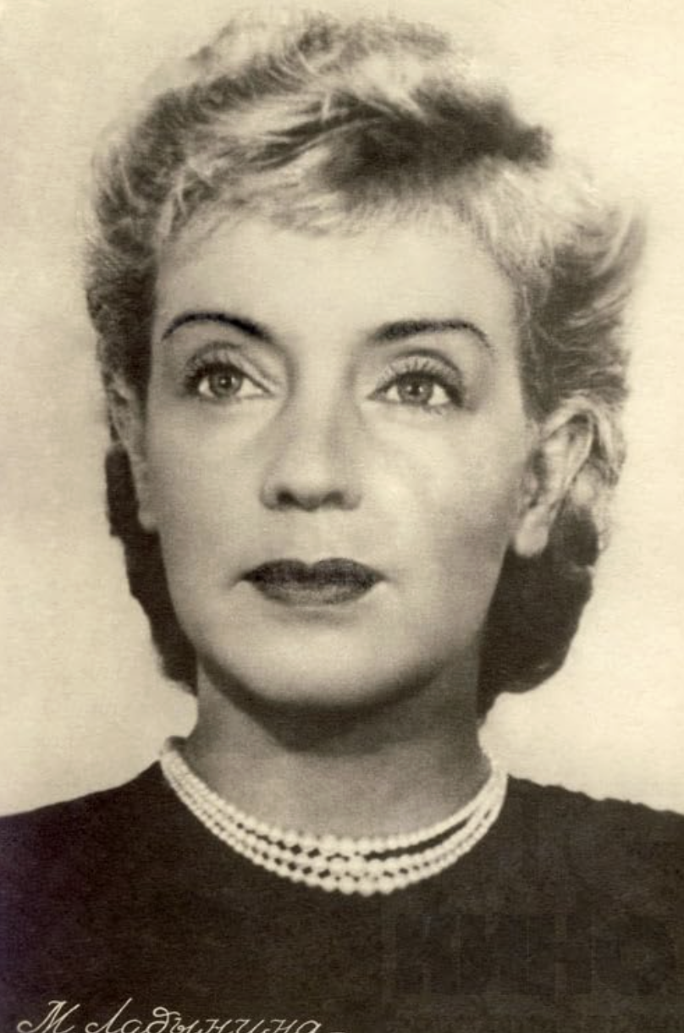
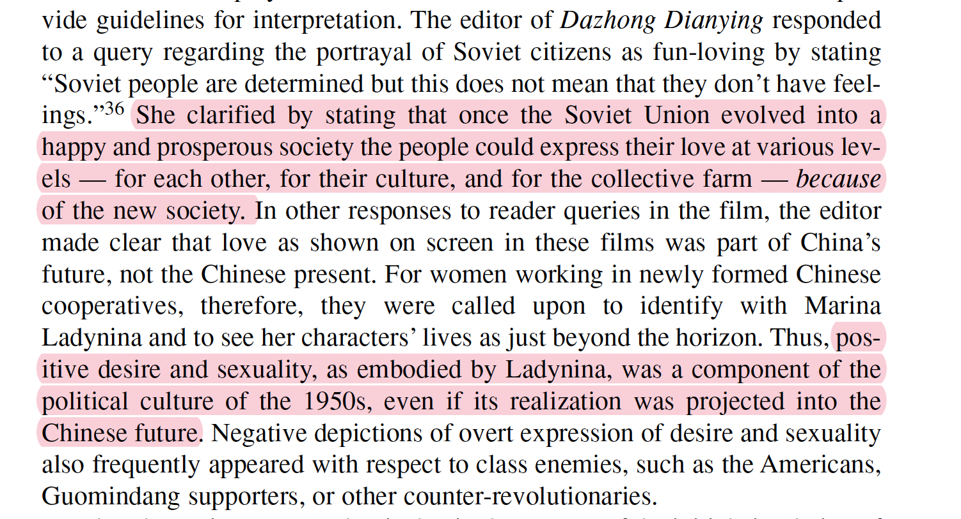
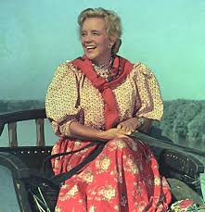
Soviet Love, Sexuality & Media Abroad
Marina Ladynina

Slide 10
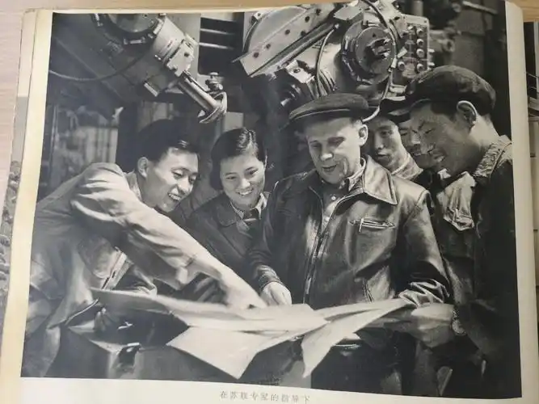
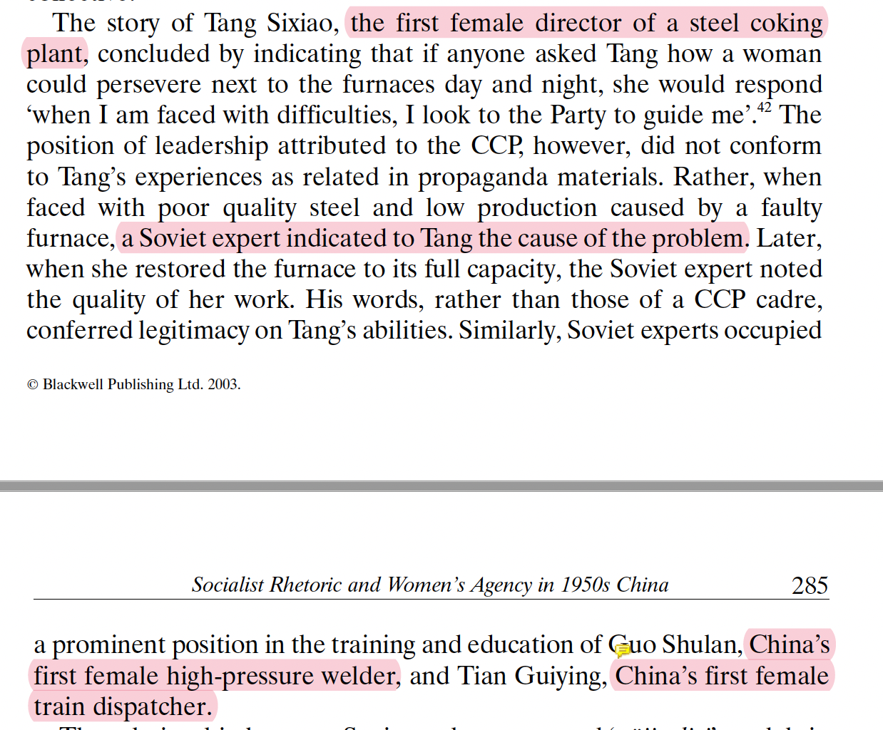
Chen, Tina Mai. "Female icons, feminist iconography? Socialist rhetoric and women's agency in 1950s China." Gender & History 15, no. 2 (2003): 268-295.

Slide 11
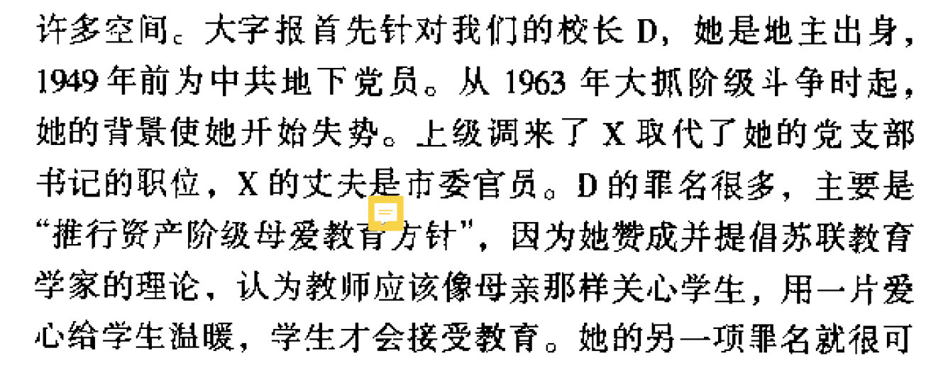
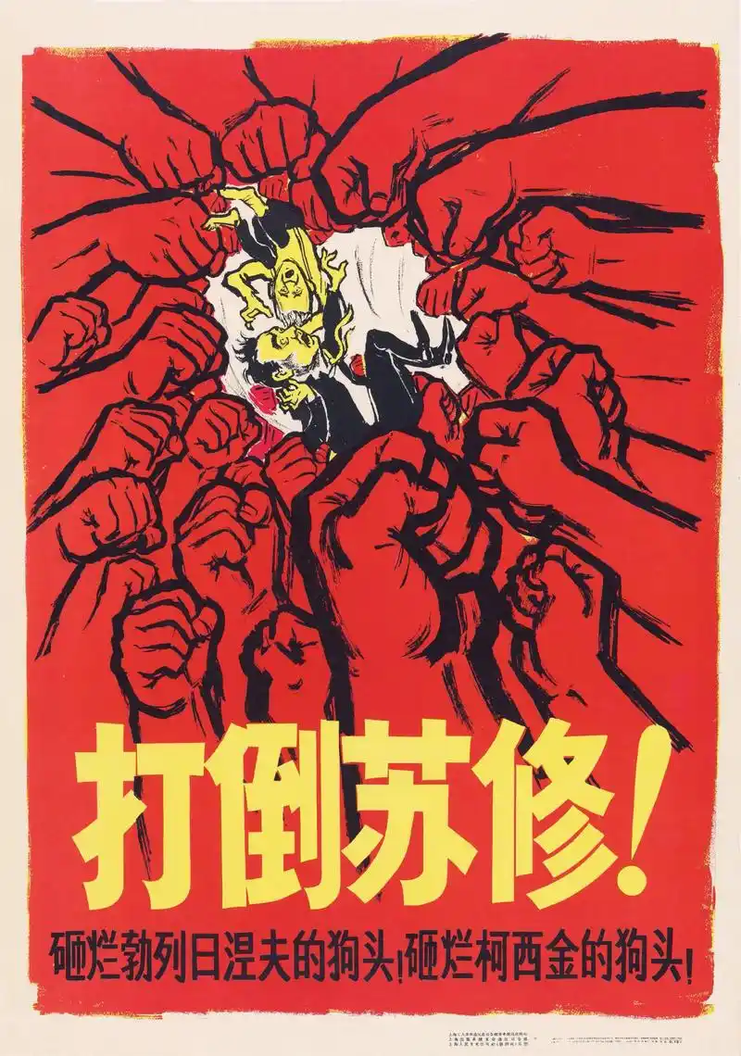
The Sino-Soviet split
“D was accused of many crimes, the main one being ‘promoting the bourgeois maternal love education policy,’ because she praised and supported the Soviet educational theorists who believed that teachers should care for students like mothers do：using love to warm students’ hearts so they could truly accept education.”

Slide 12
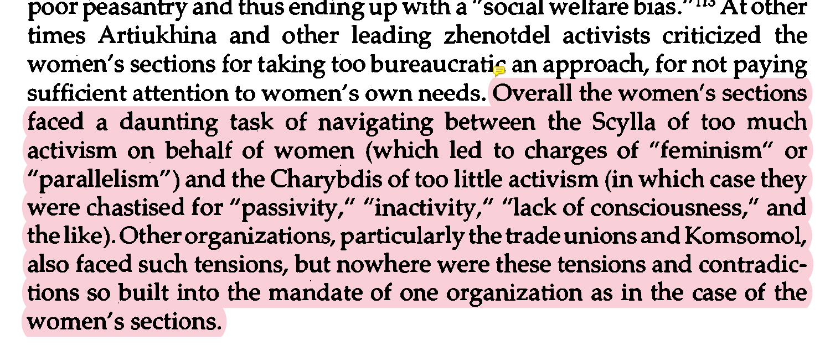
Incorporating women into “intellectual history”
Sources/genre: memoirs, diaries, magazines, oral histories (anecdotes)
Private VS Public dichotomy; “The Scylla and the Charybis”
The woman question - women as subject or object?

