Slide 1
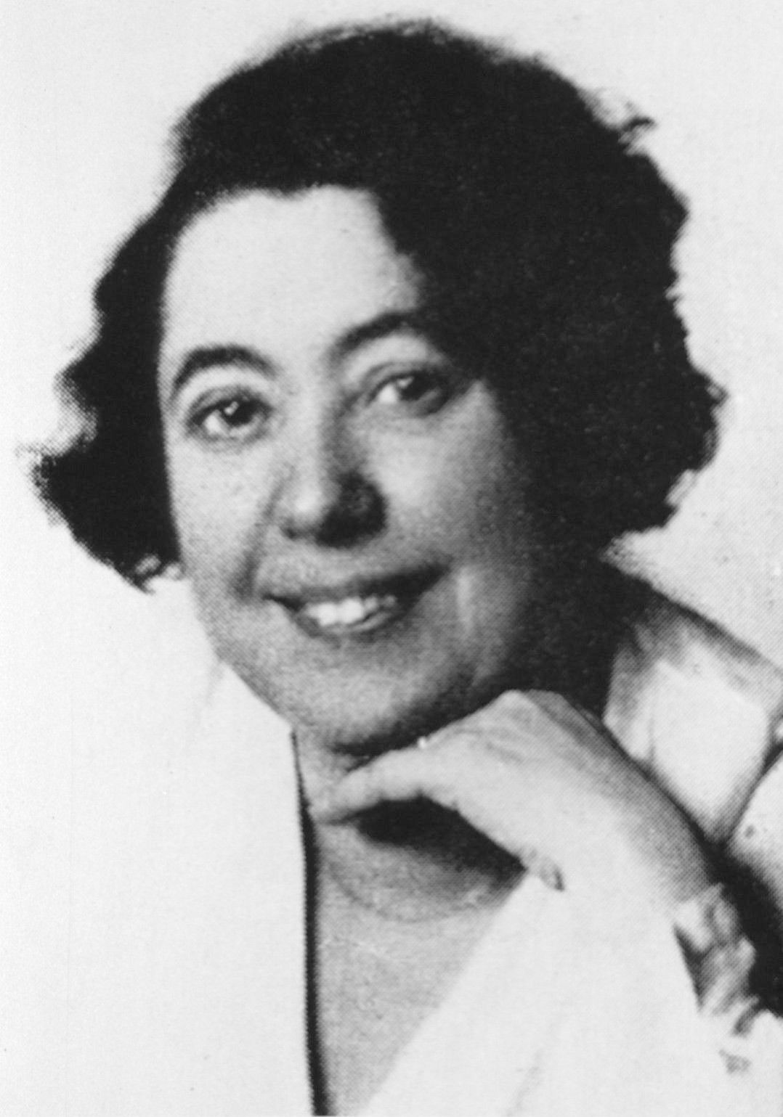
Lina Solomonova Štern / Лина Соломоновна Штерн
26.08.1878 – 07.03.1968
Biochemist and Physiologist
Known for her research on the blood-brain barrier

Slide 2
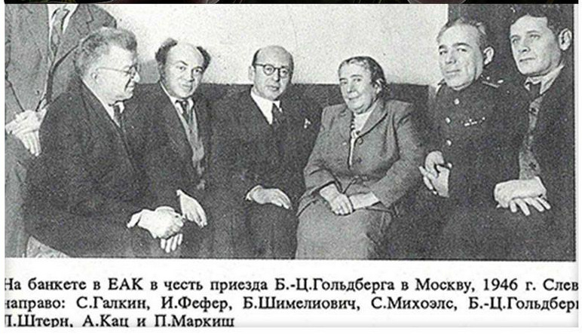
A meeting of the Jewish Anti-Fascist Committe in 1946.

