Slide 1
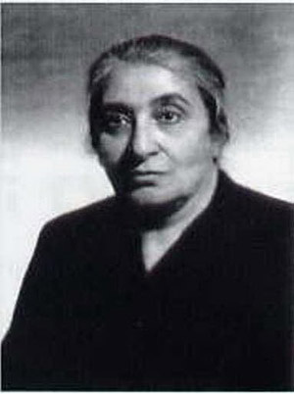
Kulthum ‘Awda
(Klavdia Ode-Vasilieva),
1892-1965

Slide 2
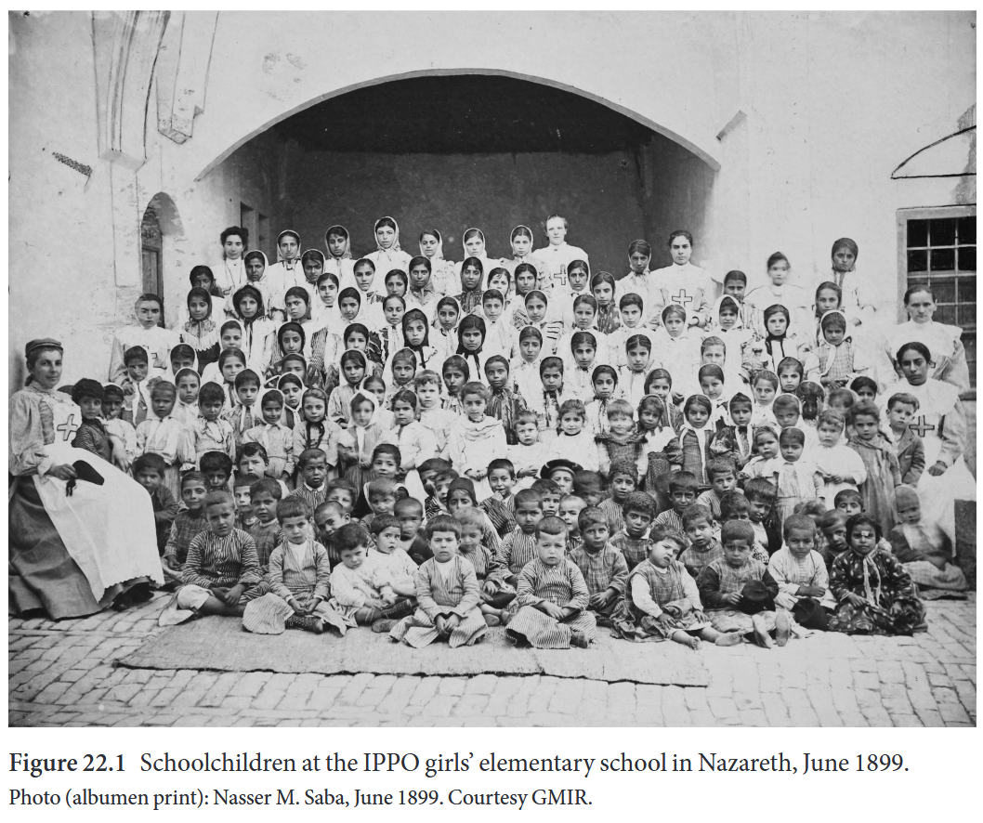
Schoolchildren at the Imperial Orthodox Palestine Society’s girls’ elementary school in Nazareth, June 1899

Slide 3
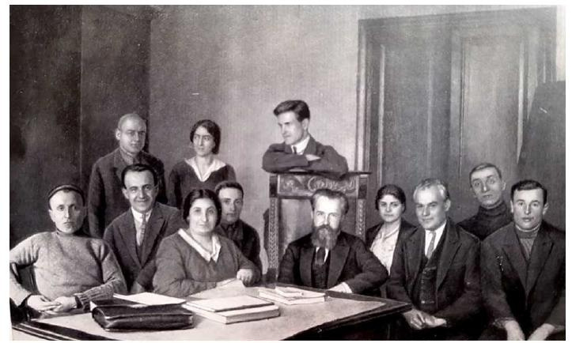
Kulthum ‘Awda and Ignatii Krachkovskii with their colleagues at the Leningrad Oriental Institute, 1928

Slide 4
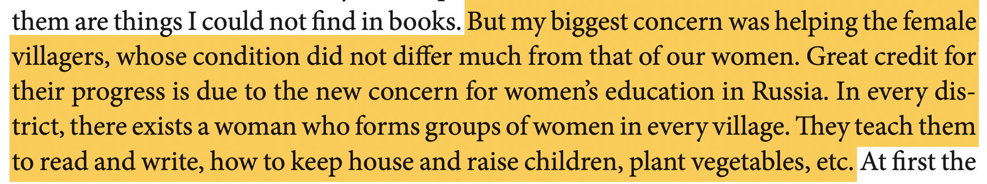
‘Awda about the Soviet modernization

Slide 5
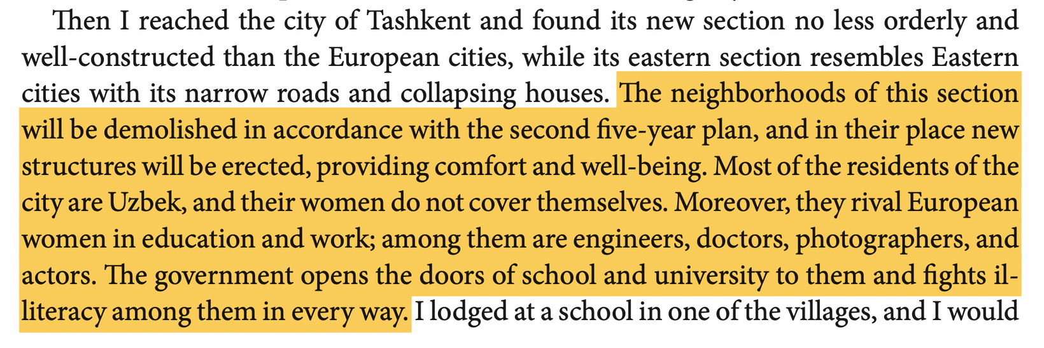
‘Awda about the Soviet modernization

Slide 6
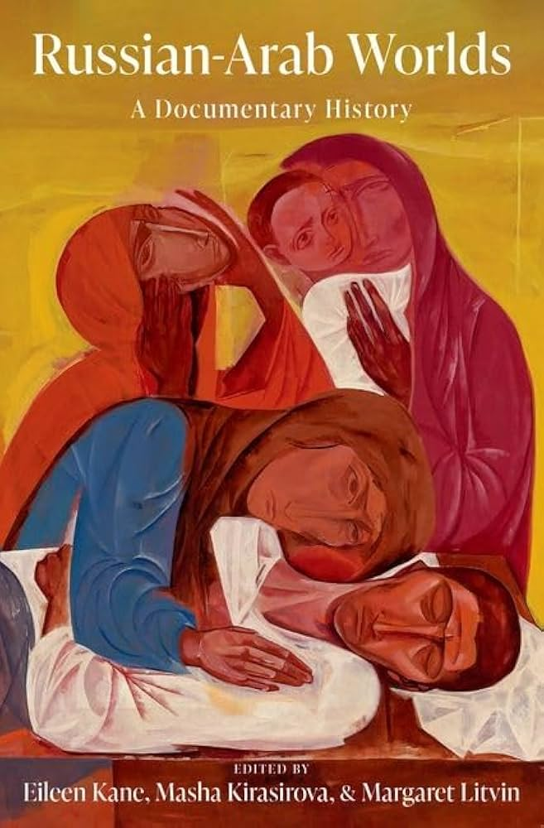
From Nazareth to Moscow: Kulthum ‘Awda-Vasilieva’s “Happy Life” in Russia (1927, 1937, 1965)
Khayat, Nicole, and Maria Vologzhanina, “From Nazareth to Moscow: Kulthum ‘Awda-Vasilieva’s “Happy Life” in Russia (1927, 1937, 1965),” in Russian-Arab Worlds: A Documentary History (New York, 2023; online edn, Oxford Academic, 22 June 2023),

