Slide 1
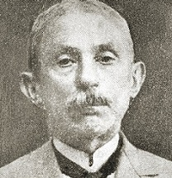
An Ottoman Response to Darwinism:
İsmail Fenni on Islam and Evolution
Ru Shiyao

Slide 2
Darwinism in Ottoman Culture
Evolutionary views received acceptance among the Ottomans from the 1860s.
The Young Turks and Büchnerian Darwinism
- materialist and anti-religious
- biology and politics
· Science & Islam
Conflicts? Reconciliation? (İzmirli İsmail Hakkı, Ahmed Midhat and Filibeli Ahmed Hilmi)

Slide 3
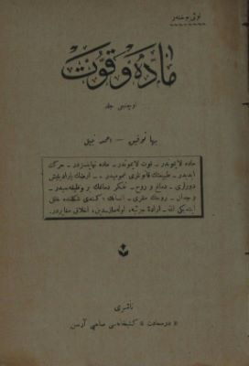
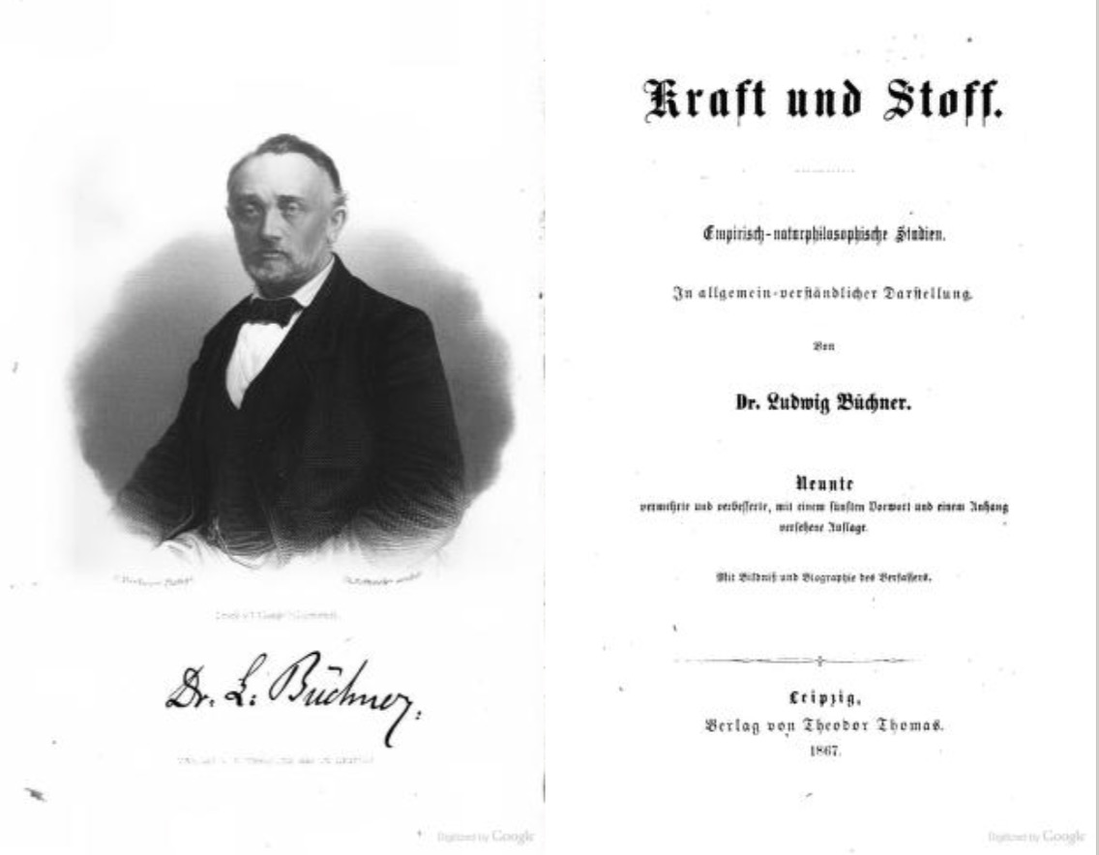
Kraft und Stoff by Ludwig Büchner
Madde ve Kuvvet trans. Baha Tevfik , Ahmed Nebil

Slide 4
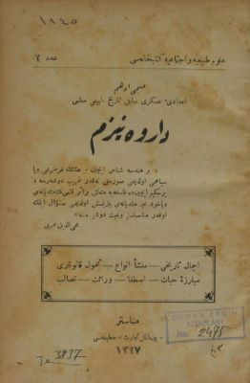
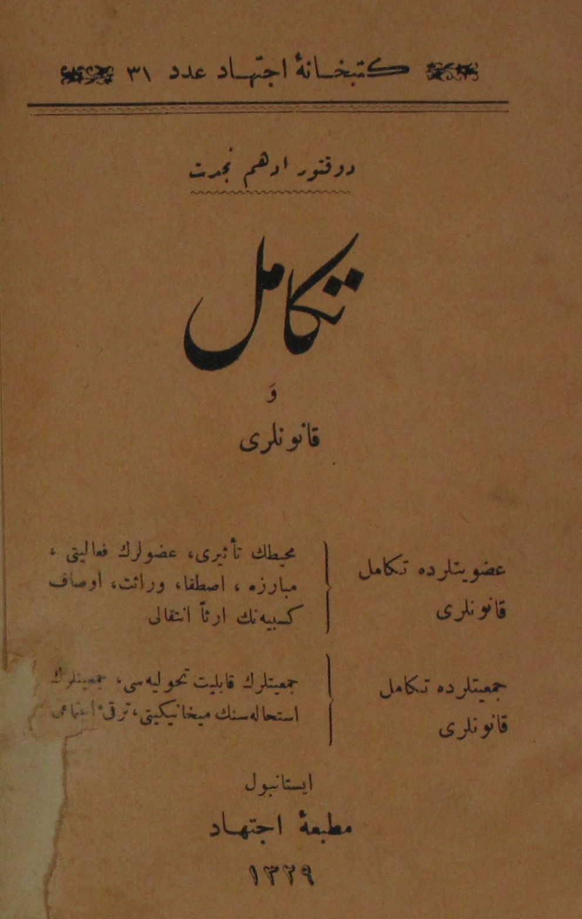

Darvenizm by Subhi Edhem
1327 AH [ 1909 ]
Tekâmül ve Kanunları by Edhem Necdet
1329 Rumi [ 1913 ]
Servet-i Fünun

Slide 5
İsmail Fenni [Ertuğrul]
İsmail Fenni [Ertuğrul] was born in Tarnovo (now Bulgaria) in 1855, into a notable family.
After finishing secondary school, he attended a madrasa and was trained in accounting.
During the Ottoman-Russian war of 1877-1878 he moved to Istanbul and was educated in a language school (French and Arabic). But he also studied English privately for four years.
He worked as the accounting officer in the ministry of domestic affairs until 1908, after which he retired to write his books defending Islamic creed against materialism.
The Collapse of the Materialist Creed (1928)

Slide 6
İsmail Fenni on Islam and Evolution
Darwinism is refuted by the contemporary scientific evidence;
Islam can be reconciled with Darwinism;
Darwinism might constitute a threat to morality;
Despite its major flaws, Darwinism should not be banned, since scientific development requires freedom.

Slide 7
Conclusion
It was through Büchner’s book that Darwinism was introduced to the Ottoman Empire and, as a result, the way he presented Darwinism shaped early responses among his Turkish readers. Meanwhile, the conservative circle slammed Darwinism as anti-Islamic and immoral.
The arguments of Fenni muddy any clear distinction between these anti-Islamic Darwinists and anti-Darwinist Islamists. He showed that one did not need to serve an anti-religious political agenda in order to defend scientific freedom against extra-scientific authorities.

