Slide 1
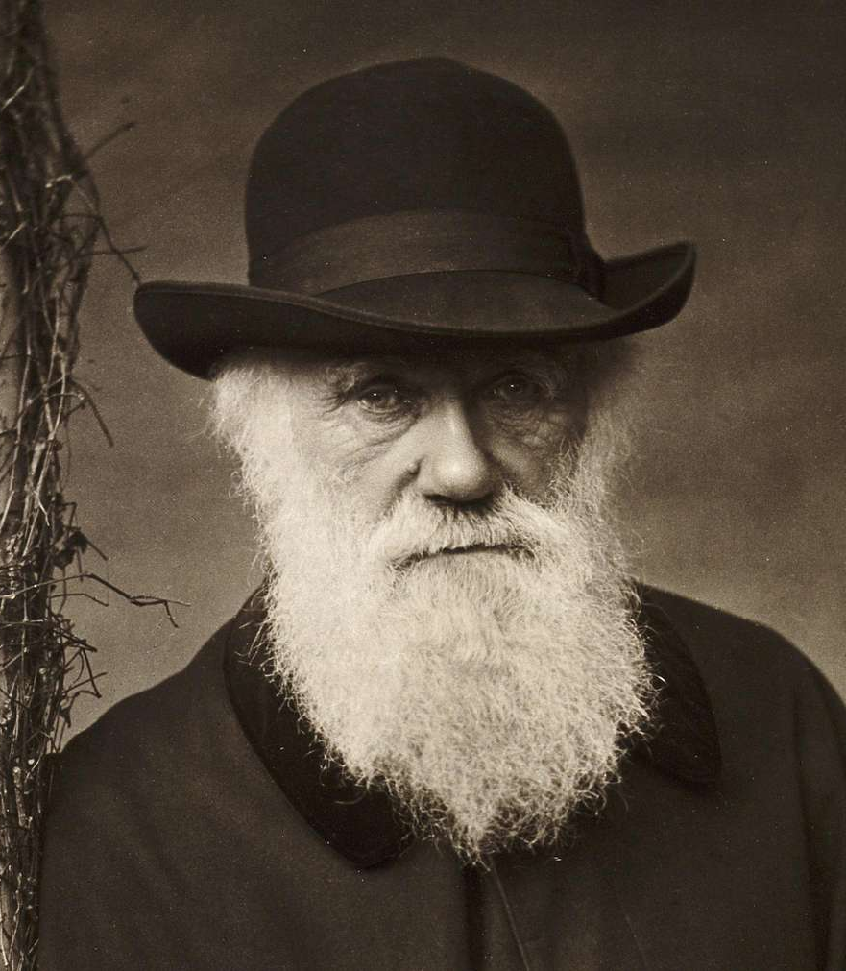
Reconsidering Teleology in Darwin’s Evolutionary Theory: Robert Richard’s The Meaning of Evolution
Ilgar Gapagov

Slide 2
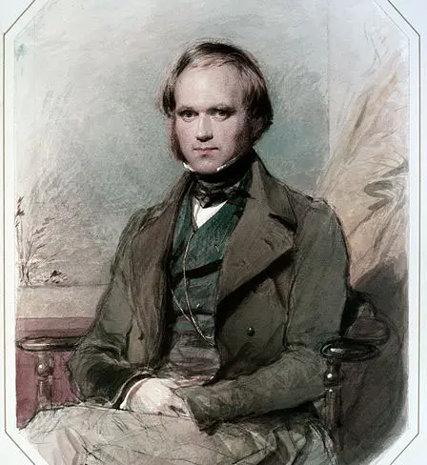
The Teleological Foundation of Darwinism
Charles Darwin’s theory of species descent was rooted in 19th-century embryological models that viewed evolution as a purposeful, progressive process. By adopting the principle of recapitulation, Darwin integrated “progress toward perfection” into the logic of natural selection, framing species history as a macrocosmic version of individual development.
  “Darwin’s theory, from its conception to its maturation, pulsed to the rhythms of that ever-fascinating principle [recapitulation]” (Richards, 1992, p. xiv).
  “Progressive development gives final cause for enormous periods anterior to Man” (Charles Darwin, Notebook B, 1837, as cited in Richards, 1992, p. 82).
Charles Darwin, 1809–1882, wedding portrait done in 1841.
This portrait captures Darwin at age 32, the period during which he was privately formulating his transmutation theory in his notebooks, explicitly drawing on embryological analogies of progressive development

Slide 3
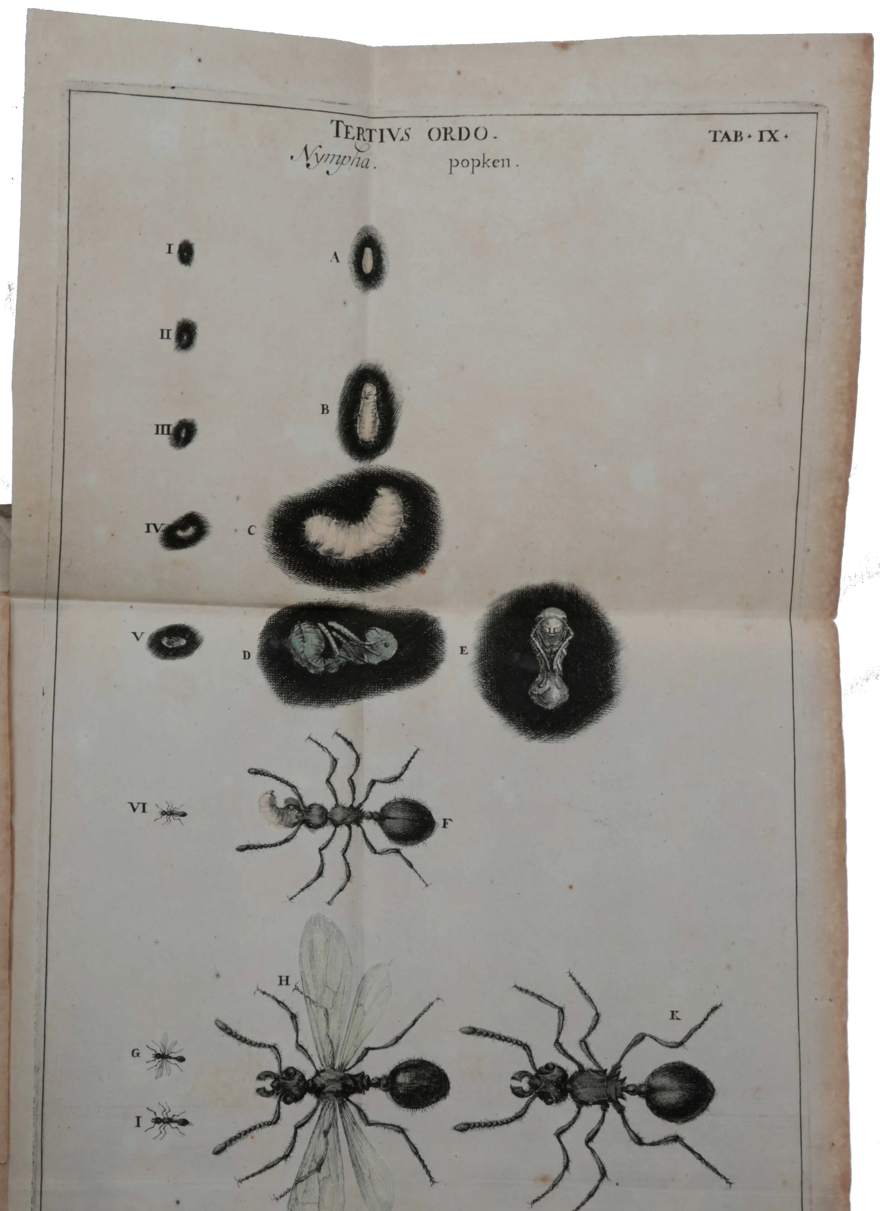
The Pre-Darwinian Context
In the 17th and 18th centuries, “evolution” (evolutio) referred exclusively to the embryological theory of preformationism, where a miniature adult unfolded during gestation. Put differently, the embryo was considered to be a miniature version of the complex organism that it would evolve into.
  “All the viscera, muscles, and remaining solid parts have already existed in the first beginnings of the invisible human embryo... successively become apparent in those places where they have been slowly dilated by an influxing humor” (Albrecht von Haller, 1744, as cited in Richards, 1992, p. 23).
  “Certainly the forms and articulations of all the parts preexist in the fecund semen” (Jan Swammerdam, 1685, as cited in Richards, 1992, p. 7).
The development of the ant. From Jan Swammerdam, Historia Insectorum Generalis (1685). Swammerdam’s illustrations of the ant larva were used by Haller to argue that the adult form lay "encapsulated" within the embryo, defining the original 17th-century meaning of "evolution" as a literal unfolding of pre-existing parts.

Slide 4
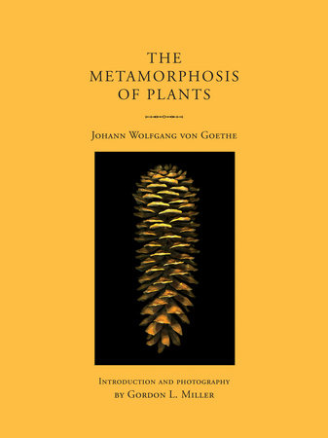
Romantic Naturphilosophie – The Ideal Archetype
Romantic naturalists, led by Johann Wolfgang von Goethe and Friedrich Schelling, sought to identify a “unity of type” or a single original plan (Urbild) underlying all organic diversity. They believed that living beings expressed an internal purposiveness (intellectus archetypus) where every part is directed toward the life of the whole, a metaphysical framework that Darwin would eventually naturalize by turning these ideal “types” into real historical ancestors.
  “The vertebrates were ‘all formed according to a single, original plan [Urbild]’” (Johann Wolfgang von Goethe, 1796, as cited in Richards, 1992, p. 34).
  “In an ascending dialectic, nature progressed gradually through higher stages, with each stage embodying a more complete ideal type (Vorbidd): ‘so reason is symbolized in the organism just as the absolute knowledge-act is symbolized in eternal nature’” (Friedrich Schelling, 1803, as cited in Richards, 1992, p. 27).
  “Each animal is an end in itself; and because all of its parts stand in direct interaction... each animal can be looked upon as physiologically complete” (Johann Wolfgang von Goethe, 1795, as cited in Richards, 1992, p. 35).

Slide 5
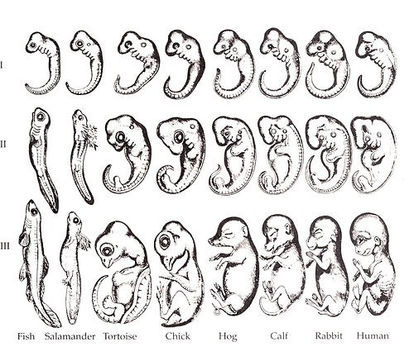
Recapitulation – The Ladder of Species Progress
Prior to Darwin, naturalists like Étienne Serres and Johann Meckel argued that embryos of ”higher” animals passed through the permanent adult stages of “lower” animals. The thesis of recapitulation is that “ontogeny recapitulates phylogeny”, meaning that an organism’s embryological development mirrors the the evolutionary stages of its ancestors.
  “Embryos, therefore, are not... the miniature of the adult animal. Before they arrive at their permanent forms, their organs traverse a multitude of fugitive forms... repeating the permanent forms of the inferior classes” (Étienne Serres, 1824, as cited in Richards, 1992, p. 15).
  “The human fetus in its development [Entwickelung] indicates the stages at which lower animals have remained throughout their entire lives” (Johann Friedrich Meckel, 1806, as cited in Richards, 1992, p. 50).
  “The force by which the series of species has been brought forth is one and the same in its nature and laws as that by which the different developmental stages [in embryogenesis] are produced” (Karl Friedrich Kielmeyer, 1793, as cited in Richards, 1992, p. 19).
This grid illustrates the "Biogenetic Law," demonstrating that the embryos of diverse vertebrates—from fish to humans—share nearly identical early forms. For Darwin, these similarities were the "pet bit" of his book because they provided the "Archimedean factual point" needed to reconstruct species history. The image visualizes how Nature preserves the past as a platform for future advancement, making progress an "intended consequence" of Darwin’s biological system rather than a series of random accidents.

Slide 6
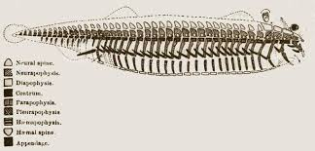
Darwin and Naturalizing the Archetype
Darwin transformed the abstract, ideal “Archetype” of Romantic naturalists like Richard Owen into a physical, biological ancestor. By historicizing the archetype, Darwin explained the “unity of type” as the shared inheritance of a purposeful, adaptive history.
  “I look at Owen’s Archetypes as more than idea, as a real representation as far as the most consummate skill & loftiest generalization can represent the parent form of the Vertebrata” (Charles Darwin, 1849, as cited in Richards, 1992, p. 105).
  “I cannot any more doubt that some primordial race existed long anterior... which had a chain of vertebrae and no skull” (Charles Darwin, DAR 74, as cited in Richards, 1992, p. 131).
Owen’s vertebrate archetype, from William Carpenter, Principles of Comparative Physiology (1854). Richard Owen’s diagram of the "ideal" vertebrate skeleton, which Darwin reinterpreted not as a Platonic idea, but as a literal description of the primordial race from which all vertebrates descended

Slide 7
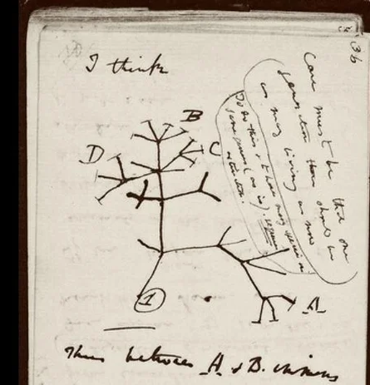
The Embryological Model in the Notebooks
In his first private “Transmutation Notebook” (1837), Darwin explicitly modeled species evolution on embryogenesis. He viewed sexual generation as a means to “IMPROVE” organization, making the progressive advancement of life the “final cause” of eons of time.
  “The ordinary kind... the new individual passing through several stages (?typical, (of the) or shortened repetition of what the original molecule has done)” (Charles Darwin, Notebook B, 1837, as cited in Richards, 1992, p. 95).
  “An originality is given... by every step of progressive increase of organization being imitated in the womb, which has been passed through to form that species.—(Man is derived from Monad)” (Charles Darwin, Notebook B, 1837, as cited in Richards, 1992, p. 95).
Darwin’s sketch of a descent tree, from "Notebook B" (1837). Darwin’s famous "I think" tree. The caption, "Thus genera would be formed—bearing relation to ancient types," indicates his belief that the nodes of the tree represent the morphological types of real ancestors.

Slide 8
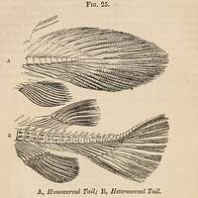
Natural Selection as a Mechanism for Perfection
Darwin viewed natural selection as a “beneficent power” that ensured progress toward perfection. Because selection works solely for the “good of each being”, it acts as an external force drawing organisms toward higher complexity, rather than being a purely random process.
  “As natural selection works solely by and for the good of each being, all corporeal and mental endowments will tend to progress towards perfection” (Charles Darwin, Origin of Species, 1859, p. 489, as cited in Richards, 1992, p. 89).
  “Man selects only for his own good; Nature only for that of the being which she tends” (Charles Darwin, Origin of Species, 1859, p. 83, as cited in Richards, 1992, p. 89).
Illustrations of homocercal and heterocercal fish tails, from Darwin’s copy of William Carpenter, Principles of Comparative Physiology. Darwin cited Louis Agassiz’s discovery that modern embryonic fish tails (homocercal) resemble the adult tails of ancient fossil fish (heterocercal) as proof that embryology preserves the history of progressive species change.

Slide 9
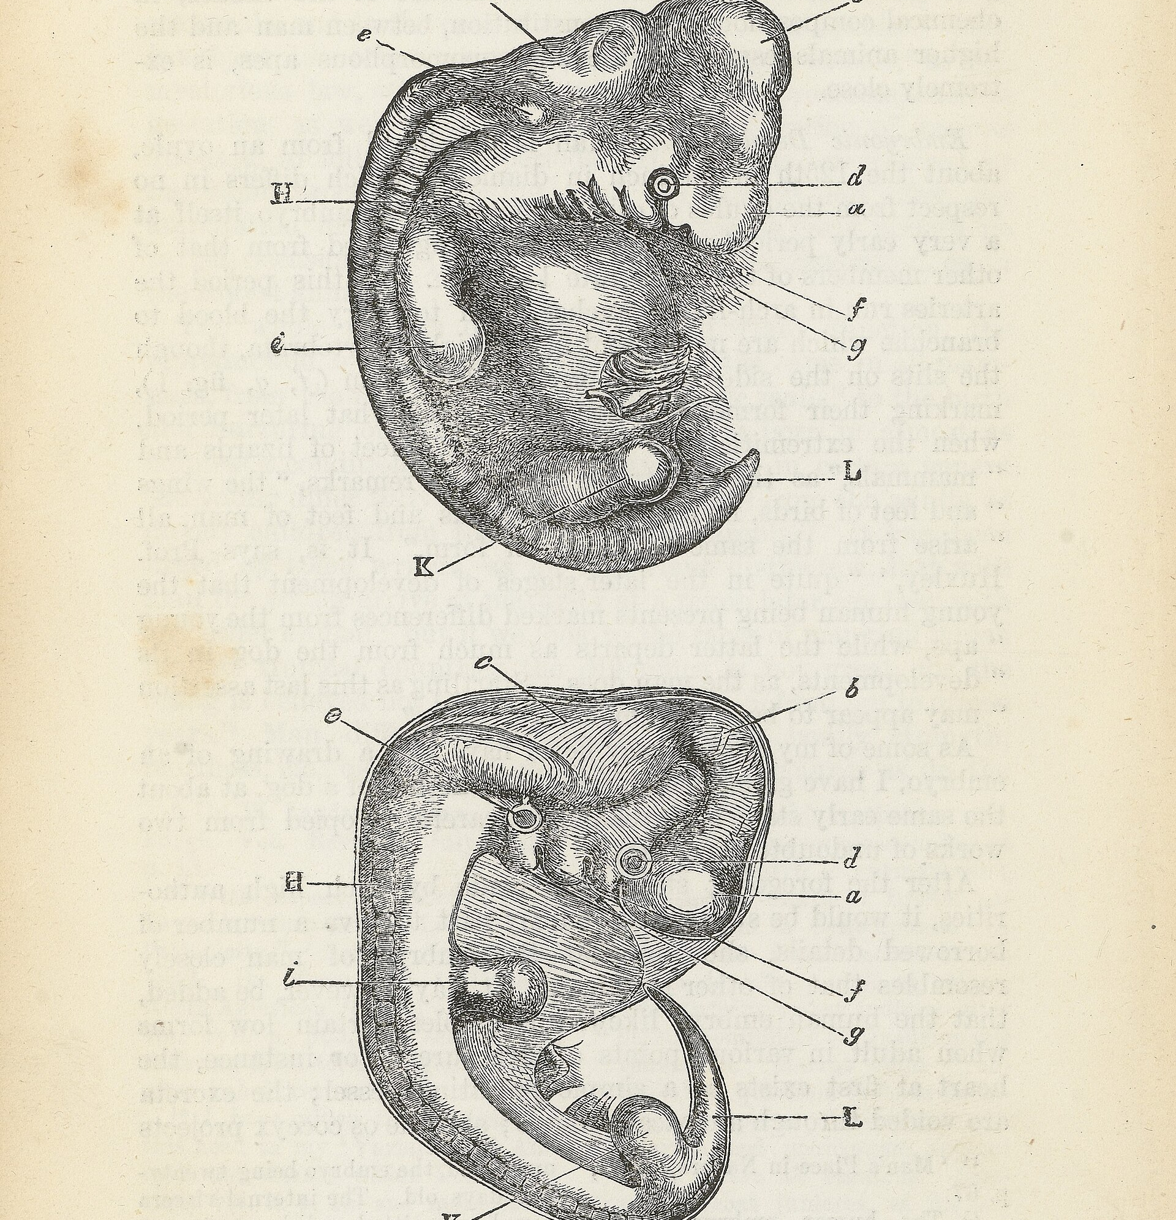
Recapitulation as a Deductive Necessity
For Darwin, recapitulation was a logical requirement of his theory: if new traits are added at the end of individual development (the adult stage), the embryo necessarily becomes a chronological “picture” of the ancestors. This allowed him to use embryology to reconstruct the “missing pages” of the imperfect geological record.
  “As the embryo often shows us more or less plainly the structure of the less modified and ancient progenitor of the group, we can see why ancient and extinct forms so often resemble in their adult state the embryos of existing species”(Charles Darwin, Origin of Species, 6th Ed., 1872, as cited in Richards, 1992, p. 156).
  “The brain of the human fetus in the seventh month reaches ‘about the same stage of development as in a baboon when adult’” (Theodor Bischoff, as cited by Darwin in Descent of Man, 1871, and Richards, 1992, p. 163).
  “We should thus be justified in believing that at an extremely remote period a group of animals existed, resembling in many respects the larvae of our present Ascidians” (Charles Darwin, Descent of Man, 1871, as cited in Richards, 1992, p. 164).
Illustrations of human and dog embryos, from Charles Darwin, Descent of Man. Darwin used these woodcuts to demonstrate that early developmental stages reveal the "hidden bond" of common descent.

Slide 10
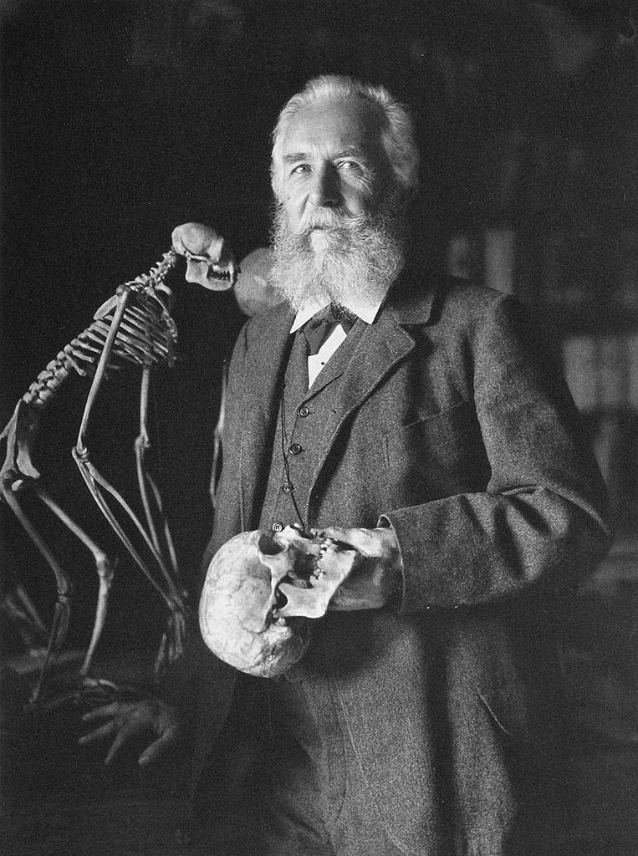
The Ideological Reconstruction of Darwinism
Richards argues that historians have ignored Darwin’s teleological progressivism to protect his status as the “patron saint” of modern biology. By projecting modern “Neo-Darwinian” standards—which reject progress—back onto him, they distance Darwin from “tainted political values” (such as racism and Prussianism) associated with later recapitulationists like Ernst Haeckel.
  “The established orthodoxy had recapitulation theory as that sign of Cain by which ideologically conceived science, like Haeckel’s, could be distinguished from the legitimate ancestor of modern neo-Darwinism” (Richards, 1992, p. xiv).
  “Gould finds in Haeckelian evolutionary thought, with its obvious progressivism, political Prussianism, and racism, a harbinger of Nazi horrors... It would therefore be simply impossible to allow Haeckel’s chief biological principle... to have been also endorsed by Darwin” (Richards, 1992, p. 177).
  “Darwin was indeed the architect of the theory that has been reconstructed as neo-Darwinism. But the architect was our ancestor, who dwelt happily enough in the nineteenth century” (Richards, 1992, p. 180).
Ernst Haeckel, 1834–1919, who gave currency to the biogenetic law. Haeckel became the "bete noire" of modern Darwinians. Historians argue Darwin must have rejected recapitulation to avoid sharing principles that Gould links to the "rise of Nazism".

Slide 11
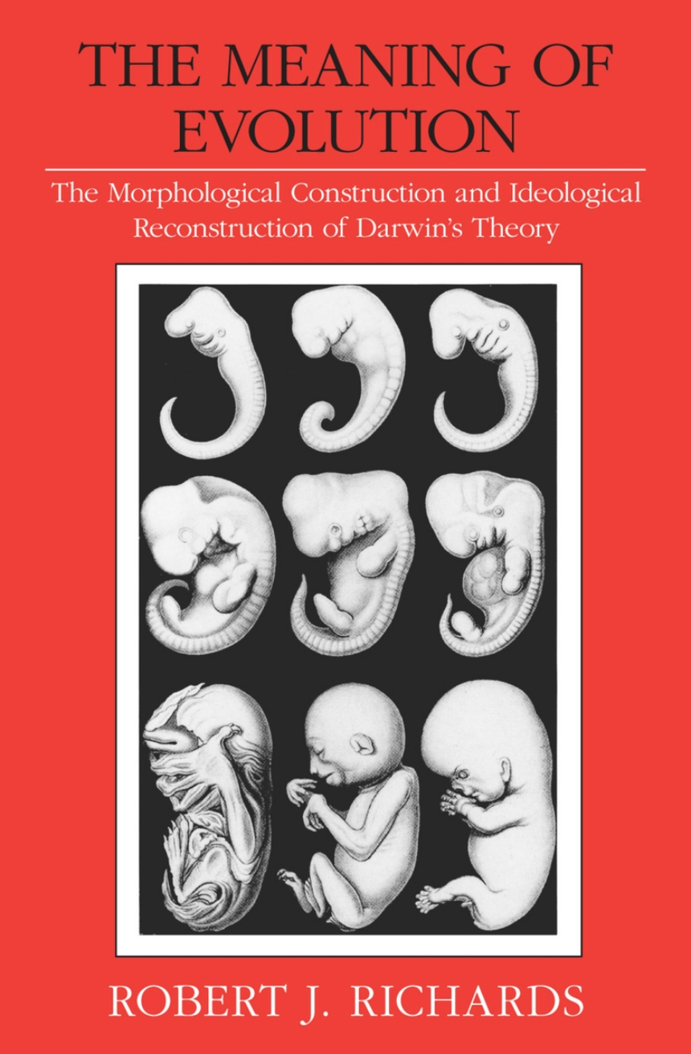
Sources
Main Secondary Source:
  Richards, R. J. (1992). The Meaning of Evolution: The Morphological Construction and Ideological Reconstruction of Darwin's Theory. University of Chicago Press.
Primary Sources (Cited within Richards, 1992):
  Agassiz, L. (1850). Lake Superior: Its Physical Character, Vegetation, and Animals.
  Autenrieth, J. H. (1797). Supplementa ad historiam embryonis humani.
  Darwin, C. (1837). Notebook B (Transmutation).
  Darwin, C. (1849). Annotation in Owen’s On the Nature of Limbs.
  Darwin, C. (1859). On the Origin of Species by Means of Natural Selection.
  Darwin, C. (1871). The Descent of Man, and Selection in Relation to Sex.
  Darwin, C. (1872). On the Origin of Species (6th ed.).
  Goethe, J. W. von. (1795). Erster Entwurf einer allgemeinen Einleitung in die vergleichende Anatomie.
  Goethe, J. W. von. (1796). Vorträge über die drei ersten Kapitel des Entwurfs einer allgemeinen Einleitung in die vergleichende Anatomie.
  Gould, S. J. (1977). Ontogeny and Phylogeny.
  Haeckel, E. (1866). Generelle Morphologie der Organismen.
  Haller, A. von. (1744). Praelectiones academicae.
  Kielmeyer, K. F. (1793). Ueber die Verhältnisse der organischen Kräfte unter einander in der Reihe der verschiedenen Organisation.
  Meckel, J. F. (1806). Abhandlungen aus der menschlichen und vergleichenden Anatomie und Physiologie.
  Milne-Edwards, H. (1844). Considérations sur quelques principes relatifs à la classification naturelle des animaux.
  Owen, R. (1846). Report on the Archetype and Homologies of the Vertebrate Skeleton.
  Owen, R. (1849). On the Nature of Limbs.
  Schelling, F. W. J. von. (1803). Ideen zu einer Philosophie der Natur (2nd ed.).
  Serres, E. R. A. (1824). Anatomie comparée du cerveau.
  Swammerdam, J. (1685). Historia insectorum generalis.

