Slide 1
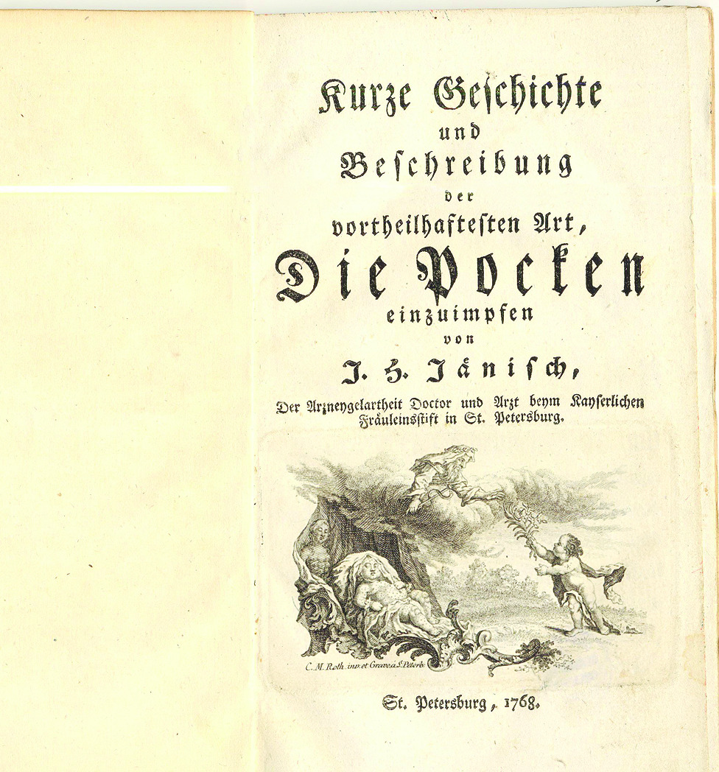
Science and Religion in the 18th Century Inoculation Controversies
Richard Kask

Slide 2
Introduction
Interest sparked by A. Cunningham’s introduction to Medicine and Religion in Enlightenment Europe (2007)
  “Ubi tres medici, ibi duo athei“
  “Religious sensitivity and sensibility was still everywhere around eighteenth century physician“
Study of Enlightenment debates about smallpox inoculation in 18th century Europe
  Focus on the inoculation controversies of 1720s and mid-18th century
  What role did religious and scientific arguments have in the discussions?

Slide 3
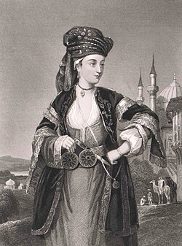
Inoculation in 18th century Europe
Intellectual background
  Cartesian and mechanical philosophy
  Humanitarianism but also biopolitics
  Idea of Europe as the center of progress
Practiced long before in Asia, reached Europe through Ottomans
First inoculations in Western Europe in 1721
  Promoted by Lady Mary Montagu and the British royal family
  Despite active polemics spreads in Anglophone world until 1730s

Slide 4
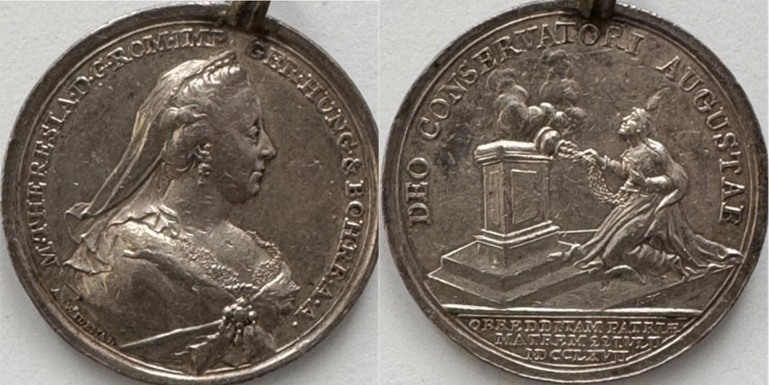
Inoculation in 18th century Europe
A new wave of inoculations in mid-century
  Introduction of “new inoculation“
  Variolation of princes, annus mirabilis of 1768
  Both social and geographical spread
  Commercialization
  Controversy at its peak
Edward Jenner’s creation of cowpox vaccine (1796)
  Gradual decrease in inoculations

Slide 5
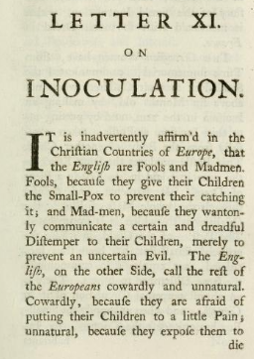
Key arguments in the inoculation controversies
Pro inoculation
  Increases longevity, is ten times less fatal than smallpox
  Maintains and improves the condition of human body
  Supports population growth, expands the greatness of state and happiness of society (Voltaire)
Contra inoculation
  “Fighting fire with fire“
  Inoculations often lead to outbreaks, thus actually increasing mortality
  Lack of statistical data (deaths, immunity, frequency of smallpox)
  William Wagstiffe: “an experiment practised only by a few ignorant women, amongst an illiterate and unthinking people“
  An instrument of Ottoman conquest?

Slide 6
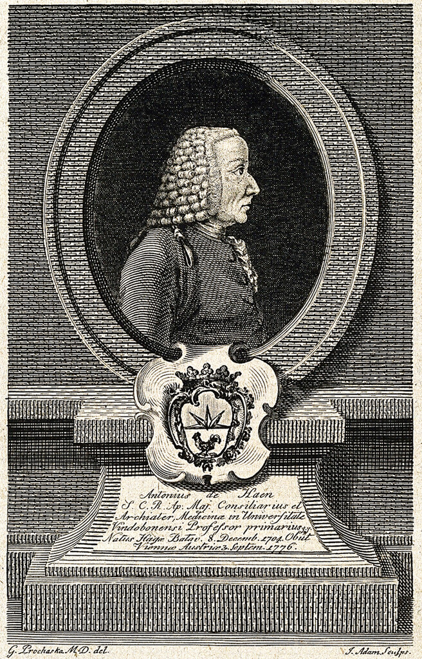
Theological criticism?
Isobel Grundy’s summary: inoculation perceived as “impious meddling in the workings of God’s Providence“
  Edmund Massey and the divine functions of disease (1722)
  “So went Satan forth from the Presence of the Lord, and smote Job with sore Boils“ (Job 2:7)
Anton de Haen (1757): is the method permissible to God?
  No mortal has a right to their life
  God permits only medical treatment that doesn’t danger life or at least prevents greater danger
  Presents his religious argument next to medical ones, but considers it sufficient for refutation
However, the dominant theological approach remained different through the 18th century

Slide 7

The Temple of Vaccinia
Mainstream religious argument described inoculation as a “boon to mankind“ or a divine blessing saving humans
  Antonio Vallisneri (1715): “the divine mind wants, that at given times, new discoveries always manifest themselves“
  William Dodd (1767): “not only as Patriots and Men, as Christians also you are called upon … to encourage this Charitable Undertaking … because your God is well pleased with“
  Harmony between progressive scientific and religious perspectives on inoculation
Also exemplified by Jenner
  “I am not surprised that men are not grateful to me; but I wonder that they are not grateful to God for the good which He has made me the instrument of conveying to my fellow creatures“

Slide 8
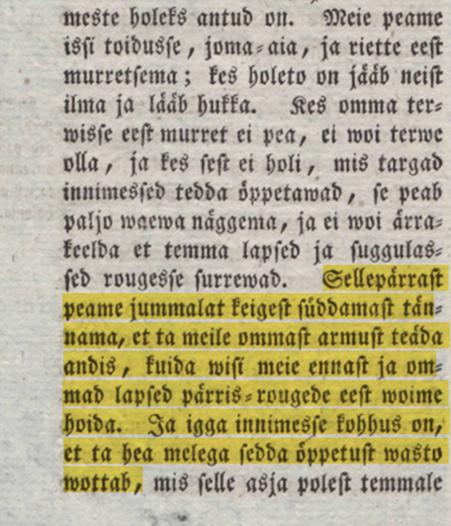
Conclusions
Although the inoculation debates were primarily scientific and social, “religious sensitivity and sensibility“ also surrounded or interacted with the discussions
Theological arguments presented by physicians, scientific arguments presented by clergy
  Deistic attitudes among scientists
  Ecumenic Merton thesis?

Slide 9
Primary sources
de Haen, Anton. Quæstiones sæpius motæ super methodo inoculandi variolas, ad quas directa eruditorum responsa hucusque desiderantur; indirecta minus satisfacere videntur: orbi medico denuo propositæ. Trattner, 1757.
Dodd, William. The Practice of Inoculation recommended in a Sermon, preached At St. James’s, Westminster, April the 9th, 1767, on the Anniversary Meeting of the Governors of the small-pox hospitals. Faden, 1767.
Voltaire. Letters concerning the English nation. Translated by John Lockman. Davis & Lyon, 1733.
Warri-rougedest ja kuida wisi neid pantakse. Müller, 1815

Slide 10
Bibliography
Bennett, Michael. War Against Smallpox. Edward Jenner and the Global Spread of Vaccination. Cambridge University Press, 2020.
Berti, Lucia. “Early Reception of Smallpox Inoculation in Italy: Insights from the Correspondence of the Fellows of the Royal Society.” In Diciottesimo secolo, 6 (2021): 5–18.
Cunningham, Andrew. ““Where there are three physicians, there are two atheists.““ In Medicine and Religion in Enlightenment Europe, edited by Ole Peter Grell and Andrew Cunningham. Routledge, 2007.
Esparza, Jose. “The illness of empress Maria Theresa as a trigger for the adoption of variolation in Austria (1768).” In Vaccine, 58 (2025).
Grundy, Isobel. Lady Mary Wortley Montagu: Comet of the Enlightenment. Oxford University Press, 1999.
Porter, Dorothy. Health, Civilization and the State. A History of Public Health from Ancient to Modern Times. Routledge, 1999.

Slide 11
Thank you for your attention!

