Slide 1
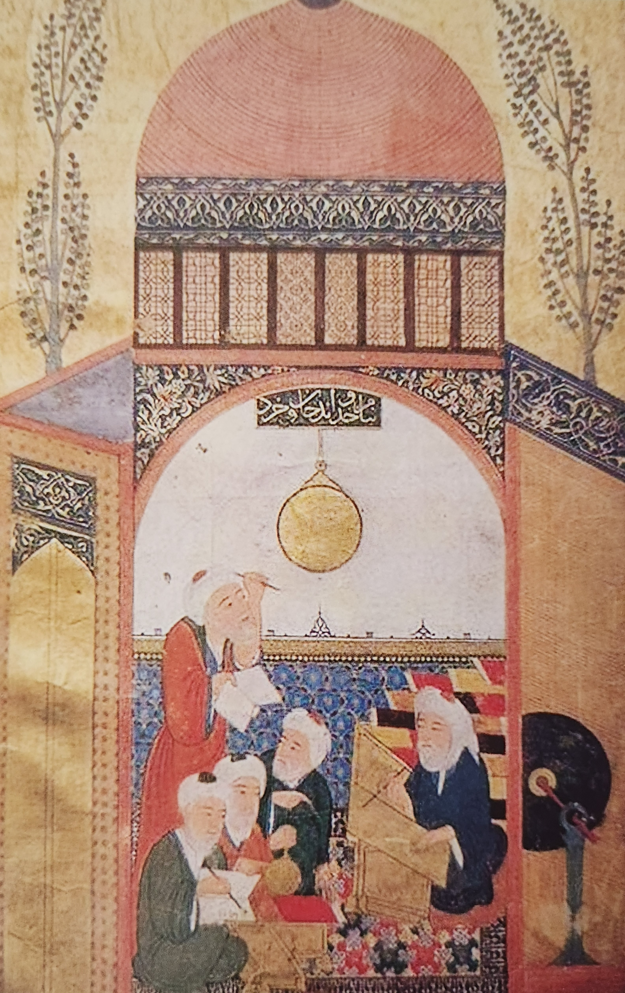
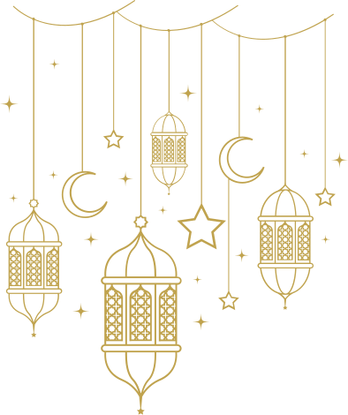
Science in the Muvakkithanes:
Testing Heilbron’s Reinterpretation of Merton's thesis in an Ottoman context.
Giray Kalkan
Science and Religion in the Modern Era (Winter 2026)

Slide 2

Epistemological Integration: 'Ilm & The Classification of Knowledge
Did Ottoman exact sciences achieve "innocence by association" with dominant religious institutions?
Vocabulary: Post-Enlightenment vs. Ottoman Context
'Ilm: [pl. ulum] Translates broadly as 'knowledge' (from geometry to jurisprudence - ultimate knowledge possessed by God).
Ulema ('the knowers,’ ‘the learned ones’): Held immense social and moral authority.
Studying the natural world was inherently tied to a comprehensive Islamic worldview, not a separate, secular pursuit.
The Organization of Knowledge
Naklî (Transmitted) Sciences: Derived from divine revelation (e.g., Qur'anic exegesis, Islamic law).
Aklî (Rational) Sciences: Derived from human intellect, perception, and experience (the exact sciences).
  Ilm-i hey’e: mostly theoretical astronomy and cosmography (before the 19th c. it could also include theoretic astrology e.g. İnterrogations [mesial], electional astrology [ihtiyârât], judgments [ahkâms])
  Ilm-i nücum: broader science of the stars (often included theoretic and practical astrology e.g. prognostication [tâliʻ-i sâl], nativities [tali’-i mevlud]).
  Ilm-i zîcet: highly mathematical preparation of astronomical tables.
  Ilm-i mik'at: the science of timekeeping.
* Classifying these as 'rational' didn't mean they were secular; both rational and transmitted sciences evolved from the same 'divine' source.

Slide 3
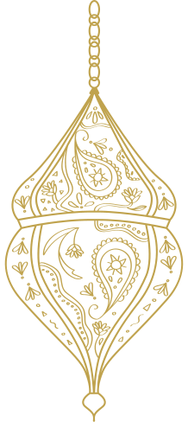
• Argument
– Early modern science survives/flourishes only with:
▪ broad social approval
▪ structural support from dominant religious institutions
• Ottoman fit: “innocence by association” via religious utility
– Exact sciences prosper where they serve religious practice:
▪ ilm-i mik‘at (timekeeping)
• prayer times
• lunar calendar / Ramadan fasting times
▪ ilm-i hey’e
• qibla (direction of Mecca)
• calendrical calculation / observation
• How “approval” is structured
Heilbron’s Italian cases (Catholic Europe)
▪ science practiced literally inside churches
▪ enabled through:
• permissions
• offices/benefices
• patronage networks (often clerical careers)
Ottoman case
▪ less “external legitimation” → more epistemological integration
• integration of sources + means of knowledge (not separate domains)
▪ in practice:
• revelation + rational inquiry as complementary “routes”
• both housed under ʿilm (unified knowledge umbrella)
• astronomer positioned within religious-intellectual establishment
“Revelation” and the “created world” function as “two complementary readings ” that complete one another, so that studying nature and interpreting scripture become mutually reinforcing ways of arriving at truth. (Malkawi 2015, 34)

Slide 4
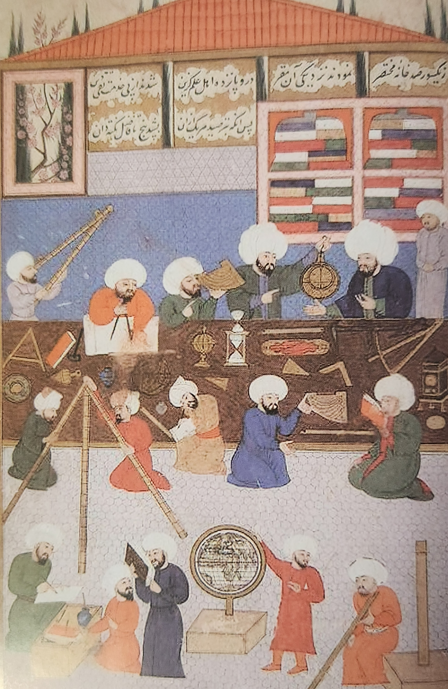
Why was astronomy a privileged science in Islam?
  Islam fundamentally needed astronomy;
Precise calculations were required for:
  Determining the five daily prayer times.
  The exact start and end of the Ramadan fast (based on the sighting of the new moon).
  Crucially, the qibla—the exact geographical direction of Mecca.
Mosques became centers for astronomical work: Employed specialized, permanent astronomers known as muvakkits.
A profound cultural drive for precision:
  Astronomers pushed this mandate much further than basic timekeeping.
  Built massive instruments to gather the most accurate observational data possible.
  Advanced geography, calendar-making, and astrology.
Sayılı 2016; The Astronomers of the Istanbul Observatory at the work in the Small Observatory, Shahinshâhnâma

Slide 5
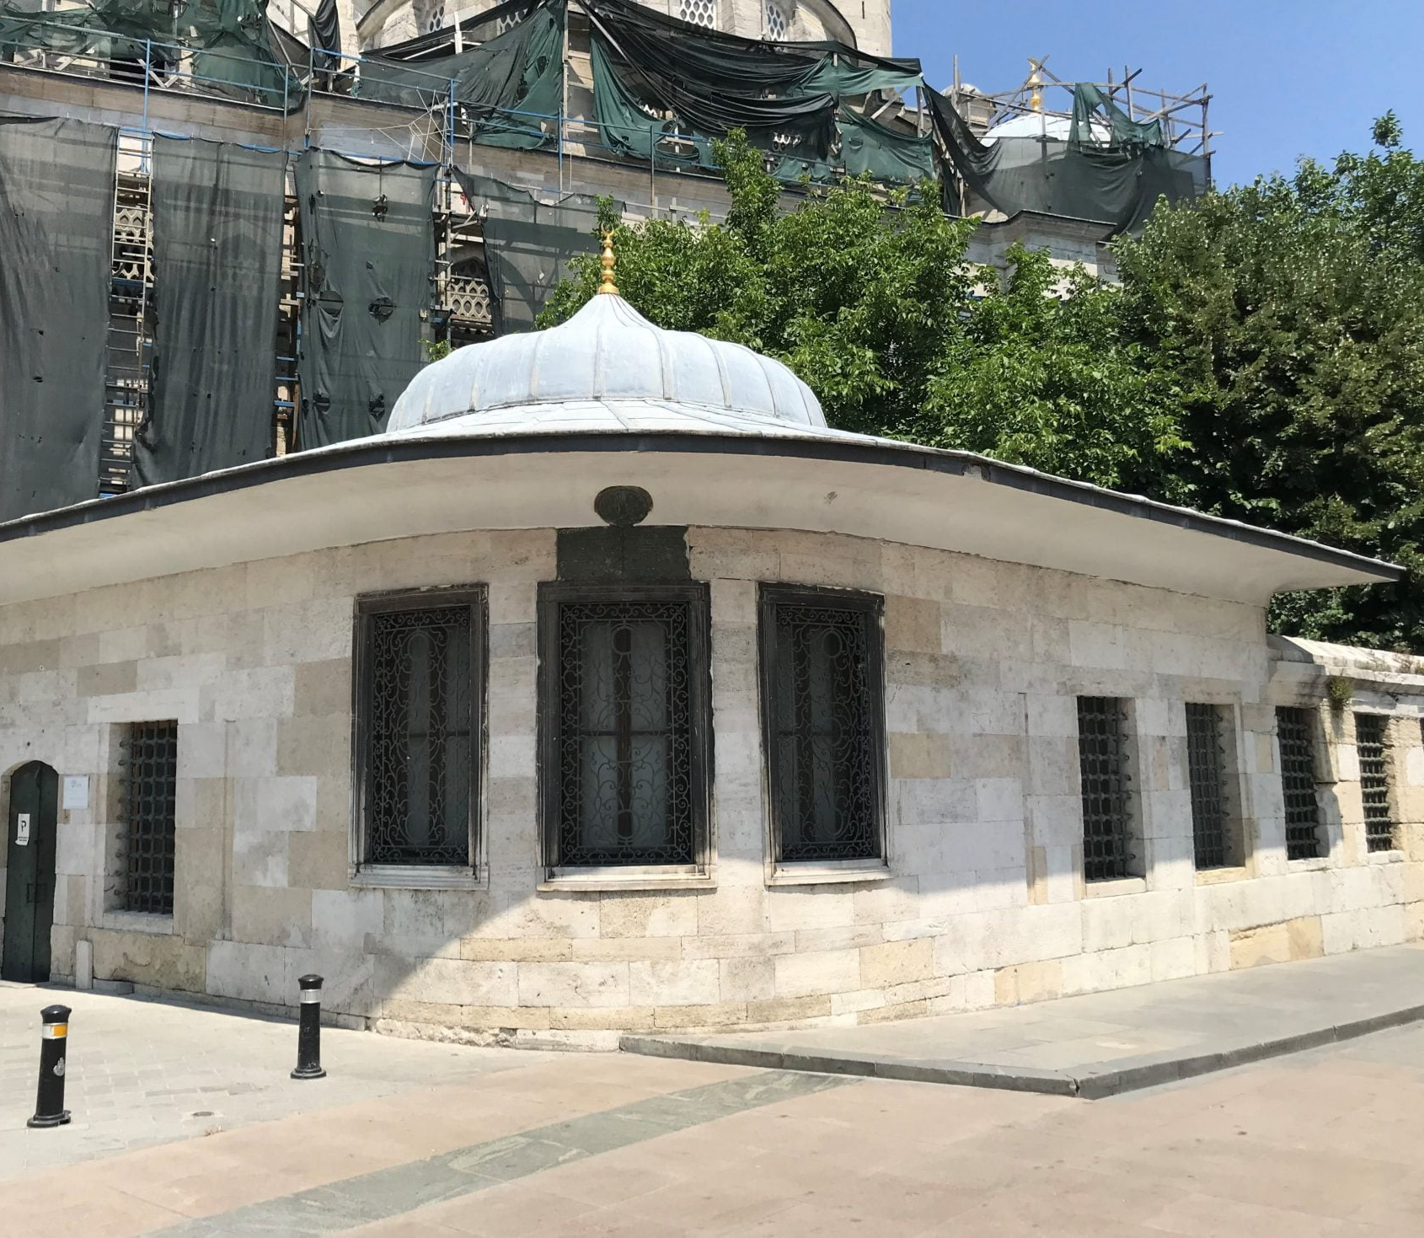
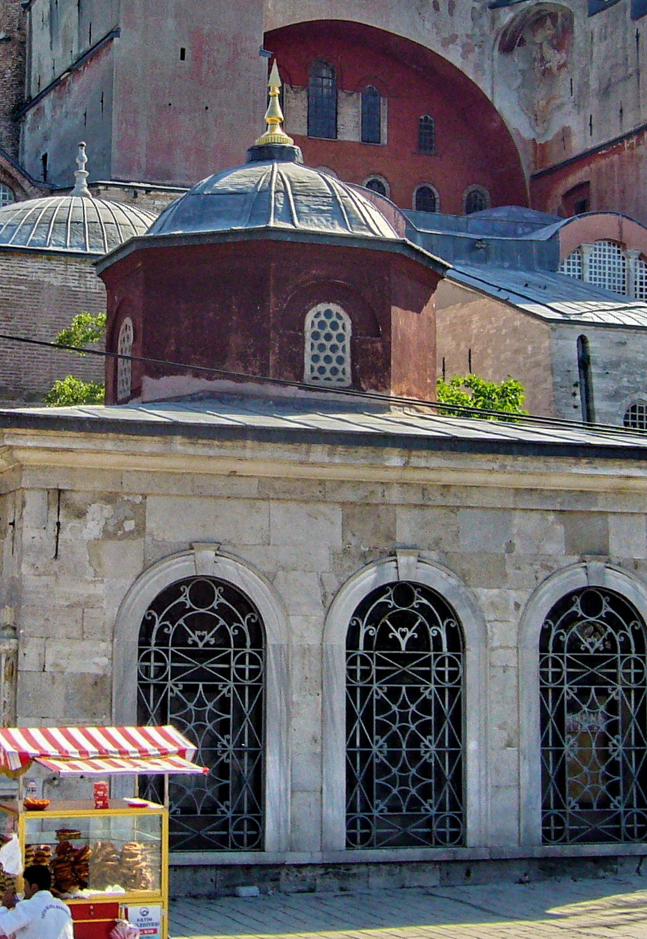
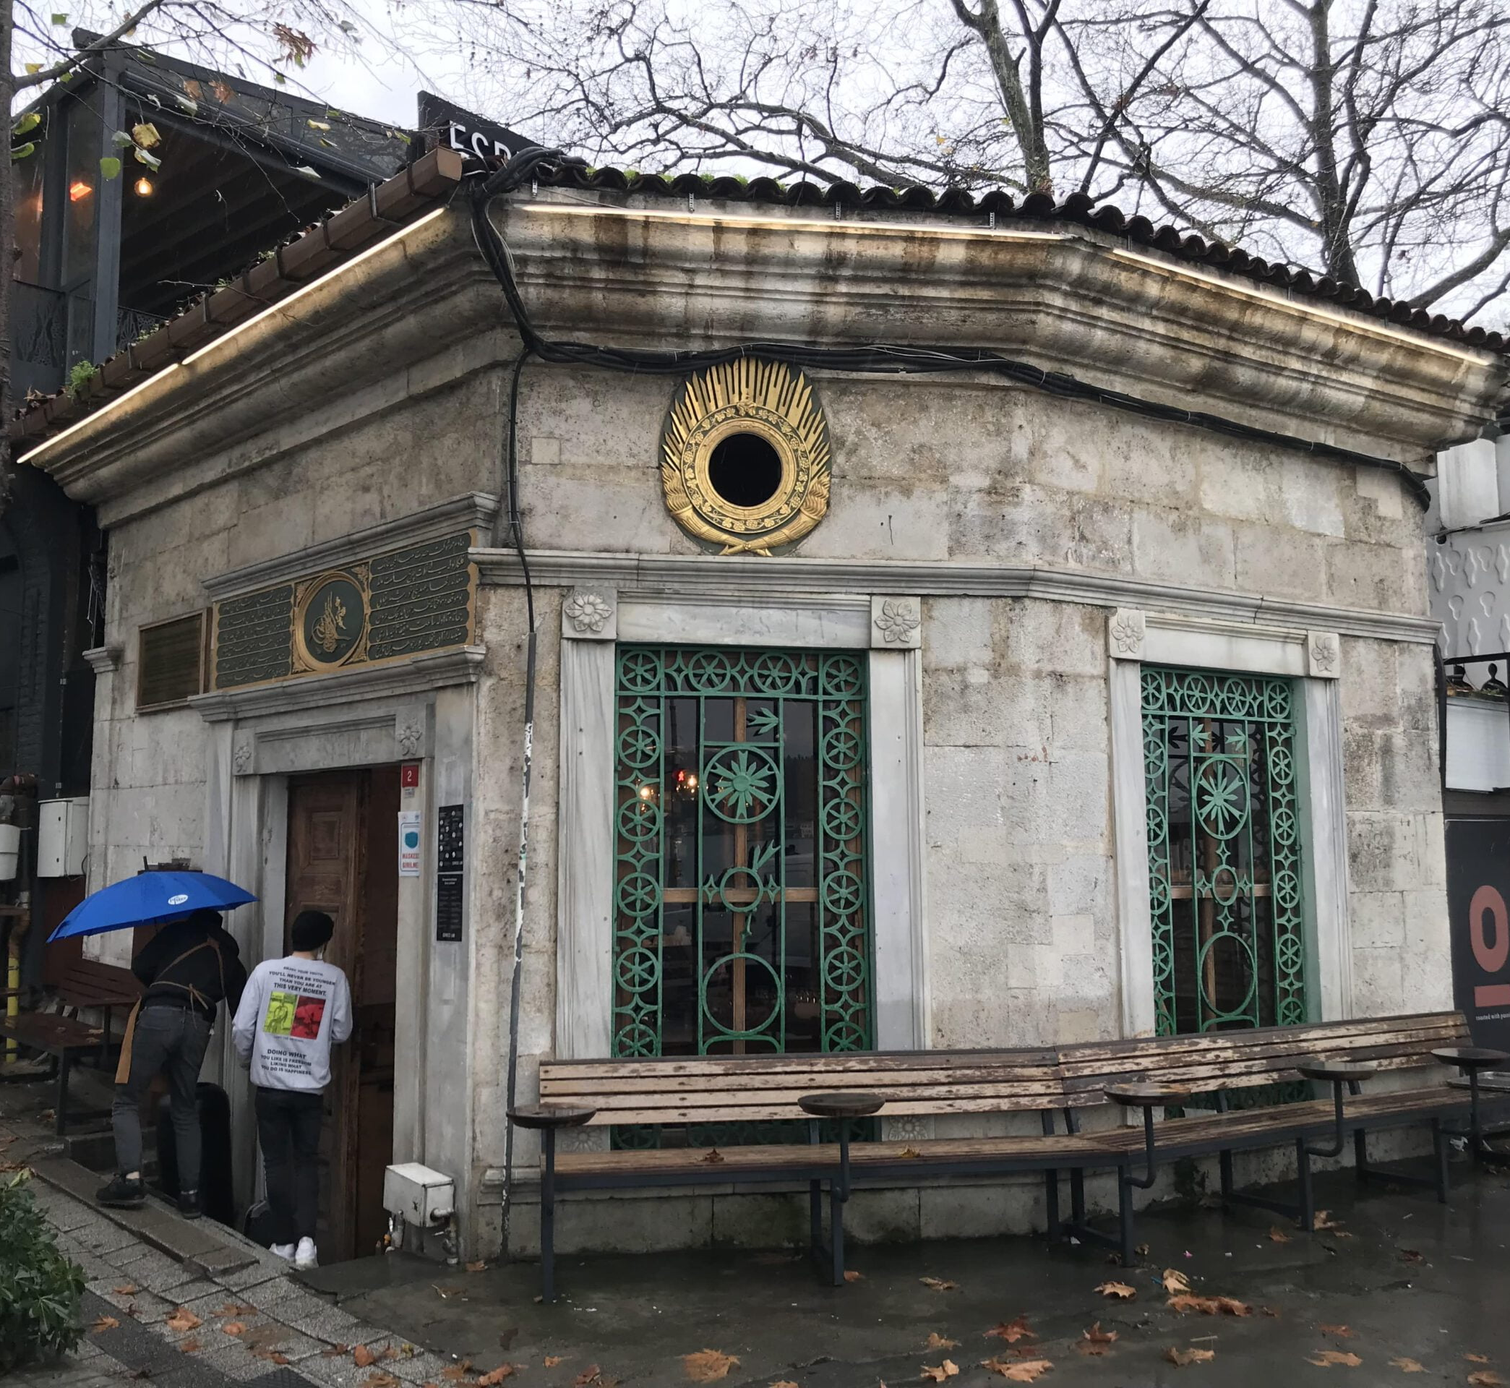
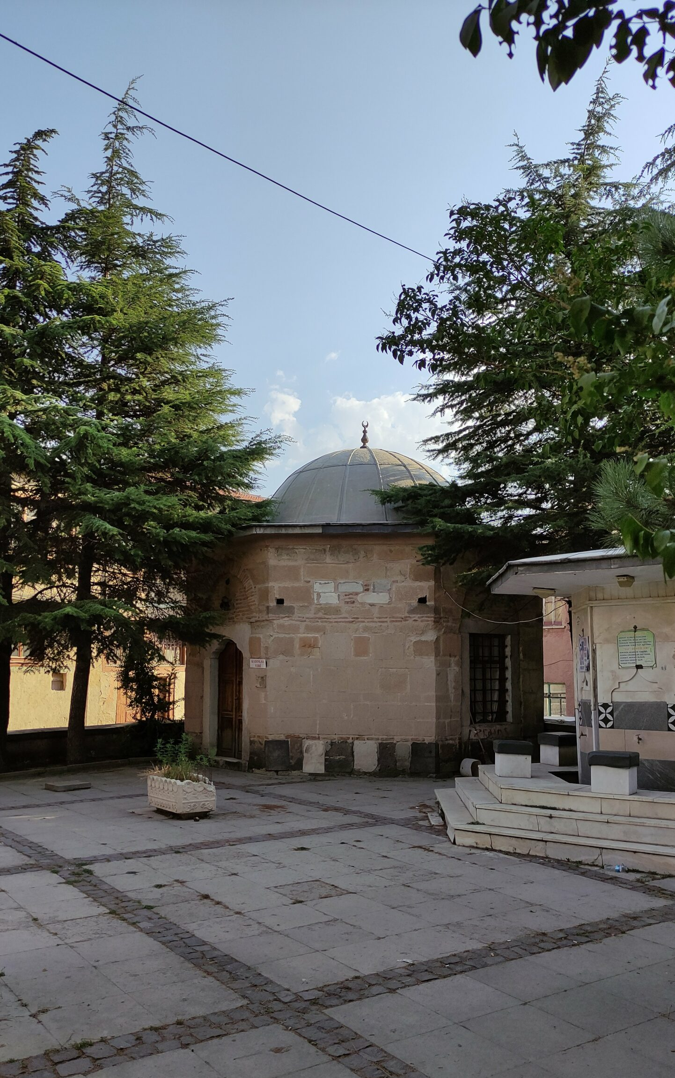
Muvakkithane of Eminönü Yenicami (1813)
The Muvakkithanes (Timekeeping Houses)
The Nature of the Muvakkithane (The most enduring of astronomical institutions, inherited from earlier Islamic states like the Mamluks.
  Permanent, fixed spaces (one or two rooms attached to a mosque or courtyard).
  Too small to be full-scale observatories conducting massive theoretical research.
  Vibrant centers of practical, observational astronomy; primary job was solving complex problems in spherical astronomy to keep exact time.
Pre-18th Century
  Instruments: Rich array of astrolabes, sine quadrants, sextants, zic tables, and traditional water clocks, sundials…
  Functioned like miniature observatories and active educational centers.
  Authored serious texts and began calculating and publishing their own annual calendars and imsakiyes.
19th-Century
  Arrival of European mechanical clocks did not make them obsolete; they absorbed the new technology and expanded their roles.
  e.g. Sultan Abdülmecid commissioned new muvakkithanes (Taif, Trabzon, Chios, Hagia Sophia) equipped with expensive mechanical clocks.
  A muvakkit had to master traditional astronomy (e.g., measuring altitude) and be a skilled watchmaker capable of maintenance and repair.
Longevity
  An effective and adaptable institution that operated well into the Republic of Turkey, officially closing in 1952.
Muvakkithane of Hagia Sophia (1849)
Muvakkithane of Emirgan mosque (1844)
“Yeni Cami Muvakkithanesi, Afyonkarahisar”, (18th c.)

Slide 6
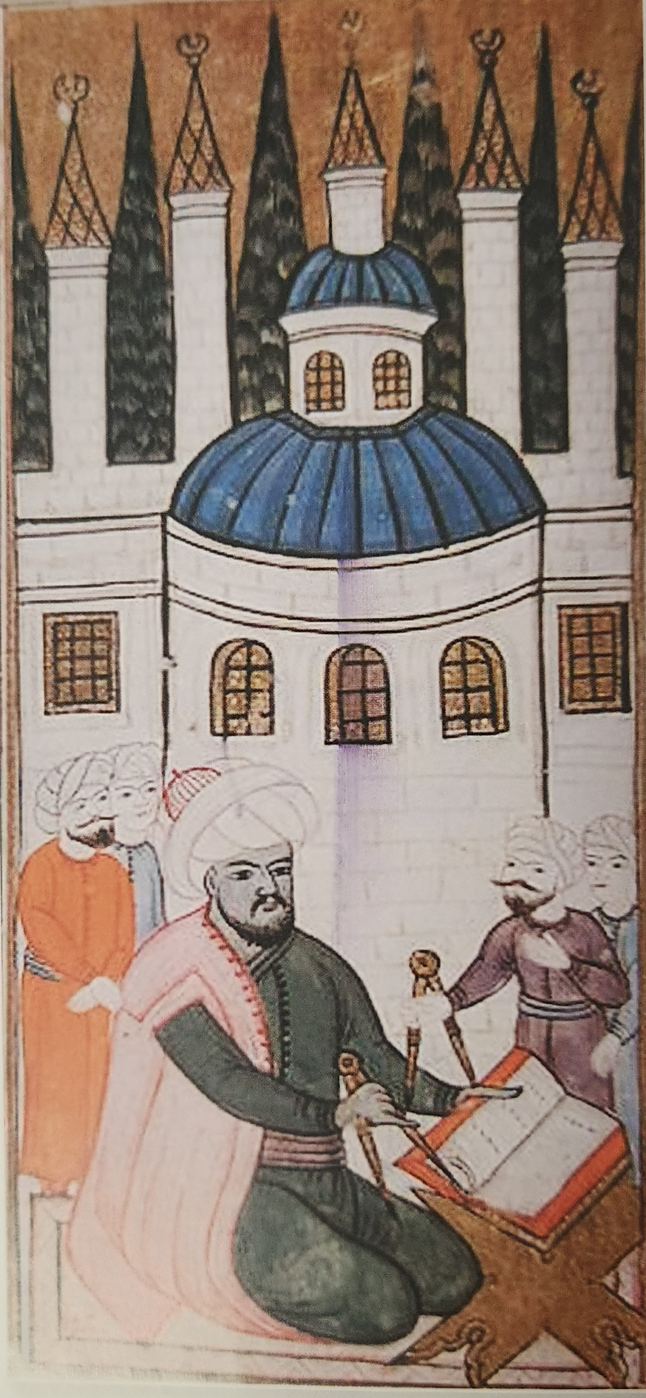
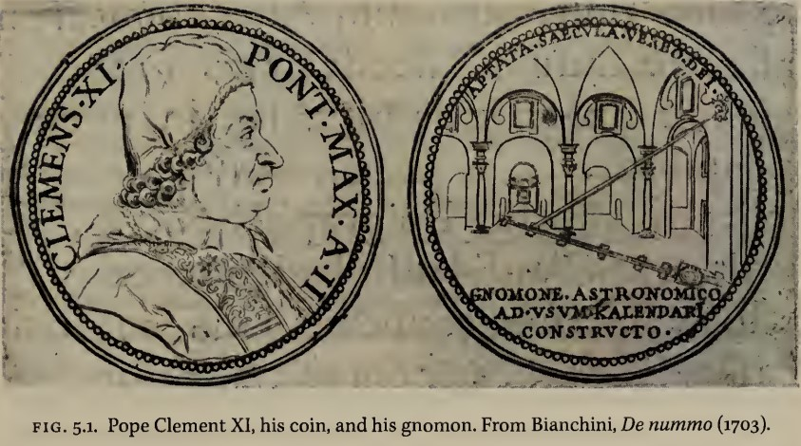
• Heilbron (Catholic Europe): support via Church-linked patronage
– Permissions + offices + patronage networks (e.g., cathedral meridiana projects)
– Continuity can depend on people + relationships (patron ↔ scholar ties)
• Discussion question:
– In a patronage-mediated system, what mechanisms make support durable
across changes in patrons, personnel, or priorities?
• The "innocence by association" applies: Ottoman exact sciences thrive with religious institutional alignment
• Mechanism differs:
– Legitimacy: epistemological integration under ʿilm and institutional embedding
– Durability: waqf’s decentralized financial base
Problem: Royal observatories often had short lifespans
– Royal patronage is unstable (succession can end support)
– New rulers often prefer founding their own projects over funding predecessors
• Key difference: Muvakkithane durability through the waqf system
– Waqf = (theoretically) permanent, inalienable endowment
– "Waqf was, theoretically at least, a permanent and inalienable endowment which was completely harmonized with religious law and Moslem ideologies... The endowment of the observatory with waqf was therefore important not only as a mere source of income, but it also constituted a sign of a more complete integration and harmonization with Moslem culture." (Sayılı, 2016)
• How waqf stabilizes scientific work
– Once founded (sultan / vizier / wealthy merchant) → legally independent entity
– Salaries funded in perpetuity via dedicated revenues (shops / baths / agricultural land)
– decentralized institutional survival (not tied to one court)
op
Heilborn (1999), p. 153.
Sayılı (2016; Âlât-i Rasadîya li Zîc-i Shahinshâhîya)

Slide 7
• Aydüz, Salim. “Osmanlı Astronomi Müesseseleri.” Türkiye Araştırmaları Literatür Dergisi, no. 4 (2004): 411–54. https://dergipark.org.tr/tr/pub/talid/issue/43397/528854.
• Deniz, Şefaattin. “Sultan Abdülmecid’in İnşa Ettirdiği Muvakkithaneler.” Osmanlı Araştırmaları, March 2017, 267–91. https://dergipark.org.tr/tr/pub/oa/issue/47404/590896.
• Heilbron, J. L. “Science in the Church.” Science in Context 3, no. 1 (1989): 9–28.
• Heilbron, J. L. The Sun in the Church: Cathedrals as Solar Observatories. Cambridge, Mass. :: Harvard University Press, Ann Arbor, Michigan: MPublishing, University of Michigan Library, 1999.
• Malkawi, Fathi Hasan. Epistemological Integration: Essentials of an Islamic Methodology. Translated by Nancy Roberts. Abridged by Wanda Krause. Herndon, VA: International Institute of Islamic Thought, 2015.
• Sayılı, Aydın. The Observatory in Islam: and Its Place in the General History of the Observatory. Edited by Remzi Demir. of Ord. Prof. Dr. Aydın Sayılı Külliyatı-4. Ankara: Atatürk Kültür Merkezi Başkanlığı, 2016.
• Shefer-Mossensohn, Miri. Science among the Ottomans: The cultural creation and exchange of knowledge. Austin: University of Texas Press, 2021.
Thank you

