Slide 1
Der Thronfolgers Untertan: Theodor von Sosnosky and Wartime “Greater-Austrian” Designs
By Dylan Thomas Mask

Slide 2
“It is rather pleasing to see how members of the most diverse ethnicities and lands are bonded in camaraderie. Germans from Lower Austria, particularly Vienna, from Upper Austria, Salzburg, Styria, and other regions, Slavs from Bohemia and Dalmatia, Italians, and Hungarians are all mixed. [...] Regardless of each individual's ethnicity, the polyglot crew exists united in service under a proud, glorious flag. Such a sight nurtures and strengthens the awareness of the unification of all nationalities under one dynastic family and in one common fatherland.”
–Erzherzog Franz Ferdinand
von Österreich-Este
Österreich-Este, Franz Ferdinand. Tagebuch Meiner Reise um die Erde, 1892-1893, page 8.

Slide 3
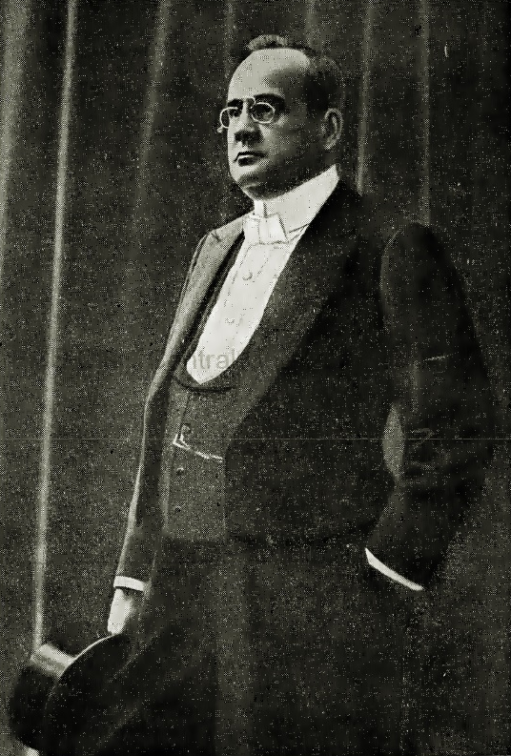
Popovici called the Ausgleich (Dualism) the “mutilation of the Empire.” Perceived Hungarian hegemony to Popovici alienated the other nationalities in the Empire, but he claimed that “no one can deny that they all need this Empire.”
Popovici knew that only the Emperor could enact any formulation of federalism and he seemed hopeless that Franz Joseph I would be the emperor to enact such wide-sweeping reforms.
Aurel Constantin Popovici (1863-1917), Die Vereinigten Staaten von Groß-Österreich [The United States of Greater-Austria], 1906, pgs. 315-317.

Slide 4
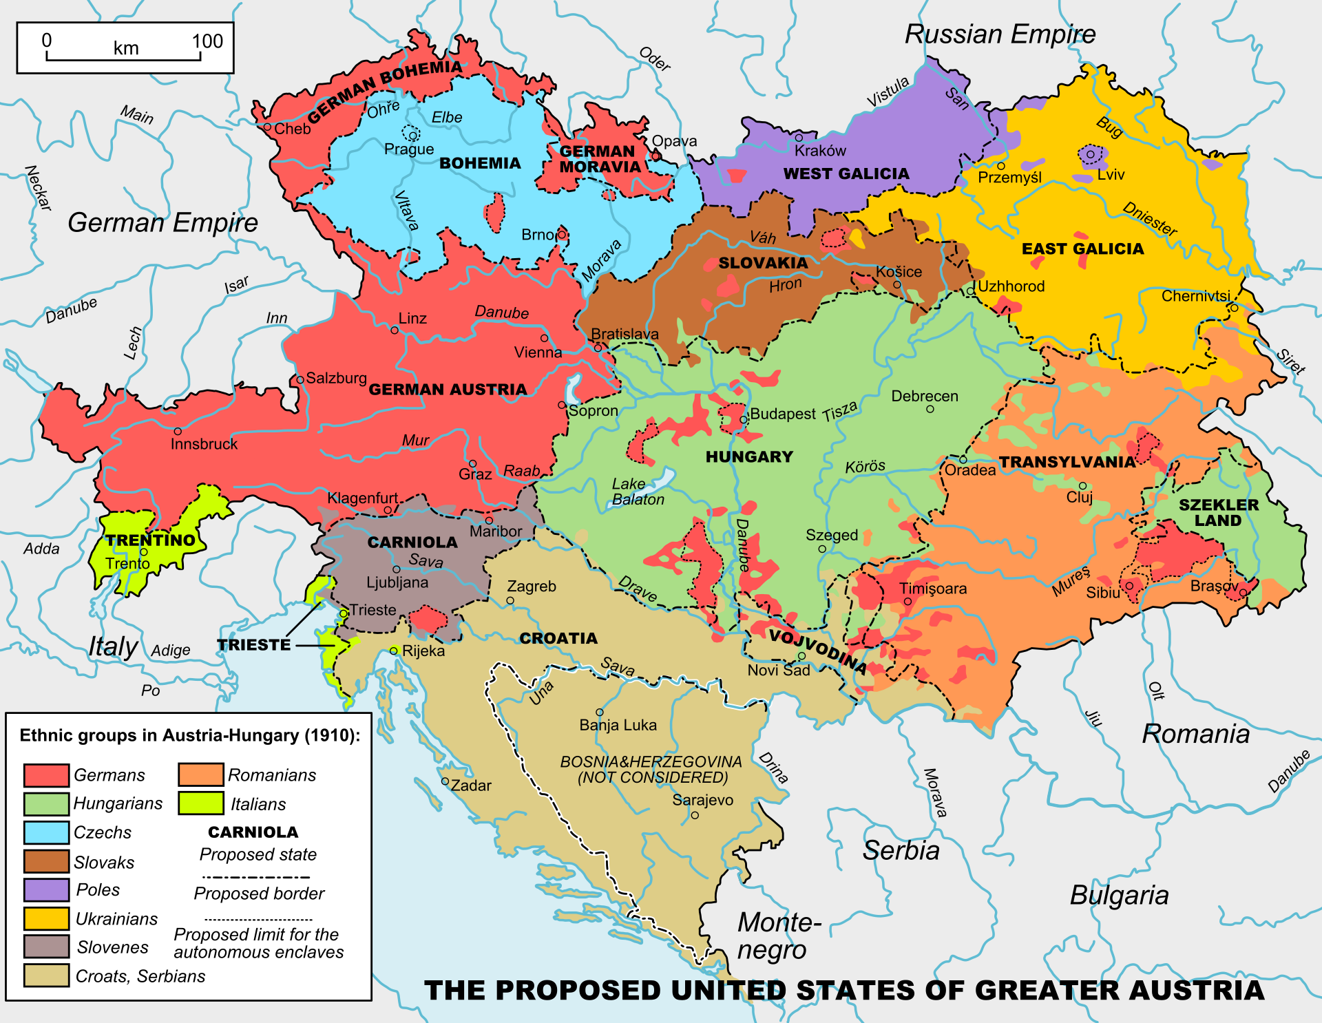
Popovici’s federalization included fourteen autonomous states under the Habsburg monarchy.

Slide 5
Theodor von Sosnosky (no photograph available) associated himself closely with Franz Ferdinand's “Belvedere Circle.” In December 1913 he wrote a biographical chapter on Franz Ferdinand which he himself deemed “Very well thought out and said” Danzer’s Armee-Zeitung July 2, 1914.
In 1937, Sosnosky reflected on Franz Ferdinand’s patronage: “I dare say without any vain presumption [Franz Ferdinand] was favorably disposed towards me, he had proven this to me, and his recognition of my historiographical and journalistic work had compensated for the malicious silence my work had met from the domestic press, which comforted me” Grazer Volksblatt, July 8, 1937.
Theodor von Sosnosky’s (1866-1943) biographical chapter on Archduke Franz Ferdinand, December 1913.

Slide 6
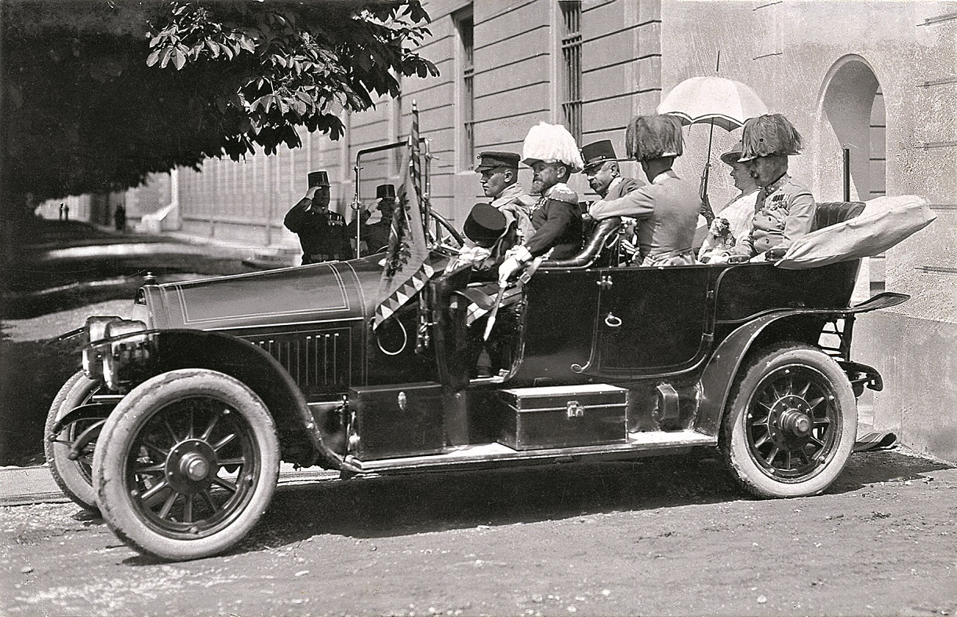

Slide 7
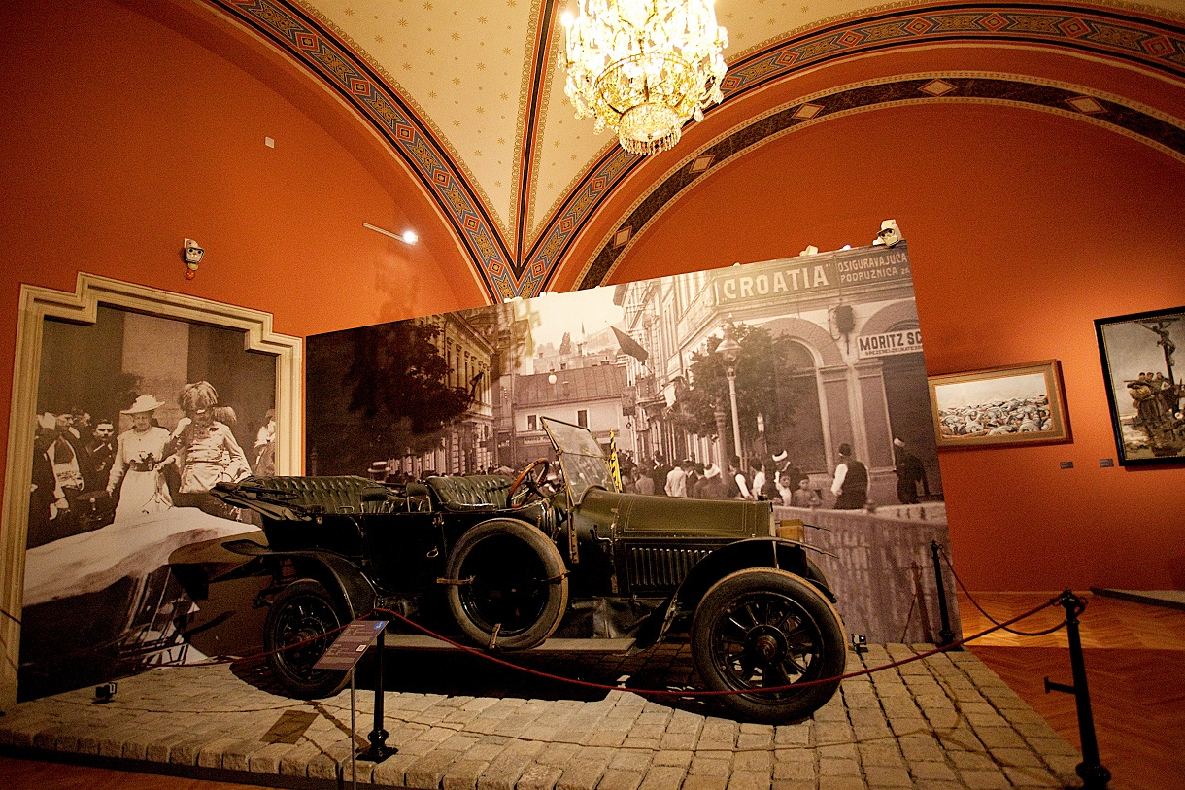
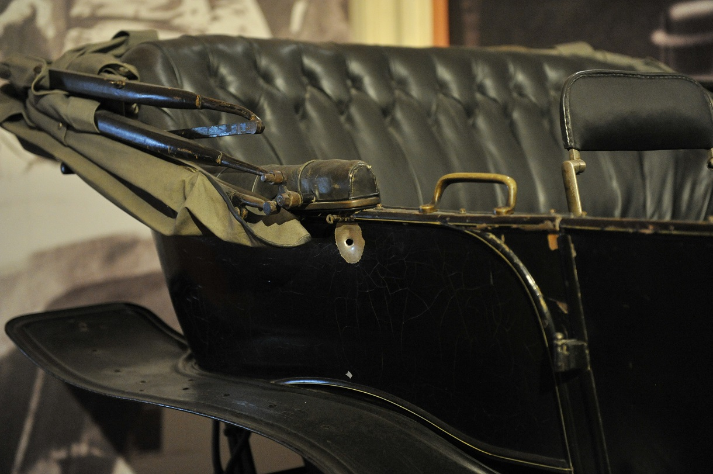
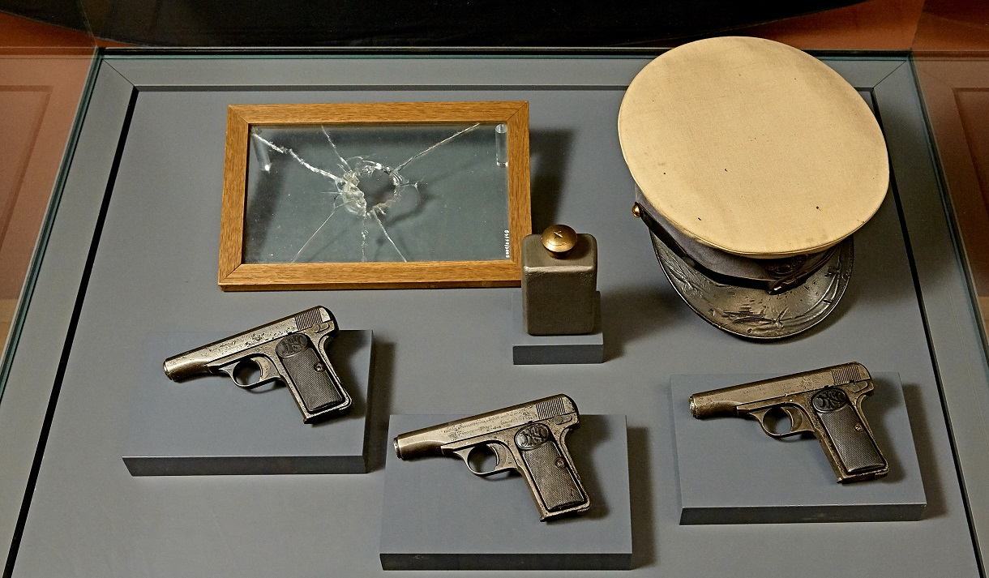
Above is the Heeresgeschichtliches Museum’s permanent exhibition on the Sarajevo assassination.

Slide 8
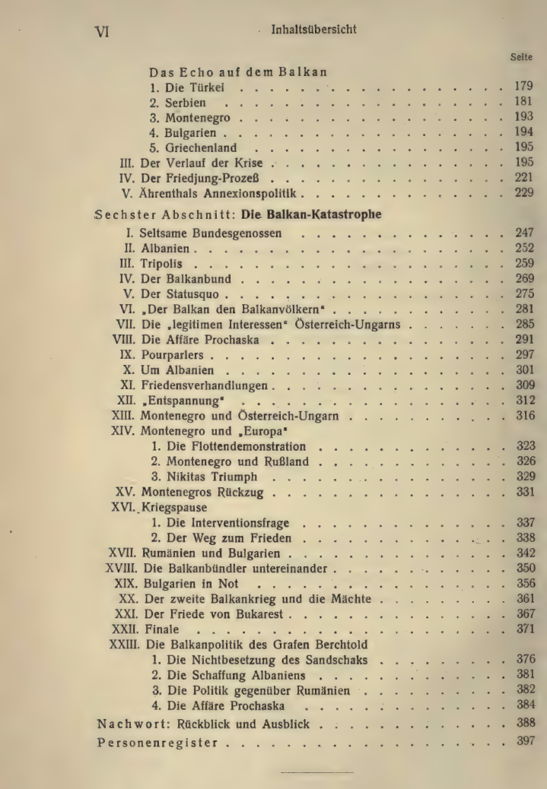
From Vol. 2’s Afterword “Retrospective and Outlook”
“The South Slavic Question is a matter of life and death for the Monarchy…Bosnia and Herzegovina should be united with Croatia-Slavonia and Dalmatia…forming a similar relationship to the monarchy as Hungary.”
“If the Monarchy wants peace—and it must have peace, or else it will financially bleed out—there is only one solution: Serbia must disappear from the map…Questions like the Serbian one are not resolved at war tables but on the battlefield; not with the pen, but with the sword; not with ink, but with blood.”
Sosnosky’s Austria-Hungary’s Balkan Politics Since 1866, Vol. 2, 1914, page 388-391.

Slide 9
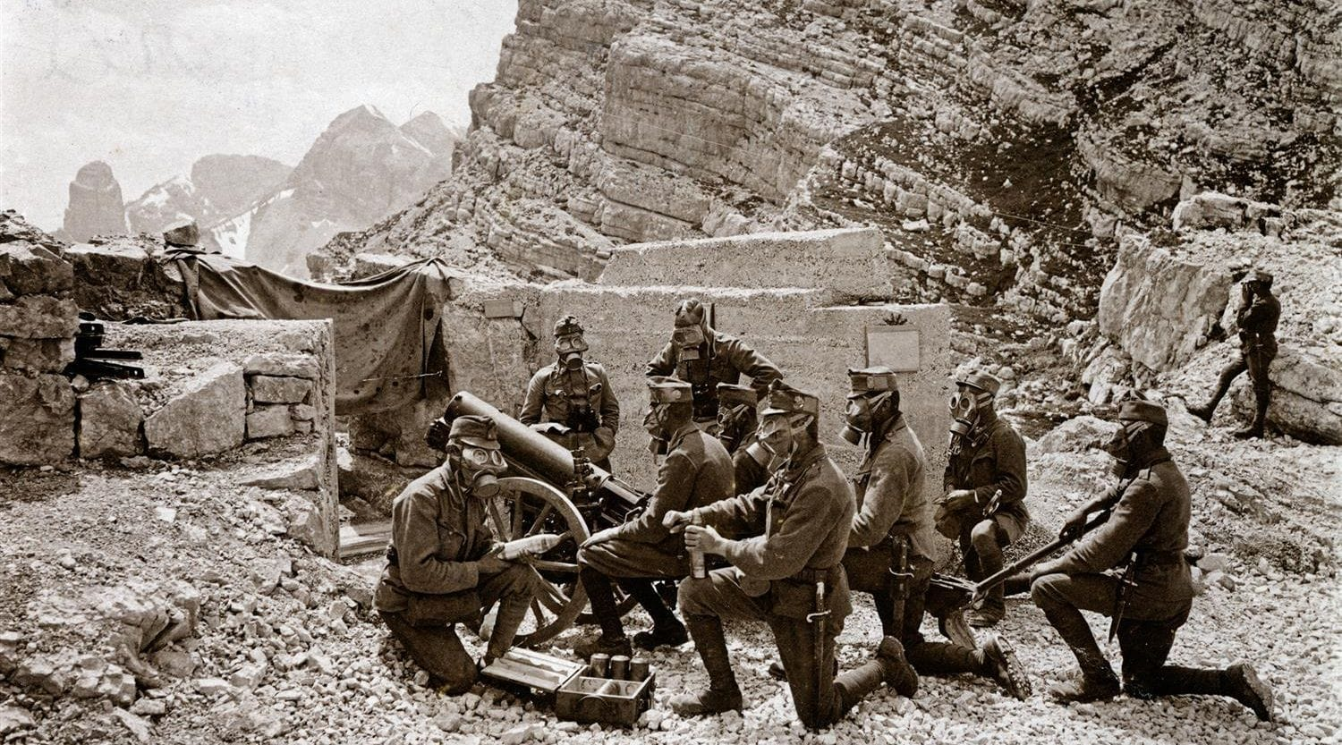
Austrian artillery unit in the Dolomites, after Italy enters the War April 26, 1915, from the Österreichische Mediathek.

Slide 10
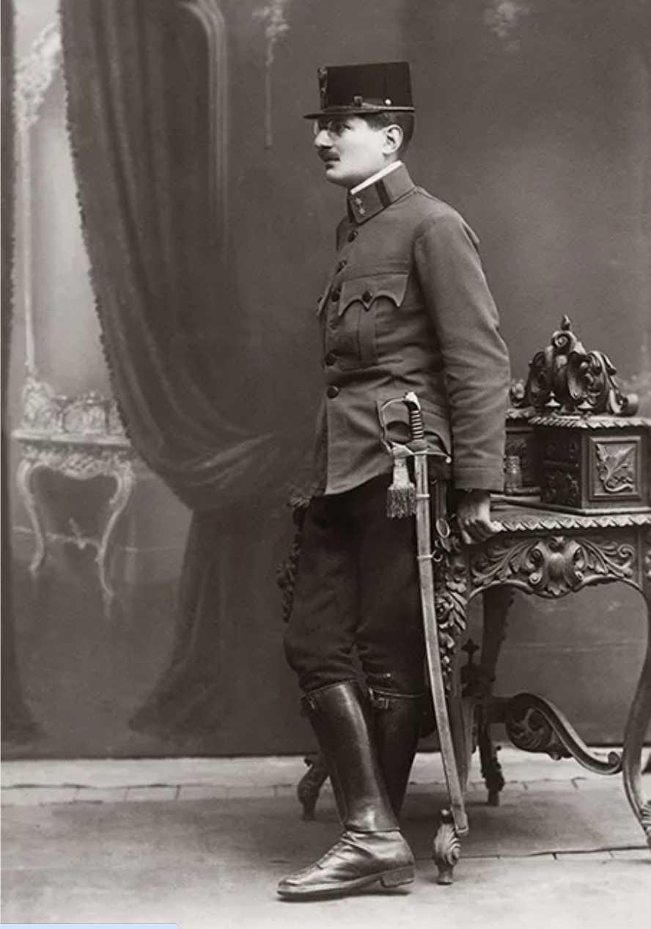
Plan from Pilar’s 1917 Memorandum on the Solution to the South Slavic Question pgs. 113-114.
Austro-Hungarian immediately exits from the War.
Emperor Karl I/IV declares a constitutional reform administratively linking Croatia, Slavonia, Dalmatia, Bosnia, and Herzegovina together.
Emperor Karl I/IV appoint a Habsburg dynastic member as Duke of the new region.
The new Duchy would be under Croatian “political leadership.”
The Duchy would give Hungary Fiume/Rijeka and railway rights as appeasement.
Ivo Pilar (1874-1933) pictured in his Bosnian “home guard” officer’s uniform c. 1916.

Slide 11
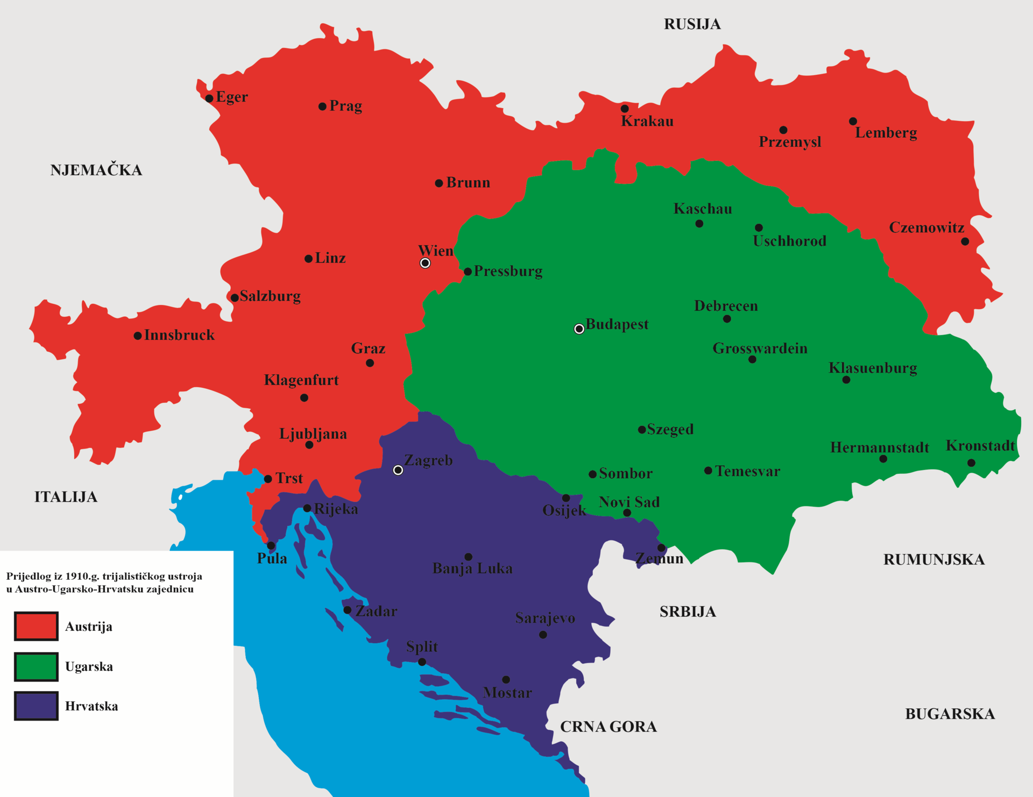
The Trialist reconfiguration of the Habsburg Monarchy first proposed in 1910.

Slide 12
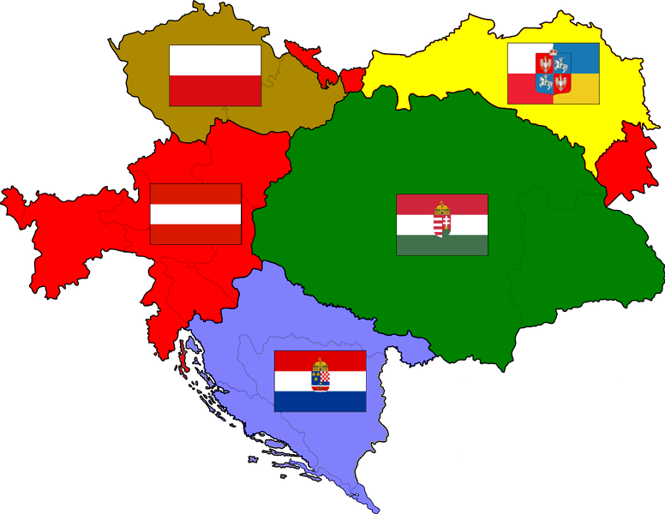
Kaiser Karl I/IV of Austria-Hungary’s proposed territorial reorganization of the monarchy dated October 16, 1918.

Slide 13
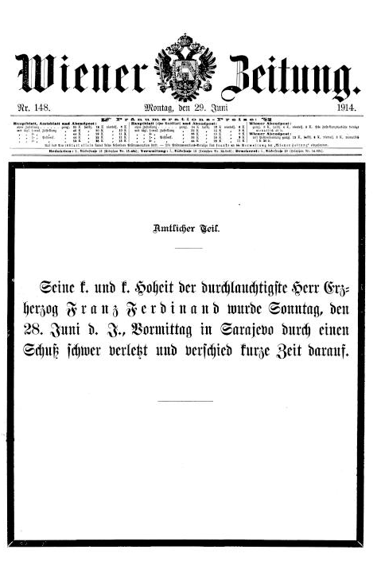
“For me, he was not just an archduke, the heir to the throne who had passed away, but the Austrian idea itself, embodied in his powerful personality. It was not just a man whom a fanatical assassin had killed, now lying lifeless on the bier; it was the entire empire” Grazer Volksblatt, July 8, 1937.
The Wiener Zeitung’s June 29, 1914 cover page conveying the Sarajevo assassination.

Slide 14
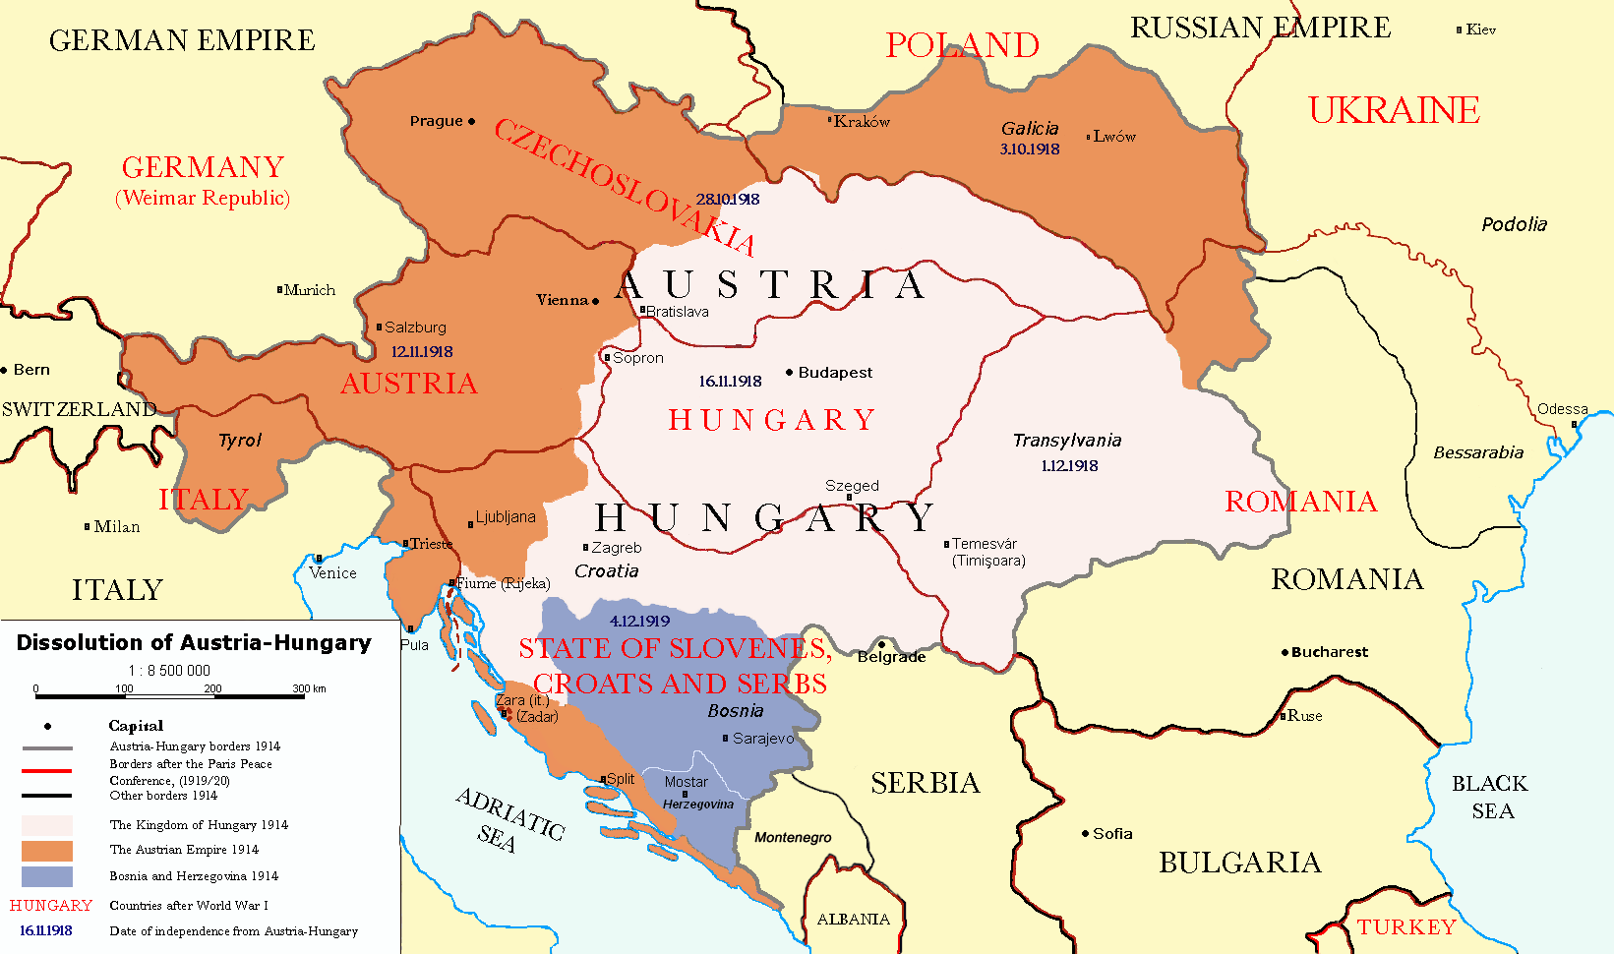
The postwar dissolution of Austria-Hungary transposed with its successor nation-states.

