Slide 1
The Influence of World War I on Literature: A Comparison of Erich Maria Remarque, Mikhail Sholokhov, and Ernst Jünger
By Anton Dzutstsati

Slide 2
World War I and its Influence on Literature
World War I as a major event that shaped literature of its time
Literature as a way to reflect on war’s impact.
Themes included loss, disillusionment, and the search for meaning.
Realism and epic storytelling were common styles.
Focus on All Quiet on the Western Front, Quiet Flows the Don, and Ernst Jünger’s perspectives.

Slide 3
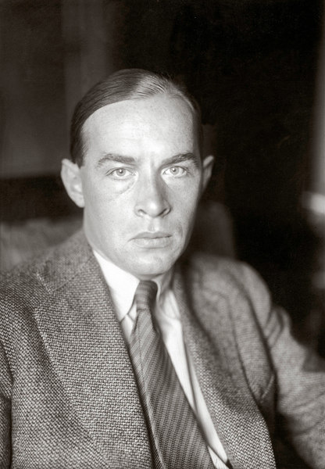
Erich Maria Remarque All Quiet on the Western Front
Themes of the book: the wastefulness of war, alienation, and friendship.
Style of the book: straightforward and realistic.

Slide 4
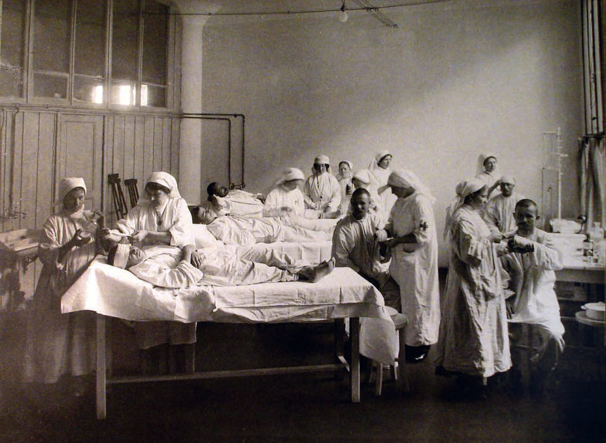
Key Passages from All Quiet on the Western Front
The boots of a dead soldier symbolize dehumanization.
Paul’s reflections on the loss of innocence.
The emotional impact of losing comrades.

Slide 5
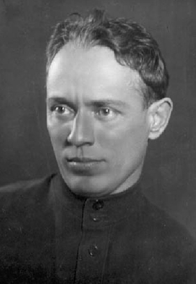
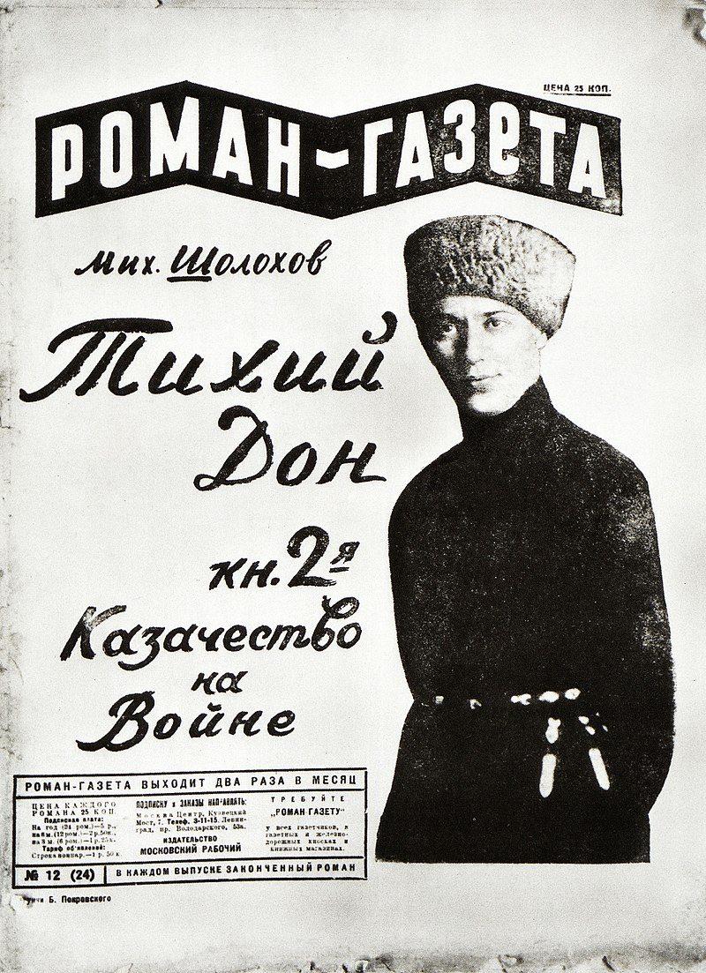
Mikhail Sholokhov And Quiet Flows the Don
Themes of the book: cultural identity, change, and personal conflict.
Style of the book: epic storytelling with cultural detail.

Slide 6
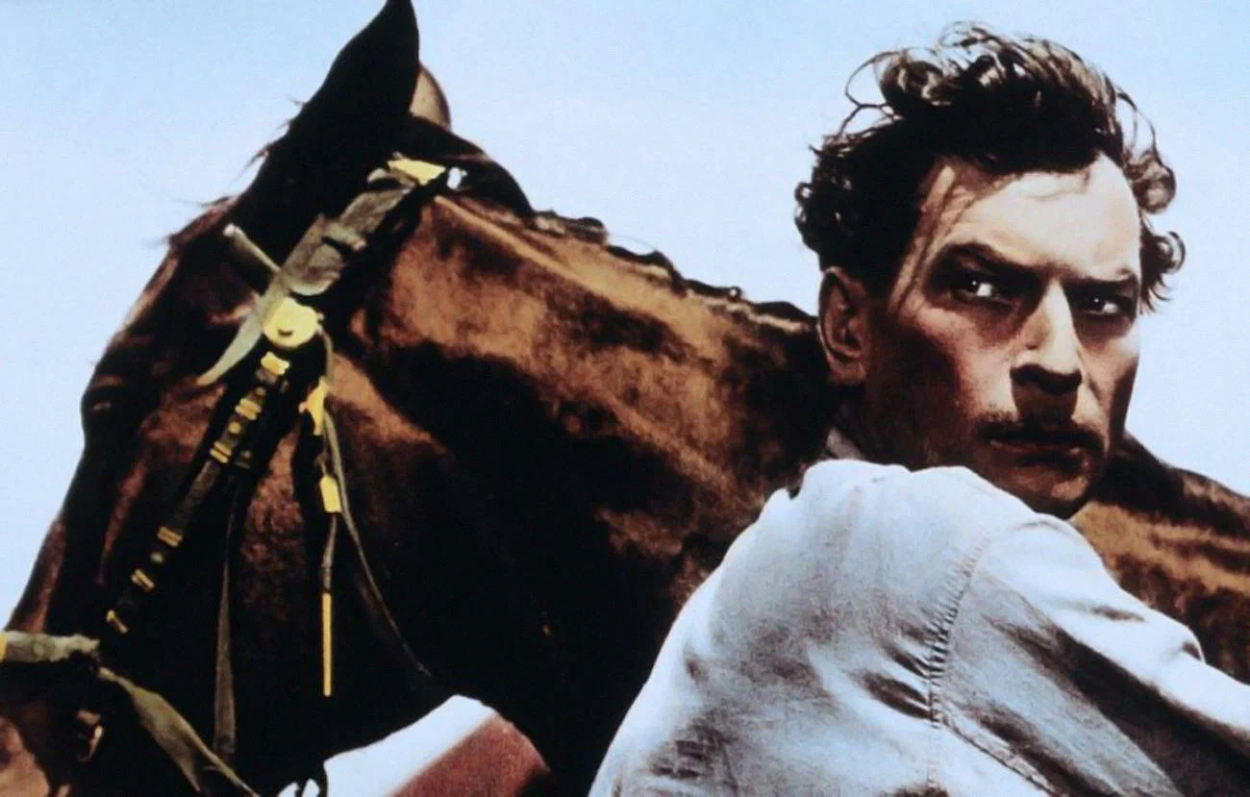
Key Passages from And Quiet Flows the Don
Grigori’s personal struggles.
Vivid descriptions of Cossack traditions.
The devastating impact of war on families and communities.

Slide 7
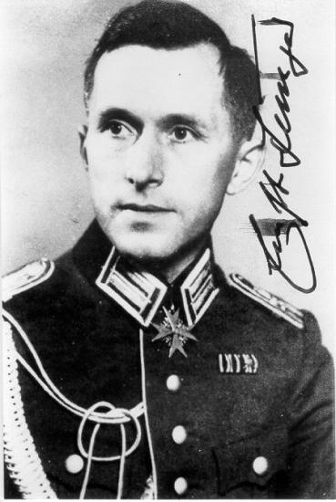
Ernst Jünger’s Perspective on War
Pro-German, heroic view of war.
Celebrated the “front experience” as a unifying and transformative force.
Emphasized technology’s beauty and power.

Slide 8
Contrasts Among the Authors
Remarque
Sholokhov
Jünger
War as senseless, dehumanizing, and emotionally destructive.
Focus on the ordinary soldier’s suffering and alienation.
Use of realism to capture the brutal, day-to-day realities of the trenches
War as a disruptor of tradition and cultural identity.
Depiction of the collective struggles of a community.
Epic storytelling combines personal and societal conflict.
War as a heroic and transformative experience.
Focus on the “front experience” as a source of strength and unity.
Aestheticization of war’s chaos and technology’s power.

Slide 9
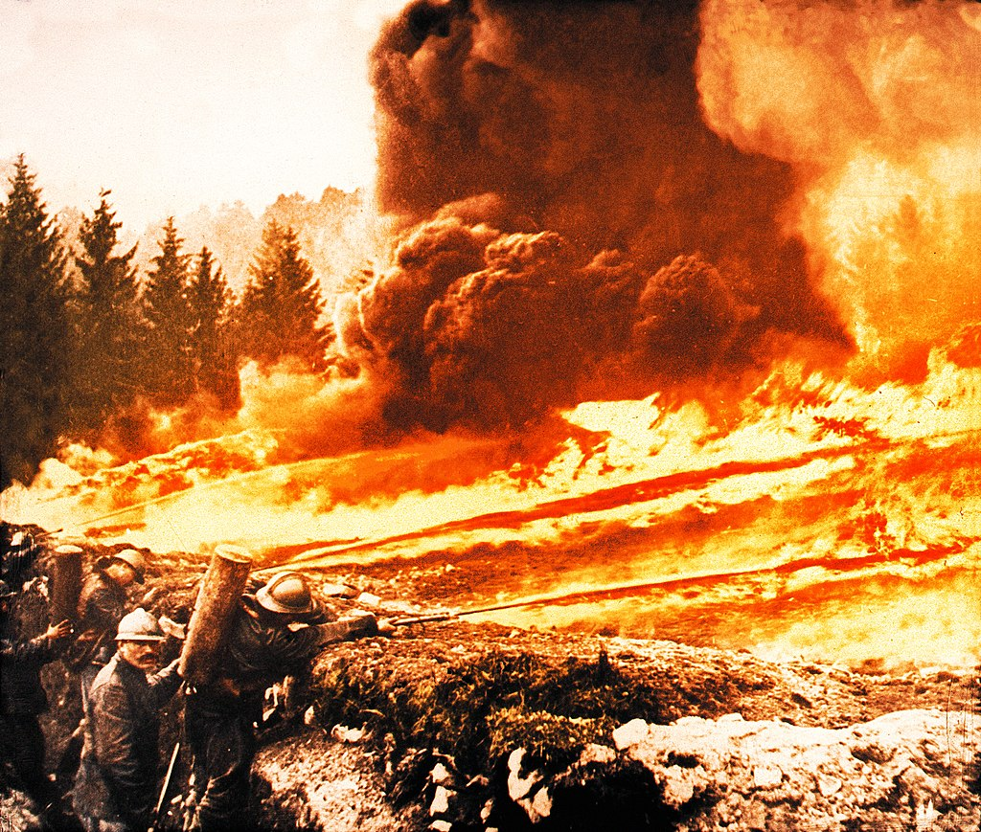
Conclusion
Literature as a mirror to history.
War’s universal and unique effects on different cultures.
Lessons for future generations.

