Slide 1
Food Provision and Logistics in Konya Province in the Great War

Slide 2
Overview of the Ottoman Empire at the outbreak of WWI
Long wars
- The Italo-Turkish War of 1911-1912
- Balkan Wars (1912-1913)
Socio-Economic Context
- Agriculture as the backbone of the Ottoman economy
- Modernization delays and insufficient infrastructure
- Low industrial capacity to support military and civilian needs

Slide 3
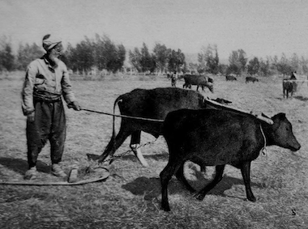

Slide 4
Hamidiye Paper Factory

Slide 5
Wartime Strain on Food Supplies
Conscription reduced agricultural output by taking labor away from the agricultural sector
Allied blockades disrupted food imports and exports

Slide 6
Logistics and Transportation Challenges
- Railroads were the main mode of transportation during the war
- The Empire's capacity to allocate resources was severely limited by inadequate infrastructure
- Military requisition of civilian supplies exacerbated shortages

Slide 7
KONYA PROVINCE
- Located in a continental climate zone due to geographical position
- Harsh climate conditions affect soil fertility and crop variety; therefore, grain farming became predominant as a necessity rather than choice.
- Farming was historically oriented toward household consumption rather than trade.
- Lack of marketplaces, such as bazaars, hindered economic growth in agriculture
- Inadequate transportation limited access to broader markets before railways

Slide 8
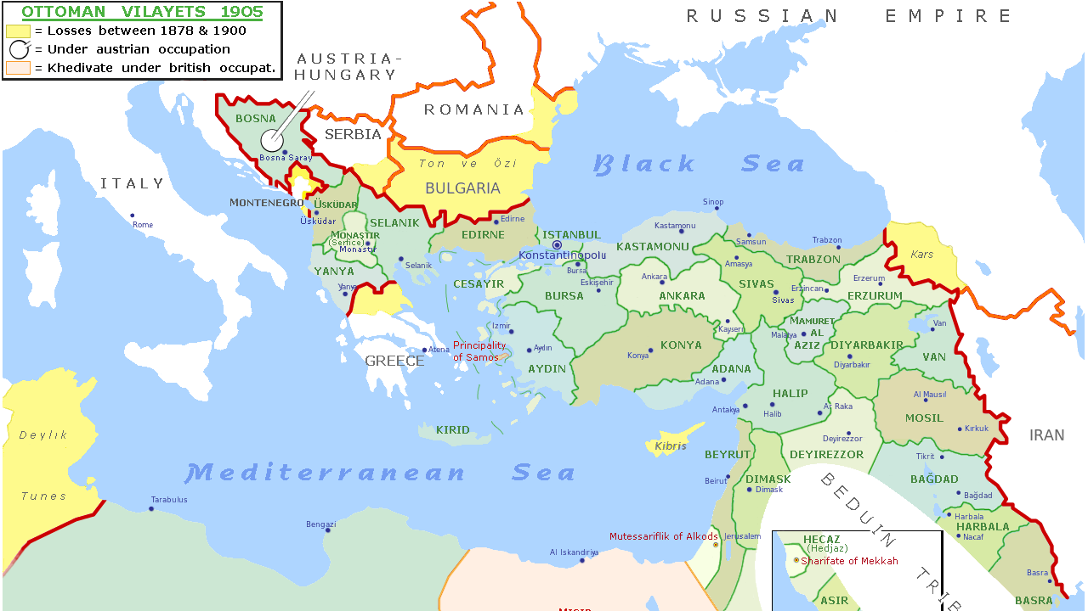

Slide 9
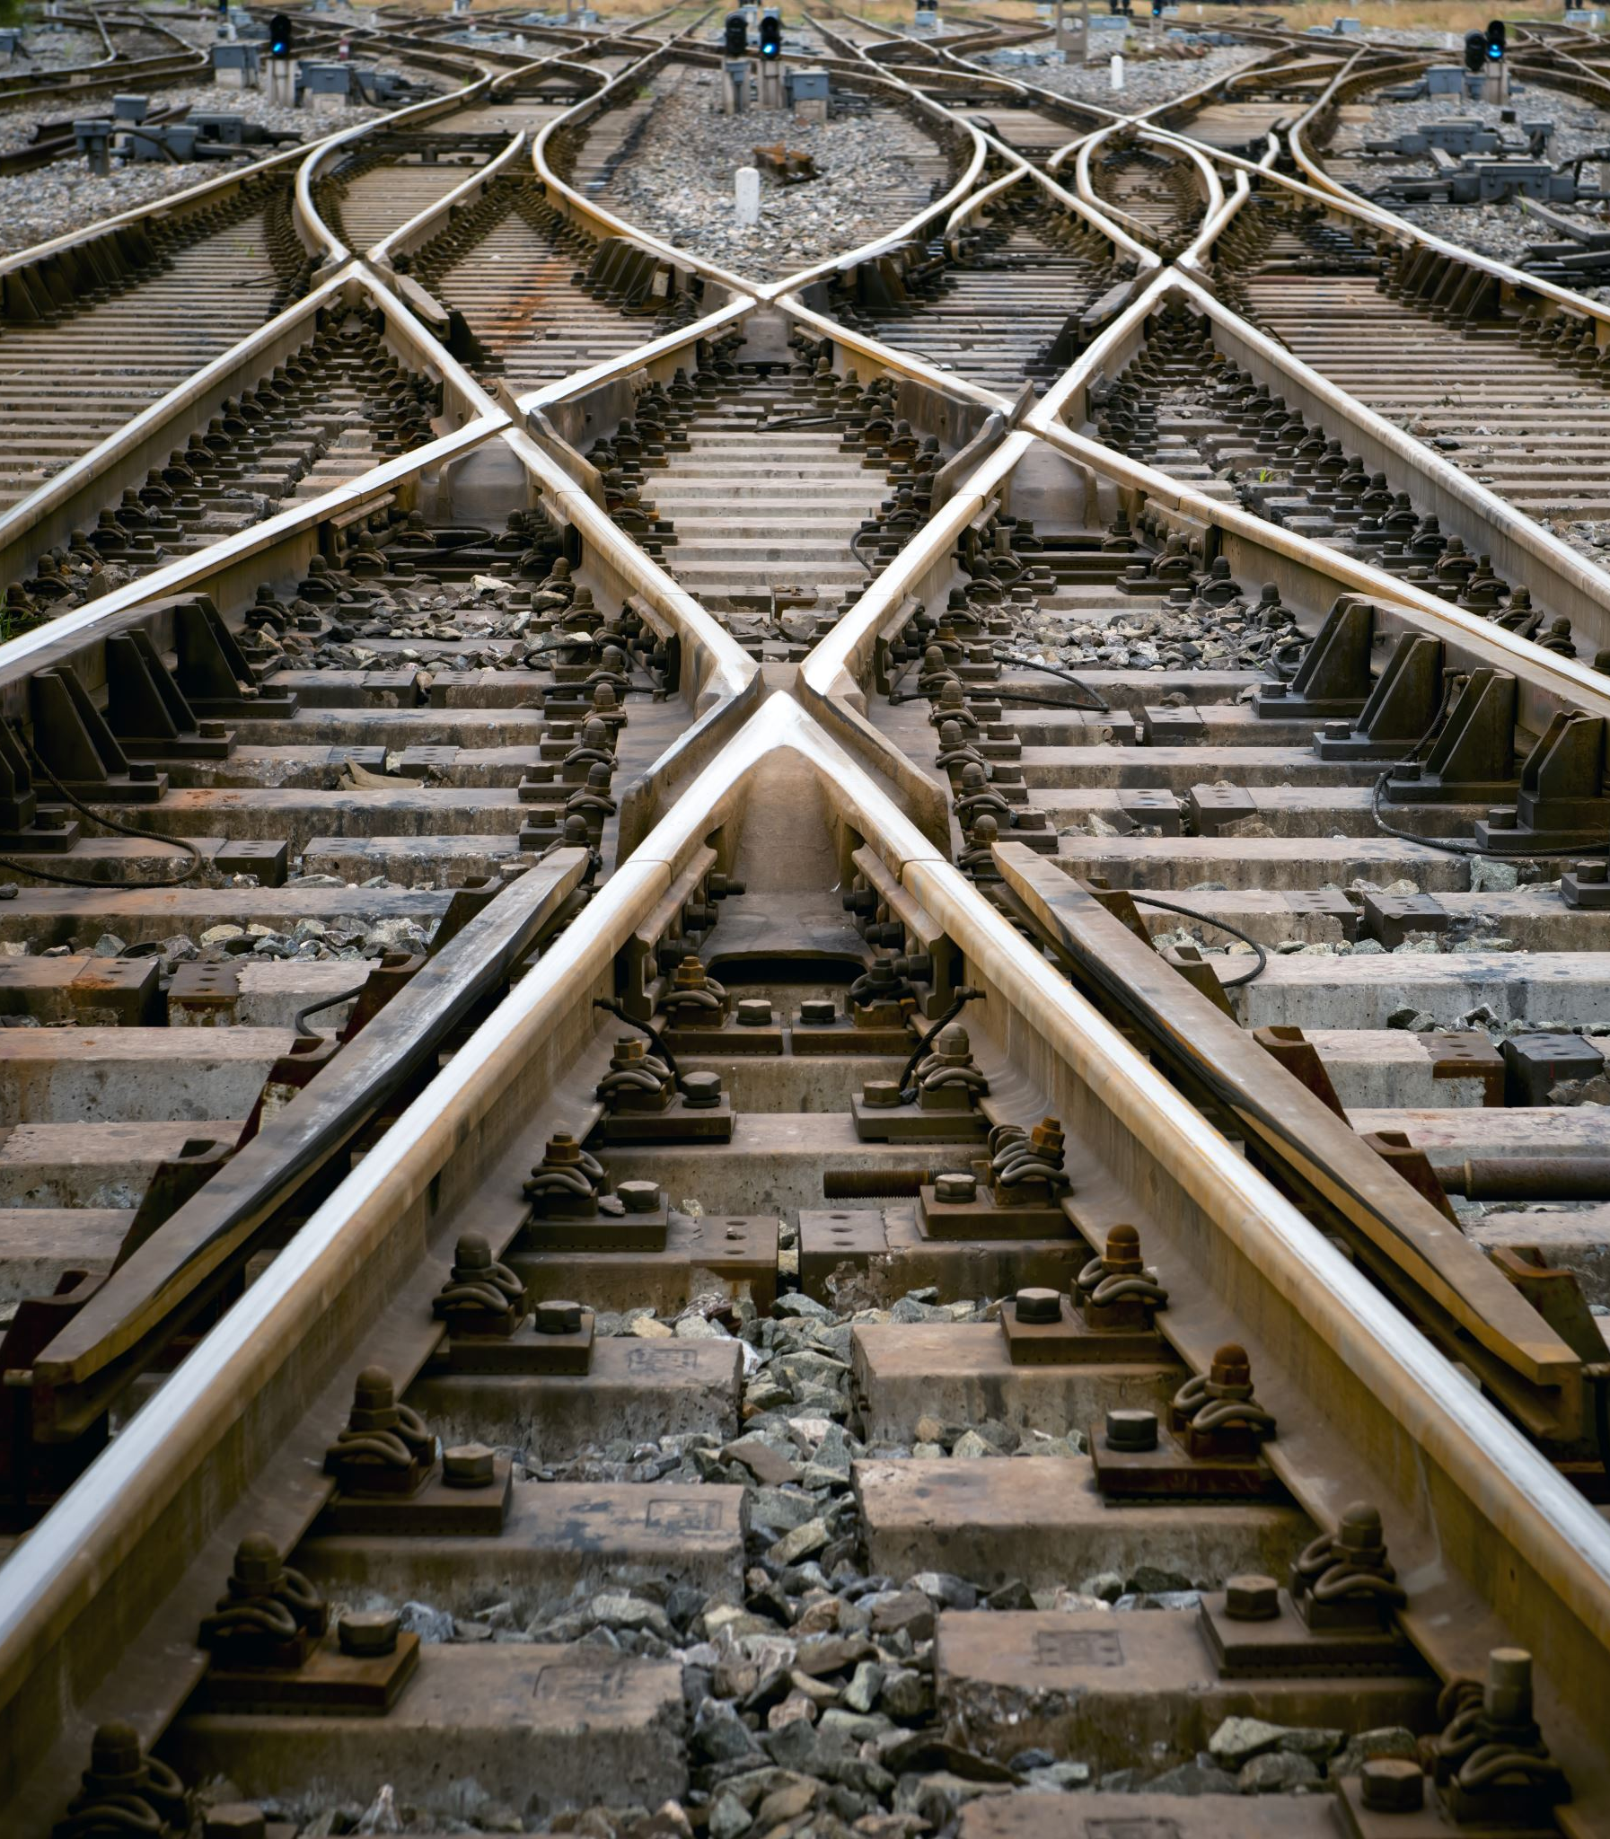
The Construction of the Anatolian Railway
- Railways were constructed by granting privileges to foreign states and companies in the late 19th century.
- The Izmir-Aydin Railway, built by the English and completed in 1866, was the first example.
- The Anatolian Railway Line extended into the central plains of Anatolia to improve connectivity.
- Germany, seeking expansion after its unification, played a key role in Ottoman railway projects.
- Deutsche Bank established the Anatolian Railway Company (La Société du Chemin de fer Ottoman d’Anatolie) on March 23, 1889.
- The railway reached Konya station on July 29, 1896, bringing significant changes to the region.

Slide 10
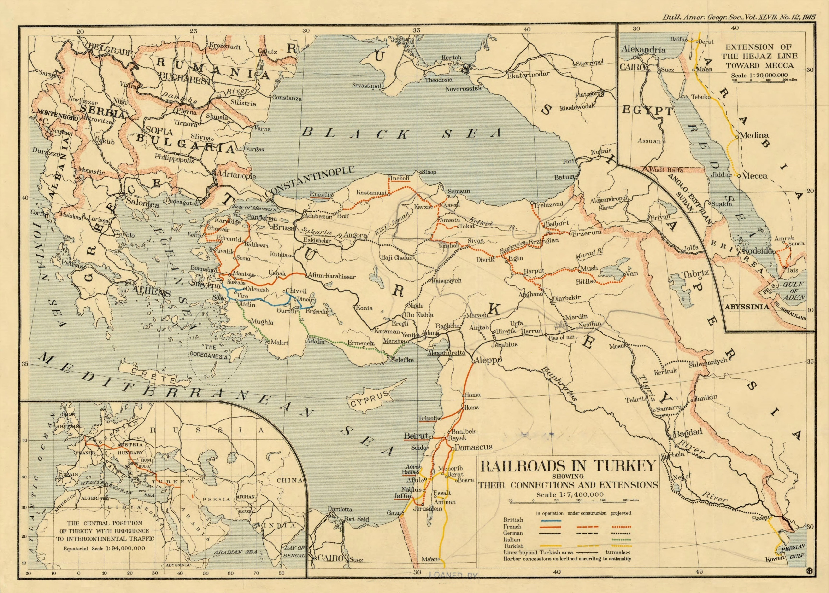

Slide 11
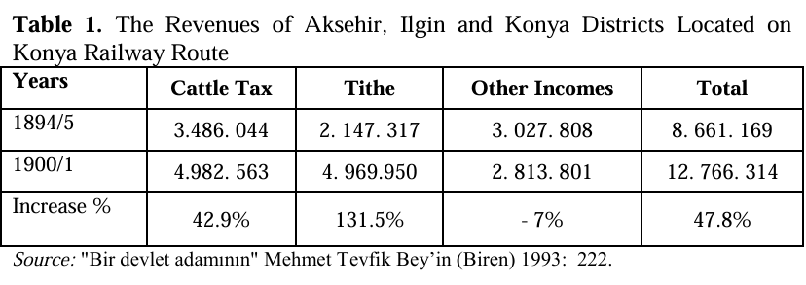
Effects of the Railways

Slide 12
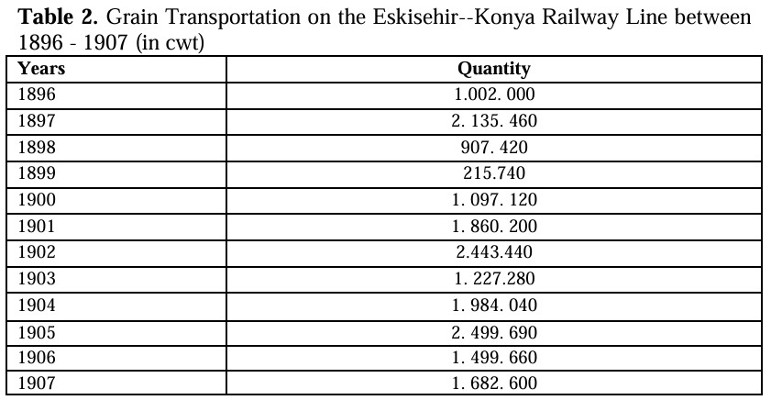
Source: Emrah Yilmaz, “Railways and Urban Transformation: The Case of Konya,” Athens Journal of History, Volume 2, Issue 4 – Pages 263-278

Slide 13
On Road to War Ministry of War – Department of General Supplies
Responsible for supervising and distributing essential supplies for the army, including food and other necessities (e.g., dairy, soap, sugar, tea, and canned foods).
Played a key role in establishing and developing military factories by providing technical equipment.
Collaborated with Germany during World War I to enhance military production capabilities.

Slide 14
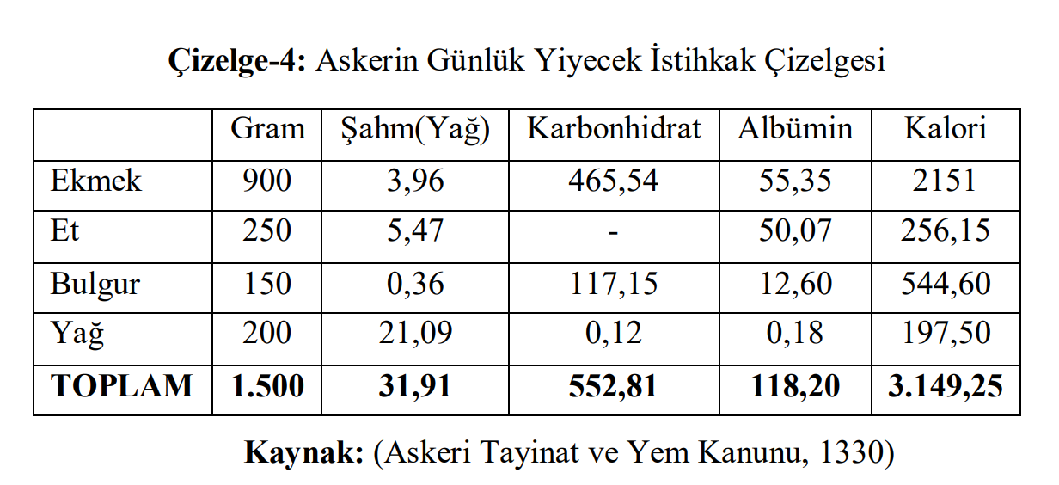

Slide 15
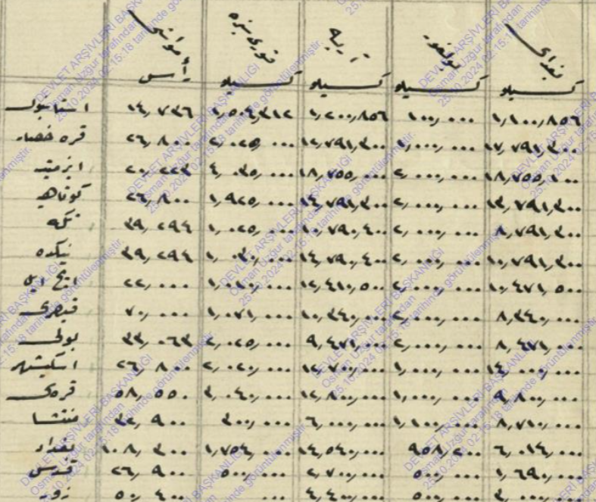

Slide 16
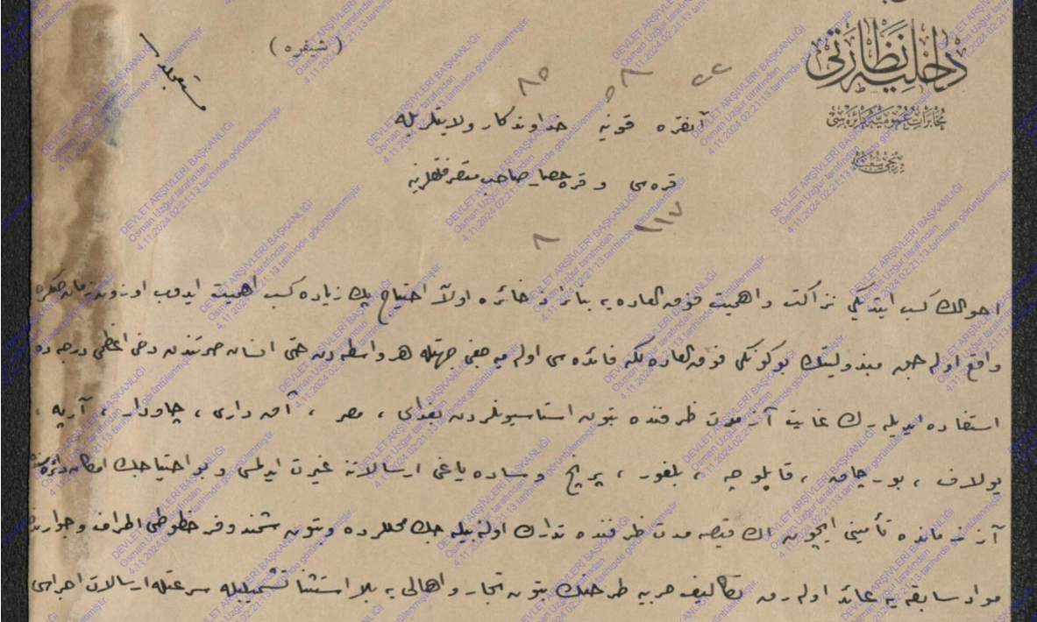
Due to a pressing need for provisions, instructions were issued for the immediate dispatch of wheat, corn, barley, oats, bitter vetch, bulgur, rice, and butter from the stations, and for the Ministry to be informed of this matter. A telegram regarding this was sent by the Directorate of General Communications to the provinces of Ankara, Konya, Hüdavendigar, and to the districts of Karesi and Karahisar-ı Sahib.

Slide 17
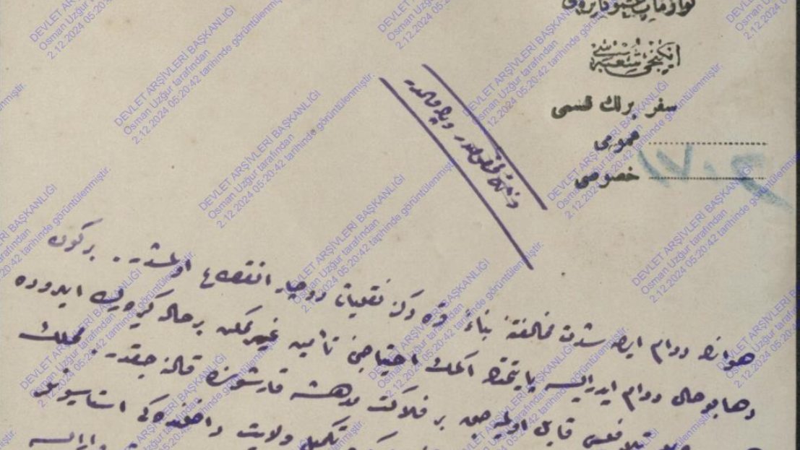
Due to adverse weather conditions preventing shipments, Istanbul experienced a shortage of grain. A telegram was sent from the Ministry of War’s Department of General Supplies to the provinces of Konya and Ankara, requesting the urgent shipment of the existing grain to Istanbul after setting aside a three-to-four-day supply for local needs.

Slide 18
The Role of Konya Province
- Agricultural production
- Location of Anatolian railway
- Security compared to other railway stations
- At the vicinity of Izmir-Aydin railway

