Slide 1
The Reception of US and the image of America within Turkish Intellectual Context: The Examples of Atsız and Kadro
Anıl Atılgan

Slide 2

Overview
  Brief Ottoman context
  Early Republic and its contextualization
  Restoration of American-Turkish diplomatic ties
  The Great Depression and its reception
  Soviet-Turkish rapproachment
  Atsız and Kadro cases
  Conclusion

Slide 3
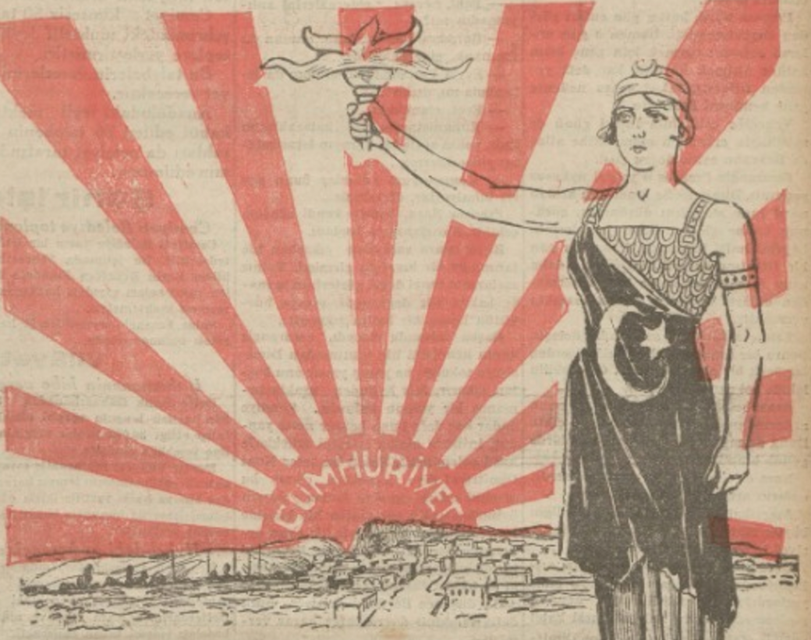
Early Republic
  New definition of Turkish identity
  The discourse focusing on the effort “elevating” Turkish culture to the level of modern civilization (muasır medeniyet)
  Firm belief in the coming of another war that would certainly be an existential threat for the nascent republic
  Adoption of non-irredentist policies in the region
  Radical reforms in all aspects of social life
Cumhuriyet Newspaper (29 October 1929)

Slide 4
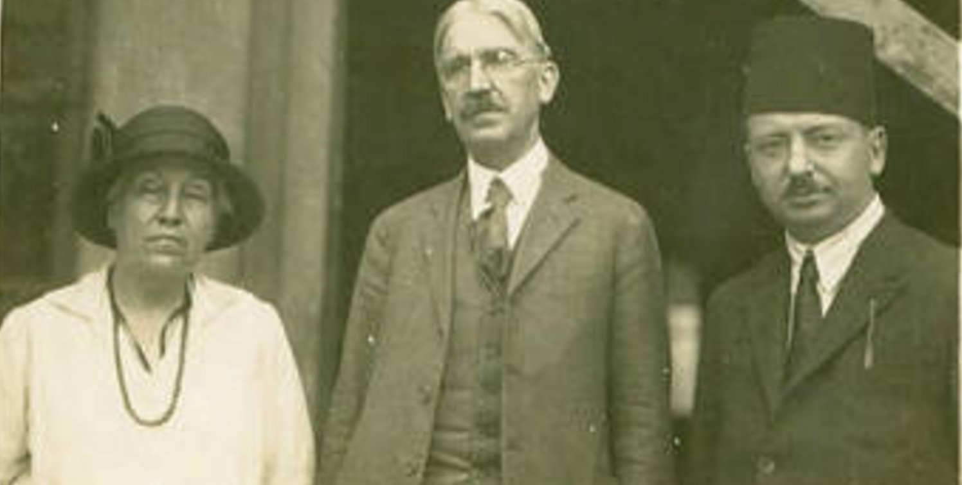
The US is back to the table
John Dewey in Turkey (1924)

Slide 5
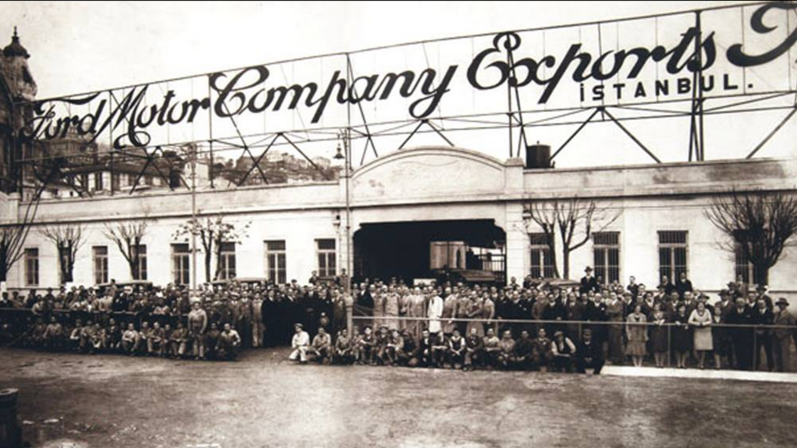
Ford Motor Company Factory in Tophane, Istanbul (1929)

Slide 6
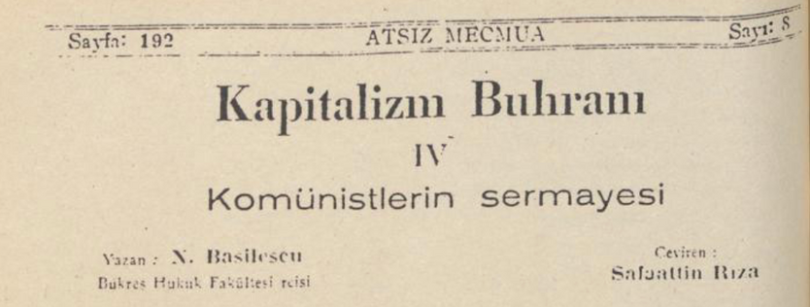
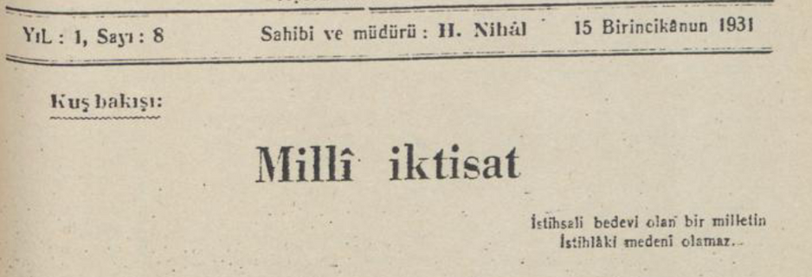
The Great Depression and ‘Cultural Turn’
  High politics vs low politics
  The increasing attention to the US
  Discussions about the future of capitalism
  Emergence of “Third Wayism” within the Turkish intellectual elite
  Increasing emphasis on the neccessity of a “national economy”
“The Crisis of Capitalism IV: The Capital of the Communists” - Atsız Mecmua (December-1931)
“National Economy” - Atsız Mecmua (December 1931)

Slide 7
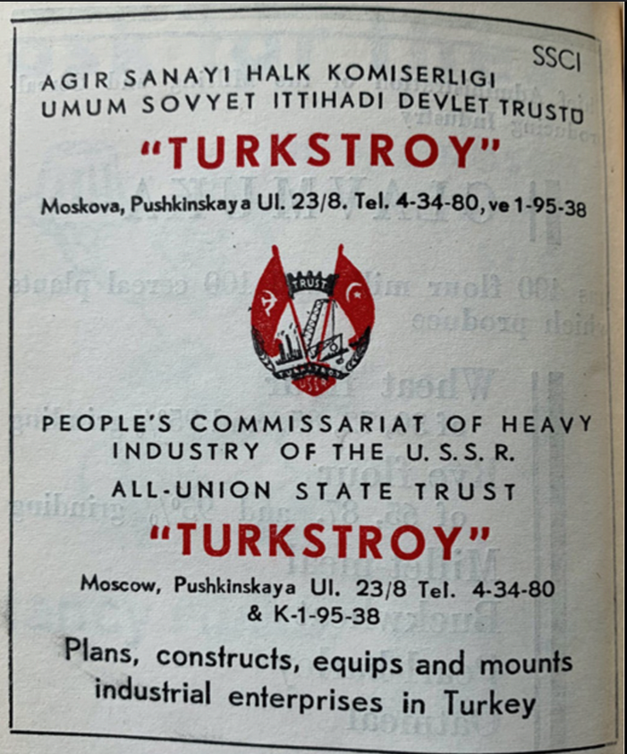
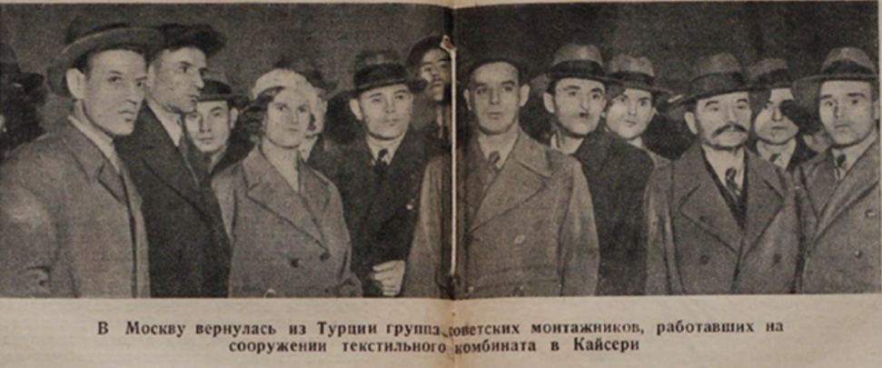
‘Statist Turn’: The Soviet Union and the Republic, 1928-1933
  Increasing cooperation of the Soviet Union and Turkey in terms of policymaking, culture, and economics based on the peripheral dynamics
  Although Turkey remained anti-communist vocally, there were numerous exchanges and visits between two states.
  Did not aim to revert the policies of the previous decade but it was born out of demands for “equal partnership” in “Western Civilization”.
Return of Soviet Workers from the Factory built in Kayseri

Slide 8
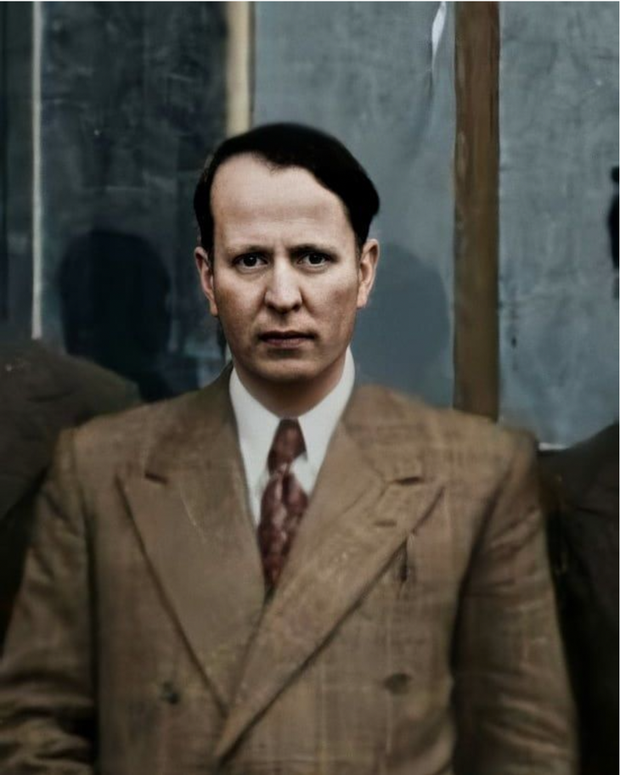
  One of the most prominent figures of Turkish racism starting from 1930s
  Former military officer dismissed because of his racist discourse
  Having done his PhD at the University of Istanbul under the supervision of Fuad Köprülü, the most prominent Ottoman historian of his time, became historian
  Actively involved in publishing sector starting from late 1920s
Hüseyin Nihal Atsız (1905-1975)

Slide 9
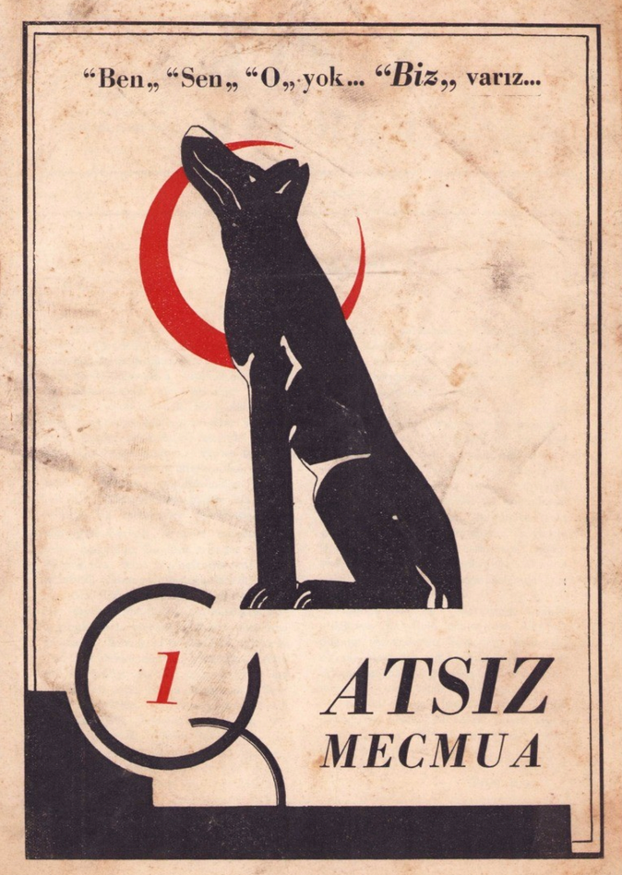
Atsız Mecmua (1931-1932)
  Published by Hüseyin Nihal Atsız and contributed by prominent figures like historians Fuad Köprülü and Zeki Velidi Togan and even Sabahattin Ali
  Political agenda of raising Turkish national consciousness
  Criticized the Kemalist elite based on their strict orientation towards ‘Western civilization’, and their reluctance for irredentist policies
  Pro-capitalist but also advocates for state intervention
  Opposes the homogenization of Turkish culture
The first issue of Atsız Mecmua (May 1931)

Slide 10
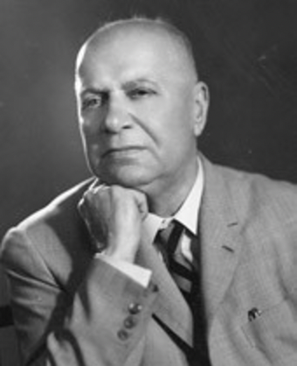
  Writer, historian, public intellectual
  The chief editor of Kadro
  Spent time in Baku and Moscow in early 1920s, influenced by Bolshevik Revolution and aftermath
  Former member of outlawed Turkish Communist Party, but left the party after the government crackdown in 1927
  Afterwards, joined the ranks of the Kemalist regime
Şevket Süreyya Aydemir (1897-1976)

Slide 11
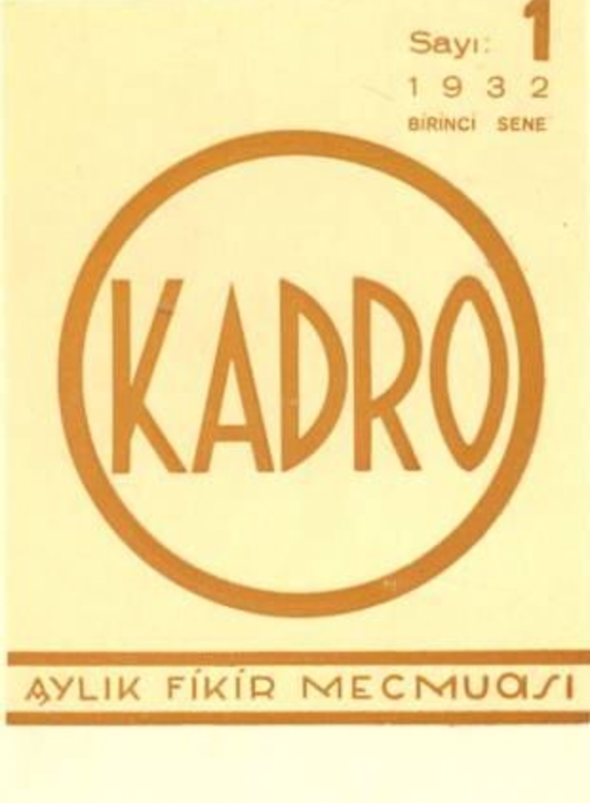
Kadro
  The name translates as “Cadre”, pointing the elite characteristics of the journal
  Not only elite in the sense of authors, but also targeted elites, bureaucrats, and policy makers
  “The most vocal voice of Statism in Turkey” (Hirst, 2013)
  Envisioned a role of Turkish leadership for all countries struggling to get rid of their imperial colonizers.
  Advocated for a Third Way against the Western-American type of bourgeois capitalism and communism of the Soviet Union
The first issue of Kadro (January 1932)

Slide 12
References
  Atsız Mecmua, ed. Hüseyin Nihal Atsız, No. 1-12, May 1931-April 1932.
  Kadro, ed. Şevket Süreyya Aydemir, No. 1-34, January 1932-October 1934.
  Hirst, Samuel J. “Anti-Westernism on the European Periphery: The Meaning of Soviet-Turkish Convergence in the 1930s.” Slavic Review 72, no. 1 (2013): 32–53.
  Işık, Mehmet, and Şakir Eşitti. “Kadro Dergisinde Üçüncü Yol Söylemi.” Türkiye Sosyal Araştırmalar Dergisi 182, no. 182 (2014): 265–94.
  Türkeş, Mustafa. “The Ideology of the Kadro [Cadre] Movement: A Patriotic Leftist Movement in Turkey.” Middle Eastern Studies 34, no. 4 (October 1998): 92–119.
  Yilmaz, Şuhnaz. “Challenging the Stereotypes: Turkish–American Relations in the Inter-War Era.” Middle Eastern Studies 42, no. 2 (March 2006): 223–37.

