Slide 1
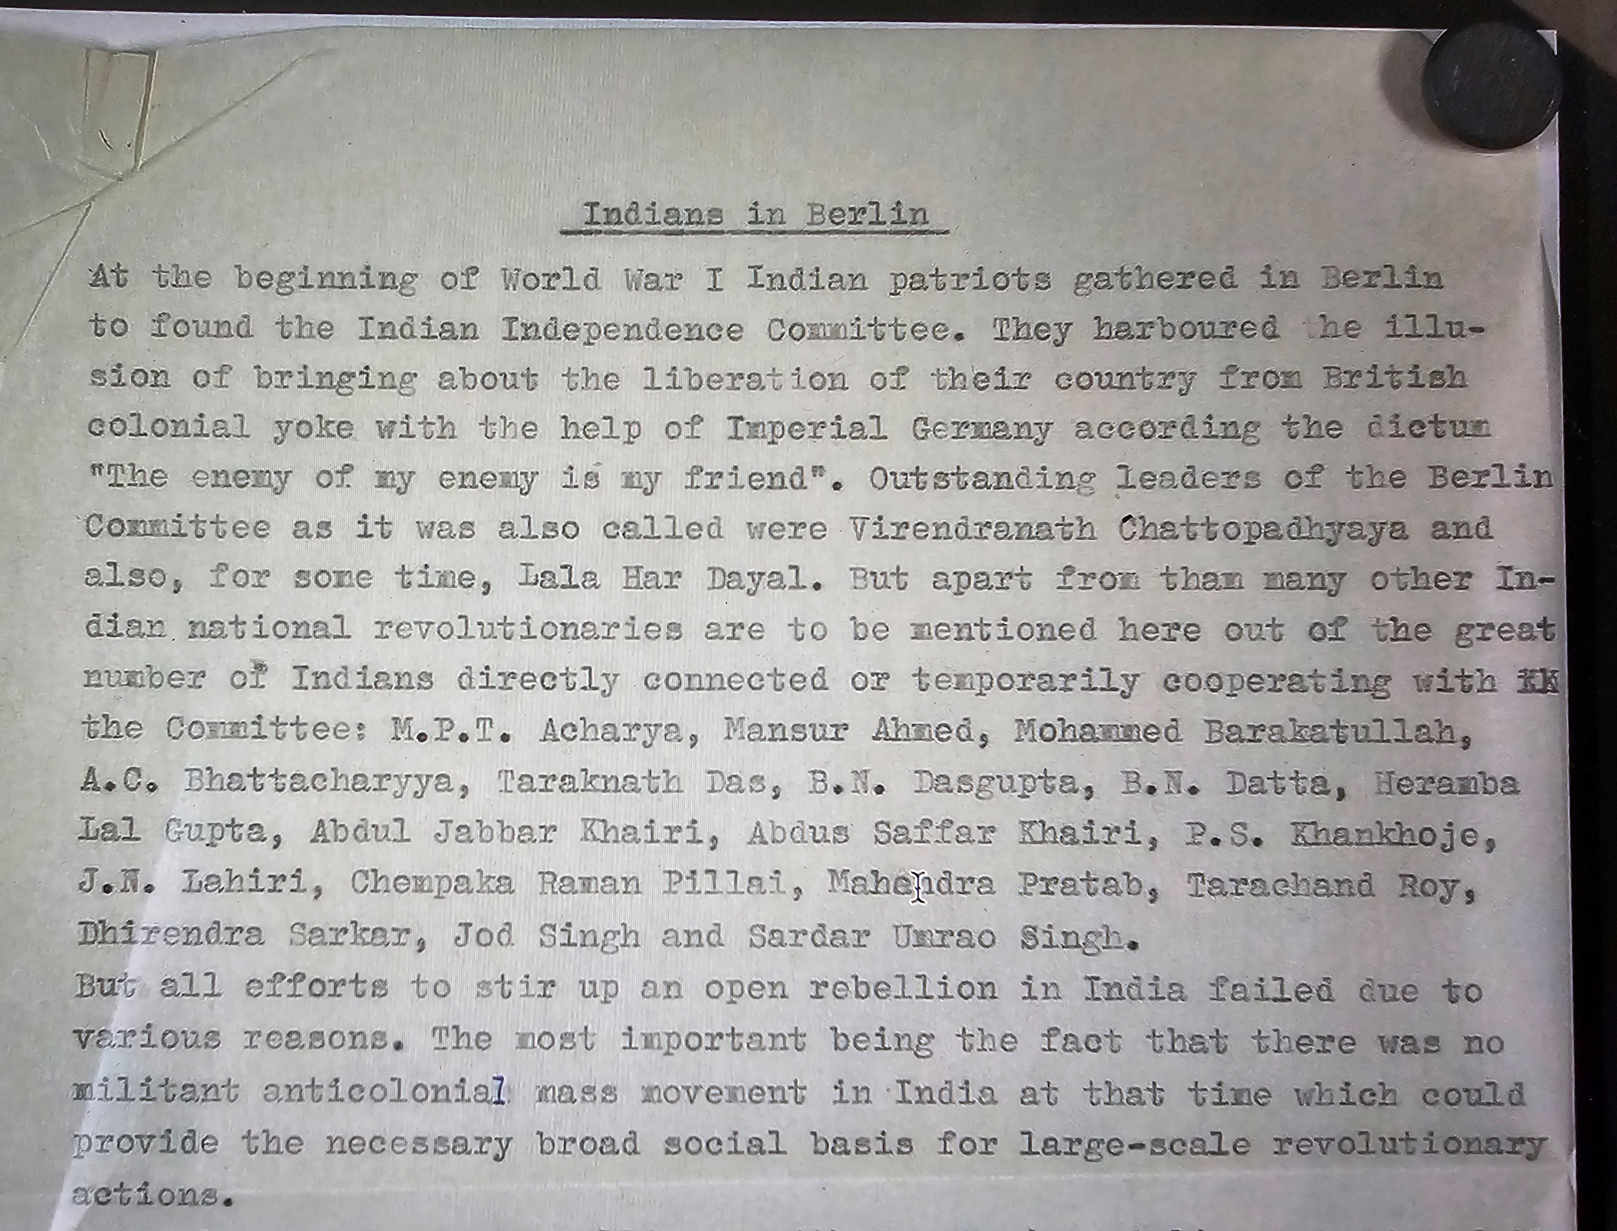
Indians in Berlin (during WW1)

Slide 2
Snippet from a report prepared by Bombay Police Commissioner’s Office

Slide 3
A British Assessment of the Plans of Berlin Committee. Their plans to exploit dynamics of colonial politics catches the metropole government off Guard (Foreign and Political Branch 1914, NAI)

Slide 4
Snippet from another British Report
The British fear was restricted to the committee’s ability to disseminate anti-British propaganda. Often, they went to great lengths with that fear.
As it appears, they did not seriously take the attempts of armed insurgency and stuff.

Slide 5
A Case of Shifting allegiances

Slide 6
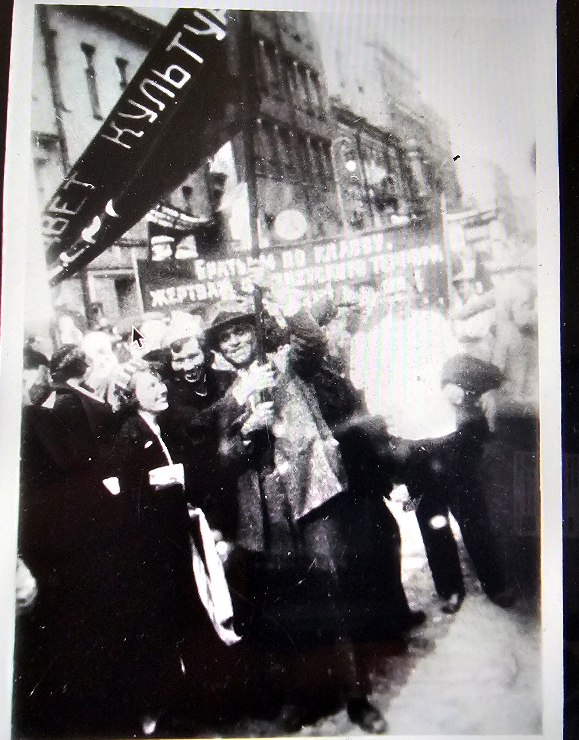
Har Dayal and Chattopadhyay- Who were they?

Slide 7
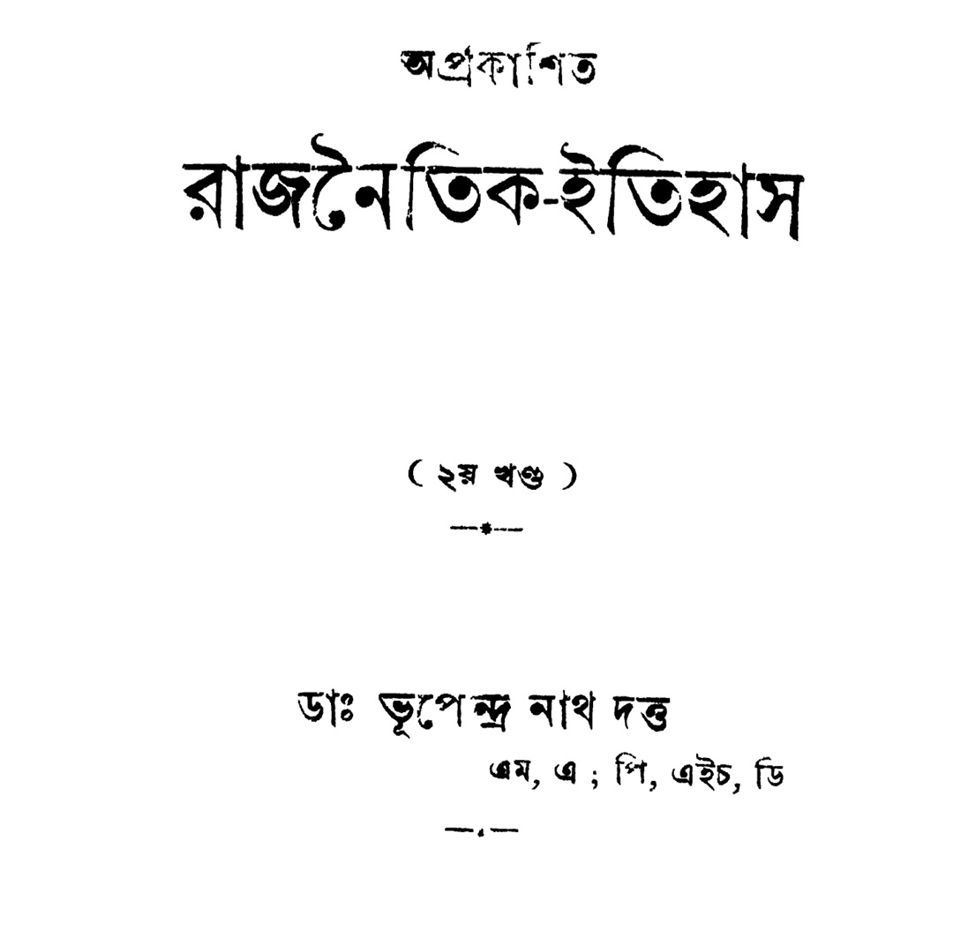
In Retrospect

