Slide 1


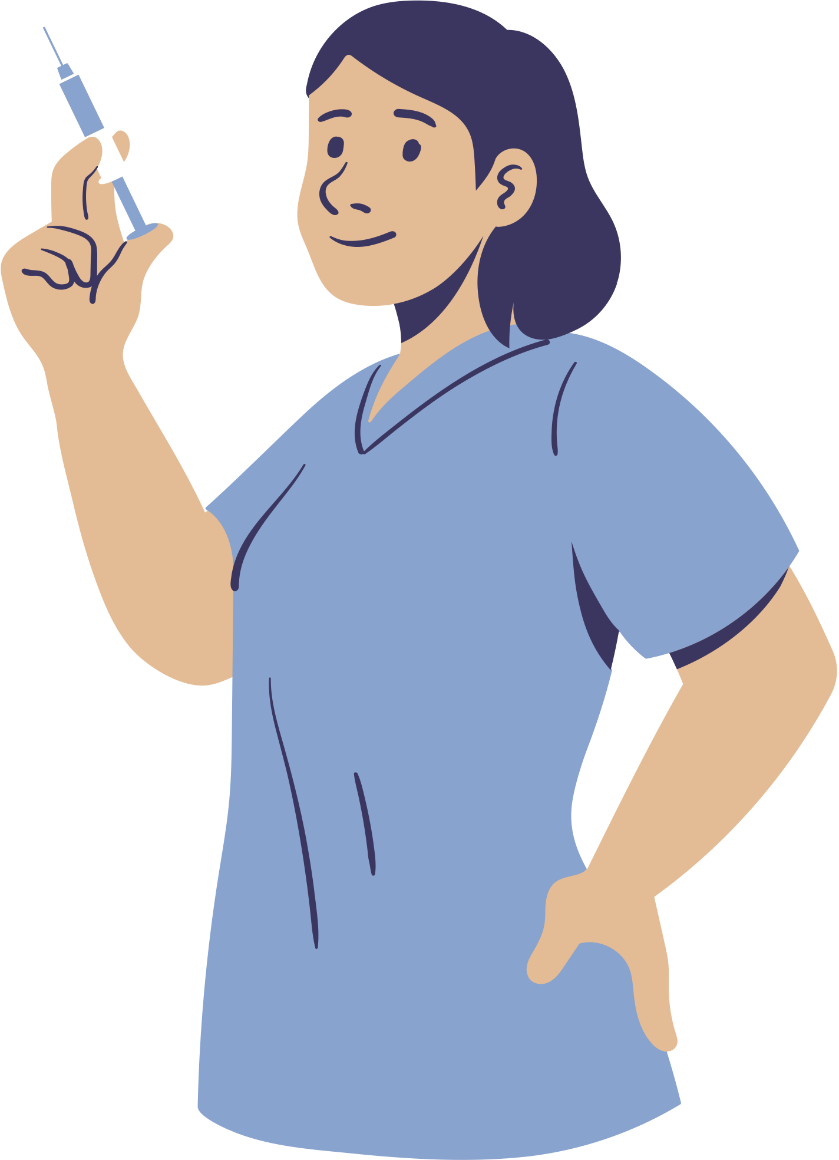


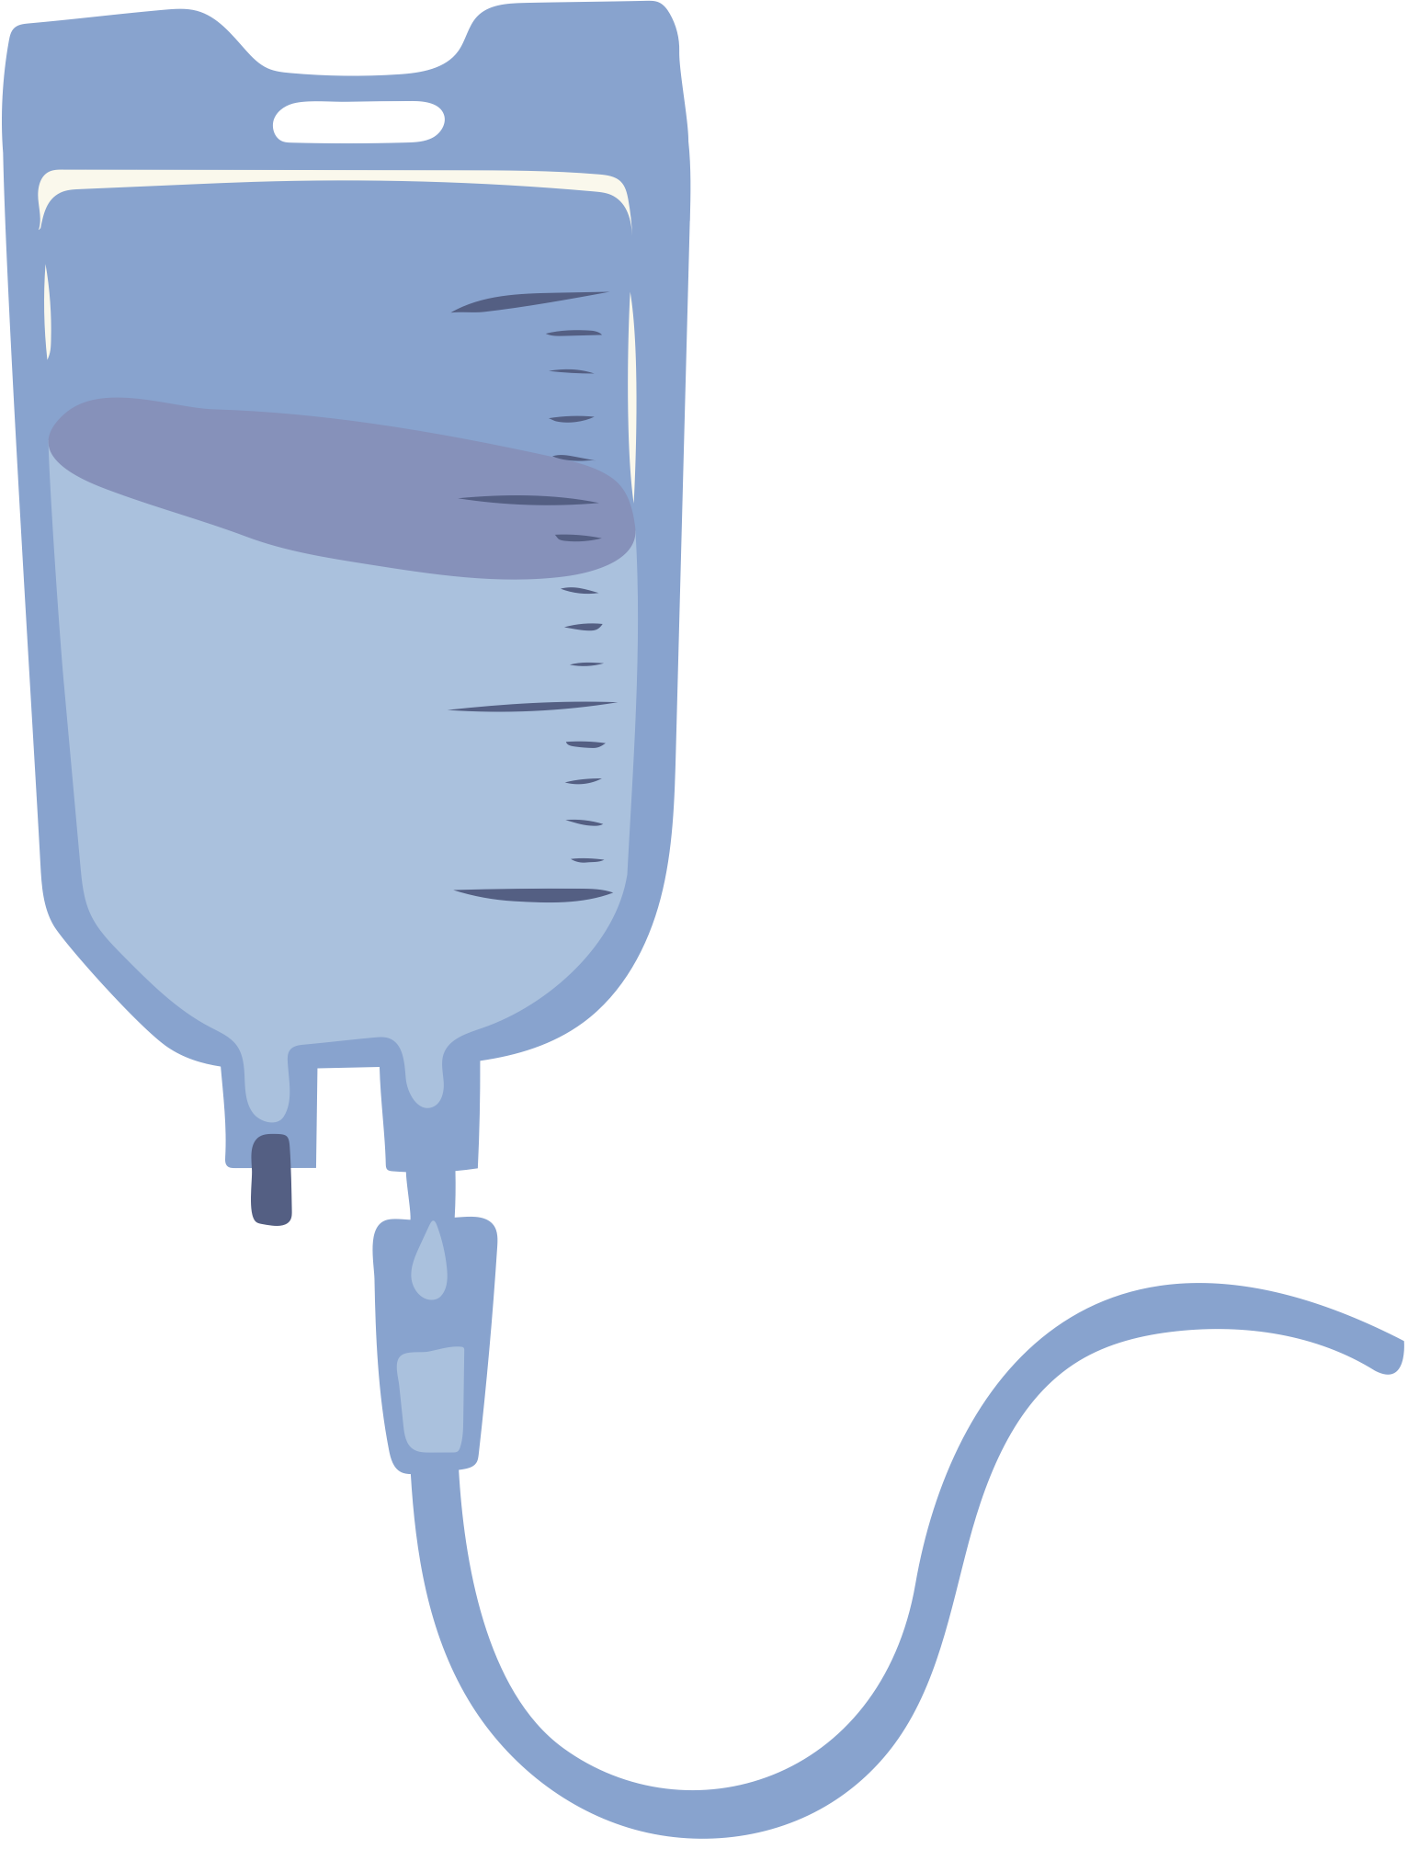
Intellectuals and World War I (Fall 2024)
On the medical front
Nikoletta Kende, 11.11.2024.

Slide 2
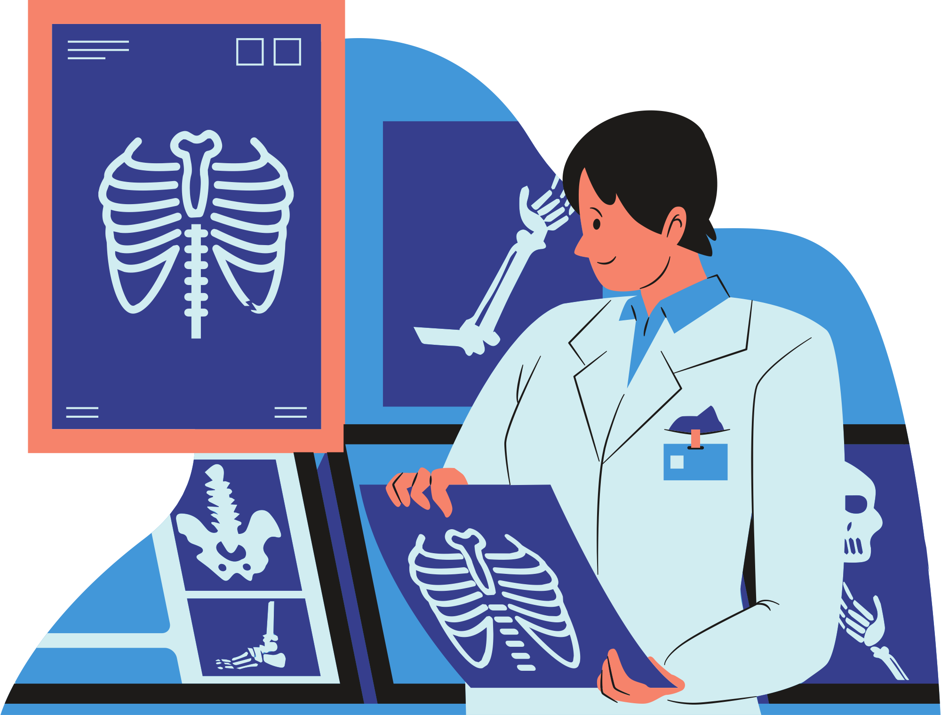


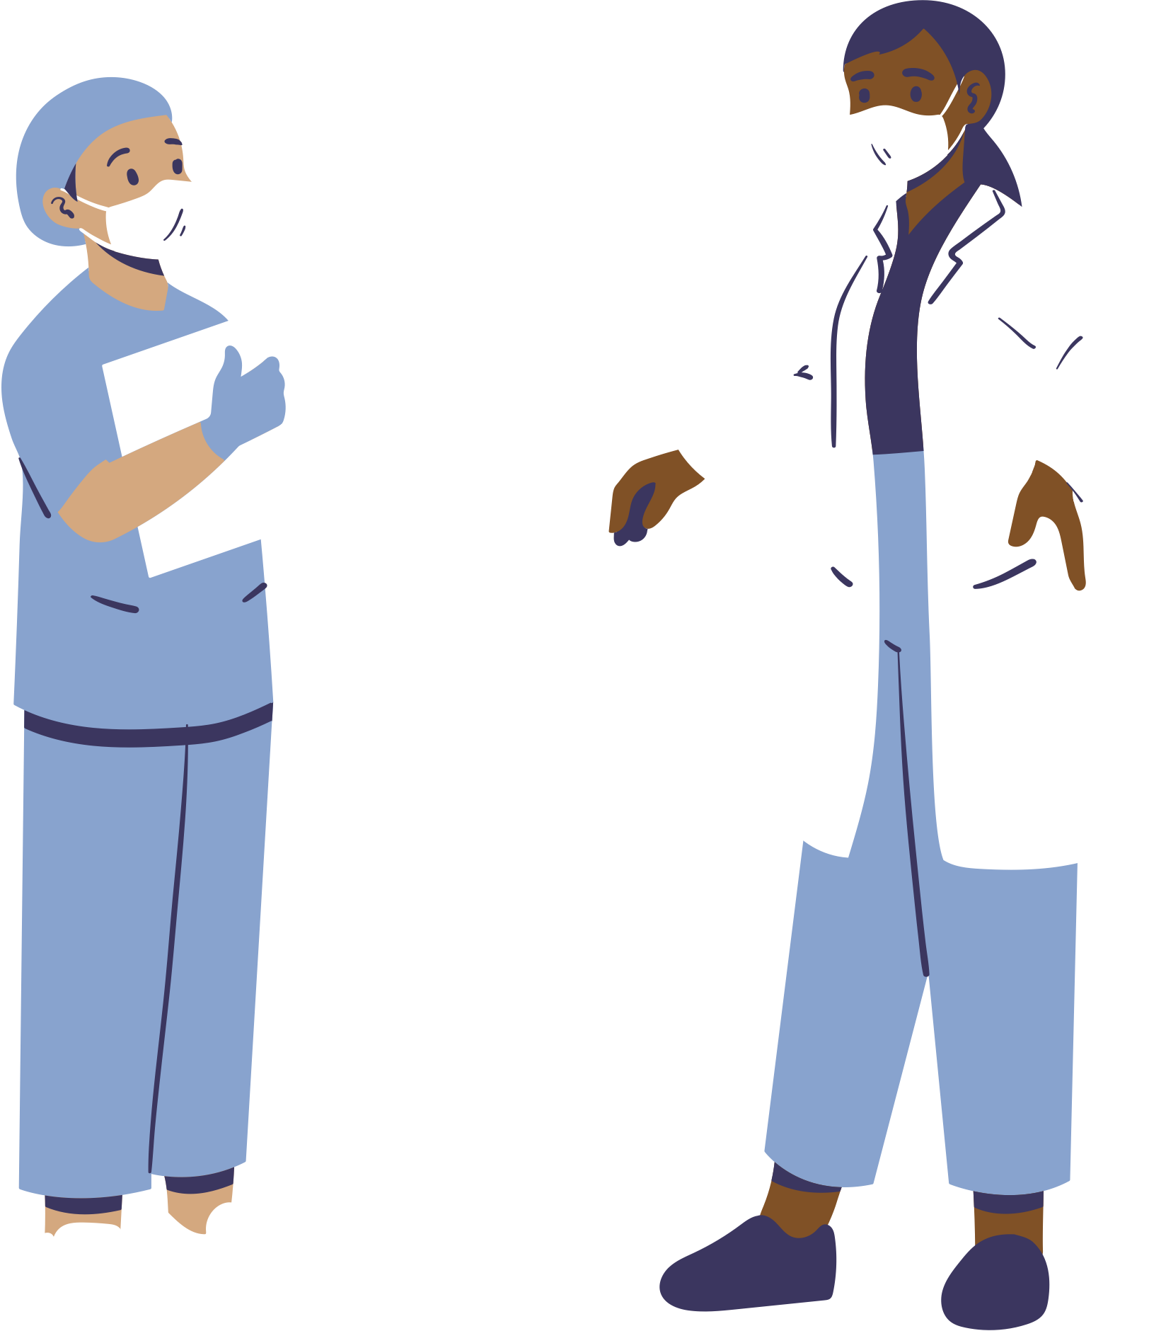

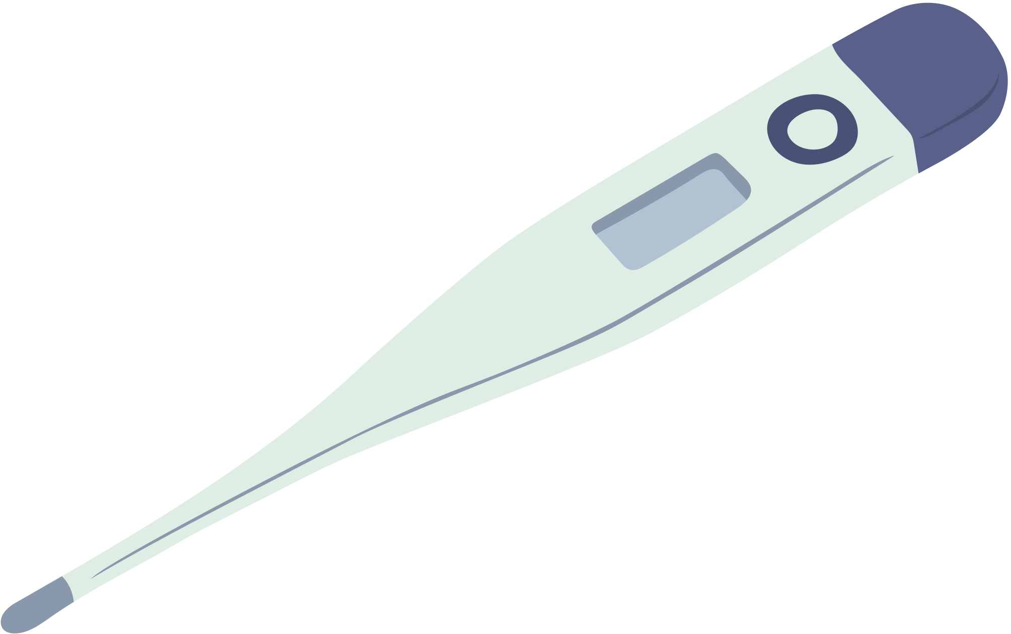
Overview
  Starting point -->
    Emil Grósz: “Medical science at war”
  From the homeland to the field
    The case of X-ray
  The perceptions of the medical intellectuals
    Can there be a bad impression of doctors?

Slide 3
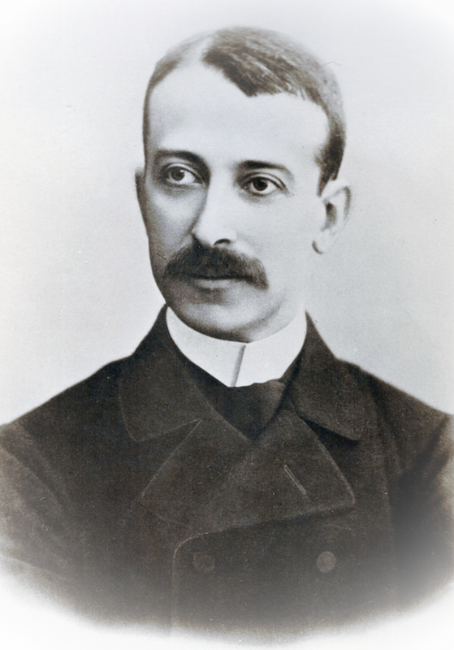
Emil Grósz - “Medical science at war”
About him
  1865-1941
  Doctor (ophthalmology)
About his paper
  Budapesti szemle
  Parallel to the horrors of war, the rise of medicine
  The two most important things to do are to:
    Treat the wounded
      Mostly gunshot wounds
      Changes in the way wounds are treated
    To combat disease, especially epidemics
      Know the pathogens and learn to defend against them
  The role of doctors
  Differences between Germany and Hungary

Slide 4

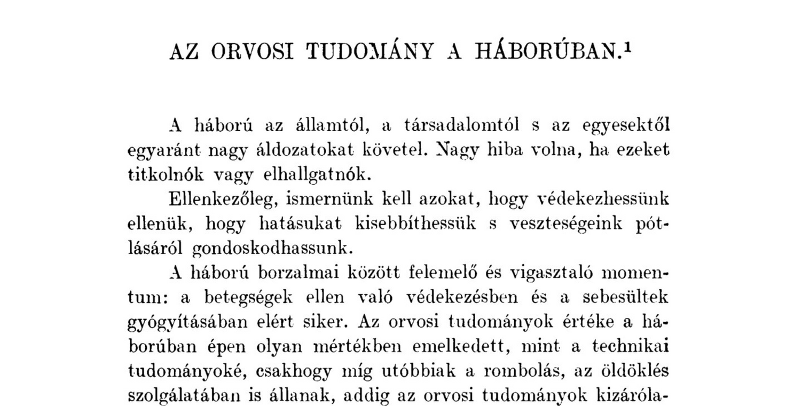
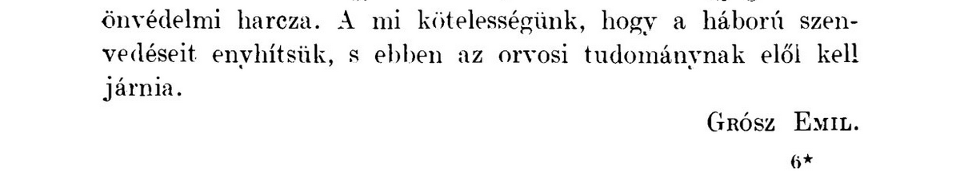
Medical science at war
”It is our duty to alleviate the suffering of war, and in this, medical science must lead the way.”
Budapest Review

Slide 5
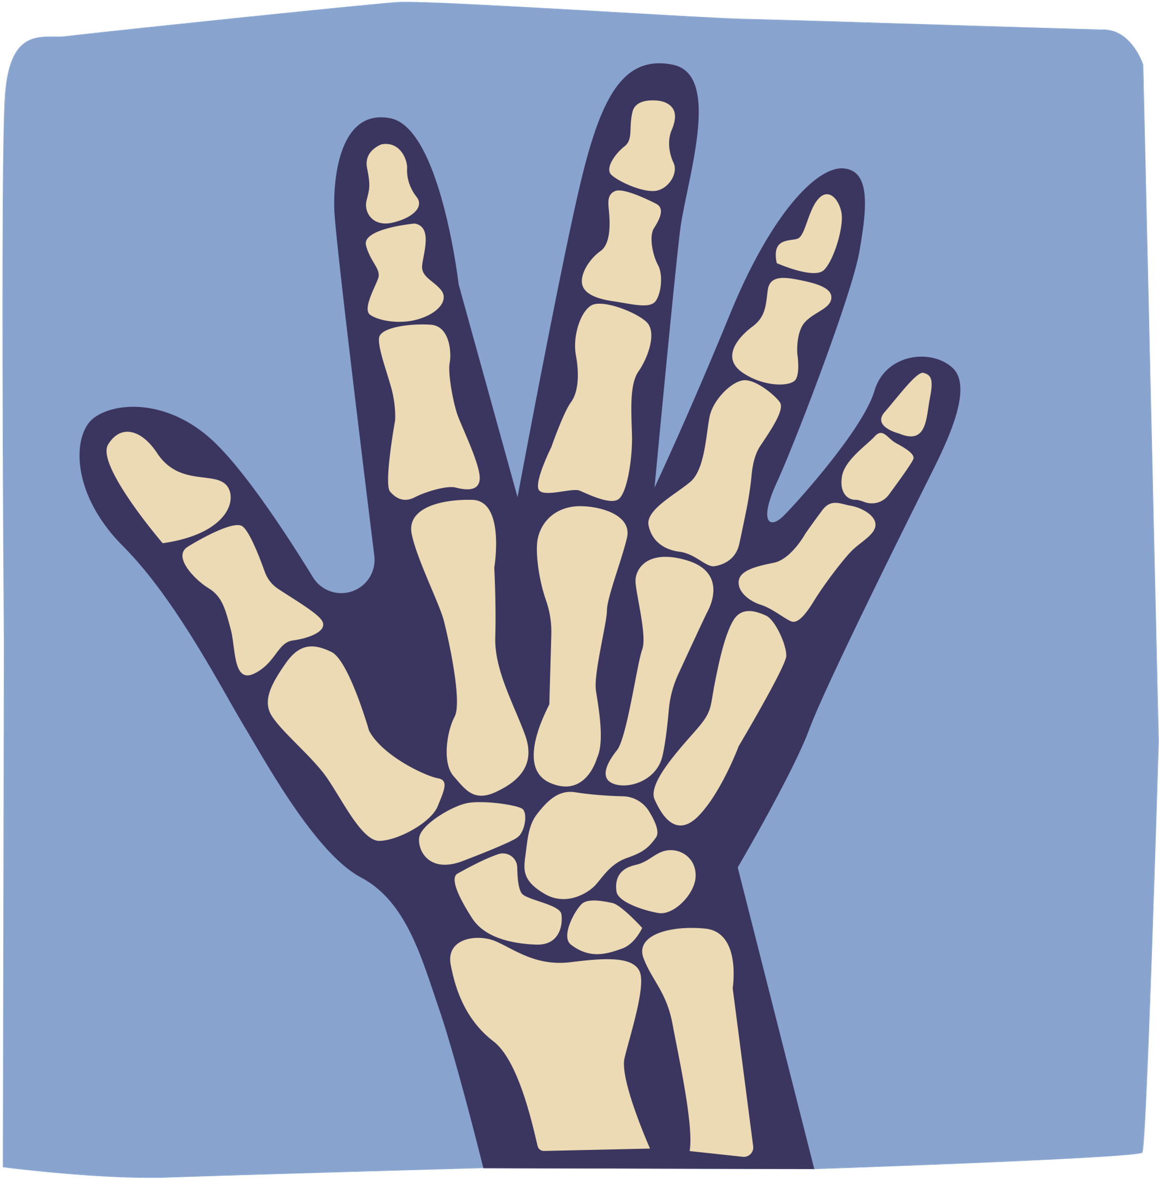
From the homeland to the field:
The case of X-ray
Barclay, Luke C., and Giovanni Mandarano: Australian medical imaging and world war one
  1895 Röntgen discovery --> a year later use
  First use of wartime x-ray imaging --> in the Italian-Ethiopian War
  The first significant implementation of X-rays was during the Boer War
  WWI --> - The changing nature brought complexities to the medical front
    Fast transformation of the battlefield = difficult to move soldiers from the front
    Change in how foreign objects in bodies were managed
    Development of vehicle use

Slide 6
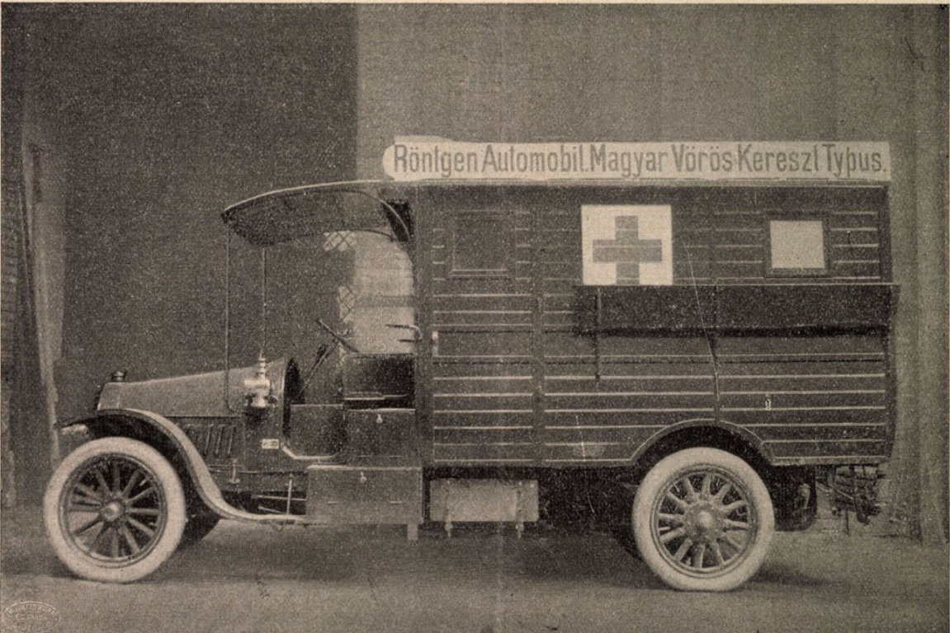
X-ray automobile in Hungary
Weekly medical journal - New type of camp X-ray automobile (1914) and Budapest Medical Journal - Radiology in war (1915)
    “Even during the first Balkan war, reports from the Red Cross Association of the countries of the Holy Crown of Hungary's branch in Sofia showed how inadequate the operation of the field hospital was without proper X-ray equipment.”
      War required the mobilization of X-rays --> Innovations.

Slide 7
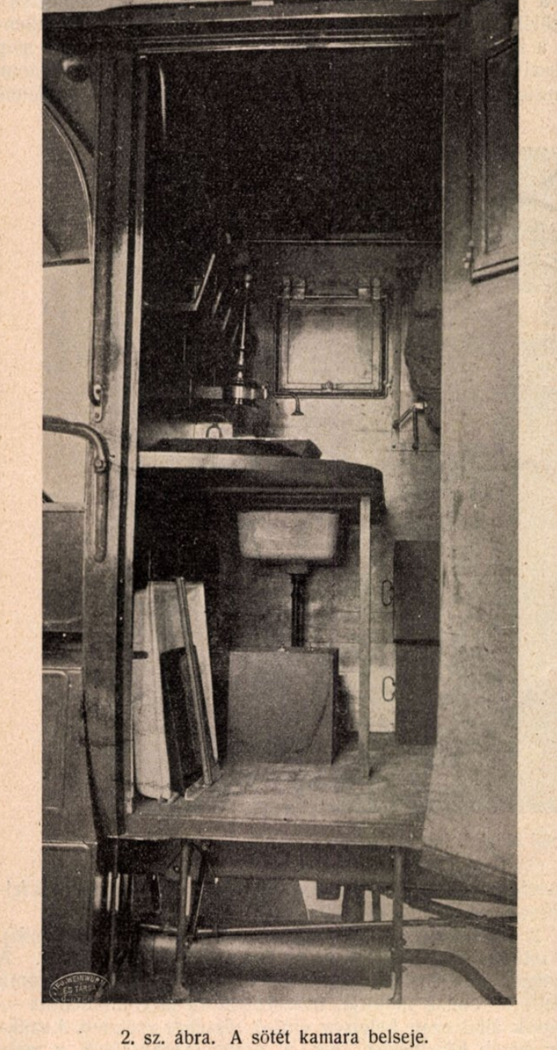
    1. "The specific connection of the car’s engine to the dynamo; as a result, the engine can be used to operate both the car and the X-ray machine."
      ( this can be relaxed if there is a suitable power source to which the X-ray can be connected)
    2. "A separate dark room built into the carosseria,...”
    4. "Another innovation is that we have a working X-ray machine immediately after opening the door of the X-ray room, with the same operability as in the most modern X-ray cabinet; we can work straight from the car. A great disadvantage of the previous camp X-ray equipment was the fact that it had to be unpacked and properly assembled beforehand."
    5. "Another innovation is that the apparatus can be used in any enclosed space (house, barn, doorway, etc.) within a few minutes;"
    10. "Finally, an innovation is the fixing and protection of X-ray lamps against jamming,..."
Weekly medical journal (1914)

Slide 8
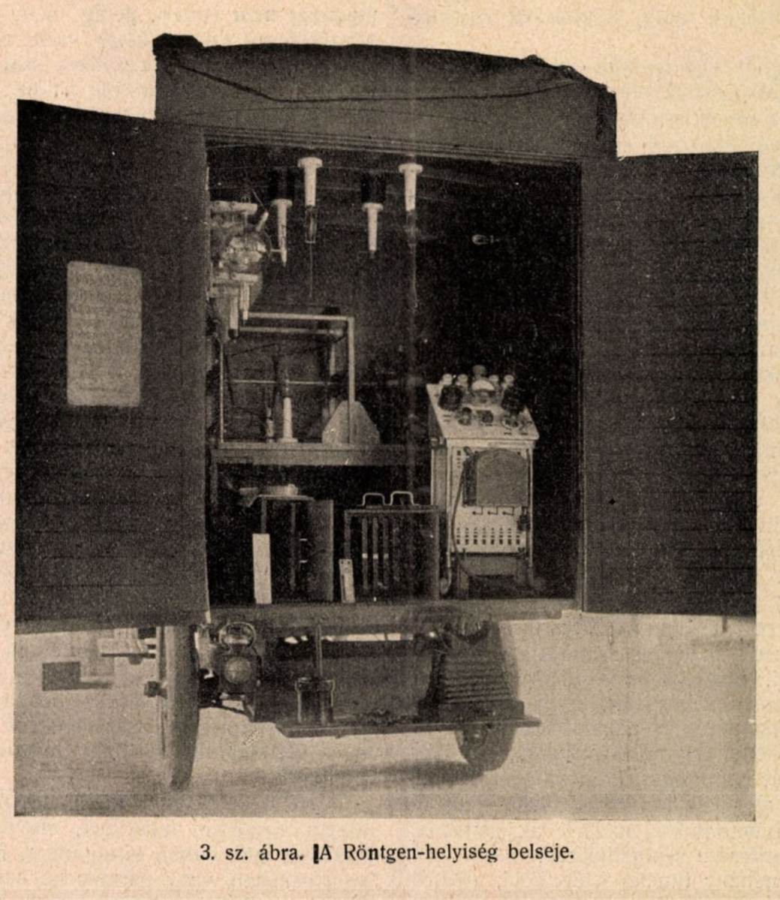
Pros
  More precise identification of injury by imaging
  Quick adaptability
  Can be used anywhere
  Multifunctional for different areas
    'it can also be used by an internist. A simple fluoroscopy can help to determine the compression of lung tissue,..." (Budapest Medical Journal, 1915)
Cons
  Difficulties to see the exact location of the injury on the pictures, and do the surgeries
  X-rays as long-term negative consequences

Slide 9
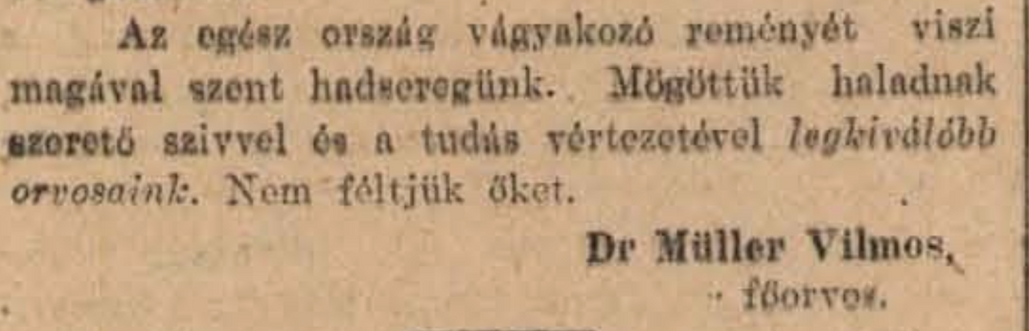
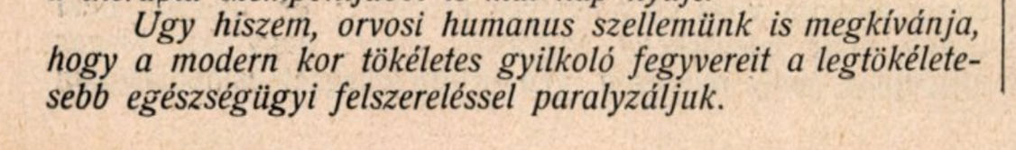
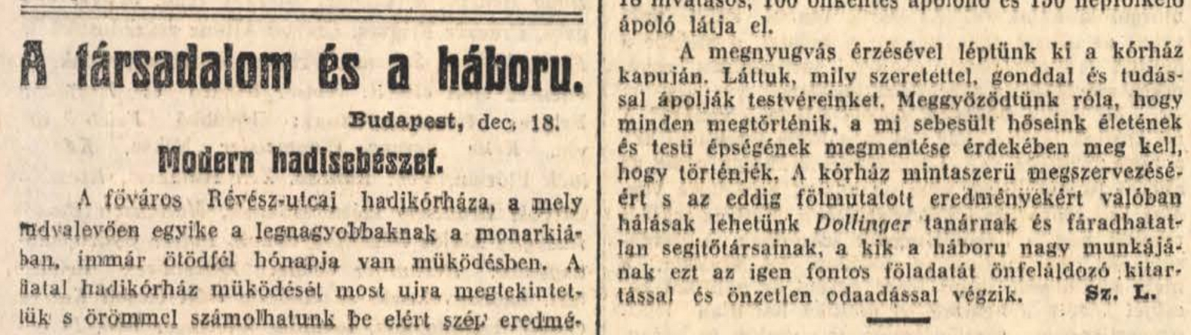
Representation of the medical profession
Medical
“I believe our medical humanism also requires that we paralyze the perfect murder weapons of the modern age with the most perfect medical equipment.”
(Weekly medical journal (1914))
“Our holy army carries the yearning hope of the entire nation with it. Behind them follow our finest doctors, with loving hearts and the armor of knowledge.”
(Pest newspaper (1914))
Traditional
“We have seen the love, care, and knowledge with which they care for our brothers and sisters. We were convinced that everything must be done to save the lives and physical integrity of our wounded heroes.”
(Budapest newspaper (1914))

Slide 10
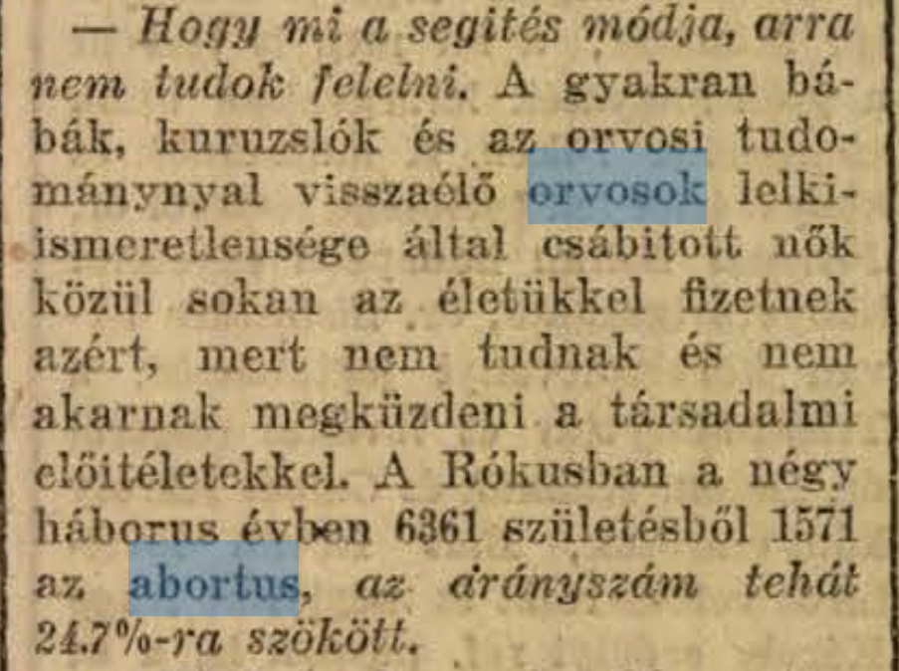
Future questions
The Evening (1918.)
  As Grósz said, the other important progress in the development of public health
    He used the example of Semmelweis “the savior of mothers”
  Conflicts and changes caused by wartime violence in --> Women's self-determination in pregnancy
    Atrocities were committed against civilians by Austrian and Hungarian soldiers as well as Russian, German, and Serbian soldiers
    In the eastern and southern border regions
  Consequences of violence:
    The debate over the authorization of abortions
    Intensified the legal, medical, moral, and ultimately ideological debates
  How the appearance of the doctor (gynaecologist) change in the articles?
"Many women, often seduced by midwives, quacks and unscrupulous doctors who misuse medical science, pay with their lives because they cannot and will not confront social prejudices."

Slide 11
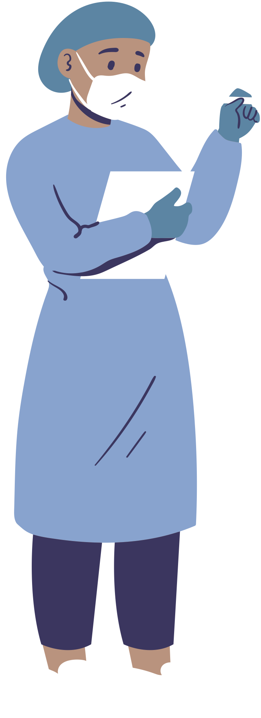
Bibliography
  Emil Grósz, "Az orvosi tudomány a háborúban" Budapesti szemle 161 (1915): 75-83.
  Barclay LC, Mandarano G. Australian medical imaging and world war one. J Med Radiat Sci. 2022 Dec; 69(4): 510-517. doi: 10.1002/jmrs.610.
  Imre Gergő (Dr.), "Uj typusú tábori Röntgen-automobil." Orvosi Hetilap, 1914. 58 (14): 272-275.
  Cohn M., Die Therapie der Gegenwart, 1915 (2) quoted in Budapest Orvosi Újság "A röntgenologia a háborúban." Budapesti Orvosi Újság, 1915. 13 (17): 132-133.
  Vilmos Müller (Dr.), “A Háború egészségügye.” Pesti Hírlap, 1914. 36 (196): 6-7.
  Fanni Svégel “Nemi erőszak az első világháborúban-Kérdések, források, problémák” Sic itur ad astra, 72 (2020): 103-131.
  Andrea Pető, Fanni Svégel, "A háborús nemi erőszak és a nőgyógyász lobbi hatása a magyarországi születésszabályozási rendszerre." Per Aspera ad Astra 8.1 (2021): 50-70.

Slide 12

Thank you for your attention

