Slide 1
Searching for the Laws of the Storm: The Observatory Experiment in British India

Slide 2
Enlightenment and meteorology
Weather was differentiated from Climate
Apocalyptic connotations were no longer assigned to extreme weather events. Rather, weather acted according to physical laws which were manifestations of God’s benevolent providence.
Climate and its impact on the human constitution
Jan Golinski argues that the unpredictability of weather also reminded the thinkers of the Enlightenment about the limits of rational inquiry
Weather diaries become a common occurrence as early as 1703 in Britain.

Slide 3
Metropole and the Colony
Deborah Coen: Acknowledgement of local variations while revealing a higher unity.
Between the metropole and the colony: this dynamic often did not work.
Colonial Climate and its challenges (first experienced in the New World)
Evokes a medical response
Improving ‘Climate’ and the Politics of Built Environments (clearing forests and draining marshes)
The concept of the Pristine Nature (later into the 19th century)

Slide 4
Political Economy and Mapping the Empire
Ironically, cartographic surveys in India (Survey Department established in 1767) pre-date their British counterparts.
First cartographic surveys were undertaken by the Ordinance department.
Land surveys used actually for taxation on land.
Coastal cities were the first to be mapped
Over time cartographic surveys give way to more specialized mapping of agrarian and geological resources
Geological Survey of India is founded only in 1851.
Mapping the unmapped frontiers (a severe colonial anxiety)

Slide 5
The Observatory Experiment
Calcutta Observatory in 1785,
Madras Observatory in 1796
Colaba Observatory in 1826.
Their nature more military than scientific (especially the Colaba Observatory)
All three were located in port cities– their objective was to serve maritime traffic rather than populated settlements
“after collecting observations for nearly a quarter of a century we do not yet know the normal data of the climatology of Bombay”—Report of Committee of Inquiry (1865)
Role of Henry Blanford

Slide 6
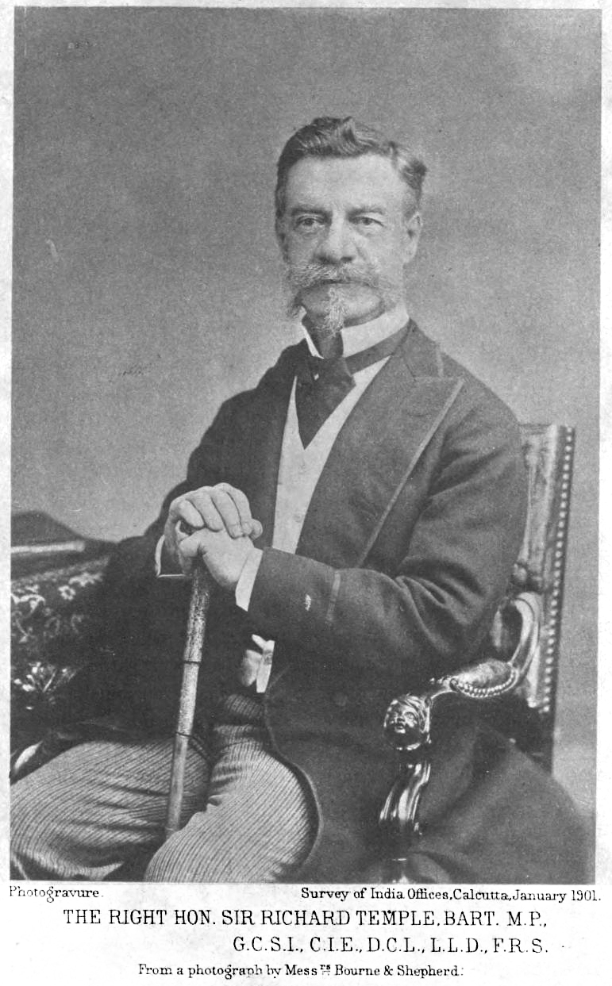
Henry Blanford and Sir Richard Temple

Slide 7
Limitations of the Experiment
“To those who are accustomed to the accurate and minute observations of European observatories, and who know how much the value of meteorological observations depends on the careful comparison of instruments and elimination of instrumental errors, and on the training and experience of observers, it may seem almost wasted labour to attempt to deduce any results from observations made in many cases by unpracticed observers, with uncompared instruments, and from such guesses at the direction and force of wind currents as can be made by persons in their own houses, unconscious of eddies, and judging from a general knowledge of the compass bearings of the place. But these are, for the most part, all that are obtainable in India, and had they been rejected, little would have remained…”
Introduction to the Report on the Calcutta Cyclone 1864. (Henry Blanford)
1876 cyclone that hits Eastern Bengal: it takes several days for the state officials to reach the place of landfall.
Unlike the 1864 cyclone, the 1876 cyclone was claimed to have been predicted.
Unlike in 1864, the port city of Calcutta takes minimal damage (1876) due to precautions but is classified as an ‘imperial disaster’.

Slide 8
Laws of the Storm: These are not the same winds
The term cyclone was used for the first time in 1840 in the Asiatic society of Calcutta.
Derived from Greek Kukloma (wheel, coil of a snake)
A ‘sea of turmoil’ after the retreat of the South-West Monsoon winds (October and November)
Henry Piddington (President of Marine Courts) coins the term cyclone
Sailors Hornbook for the Laws of the Storm (1833)

Slide 9
Blanford’s Probable Laws for storms in the Bay of Bengal
A General Law
How to read the instrumentations (the Barometer)
Predicting the Storm Wave
Laying down a predictive path for cylones
Saving human lives: an imperial responsibility
Blanford’s observations about cyclones in the Bay of Bengal may sound like a 7th grade geography lesson today but seems to be a significant advancement over Piddington’s observations

Slide 10
Conclusion
In the colonial world, more than in the metropole--- economic concerns outweigh the ‘scientific’ in scientific enterprises.
Extreme weather events when they take the shape of a natural disaster--- it becomes a test-bed for the principles of political economy (Richard Temple and relief measures in 1876)

