Slide 1
Science and Nation: the Erasure of Knowledge in 19TH CENTURY SPANISH AMERICA
Andrés Paz
March 13, 2025

Slide 2
Outline
Introduction
Colonial Foundations: How Habsburg and Bourbon science laid the groundwork for independence-era knowledge economies.
Creole Reinvention: The paradox of repurposing colonial institutions while vilifying Spain and highlighting "enlightened science", meaning mostly French and British models.
Humboldt’s Shadow: Eurocentrism as a tool of extraction and erasure.
Legacies of Ignorance: how these myths persist in historiography and how to dismantle them.

Slide 3
Introduction – Science and Nation
Thesis: Post-independence Latin American nations weaponized science to forge national identities, systematically erasing colonial contributions while elevating Eurocentric narratives. This process was deeply intertwined with political economy, as scientific institutions prioritized resource extraction and global hierarchies of knowledge.
Notes:
Hook:
"Can science ever be neutral in the project of nation-building? Imagine a map: Spanish America fractures into republics, Brazil crowns an emperor. Both use science to redraw borders and identities—but whose knowledge counts? Today, we explore how post-independence Latin America weaponized science to erase colonial contributions and elevate Eurocentric myths, all while fueling economies of extraction."
Thesis:
Science was not a neutral tool but a battleground for power. Creole elites, seeking to legitimize new nations, erased three centuries of Hispanic and Indigenous innovation. Meanwhile, figures like Alexander von Humboldt became symbols of Eurocentric exploitation, masking the colonial roots of their 'discoveries.' This process was deeply tied to political economy—who controlled resources, and who profited?

Slide 4
2. Colonial Foundations: Habsburg and Bourbon Science
The Habsburg Legacy (16th–17th Centuries)
Bourbon Reforms (18th Century)
Antonio Lafuente: “The Bourbons gave creoles the tools to dismantle the very empire that created them.”

Slide 5
Hipolito unanue (1755 –1833)
In 1790s Lima, Hipólito Unanue—a mestizo physician—founded the Mercurio Peruano, a journal blending European science with Andean knowledge. He studied Inca terraces as models of sustainable agriculture and used Quechua medicinal practices. Yet after independence, Unanue was recast as a “creole hero,” his Indigenous influences airbrushed from history.

Slide 6
3. Creole Reinvention: Science and Erasure as nation-building
Creole elites and erasure
Case Study: Francisco José de Caldas (New Granada) and Hipólito Unanue (Peru) reframed colonial science as "backward" to legitimize republicanism.
Bourbon Reforms: Centralized scientific institutions (e.g., botanical expeditions) became tools for creole nationalism.
Political economy of science
Economic Modernization: Mining (Potosí), agriculture (Brazilian coffee), and infrastructure projects relied on scientific expertise.
Institutions as Power: Botanical gardens (e.g., Rio de Janeiro) and museums (e.g., Mexican National Museum) controlled natural resources and narratives.
Notes:
Creole Elites & Erasure:
Let’s begin in New Granada, 1810. Francisco José de Caldas—a creole polymath—publishes a manifesto declaring Spanish science "superstitious." Yet Caldas himself trained in Bourbon-era botanic expeditions. His work exemplifies a paradox: post-independence leaders repurposed colonial institutions while vilifying Spain. Why? To frame independence as enlightenment breaking chains of ignorance.
Political Economy of Institutions:
Botanical gardens, like Mexico’s 18th-century Real Expedición Botánica, were colonial projects to catalog exploitable species. Post-independence, these became tools for creole elites to control resources like quinine and rubber. Science wasn’t just about knowledge—it was about profit. In Brazil, the Royal Museum of Rio (founded 1818) showcased mineral wealth to attract European investors, even as it silenced Afro-Brazilian naturalists who collected specimens.
Quote:
As Jorge Cañizares-Esguerra argues, "To be modern, republicans had to deny their colonial past."

Slide 7
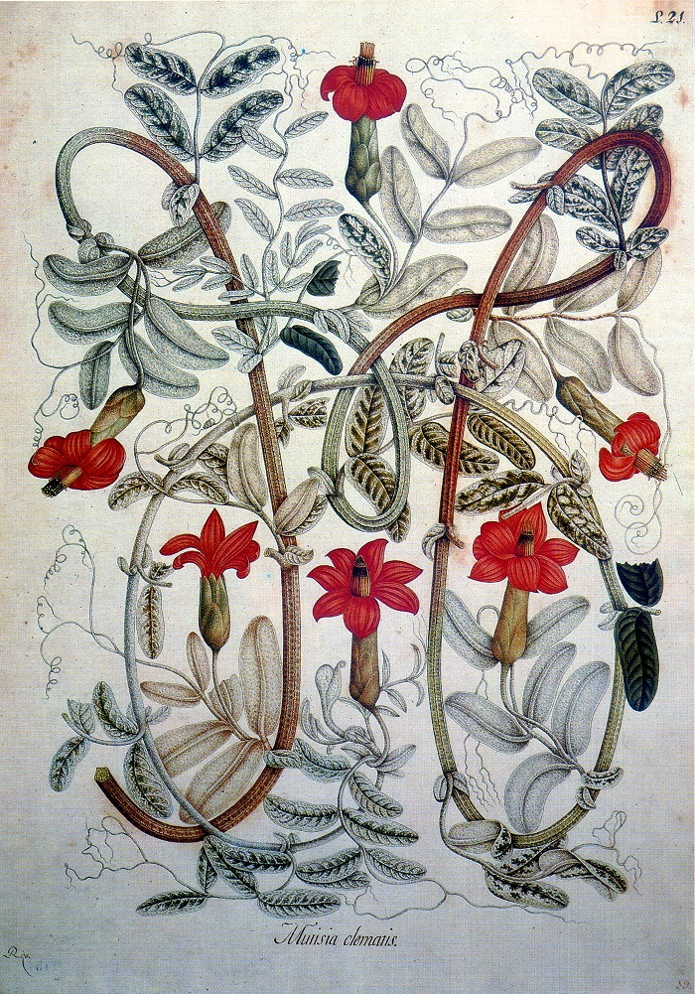
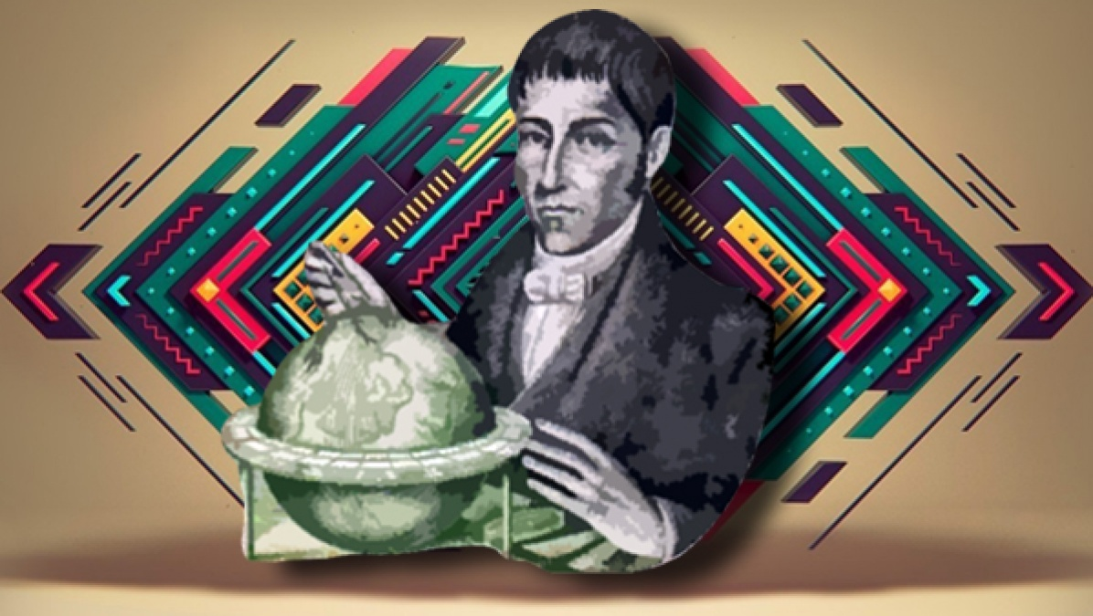
Jose celestino mutis (1732–1808) & Francisco José de caldas (1768-1816)
Real Expedicion Botanica (1783-1813)
Mutisia clematis. Pintada por Salvador Rizo durante Real Expedición Botánica del Nuevo Reino de Granada, de José Celestino Mutis, 1783-1808. Acuarela sobre papel.
"El sabio, el mártir, el héroe"

Slide 8
4. The shadow of Humboldt in spanish america
Eurocentric exploitation
Humboldt’s Political Essay on New Spain relied on Hispanic contributions (e.g., José Celestino Mutis’ botanical archives) but erased them.
Example 1: Andrés Manuel del Río’s discovery of vanadium miscredited to Europeans due to Humboldt’s negligence.
Example 2: Vicente Talledo’s corrections to Humboldt’s Magdalena River map dismissed as "local error."
Racism and extraction
Humboldt dismissed Indigenous/creole expertise (e.g., "learned nothing in Lima") while extracting knowledge for European audiences.
European science legitimized foreign investment (e.g., mining concessions, agricultural exports).
Notes:
Eurocentric Exploitation:
Enter Alexander von Humboldt. In 1803, he arrives in Lima, dismisses local scholars, yet uses their maps and data. Take Vicente Talledo, a Peruvian engineer who corrected Humboldt’s errors on the Magdalena River. Humboldt wrote, "The natives lack precision"—erasing Talledo’s work. This wasn’t oversight; it was strategy. Humboldt’s Political Essay on New Spain became a blueprint for foreign investors, legitimizing extraction by framing Latin America as "discovered" by Europe.
Case Study: Vanadium’s Erasure:
In Mexico, Andrés Manuel del Río identified a new element in 1801—erythronium. He sent samples to Humboldt, who forgot to forward them to Europe. By 1831, a Swede renamed it vanadium. Del Río died in obscurity; Humboldt’s negligence enabled European claims to "discovery."
Racism & Extraction:
Humboldt’s diaries reveal contempt for Lima’s scholars: "I learned nothing here." Yet his theories on the Inca’s "Asian origins" relied on Indigenous chronicles he never credited. Meanwhile, his companion Aimé Bonpland shipped 60,000 plant specimens to Paris—botanical looting masked as science.

Slide 9
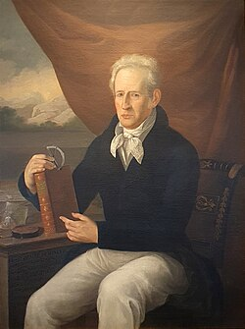
Vanadium? "Eritrhronyum"
Andrés Manuel del Río Fernández (Madrid 1764 – México 1849)

Slide 10
5. Political economy of science and knowledge. A legacy of ignorance?
Asymmetric co-production
Knowledge extraction without reciprocity (e.g., La Condamine’s plagiarism of Quito’s scientific networks).
Brazilian Case: Royal Museum of Rio tied to slavery (e.g., medical research on enslaved populations).
Legacy of Ignorance
Post-independence elites adopted the Black Legend, erasing Habsburg/Bourbon innovations (e.g., Potosí mining technology).
"To be modern, republicans had to deny their colonial past" (Cañizares-Esguerra).
Notes:
Asymmetric Co-Production:
Humboldt wasn’t unique. French geodesist Charles Marie de La Condamine "plagiarized" Quito’s scholars in the 1730s, claiming their astronomical data as his own. Knowledge flowed to Europe, but credit never returned. In Brazil, the Royal Museum used enslaved laborers to collect specimens, yet their contributions vanished from records.
Legacy of Ignorance:
Post-independence elites embraced the Black Legend, erasing Habsburg innovations like Potosí’s hydraulic mills (1580s)—the world’s most advanced mining tech. Why? To justify adopting British/French models. Mexico’s 1824 Congress called Humboldt’s flawed Political Essay "the most reliable guide"—ignoring centuries of Indigenous cartography.
Quote:
Historian Miruna Achim notes, "Humboldt’s greatest discovery was his own genius."

Slide 11
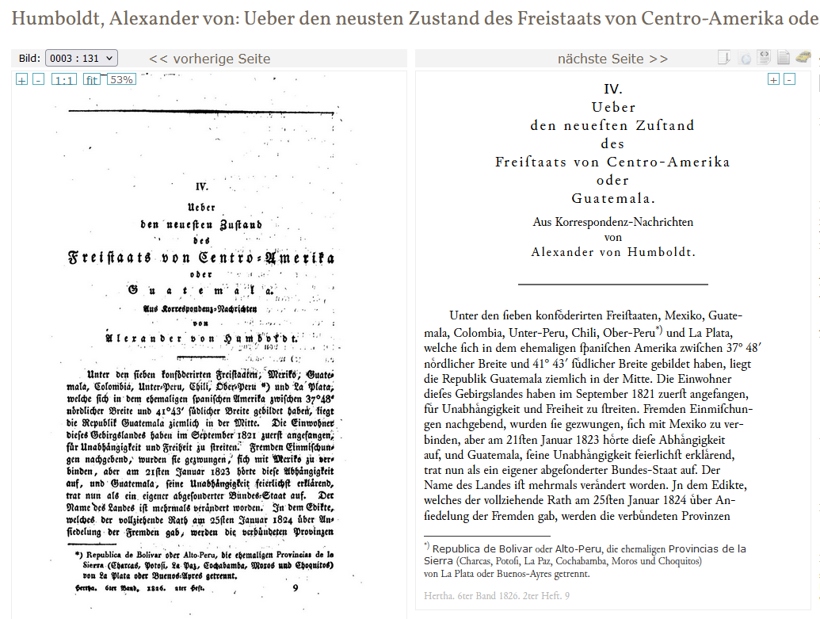
Humboldt, Alexander von: Ueber den neusten Zustand des Freistaats von Centro-Amerika oder Guatemala. In: Herta, Bd. 6 (1826), S. 131-161.
The average barometer reading in this beautiful city is unfortunately still unknown, but judging by the temperature, the altitude above sea level must certainly exceed 600 toises.
The former president of the government committee, Jose del Valle, wrote to me: "Naturally, my homeland is even more favored than Mexico. Instead of that country suffering from drought almost everywhere on the plateau, like old Spain, our Central America is crisscrossed by many wonderful, easily navigable rivers. The vegetation with which the ground is adorned seems to me to be more luxuriant than in Mexico.
If you could have visited my homeland, or if you do so one day, you will be amazed at the extent of the temperate zone (what we call tierras templadas): but these medium-high plains do not form a whole and are more often cut through by valleys. We have ports on both seas, and if these seas were to be connected by a canal near Nicaragua (about which you probably already have many documents), our free state, located in the middle of America, would have to link the trade of the Antilles to the trade of Sinai and by connecting the Indian Archipelago, they will come to occupy an important place in the ranks of nations.
Unfortunately, we have remained completely in the shadowy side of our planet until now, and when I take a look at the maps that come to us from Europe, we can hardly find the mountain ranges and rivers and the names of our most populous cities in the distorted picture of the country. When I left the capital of Mexico in 1823, I hoped to fulfill your long-expressed wish that the mountains of Oaxaca and Guatemala should finally be measured through my own efforts. I had equipped myself with a good barometer and thermometers.
Unfortunately, the barometer broke in the venta salata, and all that remained for me was to determine the altitude approximately by determining the south point, using the method that your learned friend Caldas often used with you in South America. I hope to send you these temperature observations soon

Slide 12
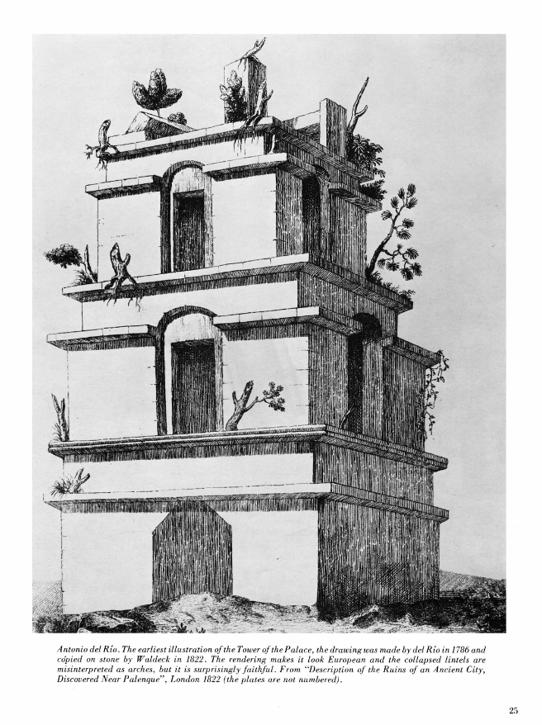
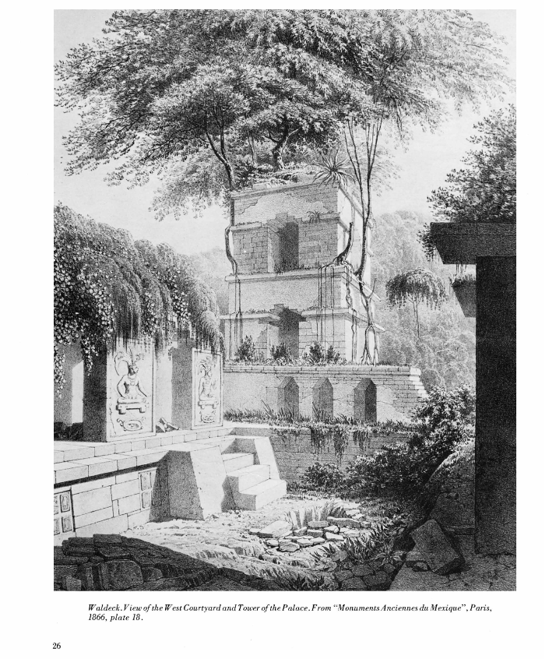
Humboldt, Alexander von: Ueber den neusten Zustand des Freistaats von Centro-Amerika oder Guatemala. In: Herta, Bd. 6 (1826), S. 131-161.
1) The ruins of the old Ciudad del Palenque or Culhuacan in the state of Chiapa, on the river Micol, north-west of the Indian village of Santo Domingo Paleuque in the formerly so-called province of Tzendales.
In the reign of King Charles III, the order was given from Madrid to the artillery captain Antonio del Rio in 1786 to examine and depict these ruins, which are several miles in circumference.
A part of his work was fortunately brought to England and published there under the title: Description of the ruins of an Ancient City discovered near. Palenque in the Kingdom of Guatemala by Captain Ant. del Rio with notes by Doctor Paul Felix Cabrera. (Lond. 1822.). A bas-relief on which a child is consecrated to a cross, the strange heads with large noses and receding foreheads, the Caligulae in Roman style for footwear, the striking resemblance to Indian deities sitting with their legs crossed, and the somewhat stiff but correctly proportioned figures*) must inspire lively interest in anyone who is interested in the prehistory of mankind. A few days ago Mr. Latour Allard (from New Orleans) brought to Paris a new collection of drawings of the ruins of Palenque in Mexico. These drawings are the fruits of the journey of Captain Dupe, a Mexican archaeologist, with whom I made several interesting excursions. I myself possess a drawing of the adoration of a holy cross from Palenque, quite different from those depicted in the English work.
"These are the reports that I have been able to gather so far about the free state of Central America. The country, endowed with the most magnificent natural products, is still almost unopened to European trade. Its young people, the so-called copper-colored Indians, are more industrious and educated than in any other part of Spanish America, not excluding even Cuzco and Michoacan. "

Slide 13
6. Conclusion
Summary:
Science was a tool of nationalism and economic control, erasing Hispanic contributions to serve Eurocentric narratives.
Post-independence Latin America’s “scientific revolution” was a myth built on erasure—of Indigenous wisdom, Afro-diasporic labor, and colonial innovation. Creole elites and European savants like Humboldt collaborated in this project, perhaps not out of malice, but because it served their political and economic interests. Science became a currency of power, and ignorance its collateral damage.
Notes:
Summary:
Science in post-independence Latin America was a tool of erasure and extraction. Creole elites weaponized it to build nations; Humboldt became a patron saint of Eurocentrism. Both relied on silencing colonial and Indigenous knowledge.
Implications:
Decolonizing science means asking: Who gets to narrate the past? Recovering figures like Talledo, Del Río, and Afro-Brazilian naturalists isn’t just about fairness—it’s about dismantling myths that still shape resource exploitation today.
Call to Action:
Next time you see a map or a museum exhibit, ask: Whose labor, whose genius, is invisible here?
Q&A Prompt:
"How might modern institutions address these erasures? Could repatriating knowledge be as vital as repatriating artifacts?

