Slide 1
“Science and Identity in Ukraine
(Late 19th – Early 20th Century)”
This presentation explores the debate within the academic sphere regarding the role of science in Ukraine during the late 19th and early 20th centuries. It examines the tension between serving the Ukrainian national cause and remaining supra-national, highlighting the diverse positions held by intellectuals and scholars of the time. We will delve into the perspectives of Ukrainophiles, cosmopolitans, and imperial loyalists, and the impact of scientific societies on nation-building.
Prepared by:
Kateryna Zinchenko

Slide 2
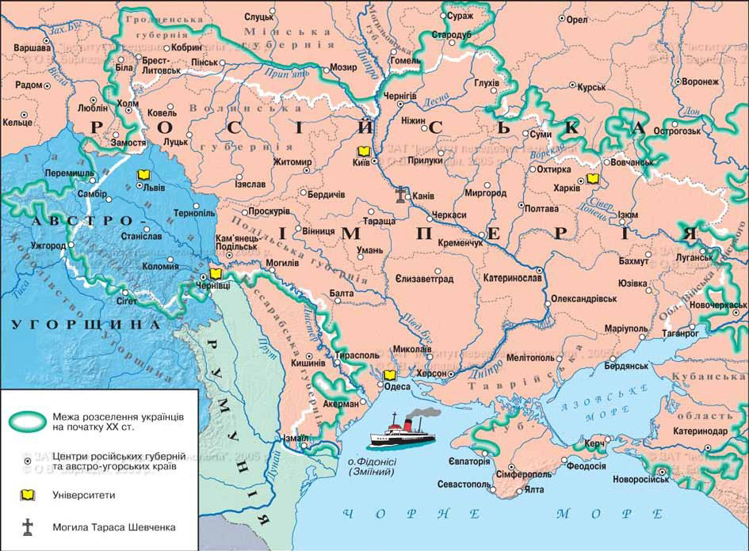
Key Scientific Centers in Ukraine
Russian Empire
Institution | City | Established | Type
Kharkiv University | Kharkiv | 1805 | University
St. Vladimir University | Kyiv | 1834 | University
Novorossiysk University | Odesa | 1865 | University
Southwestern Branch of the Russian Geographical Society | Kyiv | 1870s | Scientific Society
Kyiv Scientific Society | Kyiv | 1907 | Scientific Society
Austro-Hungarian Empire
Institution | City | Established | Type
Lviv University | Lviv | 1661 | University
Chernivtsi University | Chernivtsi | 1875 | University
Shevchenko Literary Society | Lviv | 1873 | Scientific Society
Shevchenko Scientific Society (NTSh) | Lviv | 1892 | Scientific Society
https://geomap.com.ua/uk-uh5/709.html
Zoryana, K. 2021. "The First Higher Educational Institutions of Ukraine." Published October 13, 2021. https://studies.in.ua/shpora-hukr/318-61-rozvitok-osvti-v-ukrayin-hh-st.html.

Slide 3
The Debate: Should Science Serve the Nation or Remain Universal?
Ukrainophile (nationalist) position
Most Ukrainian-speaking intellectuals believed that science was a powerful tool for awakening the nation. They aimed to establish their own Ukrainian scientific schools, terminology, and academic works on Ukrainian history, philology, and economics in their native language.
Cosmopolitan (Internationalist) Approach This view was held by scholars who believed that science transcended national borders and should develop as a unified global effort. Their priority was integration into the international scientific community, with language and national identity considered secondary.
Imperial-Loyalist (Anti-National) Approach A segment of the educated elite opposed the idea of a distinct Ukrainian scientific tradition.

Slide 4
The pro-ukrainian movement faced resistance from the authorities. In the Russian Empire, the Valuev Circular of 1863 explicitly stated that "there never was and never will be a separate Little Russian language" and banned the printing of non-academic books in Ukrainian.
The Ems Ukaz of 1876 went further, prohibiting most Ukrainian publications, including popular science works. As a result, many Ukrainophile scholars either emigrated or sent their research to Galicia, where censorship was more lenient.
Remy, Johannes. 2007. "The Valuev Circular and Censorship of Ukrainian Publications in the Russian Empire (1863-1876): Intention and Practice." Canadian Slavonic Papers / Revue Canadienne des Slavistes 49 (1/2): 87–110. https://www.jstor.org/stable/40871165.
Yerofeyev, Ivan Alekseyevich, Stebelsky, Ihor, Zasenko, Oleksa Eliseyovich, Makuch, Andrij, Hajda, Lubomyr A., Kryzhanivsky, Stepan Andriyovich. "Ukraine". Encyclopedia Britannica, 5 Mar. 2025, https://www.britannica.com/place/Ukraine.

Slide 5
The Kyiv Scientific Community
In Eastern (Russian-controlled) Ukraine, all official Ukrainian organizations were banned until 1905. However, a crypto-academic environment existed. In the 1870s–1890s, a secret Hromada (1863-1887) operated in Kyiv, bringing together Ukrainophile scholars, doctors, and lawyers such as Volodymyr Antonovych, Pavlo Chubynsky, Fedir Vovk, and Oleksandr Konysky. They published the journal Kyivska Starina in St. Petersburg—though written in Russian, it focused on Ukrainian history and ethnography, making it a de facto scholarly periodical on Ukrainian studies.
These groups often operated under the umbrella of local Prosvita (1868—1939)societies, which focused on public education and libraries. Through Prosvita, scientific knowledge in Ukrainian reached a broad audience—popular brochures on agriculture, regional geography, and Cossack history were widely distributed. This process played a crucial role in fostering national consciousness from the grassroots level.
Zhytomyr Ivan Franko State University. 2016. "The Role of Public Organizations ‘Hromada’ and ‘Prosvita’ in Organizing Social Work with the Population." Published February 14, 2016. https://studfile.net/preview/5263933/page:2/.

Slide 6
UKRAINOPHILE (NATIONALIST) POSITION
The Shevchenko Scientific Society (NTSH)
NTSH as Central Institution: Became the main academic body for Ukrainian scholars in Lviv, especially after its 1892 reorganization.
Academic Activities: Organized research sections and published Zapysky NTSH, covering history, philology, economics, and natural sciences.
Role in National Movement: United intellectual resources; under Hrushevsky, attracted contributors from the restricted Dnieper region.
Scientific Publications: Published over 100 scholarly volumes (1890–1914), including key works by Hrushevsky, Franko, Verkhratsky, and Levytsky.
Impact on Ukrainian Scholarship: Established terminology and methodology in multiple fields.
Patriotic Education: Distributed popular works through Prosvita reading rooms, increasing literacy and national awareness.
Global Recognition: Honorary members included Einstein, Hilbert, and Planck, strengthening NTSH’s international prestige.
Loktiev, V. M. Natsionalʹna akademiia nauk Ukrainy: istoriia stanovlennia, uspikhu, problem i perspektyv [National Academy of Sciences of Ukraine: History of Formation, Success, Problems, and Perspectives]. National Academy of Sciences of Ukraine, 2019. https://doi.org/10.18524/1815-7459.2019.1.159484.

Slide 7
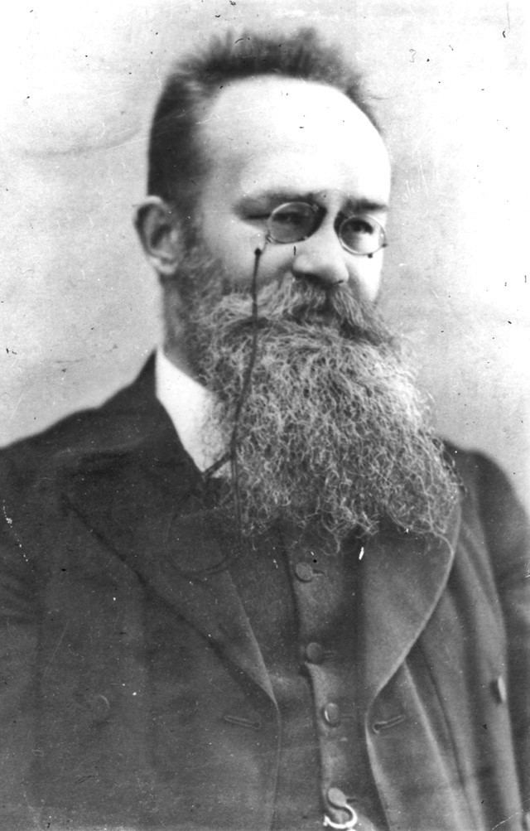
Mykhailo Hrushevsky (1866–1934) – Historian, Science Organizer
A professor of history and author of the monumental multi-volume History of Ukraine-Rus’, Hrushevsky was the head of NTSH (1897–1913) and later the head of the Central Rada of the Ukrainian People's Republic (1917–18).
As a scholar, he viewed Ukrainian history as the foundation of national formation. He reformed NTSH, turning it into a miniature academy. Upon returning to Kyiv in 1917, he initiated the establishment of the Ukrainian Academy of Sciences. His pro-Ukrainian stance is evident in his statement:
“The time has come,” Hrushevsky wrote, “to dress scholarly work, developed on Kyiv soil throughout the 19th century, in national Ukrainian attire.”
With these words, he called for Ukrainian science to have both a national form and content.
Ohloblyn, Oleksander, and Lubomyr Wynar. 1989. "Hrushevsky, Mykhailo." In Encyclopedia of Ukraine, vol. 2. Edited by Danylo Husar Struk. Toronto: University of Toronto Press. Updated version available at https://www.encyclopediaofukraine.com/display.asp?linkpath=pages%5CH%5CR%5CHrushevskyMykhailo.htm.

Slide 8
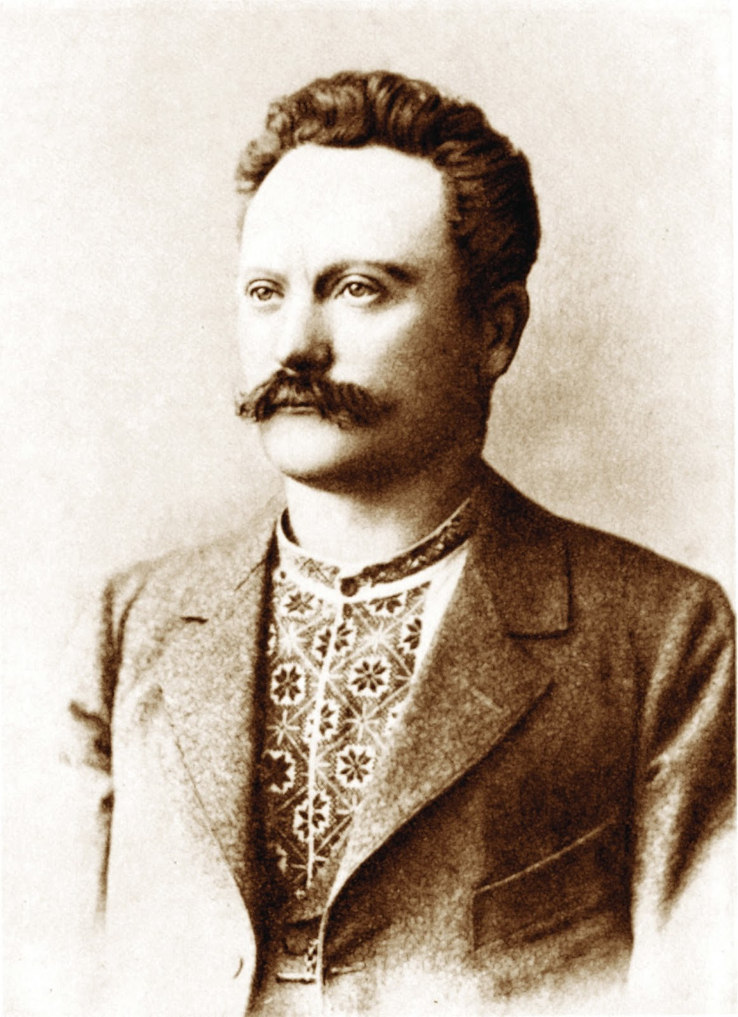
Ivan Franko (1856–1916) – Writer, Literary Scholar, Ethnographer A Doctor of Philosophy from the University of Vienna, co-editor of the Literary and Scientific Herald of NTSH, and author of numerous studies in history, economics, and folklore, Franko was one of Ukraine’s first modern European-level intellectuals. A polyglot, he passionately advocated for the unity of all Ukrainian lands and a culture accessible to the people.
“We must learn to feel like Ukrainians—not Galician, not Bukovinian Ukrainians, but Ukrainians without official borders,” Franko urged, emphasizing a broader Ukrainian identity beyond administrative divisions.
His vision underscored the necessity of national unity and the development of a common cultural and scientific space for all Ukrainians.
ArmyInform. 2019. "Ivan Franko: ‘We Must Learn to Feel Like Ukrainians—Not Galician, Not Bukovinian Ukrainians, but Ukrainians Without Official Borders.’" Published August 27, 2019. https://armyinform.com.ua/2019/08/27/ivan-franko-my-mayemo-navchytysya-vidchuvaty-sebe-ukrayinczyamy-ne-galyczkymy-ne-bukovynskymy-ne-rusynamy-a-ukrayinczyamy-bez-oficziyalnyh-kordoniv/.

Slide 9
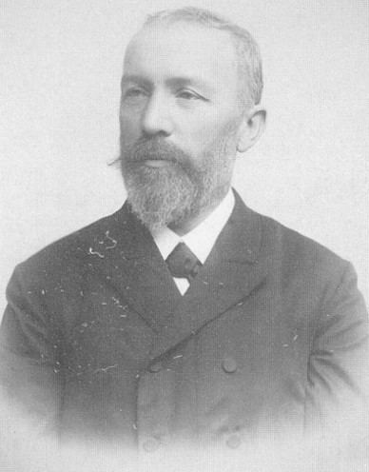
Ivan Puliui (1845–1918) – Physicist and Electrical Engineer A native of Ternopil region and a professor at the Prague Polytechnic Institute, Puliui is renowned for his discovery of X-rays simultaneously with Wilhelm Röntgen (Puliui was the first to create X-ray images). He was also an active public figure—while still a student, he translated the Bible into Ukrainian and published articles in European journals about the Ukrainian question.
He strongly supported Ukraine’s independence and, during World War I, wrote:
“Our greatest and most important desire, idea, and primary goal of our national aspirations is a Ukraine liberated from Russia… where the Ukrainian people… will lead a free national life in all directions, freely develop their great intellectual abilities, and contribute to the enrichment of the cultural treasures of all humanity.”
This passionate statement reflects Puliui’s belief that only in an independent state could Ukrainians fully realize their potential and contribute to human progress.
Kostenko, Iryna. 2023. "Incredible Facts About the Outstanding Ukrainian Who Discovered X-Rays Long Before Röntgen." RBC-Ukraine, November 18, 2023. https://www.rbc.ua/rus/styler/vidkriv-h-promeni-14-rokiv-rentgena-i-buduvav-1698954999.html.

Slide 10
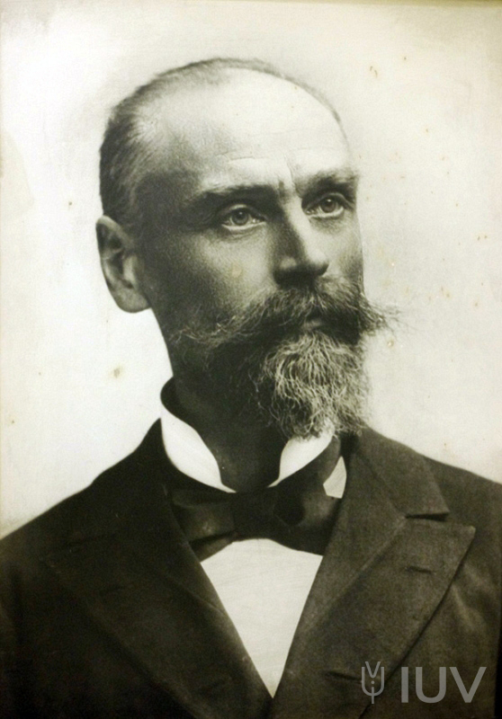
Ivan Horbachevsky (1854–1942) – Chemist and Physician The first scientist in the world to synthesize uric acid (1882), Horbachevsky is considered the founder of Ukrainian biochemistry. He was a professor at Charles University in Prague and later served as rector of the Ukrainian Free University (1924–1925). In Austria-Hungary, he held the position of Minister of Health, becoming the first Ukrainian minister in Vienna.
Despite living abroad, Horbachevsky remained devoted to Ukraine, never abandoning his native language and actively supporting the Ukrainian movement. Contemporaries noted:
"He always felt like a son of Ukrainian land and devoted all his efforts to the elevation and liberation of his people."
His dedication to Ukraine also manifested in his scientific work—he compiled the first chemistry textbooks in Ukrainian and contributed to the establishment of Ukrainian scientific departments in Vienna and Prague.
Ternopil National Medical University. 2024. "Повсякчас відчував себе сином української землі" [Always Felt Like a Son of the Ukrainian Land]. Published March 8, 2024. https://www.tdmu.edu.ua/medychna-akademia/%D0%BF%D0%BE%D0%B2%D1%81%D1%8F%D0%BA%D1%87%D0%B0%D1%81-%D0%B2%D1%96%D0%B4%D1%87%D1%83%D0%B2%D0%B0%D0%B2-%D1%81%D0%B5%D0%B1%D0%B5-%D1%81%D0%B8%D0%BD%D0%BE%D0%BC-%D1%83%D0%BA%D1%80%D0%B0%D1%97%D0%BD/.

Slide 11
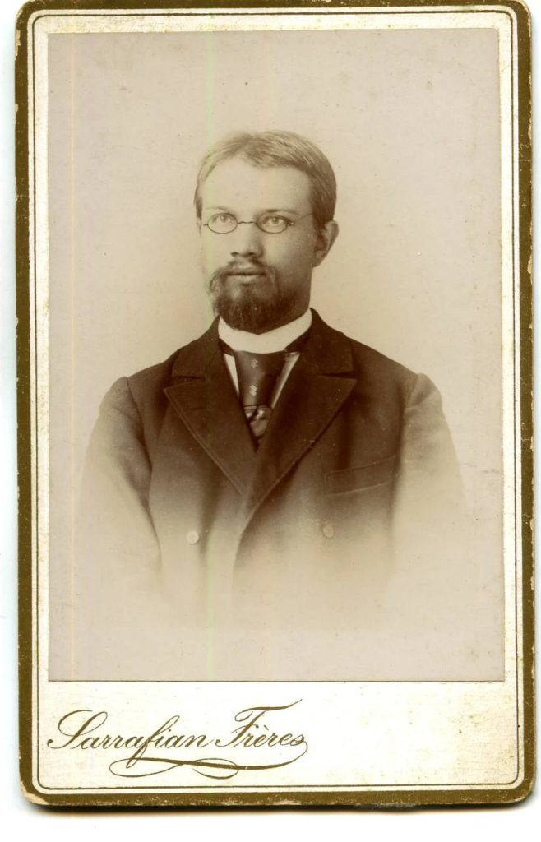
Ahatanhel Krymsky (1871–1942) – Linguist and Orientalist A founding member of the Ukrainian Academy of Sciences in 1918 and its long-time scientific secretary, Krymsky was a distinguished scholar in Eastern languages, Islam, and folklore. Born into a family with Tatar and Polish roots, he consciously chose Ukrainian identity. He famously stated:
"Not a drop of Ukrainian blood runs in my veins, yet... I am truly Ukrainian: Ukrainian in spirit, because I live on this land and love it."
Krymsky devoted his life to advancing Ukrainian scholarship, developing Ukrainian terminology in Oriental studies, corresponding in Ukrainian, and even teaching the Quran in Ukrainian.
In July 1941, he was arrested, accused of anti-Soviet nationalist activities, and imprisoned in the NKVD prison in Kustanai (Kazakhstan). On January 25, 1942, the scientist and poet died in the prison infirmary.
Orlova, Halyna. 2023. "‘Мушу бути українофілом’: дивовижна історія Агатангела Кримського" [‘I Must Be a Ukrainophile’: The Amazing Story of Ahatanhel Krymskyi]. Litopys.info, July 19, 2023. https://litopys.info/articles/mushu-buty-ukrayinofilom-dyvovyzhna-istoriya-agatangela-krymskogo-galyna-orlova/.

Slide 12
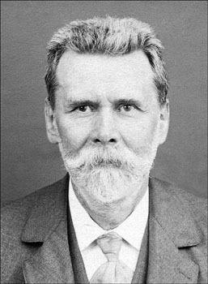
Fedir Vovk (1847–1918) – Anthropologist, Ethnographer, Archaeologist Vovk spent 26 years in exile in Switzerland and France due to persecution by the Russian imperial government. There, he became a renowned anthropologist. Returning to the Russian Empire in 1905, he led the NTSH Ethnographic Commission in Lviv.
Vovk conducted the first systematic anthropological studies of Ukrainians, proving their distinctiveness from neighboring peoples, thereby refuting the theory of a "unified Russian people." His work helped integrate Ukrainian science into the European academic world. Historian Levko Chykalenko described his contribution as follows:
"Fedir Kindratovych Vovk, though always mentally and emotionally in Ukraine, took on the difficult mission of linking Ukrainian science with French science, becoming... a bridge through which the scientific ideas of Western Europe reached us and vice versa."
This characterization highlights Vovk’s patriotic mission: to work for Ukraine even while abroad and to introduce the world to Ukrainian culture.
Bondaruk, Lesia. 2024. "Fedir Vovk: The Anthropologist Who Debunked the Theory of ‘The Merging of Three Nations.’" History Rayon, March 17, 2024. https://history.rayon.in.ua/topics/687907-fedir-vovk-antropolog-yakiy-ruynuvav-teoriyu-zlittya-trokh-narodiv.

Slide 13
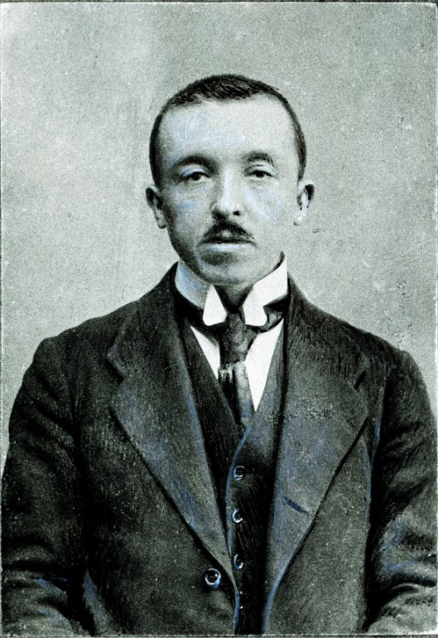
Stepan Rudnytsky (1877–1937) – Geographer and Cartographer The founder of Ukrainian scientific geography, Rudnytsky was a professor at Lviv University. From 1920, he worked in Vienna and Prague, and in 1926, he became an academician of the All-Ukrainian Academy of Sciences in Kyiv. He was the first to present Ukraine as a distinct geographical and geopolitical entity in European scholarship.
In his works "Survey of Ukraine's Territory" (1905) and "Why We Want an Independent Ukraine" (1915), he justified the necessity of Ukrainian statehood from both a geographical and national perspective. Rudnytsky emphasized that without statehood, a nation was doomed:
"Without an independent democratic national state, conditions arise for the political, economic, and cultural oppression of one people by another."
For his pro-Ukrainian stance, Rudnytsky was repressed during Soviet rule and was executed in 1937.
Geografica. n.d. "Степан Львович Рудницький" [Stepan Lvivovych Rudnytskyi]. Accessed March 5, 2025. http://geografica.net.ua/publ/cikavinki/vidomi_vcheni_geografi/stepa_n_lvo_vich_rudni_ckij/51-1-0-683.

Slide 14
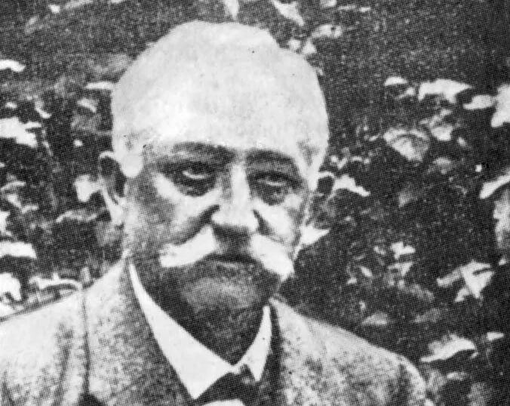
Yevhen Ozarkevych (1861–1916) – Physician and Public Figure Founder of the Ukrainian Medical Society in Lviv (1910) and initiator of the first Ukrainian hospital, Narodna Lichnytsia (1903), Ozarkevych was an active member of NTSH, leading its Medical Commission. He worked to develop medical science in the Ukrainian language, edited medical journals, and represented Ukraine at international congresses.
In 1912, during the preparation of the First All-Slavic Congress of Public Health, E. Ozarkevich, as the head of the Ukrainian Medical Sociaty, called:
“for participants from Galician and Russian Ukraine to act corporately as one whole, to create together one national section,”
and insisted on the admission of abstracts in all Slavic languages, in particular, in Ukrainian.
After September 1939 his works were classified as “enemy” publications, they were kept under the control.
Hanitkevych, Yaroslav. 2011. "Євген Озаркевич – один із засновників новітньої української медицини (До 150-річчя від дня народження)" [Yevhen Ozarkevych – One of the Founders of Modern Ukrainian Medicine (On the 150th Anniversary of His Birth)]. Published May 21, 2011. http://ntsh.org/content/ievgen-ozarkevich-odin-iz-zacnovnikiv-novitnoyi-ukrayinskoyi-medicini-do-150-richchya-vid.

Slide 15
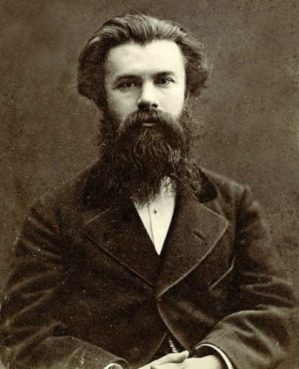
Cosmopolitan approach
Mykhailo Drahomanov (1841–1895) – Historian and Publicist
A prominent historian and publicist, Drahomanov was deeply committed to Ukrainian culture but identified himself as a "cosmopolitan in ideas and goals." He promoted federalism and broad autonomy for Ukraine rather than complete independence, a stance that drew criticism from his contemporaries, who accused him of cosmopolitanism.
Drahomanov defended his views, stating:
"Whenever necessary, I have always said the same thing: cosmopolitanism in ideas and goals, nationality in the foundation and forms of cultural work! For 30 years, I have argued against Russian pseudo-cosmopolitans, who denied Ukrainian nationality, and against Ukrainian nationalists, who... severed the guiding thread of infallible human progress."
With these words, Drahomanov asserted that love for one’s nation was not in conflict with universal human progress and warned against both imperial chauvinism and narrow nationalism.
Drahomanov, Mykhailo. 1937. "Вибрані твори. Збірка політичних творів з примітками" [Selected Works: A Collection of Political Writings with Notes], vol. 1. Edited by Pavlo Bohatsky. Prague. Accessed March 5, 2025. https://ditext.com/drahomanov/selected/notes-full.html.

Slide 16
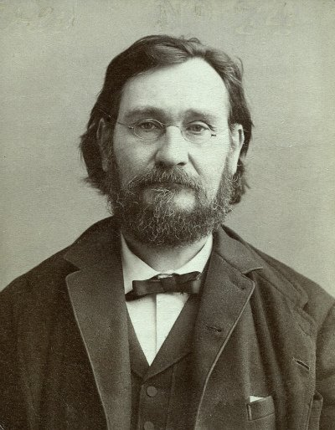
Ilya Mechnikov (1845–1916) – Nobel Laureate, Biologist and Pathologist
Born in Kharkiv region, Ilya Mechnikov was awarded the Nobel Prize in Physiology or Medicine (1908) for his pioneering work on the immune system and phagocytosis. He built his career in Odesa, St. Petersburg, and later in France (at the Pasteur Institute) but did not engage in the Ukrainian national movement.
Mechnikov believed in the progress of humanity through science and rarely addressed national issues in his works. His ideals were humanist and global. Contemporaries noted that Mechnikov saw "his homeland in the entire world of science."
Although he was acquainted with Ukrainian figures such as Oleksandr Konysky and Mykhailo Drahomanov and sympathized with their efforts, he did not link his own work to the Ukrainian cause, instead remaining a man of the world.
Korniush, Mariia. 2024. "Ілля Мечников" [Ilia Mechnikov]. Ukrainian Nation, September 8, 2024. https://ukrainian-nation.org.ua/ukraintsi/937-illia-mechnykov/.

Slide 17
Imperial-Loyalist (Anti-National) Approach
In Austria-Hungary, conservative Moscophiles in Galicia—mainly senior clergy and old-school scholars—claimed Galician Ruthenians were part of a unified Russian people and promoted a literary language based on Church Slavonic and Russian. They founded the Kachkovsky Society, publishing books in a mix of Russian and local dialects.
Moscophile scholars dismissed "Ukrainian" as a distinct identity, seeing science as a tool to reinforce unity with Great Russians. In the Russian Empire, most official historians and philologists (e.g., A. Sobolevsky, N. Pogodin) treated the Little Russian dialect as an undeveloped vernacular.
State repression, including the closure of the Kyiv Geographical Society and the exile of ethnographer Pavlo Chubynsky, intimidated scholars into avoiding conflict.
A symbolic moment came in 1903 at the Kotliarevsky Festival in Poltava: when Petro Zhytetsky of Mykolaiv University gave a speech in Ukrainian, some officials demonstratively walked out—so rare and provocative was the public use of Ukrainian in academia.
Struk, Danylo Húsar, ed. 1993. Encyclopedia of Ukraine, Volume IV: Ph–Sr. Toronto: University of Toronto Press, under the auspices of the Canadian Institute of Ukrainian Studies, the Shevchenko Scientific Society, and the Canadian Foundation for Ukrainian Studies. ISBN 0-8020-3994-4. Accessed March 5, 2025. https://dokumen.pub/encyclopedia-of-ukraine-volume-iv-ph-sr-9781442632899.html.

Slide 18
The Role of Scientific Societies in Nation-Building
Thus, by the late 19th and early 20th centuries, Ukrainian scientific societies and circles functioned as early national institutions. They did not merely produce academic content about Ukraine but also actively educated society—through books, lectures, and discussions—in the spirit of Ukrainian identity.
By 1917, when the opportunity arose to establish a state-sponsored Ukrainian Academy of Sciences, a well-connected network of Ukrainian scholars and a solid body of research were already in place, ready to form the foundation of national science.

