Slide 1
Science in the Theological Academies of the Russian Empire: Missionary Work and Theology

Slide 2
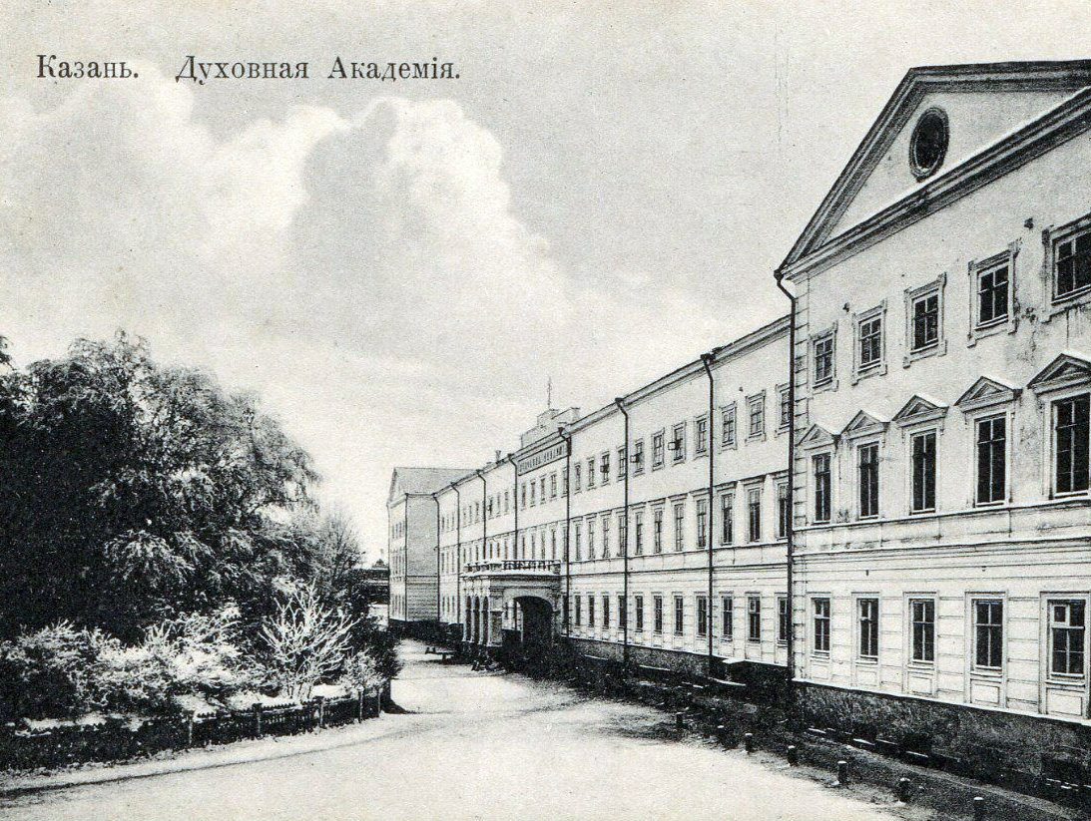
After the reform of 1869 the structure of theology as a science and its subject of study were determined to correlate scientific and theological research and their practical application to solving current church problems.

Slide 3
Implementation of historical methodologies in the higher theological school of Russia
Transition to historical methods
Reform of theological academies
Integration of Western traditions
Diversity of research directions
Preservation of the confessional position

Slide 4
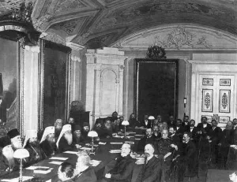
Higher Religious Education and Theology Debates in 1909
Urgent need for educational reform.
Curriculum modernization with scientific integration.
Revamping theological academies' practices.

Slide 5
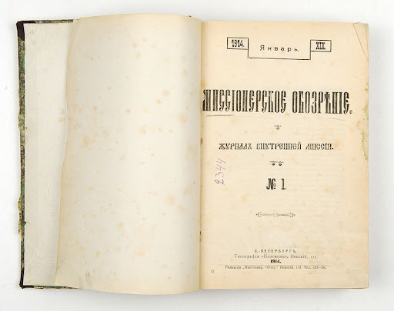
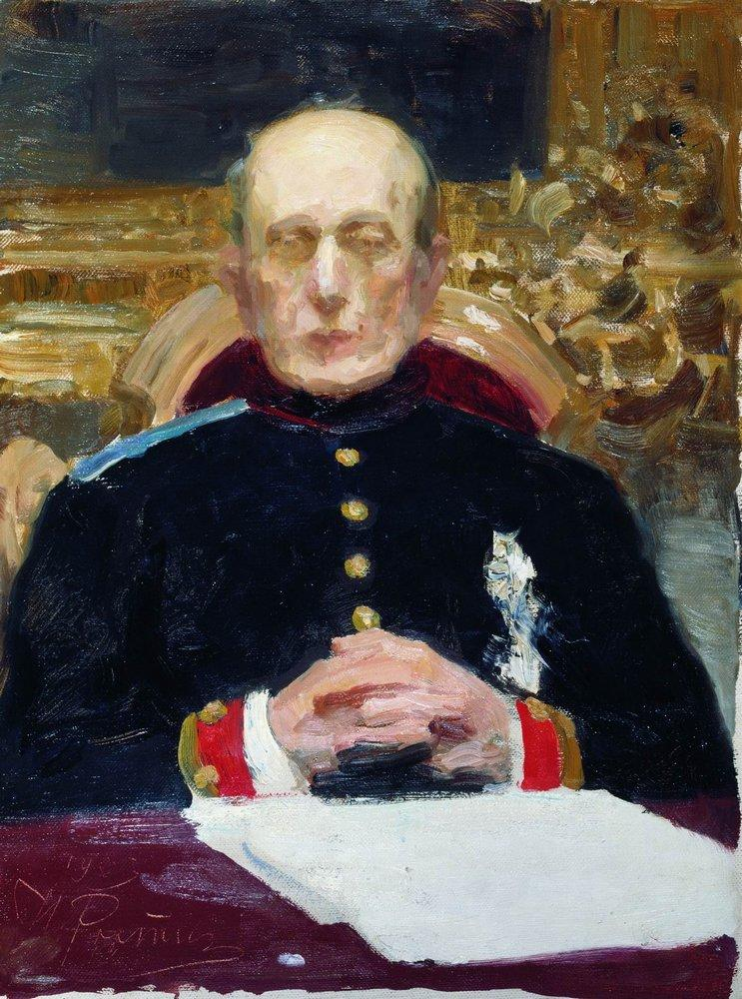
Pobedonostsev's internal missionary policies were deeply intertwined with a nationalistic vision that equated Russian identity with Orthodox faith. He supported the Russification of minority groups, advocating for their assimilation into Russian culture and Orthodoxy.

Slide 6
‘The struggle of the Church and the government against sectarianism, as a social evil, cannot but have the closest relation to the interests of Russian educated society... But... here we encounter a certain misunderstanding... If our educated society were all truly Russian in mood, ideals and worldview, then its attitude to sectarianism would be completely identical and quite definite. The cultural and historical tasks of Russia, as a state that is original and unique, depend entirely on the inviolability of its cultural historical foundations, i.e., Orthodoxy, autocracy and nationality. Everything that shakes these foundations naturally weakens the original power and hinders the cultural development of the dear fatherland. Therefore, the attitude of truly Russian society, as a cultural stratum, to sectarianism can only be purely negative’.
Missionary Review, 1896, January-June, p. VIII

Slide 7
‘But despite the inevitable difficulties, the study of Russian sectarianism is of profound interest. Sectarianism, as we know, is a painful and incorrect, but nevertheless independent attempt of the Russian people in the area of ​​faith. It is a typical manifestation of the unique historical life of the mass of the Russian people, and not only religious life, but also intellectual, moral and social. Under the influence of sectarian teachings, the domestic and family life of a significant part of our people is formed and developed. […] Therefore, in addition to the direct goal of determining the most appropriate methods of combating a painful phenomenon, the study of Russian sectarianism is also of deep interest in psychological, historical and ethnographic respects’.
Missionary Review, 1896, January-June, p. 43

Slide 8
‘How harmful and dangerous in social terms can be a false teaching like the Adventist one about the Last Judgment, about the coming of the last time and the approach of the blessed kingdom on earth, is convincingly demonstrated by the relatively recent history of the so-called “Malevan” movement…’
Missionary Review, 1896, January-June, p. 55-56
‘Now the Holy Synod, recognizing all sects as harmful to the church, teaches that the guideline for judging the particular harmfulness of one or another sect is to take into account mainly the social harm caused to the individual, family, society and state’.
Missionary Review, 1900, July - August, p. 12

