Slide 1
Warsaw Society of Friends of Learning and Polish patriotism during the Napoleonic Wars

Slide 2
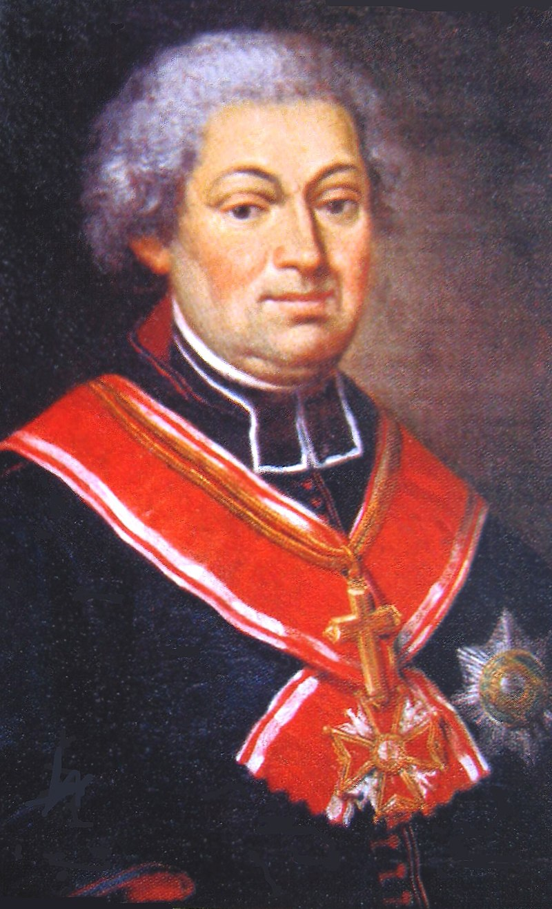
Not for themselves did our Fathers live and rule the north! Their borders, power, fame and misfortunes were the salvation and splendor of all Europe! If the marks of Christianity still shine on the Temples of God, if so many peoples and generations, Scythian arches and Asiatic turbans have not yet taken on; if the whole western part of the world, equal in fate with these once flourishing lands of the Eastern tsarism, did not find an equal fate; what gifts and benefactions, what blood has lavishly bought and paid for? Who was it that repulsed and shattered the attacks of the unstoppable savagery? Here are the breasts and weapons of your Fathers! Here those hordes, like swarming idols of the stormy sea, crashed against the Polish wall; here they found their grave, and lost the encouragement of further progress. Poland was drowning in blood for Europe, while Europe, safe behind its back, was perfecting its light and benefits.
Jan Paweł Woronicz
May 3, 1807

Slide 3
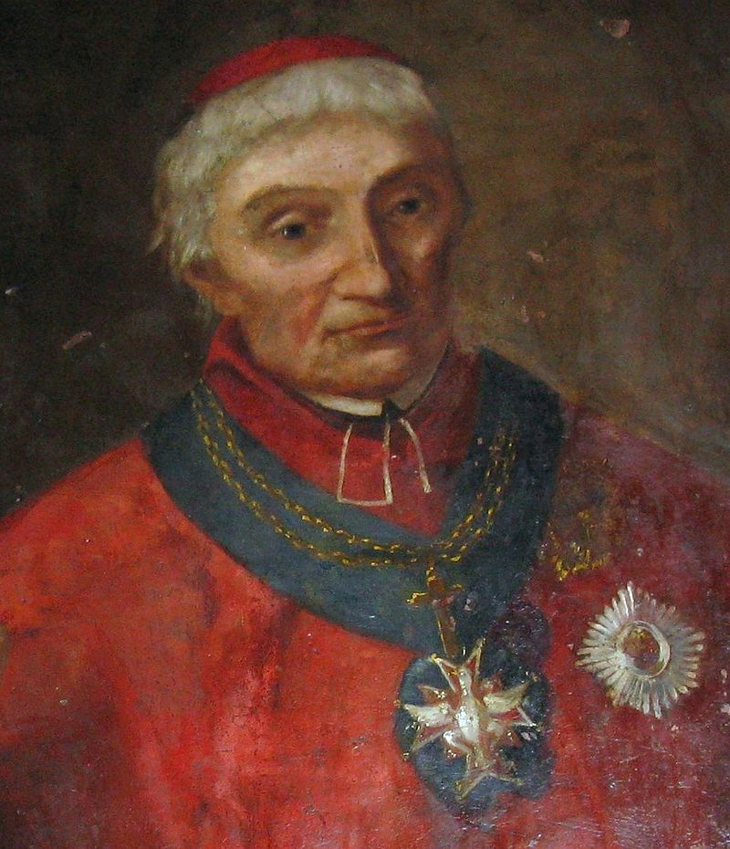
Ignacy Raczyński, Archbishop of Gniezno

Slide 4
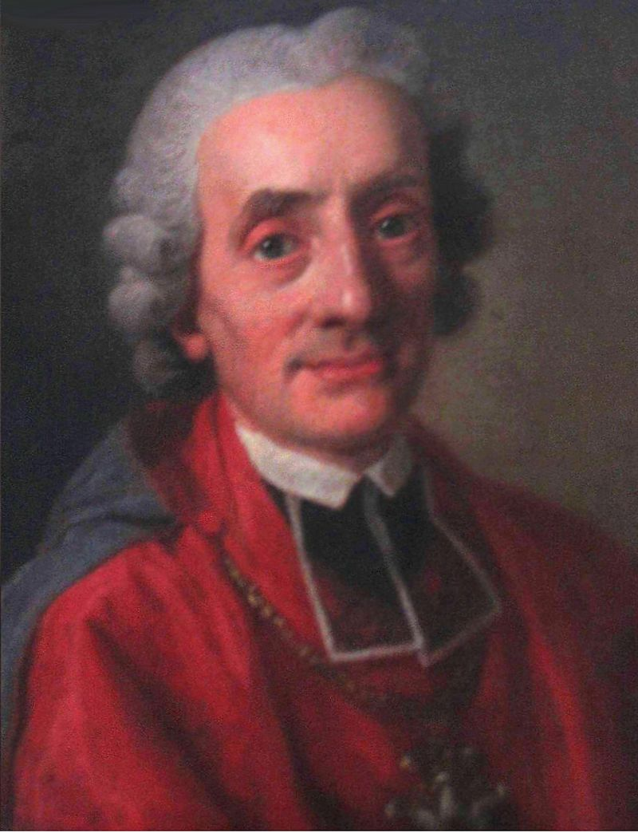
May 8, 1807
Just as great is the strenuousness of a reborn nation to speak so that at the voice of a hero before whom, as once before Alexander the Great, the bewildered world fell silent, by the noblest sacrifices it turned out to be worthy of rebirth, so with no less zeal does the Society of Friends of Science strive for this, so that the work undertaken with an uninterrupted burden becomes worthy of a reborn nation. In the collapse of the country, when it was deprived of almost any trace of life, our Society came to some agreement, albeit about the hidden life of it, and not being able to restore to it the full possession of its members and the obvious evidence of an unblemished life, restored to it at least - what was the undoubted sign of its preserved being, - the language so that it [the country] could declare to its sons that it recognizes them, that it is sensitive to their inextinguishable love, that we should not despair of his return to life and health…
…Our Society takes on a new obligation to prove for its part that it was worthy beforehand to ignite the smoldering spark of life of our common mother and, with the fullness of life, to guarantee her immortality.
Jan Albertrandi

Slide 5
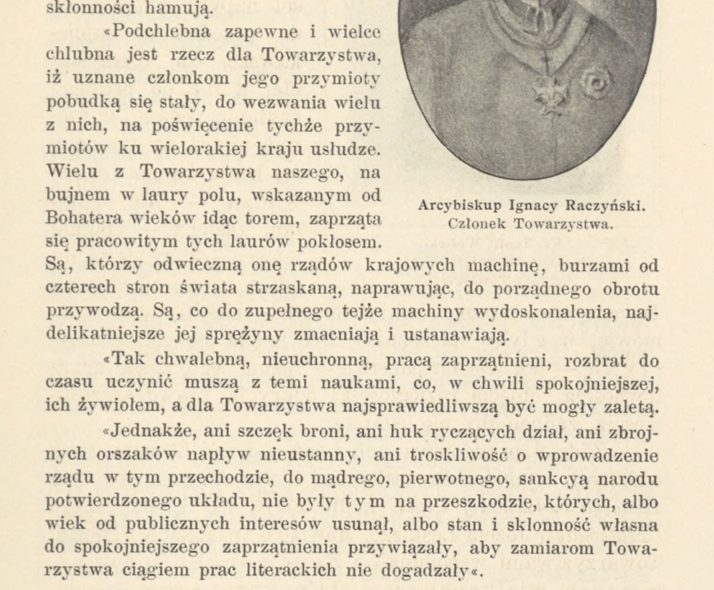
May 8, 1807
Jan Albertrandi

Slide 6
Behold, the sun had not yet reached the half-circle of its annual course, like a grave, overgrown with hawthorn memories, convinced us of the impossibility of life when the dead and ashes scattered around the world.
But the genius of the hero, higher than the earthly sphere, looked at them and said: you have not ceased to be and you will be. He did not managed to finish [saying it] yet, and that ruin of rotten bones, fantasizing into brilliant retinues of warriors, shakes with deaths and with conscious weapons clears the paths of the fatherland for its Savior. And although this miraculous ability to revive a dead body with one renunciation was reserved only for such a hero, whom the centuries had borne for the preparation of the world, nevertheless even from the very upper clouds the fire exhaled will not kindle a revitalizing ardor there, where it finds no kindled or scorching heat to receive itself... Even if our Society, founded for this holy purpose a few years ago, had brought no other service to the nation than that of protecting the national language from eternal muteness, and preserving in it the ever-regenerating feature of our being; it would surely have merited enough for the country with this one act.
Jan Paweł Woronicz

Slide 7
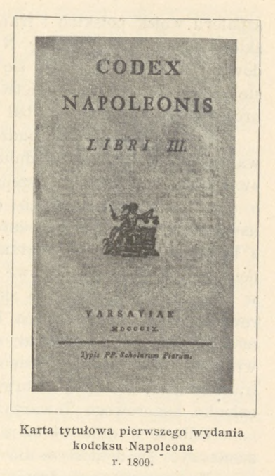
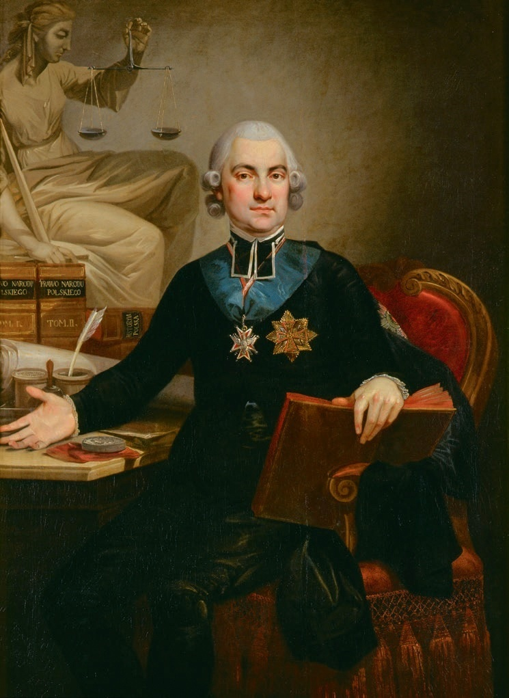
Hugo Kołłątaj
Notes on the present state of that part of the Polish land, which since the Peace of Tilsit came to be called the Duchy of Warsaw

Slide 8
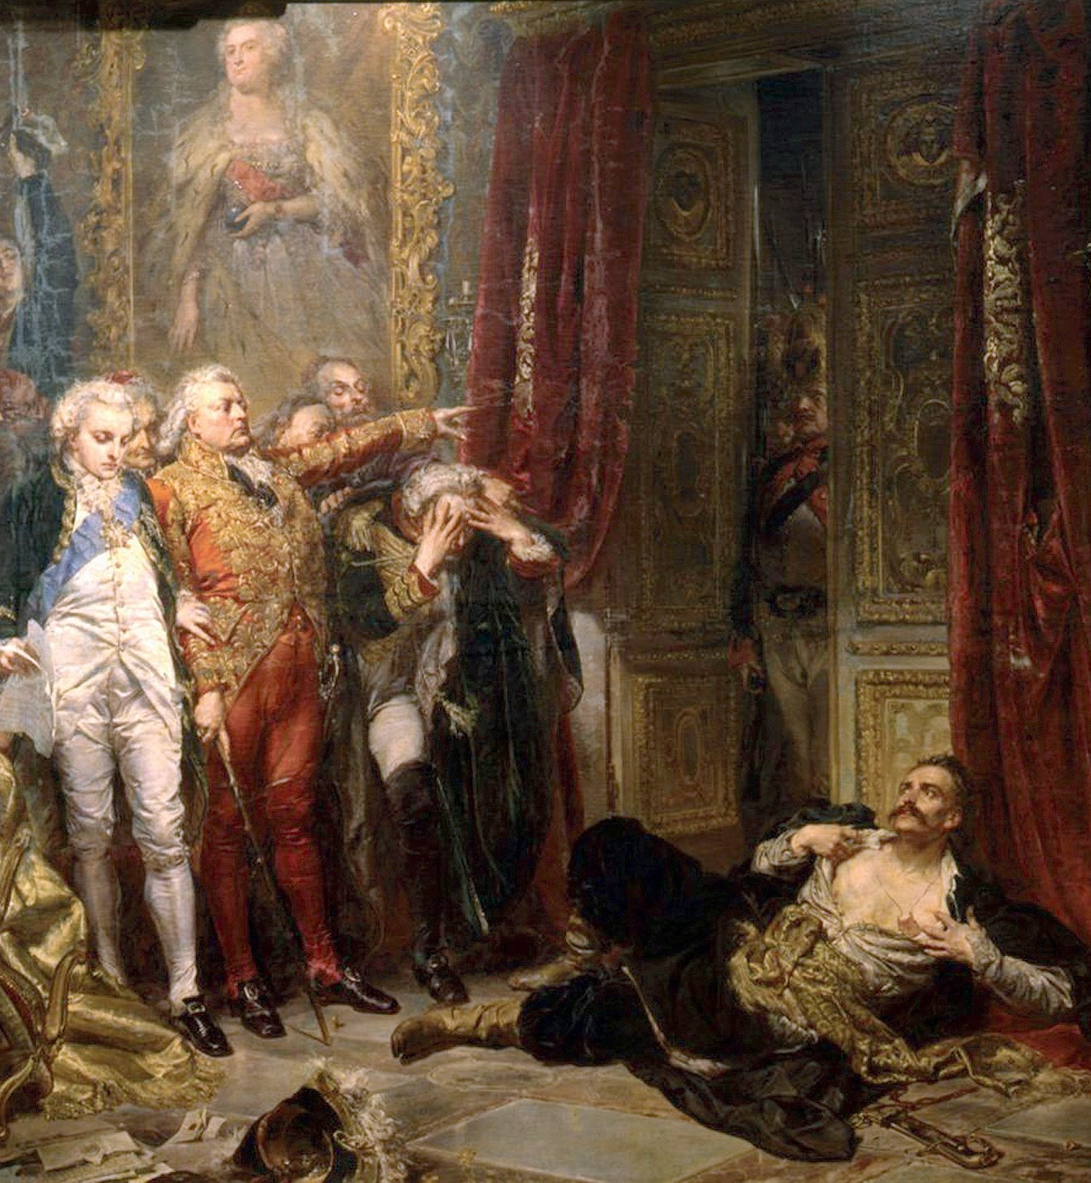
The Polish nation, before it finally came to its political death through the long time of anarchy; for a long time before that it was torn apart by the discord of the magnates, who, against their kings and against themselves, were accustomed to seek the protection of neighboring and even distant powers; and in this way, not only did they inflict so many misfortunes on their own country, until they brought it to its final doom; but moreover they often became the cause of feuds between other powers, who wished to retain for themselves this deadly influence over Polish interests, and what was worse, that they wished to secure for themselves the credit of foreign governments, they sought to slander one another

Slide 9
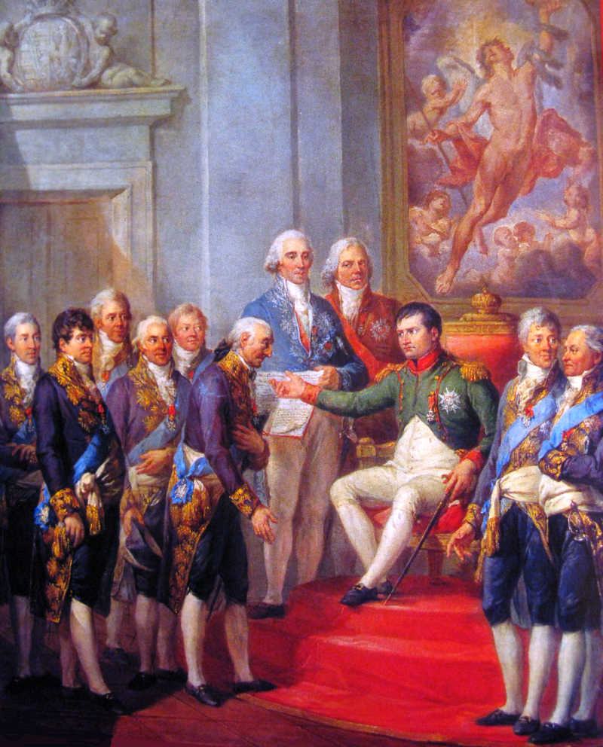
If, therefore, Poland, resurrected by the mighty hand of NAPOLEON, rises from its ashes; it will be a nation composed entirely of the same homogeneous parts, in which all the peoples understand each other through one common language, have the same customs, and are accustomed to maintain commonality as to the opinions adopted among themselves.... and behind this they will be a people of one inclinations and habits, of one character; a brave, battle-hardened people, resistant to the hardships and discomforts of life. Enough to unite them together, enough to restore to them the government of their former so good; so that they will prove worthy of their destiny; so that in their minds they will cease to have any tendency to dissension, which has been introduced among them by the misrule which has lasted for two centuries, ever since they were subjected to the despotism of one powerful noble state.
Scorned and disgraced from your proprietors, Poles! the bright, happier dawn of the future is already rising for you. NAPOLEON has turned his eye of pity on your land...
Not for nothing does he take so much care of it, not for nothing does he veil it with the victorious French army. One power has fallen, another has been humiliated: Poland must rise up and return to her former greatness; for this is what Europe's needs call upon the Lawgiver of so many nations; for he is called upon to have mercy on the injustice so great to the Polish people, for he is impelled to justice by the iniquity so flagrantly committed by our neighbors.

Slide 10
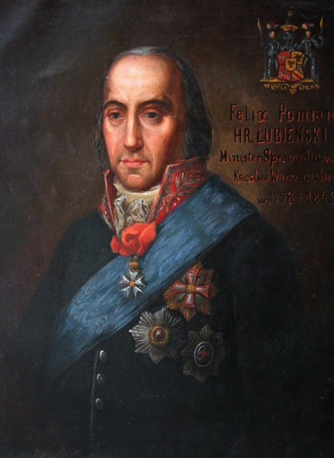
As a citizen, I feel, together with all the inhabitants of this land, the entire importance and usefulness of devoting yourselves to the national good. In your sad fall, you had enough courage and citizenship to preserve the precious monuments of science and native language from general destruction. Supported only by your own zeal, you created this esteemed Society and during the fourteen years of Prussian rule, you were able to bravely overcome all obstacles, not only to maintain but also to adorn with new polish the language of your ancestors, to enrich it with works excellent in so many kinds of sciences and to prove that the love the Fatherland’s glory in the heart of a citizen cannot be overcome by the passage of time, nor by the difficulties of adventures, nor by the diversity of political events. The sanctity of your intentions has found universal admiration among your fellow countrymen. Your example has awakened everyone and this association has won such praiseworthy honors for Polish sciences, has won such universal respect that even the Government, which has completely removed the Polish language from public affairs, if it did not wish to grant this Society a solemn authorization, nevertheless did not dare to withhold your intentions, marked by the most beautiful feature of utility.
Feliks Franciszek Łubieński
May 14, 1808

Slide 11
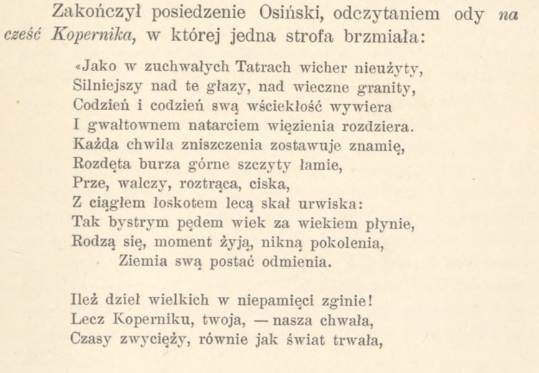
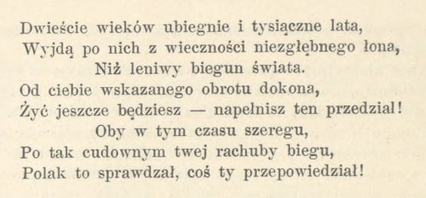

Slide 12
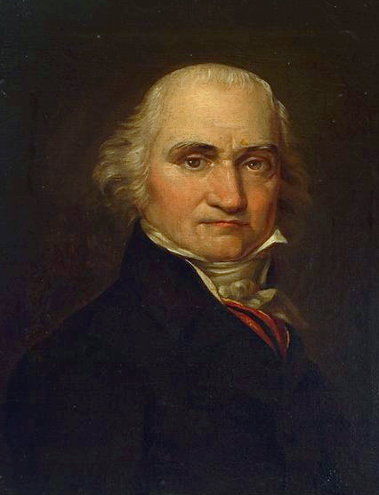
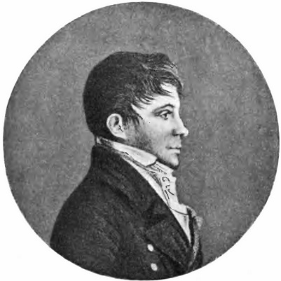
Jan Śniadecki
Józef Łęski

Slide 13
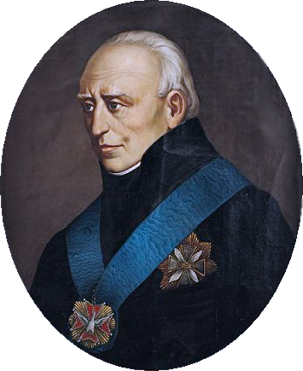
September, 1809
The history of the progress of science and knowledge proves that only through extraordinary geniuses were the main lights started. These, formerly through religious congregations, later through students and freedmen, are now collected and saved from destruction by learned societies. There they are perfected and, as if they could be universalized among peoples? There they are devised means.
Confucius, Zoroaster, Socrates, Aristotus, Copernicus, Kepler, Decartus, Newton, do great things in science. They have uttered truths that constitute epochs in the progress of human reason.
Without such societies, extraordinary wit can arise in nations, but the lights they produce cannot sustain themselves, rise, or enlighten nations. From their creators with a fleeting life they too most often perish.
Więc uczonych towarzystw pierwszym jest zamiarem: zbierać i ocalać wszczęte światło, doskonalić powszechnie odkryte wielkie prawdy, utrzymywać w swoim narodzie ten stopień umiejętności sztuk i nauk, na którym je powszechne oświecenie już w innych narodach stawiło.
Stanisław Staszic

Slide 14
September, 1809
Among the great men mentioned here, there is also our fellow countryman(nasz rodak). Errors, initiated with the first centuries, constantly pointed out by human senses, and consecrated by all nations, and therefore inviolable, were the first to be moved by Copernicus with his genius as empty, insignificant delusions, and the first to be destroyed by his immortal work among Poles.
These were indeed errors, by which the faculties of thought were so entangled, that the human mind, without being torn off by these deceptions, was not able to advance a step further in physical abilities. It, as it were, paralyzed by them, stood for nearly two thousand years without progress. Copernicus freed the human race from such harmful madnesses and showed the way of true relations in the order of the worlds.
Only in foreign lands, so perfected, did they return again to the land of their birth. Three hundred years later, first transferred and with all their conclusions in Polish, they were presented by Jan Śniadecki, a member of the Royal Society, worthy of being the interpreter of the genius of Copernicus.
This example should convince how necessary societies of scholars are to the nation; how without them, truths, whether sought out by the greatest geniuses or sought out among themselves, will become useless to it, how they can be lost to it for three centuries.
Stanisław Staszic

