Slide 1
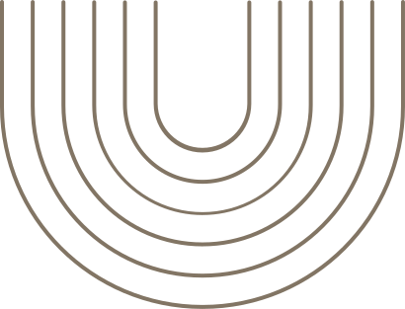
Psychology of attention
ALNURA ABDYROVA

Slide 2

  hold your attention
  short-form attention span

Slide 3

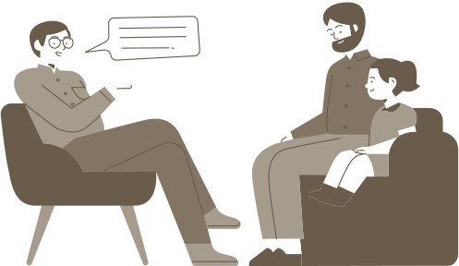
Psychology
  Late 19th century: Psychology breaks from philosophy
  Wilhelm Wundt: First experimental lab (1879, Leipzig)
  Used introspection to study conscious processes
  Psychology becomes a scientific discipline
  Applied scientific method to the mind

Slide 4


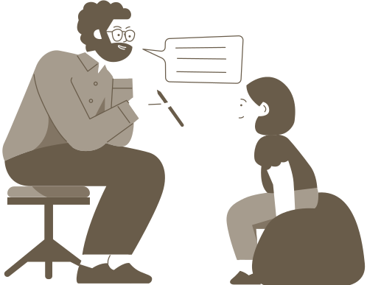
Attention
  Attention is the mental process of selectively concentrating on specific information while ignoring other stimuli.
  It is a foundational concept in cognitive psychology, influencing perception, memory, learning, and consciousness.

Slide 5

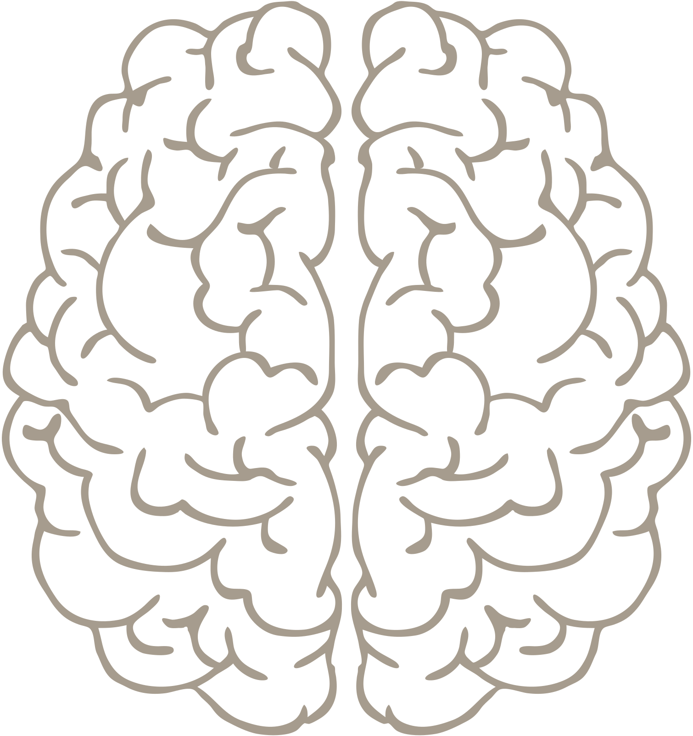

"A wealth of information creates a poverty of attention."
"Attention Economy" (Herbert A. Simon)

Slide 6
+

Slide 7
A BC D S G J E D J S P F L G F N D N K L M B D G K
K P H T P F H D E Y E Q K F L D D W S L B D U E D Y X H S
G O P N G K P T R B D W S K L F U P F D J P H O T O
D H O R D H K F R D S
R D S E W T I P F D S A
+
R D S E W T I P F D S
D H O R D H K F R D S
K P H T P F H D E Y E Q K F L D D W S L B D U E D Y X H S
A BC D S G J E D J S P F L G F N D N K L M B D G K
K P H T P F H D E Y E Q K F L D D W S L B D U E D Y X H S
A B C D S G J E D J S P F L G F N D N K L M B D G K

Slide 8
+

Slide 9
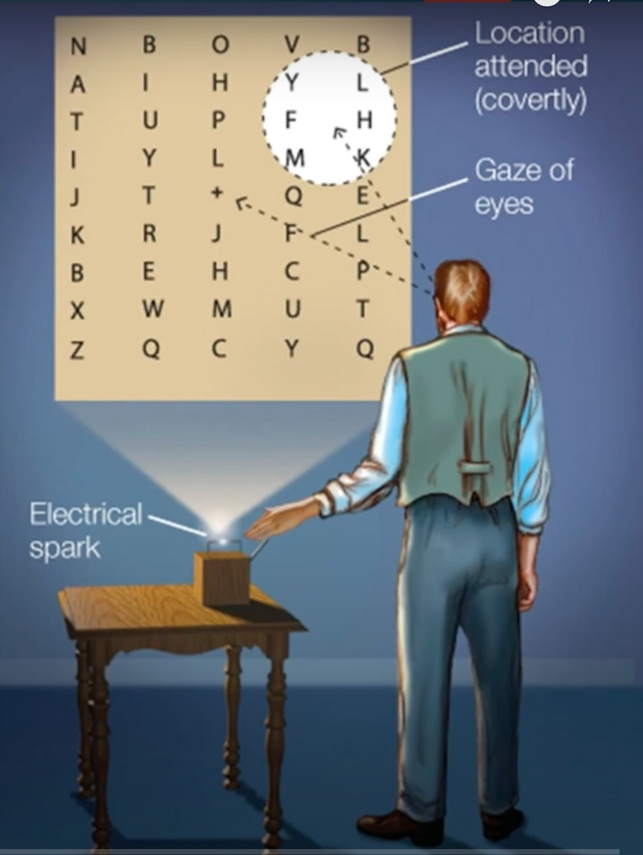
Helmholtz 1894
  Hung Hung a sheet on the wall that had letters written on it
  Used a spark to light up the room temporarily
  He decided ahead of time where he would direct his gaze when the light came on
  He noticed that he could perceive the letters in the attentional spotlight better than those that were outside of it

Slide 10
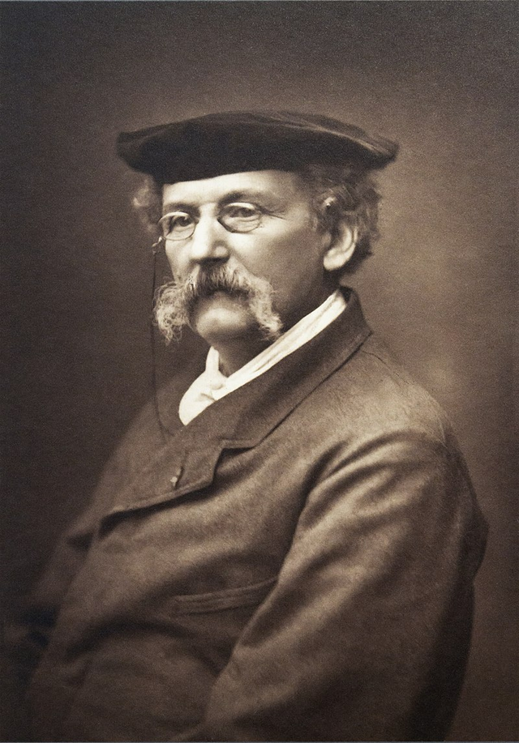
19th century:
Birth of Experimental Psychology
Théodule Ribot (1889) – The Psychology of Attention
  First systematic exploration of attention as a psychological phenomenon.
  Emphasized voluntary vs. involuntary attention, and its connection to emotions and brain pathology.
  Saw attention as a symptom of underlying mental processes, not a separate faculty.

Slide 11

Two Types of Attention
  Involuntary Attention This happens naturally when something captures our interest—no effort needed.
  Example: A beautiful sunset catches your eye or a sudden noise grabs your attention.
  Voluntary Attention
  This requires effort and control. We decide to focus even if it's hard.
  Example: Studying for an exam when you're tired.

Slide 12
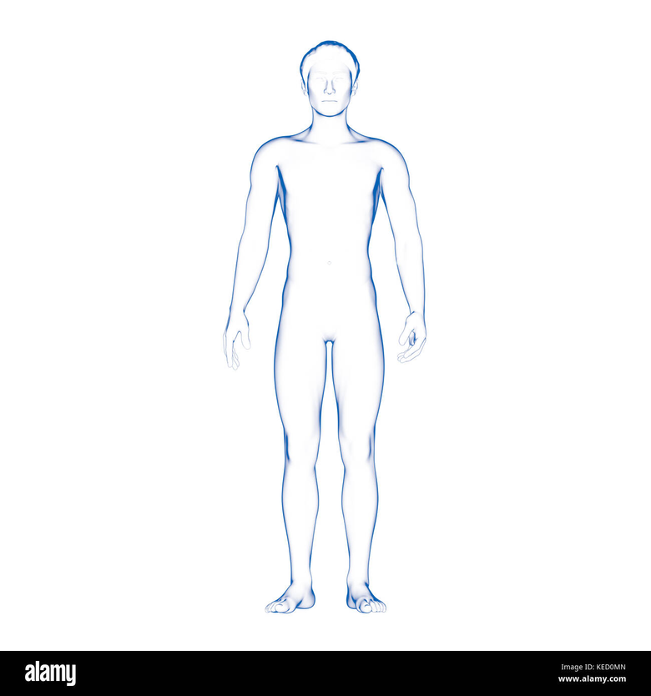
Attention is a Physical Process
Attention isn't just in the mind—it involves the body too:
  Eyes and head turn toward the object.
  Muscles tense up.
  Breathing and heartbeat can change.
Example: When you're deeply focused, you might freeze, your eyes lock onto the page or screen, and your body stays still.

Slide 13
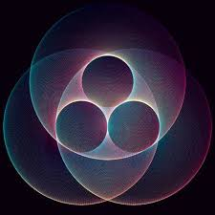
Monoideism
Attention narrows your mind to one dominant idea, but not completely. Other thoughts may float nearby but aren't in focus.
Example: When you're solving a puzzle, your brain zones in on it, though you might still notice background noise.

Slide 14
Emotions Trigger Attention
Things that cause pleasure, pain, or interest naturally grab our attention => This shows that character and interest shape what we pay attention to
Attention Is Rhythmic
It isn’t steady—it flickers. We think it's continuous, but attention actually comes in pulses

Slide 15
Physical Changes Support Attention
  Blood Flow to the Brain Increases
  When you're thinking hard, your brain gets more blood.
Example: Your face might turn red from intense concentration.
  Breathing Changes
  It becomes slower, sometimes you hold your breath.
Example: Holding your breath when trying to remember something.
  Movements Reflect Attention
  Expressions change—eyes widen, eyebrows rise.
Example: Kids pout their lips when they’re really focused, which may come from the early need to focus on feeding as infants.

Slide 16
Thank you

