Slide 1
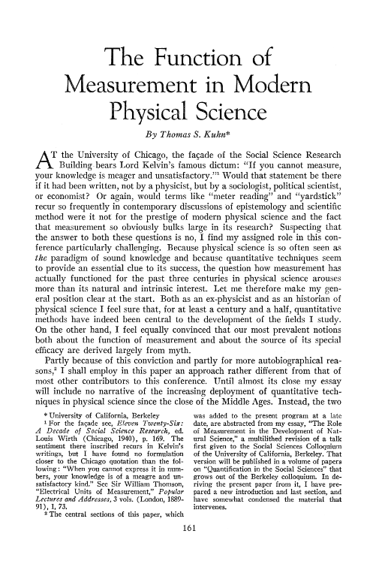
Thomas Kuhn on measurement
By Dario Mammana

Slide 2
Thomas Kuhn 1922-1996
Raised in New York City.
Completed his PhD degree in physics at Harvard.
Grew interests towards history and philosophy of science and moved to the university of California, Berkely.
Published “The Structure of Scientific Revolutions” in 1962.
Joined other prestigious universities. (Princeton and MIT)

Slide 3
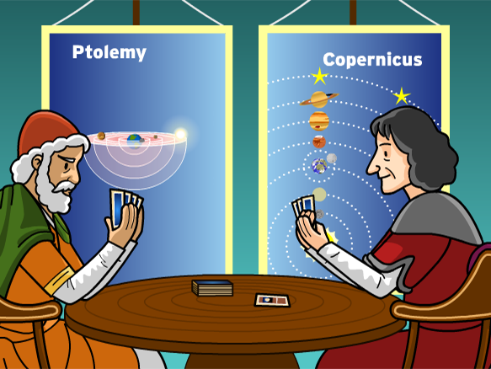
Paradigms
“Accepted examples of actual scientific practice – examples which include law, theory, application, and instrumentation together – that provide models from which spring particular coherent traditions of scientific research.”
Examples:
Ptolemaic or Copernican astronomy
Aristotelian or Newtonian dynamics

Slide 4
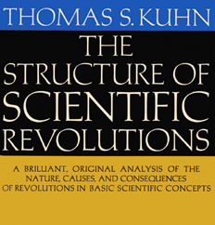
The structure of scientific revolutions
Scientific progress occurs in different steps:
Normal science,
Extremely productive within the boundaries of the paradigm.
Scientists enlarge the central paradigm by puzzle solving.
Eventually reaches a crisis because of the accumulation of anomalous results.
Scientific revolution or paradigm shift
The new paradigm can confirm the previous discoveries while explaining the exceptions.

Slide 5
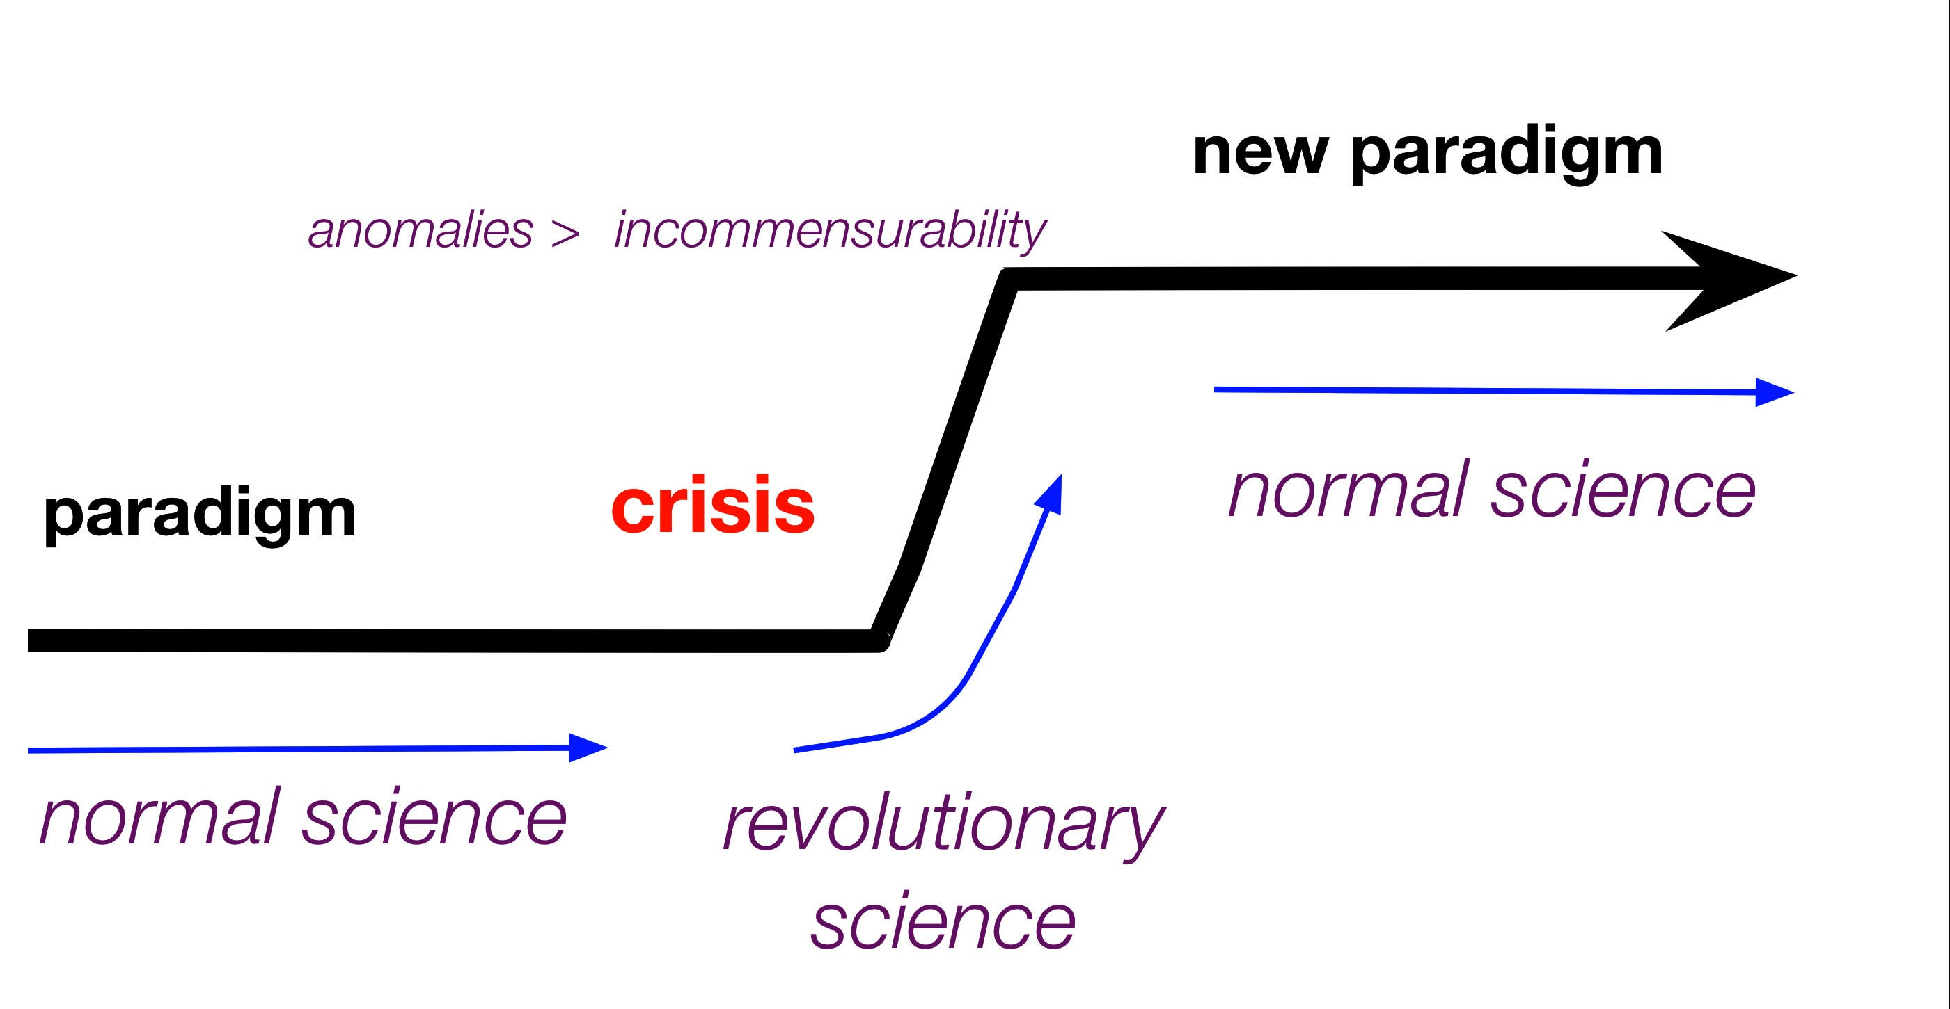
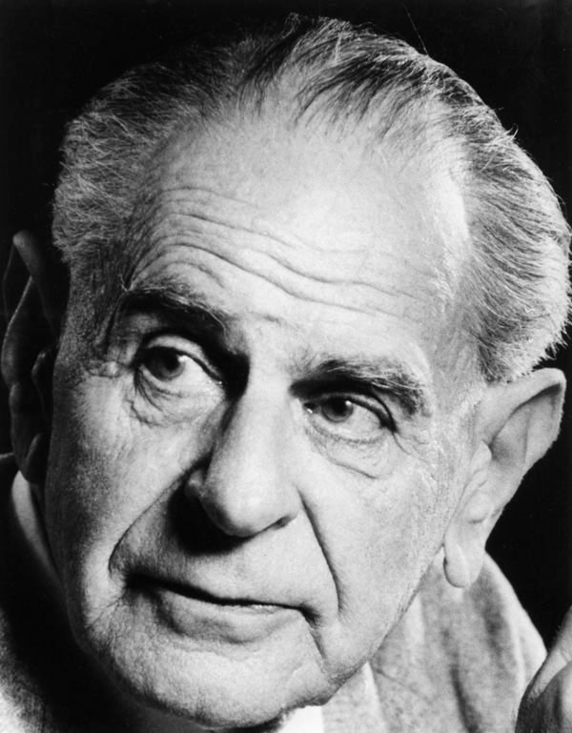
Normal Science and puzzle solving
Accumulation of knowledge and discoveries achieved adhering to a paradigm.
The paradigm dictates the rules like in a puzzle.
Example:
Ian Hacking “Granary of Science”
Highly criticized by Karl Popper for not respecting the falsifiability criterion.

Slide 6
The role of measurement
Measurement may not be the central player in scientific breakthroughs.
Example: Darwin’s discoveries were developed without heavy reliance on numbers.
Single theories and paradigms can determine what is relevant.
Example: temperature and pressure after thermodynamics or mass and acceleration after Newton.
Measurement can detect anomalies, but the theories causes the paradigm shift.
Example: Einstein relativity theory developed after many precise calculations of Mercury’s orbit.
Measurement alone cannot cause paradigm shifts.

Slide 7
Open Questions
Is it possible to identify some paradigms in statistics?
Does statistics follow the same reoccurring path described by Kuhn for physical sciences?
Can the era of big data cause a paradigm shift in the world of statistics?
Does measurement play the same role in social science and physical science?

Slide 8
Thank you for your attention

