Slide 1
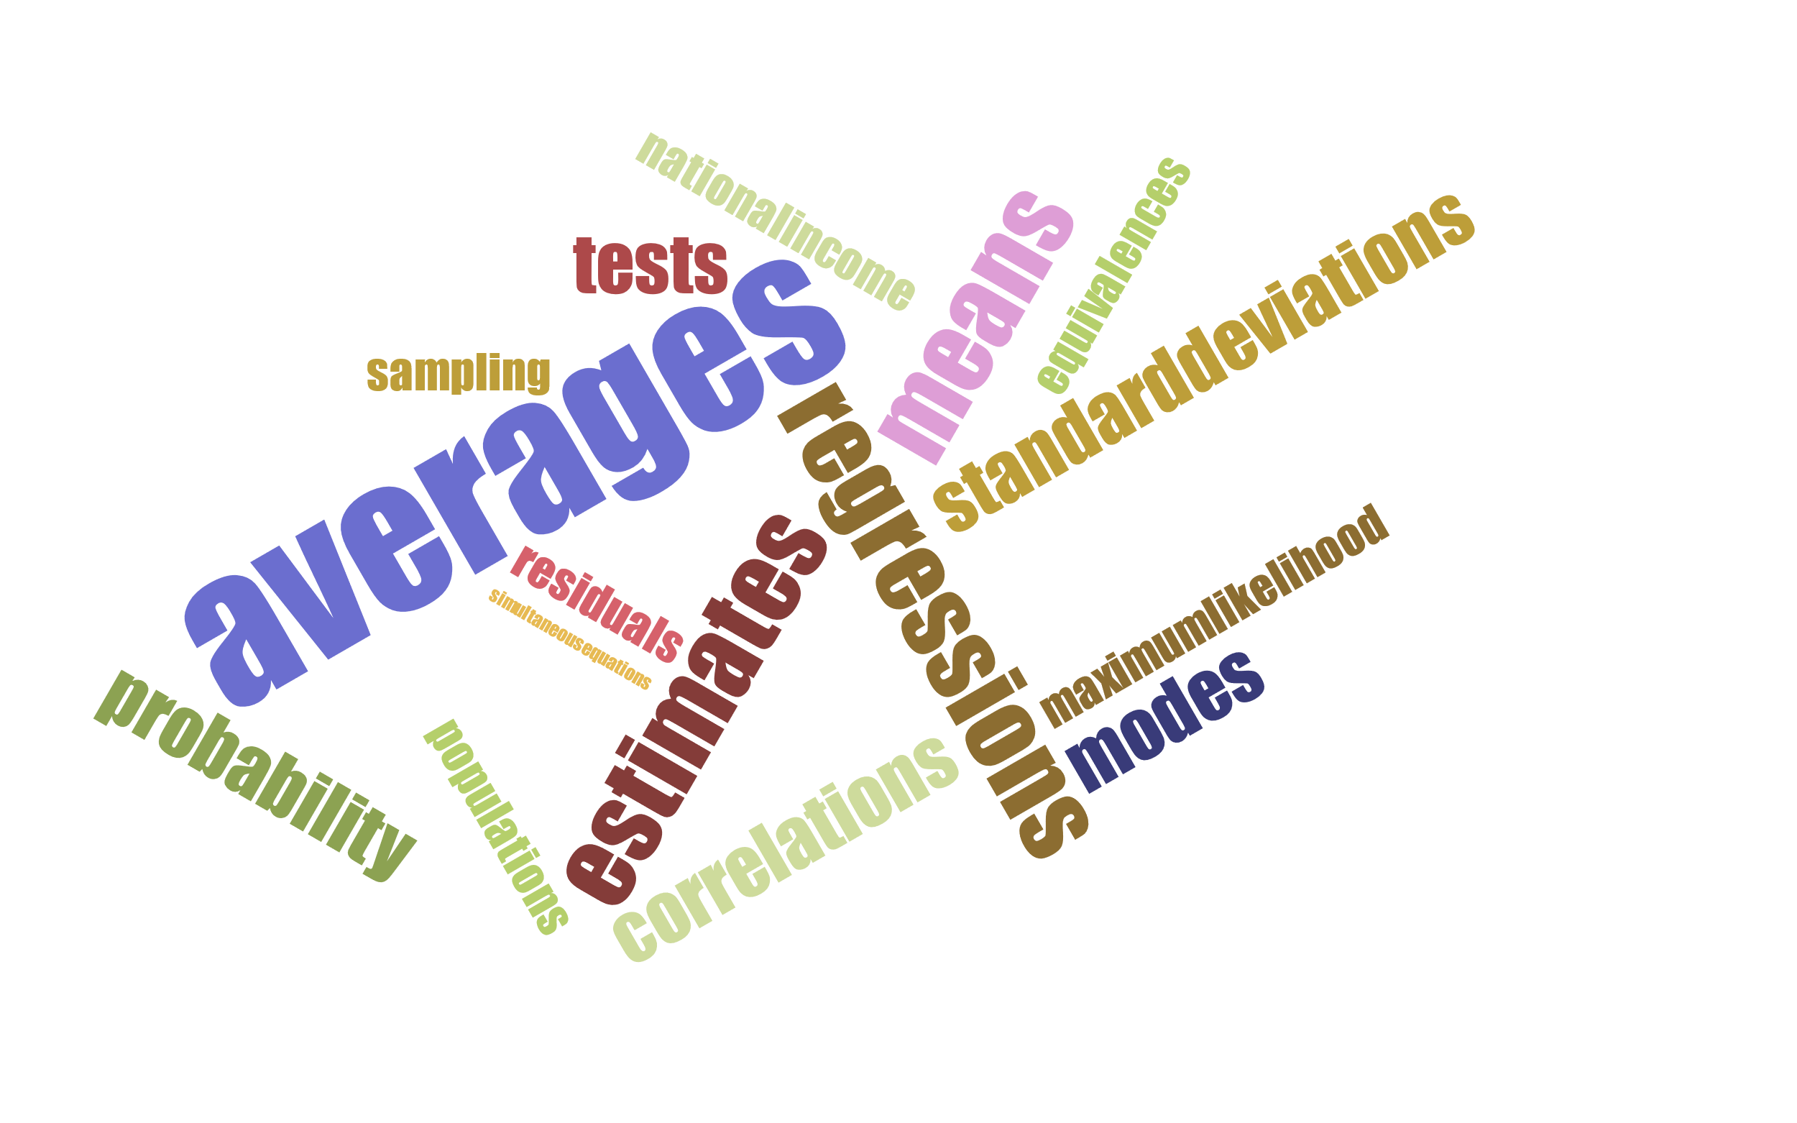
Social facts: realities or conventions?
Epistemic view: probability as degree of belief
Frequentist view: diversity and risk as part of nature itself
Both views can be combined in various ways to argue for realist or conventionalist positions about social facts

Slide 2
Pierre-Simon Laplace, A Philosophical Essay on Probabilities
CHAPTER X
Application of the Calculus of Probabilities to the Moral Sciences
We have just seen the advantages of the analysis of probabilities in the investigation of the laws of natural phenomena whose causes are unknown or so complicated that their results cannot be submitted to calculus. This is the case of nearly all subjects of the moral sciences. So many unforeseen causes, either hidden or inappreciable, influence human institutions that it is impossible to judge à priori the results. The series of events which time brings about develops these results and indicates the means of remedying those that are harmful.
It is very important to keep in each branch of the public administration an exact register of the results which the various means used have produced, and which are so many experiences made on a large scale by governments. Let us apply to the political and moral sciences the method founded upon observation and upon calculus, the method which has served us so well in the natural sciences.

Slide 3
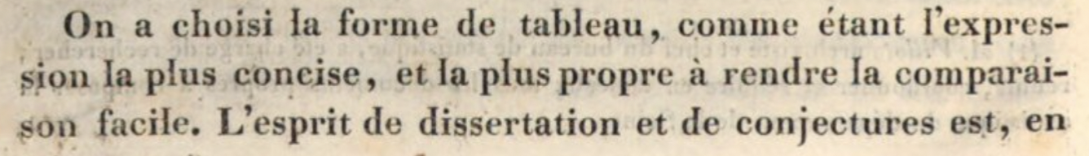
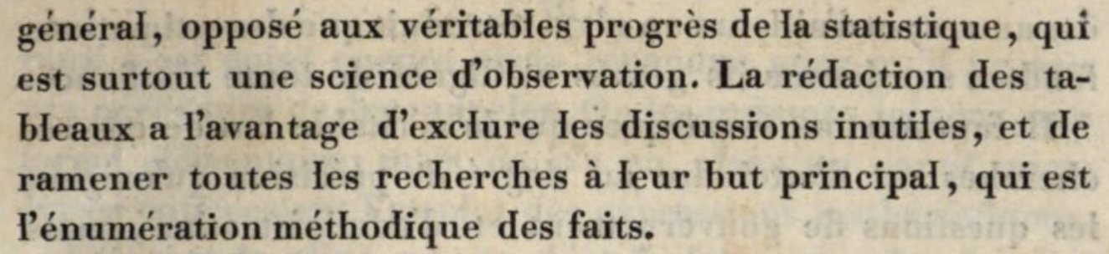
Recherches statistiques sur la ville de Paris
(1821)
“We have chosen the [numerical] table because it is the most concise form of expression and because it is the best way to render easy comparisons. The spirit of discourse and conjecture is generally opposed to the true progress of statistics, which is foremost a science of observation. The composition of tables has the advantage of excluding useless discussions; it reestablishes the principal goal of all research, which is the methodical enumeration of facts.”

Slide 4
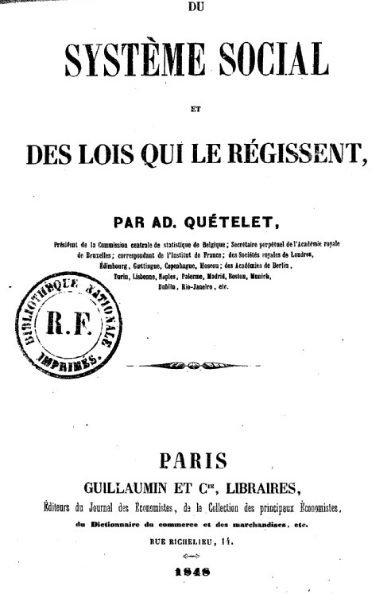
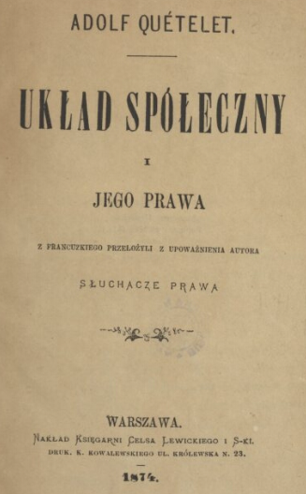
Quetelet, On the social system and the laws which govern it
“The theory of probabilities depends, for much of its practical utility, upon observations which have proved that events, which individually appear to follow no plan, are nevertheless in the mass as much the subjects of a general rule as any others.”
(Augustus De Morgan on Quetelet)
← (1848)

