Slide 1
Observatories, mathematics and numbers
Orlov Mykhaylo
Cultures of quantification
2025 winter term

Slide 2
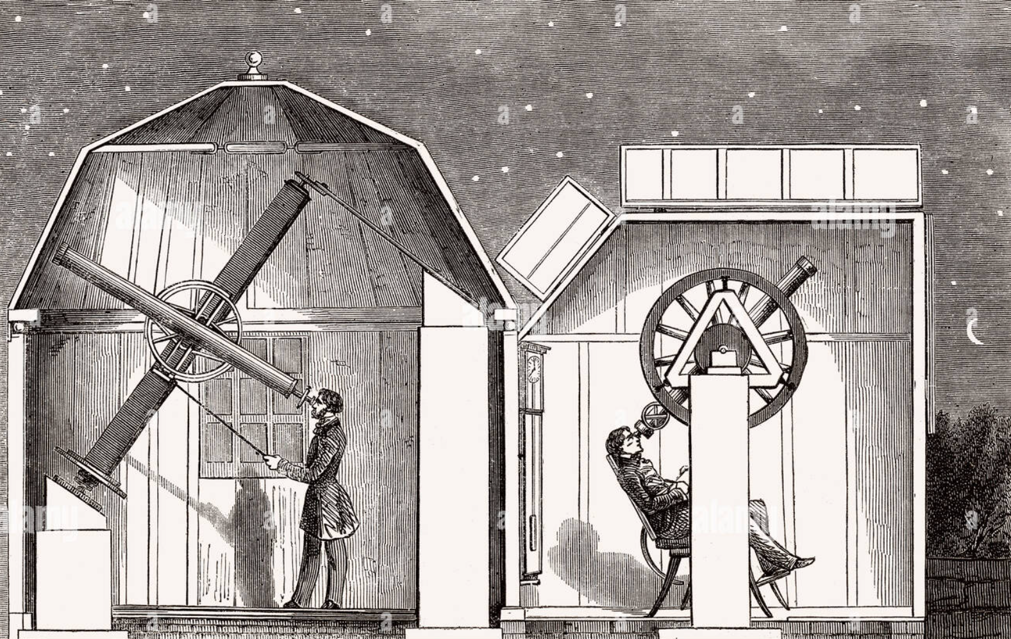
Before the xix century:
Astronomy as a core of scientific mathematics
Amateur observatoires, Interior views, vintage engraved illustration, Magasin Pittoresque 1857.
2

Slide 3
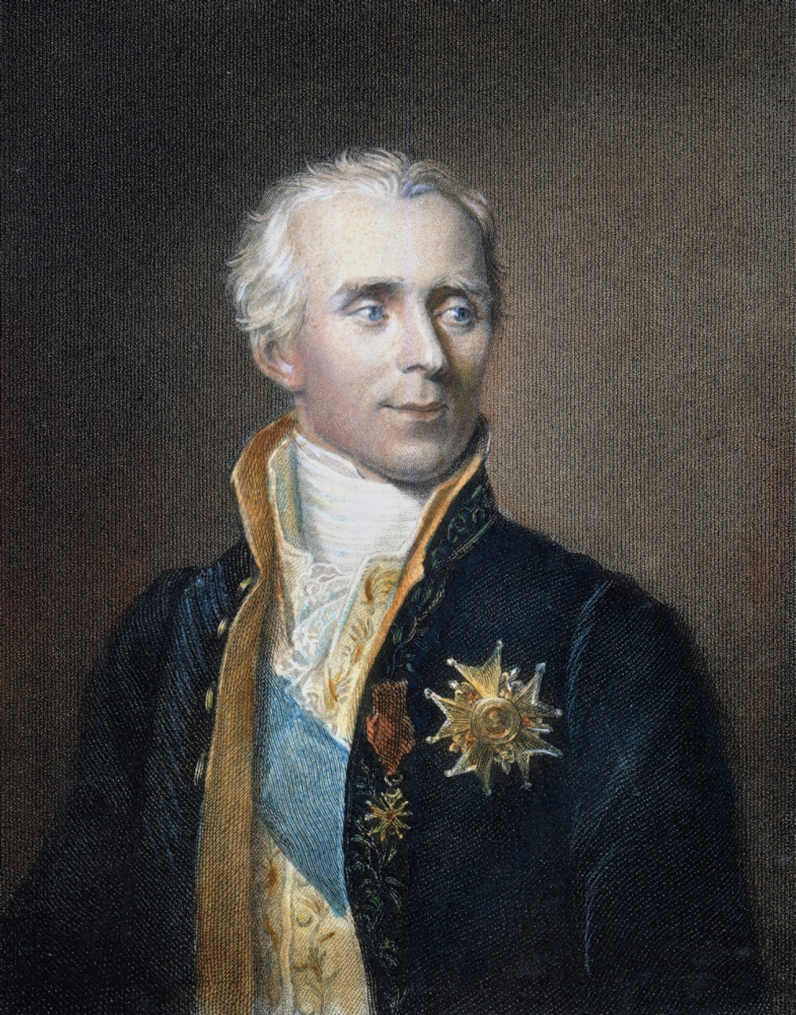
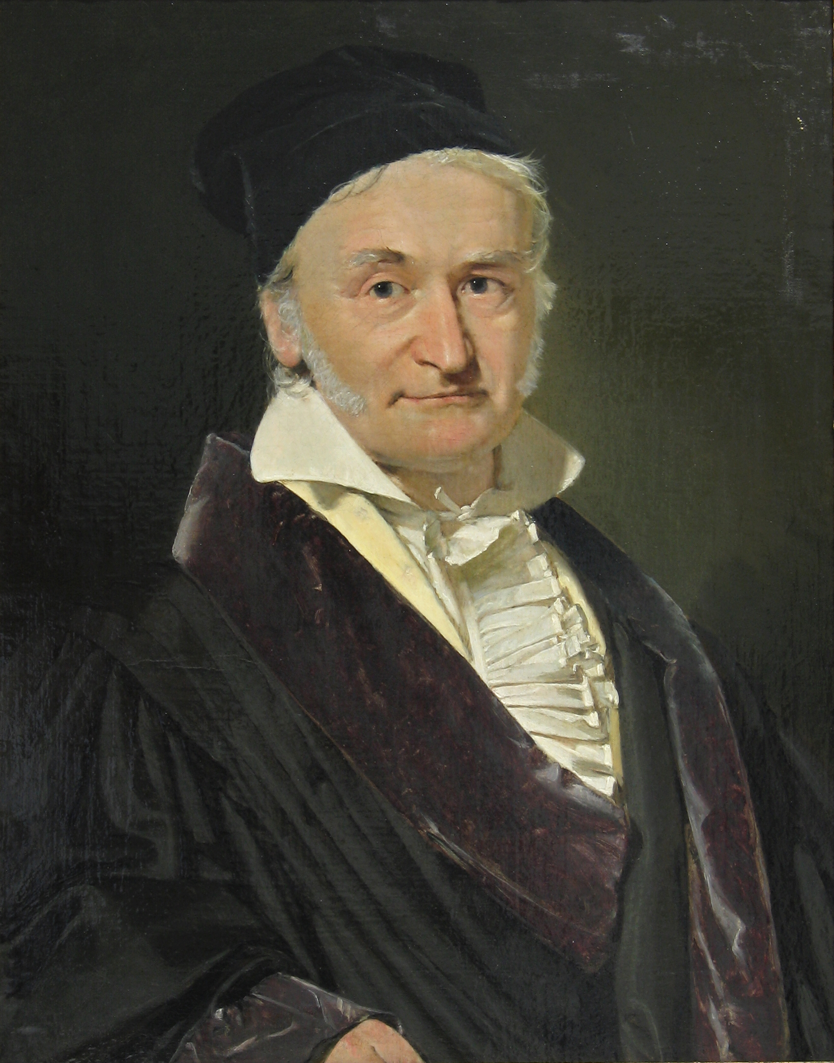
Pierre-Simon Laplace
Carl Friedrich Gauss
3

Slide 4
Observatory as a “bottleneck”
An “isolated” venture
Processing the numbers (data)
Includes a hierarchy of knowledge and responsibilities
4

Slide 5
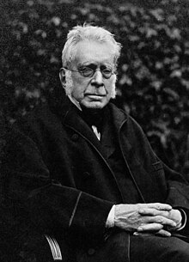
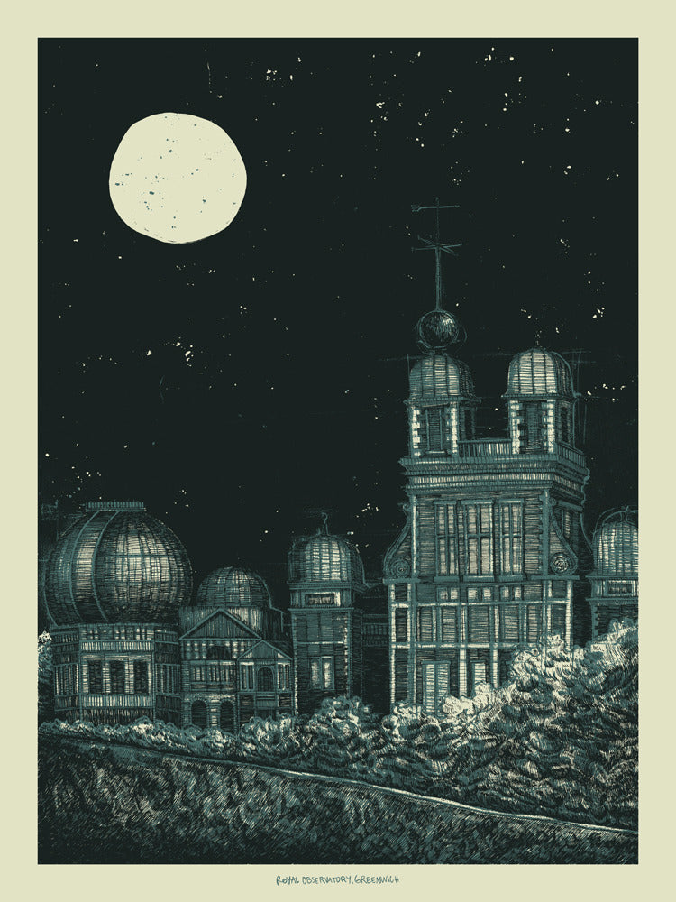
New organized approach
Head of the Royal Astronomical Society (London)
Documented and applied first structured hierarchy at observatory (Greenwich)
Prepared a ground for treating numbers on an “industrial” scale
George Biddell Airy
Greenwich History & Heritage Collection: The Royal Observatory
5

Slide 6
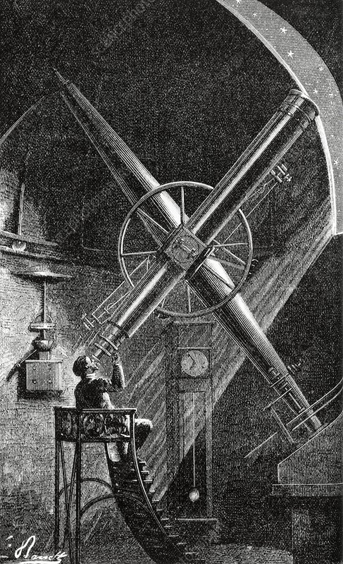
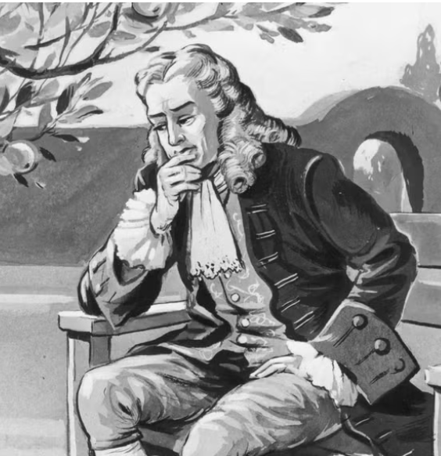
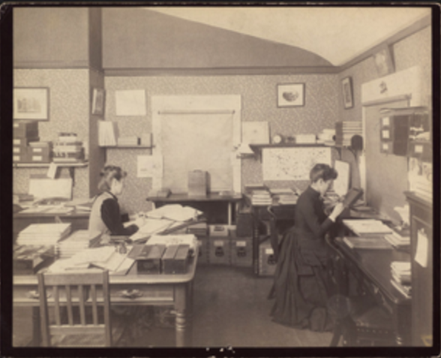
Adding computational department
6

Slide 7
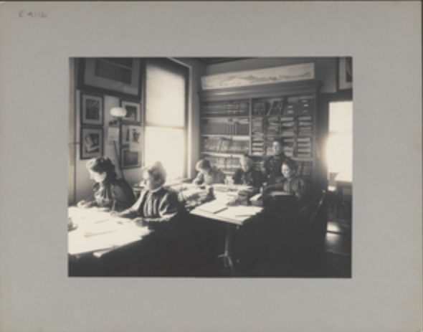
Adding computational department
Computing rooms as mediators between observers and theoreticians
Fast checking and processing numbers
Storage repositories of data
Harvard College Observatory, 1892, Harvard University archives
7

Slide 8
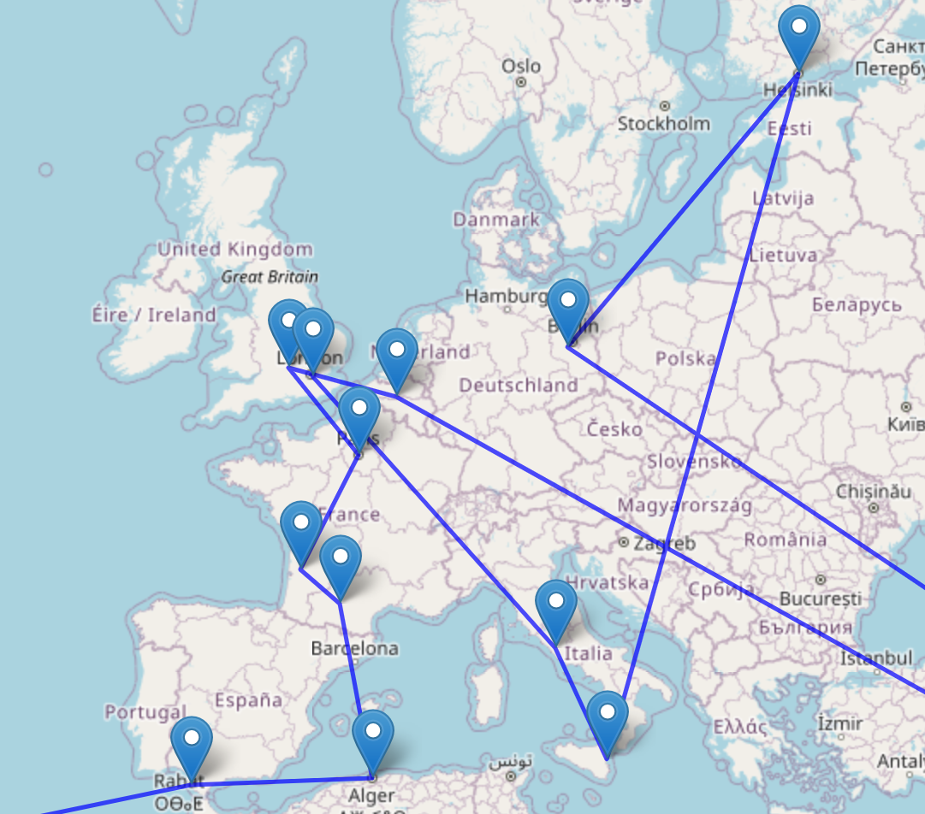
The first scientific network
Influence of geodetic surveys
“Centers of calculation”
Schematic map of observatories participated in “Carte du Ciel” project, late 19th century
8

Slide 9
Conclusions
Observatories as factories of numbers
Emerging of computing departments
Scientific network with observatories as “calculation centers”
9

Slide 10
Thank you
Main source:
Aubin, David. 2009. "Observatory Mathematics in the Nineteenth Century." In The Oxford Handbook of the History of Mathematics, edited by Eleanor Robson and Jacqueline Stedall, pages 273–298. Oxford: Oxford University Press.

