Slide 1
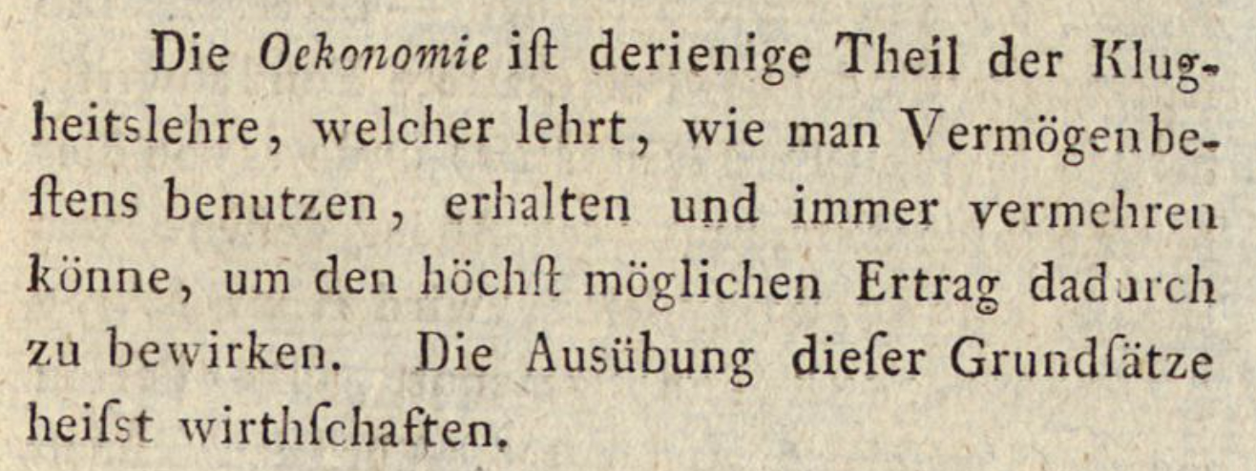
Friedrich Ludwig Walther, Attempt at a System of Cameral Sciences
“Oekonomie is that part of the theory of prudence which teaches how one can best use, preserve, and continually increase one’s assets to achieve the highest possible return. The practice of these principles is called economics [more literally: keeping house].”
(Giessen, 1793)

Slide 2
From moral philosophy to political economy
Conventional Anglophone narrative
Mercantilism Capitalism
(national balance of trade in zero-sum game) (production moves beyond guilds)
(joint stock companies) (new credit mechanisms)
(labor and land mostly unchallenged) (machines increase productivity)
(free trade leads to growth)
Less conventional Continental narrative
Cameralism
(state-centered)
(material and technological progress as route to salvation)
(circulatory mechanisms)

Slide 3
Narratives of development
Secularization
“Humanity” as core category
Autonomous domains of knowledge
Rationalization
Inert Nature
Expansion, concentration of productive resources
Conflation of “European” and “modern” in extension of European culture outside Europe
Progress tropes (reflexivity of development)

Slide 4
Nature as resource for politics and society
Nature neutral/indifferent
Nature progressive/orderly
Nature antagonistic

Slide 5
Jean-Baptiste Say, A Treatise on Political Economy
Chapter VII.
Of the Labor of Mankind, of Nature, and of Machinery Respectively.
By the term labor I shall designate that continuous action, exerted to perform any one of the operations of industry, or apart only of one of those operations.
(1803)

