Slide 1
Antoine Destutt de Tracy
The natural history of the mind as resource for the lawmaker
His contemporaries: Cabanis, Pinel, Dupuis
And from the natural sciences: Lagrange, Laplace, Berthollet, Cuvier, Saint-Hilaire, Lamarck

Slide 2
International Bureau of Weights and Measures (1875)
Article 6
The international bureau of weights and measures shall be charged with the following duties:
1st. All comparisons and verifications of the new prototypes of the meter and kilogram.
2d. The custody of the international prototypes.
3d. The periodical comparison of the national standards with the international prototypes and with their test copies, as well as comparisons of the standard thermometers.
4th. The comparison of the prototypes with the fundamental standards of non-metrical weights and measures used in different countries for scientific purposes.
5th. The standarding and comparison of geodesic measuring-bars.
6th. The comparison of standards and scales of precision, the verification of which may be requested by governments or scientific societies, or even by constructors or men of science.

Slide 3
Mikhail Pogodin, Historical Aphorisms
“Everything is headed toward unity: thus in Europe there is already a single system of chronology, while earlier there was one among the Romans, one among the Greeks, one among the Galls. Napoleon wanted to introduce a single [system of] measure, a single weight, a single currency, and in all likelihood such questions will soon be proposed at European congresses, supplanting political questions, war and peace, all of which will cease, at least for the earlier causes and motives.”
(1836)
“Все идет к единству: так в Европе уже одно летосчисление, а прежде у Римлян свое, у Греков свое, у Галлов свое. Наполеон хотел ввести одну меру, один вес, одну монету, и очень вероятно такие вопросы скоро будут предлагаться на конгрессах Европейских, вытесняя собою вопросы политические, миры и войны, которые, по крайней мере за прежние причины и поводы, прекратятся. ”

Slide 4
Should bookish men set the standards?
“The times destroy, the times create anew. It is long since so many changes in the law have thronged in Europe as in a period [i.e., Napoleonic] upon which future generations will look back with horror. It seemed as if people wanted this to multiply the general distress and confusion even further. Where once businessmen, men of the world, and people with human and factual expertise drafted laws and ordinances or their counsel was surely sought thereby, now too often it is purely bookish men, literati educated within four walls. What came from the former was suited for living, what stems from the latter is at best suited for speculation.”
The latest arts of money, coinage, mass, and weight for salespeople, businessmen, and newspaper readers
(Nuremberg, 1814)

Slide 5
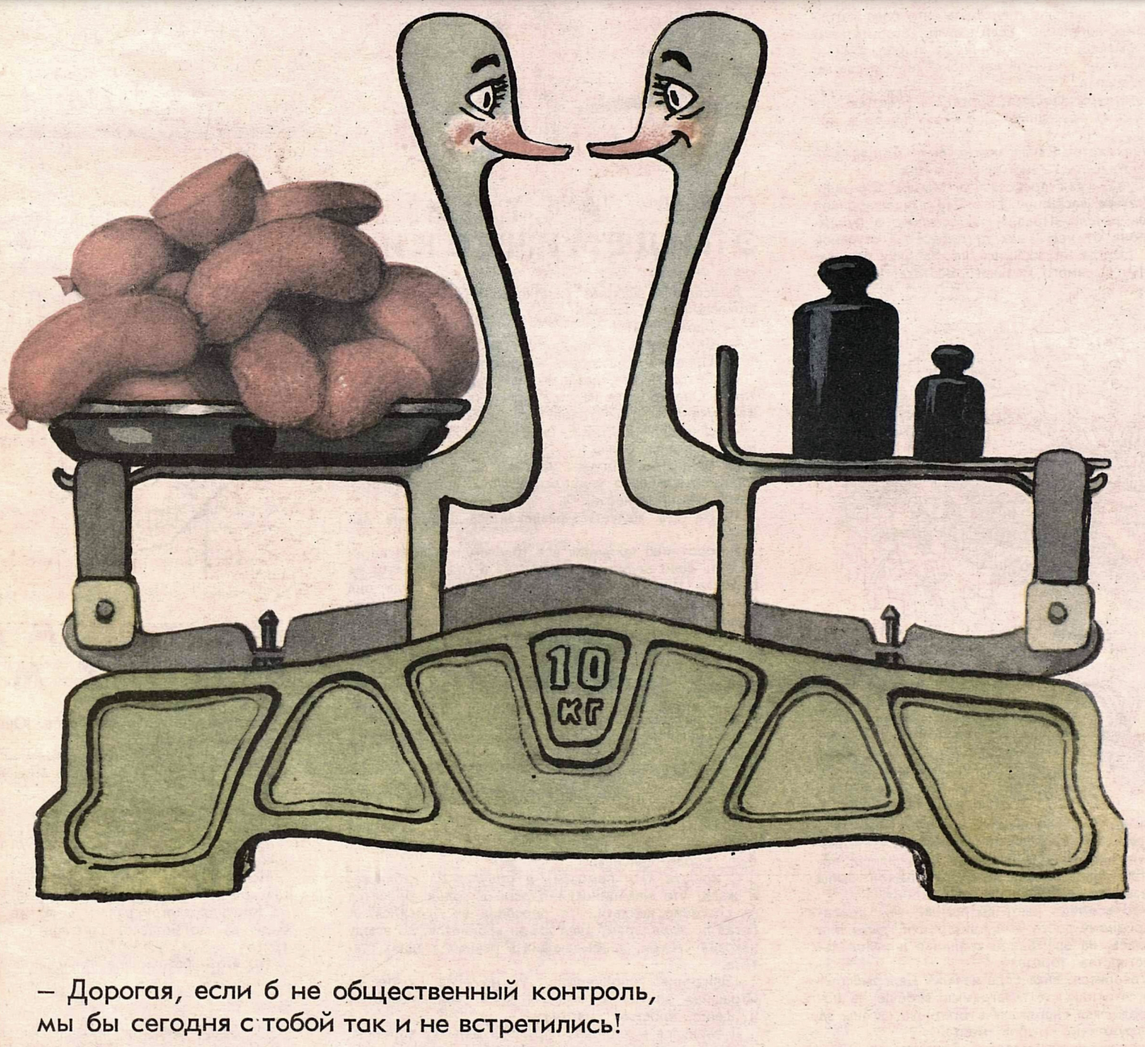
Metrology is social
“My dear, if it weren’t for social control [monitoring, inspection], we wouldn’t have gotten together like this today!”
Krokodil no. 20 (1965)

