Slide 1
The Old Regime in eighteenth-century Europe
Conventional history concentrating on politics and religion
Aristocratic elites with inherited legal privileges
Established churches whose highranking clergy had close ties to the monarchical state and the aristocracy
Urban labor force dominated by guilds
Rural peasantry subject to feudal obligations
Although legal structures and feudal obligations vary widely across the continent, these basic social categories remain generally viable. Regardless of social caste, most members regard social stability as the greater good.

Slide 2
The Old Regime in eighteenth-century Europe
Were there nonetheless drivers of change?
Slow but steady population expansion driving rising grain prices
New crops and new methods of land management
Expanding domestic consumption (textiles, china, brassware, silverware, wines, items from the New World)
New inventions (spinning jenny, water frame, steam engine, iron production)

Slide 3
From moral philosophy to social science
Emerging from the study of human nature…
“State of nature”
(early modern)
Modes of investigation
(modern)
Prior to society (Rousseau)
vs
social convention (Hobbes)
Ordinary shared properties
vs
exceptional and sublime
As “application” of natural science; reductionist
Autonomous within a world of disciplines; anti-reductionist (Comte)
Critique of both naturalistic modes

Slide 4
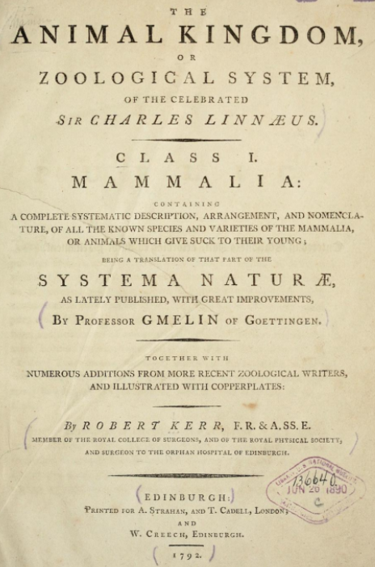
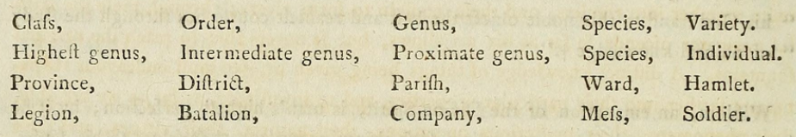
Linnaean classification
“Methodical arrangement is the soul of science…
Thus, amidst the greatest apparent confusion of things, the order of Nature is seen to retain the highest degree of exactness.”
analogizing the natural and the social

Slide 5
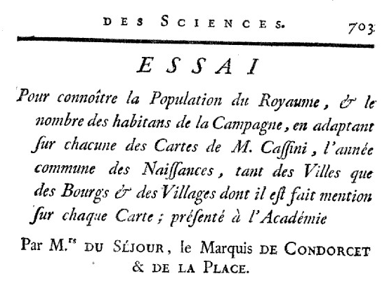
Séjour, Condorcet, Laplace [and La Michodière] (1783)
Attempt [experiment] to ascertain the Population of the Kingdom, and the number of inhabitants of the Countryside, by adapting on each of Mr. Cassini’s Maps, the common year of Births, of the Cities as well as the Towns and Villages mentioned on each Map
[Finding ways to apply “analysis” (mathematics beyond geometry) to the political and moral sciences:
a conjunction of administrative and scientific interests]

