Slide 1
Exploring the Parallels:
The Black-Scholes Equation & Natural History
Tuva Johansson

Slide 2
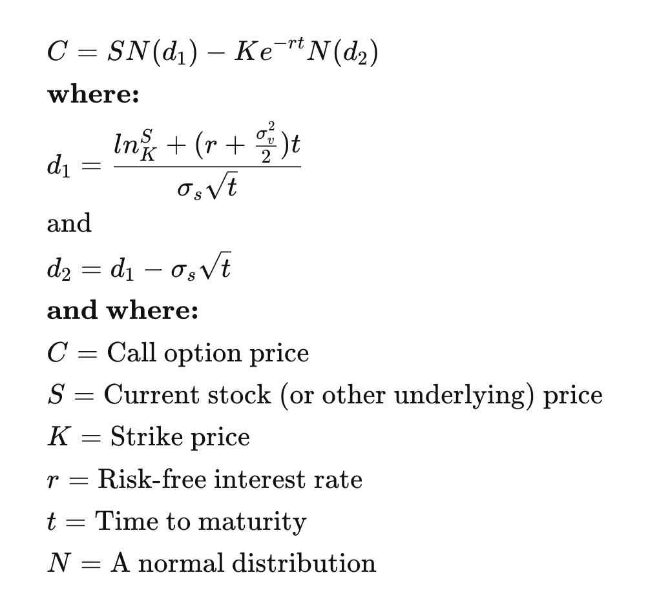
Introduction
Literature: An Equation and Its Worlds: Bricolage, Exemplars, Disunity, and Performativity in Financial Economics by Donald MacKenzie
Black-Scholes: Option pricing equation
Fundamental in modern financial economics
Noble prize 1997
What is an option?
“A contract that gives the right, but not obligation, to buy ('call' or sell ('put') an asset at a given price (the 'strike price') on, or up to, a given future date (the 'expiration').” - Donald MacKenzie
Key themes
Bricolage
Exemplary Solutions
Economic Orthodoxy and Disunity
Performativity

Slide 3

Bricolage
The development of Black-Scholes equation
No predetermined rules
Existing mathematical and theoretical tools
Creative tinkering
Usually used in scientific practice
Natural history
Piece together knowledge from various observations, specimens and theories
Charles Darwin: Geology, Biology, and Economics (Malthusian principles)
  Theory of Evolution

Slide 4
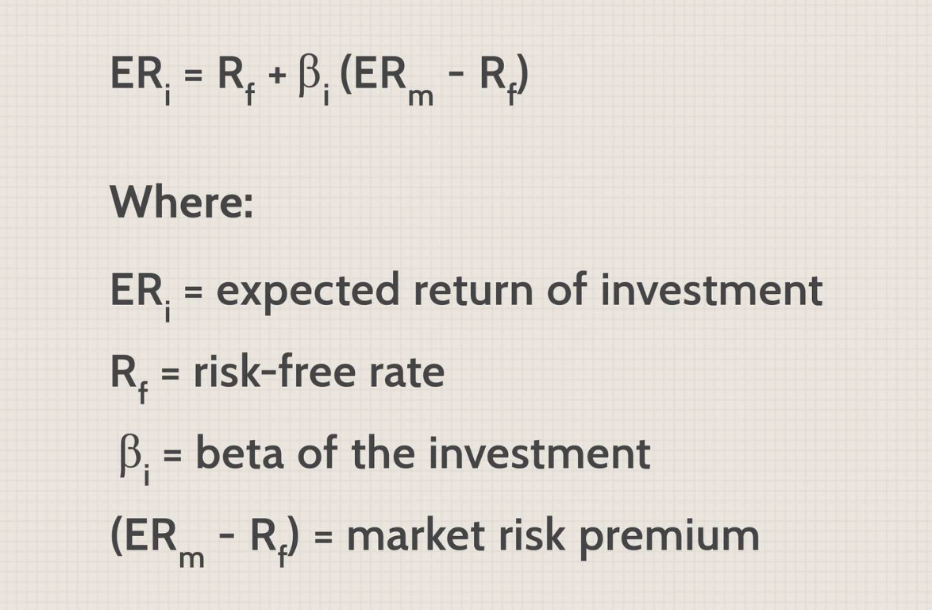
Exemplary Solutions
Capital Asset Pricing Model, CAPM
  Stock Pricing
Fischer Black and Myron Scholes wanted to solve option pricing problems similar to CAPM - Existing Solutions
Different approach to the traditional view
Natural history
Existing theories to guide new theories
Darwin’s theory of evolution
  Foundations to theories of biology and genetics

Slide 5
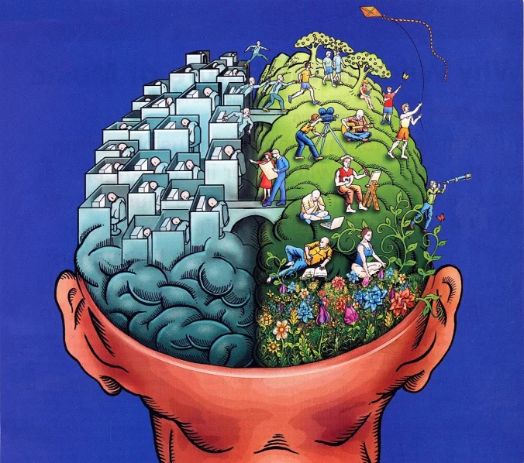
Economic Orthodoxy and Disunity
Orthodox economics: Black, Scholes, Merton etc
Non-unitary nature of economic orthodoxy
Approaches and understandings varied significantly
Diversity = Strength of Black-Scholes
Nature
Nature and natural history has similar diversity of approaches and theories
Diversity enriches the field both in financial economics and nature
→ More robust and comprehensive understanding of the natural world​​

Slide 6
Performativity and Influence
Theory of Black-Scholes is performative
  Not only describe financial markets, it influence and changed it
  More applicable and true
Natural history
Natural history does not change nature directly
However, the understanding and dissemination of natural history knowledge influence how we interact with nature
→ Affects what parts of the natural world we study

Slide 7
Conclusion
Methodologies
Intellectual diversity
Impact of Theories in financial economics
Black-Scholes shows the universality of scientific methods and its impacts across fields

