Slide 1

Animal Behavior, Rats, and
Female Choice
Natural and Social Sciences in the 20th Century
Rahel Peterlini

Slide 2



Contents:
C
Scene Setting & Core Questions
Background & Context
Looking for a Few Good Males
Rats, Men and the Welfare State
Conclusion

Slide 3
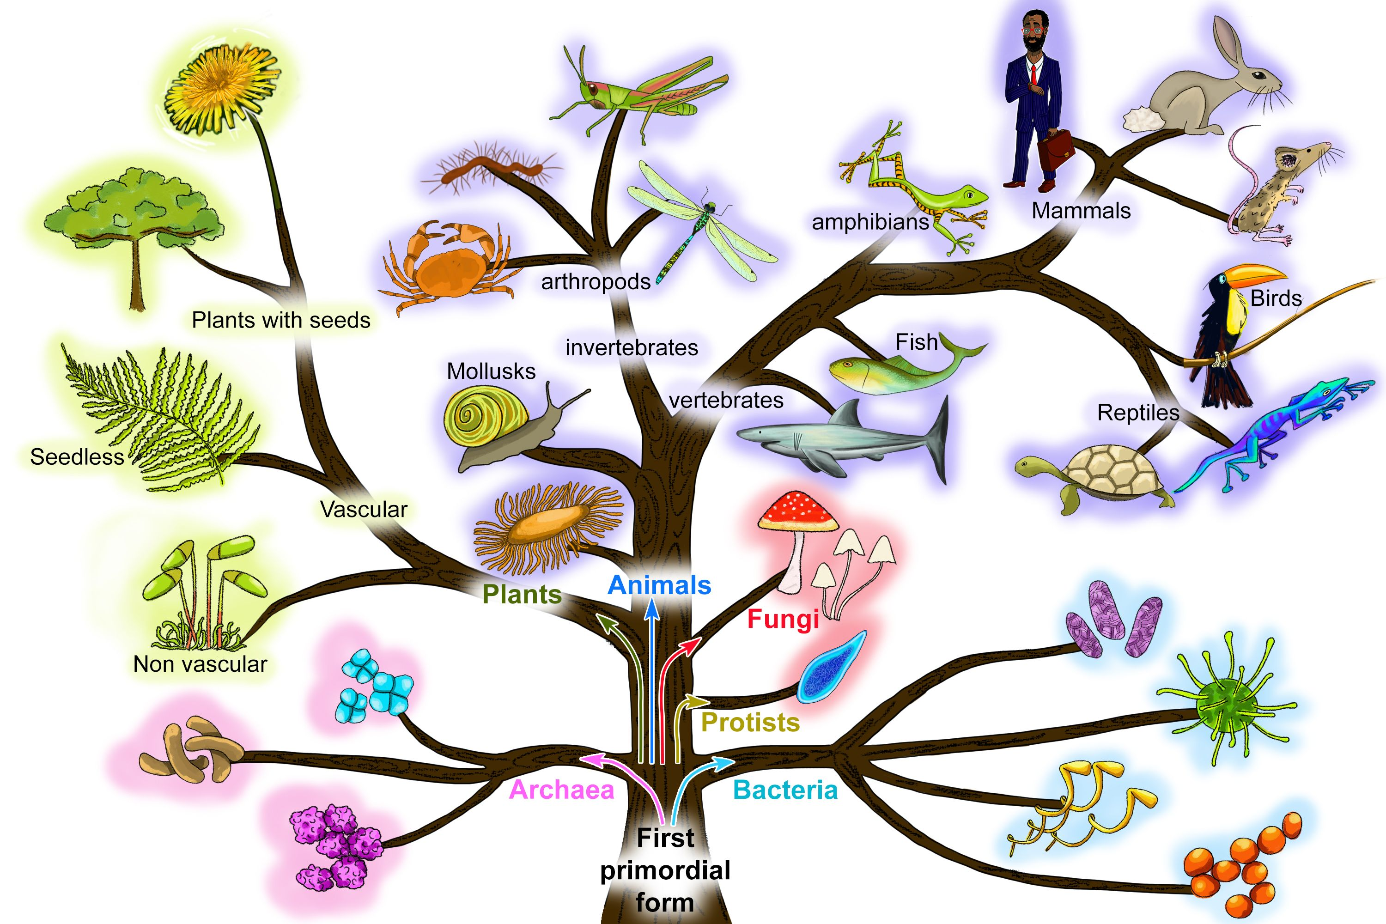
Scene Setting and Core Questions
20th Century inter-war & after-war period
Europe and United States
Core Questions:
Why do animals behave the way they do? Ethology
How should animals best be studied? Field versus Lab
How is their behavior related to survival of the species (reproduction)?
Demographics after the two wars
How do humans and animals relate? (evolution as speciation, domestication as regression?) Can one inform us about the other?

Slide 4
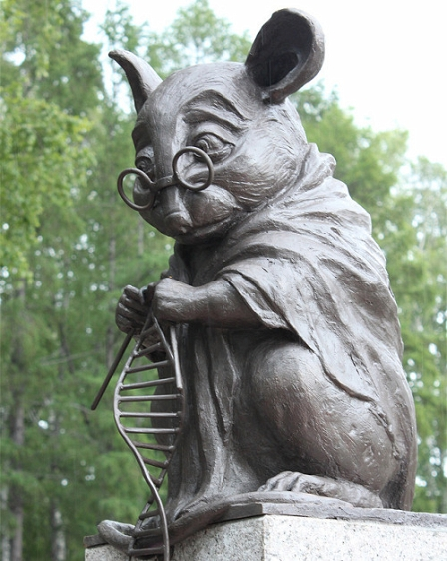
Background and Context
Industrialization and Standardization of Science
→ Statistics and scientific (experimental) methods
→ instruments and machines: precision, replicability →laboratory → Wistar rat
Ethology: study of animal behavior from a biological perspective
→How might behaviour affect evolutionary change
Comparative psychology (US)
→ Studying non-human animal behavior to elucidate human social interactions (comparing the behavior of different animals)

Slide 5
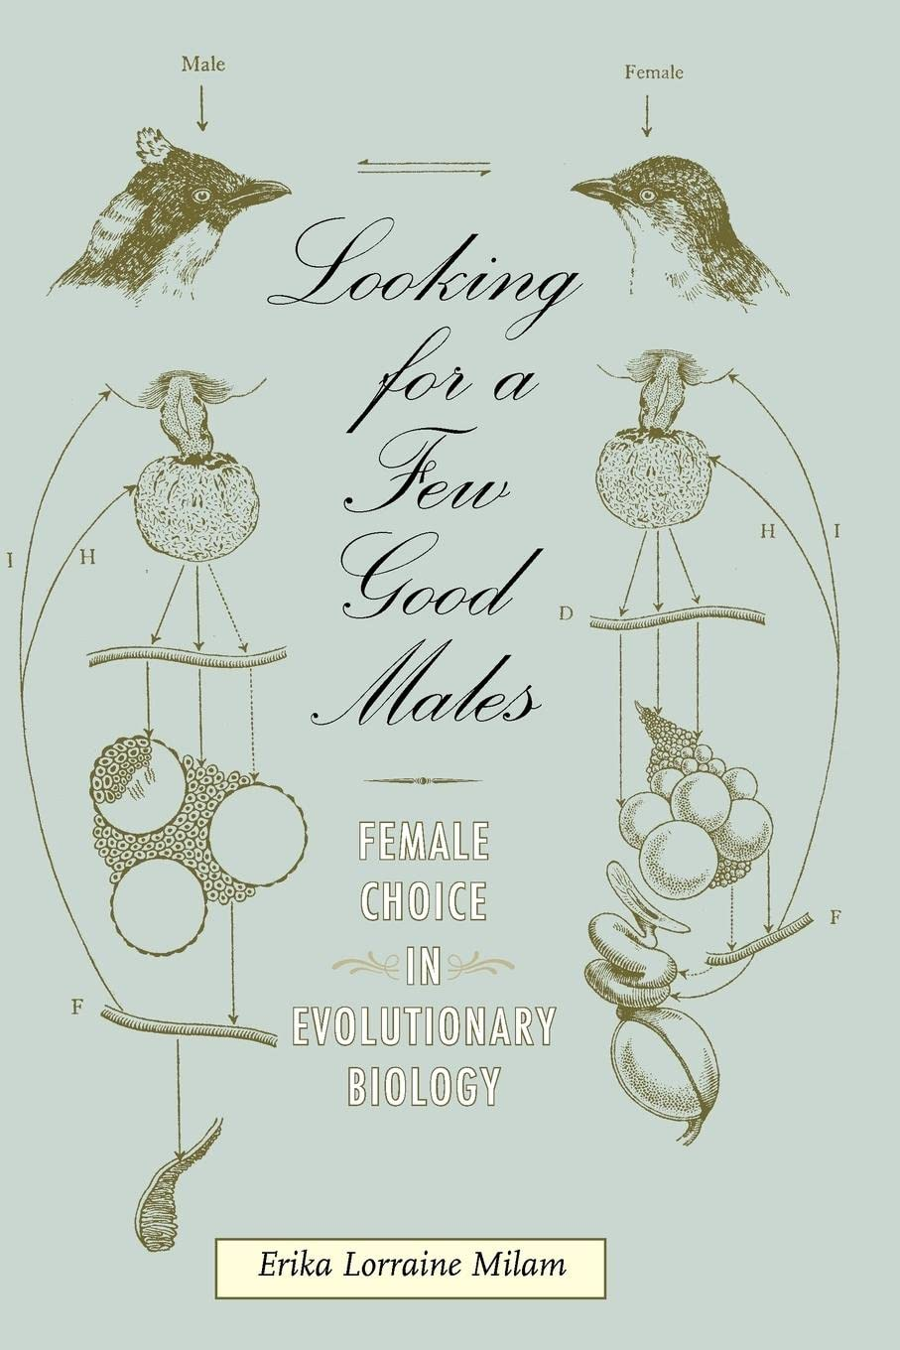
Looking for a Few Good Males
- Erika Lorrain Milam 2010
Darwin sexual selection explains beauty and horns
Choice: rational ability? Instinct? Genetically determined? (Lorenz Hydromechanical Model)
Female choice or male competition?
→ Kellog “Headquarters Nights” 1917
Positive Eugenics after WW

Slide 6
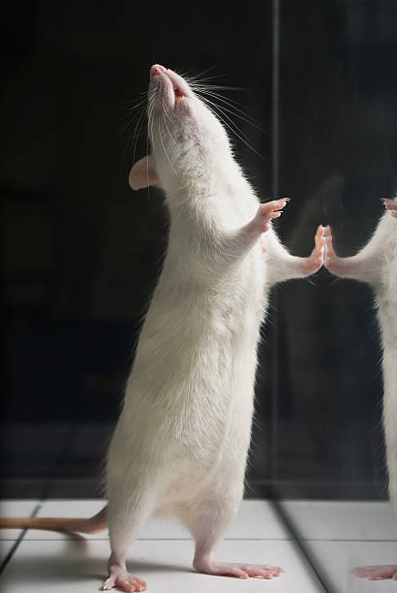
Rats, Men, and the Welfare State
- Curt Richter 1959
American society perceived as sick, prone to disease, and hypersensitivity to the environment (diabetes, asthma, …)
Search for a casual relationship between civilization and deterioration of the human health
lab rat compared to ancestor grey Norway rat analogy to Welfare state citizen and primitive natives
natural selection is less effective in domesticated rats
Welfare state: survival of the less fit individuals → they reproduce

Slide 7
Looking for a Few Good Males
- Erika Lorrain Milam 2010
“are we building a general science of behavior or only a science of rat learning?”
Standardized lab (ACP) versus Field Studies (British ethologists)
Pop-ethology: application of ethology frameworks to humans
Zoologists reclaim right to talk about humans
Humans just another animal – what is their natural environment?

Slide 8
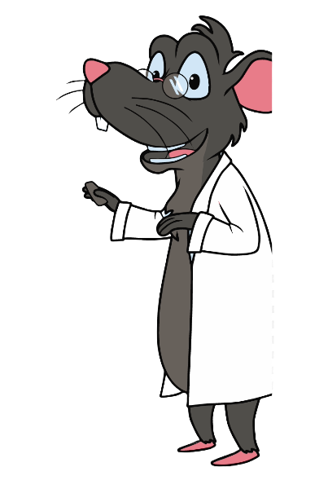
Summary
Rise of Ethology and Comparative Psychology
Standardization of Science:
Rise of the Laboratory and the Lab Rat
Question of Reproduction and Positive Eugenics
Evolution as Speciation:
Animals NOT less complex forms of Humans → Humans are just another animal

Slide 9
Scene Setting and Core Questions
Richter, Curt P. “Rats, Man, and the Welfare State.” American Psychologist 14, no. 1 (1959): 18–28. https://doi.org/10.1037/h0043834.
Milam, Erika Lorraine. Looking for a few good males: Female choice in Evolutionary Biology. Baltimore, MD: Johns Hopkins University Press, 2011.

