Slide 1
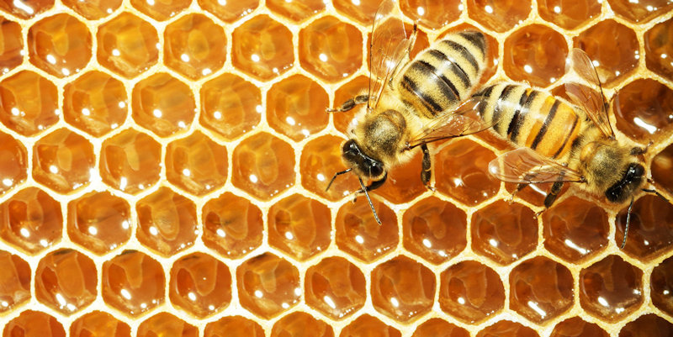
An ocean liner’s innards
The modern steamship as a ten-story Zellenstaat, a beehive of humans…
…with a complex class hierarchy.
Illustrirter Kronen-Zeitung
Vienna, 1906

Slide 2
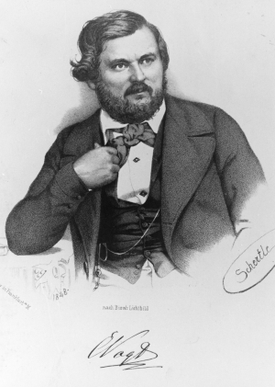
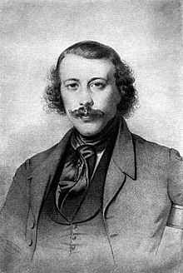
Carl Vogt
Mikhail Bakunin
“He [Bakunin] is now studying with great zeal the manners and customs of these strange creatures that feel every bit as well in their borrowed housings as other snails in self-built housing. Bakunin has therefore concluded that communism is entirely justified in the natural order of things, and that those people whose holdings have some analogy with the St. Bernhard crawfish are also perfectly entitled to make claims upon houses other than theirs. Yet envy is precisely one of the essential basic properties of the human mind, one that constantly wishes to own what already belongs to others and for this reason one must also acknowledge that communism would have to be vindicated to the human race as a whole.”

Slide 3

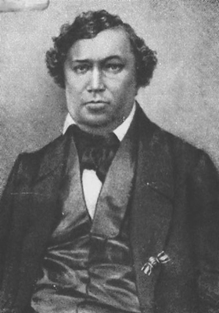
“From time immemorial, the society of bees has attracted attention with its extraordinary rectitude and harmony. ‘Let us go learn from the bees’ has been a very common phrase from the Greeks, from Pliny, and right up to the renaissance of the natural sciences. Then, whenever one wanted to look at the individual relations of this harmoniously whole, excellently organized society, it turned out that all the individual relations perfectly flow together as a whole, as a result of common labor, but all these particulars in themselves are purely paradoxical,
so that to a person who has not seen them,
it is difficult to believe in the reality of their
existence.”
Karl Rouillier, Three Discoveries in the Natural History of the Bee
Moscow, 1857

Slide 4


Theory and practice of the new beekeeping
Jan Dzierżon
1848

Slide 5

Beekeeping periodicals in the nineteenth century
Die Biene. Organ des unterfränkischen Bienzüchter-Vereins (Aschaffenburg)
Bienen-Zeitung, Organ des Vereins der deutschen und österreichischen Bienenwirthe (Nördlingen)
Sächsicher Bienenfreund
Schlesische BIenen-Zeitung
Oesterreichische-ungarische Bienen-Zeitung
Bienenwirthschaftliches Centralblatt für Hannover
Der Bienen-Freund an der Salzach und am Inn
Der schlesische Imker
Deutscher Bienenfreund
Vereins-Blatt des Westfälisch-Rheinischen Vereins für Bienen- und Seidenzucht
Münchener Bienen-Zeitung
Bienenwirthschaftliches Centralblatt
Die Biene und ihre Zucht. Monatsblatt des badischen Vereins für Bienenzucht
Der Bienenvater aus Böhmen
Blätter für Bienenzucht, Haus- & Landwirthschaft (Oberdorf)
Jahrbuch der Bienen-Zucht, zugleich Bienenkalender und Notizbuch (Mannheim)
Die Bienenplfege. Württembergische Monatsschrift zur Verbreitung bienenwirthschaftlicher Kenntnisse
Die niederbayerische Bienenfreund
Der Elsässisch-lothringische Bienenzüchter
Die Honigbiene: Mittheilungen der Vereine für Bienenzucht in den Provinzen Brandenburg, Pommern, Preussen und Schlesien
Honigbiene von Brünn
Illustrirte Dorfzeitung für pracktische Bienenzucht (Ravensburg)
Mittheilungen über Bienenzucht. Vereinsblatt für die Bienenzüchtervereine des Grossherzogthums Hessen
Bienenvater: Fachblatt des Österreichischen Imkerbundes
Die Krainer Biene
Leipziger Bienen-Zeitung
Ostdeutsche Bienenzeitung
Schweizerische Bienen-Zeitung
Bienen-Zeitung für die Schweiz
Mährische Biene
Ungarische Biene
Die Bienenpflege
Deutsche Illustrierte Bienenzeitung (Braunschweig)
Zeitschrift für Bienenzucht
Bienenwirthschaftliches Centralblatt
Bartnik Postępowy. Pismo poświęcone pszczelnistwu i ogrodnictwu
Sbornik vcelarský
Včelařské Listy: časopis včelařského spolku
Výroční zpráva odboru včelařského c.k. mor. slez. společnosti ku zvelebení orby, znalosti přírody a vlasti
Vcela brnenska: Casopis pratel vcelarstvi na Morave a Slezsku
Méhészeti közlöny
Méhészeti lapok
Magyar méh
Slovenska čbela
Revue internationale d’apiculture (Swiss)
L’Apiculteur (Paris)
L' apicoltura razionale risorta in Italia
L'Apicoltore, periodico dell'Associazione centrale d'incoraggiamento per l'apicoltura in Italia
British Bee Journal, and Bee Keeper’s Adviser
Bee-keeper’s Magazine
American Bee Journal
The American Bee Keeper
National Bee Journal
The Bee Keepers Exchange
Moon’s Bee World
The Kansas Bee Keeper
Progressive Bee-keeper
The Bee-hive, Published for and in the Interest of Bee-keepers
Gleanings in Bee Culture
Canadian Horticulturist and Beekeeper

Slide 6
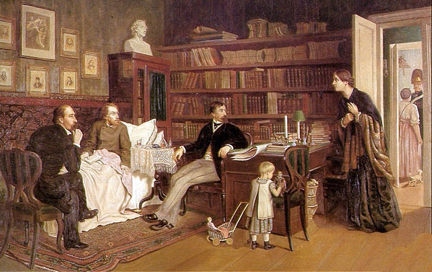
N. A. Nekrasov and I. I. Panaev with the ailing V. G. Belinskii, 1840s (A. Naumov, 1881)
“From this point of view there is nothing more entertaining than Russian philosophy and Russian books on philosophy. No one here has troubled with philosophy as a science; but all our philosophers think that in order to become a philosopher one has only to wish it. They do not regard it as necessary to study philosophy; it is easier to declare that all German philosophers are lying than to read through even one of them. Our philosophers do not understand that in Russia there is not yet either soil or need for philosophy. Our philosopher is suddenly overcome by the urge to philosophize, and since there are no tariffs for chatter, the outcome of this unexpected attack of philosophizing is a small book in which everything is said, everything explained, everything solved, except for one thing—why and for whom all this nonsense was written…”

Slide 7
Dobroliubov Chernyshevskii
Turgenev

Slide 8
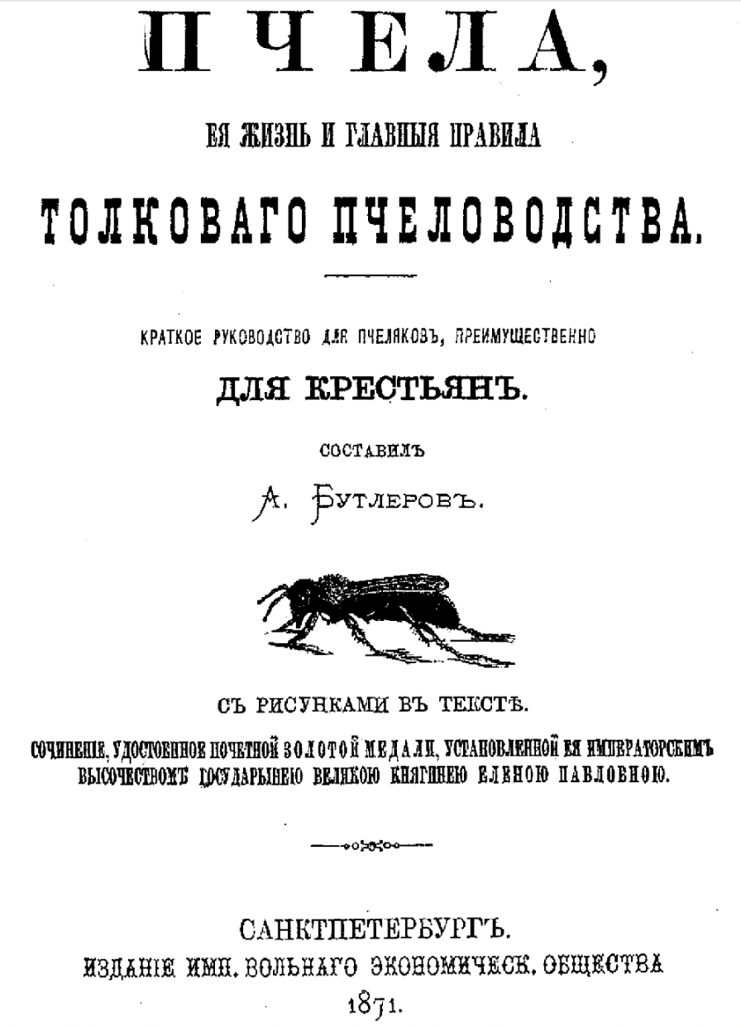
The scientific hobby of an organic chemist
“Bee science is not a very tricky business, you just need a firm knowledge how a bee lives, how it reproduces and manages in the hive, and to work with a savvy mind so that you can apply your knowledge to business when needed. And after all, the peasant won’t have a problem with this: ’Just because the tunic is threadbare doesn’t mean somebody has eaten his mind’.”
Aleksandr Butlerov, The Bee, its Life and the Chief Rules of Intelligent Beekeeping.
A Brief Guide for Beekeepers, primarily for Peasants
St Petersburg, 1871

Slide 9
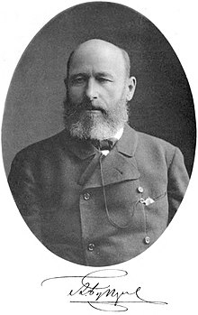
Aleksandr Butlerov’s version of materialism (1884)
“It is not without foundation that people complain about the decline of ideals, about the predominance of crude materialism, but it is completely unfounded that they blame positive knowledge for this. It teaches one to strictly distinguish fact from conclusion; it indicates only what exists, limiting itself to the field of observation and experience; it does not at all talk about the non-existence or impossibility of existence of anything. It is not the fault of positive knowledge if some of its overzealous and insufficiently rigorous adepts take things too far. The best sure cure for their delusions may be the same positive knowledge: any denial falls before reality and common sense, provided the deluded person is truly a man of knowledge, and not a fanatic inaccessible to the discourse of facts. That fanaticism is not uncommon in denial is beyond any doubt. The facts, we think, are beginning to speak louder and louder against denial. Now it is the turn of materialism: it must, bowing before reality, sacrifice its ideal, if the desire to reduce everything that exists, without exception, to something that people can see, feel, smell, measure, weigh, and lock in a jar can be called an “ideal.” Observing impartially, from the outside, you clearly notice how, little by little, step by step, scientific facts accumulate, lowering the pedestal on which matter has been elevated, and the predominant importance of force comes forward.”

Slide 10
Aleksandr Butlerov’s version of materialism (1884)
“Let the custodians mutually appease each other; the facts accumulate alongside them, too, and under the pressure of facts the opponents are transformed into allies. Without consulting human sympathies, antipathies, and careerists, true knowledge takes its course, and anyone who does not follow it will quickly be among the laggards.”

Slide 11
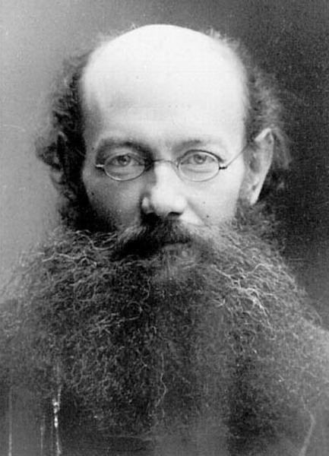
Petr Kropotkin, Mutual aid among animals,” Nineteenth Century (1890)
“As soon as we study animals—not in laboratories and museums only, but in the forest and the prairie, in the steppe and the mountains—we at once perceive that though there is an immense amount of warfare and extermination going on amidst various species, and especially amidst various classes of animals, there is, at the same time, as much, or perhaps even more, of mutual support, mutual aid, and mutual defense amidst animals belonging to the same species or, at least, to the same society. Sociability is as much a law of nature as mutual struggle.”

Slide 12
Central European University
Professor Karl Hall
text

Slide 13
Central European University
Professor Karl Hall
caption
caption
caption
caption
text
text
text

Slide 14
Central European University
Professor Karl Hall
text
caption
text
caption
text

