Slide 1
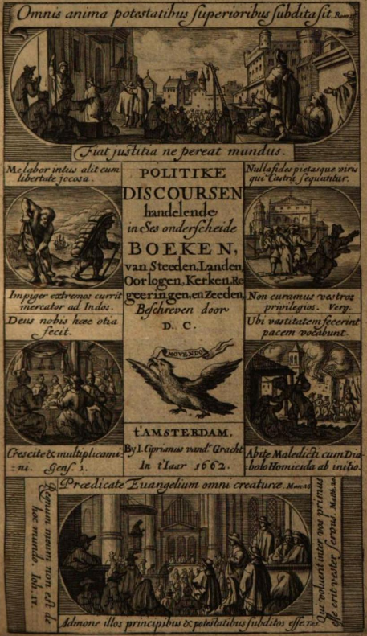
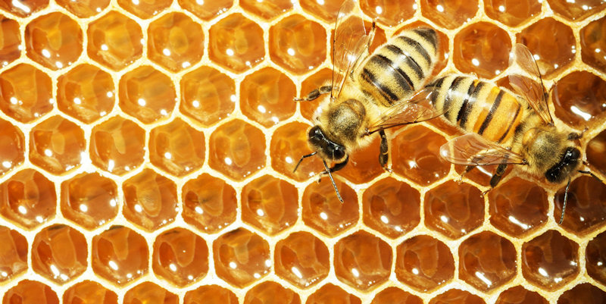
Optimistic Hobbesianism:
The Dutch Republic as a contract imposed to avoid conflict, yet men (sic!) in their natural state are able to calculate from self-interest to achieve the best collective institutions
Johan de la Court
Political discourses dealing… with cities, countries, wars, churches…
Amsterdam, 1662

Slide 2
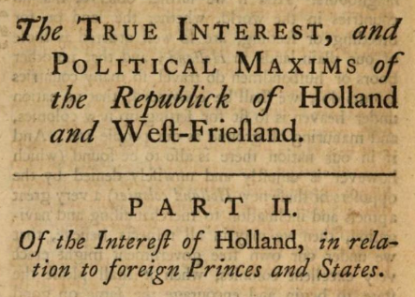
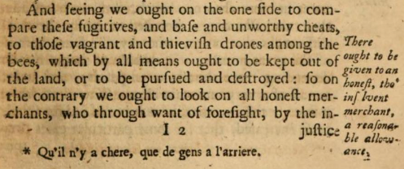
Individual virtues always serve the common good, provided the form of government is Republican
Keeping out “those vagrant and thievish drones among the bees”
John de Witt
2nd ed. 1746 [1st ed. 1702; original Dutch from the 1660s]

Slide 3
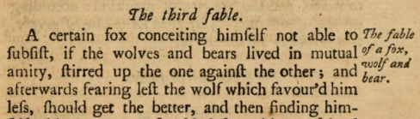
Fables help make the argument
“As false self-love is the root of all mischief, so prudence and well-grounded self-love is the only cause of all good and virtuous actions.”
John de Witt
2nd ed. 1746 [1st ed. 1702;
original Dutch from the 1660s]

Slide 4
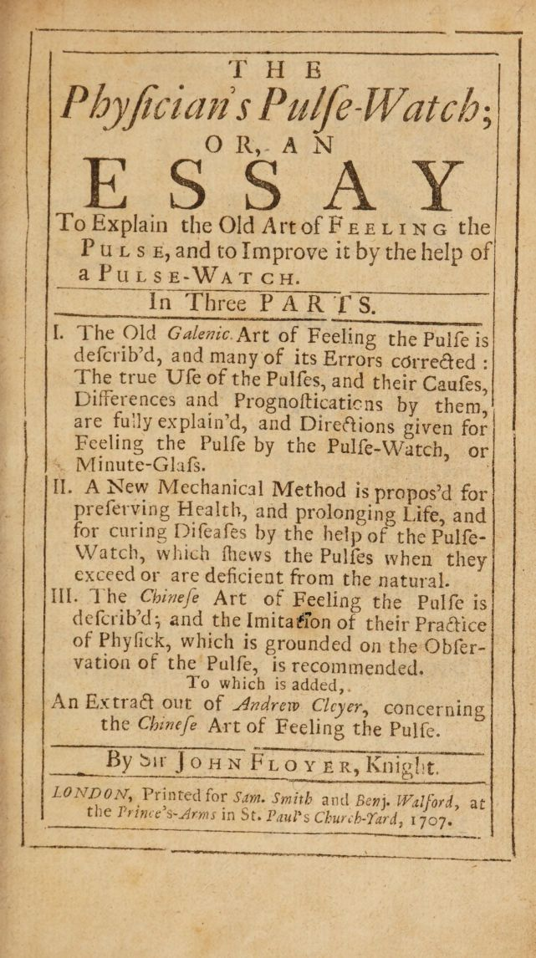
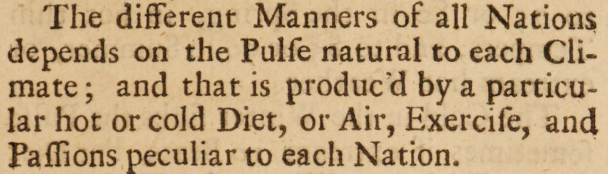
Passions
John Floyer
1707

Slide 5
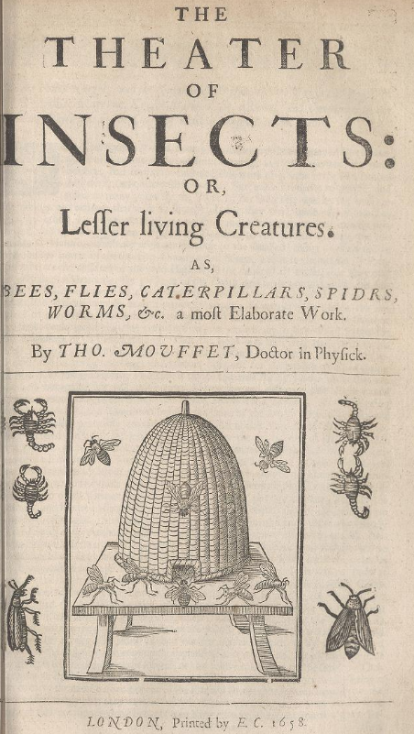
From Topsell’s The History of Four-Footed Beasts (1658)
Chapter 2. Of the Politick, Ethick, and Oeconomick virtues of Bees
“Bees are swayed by sovereinty, not tyranny, neither do they admit of a King properly so called, by succession or by lot, but by due advice, and circumspect choice; and though they willingly submit to regal authority; yet so, as they retain their liberty; because they still keep their Prerogative of Election; and when their King is once made sure to them by oath, they do in a principal manner love him… For their law is the law of nature, not written but imprinted in their manners.”

Slide 6
Early modern classifications of emotions, passions, affects, sentiments
Self-directed vs. Other-directed
Sociable vs anti-social
Good vs Bad

Slide 7
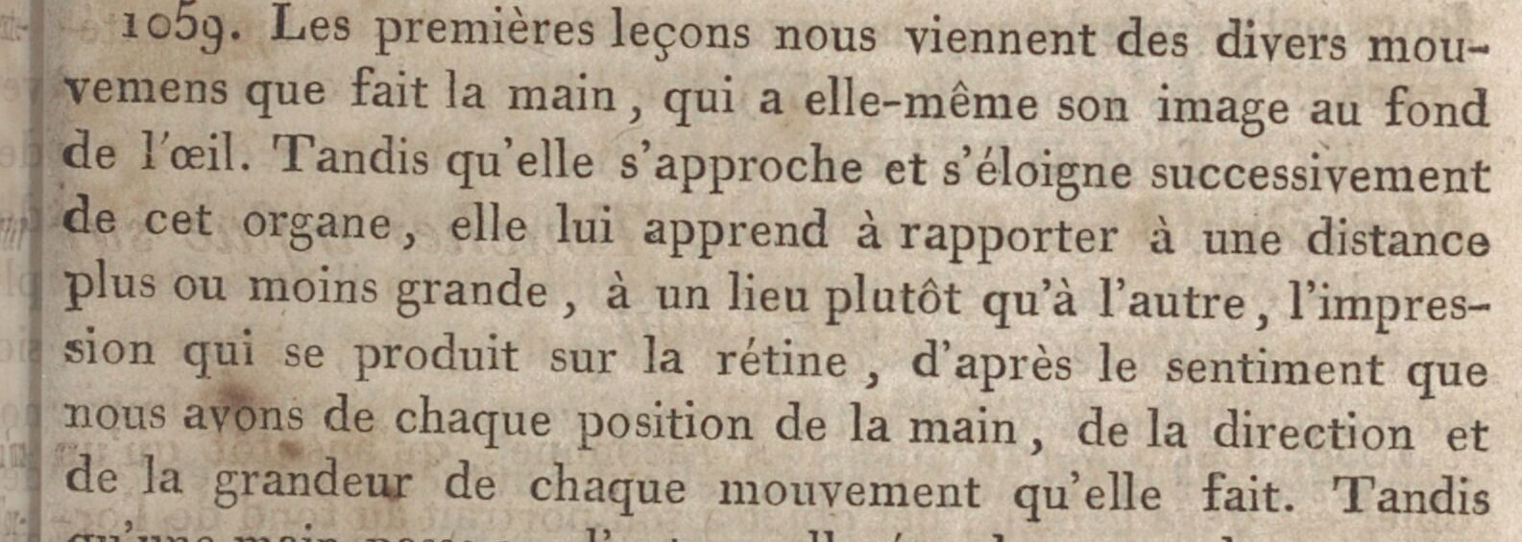
René Just Haüy, Traité élémentaire de physique (1806)
René Just Haüy, An Elementary Treatise on Natural Philosophy (1807)
Light // Structure of the Eye
Our first lessons are derived from the various motions which the hand makes, that has its own image in the bottom of the eye. While in turns it approaches nearer to or withdraws farther from this organ, it teaches it to refer to a greater or less distance, to one place rather than to another, the impression that is produced on the retina, from the sentiment we have of every position of the hand, and of the direction and extent of every movement it makes.

Slide 8
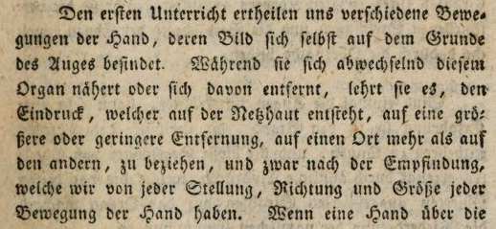
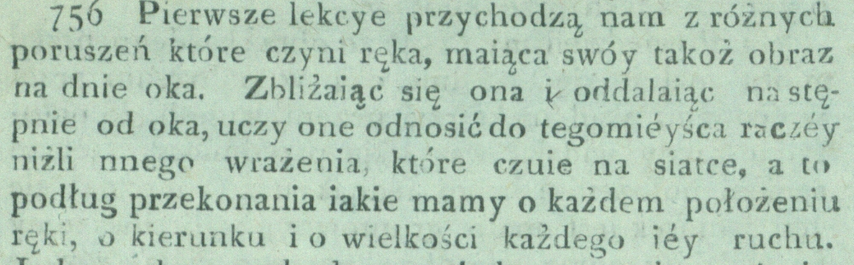
René Just Haüy, Grundlehren der Physik (1804)
René Just Haüy, Traktat początkowy fizyki (1806)
Moving away from early modern meaning?

Slide 9
Early modern
Modern
Human nature
Single object of study
Parts belong to disciplines
There can be a “science of human nature”
Anthropology
Psychology
Natural history
Philosophy
Origins of language, ethnographic differences
Science of mental actions
Human ‘animal’ behavior linked to moral philosophy?
Metaphysics of passions
Intelligibility preference
Analogies
System coherence vs greatest usefulness
Deduction vs induction
Rational (universal principles) vs empirical (including history!)
Mechanical (physical) vs organic (physiological)
From moral philosophy to social science
“State of nature”
Modes
Prior to society (Rousseau) vs social convention (Hobbes)
Ordinary shared properties vs exceptional and sublime
As “application” of natural science; reductionist
Autonomous within a world of disciplines; anti-reductionist (Comte)
Critique of both naturalistic modes

Slide 10
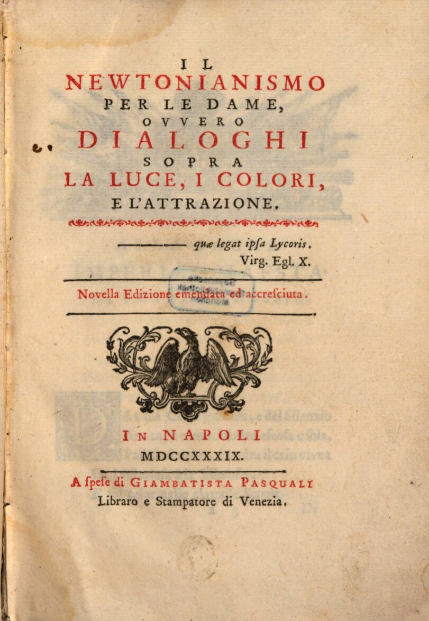
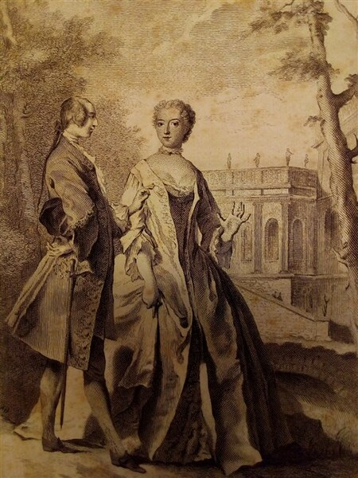
Algarotti, Newtonianism for the Ladies
Frontispiece likely modeled on
Emilie Du Châtelet
(1737)

Slide 11
An idealized French Republic of Letters, including Fontenelle, Montesquieu, Diderot
Depicting a reading of Voltaire’s tragedy of the Orphan of China in the salon of Marie Thérèse Rodet Geoffrin
Lemonnier
1812

Slide 12
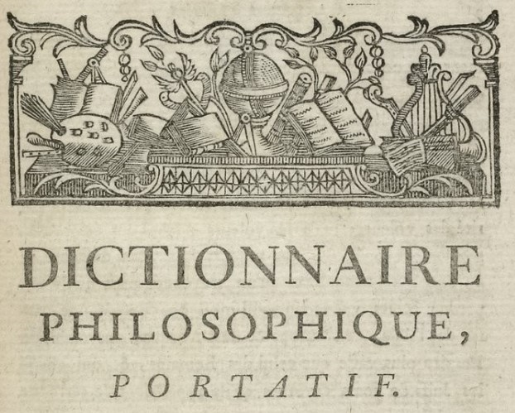
A chicken-run is visibly the most perfect monarchic state…
If it be true that the bees are governed by a queen to whom all her subjects make love, that is a still more perfect government.
The ants are considered to be an excellent democracy. Democracy is above all the other States, because there everyone is equal, and each individual works for the good of all.
The republic of the beavers is still superior to that of the ants, at least if we judge by their masonry work.
The monkeys resemble strolling players rather than a civilized people; and they do not appear to be gathered together under fixed, fundamental laws, like the preceding species.
We resemble the monkeys more than any other animal by the gift of imitation, the frivolity of our ideas, and by our inconstancy which has never allowed us to have uniform and durable laws.
Voltaire, Philosophical Dictionary
London, 1764

Slide 13
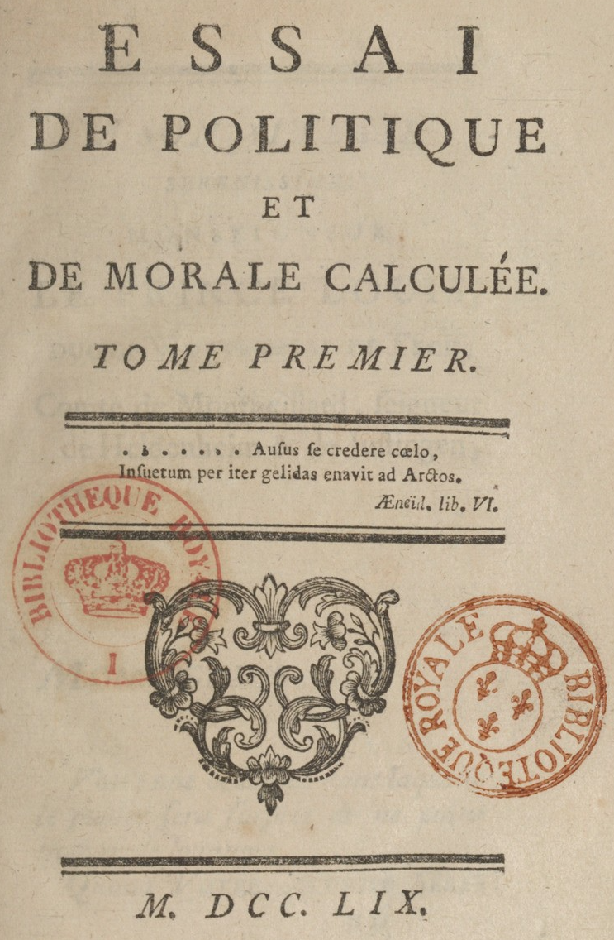
Essay on Politics and Moral Calculus (1759)
“In morality, as in physics, one movement always causes another, which produces new relationships between the beings on which it acts. It is these relationships that luxury gives rise to in ideas, which form what we call the spirit of different centuries.”

Slide 14
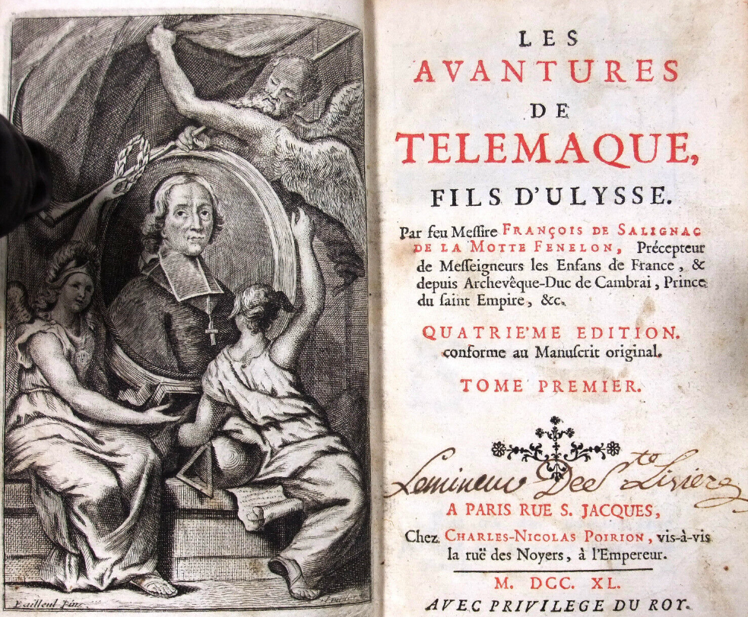
Fenélon, The Adventures of Telemachus (1699)
Revisiting classical mythology as a vehicle for moralizing:
Primitive society
innocent, honest, virtuous, poor
Commercial society
polite, corrupt, given to vice, luxury, and the passions

Slide 15
Translating The Fable of the Bees
Mandeville:
“I believe Man (besides Skin, Flesh, Bones, &c. that are obvious to the Eye) to be a compound of various Passions, that all of them, as they are provoked and come uppermost, govern him by turns, whether he will or no.”
Du Châtelet:
“Nostre ame est composée de passions differentes, comme nostre corps l’est d’os, de chair de muscles, etc. Ces passions nous gouvernent tour a tour et sont la source de nos vertus et de nos vices.”
[Our soul is composed of different passions, as our body is of bones, flesh, muscles, etc. These passions govern us in turn and are the source of our virtues and our vices.] [NB: excises “whether he will or no”]

Slide 16
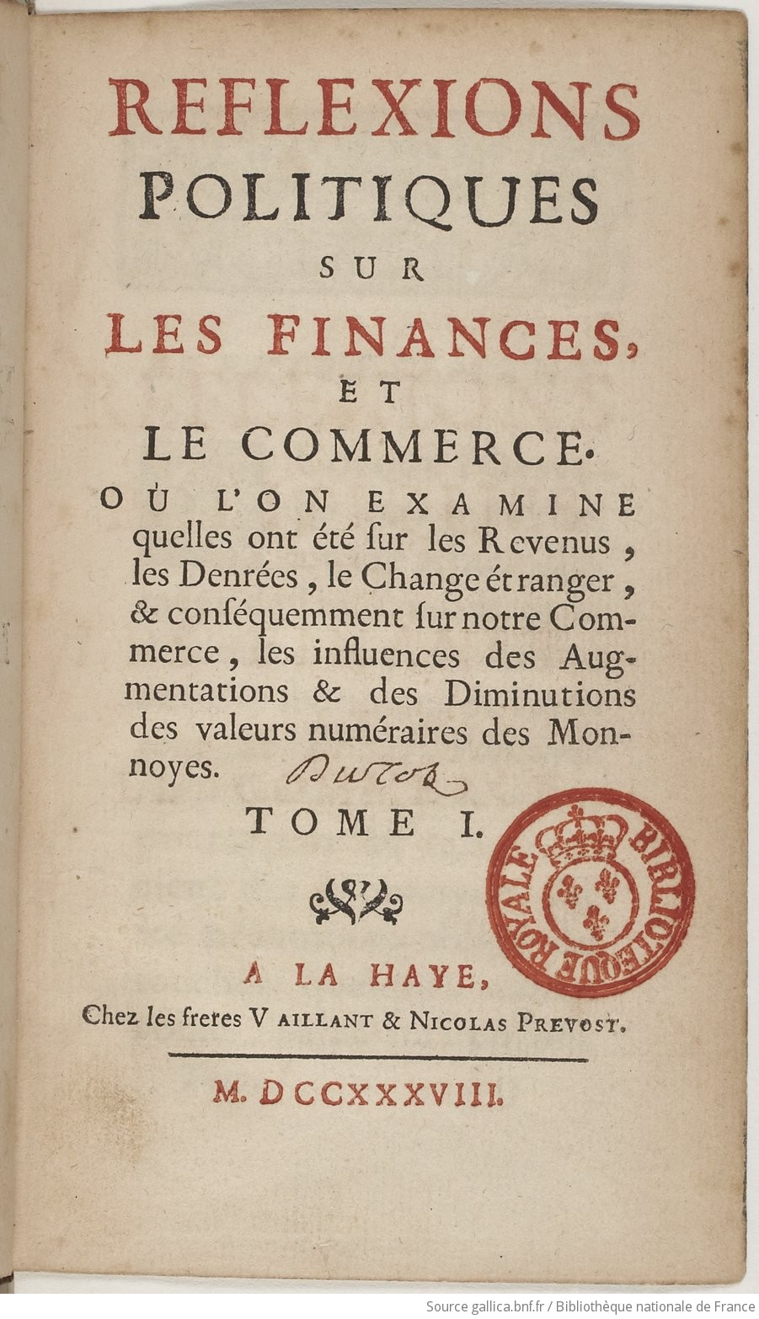
Dutot, Political Reflections on Finances and Commerce (1738)
Luxury as a constitutive factor in (French) commercial society

Slide 17
Central European University
Professor Karl Hall
text
caption
text
caption
text

