Slide 1






Bees and the Development of Empiricism in the Scientific Revolution
Karim Aoun, 24.10.2023

Slide 2
Table of Contents
Introduction
Robert Boyle's Experiments with Bees
Isaac Newton's Apiary
John Locke and the Tabula Rasa (Problems with Innate Ideas)
Conclusion

Slide 3

01
Introduction

Slide 4
Knowledge of nature based on speculation, not observation before 17th century
Boyle, Newton, Locke challenged older rationalist views, ushered in empiricism
Observation of honeybee colonies was a driving force behind this shift
Their studies exemplified empirical method of gathering facts through observation
Insights from bees directly informed later works applying lessons of patience
Close study of bees encouraged rise of empirical methods in modern science
Studying bees encouraged evidence-based, data-driven approach to science

Slide 5
02
Robert Boyle's Experiments with Bees

Slide 6
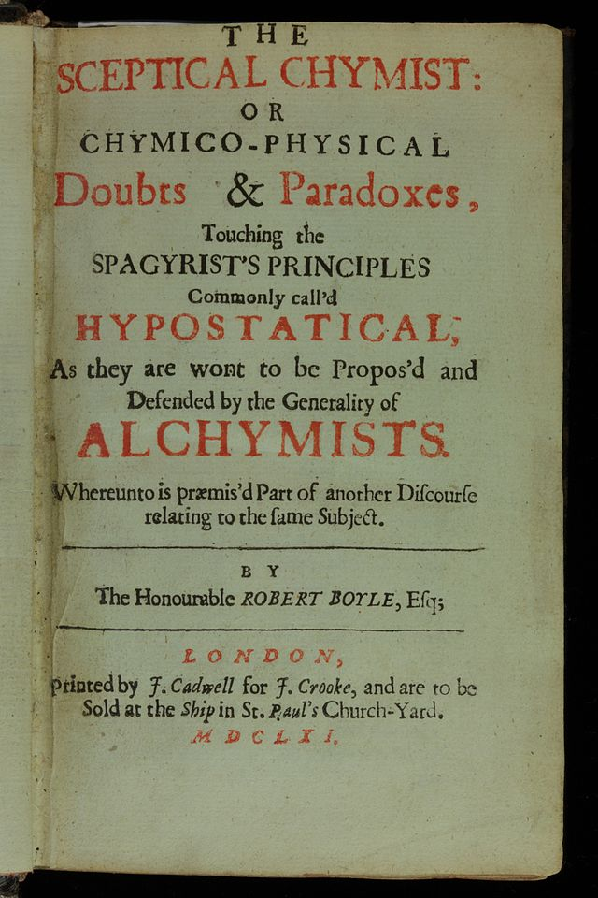
Boyle studied bee anatomy in 1660s using early microscopes
Documented intricate structures like feathered wings, eyes, extendable tongue
Boyle's work forced re-evaluation of earlier speculative accounts of bee physiology
Published findings in 1661's The Skeptical Chymist
Challenged reliance on authorities, advocated observation
He exemplified empirical method of gathering knowledge through observation
Meticulous bee studies influenced future generations
Showed nature's secrets revealed through patience and open mind free of notions
Advanced microscopy and empiricism in science

Slide 7
03
Isaac Newton's Apiary

Slide 8
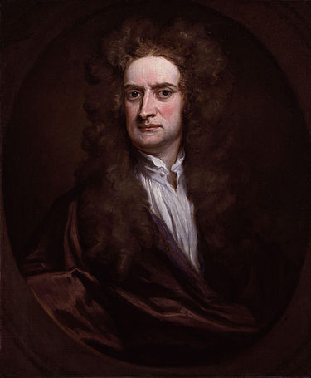
Newton influenced by observing bee colonies as a youth
Kept beehives at Woolsthorpe Manor and conducted apiary experiments
Documented complex social structures and communication methods of bees
Bee observations directly informed Newton's scientific method
Embraced inductive approach of deriving principles from observations
Bees taught orderly, discoverable natural laws over randomness
Insights exemplified empirical, evidence-based approach in his work
Developed movable frame hives still used today for safer observation
Apiarian studies provided empirical understanding guiding future work

Slide 9
04
John Locke and the Tabula Rasa

Slide 10
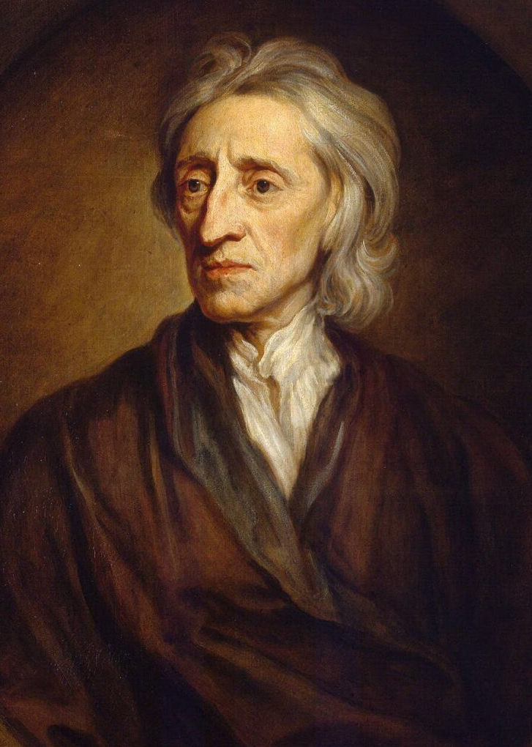
John Locke influenced by observation-based bee studies
Developed theory of tabula rasa, mind shaped by experience
Rejection of innate ideas from studying bees, empirical science
Through Boyle, recognized power of observation, experimentation
No evidence found of innate bee behaviors like communication
Abilities emerged through environment, not innate knowledge
Proof human mind also lacked innate ideas
Shifted thinking to formative role of environment, nurture
Laid groundwork for empiricism in fields like psychology
Understanding only gained through observation, experiment on people
Locke's blank slate from observation-based bee cognition studies
Apiarian experiments reinforced empiricism, real-world examples

Slide 11
05
Conclusion

Slide 12
Presentation illustrated how bee observation encouraged empiricism
Boyle, Newton, Locke directly influenced by precise bee studies
Gathered facts through repeated observation, not ancient authorities
Bee insights informed subsequent scientific endeavors
Studies exemplified evidence-based natural philosophy in action
Newton's beekeeping legacy in movable frame hives development
Empirical tradition established scientific method demands
Honeybees unintentionally shaping modern science
Reinforced precision, fact-finding over speculation
Encouraged rationalism, evidence-based thinking in Enlightenment

Slide 13
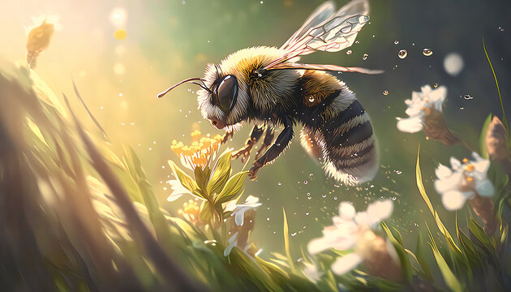
Thanks!
DO YOU HAVE ANY QUESTIONS?

