Slide 1
Women – Gender – History – Ideas
The sociological question¹: Where are women in any given historical account?
The sociological question²: How do homosocial fields of intellectual endeavor function? (Even if we have not raised normative questions about why they are homosocial to begin with.)
The labor question: When we rectify empirical gaps to include women in intellectual fields, how do we account for the manifest hierarchies of labor? Why social expansion of roles but subaltern status?
The gender question¹: Does the mode of historical explanation change when women are conceived as actors and social forces?
The gender question²: How have scientific investigations of biological sex and social gender roles influenced our historical understanding of a given intellectual discipline? Has science enabled patriarchal phenomena, and if so, how could this be analyzed historically (and, implicitly, opened to change)?

Slide 2

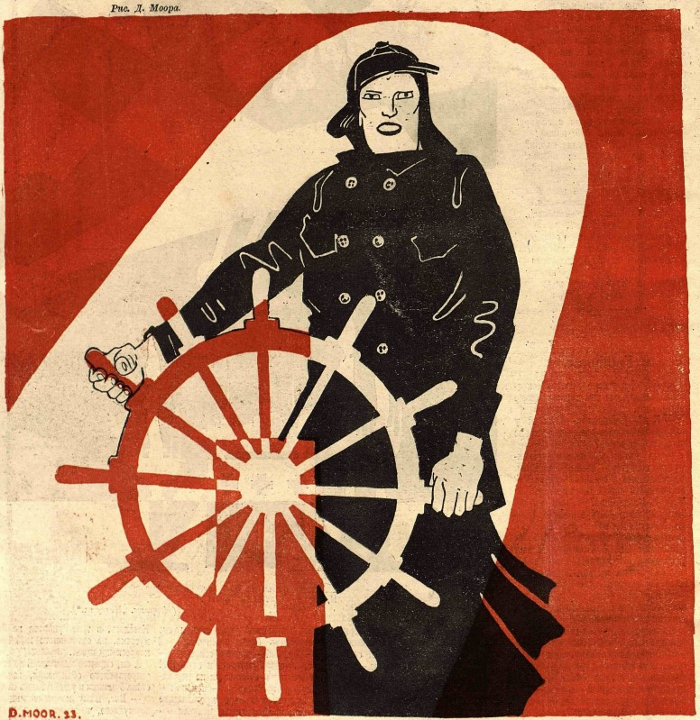
Women steering the revolution
Daughters of the Revolution
(1923)
Political history
D. Moor in
Krokodil no. 10 (1923)

Slide 3

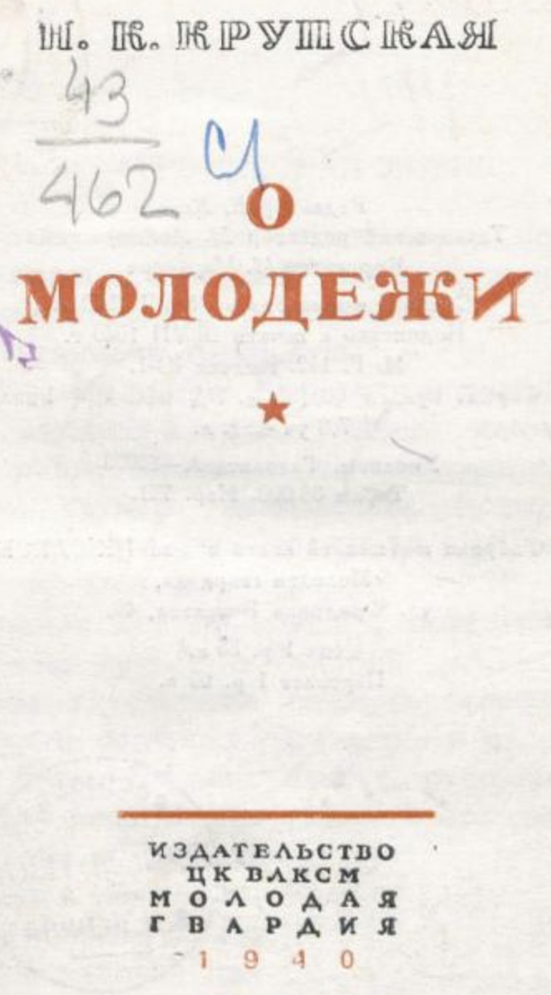
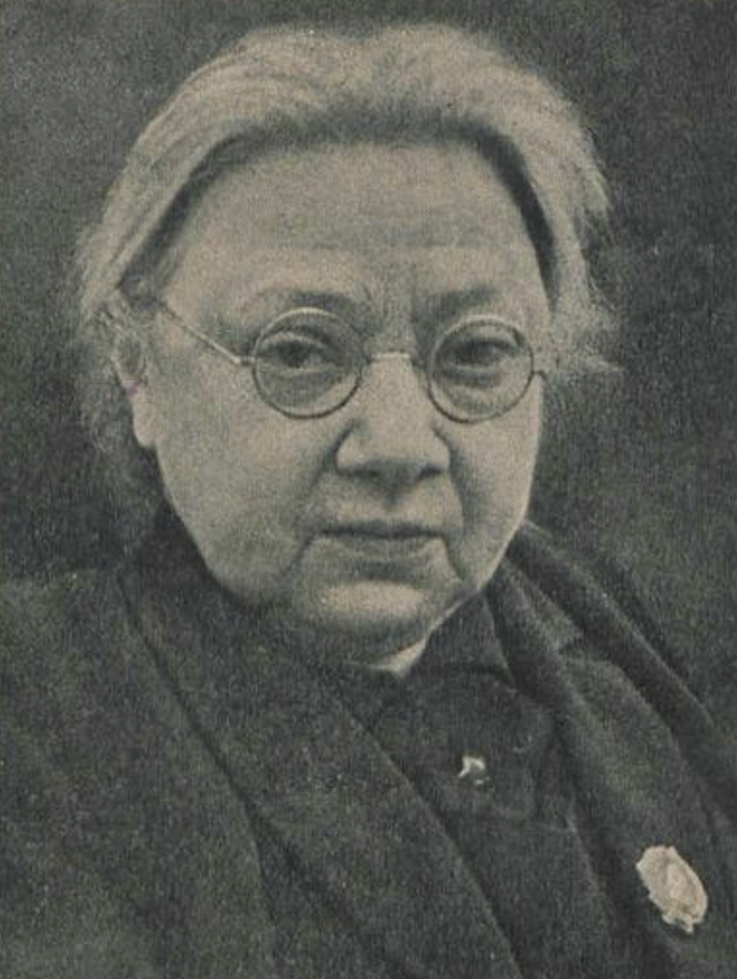
Nadezhda Krupskaia
National Education and Democracy
On Youth
Major advocate of polytechnical labor in schooling
“It is as if comrade Krupskaia doesn’t live on our sinful planet. We need polytechnical schooling, proposed comrade Krupskaia, and we need it right now. “Right now” is already going on for five years, and there is no polytechnical education, there is just middle school training by sickly intellectuals.” (Shapkin, RKSM 1922)

Slide 4
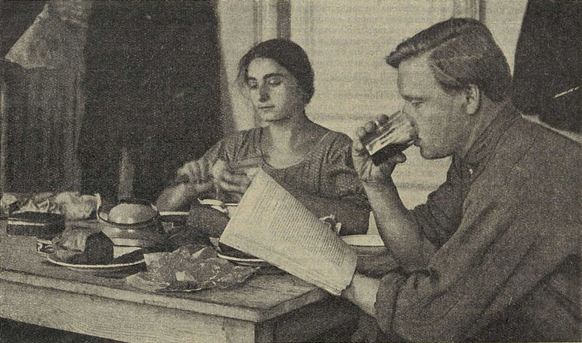
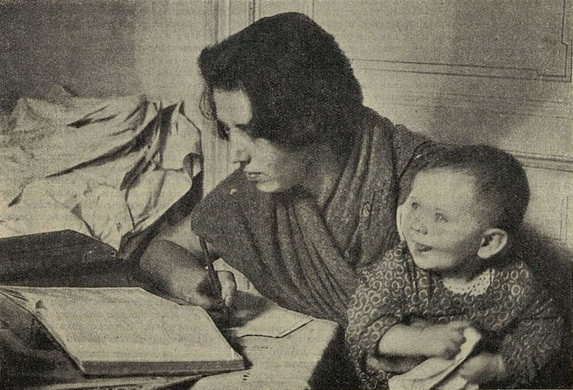
Red student families
Social history
Prozhektor no. 19 (1927)

Slide 5
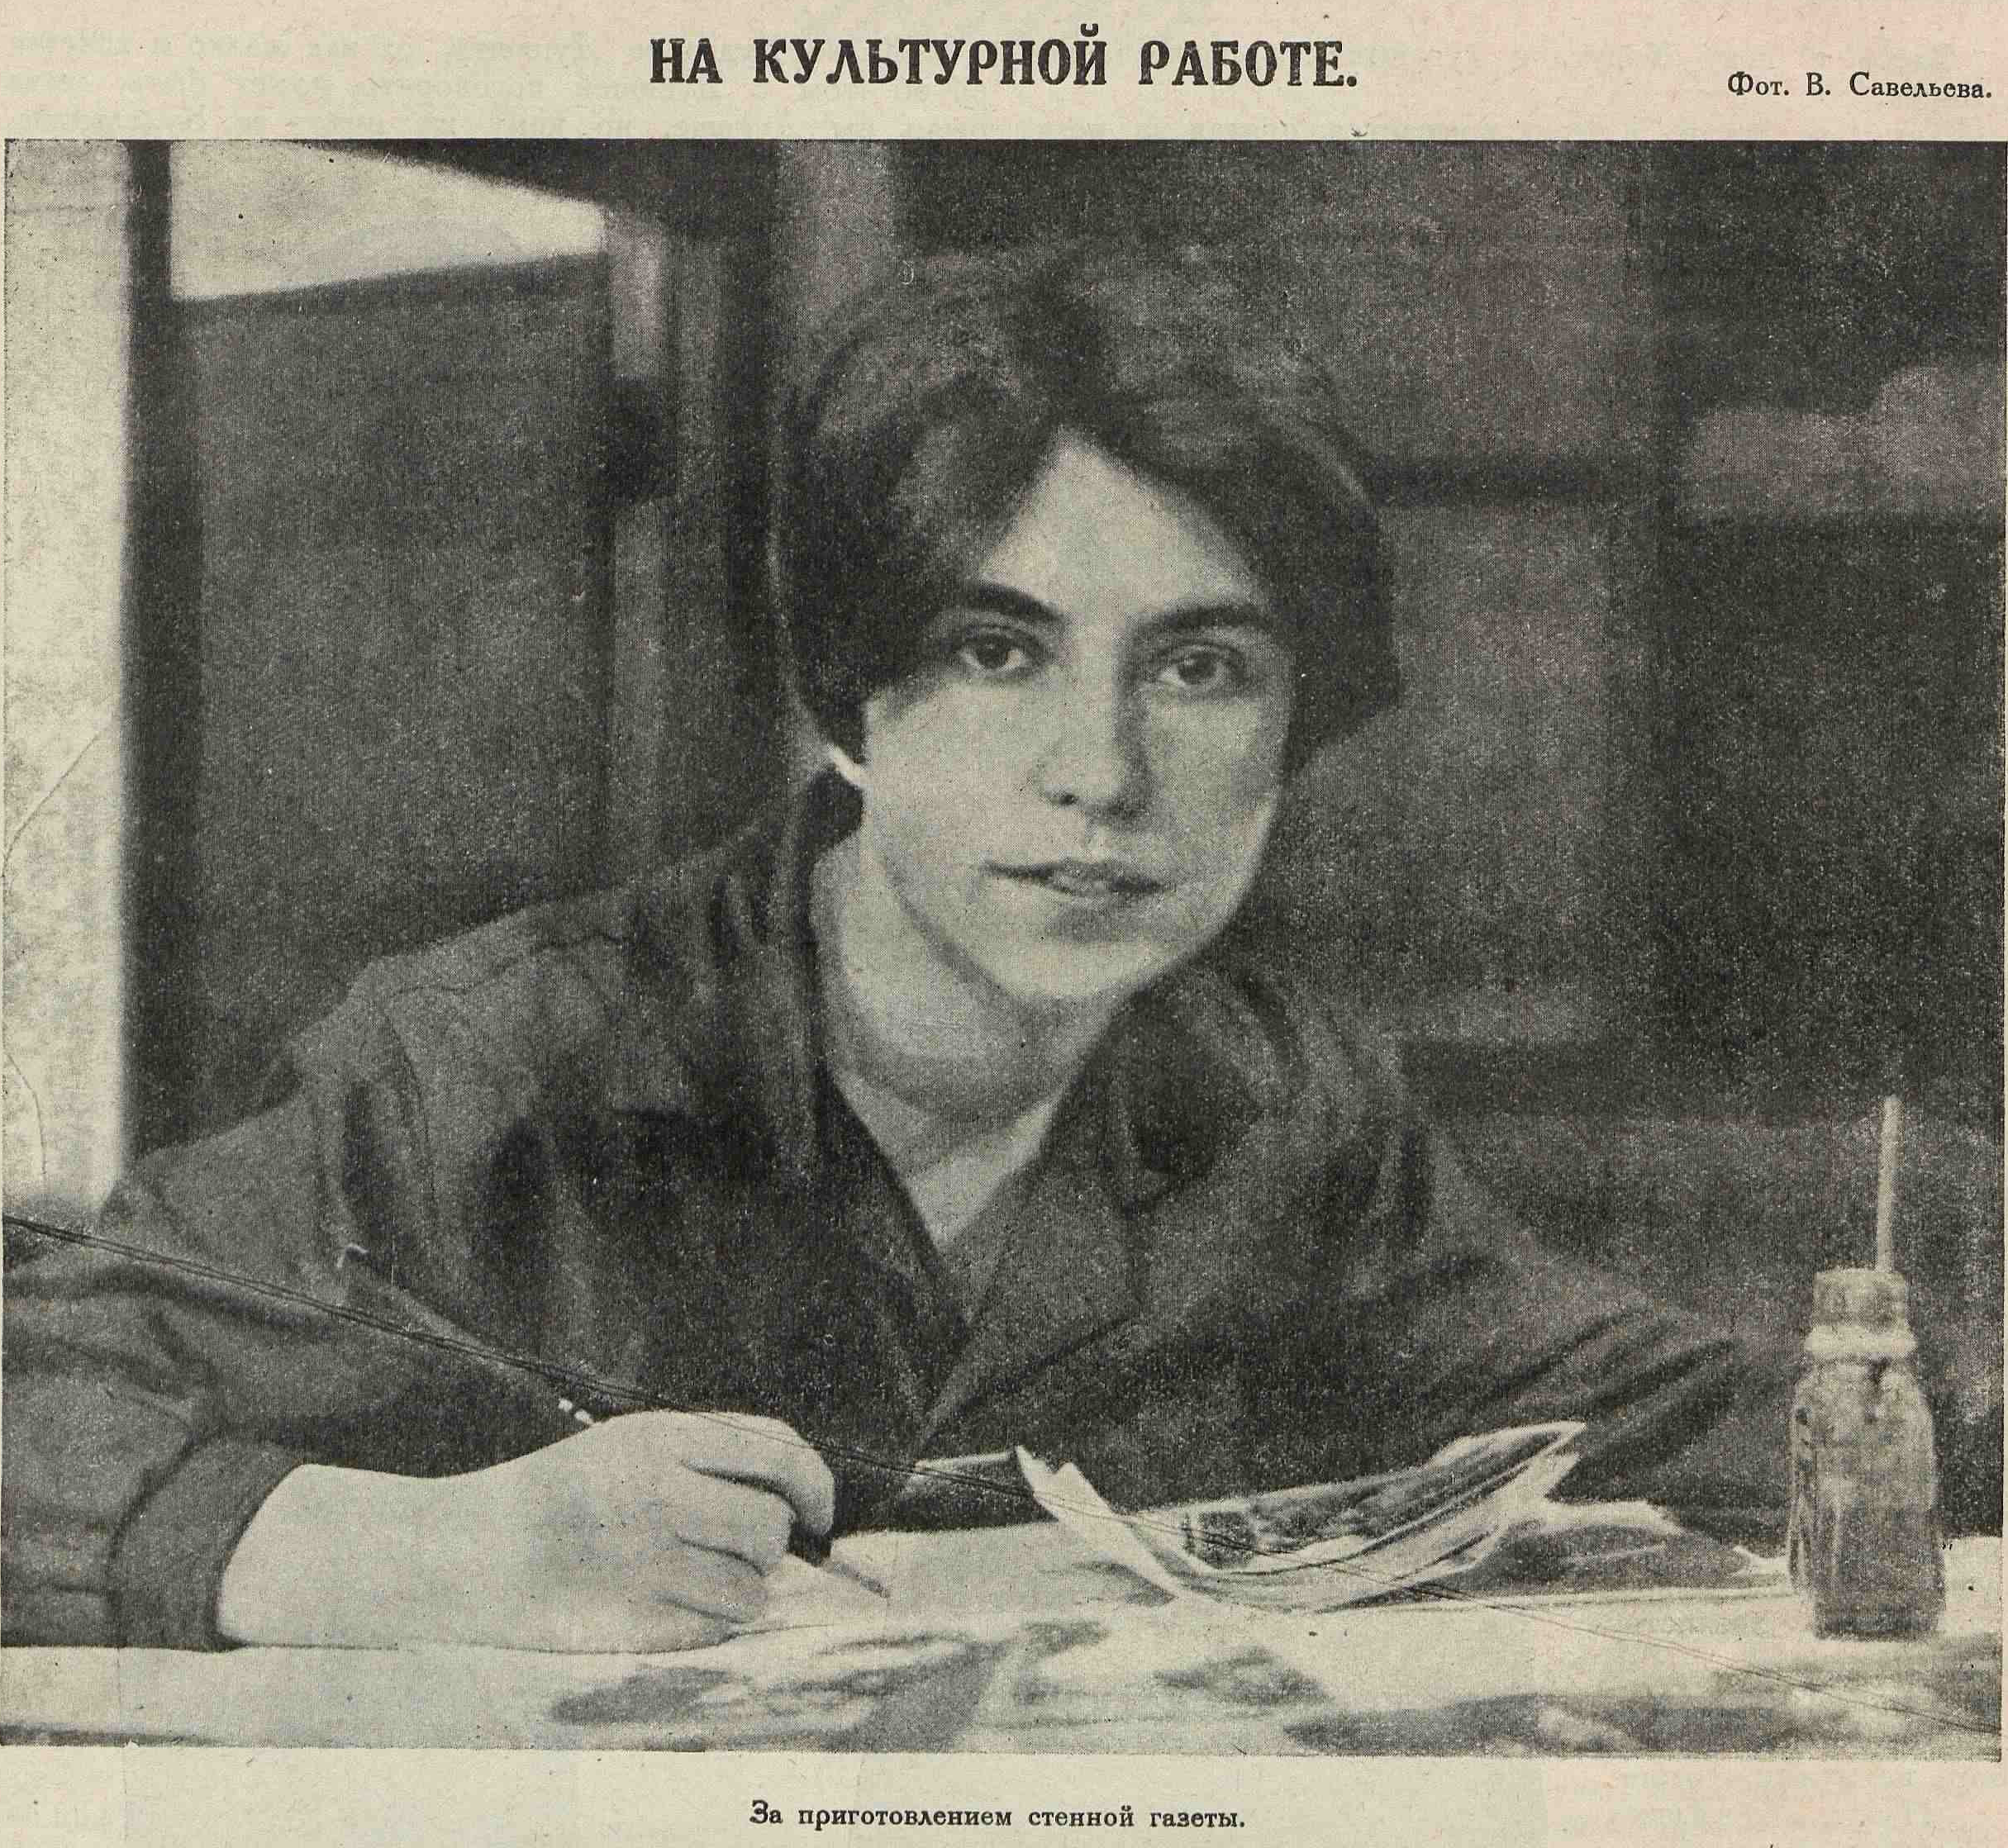
Cultural work
Assembling the in-house bulletin
Cultural history
Prozhekter no. 4 (1925)

Slide 6
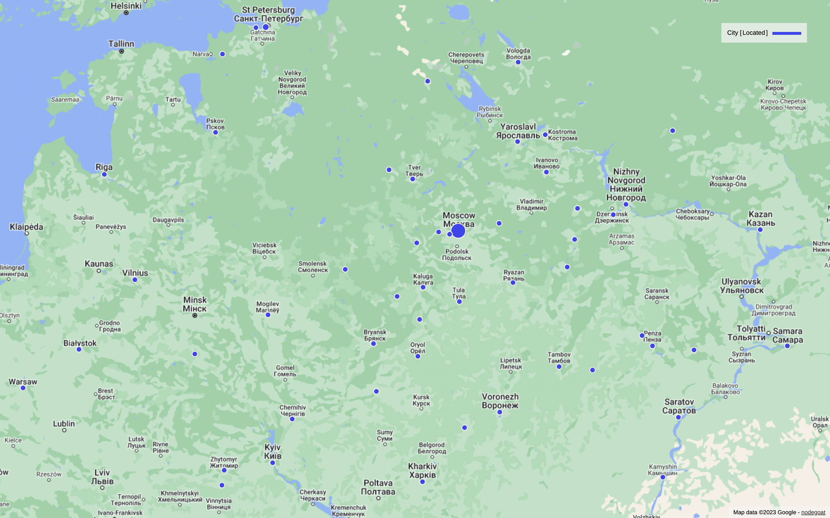
Congress of Russian Naturalists and Physicians
Moscow, 1910
~700 women attend
(nearly one quarter
of total)
~500 from Moscow
~60 from St Pb

Slide 7
Women – Gender – History – Ideas
The sociological question¹: Where are women in any given historical account?
The sociological question²: How do homosocial fields of intellectual endeavor function? (Even if we have not raised normative questions about why they are homosocial to begin with.)
The labor question: When we rectify empirical gaps to include women in intellectual fields, how do we account for the manifest hierarchies of labor? Why social expansion of roles but subaltern status?
The gender question¹: Does the mode of historical explanation change when women are conceived as actors and social forces?
The gender question²: How have scientific investigations of biological sex and social gender roles influenced our historical understanding of a given intellectual discipline? Has science enabled patriarchal phenomena, and if so, how could this be analyzed historically (and, implicitly, opened to change)?

Slide 8
Scientific Workers of the USSSR
Gender of scientific workers
Moscow
(18% women)
Outside Moscow and Leningrad→
(14% women)

Slide 9

Sharon Traweek
Chapter 3: Pilgrim’s Progress:
Male Tales Told During a Life in Physics
Picaresque adventures
The scientist as hero
(capable of great sacrifice)
Stages of training associate distinctive intellectual problem-solving qualities with certain emotional states

Slide 10
Women – Gender – History – Ideas
The sociological question¹: Where are women in any given historical account?
The sociological question²: How do homosocial fields of intellectual endeavor function? (Even if we have not raised normative questions about why they are homosocial to begin with.)
The labor question: When we rectify empirical gaps to include women in intellectual fields, how do we account for the manifest hierarchies of labor? Why social expansion of roles but subaltern status?
The gender question¹: Does the mode of historical explanation change when women are conceived as actors and social forces?
The gender question²: How have scientific investigations of biological sex and social gender roles influenced our historical understanding of a given intellectual discipline? Has science enabled patriarchal phenomena, and if so, how could this be analyzed historically (and, implicitly, opened to change)?

Slide 11
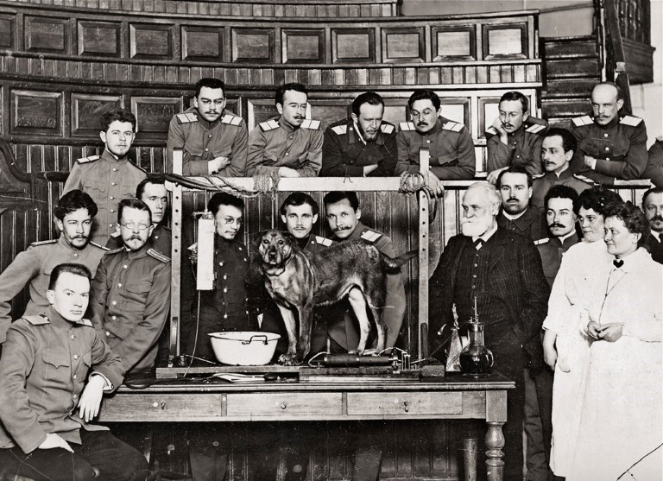
Ivan Pavlov and colleagues at Military Medical Academy
Pavlov as the model of a new kind of scientific manager
Female scientists are present, but low in the hierarchy of labor
(1912)

Slide 12
Women – Gender – History – Ideas
The sociological question¹: Where are women in any given historical account?
The sociological question²: How do homosocial fields of intellectual endeavor function? (Even if we have not raised normative questions about why they are homosocial to begin with.)
The labor question: When we rectify empirical gaps to include women in intellectual fields, how do we account for the manifest hierarchies of labor? Why social expansion of roles but subaltern status?
The gender question¹: Does the mode of historical explanation change when women are conceived as actors and social forces?
The gender question²: How have scientific investigations of biological sex and social gender roles influenced our historical understanding of a given intellectual discipline? Has science enabled patriarchal phenomena, and if so, how could this be analyzed historically (and, implicitly, opened to change)?

Slide 13
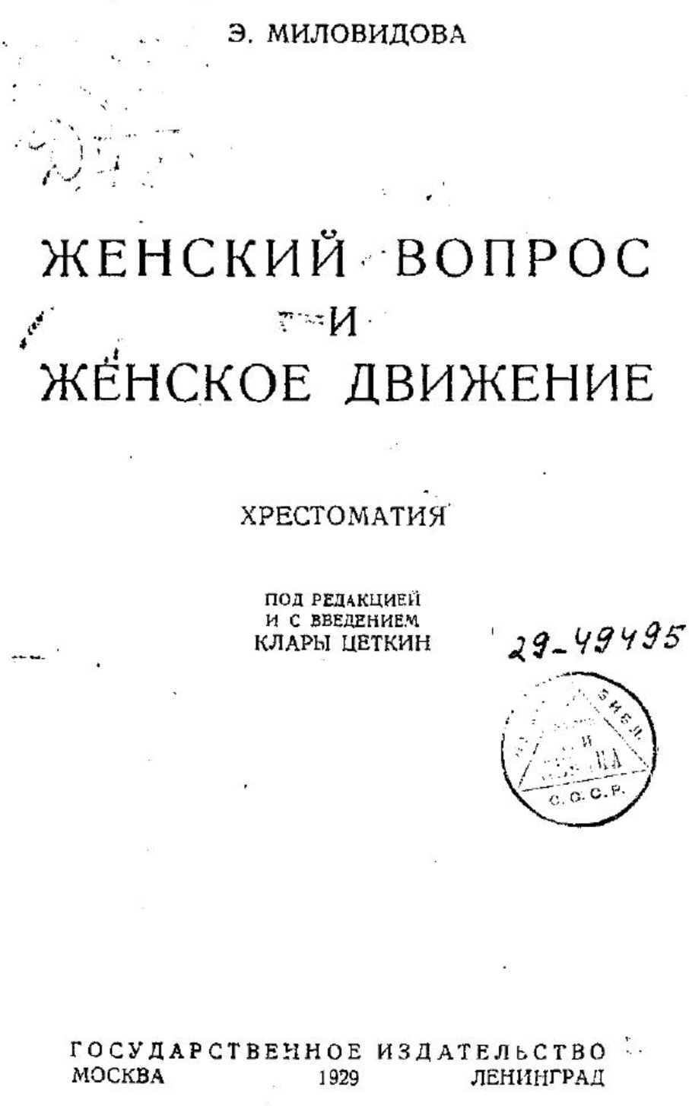
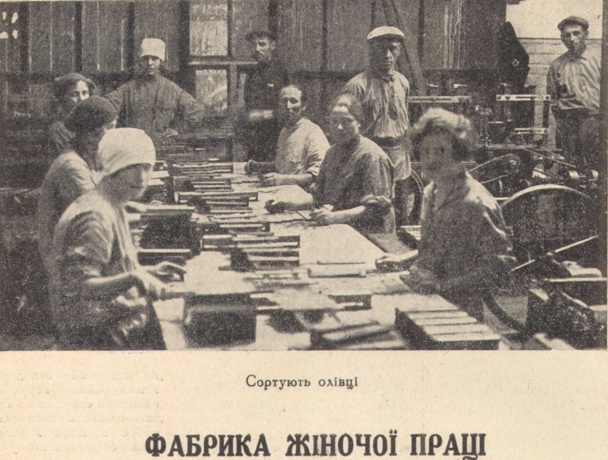
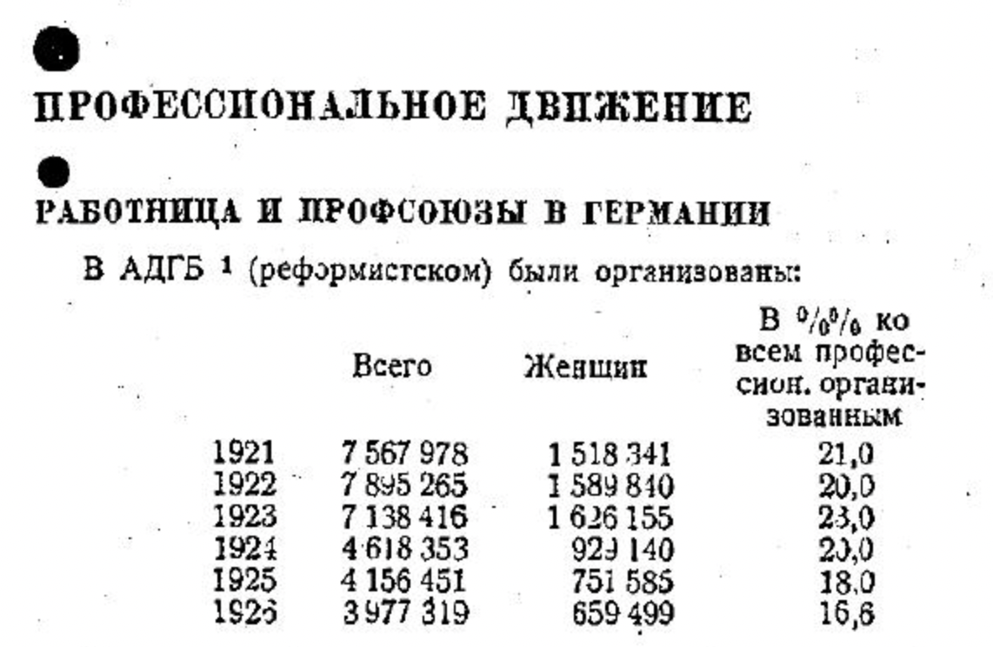
Milovidova, The Women’s Question and the Women’s Movement: An Anthology
“Professional” questions still focused entirely on the trade union movement
1929

Slide 14
Women – Gender – History – Ideas
The sociological question¹: Where are women in any given historical account?
The sociological question²: How do homosocial fields of intellectual endeavor function? (Even if we have not raised normative questions about why they are homosocial to begin with.)
The labor question: When we rectify empirical gaps to include women in intellectual fields, how do we account for the manifest hierarchies of labor? Why social expansion of roles but subaltern status?
The gender question¹: Does the mode of historical explanation change when women are conceived as actors and social forces?
The gender question²: How have scientific investigations of biological sex and social gender roles influenced our historical understanding of a given intellectual discipline? Has science enabled patriarchal phenomena, and if so, how could this be analyzed historically (and, implicitly, opened to change)?

Slide 15
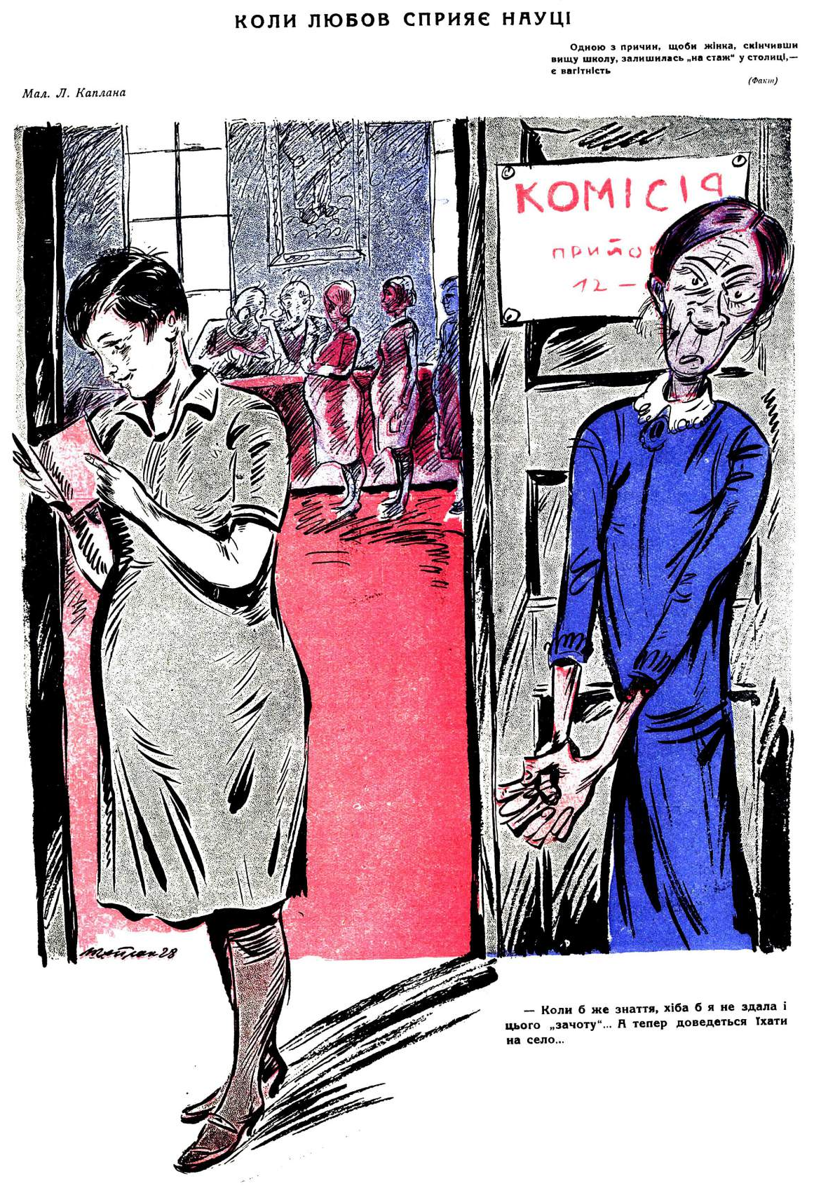
When love promotes science
(Motive for the cartoon: “One of the reasons why a woman who has completed higher education stays on to “gain experience” in the capital is pregnancy.”)
Spinster emerging from exam commission
“If only I had known, I would have passed this “test,” too... And now I will have to go back to the village...”
Perets (1928)

Slide 16
Charles Darwin, The Descent of Man
and Selection in Relation to Sex
“With quadrupeds, when, as is often the case, the sexes differ in size, the males are, I believe, always larger and stronger.”
“I have specified the foregoing familiar differences between the male and female sex in mankind, because they are curiously the same as in the Quadrumana… With most of the species the males are larger and much stronger than the females, of which fact the gorilla offers a well-known instance.”
“There can be little doubt that the greater size and strength of man, in comparison with woman, together with his broader shoulders, more developed muscles, rugged outline of body, his greater courage and pugnacity, are all due in chief part to inheritance from some early male progenitor, who, like the existing anthropoid apes, was thus characterised. These characters will, however, have been preserved or even augmented during the long ages whilst man was still in a barbarous condition, by the strongest and boldest men having succeeded best in the general struggle for life, as well as in securing wives, and thus having left a large number of offspring. It is not probable that the greater strength of man was primarily acquired through the inherited effects of his having worked harder than woman for his own subsistence and that of his family.” (1871)

Slide 17
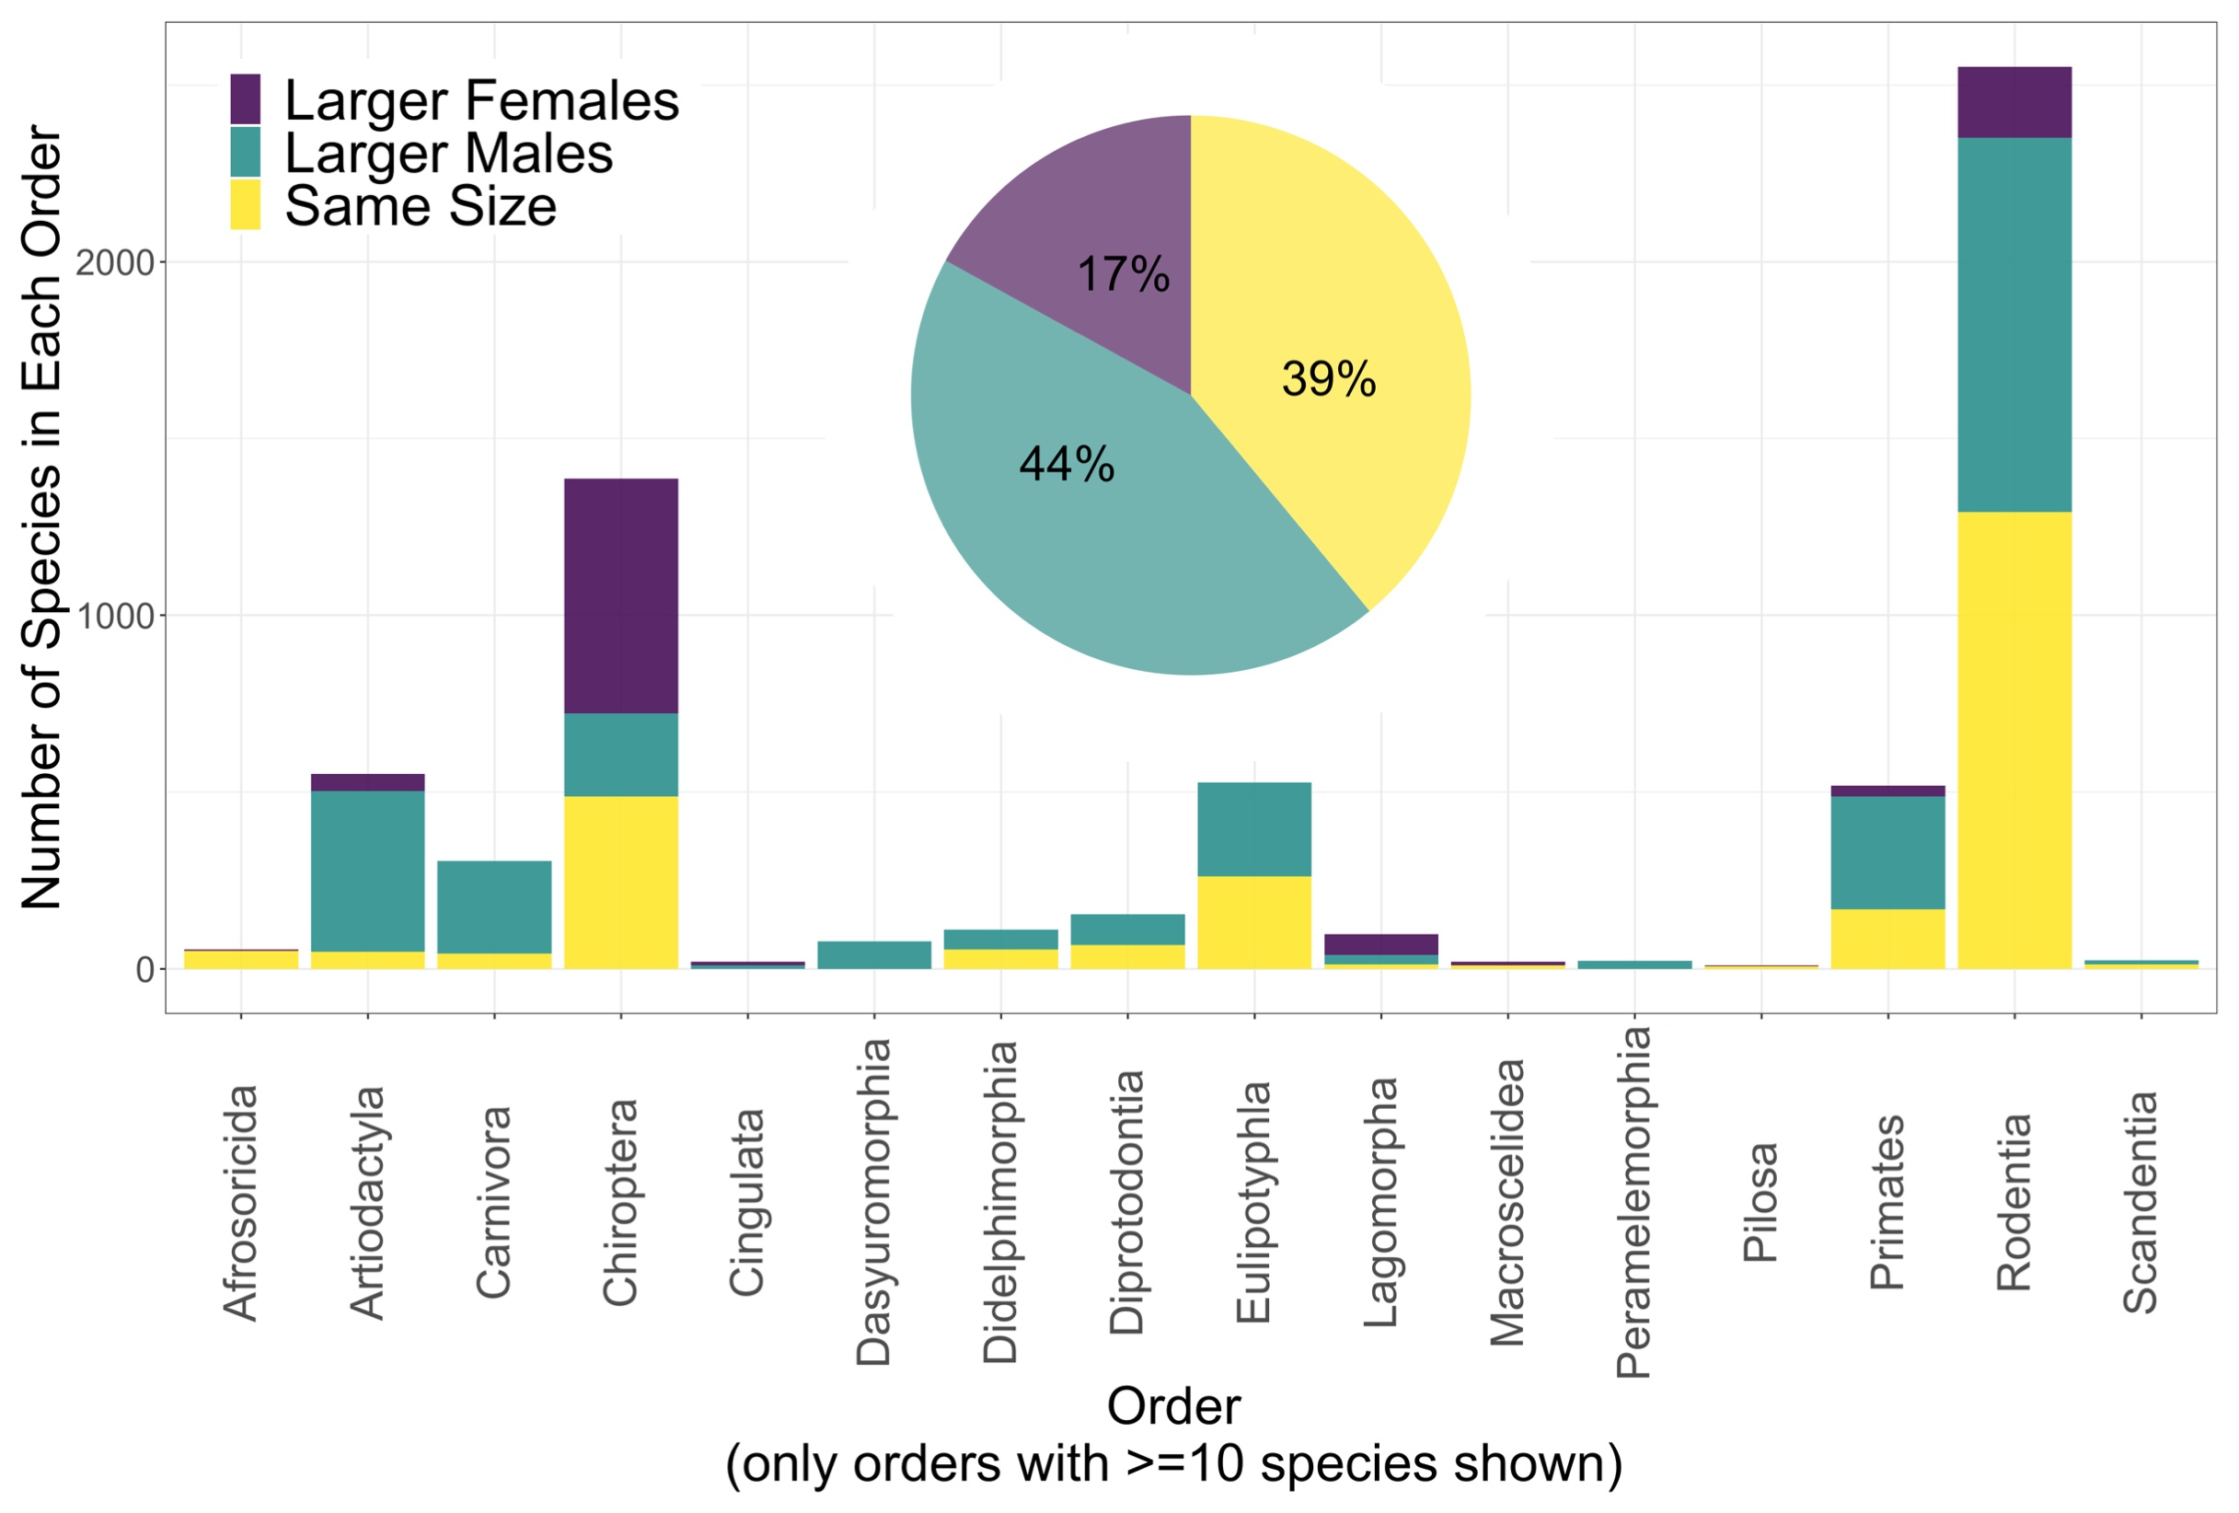
Sexual dimorphism in mammals: Contra Darwin
Kaia Tombak
et al. (2023)
even-toed ungulates
(horns, tusks)
bats

Slide 18

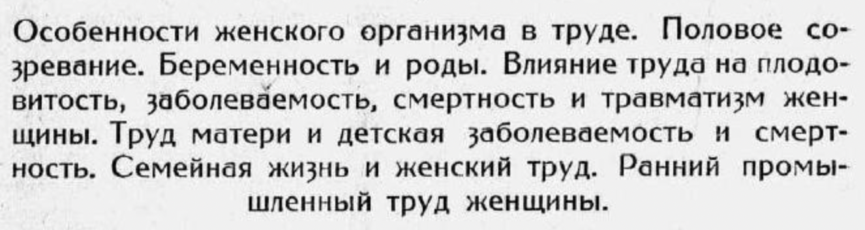
Vasilevskii, Public Health and Female Labor
Equality as equal protection
of biological difference
(implicitly reifying social roles)
Particularities of the female organism in labor. Sexual competition. Pregnancy and birth. Influence of labor on female fertility, morbidity, mortality, and trauma. Maternal labor and childhood morbidity and mortality. Family life and female labor. Early female industrial labor.

Slide 19
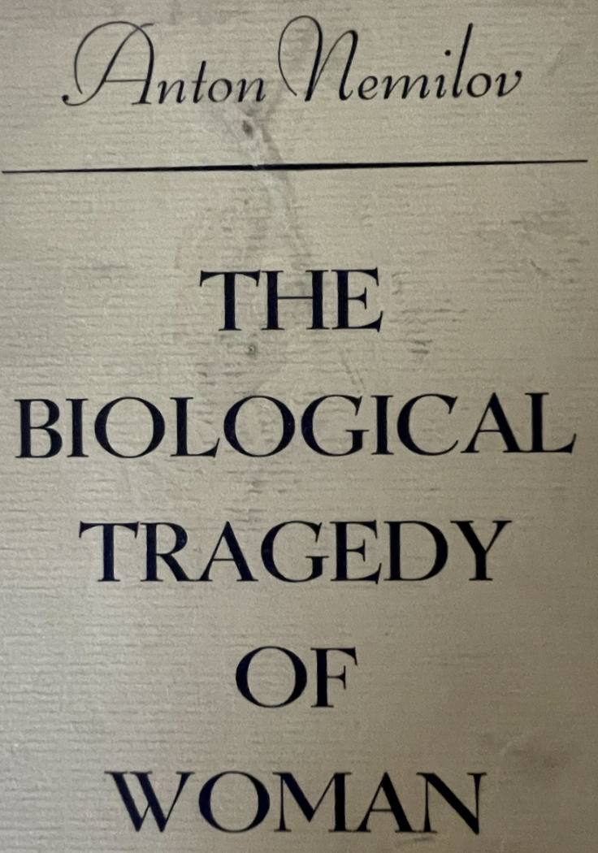
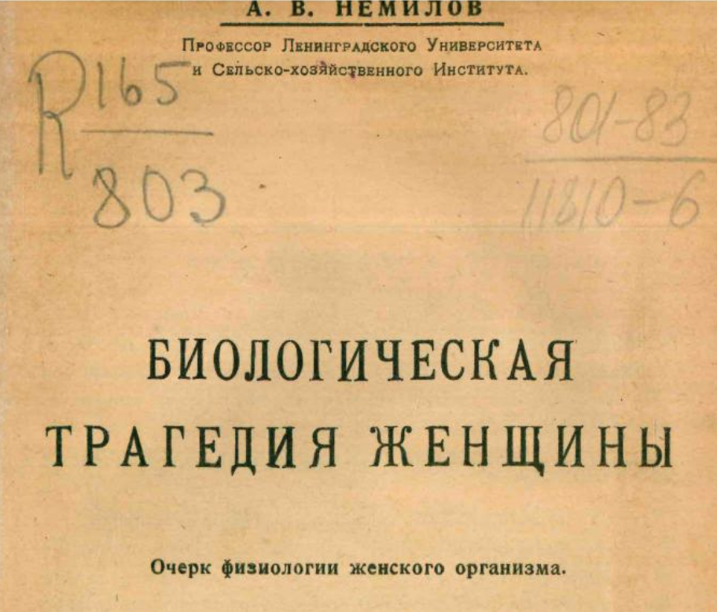
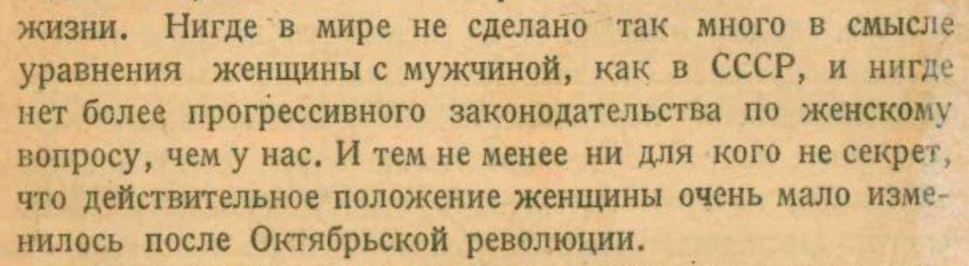
A. V. Nemilov, The Biological Tragedy of Woman
An Outline of the Physiology of the Female Organism
(1925)
”Nowhere in the world has more been done in the sense of equality of female with male than in the USSR, and nowhere is there more progressive legislation on the woman question than here. And yet it is no secret that the actual situation of women has not changed much since the October Revolution.”
(1879-1942)

Slide 20
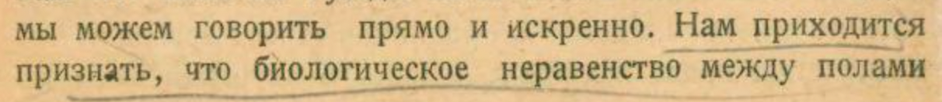
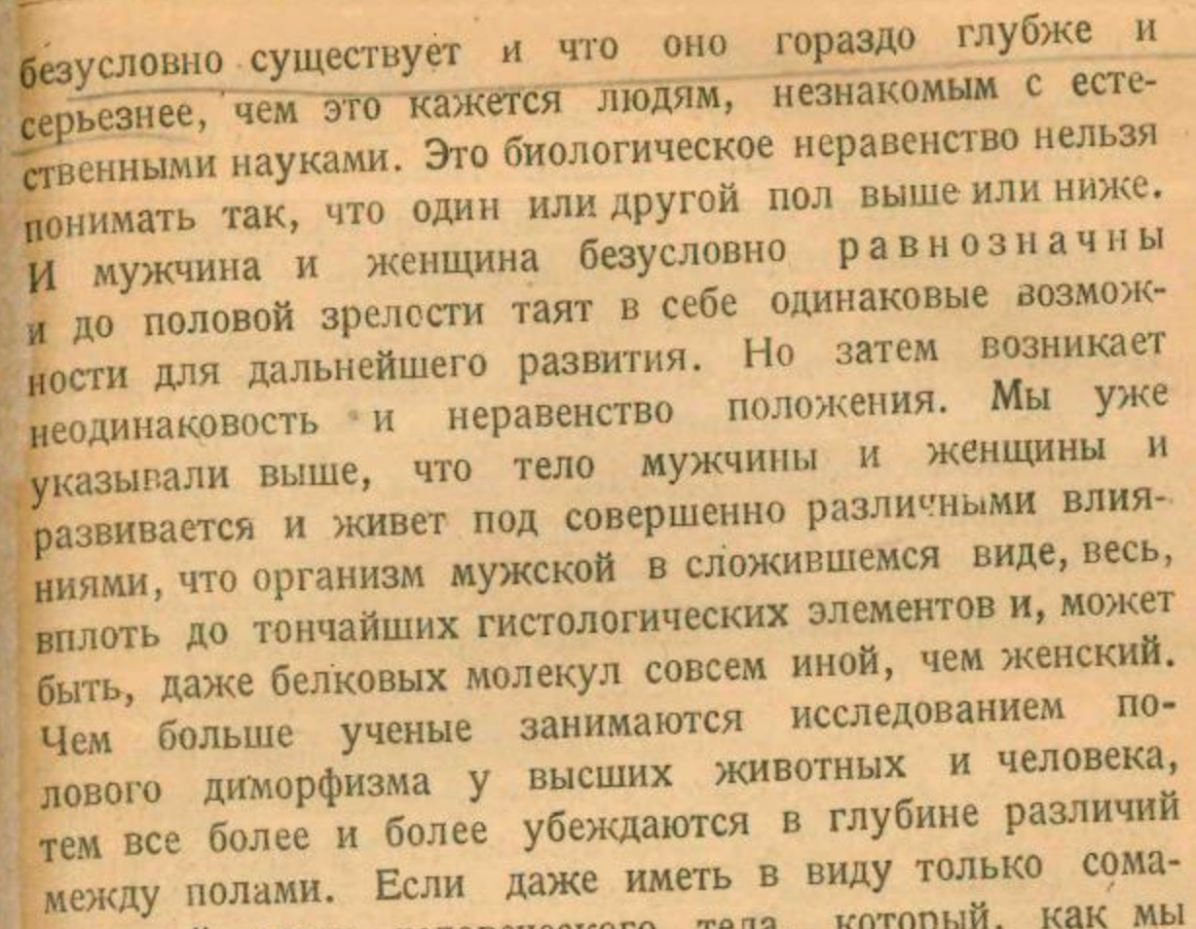
A. V. Nemilov, The Biological Tragedy of Woman
”We have to recognize that biological inequality between the sexes absolutely exists and that it is rather more profound and serious than it appears to people unacquainted with the natural sciences. This biological inequality must not be understood as one or the other sex being higher or lower. Both the male and the female are absolutely equivalent and until puberty they conceal in themselves the same possibilities for further development. But then the dissimilarity and inequivalence of the situation arises. We indicated above that the bodies of the male and the female develop and live under completely distinct influences, that the male organism in current form is entirely, down to the subtlest histological elements and perhaps even the protein molecules, different than the female. The more that scientists take up the study of sexual dimorphism among higher animals and humans, the more they are convinced of the profundity of the differences between the sexes.”

Slide 21
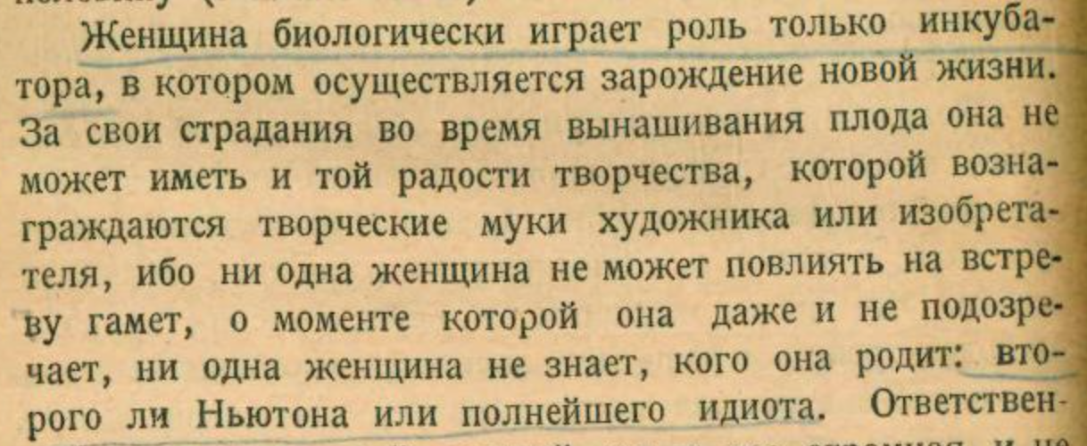
A. V. Nemilov, The Biological Tragedy of Woman
“Biologically the female only plays the role of incubator in which the birth of new life is realized. For her sufferings during gestation she also cannot have the joy of creation that rewards the creative torments of the artist or inventor, for no female can influence the meeting of gametes, a moment she does not even surmise, and no female knows whom she gives birth to: a second Newton or a complete idiot.”

Slide 22
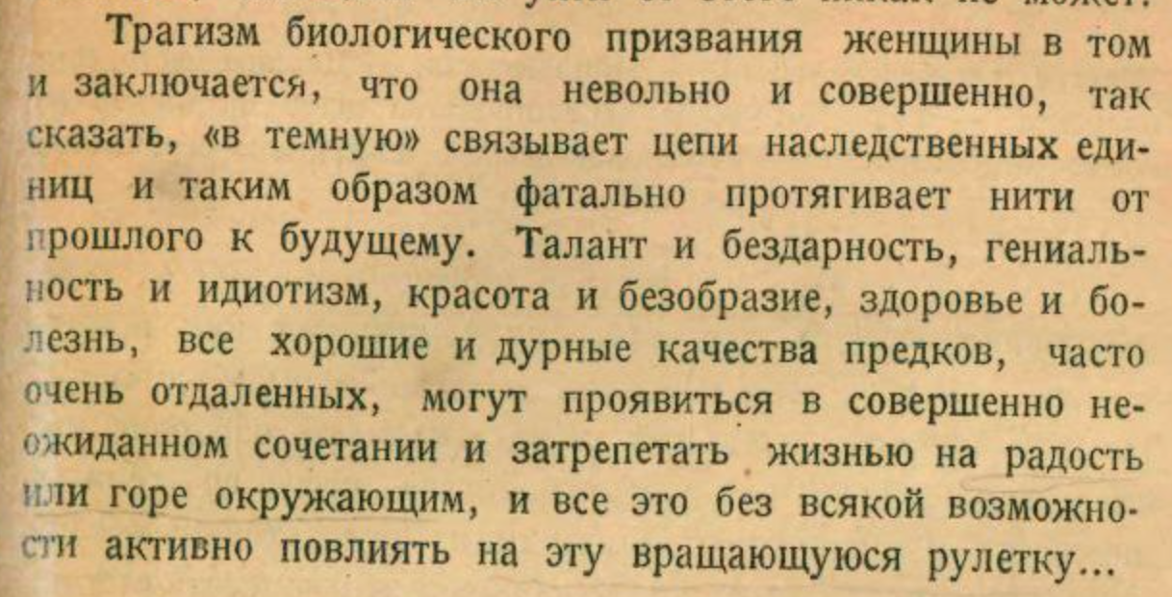
A. V. Nemilov, The Biological Tragedy of Woman
“The tragedy of the biological calling of the female is that she is, so to speak, “in the dark,” unwittingly and completely binding the chains of hereditary units and thus fatefully drawing the thread from past to future. Talent and mediocrity, genius and idiocy, beauty and deformity, health and sickness, all the good and bad qualities of ancestors, often quite distant ones, can manifest themselves in completely unexpected combinations and begin to palpitate with life upon the joy and sorrow of those around her, and all of this without any possibility of actively influencing this revolving roulette.”

Slide 23
Women – Gender – History – Ideas
The gender question³: Beyond the empirical distortion of historical accounts dominated by men, are there gendered modes of reasoning (e.g., mechanistic materialism?), however restricted or general in scope? (Biological essentialism as frequent but not necessary presupposition.) Put crudely: are some disciplines more “masculine,” others more “feminine”?
The philosophical question: If global scientific norms like objectivity and rationality are susceptible to gender critiques, can feminist philosophy reorient them (with the aid of history)?
The Soviet question: Are there questions in women’s or gender history that we would approach differently when applied to the Soviet experience?

Slide 24
Women – Gender – History – Ideas
The gender question³: Beyond the empirical distortion of historical accounts dominated by men, are there gendered modes of reasoning (e.g., mechanistic materialism?), however restricted or general in scope? (Biological essentialism as frequent but not necessary presupposition.) Put crudely: are some disciplines more “masculine,” others more “feminine”?
The philosophical question: If global scientific norms like objectivity and rationality are susceptible to gender critiques, can feminist philosophy reorient them (with the aid of history)?
The Soviet question: Are there questions in women’s or gender history that we would approach differently when applied to the Soviet experience?

Slide 25
Donna Haraway
We need more than “epistemological shock therapy”: critique is not enough.
The challenge: how to combine radical historical contingency with a no-nonsense commitment to faithful accounts of the “real” world.
(Realism as a kind of ethics, not just a bid for unlimited instrumental power).
“Only partial perspective promises objective vision.”
“Situated knowledges: The science question in feminism”
(1988)

Slide 26
Women – Gender – History – Ideas
The gender question³: Beyond the empirical distortion of historical accounts dominated by men, are there gendered modes of reasoning (e.g., mechanistic materialism?), however restricted or general in scope? (Biological essentialism as frequent but not necessary presupposition.) Put crudely: are some disciplines more “masculine,” others more “feminine”?
The philosophical question: If global scientific norms like objectivity and rationality are susceptible to gender critiques, can feminist philosophy reorient them (with the aid of history)?
The Soviet question: Are there questions in women’s or gender history that we would approach differently when applied to the Soviet experience?

Slide 27
Evgenii Preobrazhenskii, On morals and class norms
Communist society reposes the problem of sexual relations outside the family, and “it becomes a social problem, primarily in terms of the physical health of the race [rasa].”
“The fundamental condition for the physical rebirth of the race is, of course, the elimination of extreme labor, the improvement of the material situation and living conditions, the development of a system of physical education of the masses, etc.”
From the 1930s onward, however, “communist morality” points to much more conventional strictures (cf. restrictive abortion and divorce laws; rewards for maternal heroines).

Slide 28
A. B. Zalkind, “Twelve sexual commandments
of the revolutionary proletariat”
Залкинд А. Б. Двенадцать половых заповедей революционного пролетариата
Брошюра "Революция и молодежь” (1924)
I. Не должно быть слишком раннего развития половой жизни в среде пролетариата-первая половая заповедь революционного рабочего класса.
[The first sexual commandment of the revolutionary working class is that sexual development should not be too early among the proletariat.]
II. Необходимо половое воздержание до брака, а брак лишь в состоянии полной социальной и биологической зрелости (т.e. 20-25 лет) – вторая половая заповедь пролетариата.
[The second sexual commandment of the proletariat is that sexual abstinence is necessary until marriage, and marriage only in a state of full social and biological maturity (i.e., 20-25 years).]
III. Половая связь – лишь как конечное завершение глубокой всесторонней симпатии и привязанности к объекту половой любви.
[Sexual relations are only the final culmination of a deep mutual affection and devotion to the object of sexual love.]

Slide 29
A. B. Zalkind, “Twelve sexual commandments
of the revolutionary proletariat”
IV. Половой акт должен быть лишь конечным звеном в цепи глубоких и сложных переживаний, связывающих в данный момент любящих.
[The sexual act should only be the final link in a chain of deep and complex experiences connecting the lovers at a given moment.]
V. Половой акт не должен часто повторяться.
[The sexual act should not be repeated frequently.]
VI. Не надо часто менять половой объект. Поменьше полового разнообразия.
[The sexual object must not be changed frequently. Less of sexual diversity.]
VII. Любовь должна быть моногамной, моноандрической (одна жена, один муж).
[Love should be monogamous, monoandric (one wife, one husband).]

Slide 30
A. B. Zalkind, “Twelve sexual commandments
of the revolutionary proletariat”
VIII. При всяком половом акте всегда надо помнить о возможности зарождения ребенка и вообще помнить о потомстве. [During each sexual act one always has to remember the possibility of conceiving a child and generally remember about posterity.]
IX. Половой подбор должен строиться по линии классовой, революционно-пролетарской целесообразности. В любовные отношения не должны вноситься элементы флирта, ухаживания, кокетства и прочие методы специально полового завоевания.
[Sexual selection should be built along the lines of class and revolutionary-proletarian expediency. The elements of flirting, courting, coquetry, and such methods of specifically sexual conquest should not enter into sexual relations.]
X. Не должно быть ревности. Половая любовная жизнь, построенная на взаимном уважении, на равенстве, на глубокой идейной близости, на взаимном доверии, не допускает лжи, подозрения, ревности.
[There should not be jealousy. Sexual love life constructed on mutual respect, on equality, on deep intimacy of ideas, on mutual trust, does not allow lies, suspicions, jealousies.]

Slide 31
A. B. Zalkind, “Twelve sexual commandments
of the revolutionary proletariat”
XI. Не должно быть половых извращений.
[There should not be sexual perversions.]
XII. Класс в интересах революционной целесообразности имеет право вмешаться в половую жизнь своих сочленов. Половое должно во всем подчиняться классовому, ничем последнему не мешая, во всем его обслуживая.
[Class has the right to interfere in the sexual life of its members in the interests of revolutionary expediency. The sexual should be subordinate to class in everything, in no way interfering with the latter, and serving it in everything.]

Slide 32
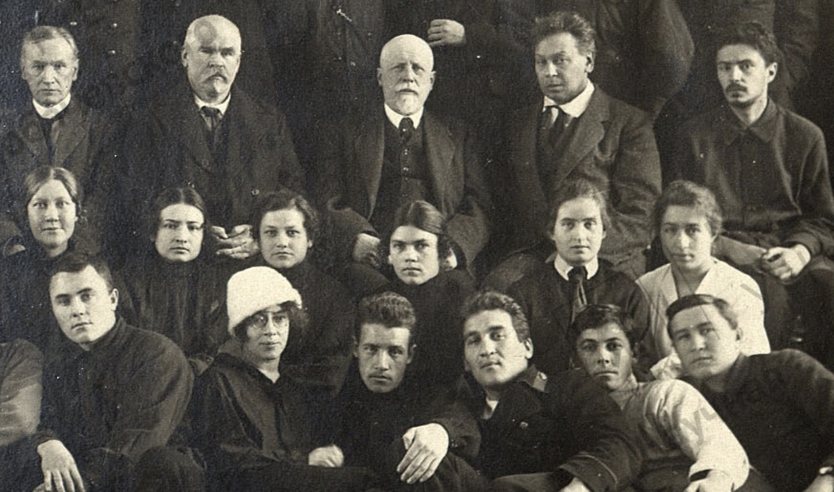
Students and teachers of the physics and math faculty, Kazan
1922

Slide 33
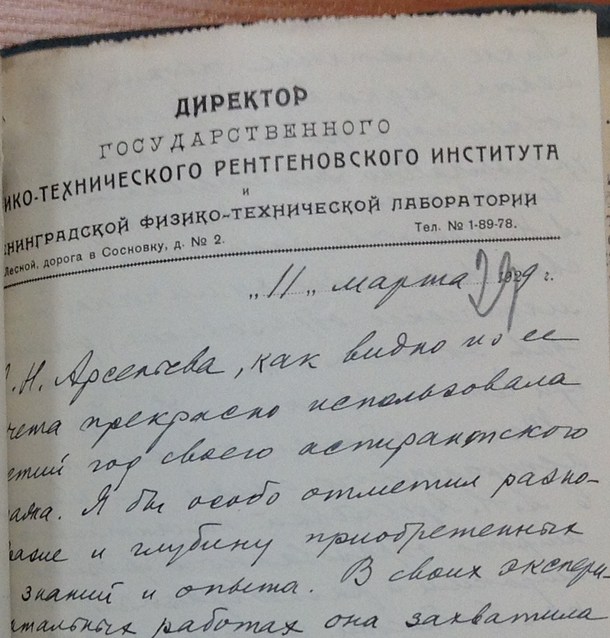
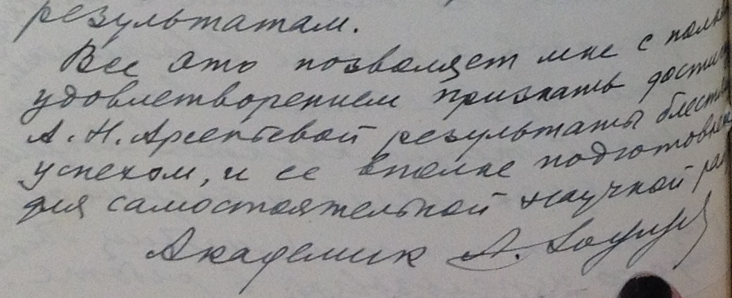
Academician Joffe recommends Anna Arsenieva
”All of this permits me with great satisfaction to acknowledge the results obtained by Anna Arsenieva as a brilliant success, and her as fully prepared for independent scientific work.”
(1929)

Slide 34
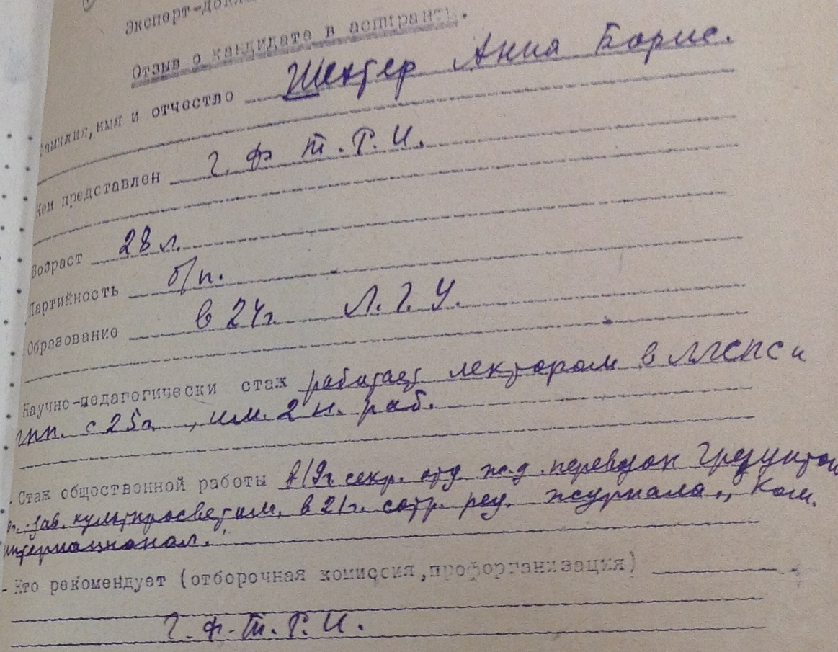
Anna Borisovna Shekhter applies to graduate school
Sponsor: State Physico-Technical Institute, Leningrad
Age: 28 years
Party member: no
Education: Leningrad State University (1924)
Teaching experience: worked as lecturer at LLSPS…, published 2 papers.
Social work experience: Scientific secretary at … cultural education. Editorial work at Communist International journal in 1921.
Recommender: SPTI

Slide 35
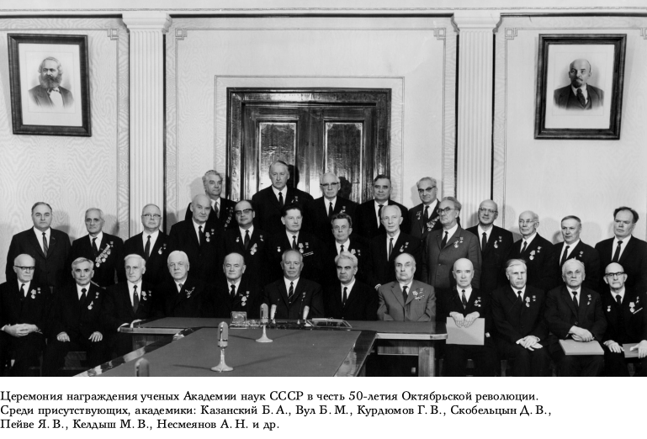
The USSR Academy of Sciences honors the 50th anniversary of October
1967
Basov (Nobel)
Vul (Red, proletarian, Jewish)
Tamm (Nobel)
Skobeltsyn (U.N., Pugwash)
Keldysh (president)
Nesmeianov
(former president)

Slide 36
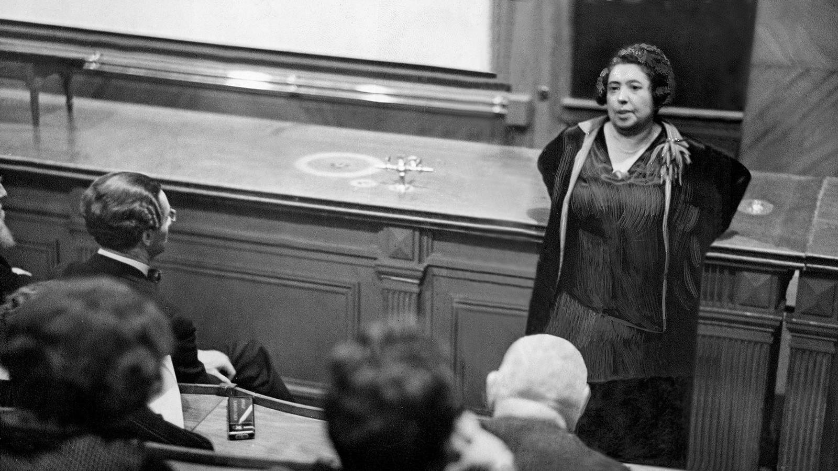
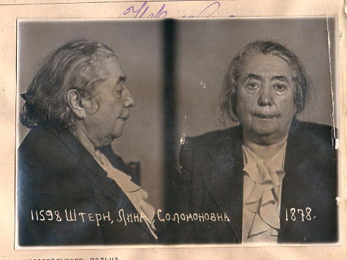
Lina Solomonovna Stern
Trained as physician in Geneva
Neurophysiologist
Party member (1938)
First woman elected to the Academy (1939)
Arrested 1949

Slide 37
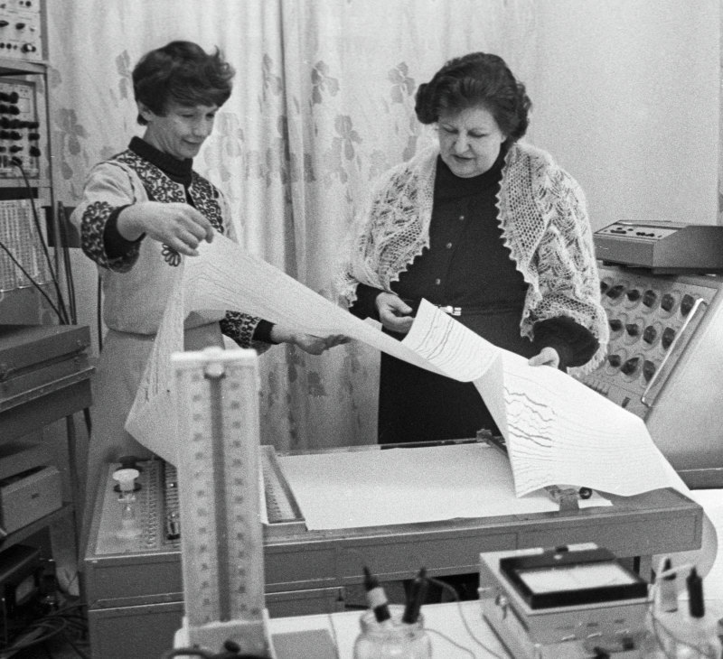
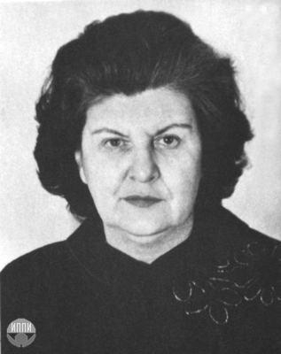
Natalia Bekhtereva
Neurophysiologist and granddaughter of Vladimir Bekhterev
Parents repressed in 1930s
Initial training in medicine
Elected to Academy in 1981

Slide 38
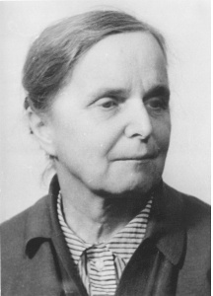
Maria Ivanovna Petrashen
(1906-1977)
“Any violation of the high ethical standards of a scientist evoked the condemnation of Petrashen even (and perhaps even more so) if these violations were committed by capable people. Interacting with Maria Ivanovna enriched everyone. The mere consciousness that Maria Ivanovna would not approve or would condemn something was enough to prevent a bad or dubious act. She was distinguished by exceptional honesty, combined with firmness of character and modesty, the qualities of a real Russian intellectual.”

Slide 39

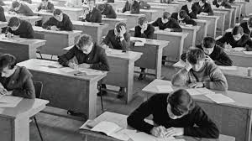
Soviet Mathematics Olympiads
Early socialization

