Slide 1
The Human Body as a Machine
Brooklyn Hortenstine
Intellectuals and World War I
November 3, 2022

Slide 2
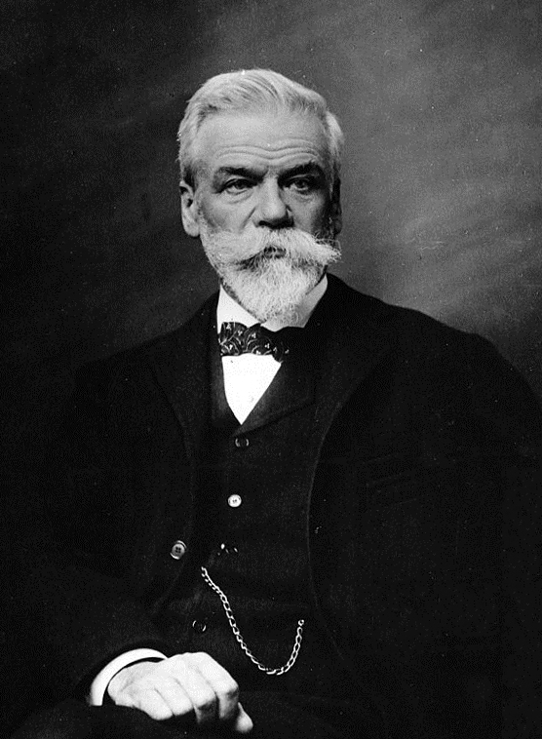
The Human Machine and the State
Ernest Solvay and “Productivism”
Wilhelm Ostwald: All progress can be measured through energy
Energy and fatigue studies as an intersection of political economy, social hygiene, and biology
Worker’s Reform

Slide 3
Militarism, Energy, and Fatigue
Arbeitswissenschaft and its legacy
Studies On The Physiology Of Marching, Zuntz and Schumburg
Kaiser Wilhelm Society for Labor Physiology
Shift away from the workers + Taylorism
War as an opportunity to test existing ideas of energy and fatigue

Slide 4
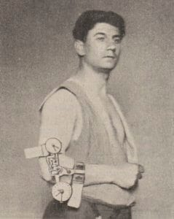
On the Medical Front
Role of the military doctor on the Front (Kassowitz)
Jules Amar and ideas of veterans: “Amputees and severely disabled… could still be “capable of complete utilization, representing a sometimes integral value” for industry” (Rabinbach, The Human Motor, p. 266.)

Slide 5
Questions/Things to Consider
What is the future of productivity in nations when juxtaposed with the idea of rehabilitation and care? Are these ideas contradictory?
How do the ideas of this time relate to the future care of veterans wounded at the front? (Maybe a good question to come back to after the session on trauma.)

